Slide 1


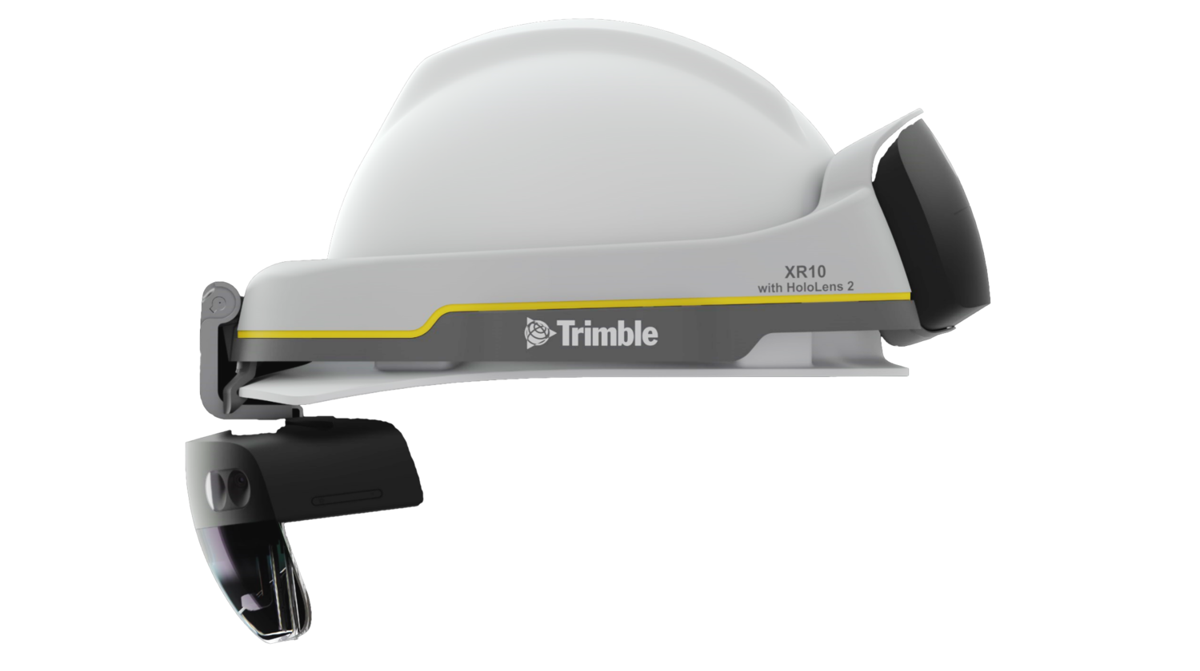
Digitalise real-time data in a physical industrial environment using mixed reality
Dhanil Capil Duvarcadas

Slide 2
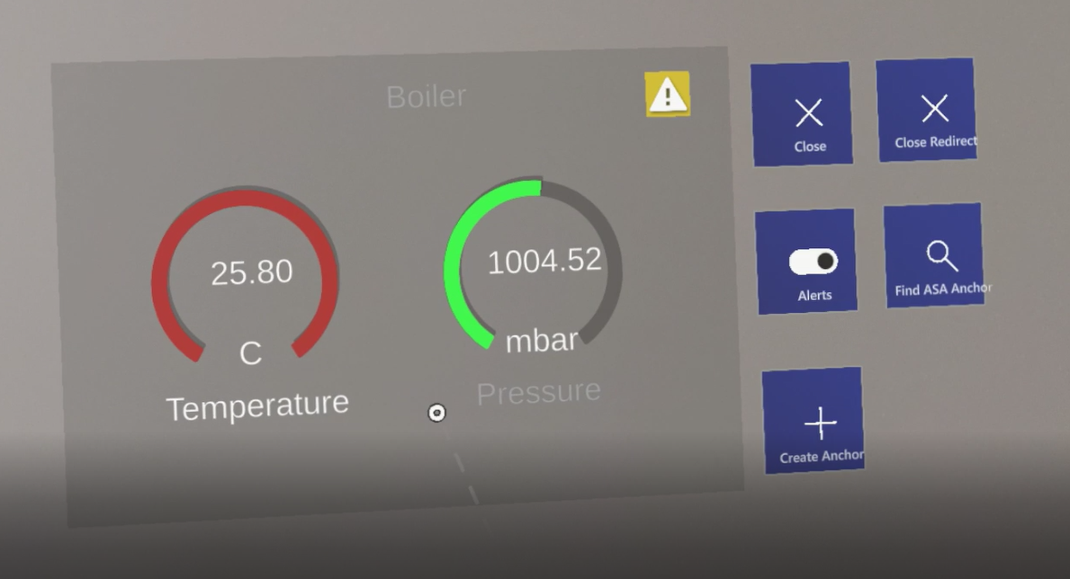
Aims & Objectives
Build a Mixed Reality Microsoft HoloLens PoC application
Helps visualise IoT Data of power stations
See current sensor telemetry (either from Raspberry Pi or device simulator
Able to see alerts
Redirect to the alert
Save the location of the dashboard
Scale it to multiple sensors
Picture of the dashboard

Slide 3
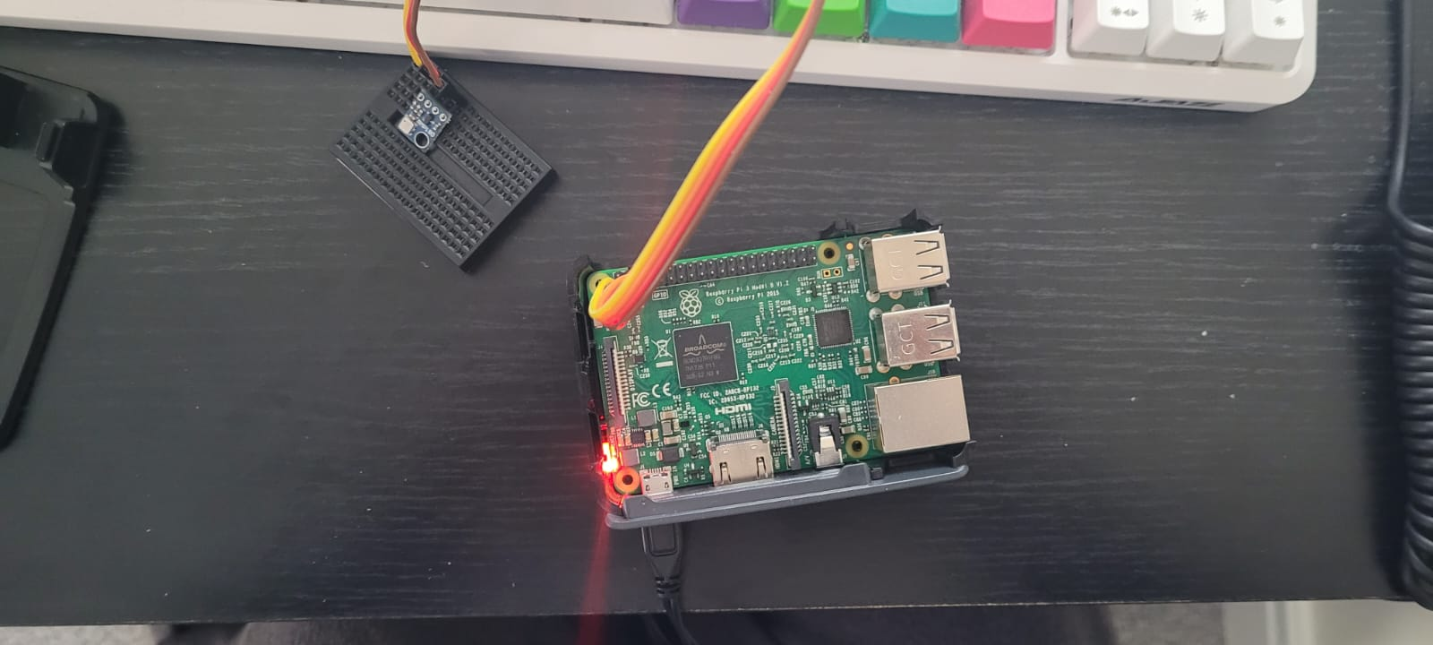
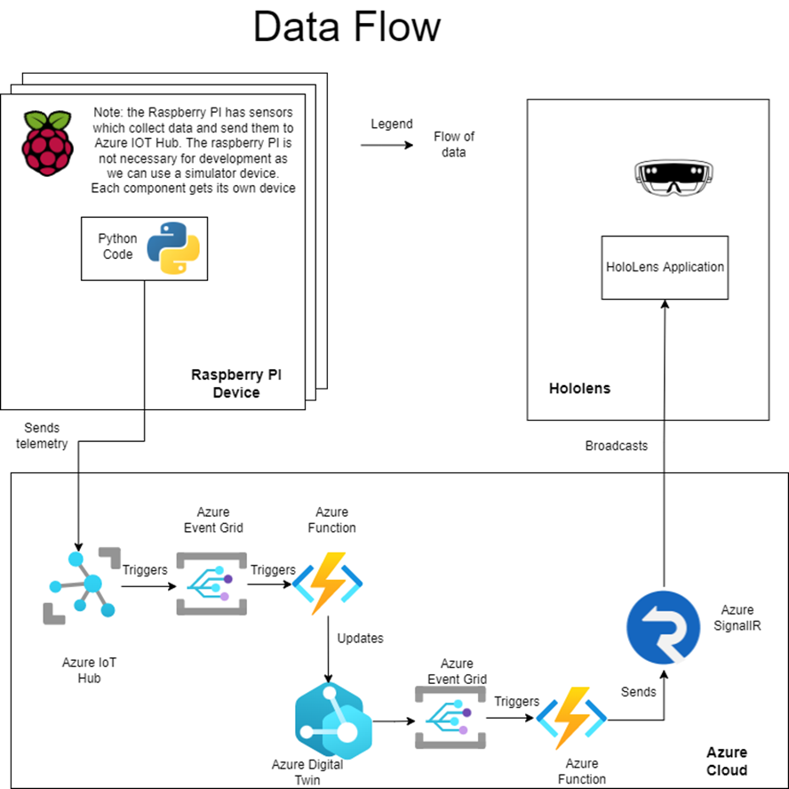
Architecture
Device simulator or Raspberry Pi- Python
Azure cloud:
IoT Hub
Digital Twins - DTDL
Azure functions – C#
Event Grid
SignalR
Unity3D Application - C#

Slide 4
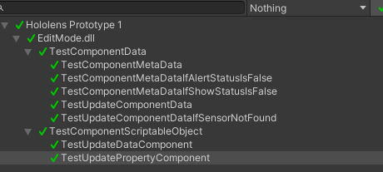
Testing
Unit testing
Integration testing
Manual Testing
Usability Testing & Black Box Testing with 4 users
1 Bug Found with the Spatial Anchors
Users liked and found the software futuristic:
Feeling like “Iron-Man”
Like the hand menu
Directions to the component felt useful
Screenshot of the unit test

Slide 5
Challenges, Difficulties & Complexity
Learning Unity and Mixed Reality Toolkit (MRTK) library
Very high learning curve
Mixed Reality is a new field
Poor documentation
Very Early Access- loads of broken stuff
Little to no tutorials
Spatial Anchor used to fix the dashboard location is hard to debug
Planning and Building the architecture
Cloud infrastructure that I am not familiar with
Learning a new languages- C# & DTDL
The specific HoloLens I have gets uncomfortable after a while

Slide 6
Demo

Slide 7
Conclusion
I believe this is a successful PoC that shows how the technology can be used
Successfully uses MR
Learned about the Cloud
Better documentation is needed for development
Hopefully most if the issues raised will be solved by a new generation of hardware:
Ergonomics
Battery Life
Hardware capabilities

Slide 8
Resources
https://github.com/microsoft/MixedRealityToolkit-Unity/issues/8214#issuecomment-1034170535
https://github.com/Azure/azure-iot-explorer/issues/477#issuecomment-995644401
https://github.com/Azure/azure-iot-explorer/issues/481
http://static1.squarespace.com/static/5dda637dfbf6af7c4b317507/5de68068c10a1a142df793a3/5e143f83553f9b060f2a2282/1648456059704/Trimble+Hololens2_XR10_transparent.png?format=1500w

