Slide 1

KidsCareerDecoder
Web-Based Child Aptitude Assessment
and Career Insight Platform
Neel Kapoor | BCA Final Year, Semester VI
Chandigarh University
Guide: Rohit Jha
Date: 22 May 2026

Slide 2
Problem Statement
Parents lack structured, child-friendly insight into strengths
Generic quizzes are not traceable or visible to guardians
Need: secure family accounts, quizzes, AI careers with regional context
KidsCareerDecoder | 22 May 2026

Slide 3
Objectives
Parent / child / admin roles with JWT security
Published quizzes and adaptive session flow
Six aptitude stripes + AI / fallback careers
Parent dashboards, child results, admin console
KidsCareerDecoder | 22 May 2026

Slide 4
Literature & Gap
Holland RIASEC vs six transparent aptitude stripes
LMS quizzes lack parent analytics + LLM careers
Gap closed: traceable scoring + admin + JSON-bound AI
KidsCareerDecoder | 22 May 2026

Slide 5
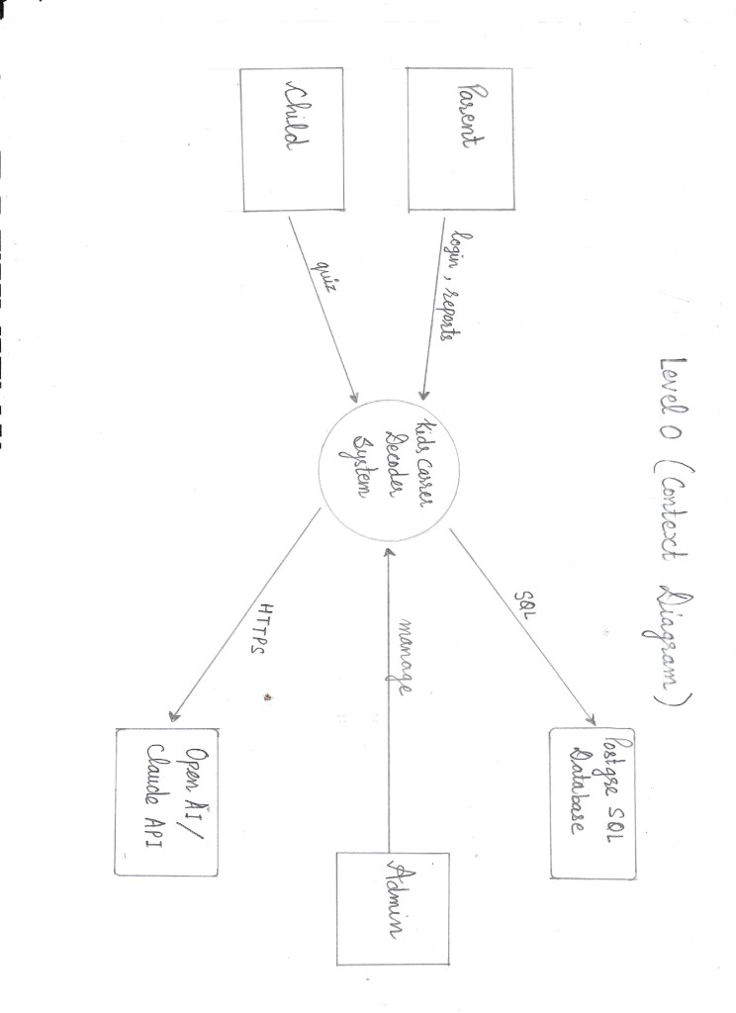
System Architecture (DFD Level 0)
Parent: login, reports
Child: quiz
Admin: manage
PostgreSQL (SQL) + OpenAI/Claude (HTTPS)
KidsCareerDecoder | 22 May 2026

Slide 6
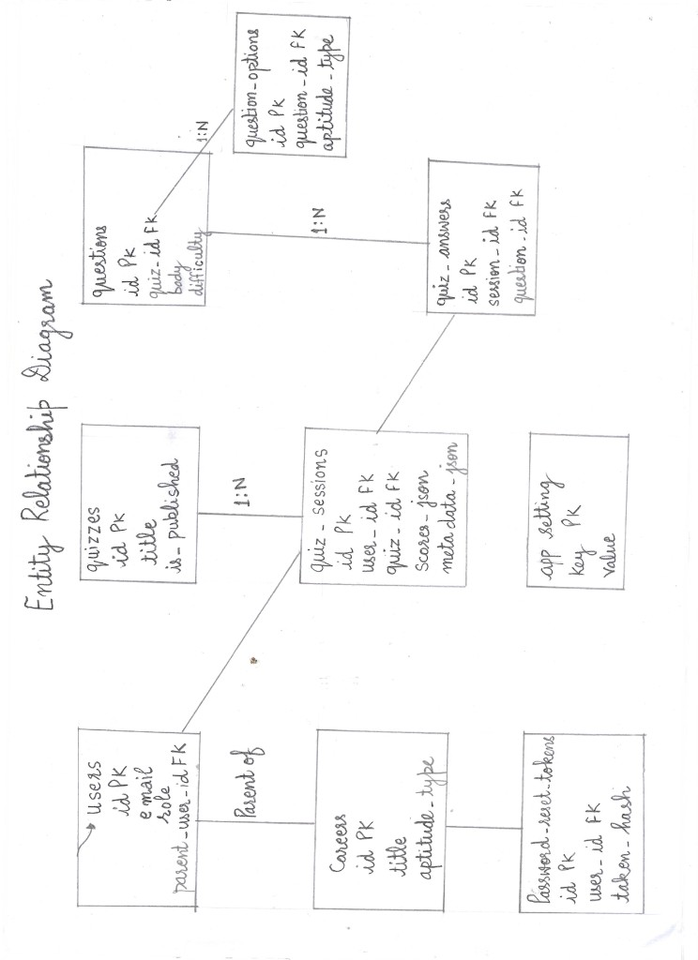
Database Design (ER Diagram)
users, quizzes, questions, question_options
quiz_sessions (scores_json, metadata_json)
quiz_answers, careers, app_settings
KidsCareerDecoder | 22 May 2026

Slide 7
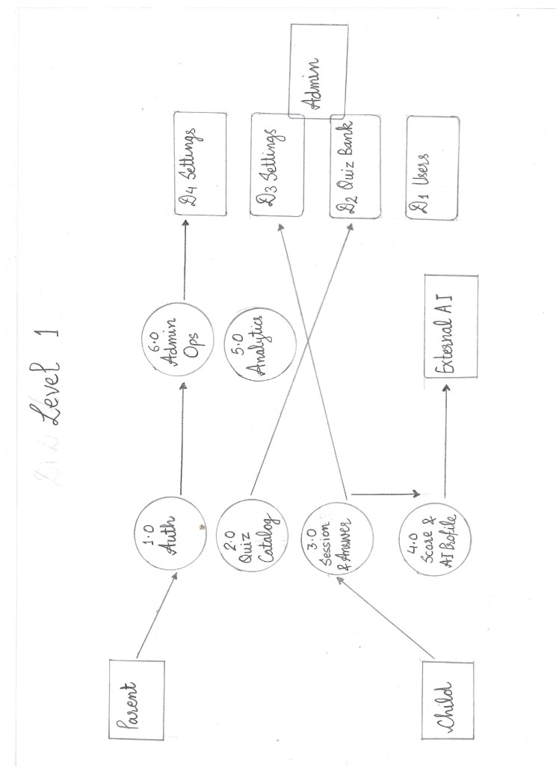
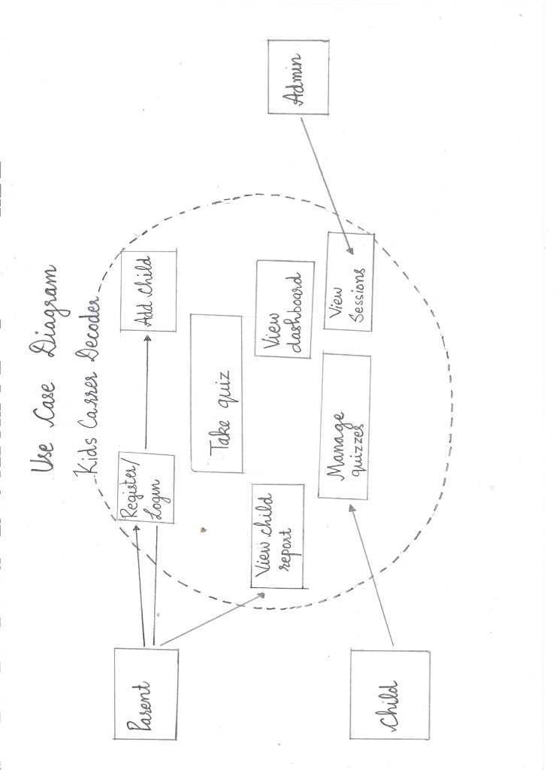
Design — DFD Level 1 & Use Cases
Processes 1.0–6.0 and actor use cases (hand-drawn)
KidsCareerDecoder | 22 May 2026

Slide 8
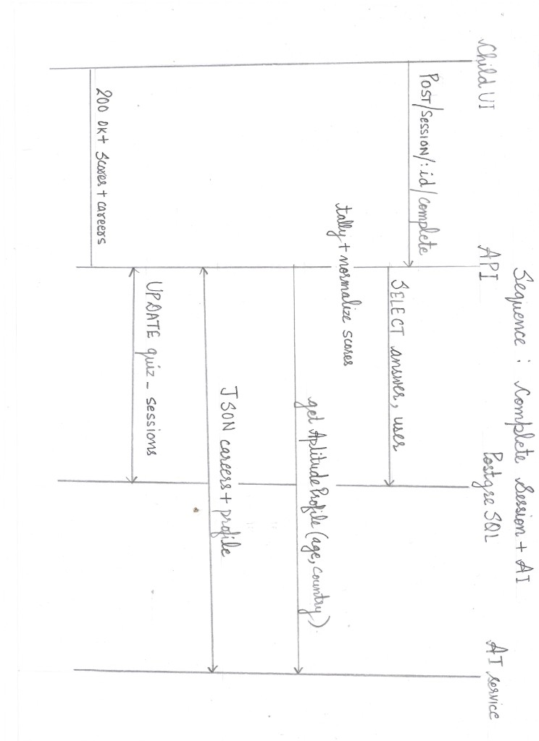
Sequence: Complete Session + AI
POST /session/:id/complete
Tally + normalize scores → AI profile
UPDATE quiz_sessions → 200 OK + careers
KidsCareerDecoder | 22 May 2026

Slide 9
Implementation Highlights
bcrypt + JWT authentication
sessionController: preprocess → getAptitudeProfile
CareerResultCard: child vs parent variant
Admin runtime AI provider selection
KidsCareerDecoder | 22 May 2026

Slide 10
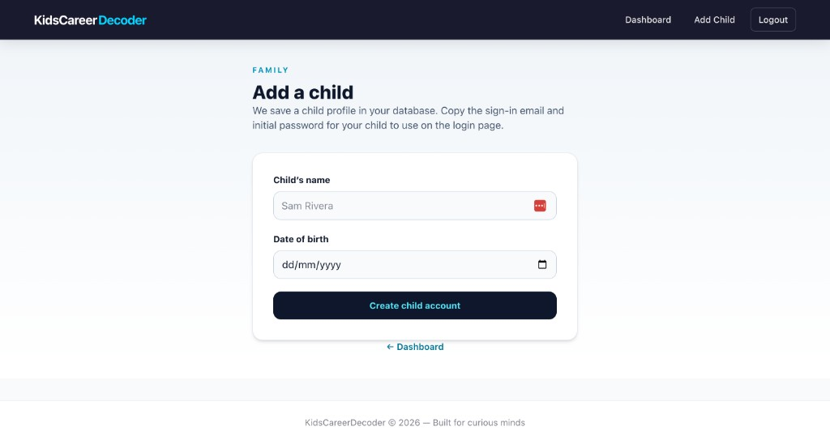
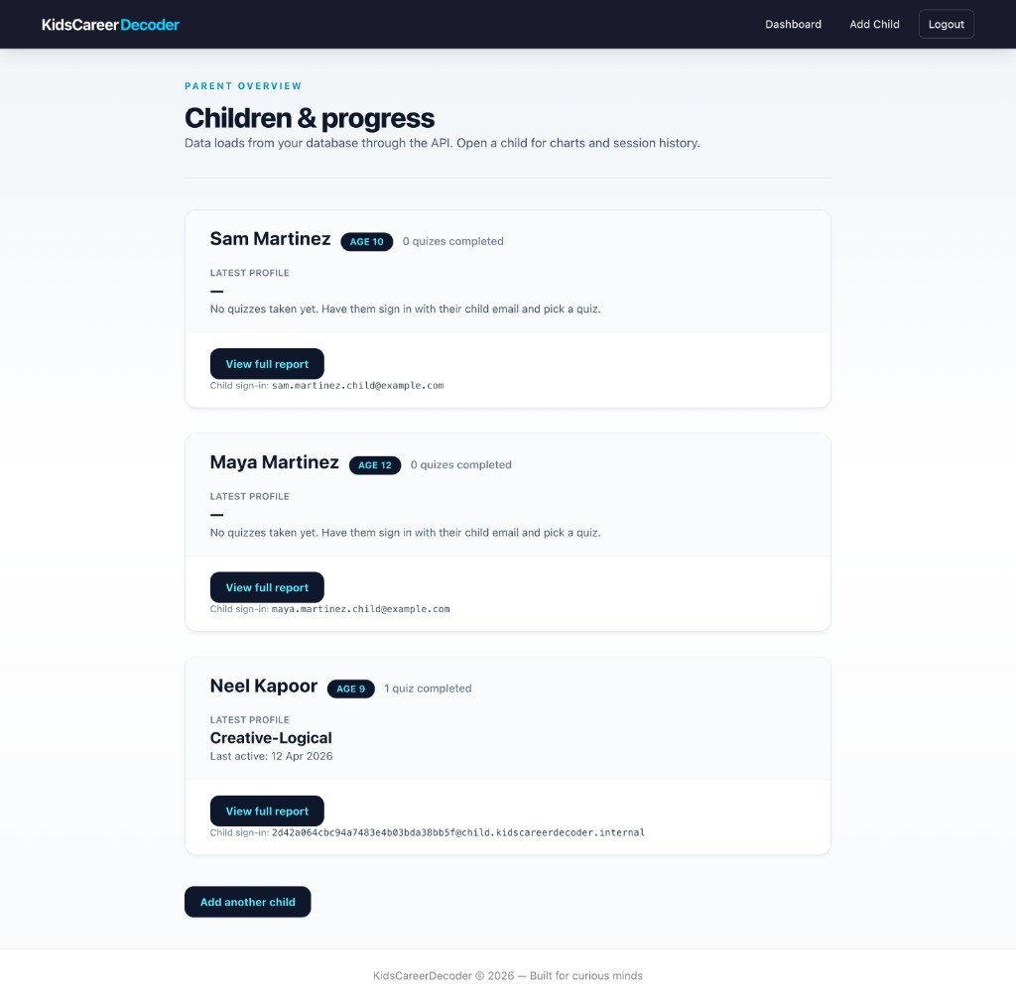
Parent Interface
Add child and dashboard (Fig 5.1, 5.2)
KidsCareerDecoder | 22 May 2026

Slide 11
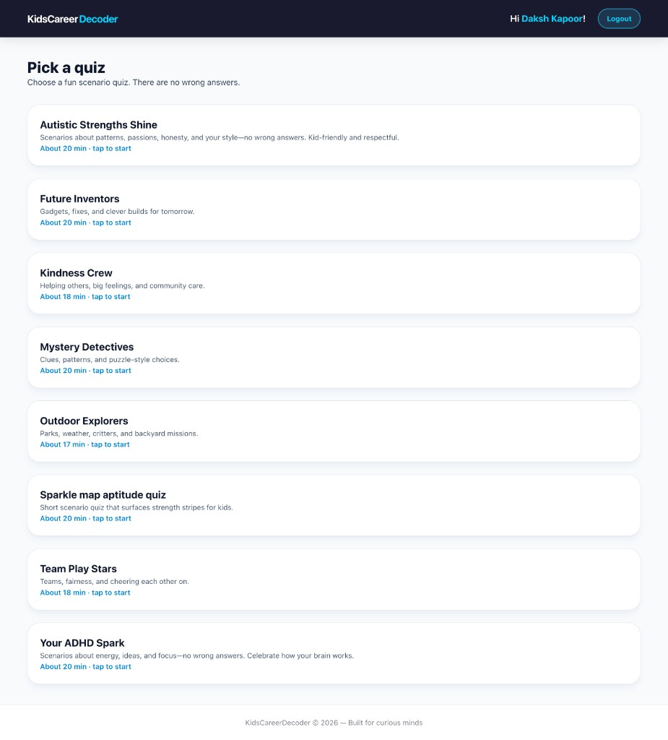
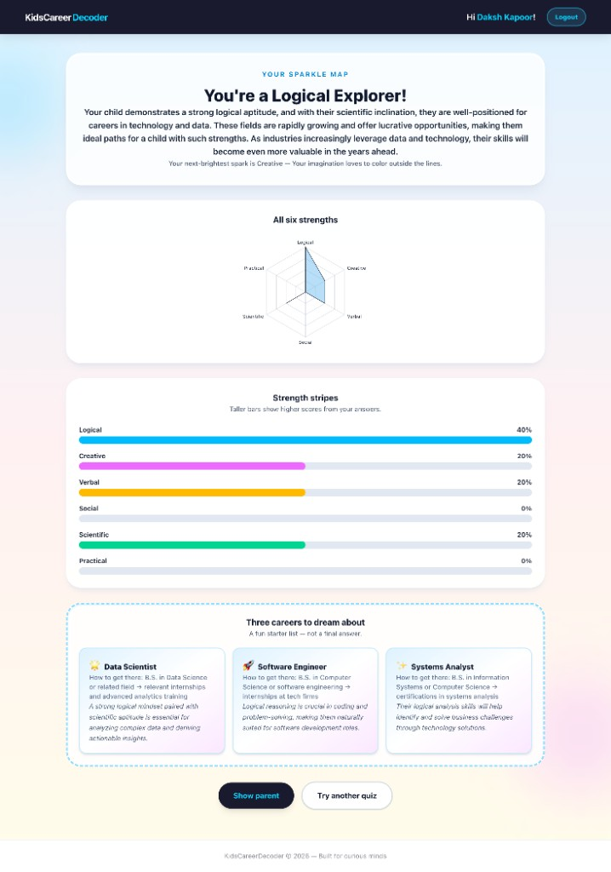
Child Interface
Quiz selection and AI results (Fig 5.3, 7.2)
KidsCareerDecoder | 22 May 2026

Slide 12
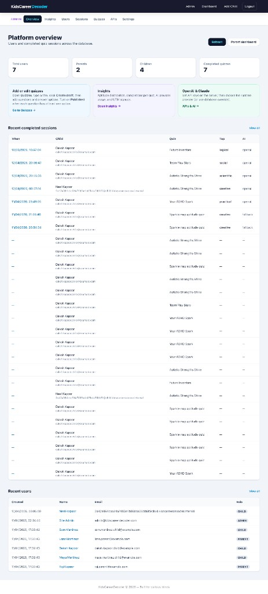
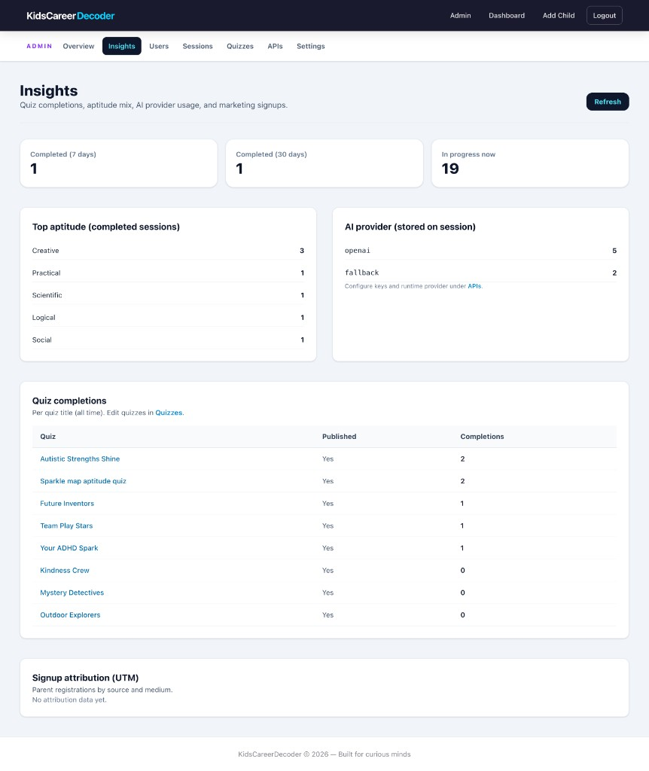
Admin Interface
Overview and insights (Fig 5.5–5.6)
KidsCareerDecoder | 22 May 2026

Slide 13
AI & Data Preprocessing
Tally answers → six percentage scores
Age + country → Claude or OpenAI JSON careers
Python notebook mirrors server math
fallback_only when API unavailable
KidsCareerDecoder | 22 May 2026

Slide 14
Testing Summary
27 documented test cases — Pass
Auth, session, AI, admin, security scenarios
CORS, JWT 401/403, reset token validation
KidsCareerDecoder | 22 May 2026

Slide 15
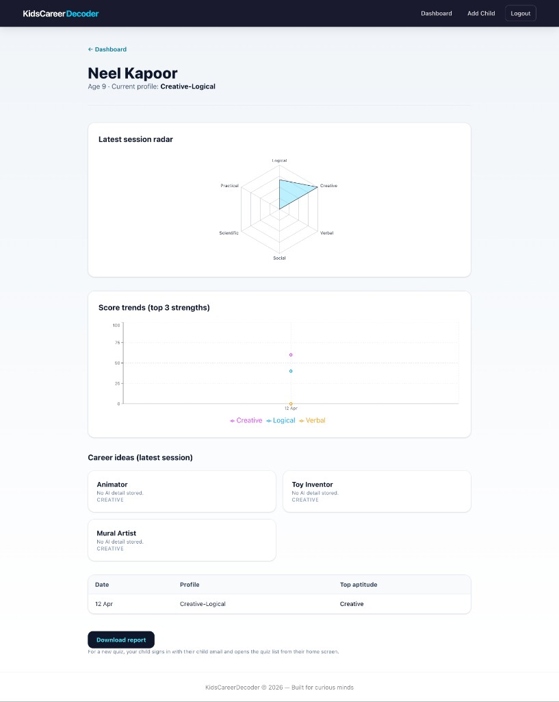
Results
Parent report and child Logical Explorer results
KidsCareerDecoder | 22 May 2026

Slide 16
Future Enhancements
Mobile app and HttpOnly cookie sessions
Automated CI tests and Hindi UI
IRT-based adaptive difficulty
Cloud deployment documentation
KidsCareerDecoder | 22 May 2026

Slide 17
Thank You
Questions?
Neel Kapoor | O23BCA110261@cuchd.in
Guide: Rohit Jha
Date: 22 May 2026

