Slide 1
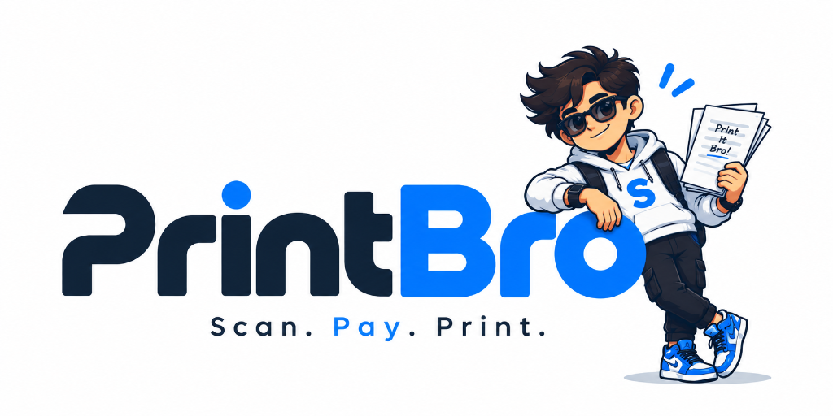
PRINT BRO
Scan. Pay. Print. — Autonomous Campus Kiosks
Slide 01 — The Problem with Traditional Campus Printing
• College students frequently need to print assignments, lab records, resumes, notes, project reports & certificates.
• Most campuses depend on 1 or 2 congested Xerox shops handling printing alongside binding, scanning, stationery & lamination.
• A shopkeeper must manually: receive file, inspect, select settings, take payment, print, and hand over — taking several minutes per student.
KEY ISSUE: Concentrating thousands of students and multiple services at one physical counter creates massive waiting queues.
CIE Pitch Presentation
Centre for Innovation & Entrepreneurship
G. Pulla Reddy Engineering College (GPREC)

Slide 2
PRINT BRO | CIE PITCH DECK • SLIDE 02
The Current Student Experience
The painful friction points in an everyday student's printing journey
CURRENT FLOW:
Student needs print → Goes to Xerox shop → Finds crowd → Waits in queue → Shares file → Payment → Printing → Collects pages
[FRICTION 1] Queue & Time Loss
• 🔴 Long queues during morning rush
• 🔴 15 to 45 mins spent just waiting
• 🔴 Peak-hour crowding before deadlines
• 🔴 Risk of arriving late to classes/labs
[FRICTION 2] Manual Bottlenecks
• 🔴 Manual file handling takes operator time
• 🔴 WhatsApp file sharing creates privacy issues
• 🔴 USB drive transfers spread computer viruses
• 🔴 Frequent manual billing & cash disputes
[FRICTION 3] Location & Hours
• 🔴 Limited printing locations across campus
• 🔴 Heavy dependence on 1 or 2 shops
• 🔴 Closed early mornings and late evenings
• 🔴 Zero 24/7 printing option for hostels

Slide 3
PRINT BRO | CIE PITCH DECK • SLIDE 03
More Than Just a Printing Problem
The issue isn't simply the cost of printing — it is Time + Accessibility + Operational Efficiency
[TIME DEFICIT] The Disproportionate Time Equation
• A student who needs only 5–10 pages spends significantly more time travelling to the shop, waiting in queue, and completing the transaction than the actual printing time.
• Walking to shop & return: 10–15 mins
• Waiting in peak-hour queue: 20–30 mins
• Operator file handling: 3–5 mins
• Actual machine print time: Just 15–20 SECONDS!
• Result: Over 90% of student time is pure deadweight waiting.
• Across 4,000+ students, thousands of academic hours are wasted.
[CAMPUS PRESSURE] High-Stakes Deadline Chaos
• This becomes especially problematic during critical periods:
• • Before Exams (Hall tickets, formulas)
• • During Assignment Submissions
• • During Project Reviews & Reports
• • During Record Submissions
• • During Placement & Job Application Drives
• • During College Events & Conferences
• Academic impact: Unavoidable delays cause panic, late penalties, and missed deadlines outside student control.

Slide 4
PRINT BRO | CIE PITCH DECK • SLIDE 04
Why Existing Xerox Shops Struggle
Limitations of the traditional model: Designed around the shop, rather than student convenience
Traditional Xerox Shop | Operational Bottleneck / Problem
Single counter | Creates long queues and severe single-point bottlenecks.
Manual file handling | Takes operator time for every single customer.
Multiple services | Printing gets mixed with binding, scanning, and stationery orders.
Limited working hours | Students cannot print anytime (closed at night/early morning).
Physical presence required | Student must stand at the counter to keep their place in line.
High peak-hour demand | Crowding increases drastically before classes and deadlines.
Operator-dependent | Every single order requires manual intervention to execute.
CORE OBSERVATION: The existing model is designed around the shop, rather than around the student's convenience.

Slide 5
PRINT BRO | CIE PITCH DECK • SLIDE 05
Our Opportunity: What If Printing Was Self-Service?
Imagine a student walking up to a kiosk: Upload Document → Select Pages → Choose B/W or Colour → Pay → Print → Collect
[NO MORE] What We Eliminate
• ❌ Waiting for an operator
• ❌ Standing in a long queue
• ❌ Sharing files through WhatsApp repeatedly
• ❌ Manual order processing & paper settings
• ❌ Waiting behind spiral binding and lamination orders
• ❌ Cash change hassles or manual calculation errors
[INSTEAD] The Print Bro Advantage
• ✅ 100% Self-Service: Full student control via phone or touch
• ✅ Fast: Total transaction finished in under 45 seconds
• ✅ Digital Payment: Instant UPI (PhonePe, GPay, Paytm)
• ✅ Automated Printing: Cloud-orchestrated instant output
• ✅ Available Inside Campus: Deployed in blocks & hostels
• ✅ 24/7 Access: Ready whenever academic buildings are open

Slide 6
PRINT BRO | CIE PITCH DECK • SLIDE 06
Introducing Print Bro / Smart Campus Printing Kiosk
Print Bro is a self-service printing kiosk designed specifically for colleges, schools and institutional campuses
STEP 1
1. UPLOAD
Upload PDF / document through QR or kiosk interface
STEP 2
2. CONFIGURE
Select exact pages, copies, B/W or colour
STEP 3
3. PAY
Pay digitally using UPI (GPay, PhonePe, Paytm)
STEP 4
4. PRINT
Automated high-speed printing starts immediately
STEP 5
5. COLLECT
Student receives the printed document neatly sorted
GOAL: Turn a traditional counter-based printing experience into a self-service digital experience.

Slide 7
PRINT BRO | CIE PITCH DECK • SLIDE 07
Why This Can Reduce Crowding
From One Counter → Multiple Self-Service Points across the campus
[EFFICIENCY SHIFT] Model Comparison
• Traditional Model:
• 100 students → 1 shop counter → 1 operator → Long Queue
•
• Print Bro Model:
• 100 students → Self-service kiosks → Automated processing → Zero Congestion
•
• Key Operational Impact:
• • Eliminates single-counter bottlenecks
• • Parallel autonomous processing across campus
• • Instant turnover under 45 seconds per student
[CAMPUS DEPLOYMENT] Multiple Kiosks Deployed At
• • College Academic Blocks & Department Corridors
• • Central Library & Reference Sections
• • Student Hostels (Boys & Girls for 24/7 access)
• • Administrative & Placement Cell Buildings
• • Canteen & Student Recreation Areas
• • Academic Laboratory Departments
•
• This creates a distributed printing network instead of concentrating demand at one shop.

Slide 8
PRINT BRO | CIE PITCH DECK • SLIDE 08
Additional Opportunity: Printing + Digital Advertising
This is where your idea becomes especially interesting for CIE: Captive Attention & Dual Revenue
[HIGH-IMPACT DOOH] Kiosk Display Screen & Dwell Time
• The kiosk has a dedicated digital display screen.
• While students are using the kiosk or waiting for their print:
• Screen → Campus & Brand Advertisements
•
• Potential Advertisers:
• • Food & Beverage brands, cafes, delivery apps
• • EdTech & Skill-building companies (GATE, Coding)
• • Banks / Fintech (Student accounts, cards)
• • Local businesses & retailers
• • Student-focused products & gadgets
• • College clubs, events, and hackathons
[STRATEGIC SYNERGY] Expanded Venture Ecosystem
• So the model isn't only:
• Student → Pays → Print
•
• It becomes a three-sided value engine:
•
• 1. Student → Gets fast, autonomous printing service
•
• 2. Brand → Gets targeted advertising to verified 18-24 college students
•
• 3. College → Gets modern smart campus utility infrastructure at zero capital strain

Slide 9
PRINT BRO | CIE PITCH DECK • SLIDE 09
Business Model: How Print Bro Can Generate Revenue
Three diversified revenue streams ensuring rapid sustainability and venture scalability
[PRINTING] Revenue Stream 1
• Printing Transactions
•
• Revenue from:
• • B/W printing (high daily academic volume)
• • Colour printing (diagrams, certificates, project reports)
• • Bulk printing & submission packages
•
• Direct student UPI payment with immediate ledger settlement.
[ADVERTISING] Revenue Stream 2
• Digital Advertising
•
• Brands pay for advertising displayed on kiosk screens.
•
• • Sponsored display slots
• • Video ad impressions during dwell time
• • Brand-subsidized student print discounts
• • High gross margin (90%+) software revenue
[CAMPUS SAAS] Revenue Stream 3
• Institutional SaaS
•
• Colleges / schools can subscribe to the system for:
• • Kiosk fleet management
• • Printing analytics & consumption
• • Revenue & quota tracking
• • Advertisement management
• • Usage monitoring & remote alerts

Slide 10
PRINT BRO | CIE PITCH DECK • SLIDE 10
Vision: From Printing Kiosk to Campus Utility Network
Building a smart self-service network that makes everyday campus services faster and accessible
[EVOLUTION] Service Expansion Path
• Start with:
• Printing
•
• ↓ Then add:
• Scanning (to Email, DigiLocker, Google Drive)
• Document services (ID duplicates, certificates)
• Stationery dispenser (pens, graph sheets, covers)
• Digital forms & administrative submissions
• Campus payments & smart ID integration
• Campus & Brand Advertising
• Other self-service utilities
[VENTURE GOAL] The Ultimate Vision
• Build a network of smart self-service kiosks that make everyday campus services:
• • Faster (< 45 seconds)
• • More accessible (24/7 across campus)
• • Less dependent on manual counters
•
• Position Print Bro as the essential academic utility infrastructure for colleges, schools, and institutional campuses nationwide.

Slide 11
PRINT BRO | CIE PITCH DECK • SLIDE 11
Proposed Pilot — G. Pulla Reddy Engineering College
Start with one working prototype at GPREC to validate student adoption and unit economics
[GPREC TRIAL] Pilot Objectives to Measure
• Start with 1 working prototype kiosk at GPREC.
•
• Key Pilot Objectives:
• ✓ Test real student usage & daily print volumes
• ✓ Measure average printing time (< 45s target)
• ✓ Measure peak-hour demand & queue reduction
• ✓ Study student adoption & repeat usage
• ✓ Calculate operating cost per page (paper, toner)
• ✓ Test digital payment workflow (UPI reliability)
• ✓ Test advertisement display & engagement
• ✓ Collect direct student & faculty feedback
[SCALE-UP] Post-Validation Scale Path
• After successful validation at GPREC:
•
• 1 Kiosk (Prototype validation)
• ↓
• Multiple Kiosks (Library, Mech/CSE block, Hostels)
• ↓
• Other Engineering Colleges in Kurnool / AP
• ↓
• Schools, Degree Colleges & Universities Nationwide
•
• Transforming regional campus utilities with local manufacturing and scalable cloud management.

Slide 12
PRINT BRO | CIE PITCH DECK • SLIDE 12
Final Problem → Solution
Direct comparison between traditional campus printing and the Print Bro innovation
Existing Problem | Print Bro Solution
❌ Long queues | ✅ Self-service
❌ Manual processing | ✅ Automated workflow
❌ Crowded Xerox shops | ✅ Distributed kiosks
❌ Operator dependency | ✅ Student-controlled
❌ Limited accessibility | ✅ Campus deployment
❌ No additional revenue | ✅ Advertising screen
❌ No usage visibility | ✅ Central dashboard
Scan. Pay. Print.
PRINT BRO: Smart Campus Printing Kiosks | Ready for CIE Pilot & Faculty Discussion | Thank You!

