Slide 1
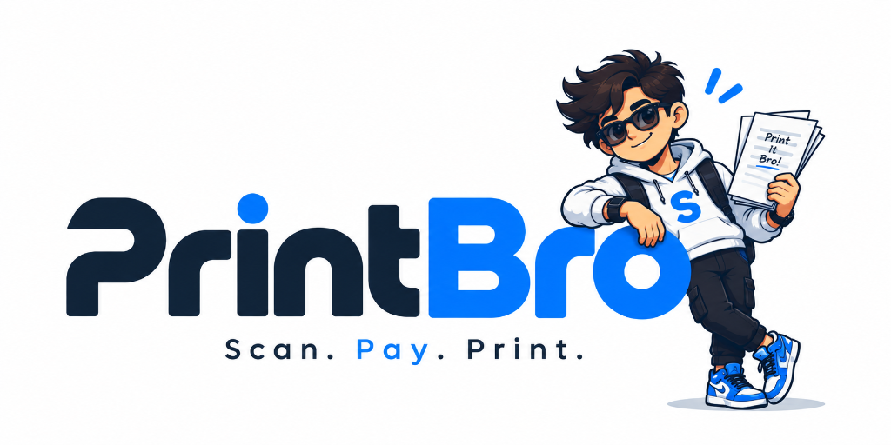
PRINT BRO
Scan. Pay. Print. — Autonomous Campus Kiosks
The Problem with Traditional Campus Printing
• College students frequently need to print assignments, lab records, resumes, notes, project reports & certificates.
• Most campuses depend on 1 or 2 congested Xerox shops handling printing alongside binding, scanning, stationery & lamination.
• A shopkeeper must manually: receive file, inspect, select settings, take payment, print, and hand over taking several minutes per student.

Slide 2
The Current Student Experience
The painful friction points in an everyday student's printing journey
CURRENT FLOW:
Student needs print → Goes to Xerox shop → Finds crowd → Waits in queue → Shares file → Payment → Printing → Collects pages
[FRICTION 3] Location & Hours
• 🔴 Limited printing locations across campus
• 🔴 Heavy dependence on 1 or 2 shops
• 🔴 Closed early mornings and late evenings
• 🔴 Zero 24/7 printing option for hostels
[FRICTION 1] Queue & Time Loss
• 🔴 Long queues during breaks
• 🔴 10 to 15 mins spent just waiting
• 🔴 Peak-hour crowding before deadlines
• 🔴 Arriving late to classes/labs
[FRICTION 2] Manual Bottlenecks
• 🔴 Manual file handling takes operator time
• 🔴 WhatsApp file sharing creates privacy issues
• 🔴 Frequent manual billing & cash disputes

Slide 3
PRINT BRO | CIE PITCH DECK • SLIDE 03
More Than Just a Printing Problem
The issue isn't simply the cost of printing — it is Time + Accessibility + Operational Efficiency
[TIME DEFICIT] The Disproportionate Time Equation
• A student who needs only 5–10 pages spends significantly more time travelling to the shop, waiting in queue, and completing the transaction than the actual printing time.
• Walking to shop & return: 10–15 mins
• Waiting in peak-hour queue: 15–30 mins
• Operator file handling: 3–5 mins
• Actual machine print time: Just 30–40 SECONDS!
• Result: Over 90% of student time is pure deadweight waiting.
• Across 4,000+ students, thousands of academic hours are wasted.
[CAMPUS PRESSURE] High-Stakes Deadline Chaos
• This becomes especially problematic during critical periods:
• • Before Exams (Hall tickets, formulas)
• • During Assignment Submissions
• • During Project Reviews & Reports
• • During Record Submissions
• • During Placement & Job Application Drives
• • During College Events & Conferences
• Academic impact: Unavoidable delays cause panic, late , and missed deadlines outside student control.

Slide 4
Why Existing Xerox Shops Struggle
Limitations of the traditional model: Designed around the shop, rather than student convenience
Traditional Xerox Shop | Operational Bottleneck / Problem
Single counter | Creates long queues and severe single-point bottlenecks.
Manual file handling | Takes operator time for every single customer.
Multiple services | Printing gets mixed with binding, scanning, and stationery orders.
Limited working hours | Students cannot print anytime (closed at night/early morning).
Physical presence required | Student must stand at the counter to keep their place in line.
High peak-hour demand | Crowding increases drastically before classes and deadlines.
Operator-dependent | Every single order requires manual intervention to execute.
CORE OBSERVATION: The existing model is designed around the shop, rather than around the student's convenience.

Slide 5
Our Opportunity: What If Printing Was Self-Service?
Imagine a student walking up to a kiosk: Upload Document → Select Pages → Choose B/W or Colour → Pay → Print → Collect
[NO MORE] What We Eliminate
• ❌ Waiting for an operator
• ❌ Standing in a long queue
• ❌ Sharing files through WhatsApp repeatedly
• ❌ Manual order processing & paper settings
• ❌ Waiting behind spiral binding and lamination orders
• ❌ Cash change hassles or manual calculation errors
[INSTEAD] The Print Bro Advantage
• ✅ 100% Self-Service: Full student control via phone or touch
• ✅ Fast: Total transaction finished in under 45 seconds
• ✅ Digital Payment: Instant UPI (PhonePe, GPay, Paytm)
• ✅ Automated Printing: Cloud-orchestrated instant output
• ✅ Available Inside Campus: Deployable in blocks & hostels

Slide 6
Introducing Print Bro / Smart Campus Printing Kiosk
Print Bro is a self-service printing kiosk designed specifically for colleges, schools and institutional campuses
STEP 1
1. UPLOAD
Upload PDF / document through QR or kiosk interface
STEP 2
2.CONFIGURE
Select exact pages, copies, B/W or colour
STEP 3
3. PAY
Pay digitally using UPI and get code
STEP 4
4. ENTER CODE
Automated high-speed printing starts immediately
STEP 5
5. COLLECT
Student receives the printed document neatly sorted
GOAL: Turn a traditional counter-based printing experience into a self-service digital experience.

Slide 7
Final Problem → Solution
Direct comparison between traditional campus printing and the Print Bro innovation
Existing Problem | Print Bro Solution
❌ Long queues | ✅ Self-service
❌ Manual processing | ✅ Automated workflow
❌ Crowded Xerox shops | ✅ Distributed kiosks
❌ Operator dependency | ✅ Student-controlled
❌ Limited accessibility | ✅ Campus deployment
❌ No additional revenue | ✅ Advertising screen
❌ No usage visibility | ✅ Central dashboard
PRINT BRO: Smart Campus Printing Kiosks | Thank You!

Slide 8
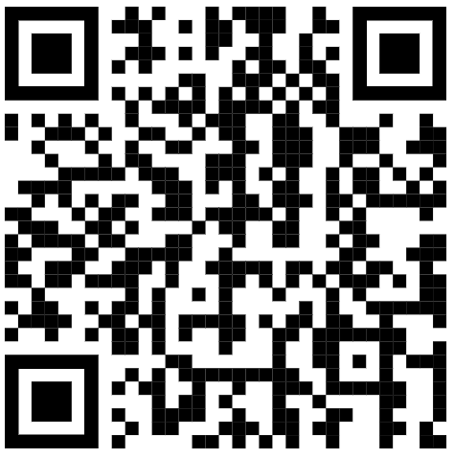
PRINT BRO: Smart Campus Printing Kiosks | Thank You!

