Slide 1
MINI-PROJECT TITLE
MINI-PROJECT PHASE - 1
Presented By:
NISARGA K 1DS20IS065
NITHYA M 1DS20IS067
SAIJYOTI G METI 1DS20IS085
SANJANA GOUD 1DS20IS092
Under The Guidance Of
Dr CHANDRAKALA B M
Associate Professor
Dept. of Information Science and Engineering
DSCE, Bangalore

Slide 2
ABSTRACT
A proposed solution to address the inefficiency and vulnerabilities in India's current voting system is the development of an online, biometric fingerprint-based voting machine. This system eliminates the need for voters to carry identification cards, as their fingerprints serve as identification at the polling booth. The fingerprint reader acquires the voter's fingerprint and verifies it with pre-stored data during registration. If the data matches, the person is allowed to cast their vote manually using push buttons. The system ensures anonymity by assigning each user a unique and random ID, ensuring no connection to their personal details. The interface is designed to be user-friendly and simple, prioritizing visual representation of data and basic functionalities.

Slide 3
CONTENTS
Introduction
Literature Survey
Problem Statement
Proposed Technique
Requirements
System Design.
Existing system
Proposed system
System Architecture
Flow chart
Methodology
Implementation
Results & Conclusions
References
Demo

Slide 4
INTRODUCTION
Biometrics is a technology that uses biological data, such as fingerprints, to authenticate individuals. Fingerprint scanning has become a widely used method for identification, particularly in law enforcement. In our project, we utilize fingerprint scanners for voter identification in order to enhance the accuracy and security of the voting process. Each individual's fingerprint is unique, minimizing errors and preventing illegal or repeated voting. By creating a database of voter fingerprints and implementing accurate coding, this fingerprint-based Electronic Voting Machine (EVM) system aims to ensure fair and rigging-free elections, while also streamlining the voting process and reducing costs.

Slide 5
LITERATURE SURVEY
In our survey of various research papers, we have gained insights into different aspects of developing a fingerprint-based biometric voting machine.
One paper [1] explains the working principle of the fingerprint sensor and its potential for detecting fraud in Electronic Voting Machines (EVMs).
Another paper [2] explores the use of Internet of Things (IoT) in building such a system, highlighting the interconnectivity of devices and the associated risks. Additionally, a paper [3] proposes storing fingerprints in a database, providing immediate notifications of casted votes for transparency, and delivering prompt election results.
Furthermore, another paper [4] suggests using fingerprint sensors to input data without duplication and enabling online voting from the comfort of one's location. These studies contribute valuable insights to the development of an efficient and secure fingerprint-based voting system.

Slide 6
PROBLEM STATEMENT
The existing voting system in India is plagued by inefficiency and vulnerabilities in voter authentication. Relying solely on voter ID cards, which can be easily faked, poses significant security risks. Additionally, manual identity verification processes require a substantial workforce. The system lacks real-time monitoring of Electronic Voting Machines (EVMs), leading to delays, and the manual vote counting process is time-consuming. These issues highlight the need for a more secure and efficient voting system that automates authentication, reduces the risk of fraud, and ensures faster and accurate vote counting

Slide 7
PROPOSED TECHNIQUE
The proposed fingerprint-based fraud detection voting system combines biometric fingerprint authentication with advanced fraud detection techniques. Eligible voters enroll their fingerprints, which are securely stored in a database. At the voting booth, voters' fingerprints are scanned and compared against the stored records for authentication. Fraud detection techniques, such as real-time monitoring and machine learning algorithms, are used to identify suspicious activities and anomalies. The system includes auditing and verification mechanisms to ensure the integrity of the voting process, logging all activities and conducting independent audits. Strong security measures are implemented to protect the fingerprint data and the overall system. This system provides a reliable and secure method of voter authentication, minimizing the risk of fraudulent activities and ensuring the fairness and accuracy of the voting process

Slide 8
REQUIREMENTS
DETAILS OF HARDWARE
Power Supply : 12V DC
Micro controller : Arduino
DC Motor
RS 232 converter : MAX 232
Finger print reader
DETAILS OF SOFTWARE
Arduino Suite
C Programming

Slide 9
SYSTEM DESIGN
4.1 Existing system
The existing system for fingerprint-based fraud detection in a voting system might involve traditional paper-based voting methods where individuals cast their votes by marking their preferences on paper ballots. This system typically relies on manual verification processes, such as signature verification or ID checks, to detect fraudulent activities. However, these methods are susceptible to human errors and can be easily manipulated, leading to potential voting fraud.
Proposed system
The proposed system is a fingerprint-based fraud detection voting system that leverages biometric technology to enhance the security and integrity of the voting process. In this system, each eligible voter's fingerprint is enrolled and stored in a database before the election. During the voting process, voters' fingerprints are captured and compared against the enrolled fingerprints to verify their identity and eligibility to vote.

Slide 10
METHODOLGY
Project flow:
Before casting the vote, a voter must register his fingerprint to verify his vote is a valid one or not.
After registering the fingerprints of different voters, the voting process is conducted further.
Voters upon arriving at the ballot stations will form a queue outside the entry gate controlled by a servo motor.
The voter enters the ballot room, places his fingerprint on the fingerprint module to identify his details and if it matches with the details given during registration, he is further allowed to cast his vote
Candidate options are given to the voter, and he is allowed to vote for the candidate whom he decides to cast his vote for.

Slide 11
IMPLEMENTATION
void Enroll()
{
int count=0;
lcd.clear();
lcd.print("Enter Finger ID:");
while(1) {
lcd.setCursor(0,1);
lcd.print(count);
if(digitalRead(up) == 0) {
count++;
if(count>25)
count=0;
delay(500);
}

Slide 12
IMPLEMENTATION
else if(digitalRead(down) == 0) {
count--;
if(count<0)
count=25;
delay(500);
}
else if(digitalRead(del) == 0) {
id=count;
getFingerprintEnroll();
for(int i=0;i<records;i++){
if(EEPROM.read(i+10) == 0xff){
EEPROM.write(i+10, id);
break;
}
}
return;
else if(digitalRead(enroll) == 0)
return;

Slide 13
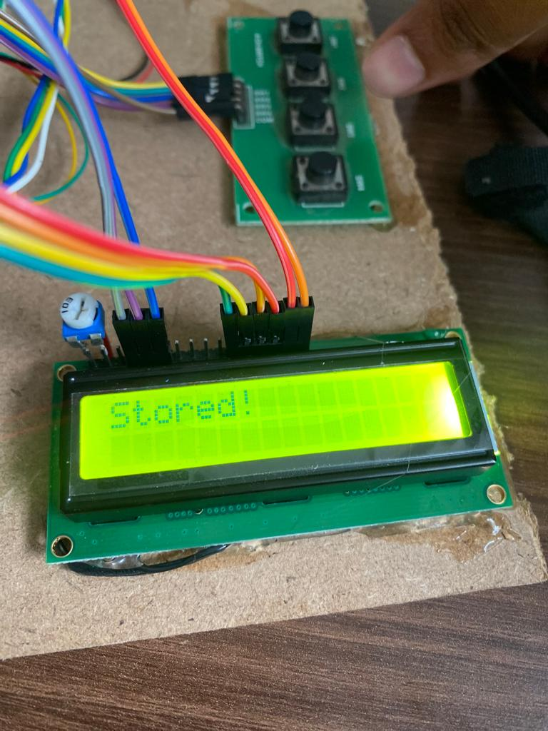
RESULTS AND CONCLUSION
In this project we have used LCD to indicate the status of the voting system.
Step 1:Enrolling of the fingerprints.

Slide 14
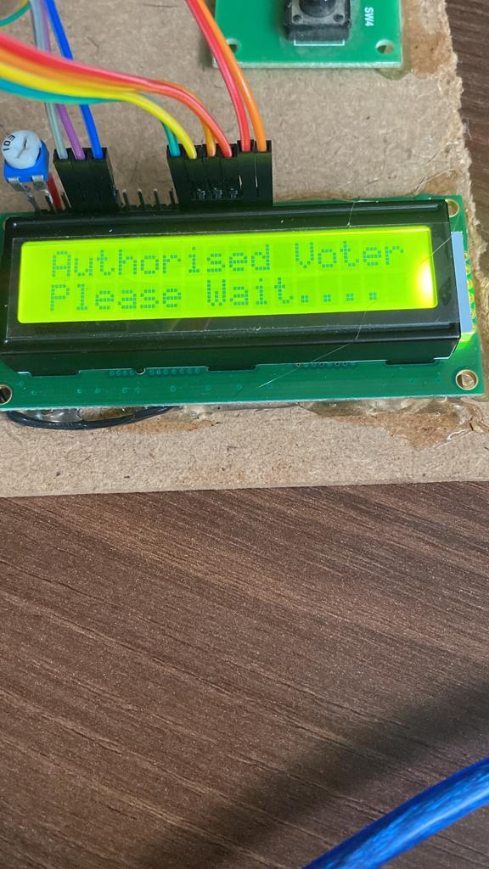
RESULTS AND DISCUSSION
Step 2:The voter’s identity will be checked by the fingerprints before casting the votes.
CASE 1: If voter has enrolled before casting his vote.

Slide 15
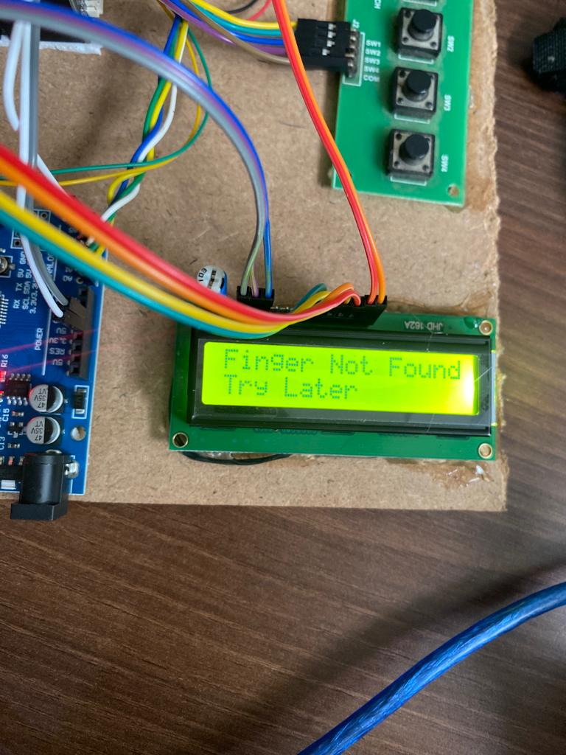
RESULTS AND DOCUMENTATION
CASE 2: If voter has not enrolled before casting his vote

Slide 16
REFERENCES
Research papers: 1. Rudrappa B. Gujanatti1 , Shivaram N. Tolanur2 ,Murughendra S. Nemagoud3 , Shanta S. Reddy4 , Sangameshwar Neelagund5 , Assistant Professor 1 ,Electronics and Communication Department K. L. E. Dr. MSSCET, Belgaum, India1,2,3,4,5, International Journal of Engineering Research & Technology (IJERT) ISSN: 2278-0181 IJERTV4IS050948, Vol. 4 Issue 05, May- 2015 -“A Finger Print based Voting System”. Available: https://www.ijert.org/research/a-finger-print-based-voting-system-IJERTV4IS050948
2. Khadija Hasta1 ,Aditya Date2 ,Aparna Shrivastava3 ,Prajakta Jhade4 , S. N. Shelke5 , Computer Engineering (SPPU), Pune, India1,2,3,4,5 , Published in 2019 International Conference on Advances in Computing, Communication and Control (ICAC3). -“Fingerprint Based Secured Voting”. Available: https://ieeexplore.ieee.org/document/9036777

Slide 17
REFERENCES
3. Mohammed Khasawneh1,Mohammad Malkawi2,Omar Al-Jarrah3,Laith Barakat4,Thaier S.Hayajneh5,Munzer.S.Ebaid6, College of Engineering, University of Illinois, Urbana- Champaign,Urbana,IL,USA1,AIM Wireless2, Jordan University of Science and Technology, Irbid, Jordan3,4,School of Information Systems, University of Pittsburgh, Pittsburgh, PA, USA5, King Abdullah IIDesign and Development Bureau, Amman, Jordan6,Published in 2008 5th International Symposium on Mechatronics and Its
Applications -“A biometric-secure e-voting system for election processes”.
Available: https://ieeexplore.ieee.org/document/4648818
4. Oluwatosin Adesua, University of Ibadan, March 2015, Thesis for: B.Sc. (Hons) -“Online voting system with biometric authentication for ui elections”.
Available:https://www.researchgate.net/publication/310597883_ONLINE_VOTING_SYSTEM_ WITH_BIOMETRIC_AUTHENTICATION_FOR_UI_ELECTIONS

Slide 18
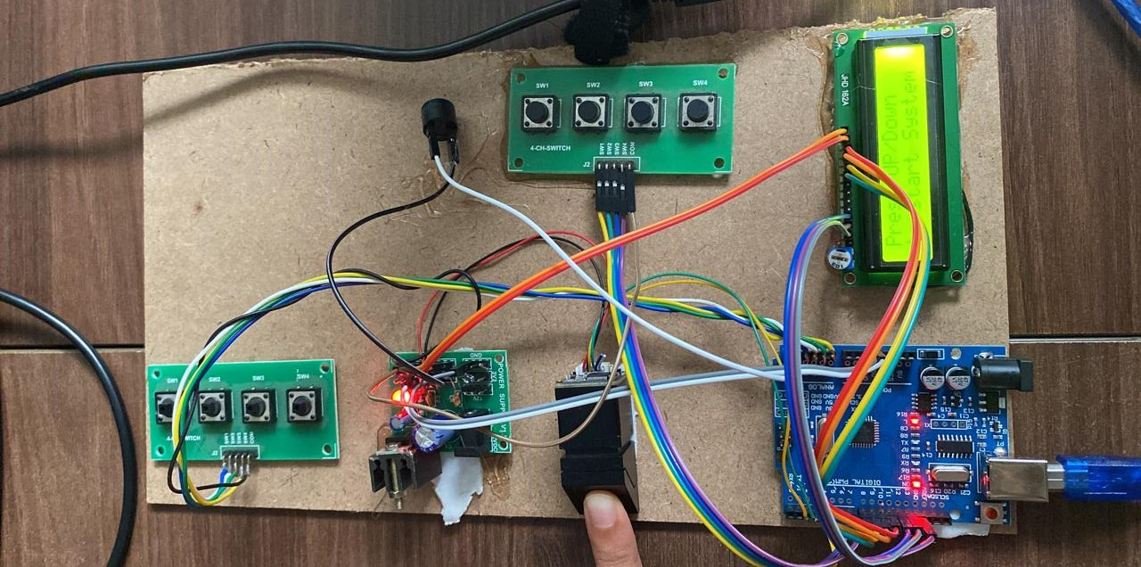
DEMO

Slide 19
THANK YOU

