Slide 1


Slide 2

PRESENTER:
Robert
Product Solutions Specialist
July 2018
Copyright © 2018 AdventureWorks, Inc. All rights reserved.

Slide 3
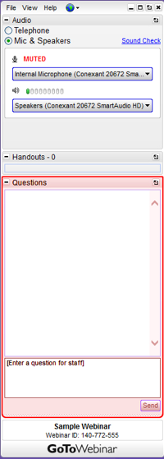
Q&A SEGMENT
Q&A segment will be at the end of the webinar.
Please enter your questions in the Questions window.
A recording of the webinar will be available within a week.
July 2018
Copyright © 2018 AdventureWorks, Inc. All rights reserved.

Slide 4
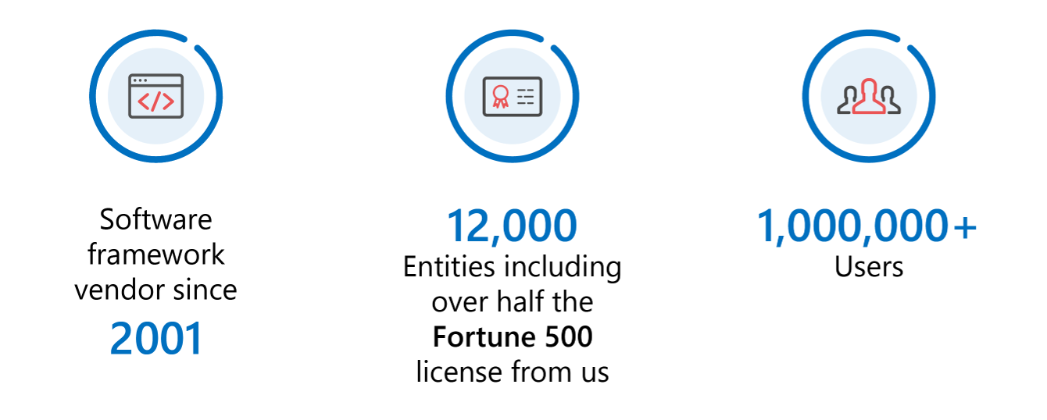
ABOUT Adventure Works
®
July 2018
Copyright © 2018 AdventureWorks, Inc. All rights reserved.

Slide 5






ALL THE TOOLS. ONE FLAT FEE. NO HASSLE.
Connect with us on social media:
Send us an email:
sales@adventureworks.com
July 2018
Copyright © 2018 AdventureWorks, Inc. All rights reserved.

