Slide 1

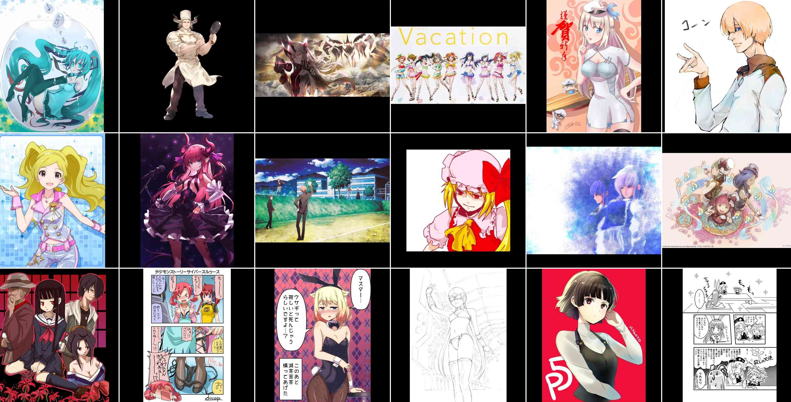
Efficient Tag Estimation on Cartoon using Deep Hierarchical Attribute Learning
Dong Yul Oh
Min Ki Jo
Ga Young Lee
Naver Webtoon Corporation
Motivation
Data Description
Deep learning has been successfully applied to approximate a complex many-to-one function well when a large amount of training data is provided.
However, it is still challenging to model complex structured output representations that effectively make diverse predictions.
DANBOORU2017: A Large-Scale Crowdsourced and Tagged Anime Illustration Dataset
2,233,928 images with 77,565,442 tags are uploaded and tagged by users.
The top 9 tags are 1girl, solo, long hair, highres, breasts, blush, short hair, smile, multiple girls.
The number of unique tags is 333,333 and the average number of tags per image is 26.
Main Idea
Separate given labels into high-levels and low-levels of which a hierarchical structure high-level labels includes sub-labels.
The high-level label classification can be more reliable, but easier than lower one. This provides a perceptual guideline similar with fine-grained classification.

Slide 2
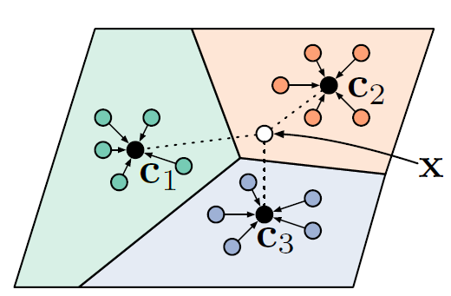
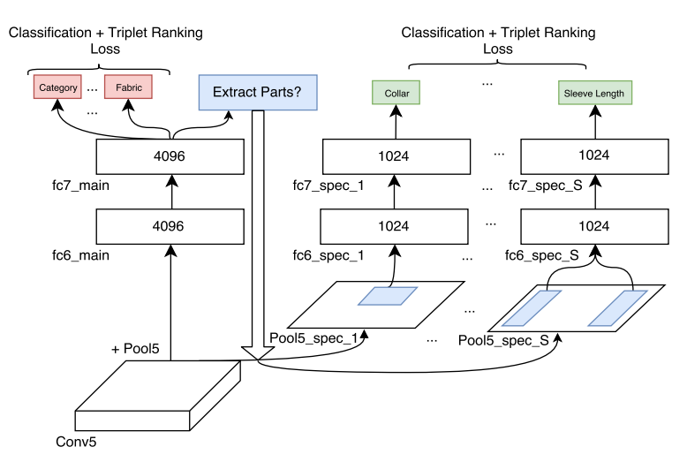
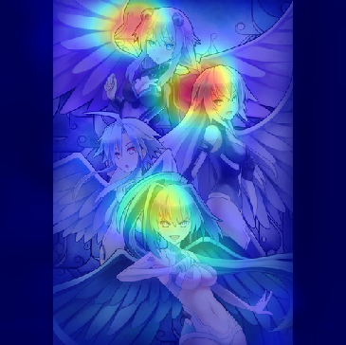
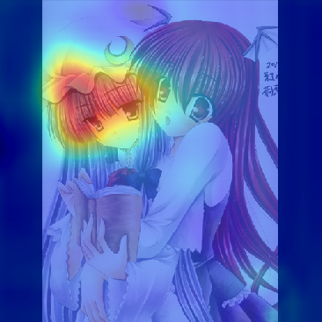
Baseline
Current Plan
Previous approach considers every attributes are independent each other.
However, the tags in Danbooru has a correlation. We will apply the hierarchical multi-attribute learning that considers inter-dependencies among labels.
G
F
Embedding Space (Tags)
Image Feature Extractor
Embedding
Matrix
Embedding model that maps from single input to many possible outputs. Current model directly learn this mapping (the image to multiple attributes).
It works well in usual cases, but suffers from trivial strategy such as visual tendency. We can improve this with pre-trained feature extractor on other similar domains for better representations.
Reference
Ak, Kenan E., et al. "Efficient Multi-Attribute Similarity Learning Towards Attribute-based Fashion Search." 2018 IEEE Winter Conference on Applications of Computer Vision (WACV). IEEE, 2018.
Sohn, Kihyuk, Honglak Lee, and Xinchen Yan. "Learning structured output representation using deep conditional generative models." Advances in Neural Information Processing Systems. 2015.

