Slide 1

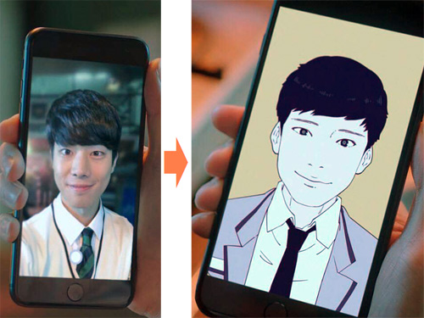
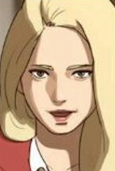
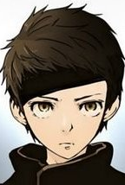
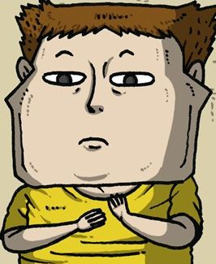
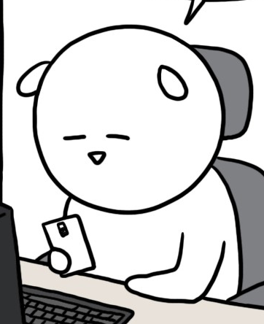
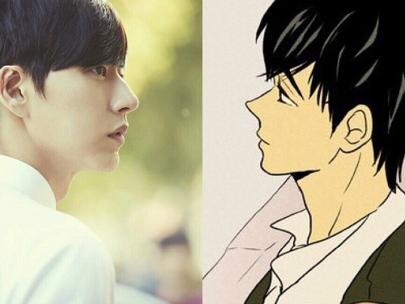
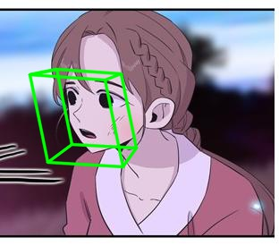
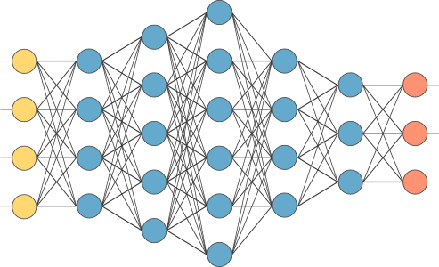
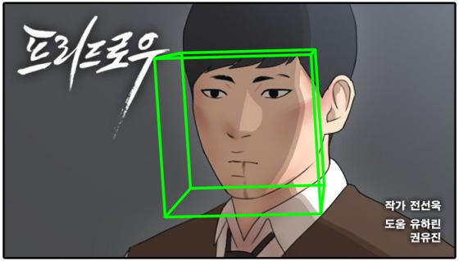
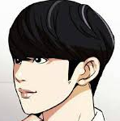
Unsupervised Learning for Face Image to Cartoon Image Translation
Min Ki Jo
Ga Young Lee
Motivation & Problem
Data Description
Realistic
Shaped like
a human
Highly abstract
Not a human
As we can see in webtoon ‘마주쳤다’, high quality face to cartoon character translation is already in service. However there are additional costs to apply the translation on other cartoons.
Every cartoonist has their own unique drawing style, so pictures from different cartoons have different domains. However, in general, target domains can be grouped by their level of the abstraction.
Face to cartoon translation can be generalized as unsupervised Image to Image translation.
In order to apply facial data analyzing model based on real human face data, cartoons in earlier two groups will be used for this project. (Realistic, human like …)

Slide 2
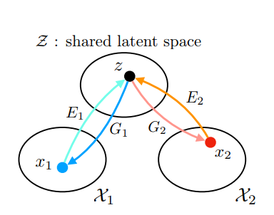
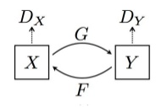
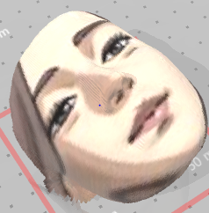
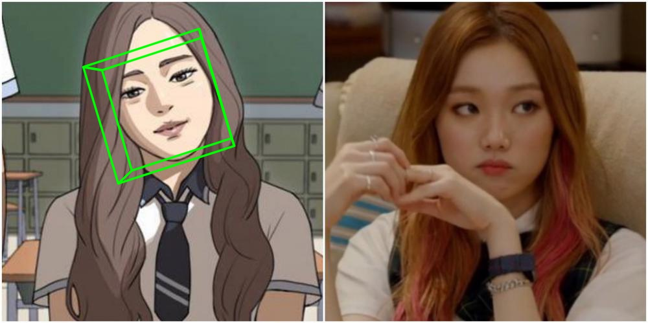
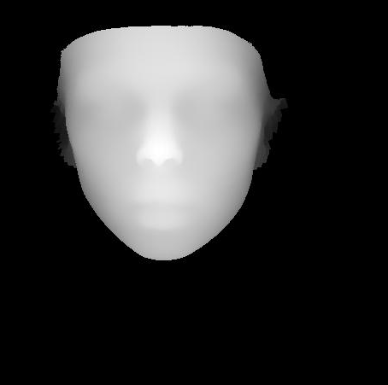

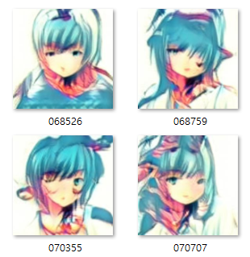
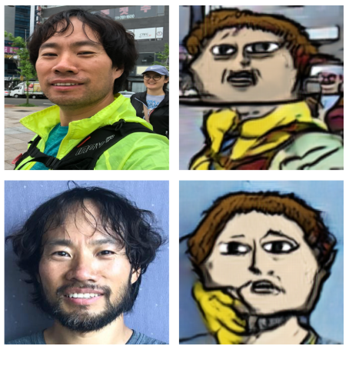
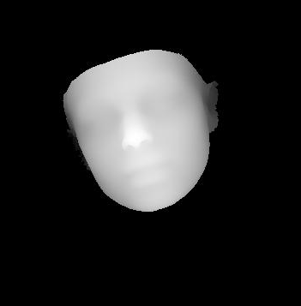
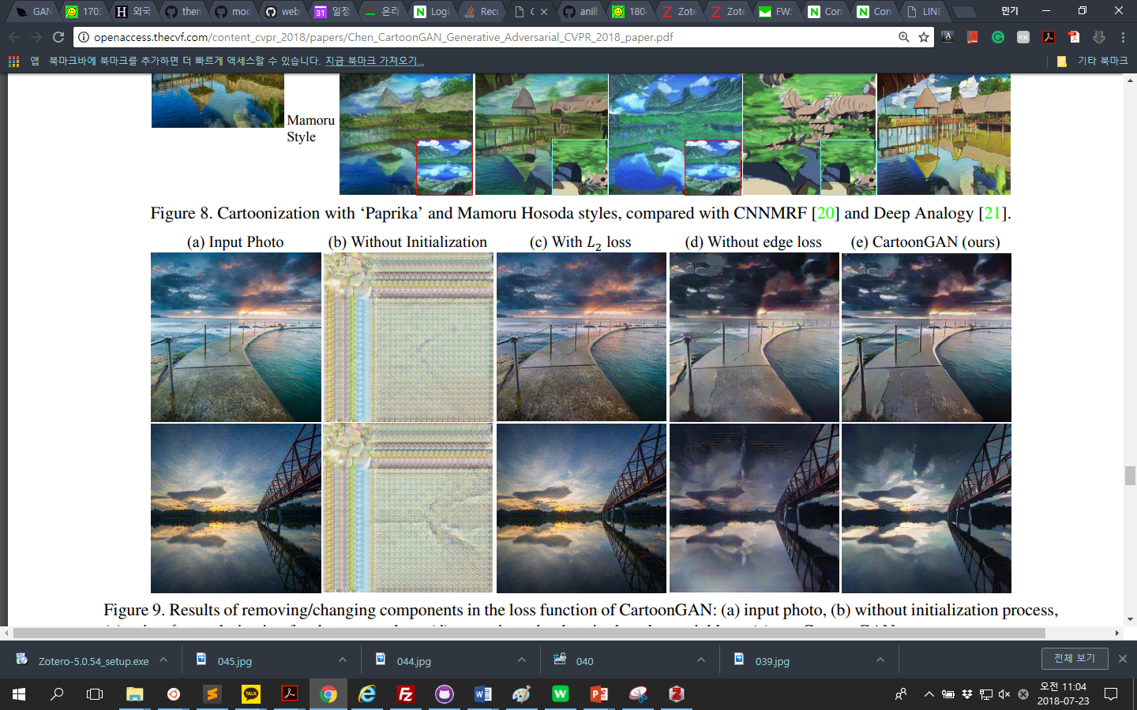
Baseline & Current Result
Current Plan
Currently, the main objective of the project is recovering the shape of the face so the parts of the face land on the place where they should be. Facial information will be used to do this.
I will use Cycle GAN and UNIT as the baseline. Both models generate cartoon like picture, but the shape of the generated face is distorted: eyes and nose tend to lose their position.
Source Image
3D facial contour
Target Image
UNIT 250k step
Former project (Based on UNIT)
There will be two phases in the training. 1. learn how to roughly construct the content (the original face). 2. Apply GAN loss so the generator will learn the cartoon style and detail expression.
Reference
Pix2Pix, CycleGAN, UNIT, CartoonGAN, PR NET
Input
Content
Style
Ming-Yu Liu, Thomas Breuel, Jan Kautz, “Unsupervised Image-to-Image Translation Networks”
Chandrasekhar Bhagavatula, Chenchen Zhu “Faster Than Real-time Facial Alignment: A 3D Spatial Transformer Network Approach in Unconstrained Poses”
When a side view of a cartoon character is given, human knows that the character has turned their face. However, what machine perceives is a slanted face. As a result, eyes and nose of the generated image slides off from where they are supposed to be. Thus, additional guidance would help the machine to understand the cartoon image.

