Slide 1

Unsupervised Learning for Face Image to Cartoon Image Translation
Min Ki Jo
Ga Young Lee
Naver Webtoon Corp.
Motivation
Data Description
Deep learning has been successfully applied to approximate a complex many-to-one function well when a large amount of training data is provided.
However, it is still challenging to model complex
structured output representations that effectively perform probabilistic inference
and make diverse predictions.
The chest X-rays, similar to other radiographs, are high-texture quality images of which the color depth it is very heavy to handle at least 1024×1024 size of these images.
Key Idea
The chest X-rays, similar to other radiographs, are high-texture quality images of which the color depth it is very heavy to handle at least 1024×1024 size of these images.

Slide 2
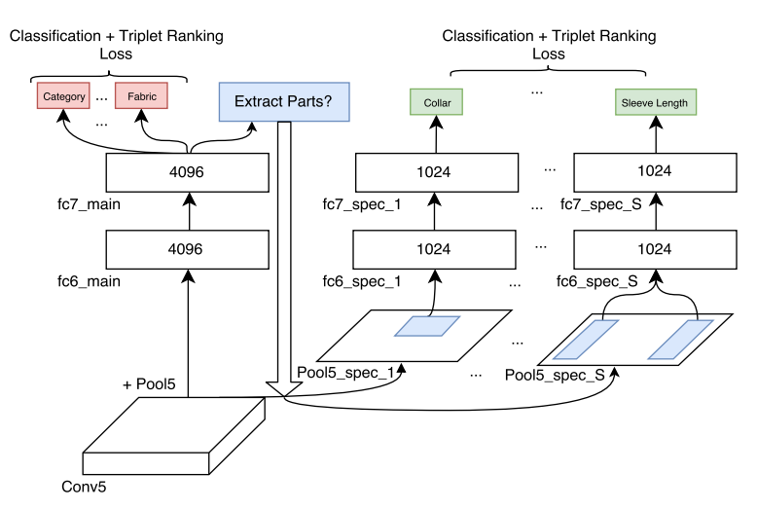
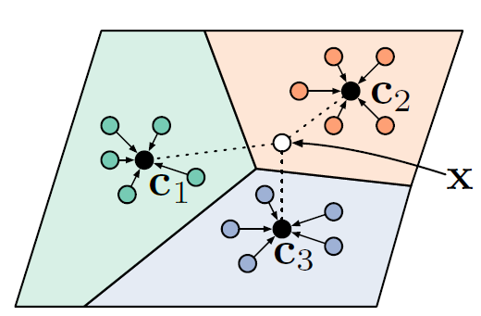
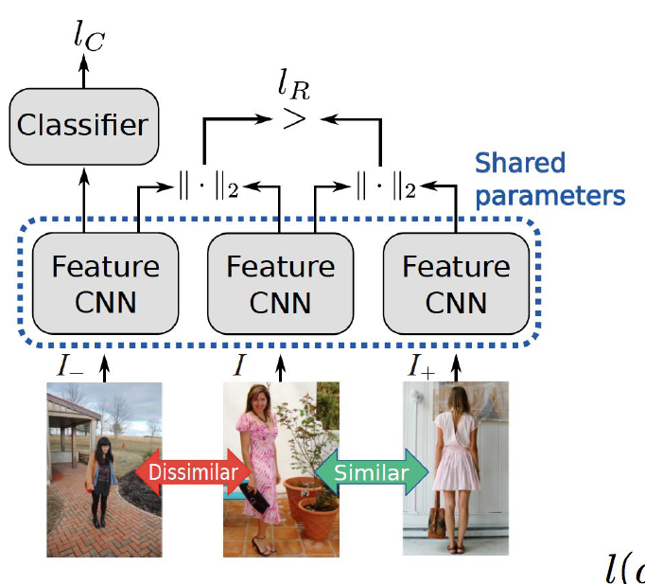
Baseline
Experiment Results
G
F
Embedding Space (Tags)
Image Feature Extractor
Embedding
Matrix
Embedding model mapping from single input to many possible outputs. Currently, our model learn the function that directly map the image to tags(multiple attributes).
Current model works well when every attributes are independent each other, but the tags in our problem has a correlation. Thus, we can apply the method for the hierarchical multi attribute classification problem.
Current model perform well for usual cases, but some times the network takes trivial strategy. We can improve this by adding pre-trained feature extractor so it gets better representation for the image data.

