Slide 1
Studying Variation and Change

Slide 2
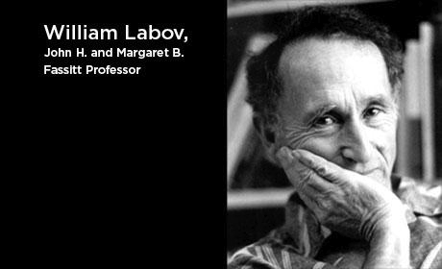
A scientist in action

Slide 3
A researcher’s approach:
Questions
Background Knowledge
Methodology
Analysis
Results
Discussion - interpretation
Conclusion

Slide 4
Questions
One of the pioneers of sociolinguistic research William Labov stresses that the most interestending problems of sociolinguistics are those that are related to language change. In his own words:
“For me, the largest questions that require analysis of social variation are the problems of language change: how such changes are initiated, how they are transmitted across generations, what drives them forward, how they reach completion” {Labov, 2006 #258, 508}
The problems that are related to language change have not been dealt successfully but those researchers that examine language as a synchronic but static system.

Slide 5
Questions
Another problem is according to Labov how social information is stored and in what form it is retrived {Labov, 2006 #258, 513}.

Slide 6
In an older work Labov positions the problem of explaining language in three distinct problems:
(a) the origin of linguistic variations.
(b) the spread and propagation of linguistic changes.
(c) the regularity of linguistic change.

Slide 7
First Generation Phase: The model which underlies this three-way division requires as a starting poing a variation in one or several words in the speech of one or two individuals.
Propagation Phase: These variations may be induced by the processes of assimilation or differentiation, by analogy, borrowing, fusion, contamination, random variation, or any number of processes in which the language system interacts with the psysiological or psychological characteristics of the individual.
Death Phase: Most variations occur only onse, and are extinguished as quickly as they arise.
Regularity Phase: However, a few recur, and in a second stage they may be imitated more or less widely, and may spread to the point where the new forms are in contrast with the older forms along a wide front.
Adultness: Finally, at some later stage, one or the other of the two forms usually thriumphs, and regularity is achieved.

Slide 8
Background Knowledge

Slide 9
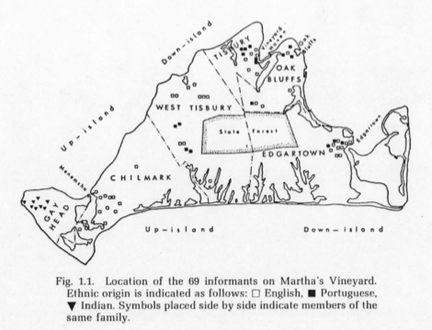
Martha’s Vineyard

Slide 10
The Place
Up-island: 3 cities where the ¾ of the total population live.
Down-island: rural area

Slide 11
The People
The 6,000 native Vineyarders fall into four ethnic groups which are essentially endogamous.
A. The descendants of the o1d families of English stock, who first settled the island in the 17th and 18th centuries: the Mayhews, Nortons. Hancocks, Allens, Tiltons, Vincents, Wests, Pooles—all closely related after ten generations of intermarriage.
B. There is a large group of Portuguese descent, immigrants from the Azores, Madeira, and the Cape Verde Islands. C. The third ethnic group is the Indian remnant at Gay Head.
D. The fourth is the miscellaneous group of various origins: English, French Canadian, Irish, German, Polish. > Labov does not consider this group.

Slide 12
Language
Vineyard “an island of r-pronouncers in a sea of r-lessness.” Labov (1972:6).
Lexical survivals of the 17th century English:
Bannock: fried cake of corn meanl
Studdled: dirty, roiled water
Tempest

Slide 13
The History of Centralized Dipthongs

Slide 14
/ay/
16th and 17th century: /ay/ was a mid-central vowel [əi] in right, pride, wine and wife. This is what Thomas Mayhew uttered in 1642 when he bought his new property in Martha’s Vineyard!
19th century: [əi] continued to be the favored form well into the 19th century.

Slide 15
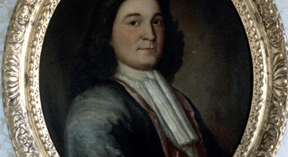
Thomas Mayhew, the Elder (March 31, 1593 – March 25, 1682)

Slide 16
/aw/
16th and 17th century: it is unlikely that Thomas Mayhew used /əʊ/ in out and house. The American evidence of the late 18th and 19th centuries, as summed up by Krap (1925, 192-6) point to /oʊ/ as the conservative, cultured form, giving way to [aʊ] or [ɑʊ], with the rural New England form as [æʊ] and [ɛʊ].
Martha’s Vineyard shows very little centralization of /aw/ in the LANE maps.
In any case, as the stage is set for our present view of Martha’s Vineyard diphthongs, /ay/ is well centralized, but /aw/ is not.

Slide 17
The Great vowel shift and Martha's Vineyward
The problem becomes all the more significant when it becomes apparanent that the present trend on Martha's Vineyard runs counter to the long-range movement of these diphthongs [namely, /ay/ and /aw/] over the past two hundred years. And while this sound change is not likely to become a phonemic change in the foreseeable future, it operates in an area where far-reaching phonemic sfits have taken place in the past. It is, in effect, the unstable residue of the Great Vowel Shift. Labov(1972, 9-10).

Slide 18
Labov in his studies refers to the linguistic variables (ay) and (aw) instead of the phonemes /ay/ and /aw/.

Slide 19
Methodology

Slide 20
Labov’s approach
In order to study this feature systematically, it was necessary to devise an interview schedule which would provide many examples of (ay) and (aw) in casual speech, emotionally colored speech, careful speech, and reading style.

Slide 21
1. A Lexical Questionnaire

Slide 22
Words containing (ay) and (aw)
spider rareripe iodine dying out sliding swipe quinine flattening out scrimy dowdy white bread nigh outhouse
white of egg pie frying pan backhnnse nightcrawler sty fry pan crouch
lightning bug firefly mow Italian shiretown rowen

Slide 23
2. Questions concerning value judgments, exploring the social orientation of the respondent, were so phrased as to elicit answers containing (ay) and (aw) forms.20

Slide 24
3. A special reading, used mainly in the high school, was offered ostensibly as a test of the ability to read a story naturally. Since these readings gave the most exact comparisons between speakers, they were utilized for the spectrographic measurements discussed below.

Slide 25
Supplementary Material
In addition to the formal interview, observations were made in a great many casual situations: on the streets of Vineyard Haven and Edgartown, in diners, restaurants, bars, stores, docks, and many places where the general sound of public conversation could be noted, if not effectively recorded.
→ But these notations only served as a supplementary check on the tape-recorded interviews.

Slide 26
Analysis

Slide 27
SPEECH ACOUSTICS

Slide 28
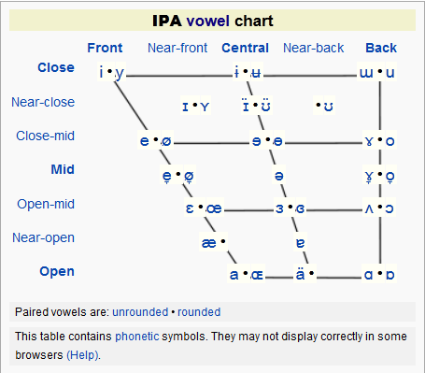

Slide 29
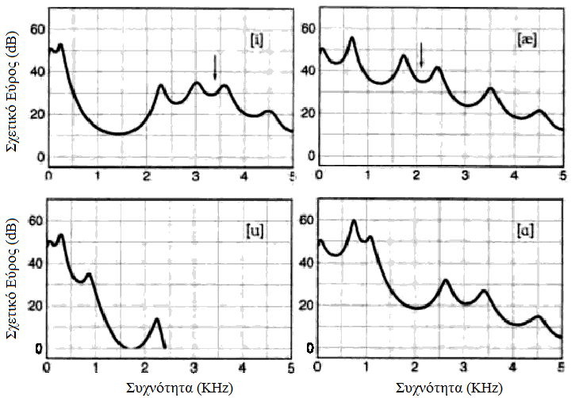
Spectral slice – English Vowels

Slide 30
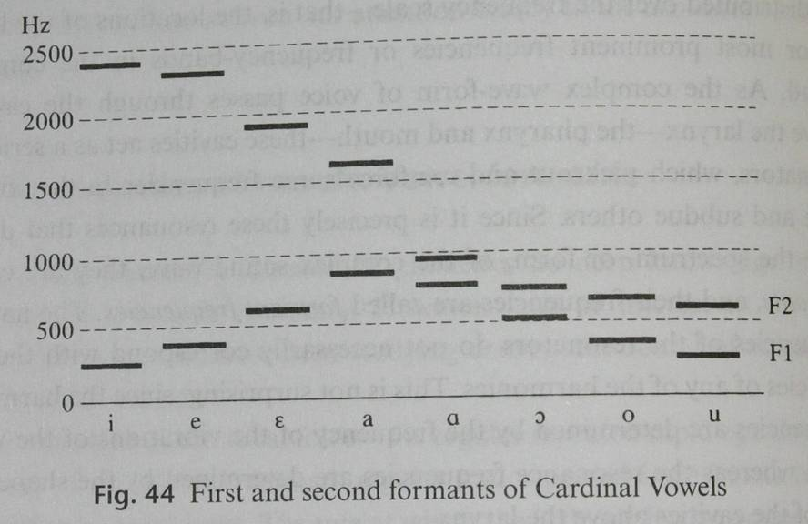
FORMANTS and vowels

Slide 31
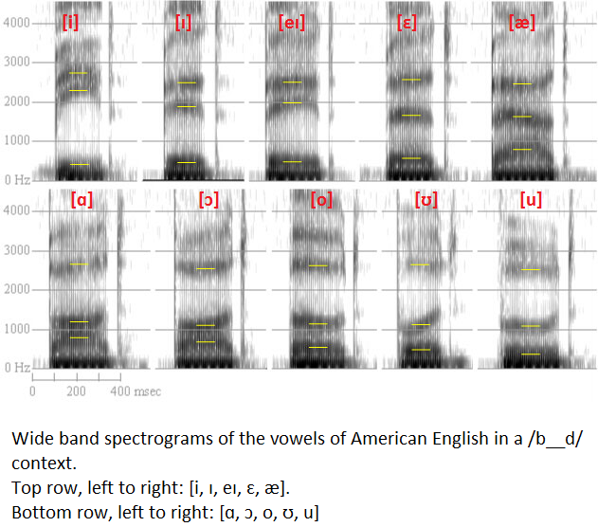

Slide 32
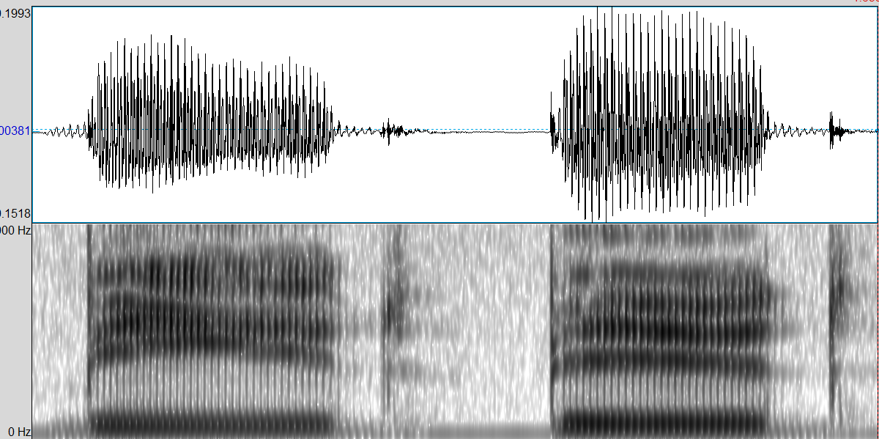
[i:] [ɪ]

Slide 33
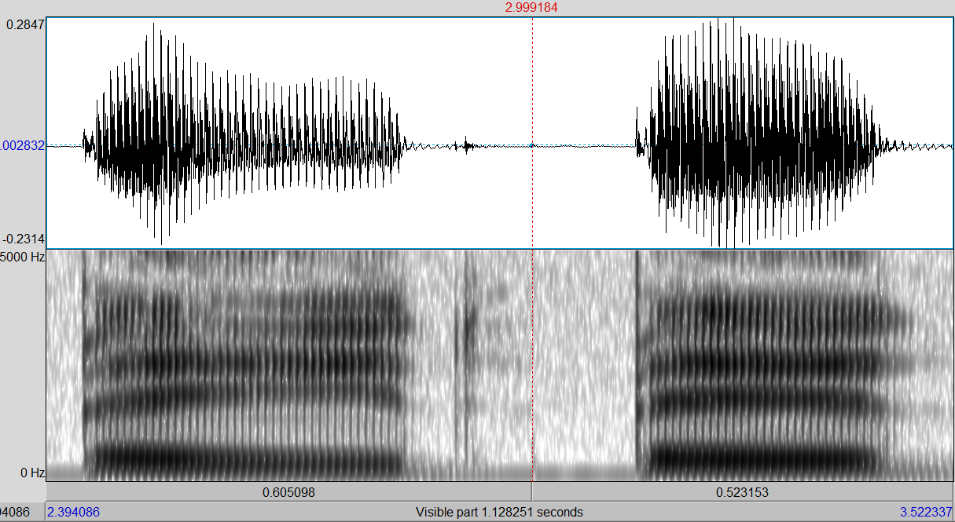
[eɪ] [ɛ]

Slide 34
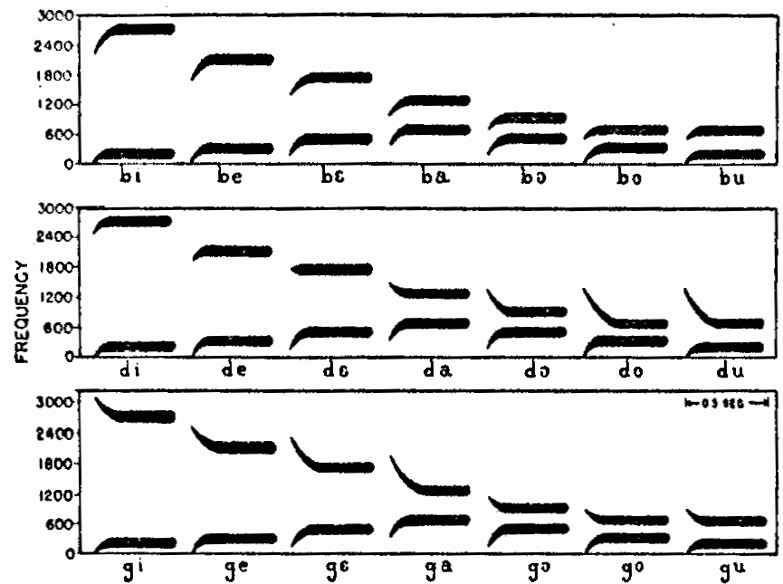
Vowel Formants & Preceding Consonants
Stylised spectrograms showing F1 and F2 transitions
Stylised spectrograms showing F1 and F2 transitions

Slide 35
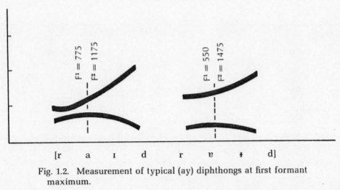
Scales of Measurement
An important step was to construct a reliable, inter-subjective index to the degree of centralization. In the original transcriptions of the tape-recorded interviews a six-point scale of height of the first element was used, ranging from the standard New England form [aɪ] to the fully centralized [əɪ].

Slide 36
Results

Slide 37
The Linguistic Environment
We can now plot the distribution of centralized forms for each speaker. This is done for each of the 69 interviews on a chart such as is shown in Fig. 1.4. We find that these charts fall into three basic types: a. uncentralized norms: all words, or almost all, fall into Grade 0, with at most only a few Grade 1’s in favored words such as right and out. b. centralized norms: most words with Grade 2, and only a few Grade 1’s for unfavored forms, such as time and cow. c. phonetic conditioning: the influence of the phonetic environment is reflected in a range of values from Grades 0 to 2. Fig. 1.4 is an example of this type.

Slide 38
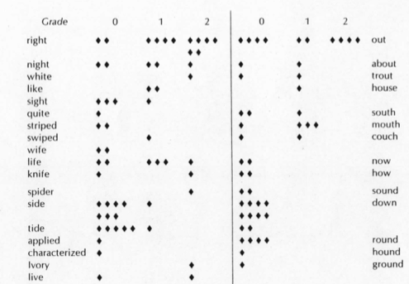
Results

Slide 39
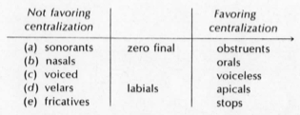
Interpreting Variation
Segmental Factors

Slide 40
Interpreting Variation
Prosodic Factors
The effect of stress (centralization)

Slide 41
Interpreting Variation
Stylistic Factors
(read the article)

Slide 42
Interpreting Variation
Lexical Considerations
(read the article)

Slide 43
Interpreting Variation
Distribution by Age and Time
(read the article)

Slide 44
The interaction of Linguistic and Social Factors

Slide 45
Centralization among other ethnic groups

Slide 46
The social meaning of centralization
(read the article) - SOS

Slide 47
The intersection of social and linguistic structures
Explaining the spread and propagation of this particular linguistic change.
1. A language feature used by a group A is marked by contrast with another standard dialect. 2. Group A is adopted as a reference group by group B, and the feature is adopted and exaggerated as a sign of social identity in response to pressure from outside forces. 3. Hypercorrection under increased pressure, in combination with the force of structural symmetry, leads to a generalization of the feature in other linguistic units of group B. 4. A new norm is established as the process of generalization levels off. 5. The new norm is adopted by neighboring and succeeding groups for whom group B serves as a reference group.

Slide 48
Limitations of the study
(read the article) - SOS

