Slide 1
Parallels
Colin Jacobs
JWST MASTER CLASS MELBOURNE 2022

Slide 2
Parallels
Parallel observations allow two (or more) instruments being used simultaneously (e.g., ACS, WFC3 on HST);
JWST will have two types of parallel observations:
Pure parallels when GO programmes can observe with an instrument not being used by the proposer, for a completely unrelated science case;
Coordinated parallels when observations with two different instruments are carried out, addressing a single science case which must be justified when making the proposal.
The use of parallels has increased the expected efficiency of JWST by 16—26%
One should note that some instrument calibrations will be taken in parallel mode and these observations take precedence over pure parallels.

Slide 3
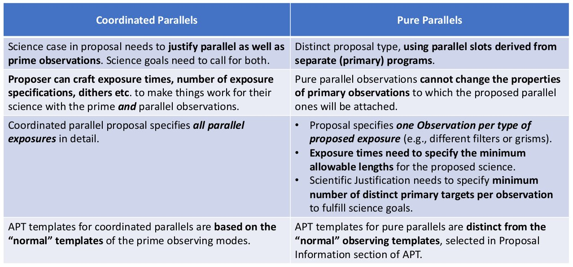
Cordinated and Pure compared
P. Goudfrooij 2019 STScI Master Class

Slide 4
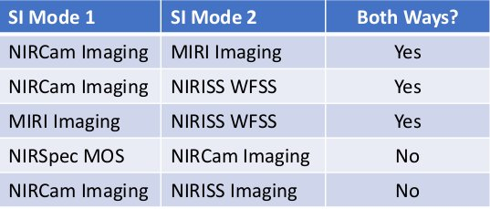
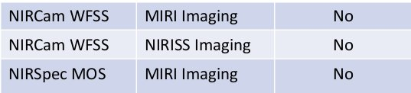
Coordinated parallels for Cycle1
P. Goudfrooij 2019 STScI Master Class

Slide 5
Coordinated Parallels
Are designed to optimise the Point Spread Function (PSF) sampling of both instruments in use.
There are certain limitations:
No mechanisms should be moved or calibration sources turned on while either instrument is acquiring data;
The exposure duration of a parallel instrument cannot be longer than the primary’s ;
Data volume is a parameter that requires careful consideration (particularly when all NIRCam detectors are being used).

Slide 6
The Exercises
There will be two exercises in this session with the emphasis on how to fill in the APT.
The first was designed for this workshop to give users basic training to prepare coordinated parallel observations.
The second was prepared for the STScI Master Class in 2019 November. The documentation is ample and allows users filling the APT files on their own.

Slide 7
Further reading
For more details on parallels (both Coordinated and Pure):
https://jwst-docs.stsci.edu/jppom/parallel-observations

