Slide 1
ETC hands-on
Colin Jacobs
JWST MASTER CLASS MELBOURNE 2022

Slide 2
Case 1: Mid-IR spectroscopy of a Y dwarf

Slide 3
MIRI low-resolution spectroscopy of a Y dwarf
Goal: understand whether these atmospheres are shaped by chemical disequilibrium driven by vertical transport or the formation of water clouds and constrain the object’s gravity, hence mass.
Method: obtain low-resolution spectroscopy from 5 to 12 µm with MIRI. Broad wavelength coverage is needed to constrain temperature, gravity.
These observations are complementary with NIRSpec spectroscopic observations presented in the Slit Spectroscopy Hands-On exercise.

Slide 4
Observational setup/ Source and Scene
Target is modelled on (but not fully physically representative of) the Y Dwarf WISE J035000.32-565830.2 (Kirkpatrick et al. 2012):
RA, Dec = 03:50:00.328, -56:58:30.23
Spectral type = Y1
F140W (HST/WFC3) = 22.3 ± 0.20 (vega mag)
Use the above coordinates for background setting, and choose level Medium
We use a custom uploaded spectrum in the ETC from the models of Morley et al 2014 (available online), assuming T 450K, log g of 4.7. This lists wavelength in µm, flux density in mJy, as required by the ETC.
Model the dwarf as a point source
Renormalise the spectrum to the above magnitude

Slide 5
Instrument & Detector
Use the MIRI LRS calculation in the “slit” setting. This pre-selects the P750L disperser (the double prism), and the FULL array readout pattern.
Strategy: Aperture Spectral Extraction
Choose sensible dimensions for the sky sample region and aperture half-height
Select 7.5 µm for the wavelength of interest
Configure exposure settings to achieve a SNR ≥ 10 at the reference wavelength

Slide 6
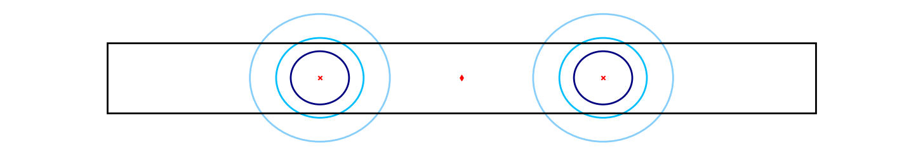
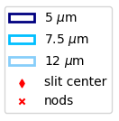
Tips
Tip 1: the LRS standard point-source dither pattern consists of 2 pointings along the slit, which are combined by the pipeline. This pattern is simulated by setting “exposures per specification’ to 2
Tip 2: you should aim for integration lengths of around ~300 s. Integrations should be < 1000 s to avoid too many cosmic ray impacts.
Tip 3: Use the “Expand “ feature to explore the SNR variation vs. groups or integrations

Slide 7
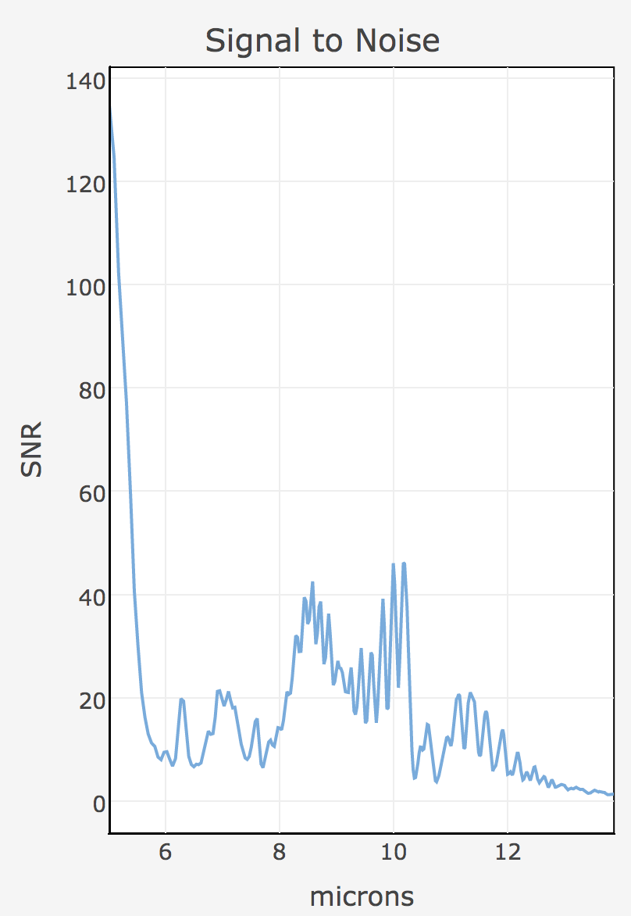

Slide 8
Target Acquisition
MIRI LRS requires very accurate placement of the target in the slit to achieve the best calibration. Investigate the best TA settings using the dedicated “Target Acquisition” calculation in the ETC. For best results, you should aim for SNR > 20 on the TA image.
Instrument setup:
TA for LRS slit, MRS and LRS slitless
Filter: F560W
Choose an appropriate readout mode and number of groups from the available lists to reach SNR > 20.
Conclusion: can this target be used for TA, or should we find a nearby offset target?

Slide 9
Case 2: Multi-Object Spectroscopy of a Deep Field of Distant Galaxies

Slide 10
NIRSpec Multi-Object Spectroscopy of distant galaxies
In this exercise we will use the Exposure Time Calculator to prepare MOS observations with NIRSpec of a Deep Field.
The ETC output will be used in tomorrow’s MOS hands-on activity.
Program Science Goal
Studying the evolution of galaxies from the earliest times (z > 10) through the end of the dark ages (z ~ 7-9) to the epoch of galaxy assembly (z ~ 2-6)

Slide 11
Exercise overview
Methodology: A “full” program would include NIRCam imaging of the field, followed by NIRSpec MOS observations. This exercise uses simplified approach focusing on the latter component, with a single galaxy in the field at z ~ 6.
Planned observations: NIRSpec MOS observation at low and medium spectral resolution
Source types: a galaxy at z ~ 6, modelled as a compact object
Observation strategy: combination of nodding and dithering, using 1 x 3 microshutter slitlets.

Slide 12
Instrument Configuration
Low spectral resolution (CLEAR/PRISM):
good continuum sensitivity
wide wavelength coverage (0.6 – 5.3 µm at once)
higher multiplex MOS thanks to shorter spectra
But: lack of spectral resolution
Medium spectral resolution (F100LP/G140M), F170LP/G235M, F290LP/G395M):
clean separation of emission lines
accurate information on the position of the line centroids
But: need 3 configs to cover 1-5.2 µm range + will see some overlap between spectra
These modes provide highly complementary capabilities so will ALL be used.

Slide 13
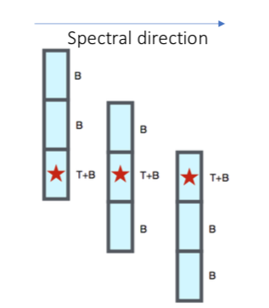
Observation strategy: Basic building block
3-shutter nodding pattern. In MOS mode, the recommended pattern for faint and compact sources is called a 3-shutter nodding pattern. It constitutes the basic building block for our MOS observations.
The baseline observing strategy is to “nod”, i.e. to move the object in each shutter in 3 consecutive exposures.
For compact objects, this strategy allows powerful exposure-level background subtraction:
[T+B] – 0.5 * ([B] + [B])
Using this scheme, the number of exposures is a multiple of 3
Each object is assigned a “slitlet” consisting of 3 shutters

Slide 14
ETC Calculations

Slide 15
ETC I: Low-resolution spectroscopy
Task: prepare an ETC calculation for a ~100 ks NIRSpec MOS observation using the prism disperser (i.e. low spectral resolution) of a z~6 galaxy with AB magnitude of 27.5 (~50 nJy) at 2 µm.
Scene and source: a z ~ 6 galaxy with AB mag = 27.5
model the galaxy as a singe point source
use the Brown et al template spectrum for a Blue Compact Dwarf galaxy, redshifted to z~6
remember to normalise to the correct magnitude or flux

Slide 16
ETC I: Low-resolution spectroscopy
Observation strategy:
assume medium background at 03:32:28.0, -27:48:30
extraction: use MSA full shutter extraction
Instrument setup: NIRSpec MOS with CLEAR/PRISM
Detector setup: NRSIRS2 (recommended for long exposure and faint-object observations); ~1.5 ks per exposure. Calculate the number of groups.
What is the SNR we expect for this galaxy?

Slide 17
ETC II: S/N for emission lines
The medium-resolution modes will be used to characterize the emission lines in more detail. Task: prepare an ETC simulation with 3 calculations: observing an emission line source with the 3 med-resolution filter/grating combinations for a total exposure time of ~100 ks.
Scene and source: create a point source in a new scene with 3 redshifted emission lines, as per the table on next slide.
Instrument setup: NIRSpec MOS, 3-shutter slitlet; F100LP/G140M, F170LP/G235M, F290LP/G395M
Detector setup: NRSIRS2 (recommended for long exposure and faint-object observations); ~1.5 ks per exposure

Slide 18
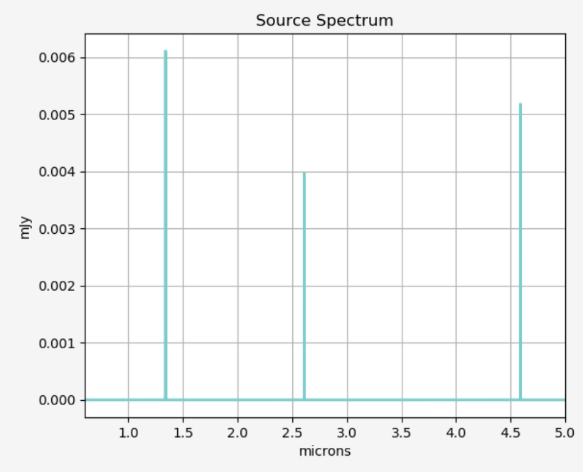
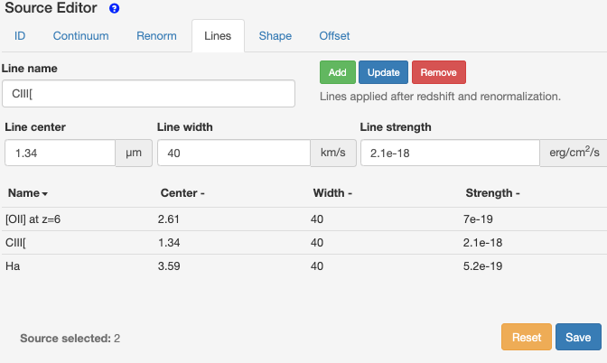
Emission line properties
Name | Centre | Width | Strength
[OII] at z=6 | 2.61 | 40 | 7e-19
CIII[ | 1.34 | 40 | 2.1e-18
Halpha at z=6 | 4.59 | 40 | 5.2e-19

Slide 19
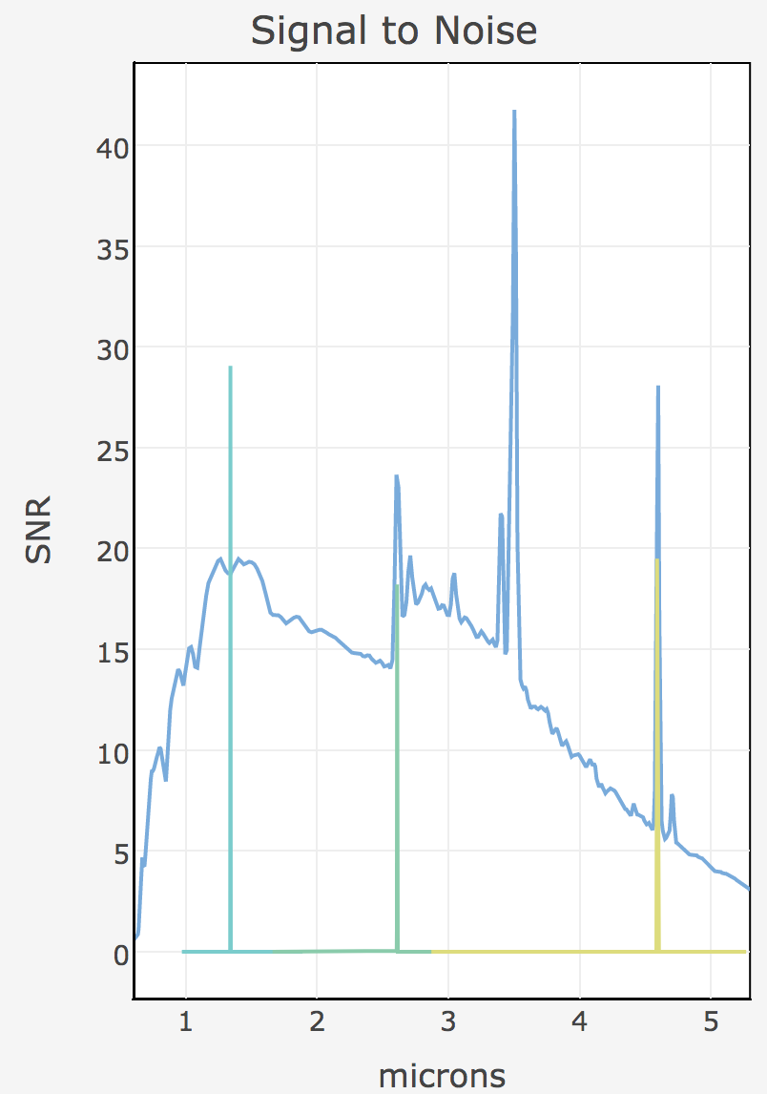
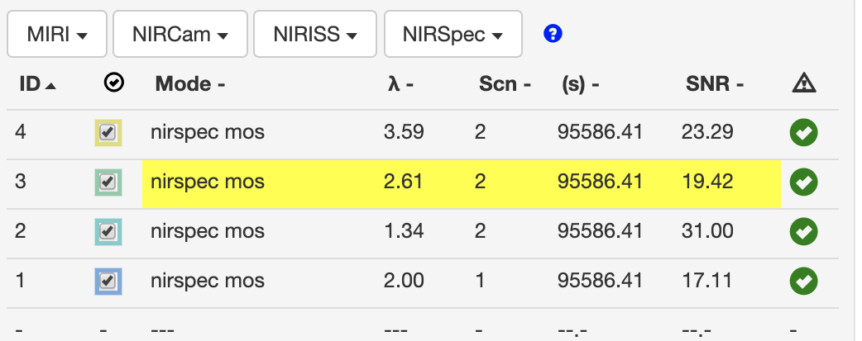
Emission lines ETC calculations

Slide 20
Further reading
JWST ETC documentation section: https://jwst-docs.stsci.edu/jwst-exposure-time-calculator-overview
JWST ETC User Supplied Spectra https://jwst-docs.stsci.edu/jwst-exposure-time-calculator-overview/jwst-etc-scenes-and-sources-page-overview/jwst-etc-user-supplied-spectra
JWST ETC overview of Calculations https://jwst-docs.stsci.edu/jwst-exposure-time-calculator-overview/jwst-etc-calculations-page-overview
JWST ETC to APT interface https://jwst-docs.stsci.edu/jwst-etc-to-apt-interface-support-information

