Slide 1
MOS hands-on
Themiya Nanayakkara
JWST MASTER CLASS MELBOURNE 2022

Slide 2
NIRSpec MOS hands-on
Multi-object spectroscopy of distant galaxies
In this hands-on session you will be asked to use
The Astronomer’s Proposal Tool (APT)
More specifically, the MOS Planning Tool (MPT) which is part of the APT
The same science case was already part of the ETC hands-on, so much of the observation planning is assumed to have been completed

Slide 3
Thinking about strategies - recap

Slide 4
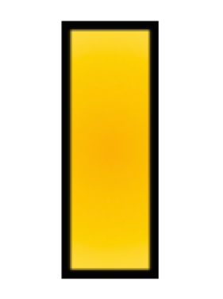
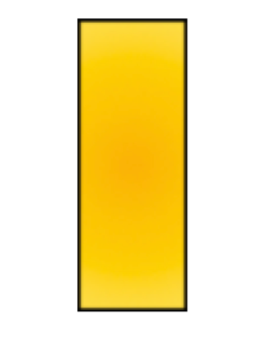


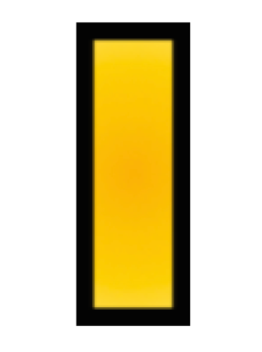
Shutter planning constraints
Slit loss is a function of the relative location in the shutter
MPT allows adjustment of the constraint on where sources can be placed in shutters
 | Unconstrained (source may be behind the bar) | Entire open shutter area (default) | Midpoint | Constrained | Tightly constrained
Minimum relative flux transmission at 2.95μm | 12% | 30% | 62% | 75% | 85%

Slide 5
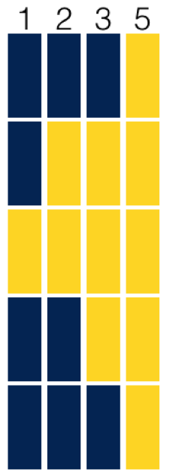
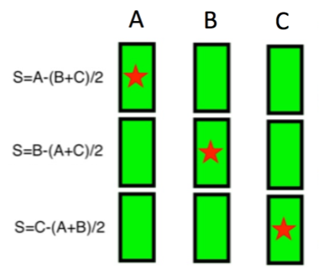
Nodding
Open slitlets in cross-dispersion direction
There are four selectable slitlets in MPT: 1, 2, 3, 5
Telescope is repositioned slightly between exposures
No MSA re-configuration
Background subtraction between nodded exposures
Improves PSF sampling and bad pixel mitigation
The spectrum from a slitlet will be segmented, with bar shadows between the individual shutters

Slide 6
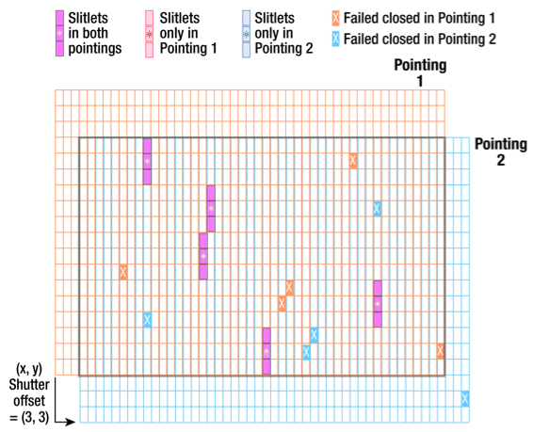
Dithering (fixed dither)
Telescope repointed and MSA re-configured so many of the same sources fall in different shutters
Can be used to cover the wavelength gap
Improves PSF sampling and mitigates bad pixels
Allows observation of additional sources e.g. those behind shutter bars or the MSA mounting plate
Can mitigate effects of light leakage through MSA
During optimisation, MPT will attempt to observe as many sources as possible at all dithers
Nodding and dithering can be used alone or together

Slide 7
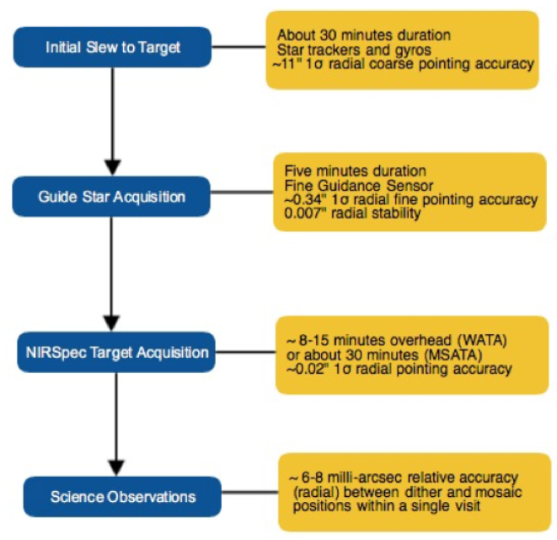
Target acquisition
MSATA is expected to be the usual TA method for the MOS
uses 5-8 reference stars over the entire MSA FoV
8 chosen as a trade-off between TA accuracy and overheads
MPT used to select reference stars at the assigned APA that will not be behind MSA bars or in failed shutters. This vetting is done at the Visit level at the first pointing in the Visit

Slide 8
Pre-imaging with NIRCam
Is imaging available with
deep enough to identify sources?
wide enough to fill the MSA and plan reference stars?
accurate enough astrometry to plan MOS?
If not, request NIRCam pre-imaging in your proposal
accurate enough astrometry to plan MOS?
NIRCam image should be large enough to allow for any NIRSpec APA
Ideally 5x5 arcmin
typically a 2x1 mosaic + dithers to cover gaps
NIRCam observations must be flight ready at proposal submission

Slide 9
The science case

Slide 10
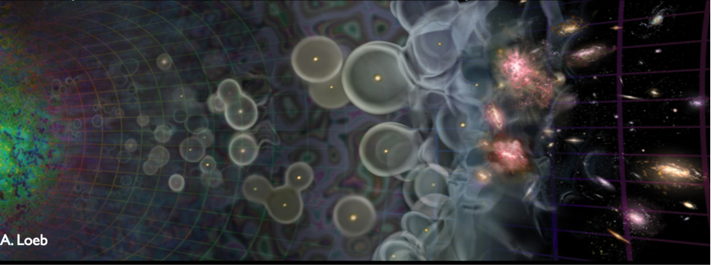
Science overview
Goal
This program aims to study the evolution of galaxies from the early Universe (z>10), through the end of the dark ages (z=7-9), to the epoch of galaxy assembly (z=2-6)
Understanding very early stages of galaxy formation
Probing the epoch of re-ionization and the role of galaxies
Constraining the build-up of stellar mass and metals through time
Understanding the role of AGNs.
And looking for surprises…

Slide 11
Observation methodology
Methodology
An in-depth program of this type would typically combine deep imaging (NIRCam) and follow-up spectroscopy (NIRSpec MOS)
In the following, we will use a much simpler example:
deep NIRSpec MOS observations at a single location
input source catalog derived from existing HST imaging
Spectral configuration
MOS at low and medium spectral resolution
Type of sources
Galaxies over a wide range of redshifts handled as compact (point-like) objects
Observation strategy
Combination of nodding (1x3 slitlets) and dithering

Slide 12
Instrument configuration
Low spectral resolution (CLEAR/PRISM)
sensitivity to continuum
wavelength coverage (0.6-5.3 μm at once)
higher-multiplex MOS thanks to the shorter spectra on the detector
Main drawback: lack of spectral resolution…
Medium spectral resolution (F100LP/G140M, F170LP/G235M, F290LP/G395M)
clean separation of emission lines
allows accurate centroid calculation for the lines
Main drawback(s):
3 configurations required to cover 1.0-5.2 μm
high multiplex only possible if spectra allowed to overlap
Configurations give complementary information: include all 4

Slide 13
Getting started

Slide 14
Getting started
Follow the steps on the handout
Plan your observation strategy
Open APT
Load the catalogue
Set-up the MPT Planner
Generate the plan
Create the observation

Slide 15
Cheat screenshots…

Slide 16
Plan your observation
Dither | Nod | CLEAR/PRISM | F100LP/G140M | F170LP/G235M | F290LP/G395M
1 | 1 | 8 | 3 | 3 | 3
 | 2 | 8 | 3 | 3 | 3
 | 3 | 8 | 3 | 3 | 3
2 | 1 | 8 | 3 | 3 | 3
 | 2 | 8 | 3 | 3 | 3
 | 3 | 8 | 3 | 3 | 3
3 | 1 | 8 | 2 | 2 | 2
 | 2 | 8 | 2 | 2 | 2
 | 3 | 8 | 2 | 2 | 2
TOTAL Exps |  | 72 | 24 | 24 | 24
NOTE: for simplicity, create a program with 27 exposures per medium-resolution grating

Slide 17
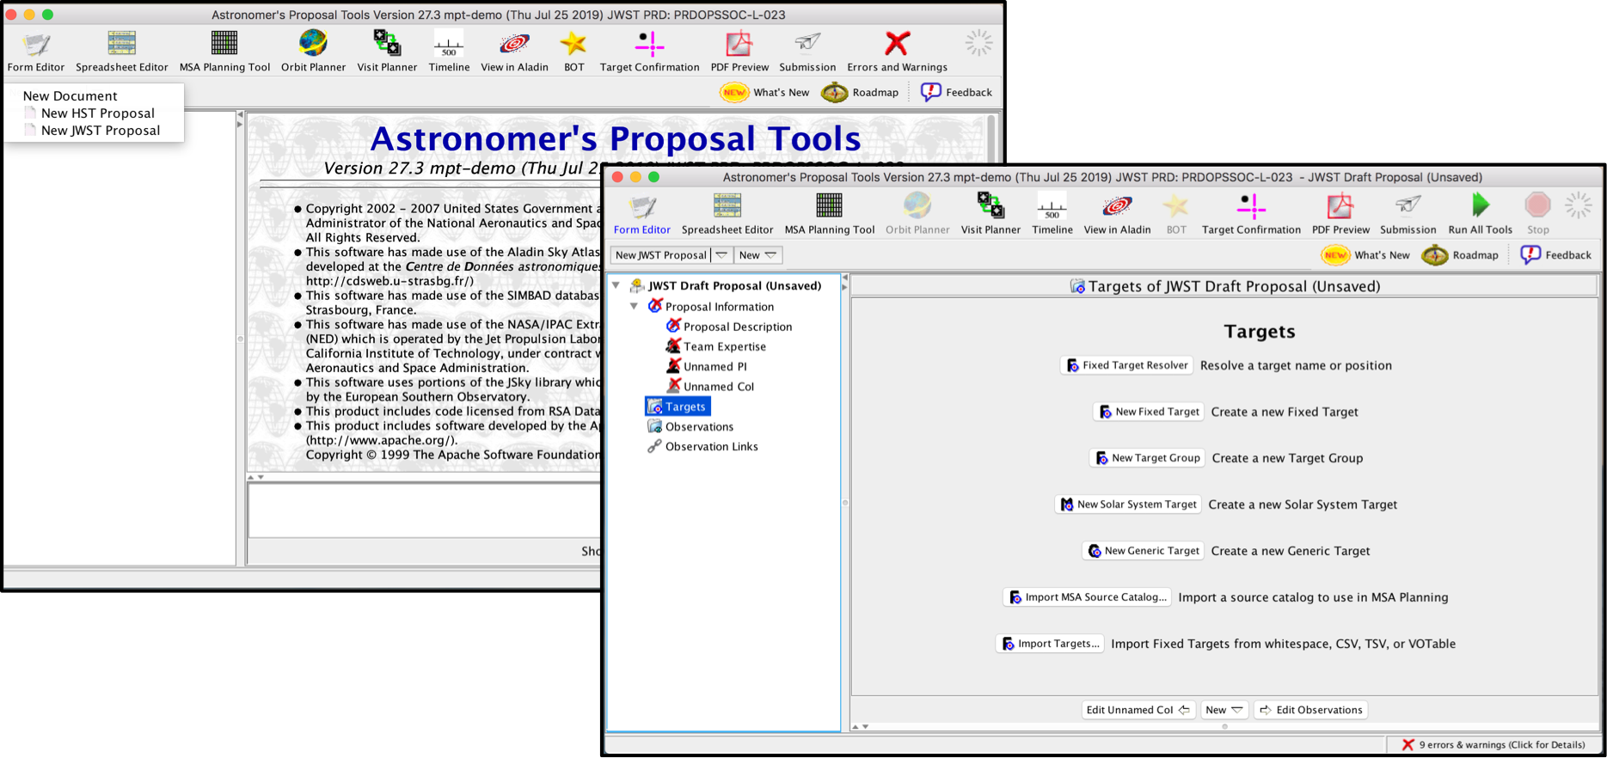
Open APT

Slide 18
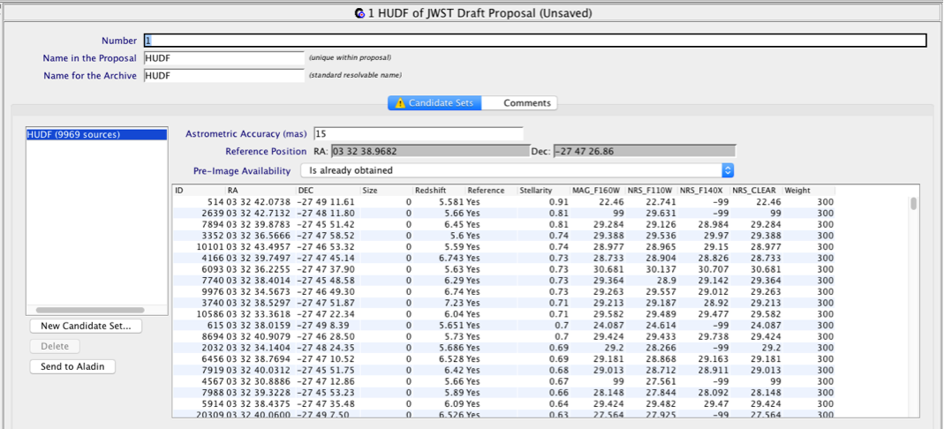
Load the catalogue

Slide 19
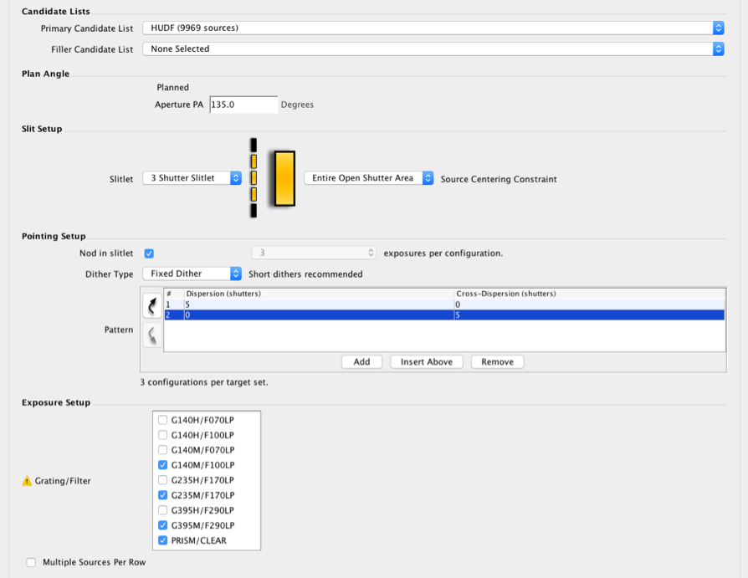
Set-up the MPT planner

Slide 20
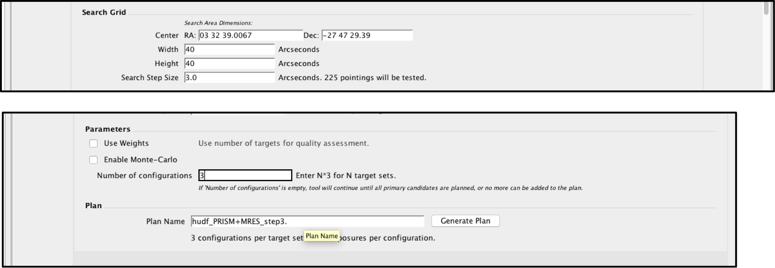
Planner parameters

Slide 21
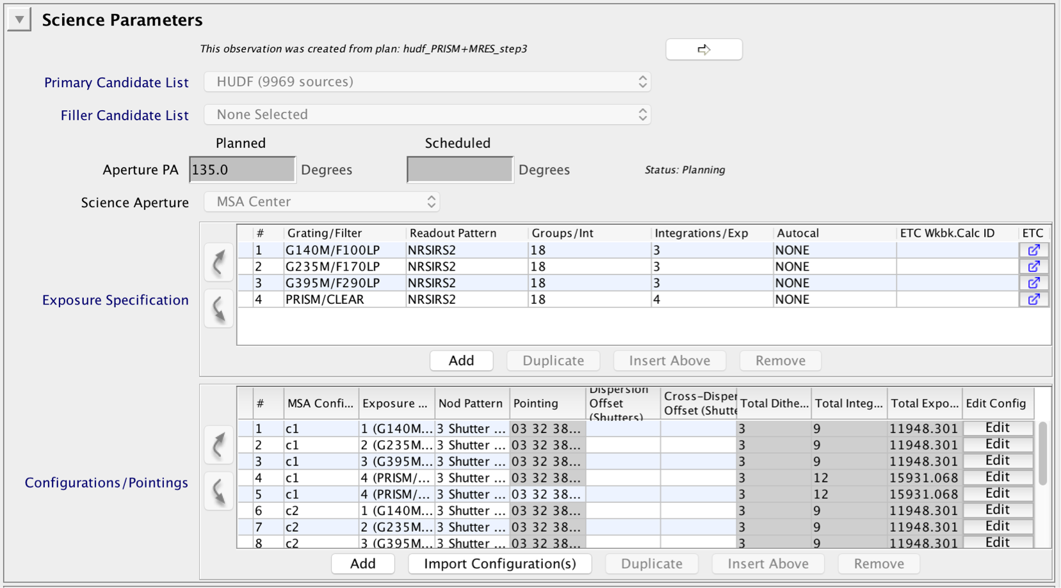
Create the observation

Slide 22
Further reading

Slide 23
MOS/MPT Help and JDox
JWST Help Desk: https://jwsthelp.stsci.edu
JDox Home page: https://jwst-docs.stsci.edu/
Updated for the new version of APT/MPT
Specific MOS/MPT materials:
MOS Roadmap
Multi-Object Spectroscopy
NIRSpec MOS Observing Process
NIRSpec MOS Operations
Catalogues and Images
Pre-Imaging Using NIRCam
Confirmation Images
Slit Losses
NIRSpec MOS Recommended Strategies
MOS APT Template

