Slide 1
Slit hands-on
Themiya Nanayakkara
JWST MASTER CLASS MELBOURNE

Slide 2
NIRSpec and MIRI LRS Slit hands-on
Infrared spectroscopy of Y dwarfs
NIRSpec
MIRI LRS
In this hands-on session you will be asked to use:
The Exposure Time Calculator (ETC) for the NIRSpec fraction
The Astronomer’s Proposal Tool (APT) for both instruments
The MIRI LRS science case was already part of the ETC hands-on, so that part of the observation planning is assumed to be covered.

Slide 3
Thinking about strategies

Slide 4
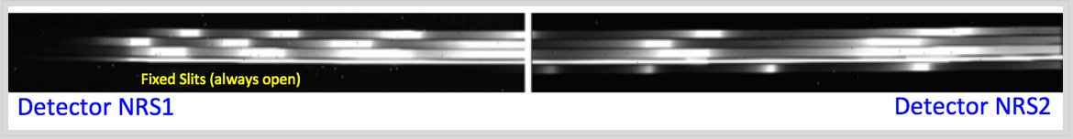
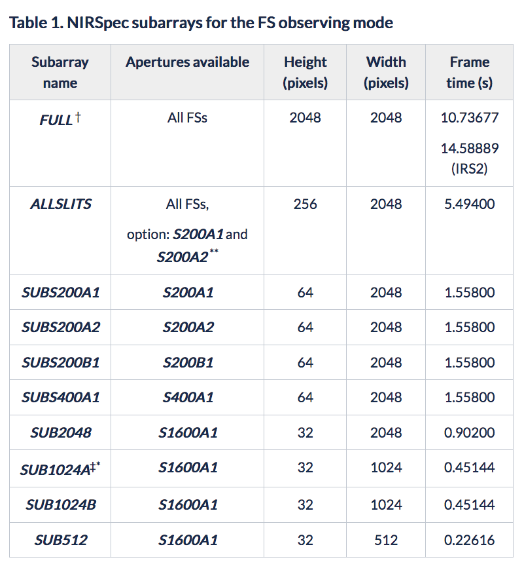
NIRSpec Subarrays and Readout patterns
Subarray:
FULL
Tailored subarrays per individual slit: SUBS200A1, SUBS200A2, SUBS200B1, SUBS400A1
S1600 subarrays: SUB2048, SUB1024A, SUB1024B, SUB512
ALLSLITS (S200A1 and S200A2 combined to bridge the detectors gap, but not only. It can also be used to estimate background)
Only traditional readout mode, not the IRS² noise reduction mode
Readout patterns: NRS and NRSRAPID
Note: maximum exposure duration is 10,000 seconds

Slide 5
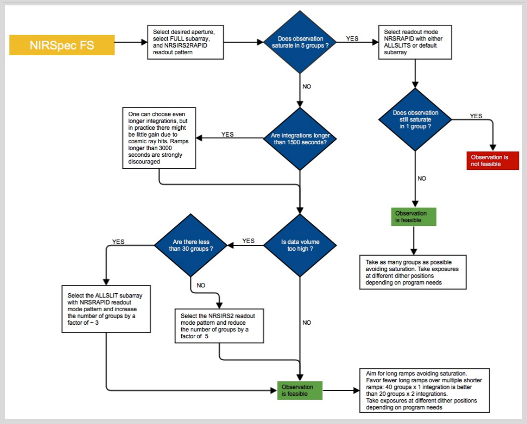
NIRSpec FS detector recommendations
Decision flow to specify detector parameters for a FS observation:
Saturation
Lower limit
Data volume

Slide 6
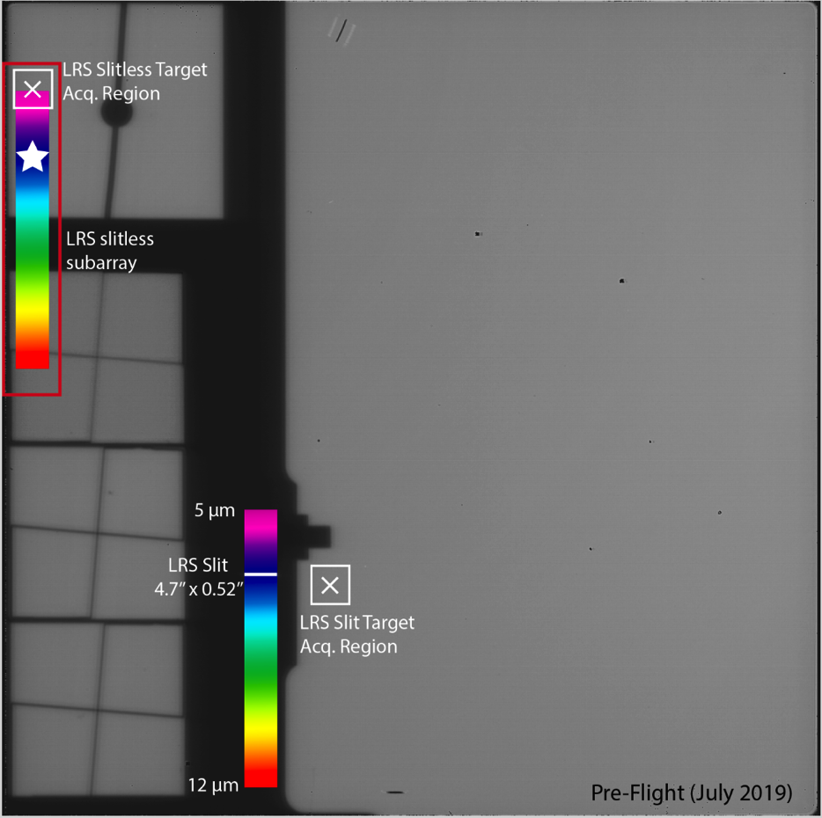
MIRI LRS Subarrays and Readout patterns
Subarray:
FULL (slit)
SLITLESSPRISM (slitless for Time Series Observations - TSO)
Readout patterns:
SLOW ( t₁=23.890 s)
FAST ( t₁=2.775 s).
In slitless mode, only FAST mode is allowed.
where t₁ is the resulting group time.
The maximum exposure duration for a single exposure with the LRS slit is 10,000 s.
LRS slit and slitless spectra positions on MIRI imager focal plane

Slide 7
Background removal strategies
Pixel-to-pixel subtraction
Compact sources: using nodding
Extended sources: associated dedicated ″blank sky″ observation at off-scene position
for NIRSpec: performed only if grating wheel has not moved between the target and off-scene exposures
Master background subtraction
Standard for extended sources
created from:
associated exposure, creating an independently flux-calibrated 1D background spectrum
list of background elements (like off-source pixels)
for NIRSpec: is set by pipeline processing if the grating wheel has moved
In ETC, FS nod/dithers are accounted for at detector level, setting the number of exposures.
APT: Dedicated observations for background must be linked to science observations in order to create an association list. This is defined at Target Level in APT. Necessary for pipeline processing flow.
APT: If the background signal is time variable throughout the year, dedicated “blank-sky” observations should be scheduled consecutively to ensure pixel-to-pixel subtraction. Special requirements: Non-interruptible

Slide 8
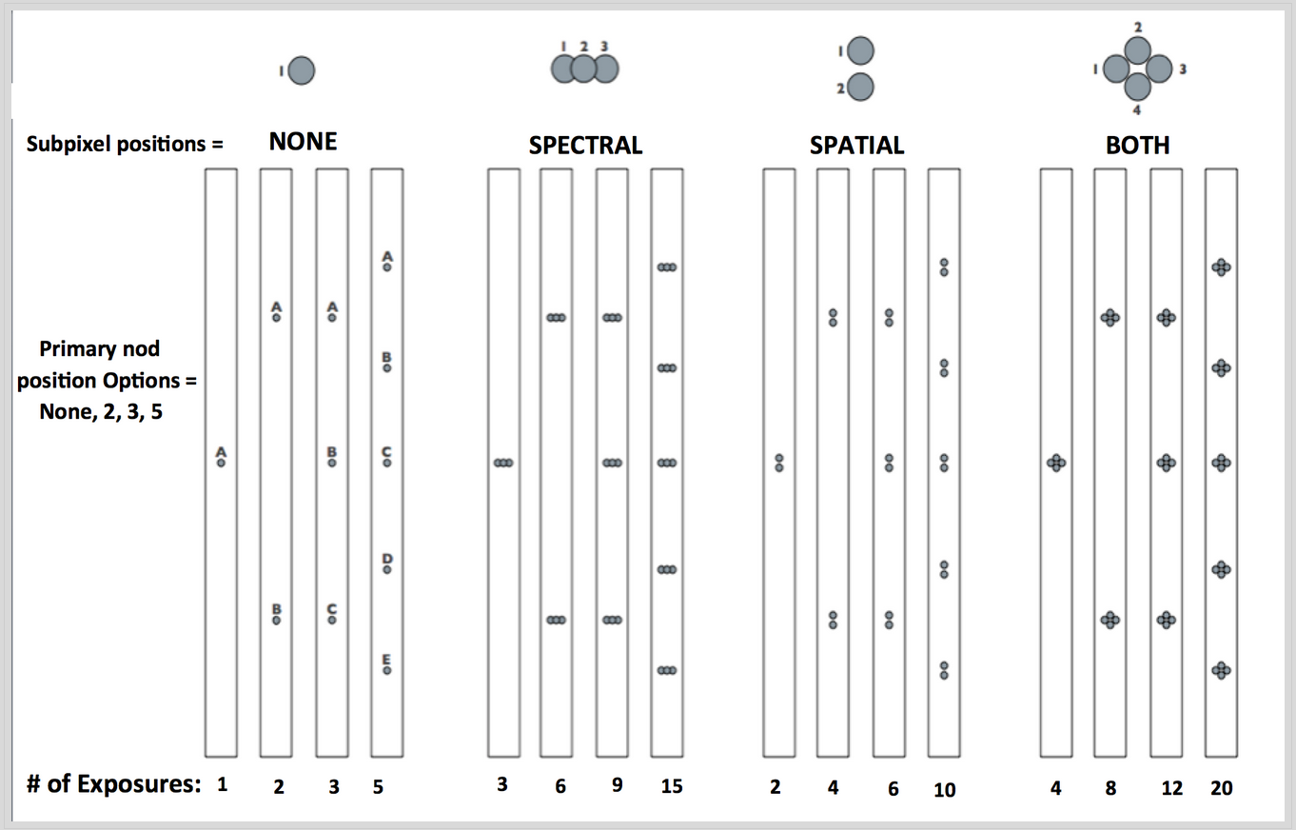
NIRSpec Nods and dithers
Nods: offsets that produce data to be subtracted in pipeline processing, in order to cancel in-field background flux. Nod options are typically best used for targets that are not significantly spatially extended. (2, 3, or 5 points), depending on the number of exposures needed/possible.
Dithers: offsets of the target position over multiple exposures, to even out or mitigate detector effects, help remove cosmic rays, improve spatial sampling, and increase signal-to-noise and flux accuracy.
APT
Primary dithers: nod along the slit used to subtract background flux. Recommended 3, 5.
Sub-pixel dithers: to improve spatial and/or spectral pixel sampling, only in addition to Primary Dither pattern for point sources. Not recommended in spectral dimension.
Across gap SAM. Offset executed by selecting the option “S200A1 and S200A2” only in the high resolution gratings

Slide 9
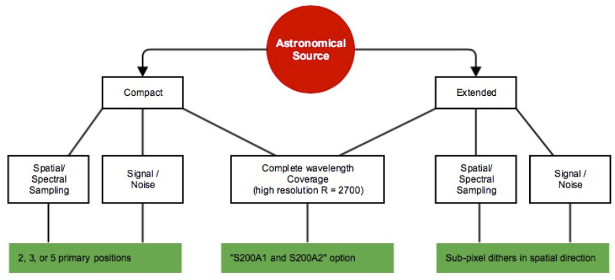
NIRSpec Nods and dithers
Decision tree for choosing the right nod/dither pattern for FS observations based on the source compactess.

Slide 10
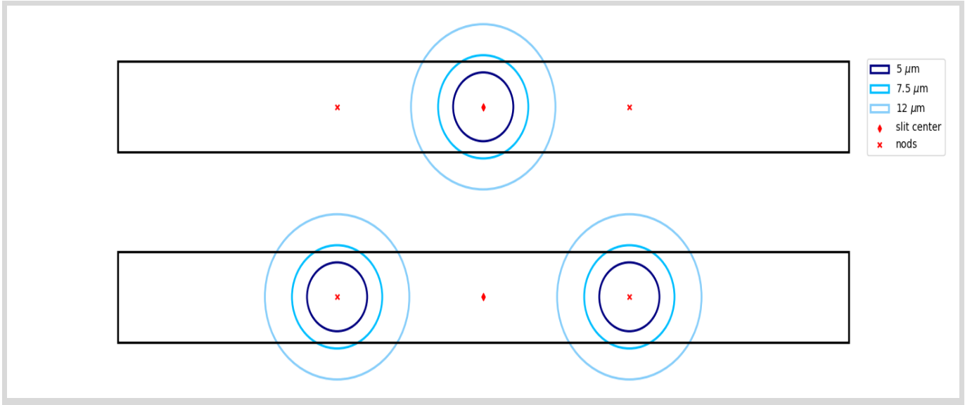
MIRI LRS Nods and dithers
For MIRI, dithering is required to achieve accurate photometry and to provide superior sampling (Gordon et al. 2015)
LRS slit dithers (for slitless mode, dithering is not allowed):
ALONG SLIT NOD (default for compact sources) uses a 2-point "nod" where a point source is dithered between positions that are located approximately 30% and 70% of the way along the slit length.
MAPPING customizable offsets along-slit and across-slit. It is recommend that the chosen step sizes are smaller than, or on the order of the slit size (approx. 4.7 x 0.5"). Extended sources mapping can also be produced by mosaicing. Recommended dither steps of 1” in both directions. A dedicated background observation may be needed.
NONE (only permitted for SLITLESSPRISM)
Dithers ALONG SLIT NOD Layout on the LRS slit

Slide 11
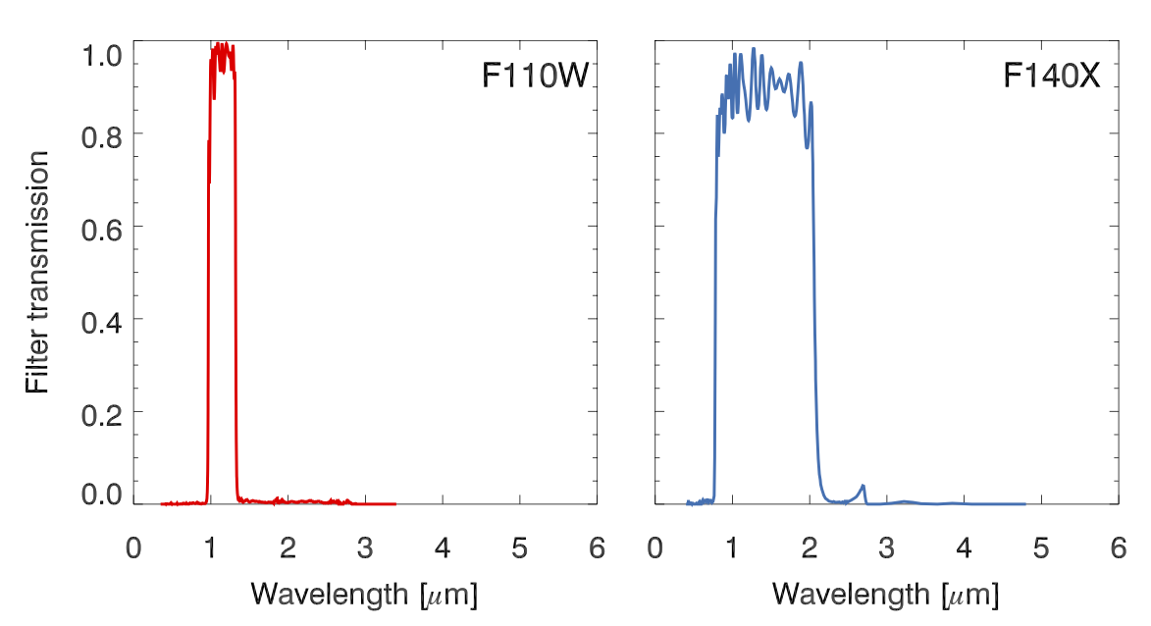
NIRSpec FS Target Acquisition
FS TA methods:
WATA (recommended) using science or offset target centred in S1600A1. 11-18 minutes. Expected accuracy: 20 mas, and depends on centroiding accuracy of the target (ephemeris).
MSATA requires defining 5-8 reference stars (may require pre-imaging). It is specified at the visit level of the observation, not directly at the observation template. 24-30 minutes. Expected accuracy: 20 – 25 mas (optimal), <50 mas (relaxed), depending on the catalogue relative accuracy.
NONE is not recommended for FS. The resulting pointing accuracy will be that delivered by the GS acquisition at the start of the observation. For reference, the absolute pointing performance of JWST for NIRSpec is expected to be 100 mas
Strategies and parameters:
WATA:
Subarray configurations: SUB32, SUB2038, FULL (increasing frame time)
MSATA:
Subarray configuration: FULL
Filters: F110W, F140X, CLEAR
Readout pattern: NRSRAPID, NRSRAPIDD1, NRSRAPIDD2, NRSRAPIDD6
Groups/Integrations are fixed
TA readout mode switch with respect to science parameters costs extra in time.

Slide 12
MIRI LRS Target Acquisition
TA procedure:
LRS slit mode
Use of science or offset target at distance <60 arcseconds
TA is NOT mandatory in the LRS slit APT template; however, for observations of point or compact sources it is highly recommended.
Strategies and parameters
Filters: F560W, F1000W, F1500W, and FND
Subarray configuration: N/A, controlled by the subarray science parameter
Readout patterns: FAST(default), FASTGRPAVG, FASTGRPAVG8, FASTGRPAVG16, FASTGRPAVG32, FASTGRPAVG64
Groups are selectable but fixed (4, 6, 8, 10), integrations is always 1
The user should always refer to the ETC for signal-to-noise calculations.

Slide 13
Science case

Slide 14
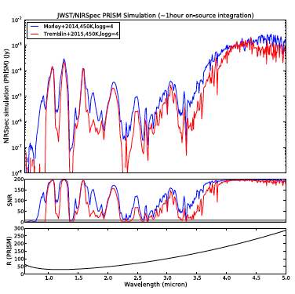
Science Overview
Goal
To obtain spectroscopic observations of a Y dwarf across the entire JWST NIRSpec and MIRI LRS wavelength ranges to understand whether these atmospheres are shaped by chemical disequilibrium driven by vertical transport or the formation of water clouds, and constrain the object’s gravity, hence mass.

Slide 15
Observations Methodology
Methodology
Compare high-quality low and medium resolution Infrared spectra from 0.6 to 13 microns, to models of cool atmospheres at different temperatures, gravity, degrees of turbulence, chemical equilibrium or disequilibrium driven by vertical transport, and clouds.
Planned observations
NIRSpec fixed slit spectroscopy
MIRI LRS slit spectroscopy
Source Type
Point source
Observation strategy
PRISM and G395M dispersers for NIRSpec to obtain R~100 and R~1000, respectively and MIRI LRS R~100
3-point nod NIRSpec / 2-point nod MIRI
TA on science source

Slide 16
Getting started ETC NIRSpec WB ID: 30896 MIRI LRS WB ID: 30989

Slide 17
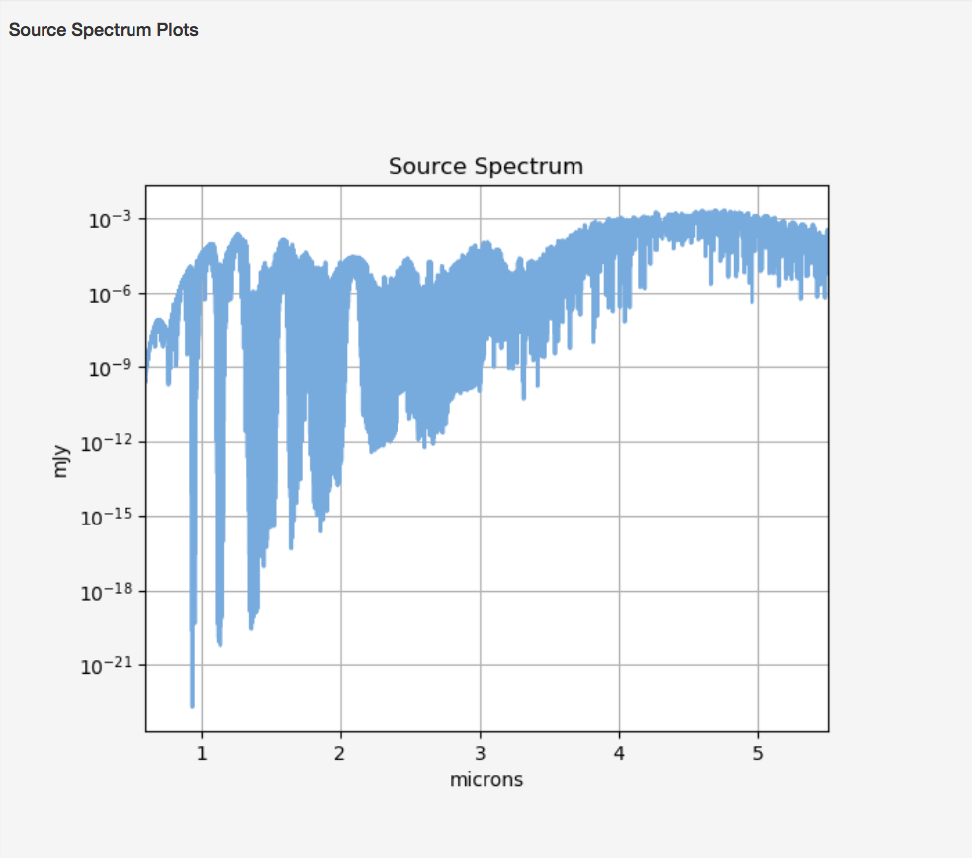
Scenes and Sources
NIRSpec:
1 source with user supplied model spectrum morley_spec_ETC_noscale.txt renormalized to measured Vega magnitudes HST/WFC3 F140X.
MIRI
Workbook: 30989

Slide 18
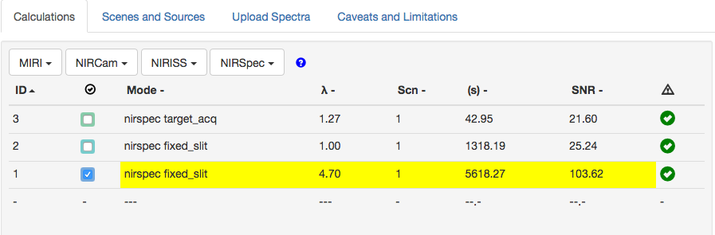
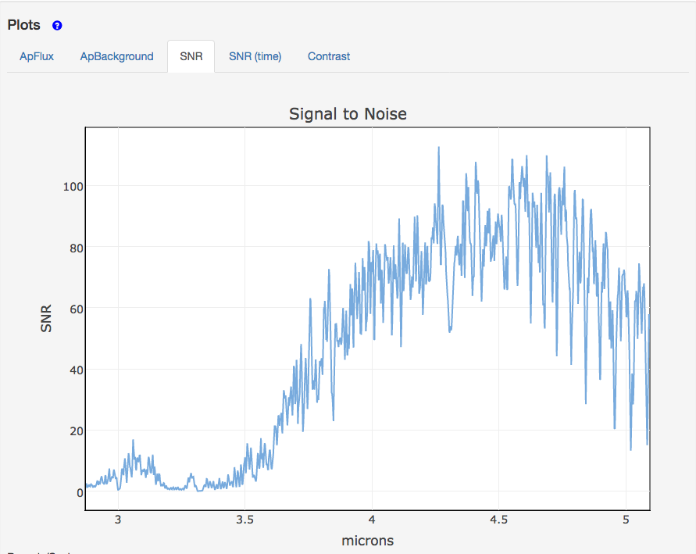
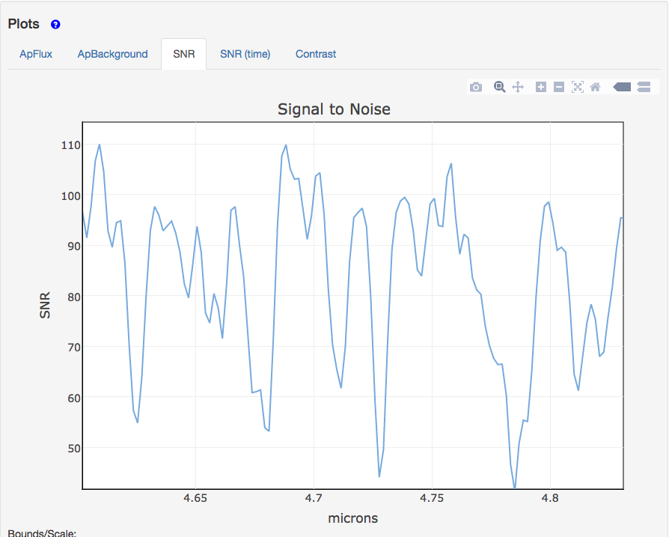
Calculations
Overview

Slide 19
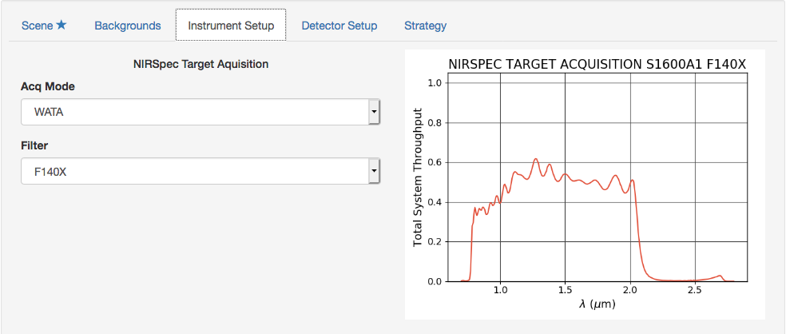
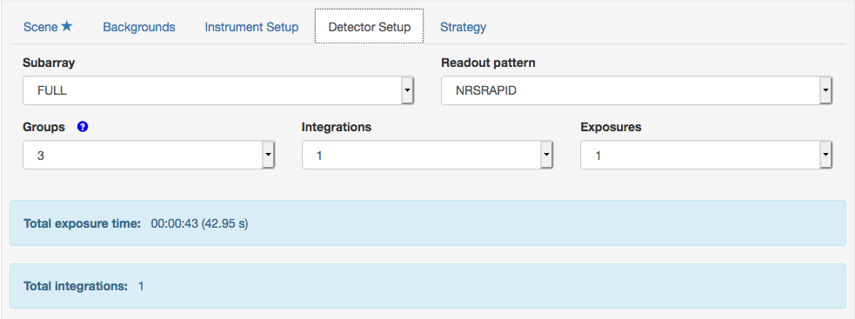
NIRSpec Calculation for Target Acquisition
WATA in ETC is available.

Slide 20
Getting started APT

Slide 21
Cheat APT screenshots…

Slide 22
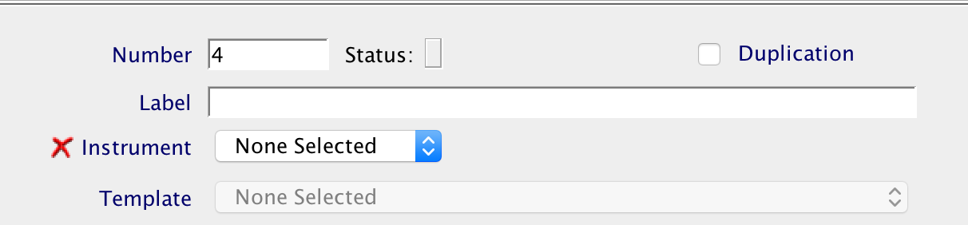
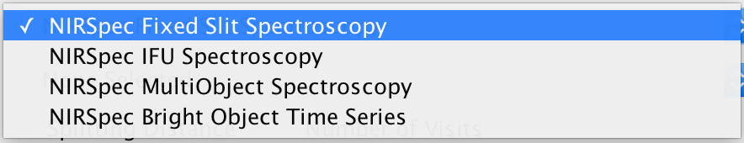
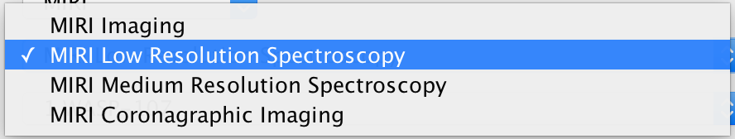
APT Fixed-slit spectroscopy templates
When creating a new observation, the user defines the APT template
APT fixed-slit spectroscopy templates are divided into four sections:
Generic information
Observation information
Target acquisition parameters
Science parameters

Slide 23
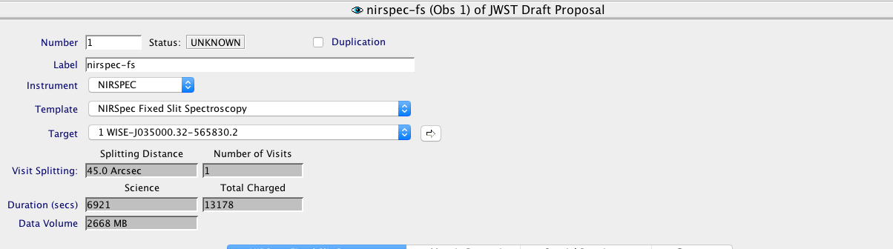
APT Fixed slit spectroscopy template
NIRSpec
Generic information
Observation information

Slide 24
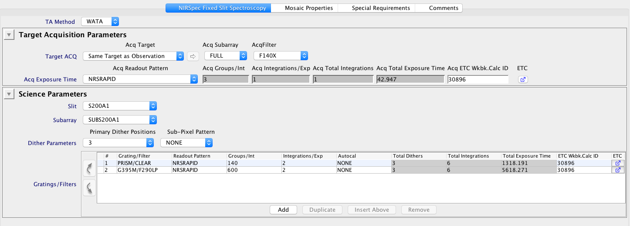
APT Fixed slit spectroscopy template
NIRSpec

Slide 25
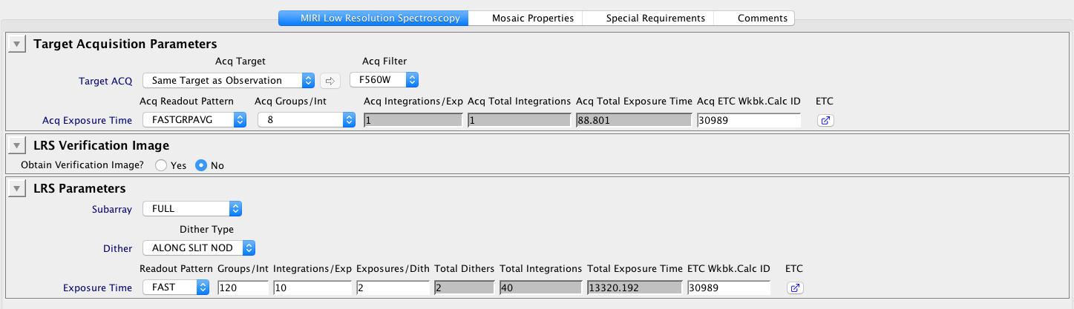
APT Fixed slit spectroscopy template
MIRI

Slide 26
Further reading

Slide 27
Slit Help and JDOX
Detector Strategies
NIRSpec detector recommended strategies
NODS and Dithers
NIRSpec Background Recommended Strategies
MIRI LRS Recommended Strategies – Background observations
NIRSpec Dithering Recommended Strategies - FS
MIRI LRS Dithering Recommended Strategies
Target Acquisition
NIRSpec Target Acquisition Recommended Strategies
MIRI Target Acquisition Generic Recommended Strategies
MIRI LRS Target Acquisition Recommended Strategies

