Slide 1
Aperture Masking Interferometry with NIRISS
JWST MASTER CLASS MELBOURNE 2022

Slide 2
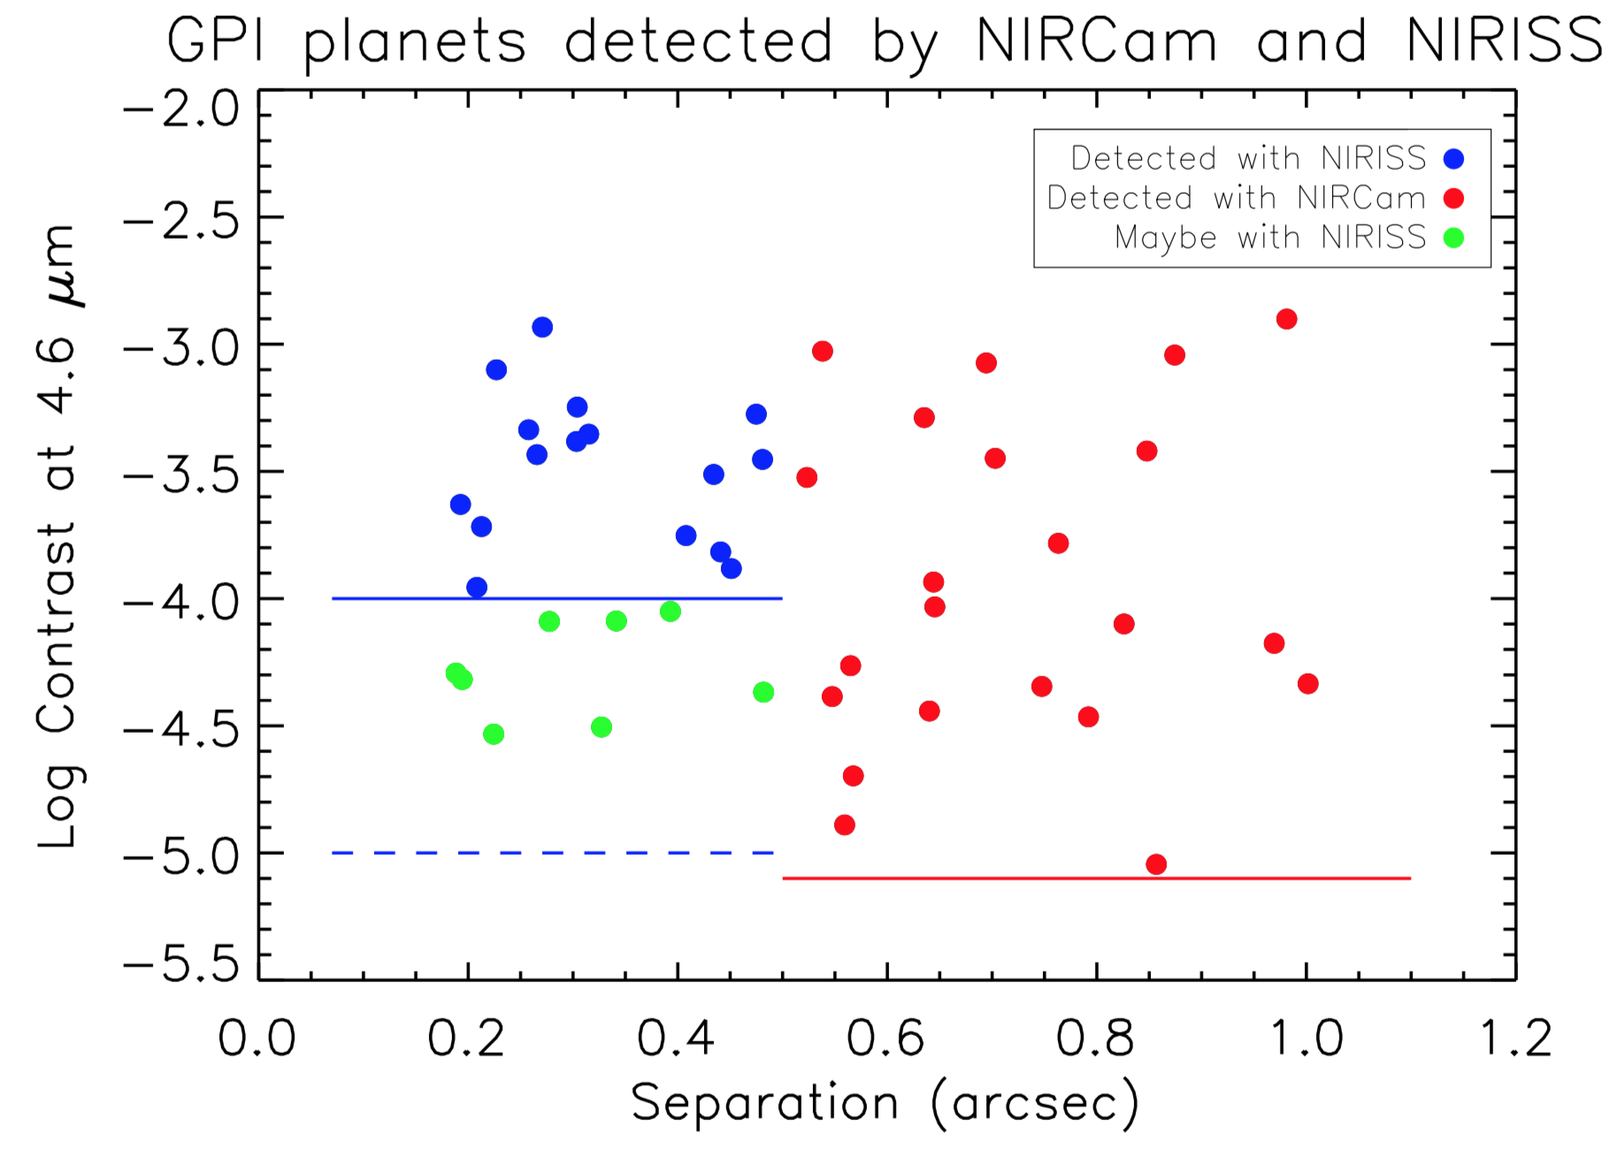
AMI “niche”
Low
NIRISS AMI
Contrast
NIRCam Coron.
High

Slide 3
Interferometry Concepts

Slide 4
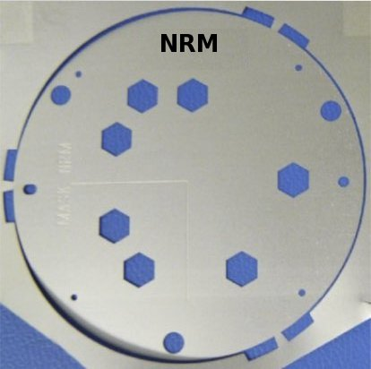
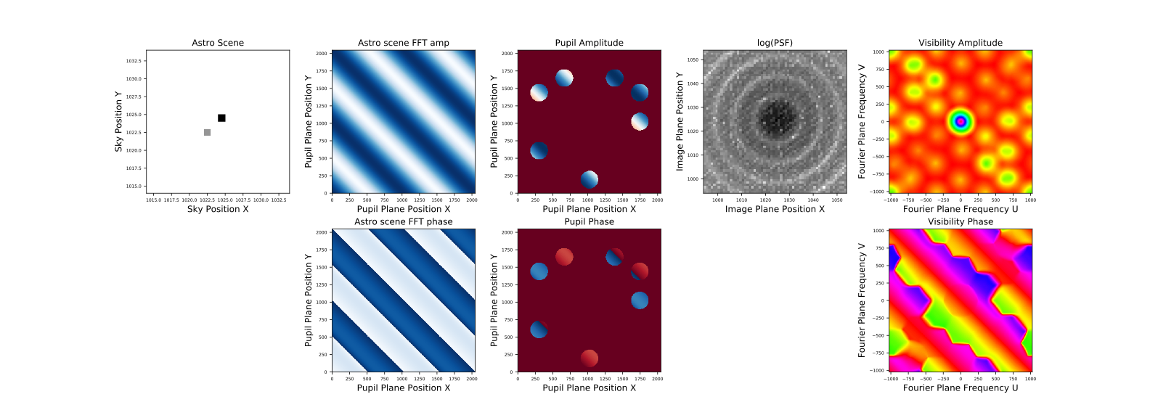
Telescope
Primary
Pupil
Detector

Slide 5
Telescope
Primary
Pupil
Detector

Slide 6
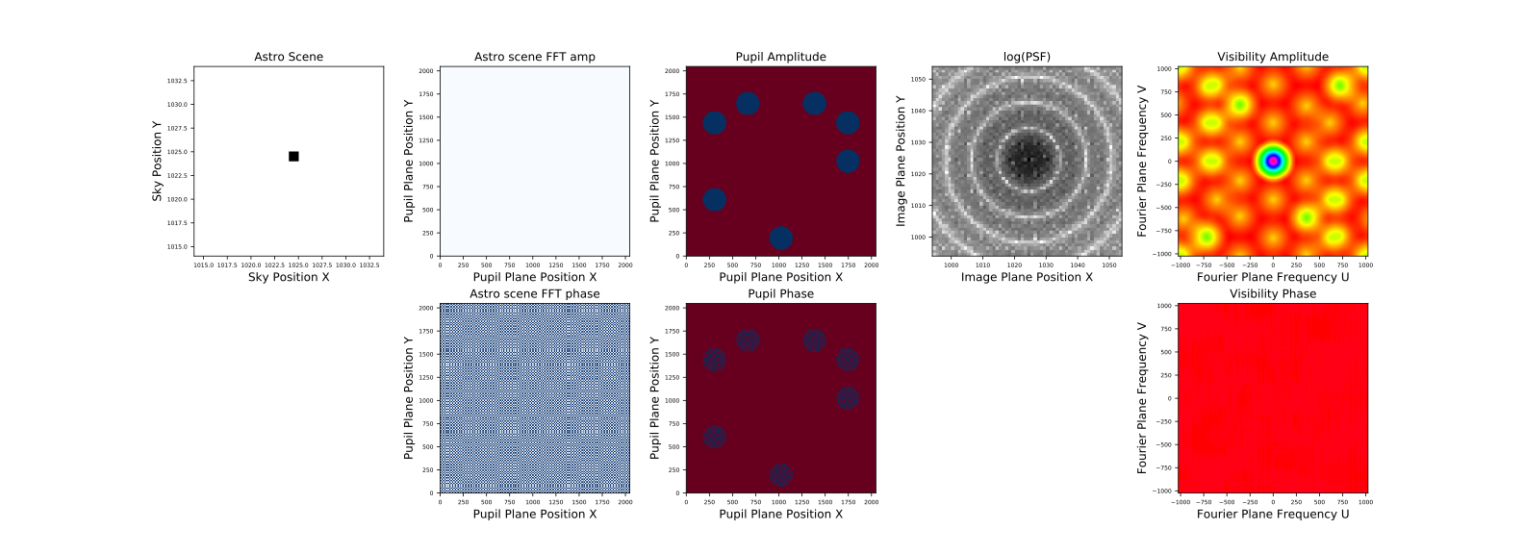
Telescope
Primary
Pupil
Detector

Slide 7
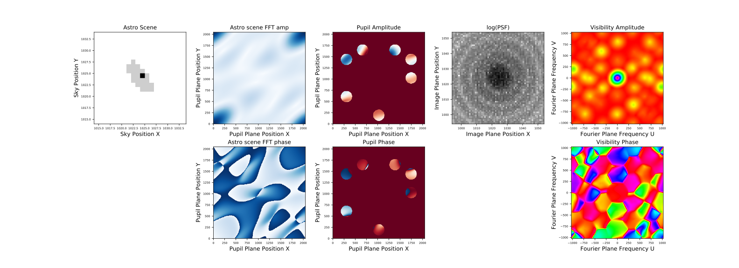
Telescope
Primary
Pupil
Detector

Slide 8
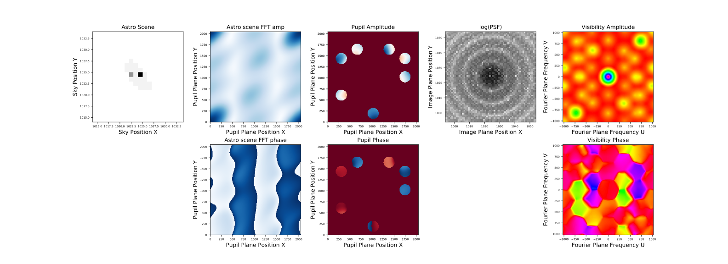
Telescope
Primary
Pupil
Detector

Slide 9
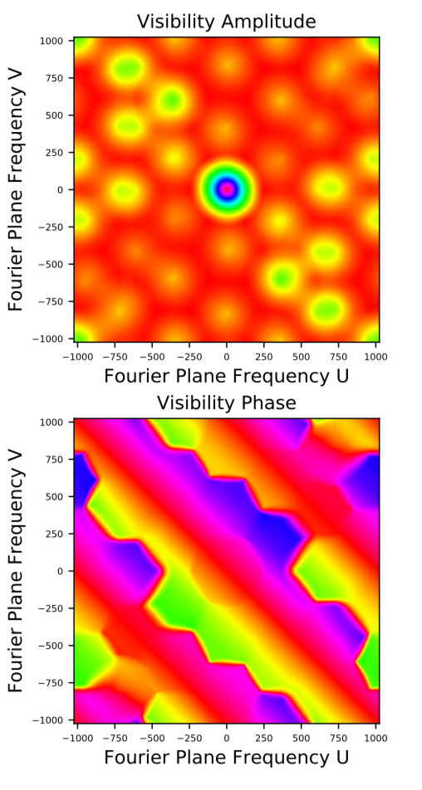
Interferometry Concepts - The Analysis
Yields ~35 independent measurements.
Compare with the same measurements performed of a model scene to find best-matching model.
AMI is suited for relatively simple scenes (binary stars, disks, spiral arms) with much less than 35 degrees of freedom.

Slide 10
Practical Considerations

Slide 11
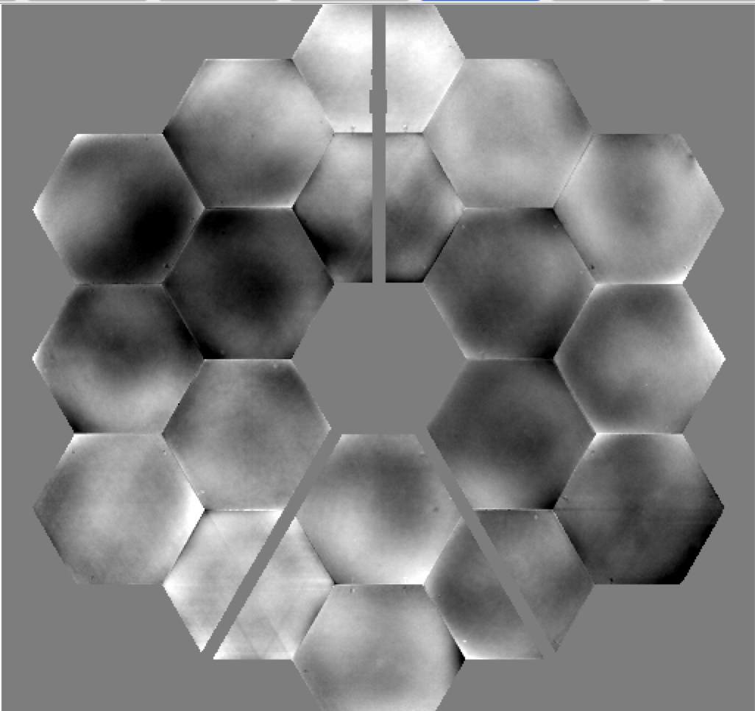
Observing a Calibrator
Why?
How to pick it?
Closest on the sky (to minimize overheads and thermal-related wavefront fluctuations)
Equal or higher brightness
Similar color (chromaticity affects how flux is spread within each Fourier blob)
For a survey, could self calibrate by using the science targets as calibrators (those that are found to be single)
JWST leaves an imprint on the otherwise flat
wavefront of a distant star

Slide 12
Operations
NRM blocks 85% of the flux, can only observe bright sources ~5 < mag < 14.5
4 filters available: F380M, F430M, F480M, F277W is under-sampled
Need very precise target acquisition to be positioned at the exact sub-pixel location to limit intra-pixel response effects between target and calibrator.
Stare on target is what the experts recommend, NO dithering.
Take a Direct image after your NRM observation for absolute flux calibration.

Slide 13
Hands on
Observe a planet-harboring star
Observe a calibrator
Skip directly to APT, using ETC numbers in the table
The important steps are highlighted in yellow

Slide 14
Supplementary Material

Slide 15
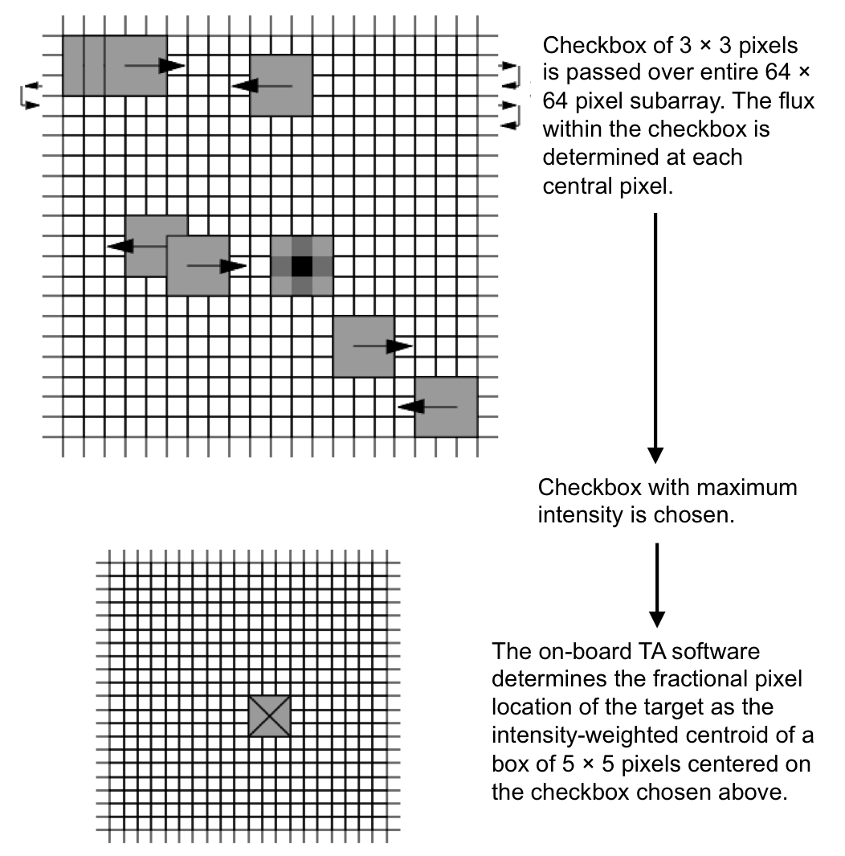
Target Acquisition
AMIBRIGHT
3 < VEGAMAG* < 9.3
Acquire on NRM + F480M images
AMIFAINT
9.3 < VEGAMAG* < 14.5
Acquire on CLEAR + F480M images
*VEGAMAG ~ WISE 2

Slide 16
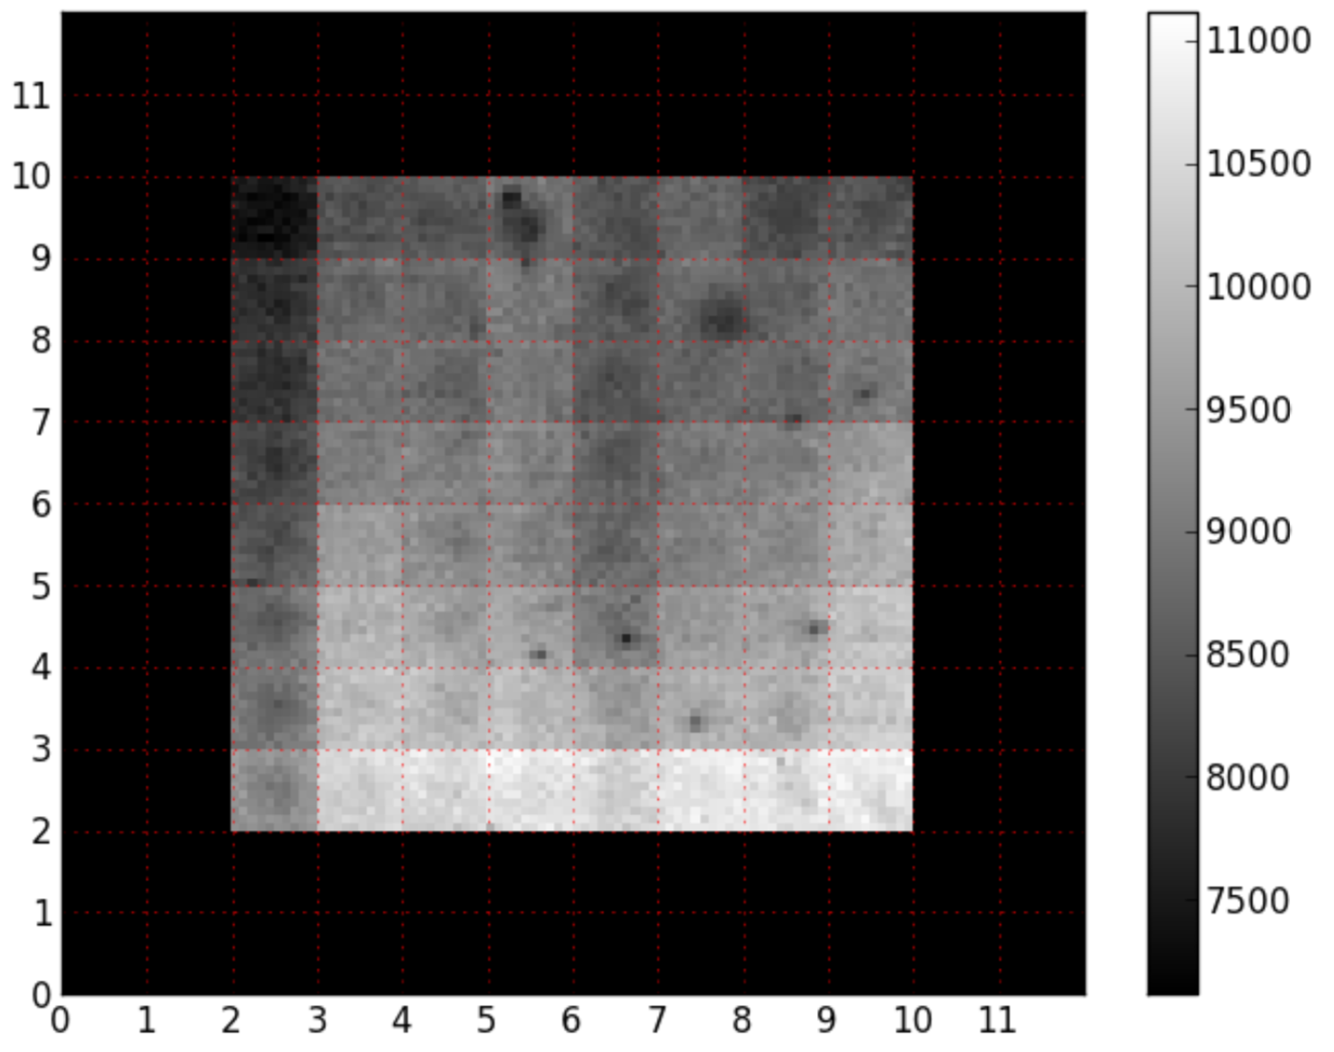
Intra Pixel Sensitivity
Scan of the sensitivity of a test detector at 10X the resolution yields this “flat field”.
Target Acquisition Accuracy: ~1/15 pixel (~4-5 mas).
Guiding Jitter: 1/10 pixel (~7 mas).
PSF fwhm: ~2 pixels (~130 mas).
No such map exists for our actual NIRISS detector. Can not apply a calibration.
PSF
Guiding jitter (~7 mas)
1 native pixel
Hardy et al. 2015

Slide 17
The Pros and Cons of Dithering
Pro: NIRISS pixels are close to being under sampled at 4 microns. Dithering allows to resample on a finer grid (2x2, 3x3, 5x5).
Pro: Dithering allows recovery of the information loss due to bad pixels.
Con: Limited pointing accuracy prevents obtaining the exact same sub-pixel positions for each different target or calibrator. In turns, this means sampling different positions in the Intra-Pixel Sensitivity (IPS) map between science targets and calibrators.
The EXPERTS currently recommend to stare, NOT to dither

Slide 18
Take Aways - short version
Science is high-resolution imaging (70-400 mas) of simple scenes (~10 d.o.f.). Complementary to NIRCam coronagraphy (>300 mas).
Requires precise Target Acq.
Use the ETC and aim for peak flux of 30000 e- (~40% full-well depth) to prevent charge diffusion that alters the PSF. Not a concern for TA so aim closer to full well for TA.
APT option to obtain a full frame image of the field after the science sequence. Useful for absolute flux and astrometry calibration and as well as for Kernel Phase Imaging (another topic!)

Slide 19
Take Aways
Science is high-resolution imaging (70-400 mas) of simple scenes (~10 d.o.f.). Complementary to NIRCam coronagraphy (>300 mas).
Moderate contrast (goal of 10⁻⁴). Performance could vary - 1st NRM in space.
Contrast performance depends on number of photons: Nphotons = 100 / contrast. For contrast of 10⁻³, Nphotons = 100 / 0.001 = 10⁸.
Bright limit: ~4.5 magnitude in the F277W, F380M, F430M and F480M.
Requires precise Target Acq., observation of a calibrator star, recommend no dithering.
Recommend to use Gaia DR2 astrometry and 2015.5 epoch so to position the target at the exact same pixel position between targets.
Use the ETC and aim for peak flux of 30000 e- (~40% full-well depth) to prevent charge diffusion that alters the PSF. Not a concern for TA so aim closer to full well for TA.
The total Exposure Time shown by the JWST ETC includes resets. For photon collection time, instead use: Time = Ngroup x Nint x Tframe. Where Tframe = 0.07544 sec for the 80x80 subarray. For the 64x64 TA subarray, each frame is read in 0.05016 sec.
APT option to obtain a full frame image of the field after the science sequence. Useful for absolute flux and astrometry calibration and as well as for Kernel Phase Imaging (another topic!)

