Slide 1
Moving Targets
JWST Master Class Melbourne 2022

Slide 2
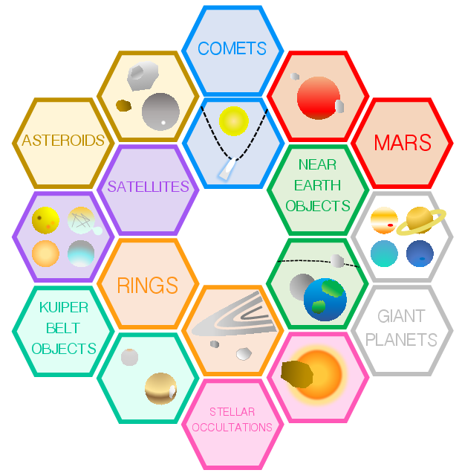
Moving Targets: Overview
Observations of moving targets (solar system objects) will likely make use of the following modes:
MIRI: Imaging, LRS Slit, MRS
NIRCam: Imaging, Time Series Imaging
NIRISS: AMI
NIRSpec: Fixed Slits, IFU, MSA (pseudo-long slit, see this page)
JWST’s field of regard (FOR) prevents observations of:
Targets near opposition, when they are brightest
The Sun, Mercury, Venus, Earth, and the Moon

Slide 3
Moving Targets: Tracking
JWST will track such that the solar system object remains fixed in the aperture and the background objects streak
JWST will be capable of tracking objects moving at 30 mas/s
This is the apparent rate of Mars
Sufficient to observe all objects outside Mars’ orbit
Rates of 45 mas/s and/or 60 mas/s may be tested on-orbit
Milam et al., 2016

Slide 4
Moving Targets: Ephemerides and TA
0.10” (1σ) blind pointing accuracy
3” x 3” FOV for NIRSpec IFU aperture
1.6” x 1.6” FOV for target acquisition
Placement of targets in small apertures can be difficult if the target’s ephemeris is not precisely known
TA is highly recommended for slit spectroscopy of point sources
Recommendation: Prospective/successful proposers should submit new astrometry to the Minor Planet Center (MPC) for any potential or approved targets (>1 year from proposal acceptance to execution of observations)

Slide 5


Moving Targets: Saturation Limits
NIRCam Imaging (SUB160)
MIRI Imaging (SUB64)

Slide 6
Moving Targets: Tools
The Moving Target Visibility Tool (MTVT) is a wrapper to the GTVT and can be used to determine target visibility and allowed position angles
APT has a separate workflow for definition of moving targets and presents additional scheduling constraints unique to moving targets
These aspects will be explored in the hands-on exercise
The JPL Horizons online ephemeris service is well-known to the solar system community and is used by both the MTVT and APT
There are no moving target-specific features in the ETC, however:
G2V Phoenix Stellar Model and blackbody template spectra can be used to model target reflected and thermal components
A power-law spatial profile is available for defining extended targets, such as comets

