Slide 1
Proposal preparation roadmap
Themiya Nanayakkara
JWST MASTER CLASS MELBOURNE 2022

Slide 2
Introduction
Notes:
Go through in detail. It's overwhelming, new telescope

Slide 3
Preparing a JWST proposal: where do I start?!
The JWST proposal toolbox has a large number of resources, some of them specific to certain observing modes or science cases
This presentation provides suggestions on how to navigate it
JDox
CTVT
JBT
GTVT
WebbPSF
???
MIRAGE
JIST
MIRISim
MPT
ESAsky
APT
ETC
Notes:
Lots of acronyms. Help to navigate

Slide 4
Deadlines
Deadline for proposal submission for Cycle 1 programs is
27th Jan 2023
Notes:
Most important thing

Slide 5
Suggestions for a roadmap
Notes:
Where to start

Slide 6
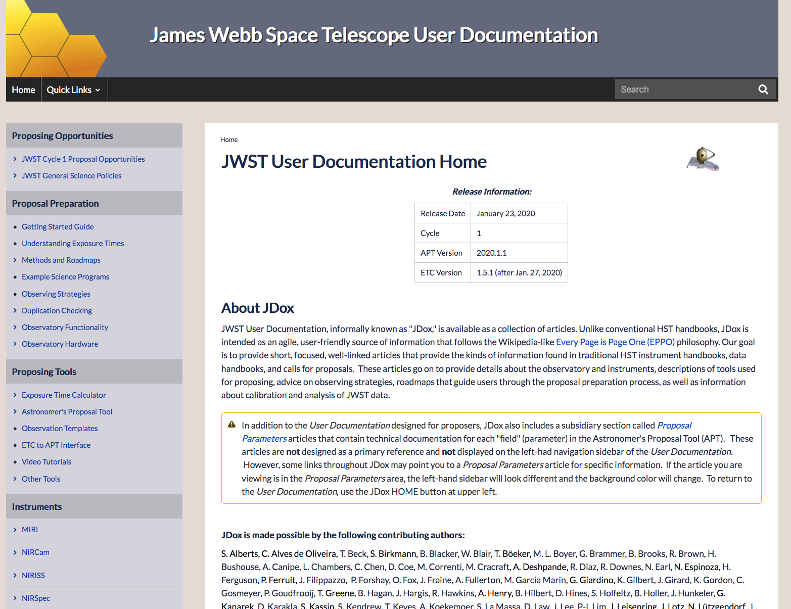
First impressions: what can JWST do?
Become familiar with JDox, the JWST documentation:
https://jwst-docs.stsci.edu/
The menu on the left points to
useful pages to start with:
Starting guide
Observatory and instruments capabilities
Examples of roadmaps for science programs
Available tools
Notes:
Best place to start is the documentattion wikl
Left has some good starting resources

Slide 7
Downselect: pick the instrument(s)/mode(s)
Identify the instruments and observing modes you need to address your science goals
Use JDox to get familiar with the documentation for that instrument:
Do operations involve dithering? Target acquisition? Mosaicking?
What are the detector readouts? Wavelength ranges? Sampling?
Browse some example science programs and recommended observing strategies for that instrument/mode:
https://jwst-docs.stsci.edu/methods-and-roadmaps
Notes:
Downselect: then go into the instrument mode and changeable parameters
How to observe in space (vs ground), e.g. target acquisition etc
Example science programs and recommended observing strategies

Slide 8
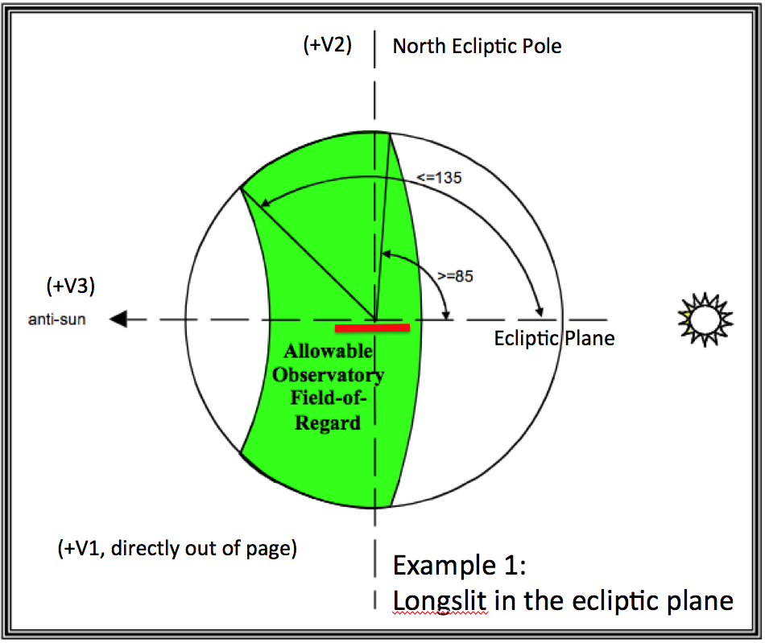
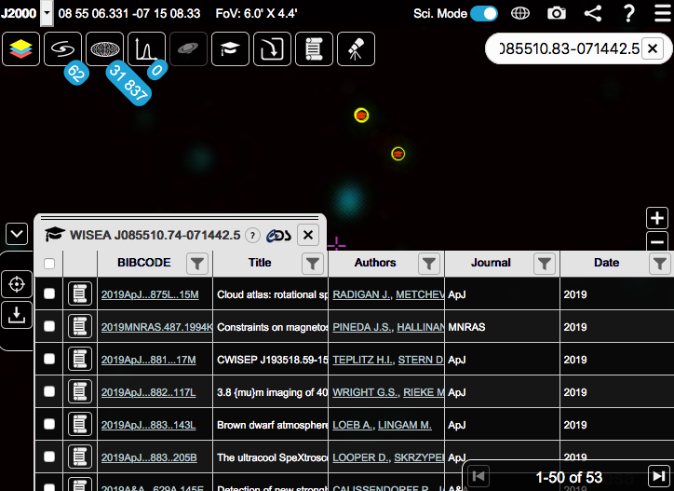
Feasibility: did I select the right target? (1)
Availability
Visibility
MAST: check for duplications in JWST ERS/GO/GTO
https://mast.stsci.edu/
ESASky: check existing observations/publications with other space missions
https://sky.esa.int
Use the Target visibility tools (TVT) to check the targets visibility
General target (GTVT)
Coronagraphic (CVT)

Slide 9
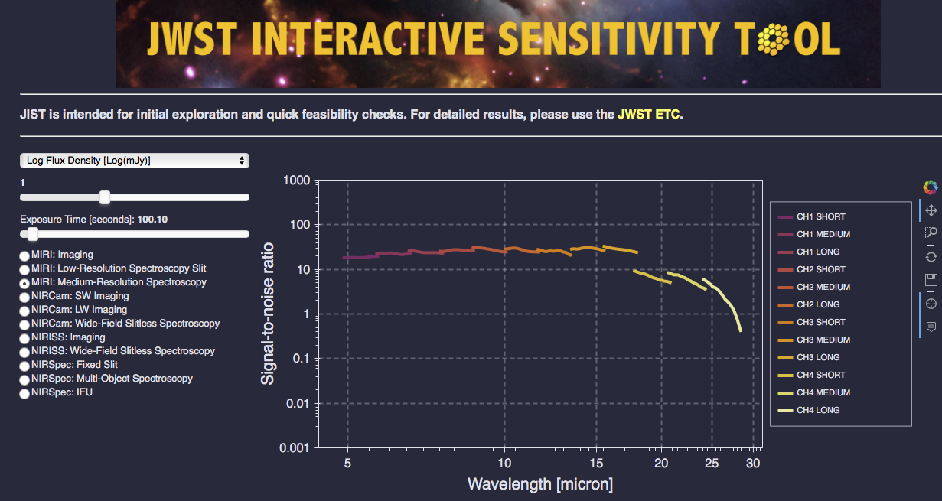
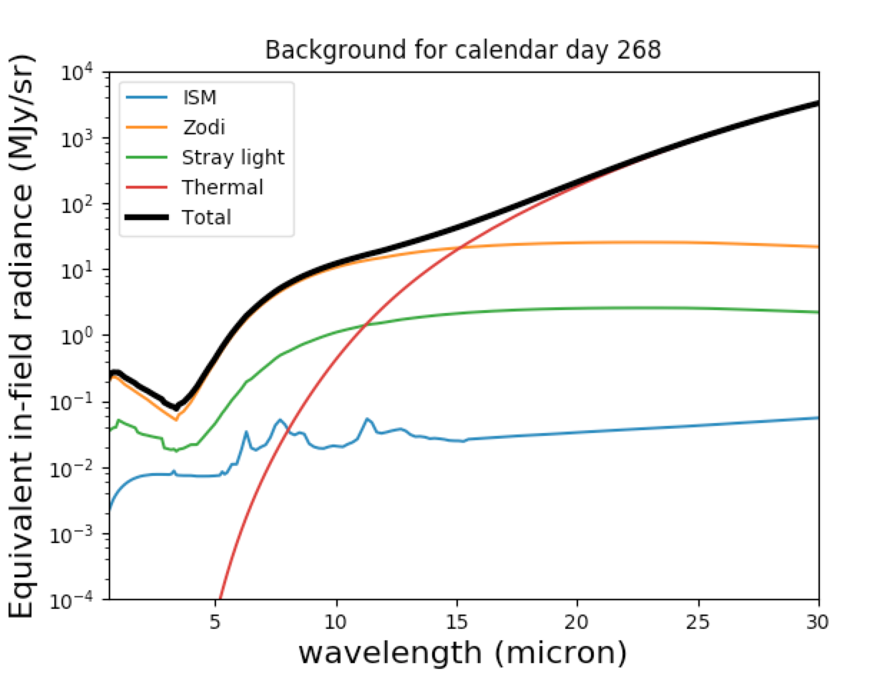
Feasibility: did I select the right target? (2)
Sensitivity
Background
JIST: JWST Interactive Sensitivity Tool works as a quick-look tool to explore the feasibility of observations for any mode
https://jist.stsci.edu/
JBT: JWST Backgrounds Tool can be used to estimate the impact of the background on the schedulability of observations
Available through pip or github
Notes:
Is it visible? Do I need a short or long proposal? JIST very handy starting point
Background variability and limits

Slide 10
Just do it: which tools do I need to propose?
Exposure Time Calculator (ETC)
https://jwst.etc.stsci.edu/
The ETC should be used to determine the exposure parameters needed to achieve the signal-to-noise for the science target
Astronomer’s Proposal Tool (APT)
The APT is where you will set up your program and submit your proposal
http://www.stsci.edu/scientific-community/software/astronomers-proposal-tool-apt/
Notes:
OK, it's new and can be done
Dive deep in the main tools (proposal tools)
No phase 2

Slide 11
A step further: what else is available?
You may want to use other available tools to better understand JWST capabilities, improve your proposal, or get ready for the data
Simulated data:
http://www.stsci.edu/jwst/science-planning/proposal-planning-toolbox/simulated-data
Real data on MAST: ERS/Treasury (several GO) programs
Simulators: WebbPSF, Mirage, Awesimsoss, MIRISIM, ExoCTK, Pandexo
https://jwst-docs.stsci.edu/jwst-other-tools
Run into an issue? Remember, there is help!
https://stsci.service-now.com/jwst
Notes:
Seveal simulators available to do further checks or want to get a head start on data analysis
Use help desk

Slide 12
Suggestion of a roadmap to submission
JDox
MAST
ESASky
TVT
JIST
JBT
ETC
SUBMIT
APT

