Slide 1
Available proposal tools:
JIST
Monserrat Martinez Marin
JWST MASTER CLASS MELBOURNE 2022

Slide 2
JWST Interactive Sensitivity Tool (JIST)

Slide 3
JWST Interactive Sensitivity Tool (JIST)
Quick-look observation feasibility
Runs directly in a browser window
Online tool: jist.stsci.edu
JDox: JIST
For all basic observing modes, explore S/N values by adjusting source flux or telescope exposure parameters

Slide 4
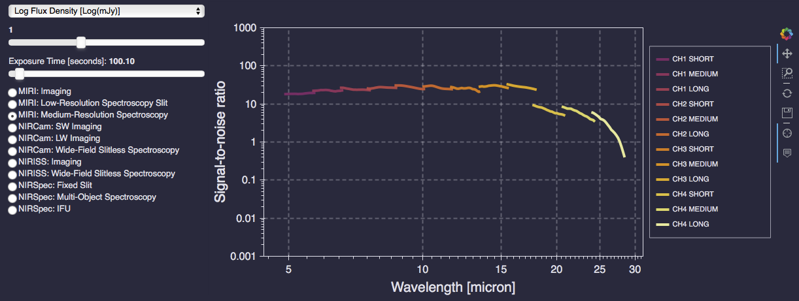
JWST Interactive Sensitivity Tool (JIST)
Example view of the interface

Slide 5
JWST Interactive Sensitivity Tool (JIST)
Beware of the simplifying assumptions…
All calculations based on a point source:
Flat SED
Background spectrum set to 120% of minimum zodiacal background at a reference point (see usage notes for more detail)
Single integrations are considered. For multiple integrations (or dithers), SNR can be scaled by SQRT(NINTS)
Saturation simply handled by setting SNR=0 (JIST is not recommended for saturated data)
For WFSS modes, only R Grism values presented (C Grism assumed identical)

Slide 6
Accessing the tool - reminder

Slide 7
Accessing the tools
Astronomer’s Proposal Tool (APT)
MSA Planning Tool (MPT)
→ apt.stsci.edu
Exposure Time Calculator (ETC)
→ jwst.etc.stsci.edu
JWST Interactive Sensitivity Tool (JIST)
→ jist.stsci.edu

