Slide 1
High Contrast Imaging with JWST:Coronagraphy
Themiya Nanayakkara
JWST MASTER CLASS MELBOURNE 2022

Slide 2
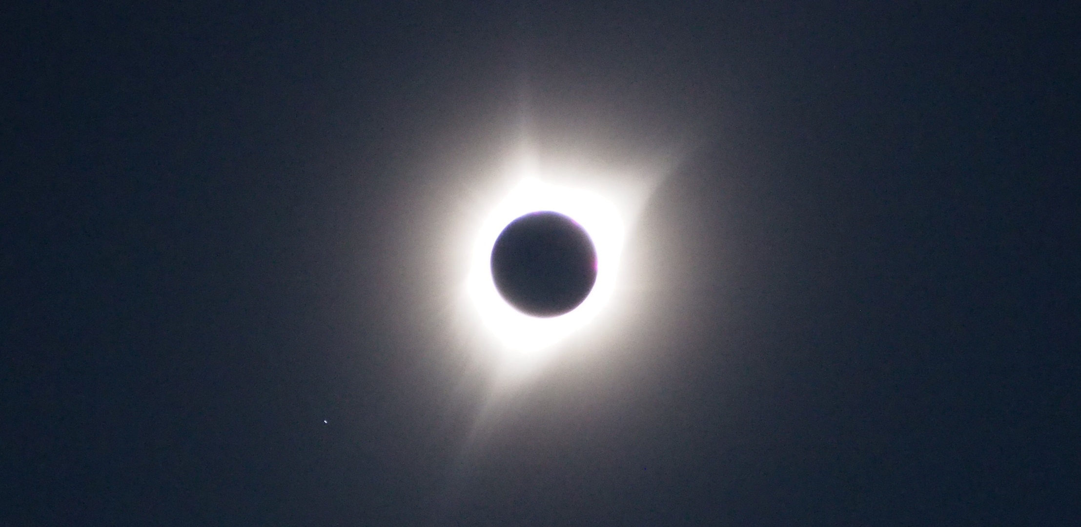
High Contrast Imaging allows observing
Extended emission
surrounding stars
Debris disks
AGN hosts
Faint companions

Slide 3
High contrast imaging combines the suppression of light from the host (“optical cancellation”) with post-processing by subtracting the scaled point-spread function (PSF) from the science image.
There are two metrics that characterise high contrast imaging
Inner Working Angle (IWA) : radial separation from host where the transmission of the occulting mask drops below 50%;
Limiting Contrast : is imposed by the speckle noise remaining after the subtraction of the PSF reference. The shape of the curve can vary depending on the flux ratio between reference and source.

Slide 4
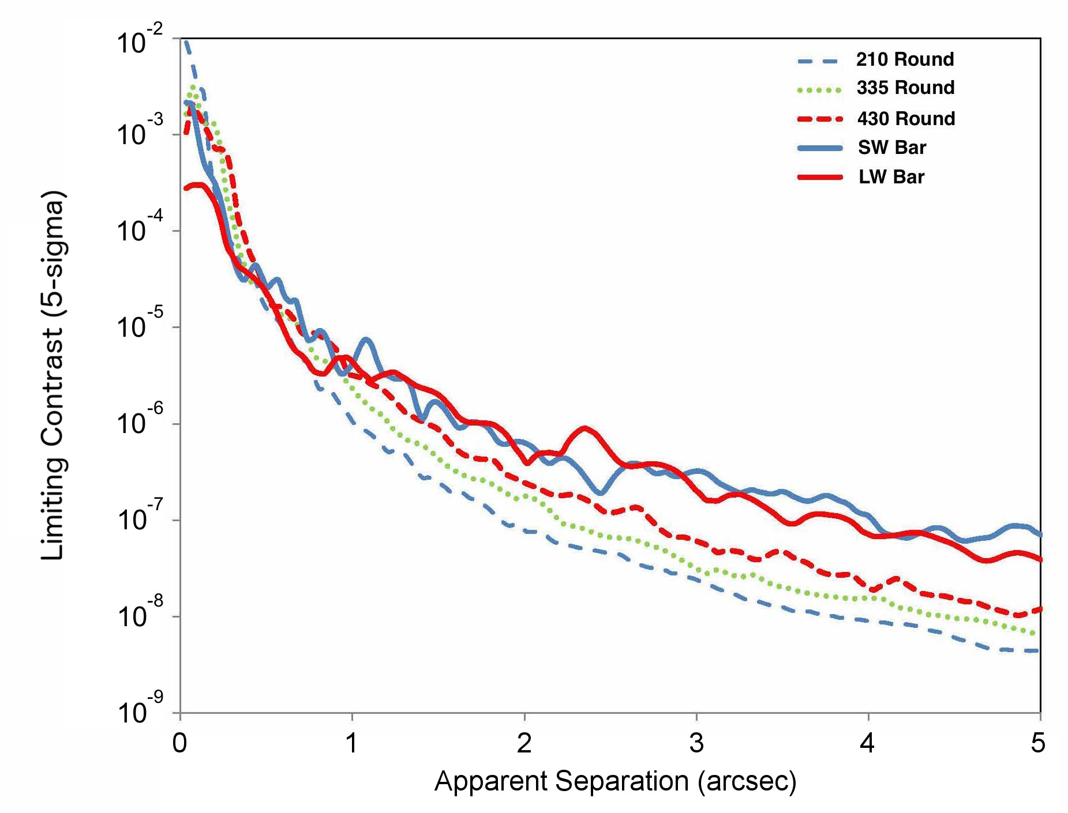
Contrast as function of separation
Beichman et al. 2010, PASP, 122, 888

Slide 5
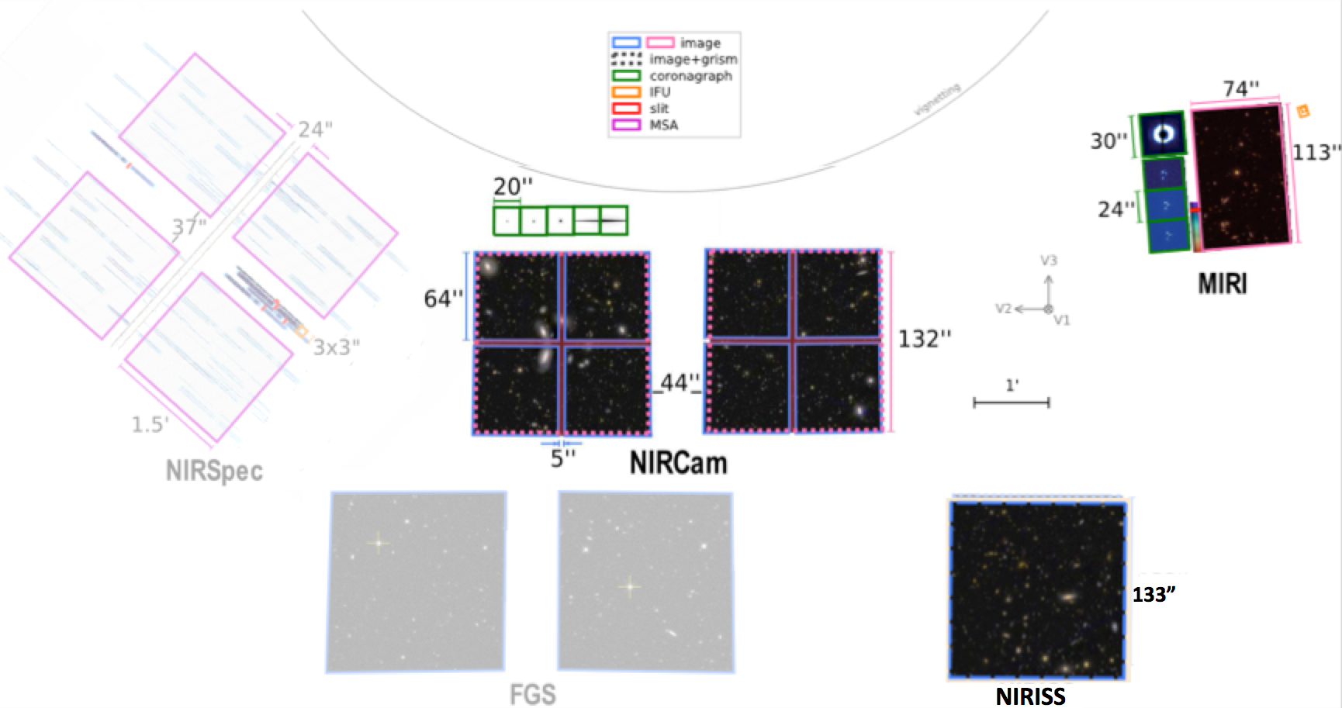
High Contrast Imaging with JWST
Three JWST instruments are
equipped for HCI
MIRI using a coronagraph and a Four-Quadrant Phase Mask (4QPM)
NIRCam coronagraph
NIRISS Aperture Masking Interferometer (optional hands-on Tuesday)
MIRI Lyot and 4QPM
NIRCam: Lyot
NIRISS : AMI
https://jwst-docs.stsci.edu/methods-and-roadmaps/jwst-imaging

Slide 6
Coronagraphy
The optical cancellation is done by:
Suppressing the host’s Airy core using Lyot masks (“occulters”);
Using Lyot stops to suppress the PSF wings remaining in the diffracted light after passing through the occulters.
The final step in the reduction is carried out after the observations are completed by using a Point Spread Function (PSF) reference observed using the same instrument setup to model and subtract the coronagraphically suppressed PSF.

Slide 7
PSF subtraction
The PSF subtraction can use two strategies:
Referenced differential imaging (RDI): coronagraphic images of both host and reference star are taken at the same roll angle and the reference star’s PSF scaled and subtracted to remove any speckle noise residuals;
Angular differential imaging (ADI): two images of the host are taken at different roll angles (differing by +/- 5 degrees) allowing to distinguish offsets of the target from noise;
The small grid dithers (SGDs) expand the RDI by moving the reference star on an accurate sub-pixel grid, from which PSF changes as function of position can be mapped and the corrections obtained through interpolation.

Slide 8
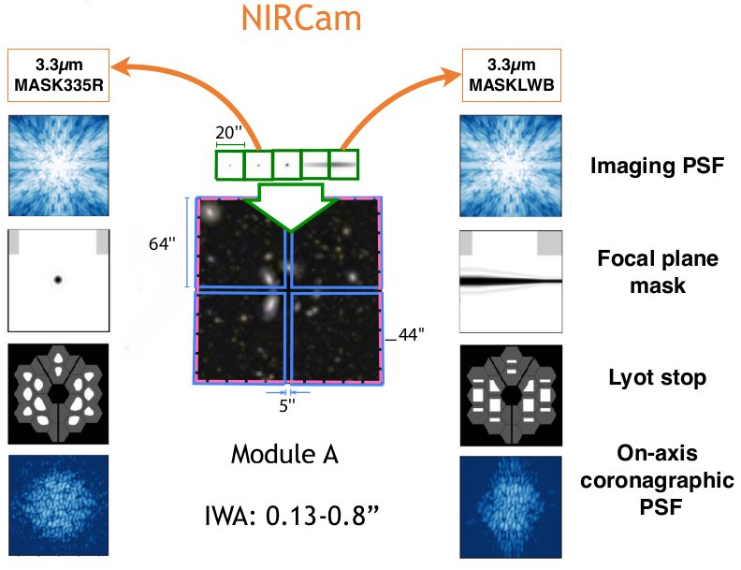
NIRCam
The NIRCam coronagraphs obtain images from regions of the sky outside the imaging field of view, which are projected onto the detectors by optical wedges located on the pupil plane Lyot stops.
Because of the throughput curve of the NIRCam coronagraphic masks, observations are only possible at wavelengths longward of 1.8 μm.
Figure by Julien Girard,
HCI Master Class 2019

Slide 9
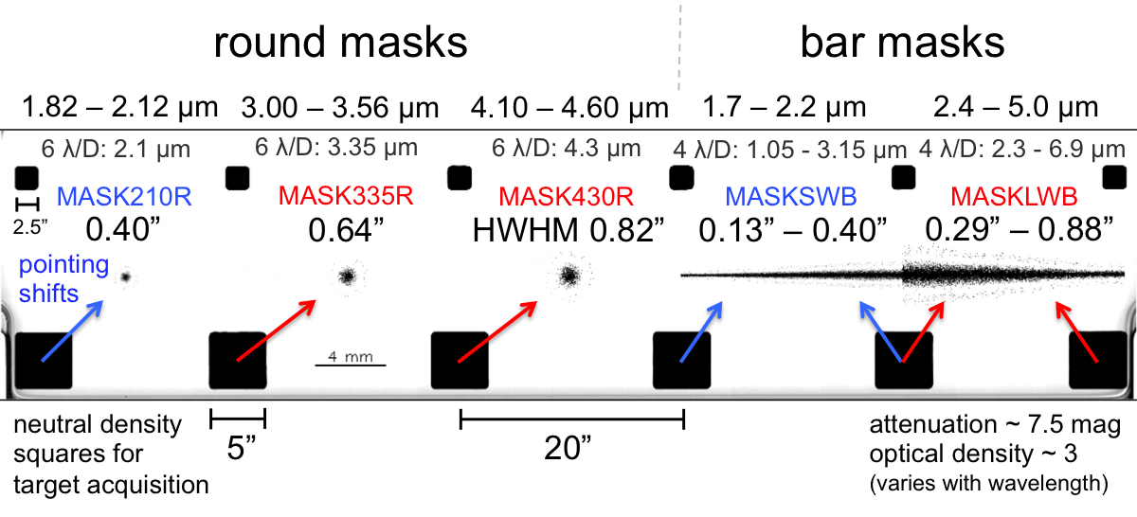
NIRCam Coronagraph
Wavelength range
Acquisition boxes
Inner working angle
Acquisition boxes
https://jwst-docs.stsci.edu/near-infrared-camera/nircam-observing-modes/nircam-coronagraphic-imaging
Blue and red colours represent masks used by NIRCam SW
and LW channels respectively

Slide 10
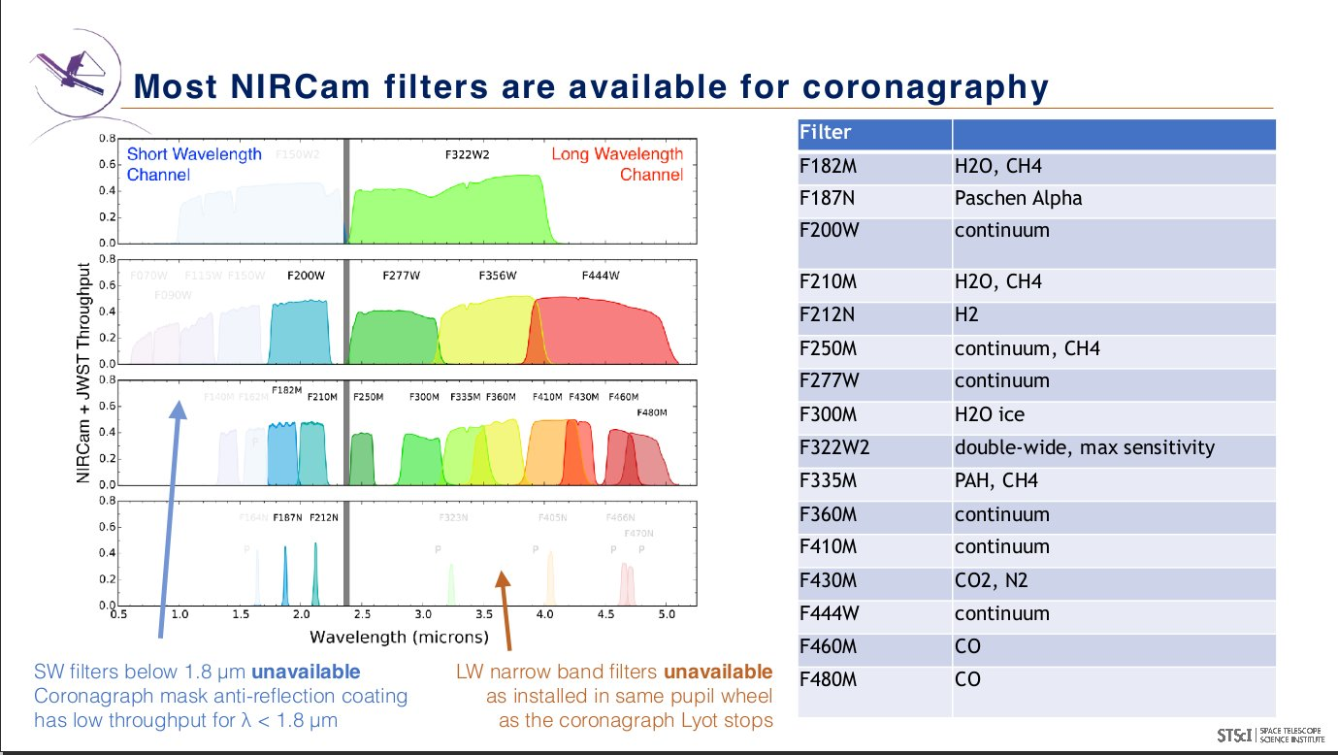
Figure by Julien Girard, HCI STScI Master Class 2019

Slide 11
NIRCam coronagraphs with round coronagraphic masks work best in narrow and medium bands centred at 1.92, 3.23, and 4.35 µm.
Coronagraphs with bar-shaped occulters work best in narrow and medium bands in the ranges 1.7–2.2 µm and 2.4–5 µm.
(https://jwst-docs.stsci.edu/methods-and-roadmaps/jwst-high-contrast-imaging/hci-supporting-technical-information/hcioptics#HCIOptics-LyC)

Slide 12
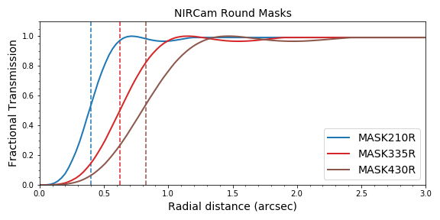
There is a wavelength dependence on the inner working angle:
Dashed lines: IWA for each filter
https://jwst-docs.stsci.edu/methods-and-roadmaps/jwst-high-contrast-imaging/hci-supporting-technical-information/hci-inner-working-angle

Slide 13
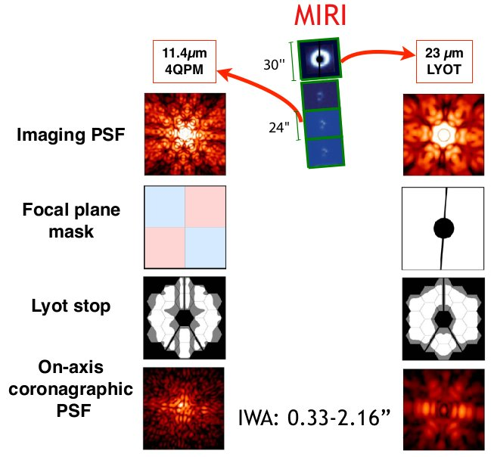
MIRI
Four possible setups;
Lyot mask for wide band
Three four-quadrant phase
masks at 10.575, 11.40 and
15.50 μm, which use destructive
interference to cancel light from
host.
Figure by Julien Girard,
HCI Master Class 2019

Slide 14
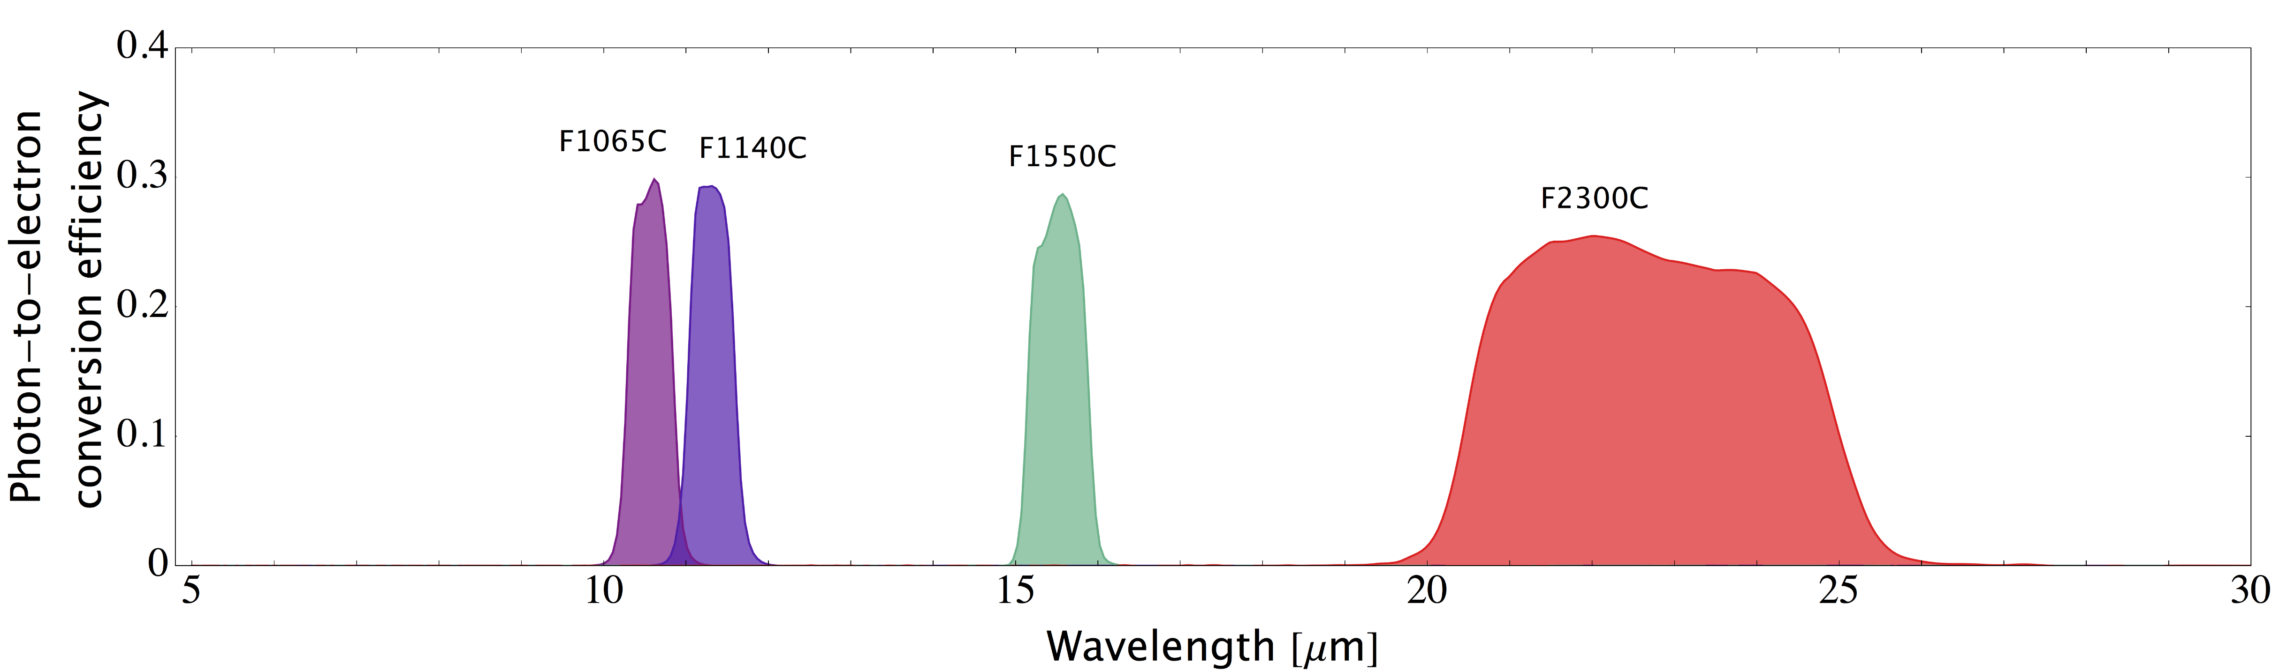
MIRI coronagraphic filters
MIRI coronagraphic filters
(https://jwst-docs.stsci.edu/mid-infrared-instrument/miri-observing-modes/miri-coronagraphic-imaging#MIRICoronagraphicImaging-CoronFiltersCoronagraphfilters)

Slide 15
The Four-Quadrant Phase Mask (4QPM)
The Lyot masks provide good contrast in the region not covered by the occulter, which typically limits the IWA to the projected radius of the occulter (≥ 3λ/D) (Boccaletti et al. 2015, PASP 127, 633).
The 4QPM can attain IWAs of the order of 1 λ/D by replacing the occulter with a transparent mask that introduces phase differences at different positions of the Focal Plane to produce destructive interference in the re-imaged pupil. Optimal suppression is attained using a monochromatic source and because of this the 4QPM mask is used with narrow-band filters (Boccaletti et al. 2015, PASP 127, 633 and references therein).
The 4QPM has similar IWA as NIRCam SW allowing both instruments to probe the same targets.
More details at JDOX: https://jwst-docs.stsci.edu/mid-infrared-instrument/miri-observing-modes/miri-coronagraphic-imaging#MIRICoronagraphicImaging-CoronFilters

Slide 16
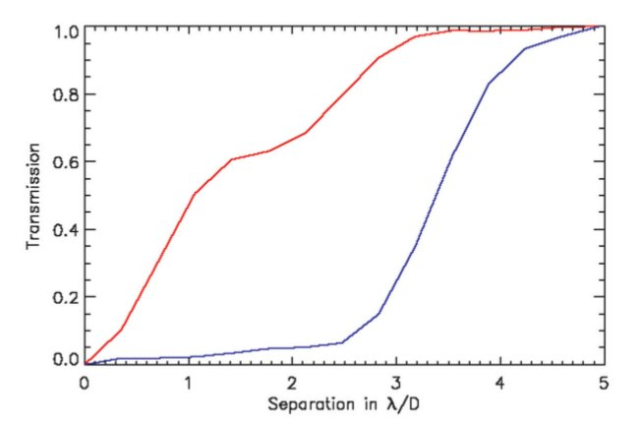
4QPM
Lyot
Transmission curves for 4QPM and Lyot masks
(Boccaletti et al. 2015)

Slide 17
Further reading
JWST high contrast imaging overview:
https://jwst-docs.stsci.edu/methods-and-roadmaps/jwst-high-contrast-imaging#JWSTHigh-ContrastImaging-Instrument
NIRCam coronagraphic imaging strategies:
https://jwst-docs.stsci.edu/near-infrared-camera/nircam-observing-strategies/nircam-coronagraphic-imaging-recommended-strategies#NIRCamCoronagraphicImagingRecommendedStrategies-Signal-to-NoiseRatio
Sub-pixel Dithering
https://jwst-docs.stsci.edu/near-infrared-camera/nircam-operations/nircam-dithers-and-mosaics/nircam-subpixel-dithers/nircam-small-grid-dithers
MIRI coronagraphic imaging strategies:
https://jwst-docs.stsci.edu/mid-infrared-instrument/miri-observing-strategies/miri-coronagraphic-recommended-strategies

Slide 18
Additional material

Slide 19
PSF subtraction
Chose PSF subtraction strategy (RDI or RDI; SDG); see page 7.
Chose PSF reference star that has spectro-photometric properties corresponding closely to the host. A brighter (non-saturating) reference will allow optimal corrections and minimise observation time (though not overheads).
The (recommended) standard observational strategy is (HCI page):
Take science observation with host centred in the coronagraphic mask;
Observe PSF reference centred in the coronagraphic mask, same roll angle;
Eventually all reference star observations will be compiled into a library for use in advanced post-processing analyses for instance PCA as in the KLIP algorithm (quoting J. Leisenring).

Slide 20
NIRCam Operations
Only Module A is available
While simultaneous coronagraphic imaging in SW and LW is technically feasible, this will not be implemented for Cycle 1.
Each occulting mask has its IWA and wavelength domain (pages 4 and 9). If a series of masks are used, each will require a separate target acquisition
Target acquisition requires S/N of at least 30 regardless of source brightness;
Taking astrometric reference images is recommended. These use the target acquisition filter and two images are taken; once when the host is away from the mask and again when the host is centred in the mask. These allow determining the precise position of the target.

Slide 21
NIRCam Operations
Coronagraphic observations benefit from the large range of exposure lengths that are available. Slow readout modes allow detecting faint diffuse sources, while saturating the inner regions.
For bright sources at small IWAs, readouts using sub-arrays can also be used.
Use the Coronagraphic Visibility Tool to assess the feasibility of observations given the position angle and separation of target relative to host
For a more detailed description refer to
https://jwst-docs.stsci.edu/near-infrared-camera/nircam-observing-strategies/nircam-coronagraphic-imaging-recommended-strategies#NIRCamCoronagraphicImagingRecommendedStrategies-Signal-to-NoiseRatio

Slide 22
NIRCam coronagraphs with round coronagraphic masks work best in narrow and medium bands centred at 1.92, 3.23, and 4.35 µm.
Coronagraphs with bar-shaped occulters work best in narrow and medium bands in the ranges 1.7–2.2 µm and 2.4–5 µm.
(https://jwst-docs.stsci.edu/methods-and-roadmaps/jwst-high-contrast-imaging/hci-supporting-technical-information/hcioptics#HCIOptics-LyC)
The Coronagraphic Visibility Tool is essential to determine the optimal orientation (and even feasibility) of the observartions, particularly in the case of the “bar” masks.

Slide 23
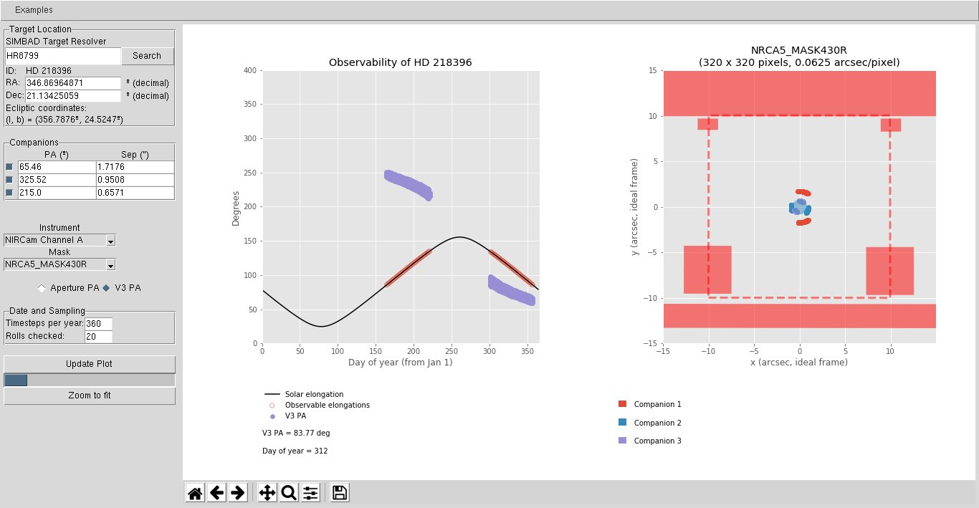
Coronagraphic Visibility Tool NIRCam

Slide 24
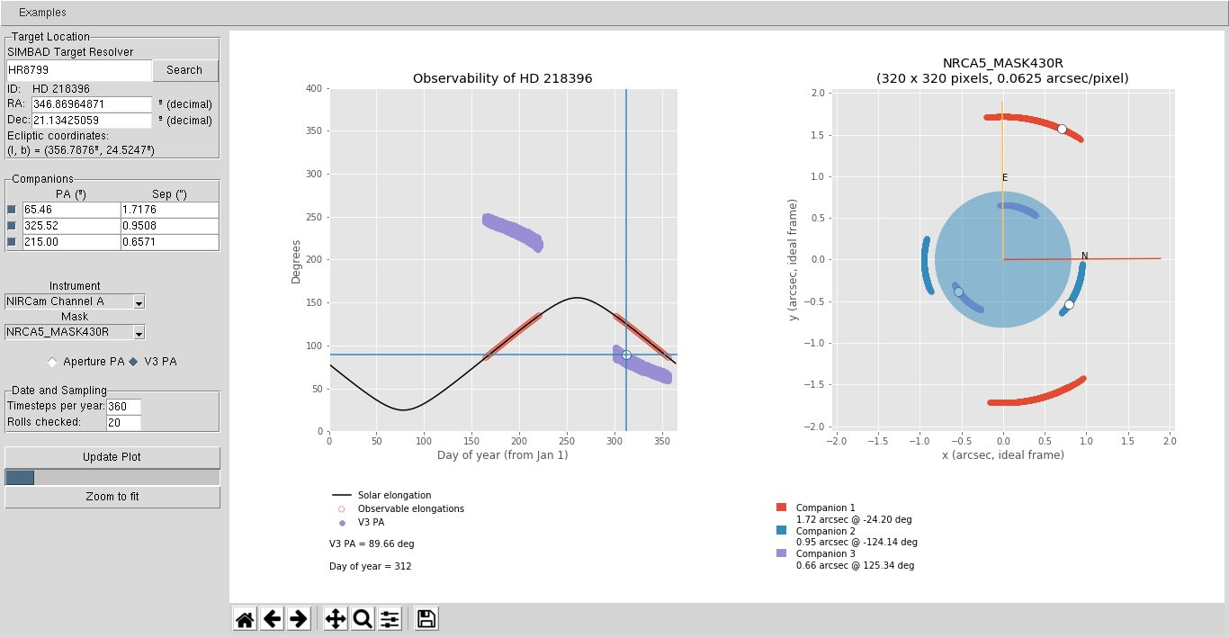

Slide 25
MIRI Operations
The main reference for this is JDOX:
https://jwst-docs.stsci.edu/mid-infrared-instrument/miri-observing-strategies/miri-coronagraphic-recommended-strategies
Choice of coronagraph is determined by contrast and separation between target and host, and possibly the target’s spectral energy distribution
Using the Coronagraphic Visibility Tool determine the feasibility of the observations given target visibility and orientation relative to the host;
Use the JWST Background Tool to determine the effect that the background (zodiacal and telescope) may have on the observations.

Slide 26
MIRI
For longer wavelengths the allowable range of roll angles (+/- 5 degrees) is not enough to enable angular differential imaging for IWA < 2.8”. For these observations a larger roll angle is required, which also means the additional data will be taken at a later date.
Target acquisition is required and filters that can be used are the F560W, F1000W, F1550W and the FND neutral density filter. These should be used to avoid saturation and generation of latent images.
In the target acquisition insure that the target will not fall in the vicinity of latent images due to light from host prior to aligning the telescope.
Accurate centroiding requires S/N >= 30

Slide 27
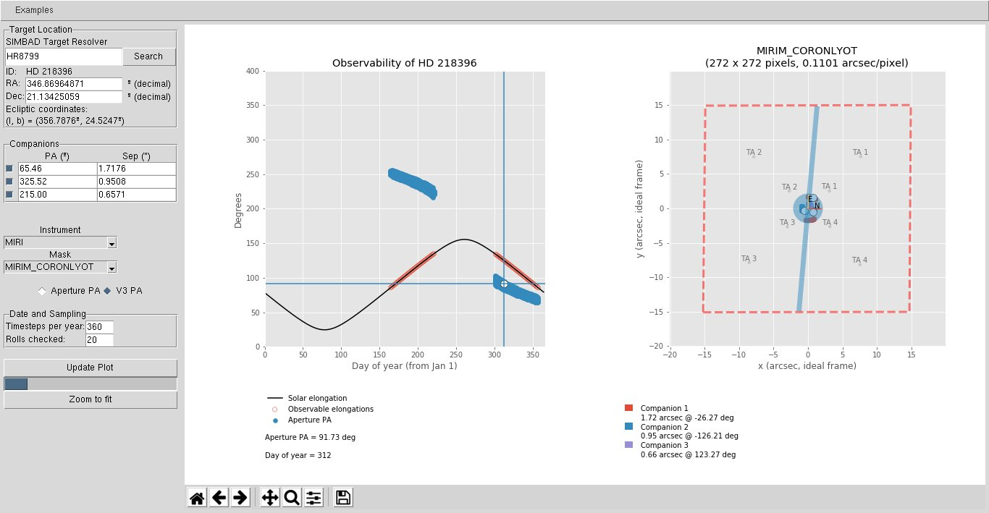
Coronagraphic Visibility Tool (Lyot)

Slide 28
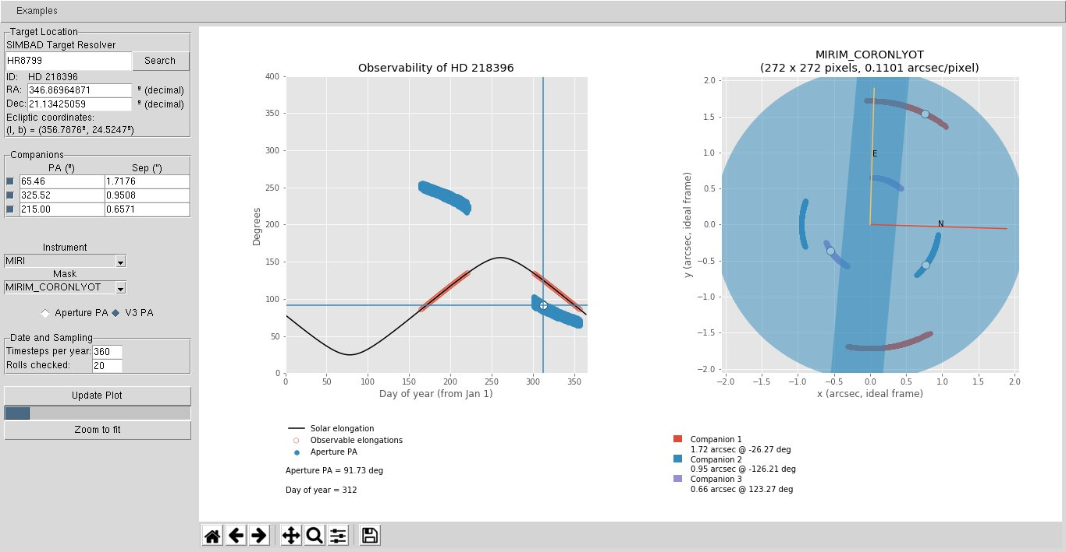
Coronagraphic Visibility Tool (Lyot)

Slide 29
4QPM
For target acquisition using the 4QPM, observers must avoid the 4QPM axes, using the diagonals because of centroiding errors;
The recommendation is that target acquisition should be performed no closer than 500 mas to the 4QPM centre and no further than ~750 mas.

Slide 30
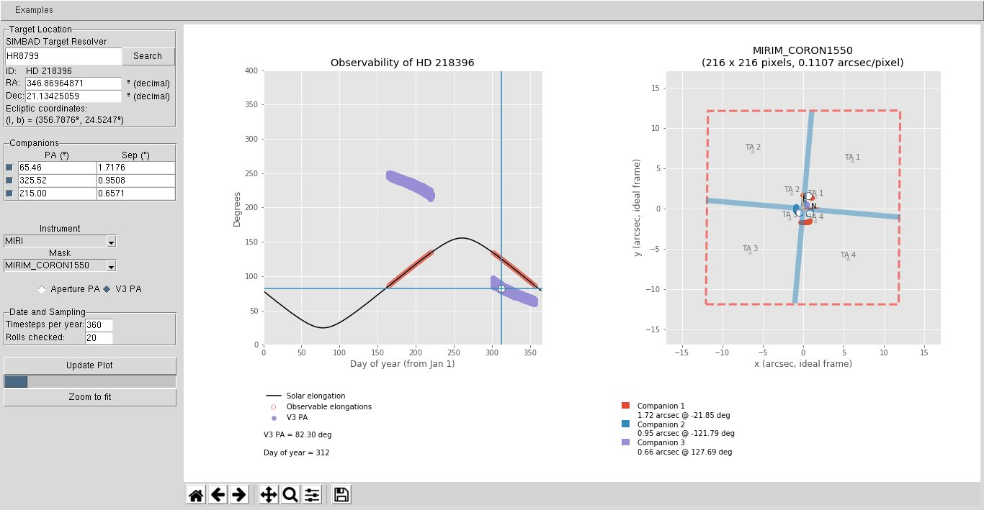
Coronagraphic Visibility Tool (4QPM)

Slide 31
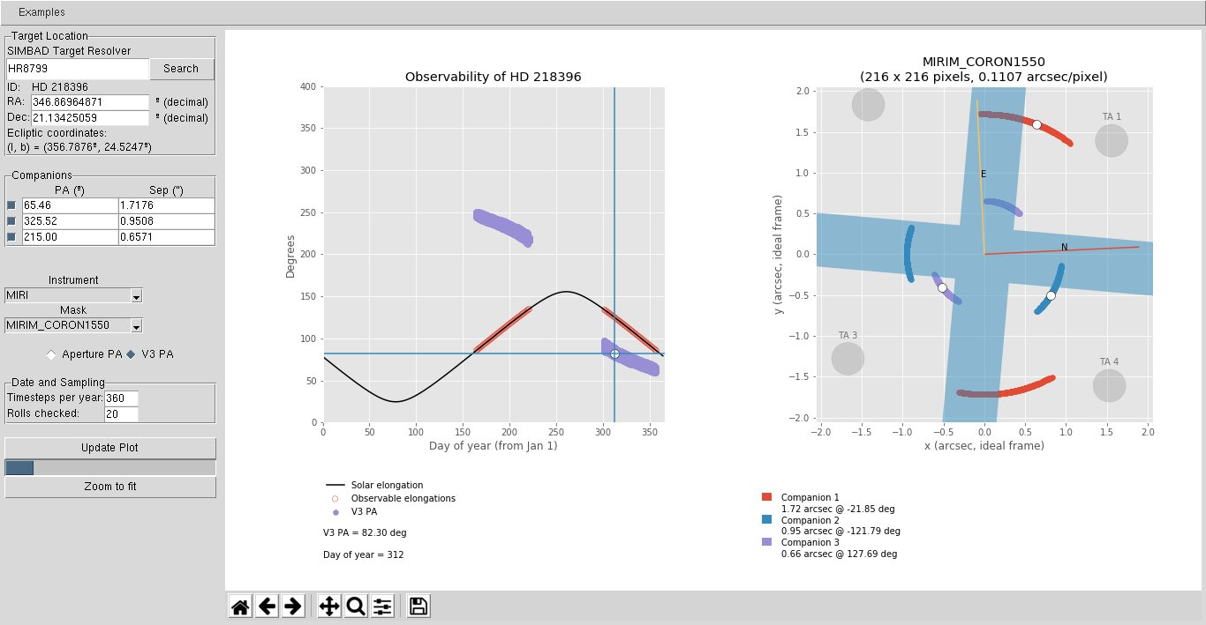
Coronagraphic Visibility Tool (4QPM)

Slide 32
Other references
PSF subtraction:
https://jwst-docs.stsci.edu/methods-and-roadmaps/jwst-high-contrast-imaging/hci-proposal-planning/hcietc-instructions (“HCI page”)
https://jwst-docs.stsci.edu/mid-infrared-instrument/miri-observing-strategies/miri-coronagraphic-recommended-strategies
https://jwst-docs.stsci.edu/near-infrared-camera/nircam-operations/nircam-coronagraphic-psf-estimation
Rough estimates of exposure time and S/N (JWST Interactive Sensitivity Tool:
https://jist.stsci.edu/jist
Coronagraphic Visibility tool:
https://jwst-docs.stsci.edu/jwst-other-tools/target-visibility-tools/jwst-coronagraphic-visibility-tool-help

