Slide 1
Parallels
Colin Jacobs

Slide 2
Parallels
Parallel observations allow two (or more) instruments being used simultaneously (e.g., ACS, WFC3 on HST);
JWST will have two types of parallel observations:
Pure parallels when GO programmes can observe with an instrument not being used by the proposer, for a completely unrelated science case;
Coordinated parallels when observations with two different instruments are carried out, addressing a single science case which must be justified when making the proposal.
The use of parallels has increased the expected efficiency of JWST by 16—26%
One should note that some instrument calibrations will be taken in parallel mode and these observations take precedence over pure parallels.

Slide 3
Cordinated and Pure compared
Coordinated Parallels | Pure Parallels
Science case in proposal needs to justify parallel as well as prime observations. Science goals need to call for both. | Distinct proposal type, using parallel slots derived from separate (primary) programs.
Proposer can craft exposure times, number of exposure specifications, dithers, etc. to make things work for their science with the prime and parallel observations. | Pure parallel observations cannot change the properties of primary observations to which the proposed parallel ones will be attached.
Coordinated parallel proposal specifies all parallel exposures in detail. | Proposal specifies one Observation per type of proposed exposure (e.g., different filters or grisms). Exposure times need to specify the minimum allowable lengths for the proposed science. Scientific Justification needs to specify minimum number of distinct primary targets per observation to fulfill science goals.
APT templates for coordinated parallels are based on the “normal” templates of the prime observing modes. | APT templates for pure parallels are distinct from the “normal” observing templates, selected in Proposal Information section of APT.

Slide 4
Coordinated Parallels
Colin Jacobs

Slide 5
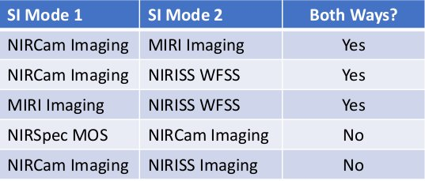
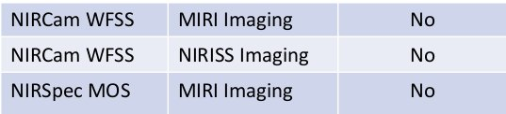
Coordinated parallels for Cycle1

Slide 6
Coordinated Parallels
Are designed to optimise the Point Spread Function (PSF) sampling of both instruments in use.
There are certain limitations:
No mechanisms should be moved or calibration sources turned on while either instrument is acquiring data;
The exposure duration of a parallel instrument cannot be longer than the primary’s ;
Data volume is a parameter that requires careful consideration (particularly when all NIRCam detectors are being used).

Slide 7
Pure Parallels
Juan Espejo

Slide 8
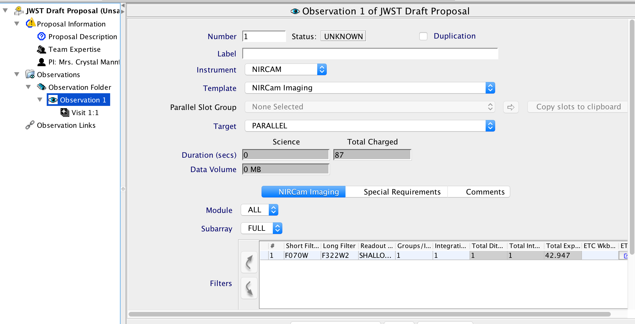
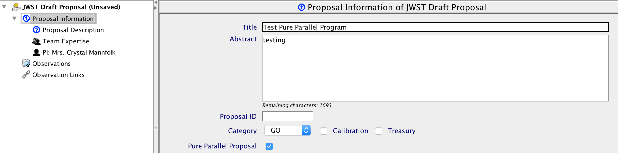
JWST Science Parallels: Proposing a Pure Parallel Program
Additional Resource:
JDox Article: JWST Parallel Observations JWST
JDox Article: APT Pure Parallel Observations
Notes:
his removes the Targets section of the APT file, and a value of "Parallel" is entered automatically into your example observations templates. The proposer should fill out one or more observing templates in APT (one typical example for each observing mode being requested) to indicate the relevant parameters of the exposures being requested.

Slide 9
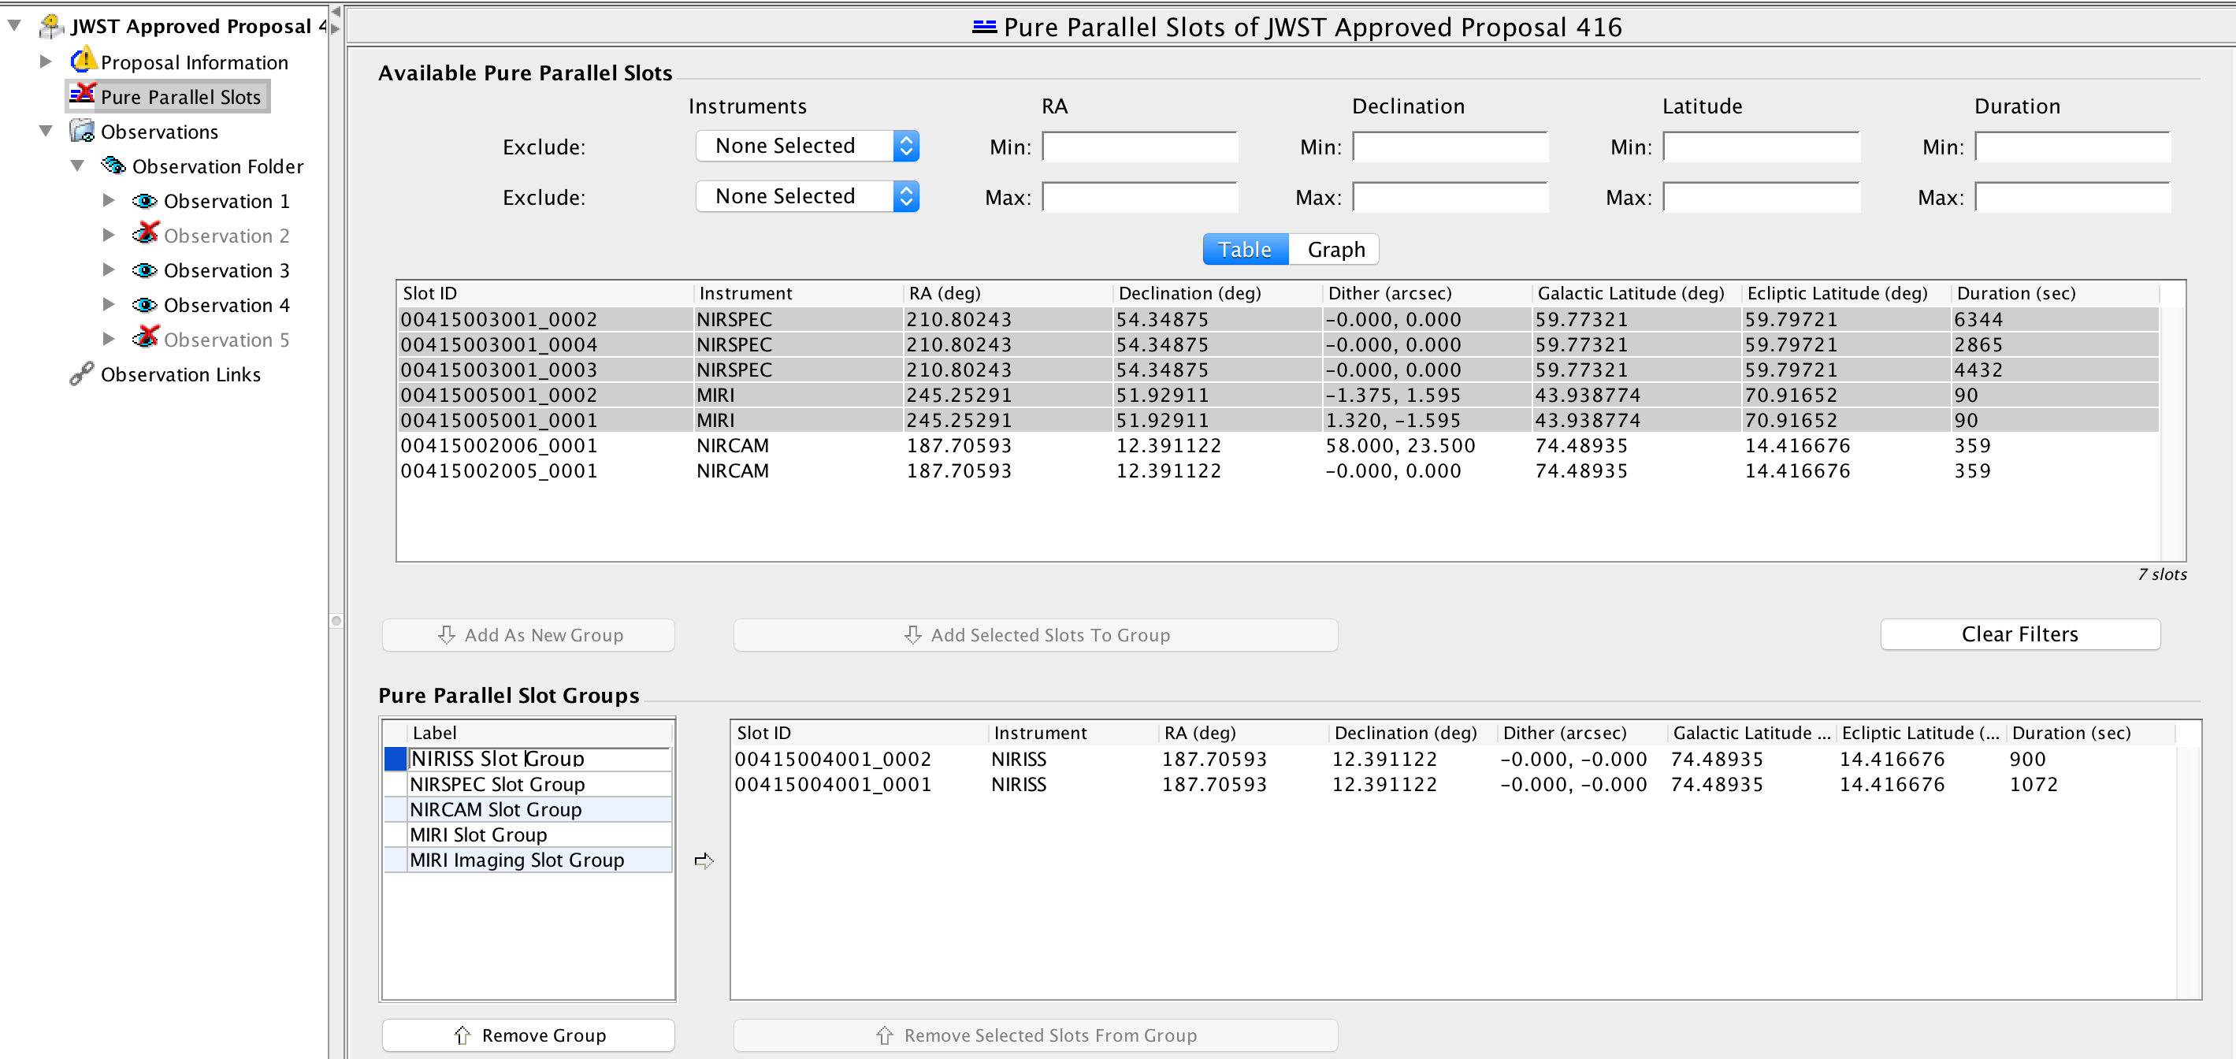
JWST Science Parallels: Phase II
After acceptance by the TAC, and when the available parallel slots are known, successful proposers will develop a “Phase II” APT proposal.
APT will show the available observing slots and their properties.
Details will depend on the severity of competition for the available slots.
Slot(s) can be selected and grouped so they can be attached to the parallel observation
Slot Groups created are shown and can be given labels
Slot Groups can contain one or more slots

Slide 10
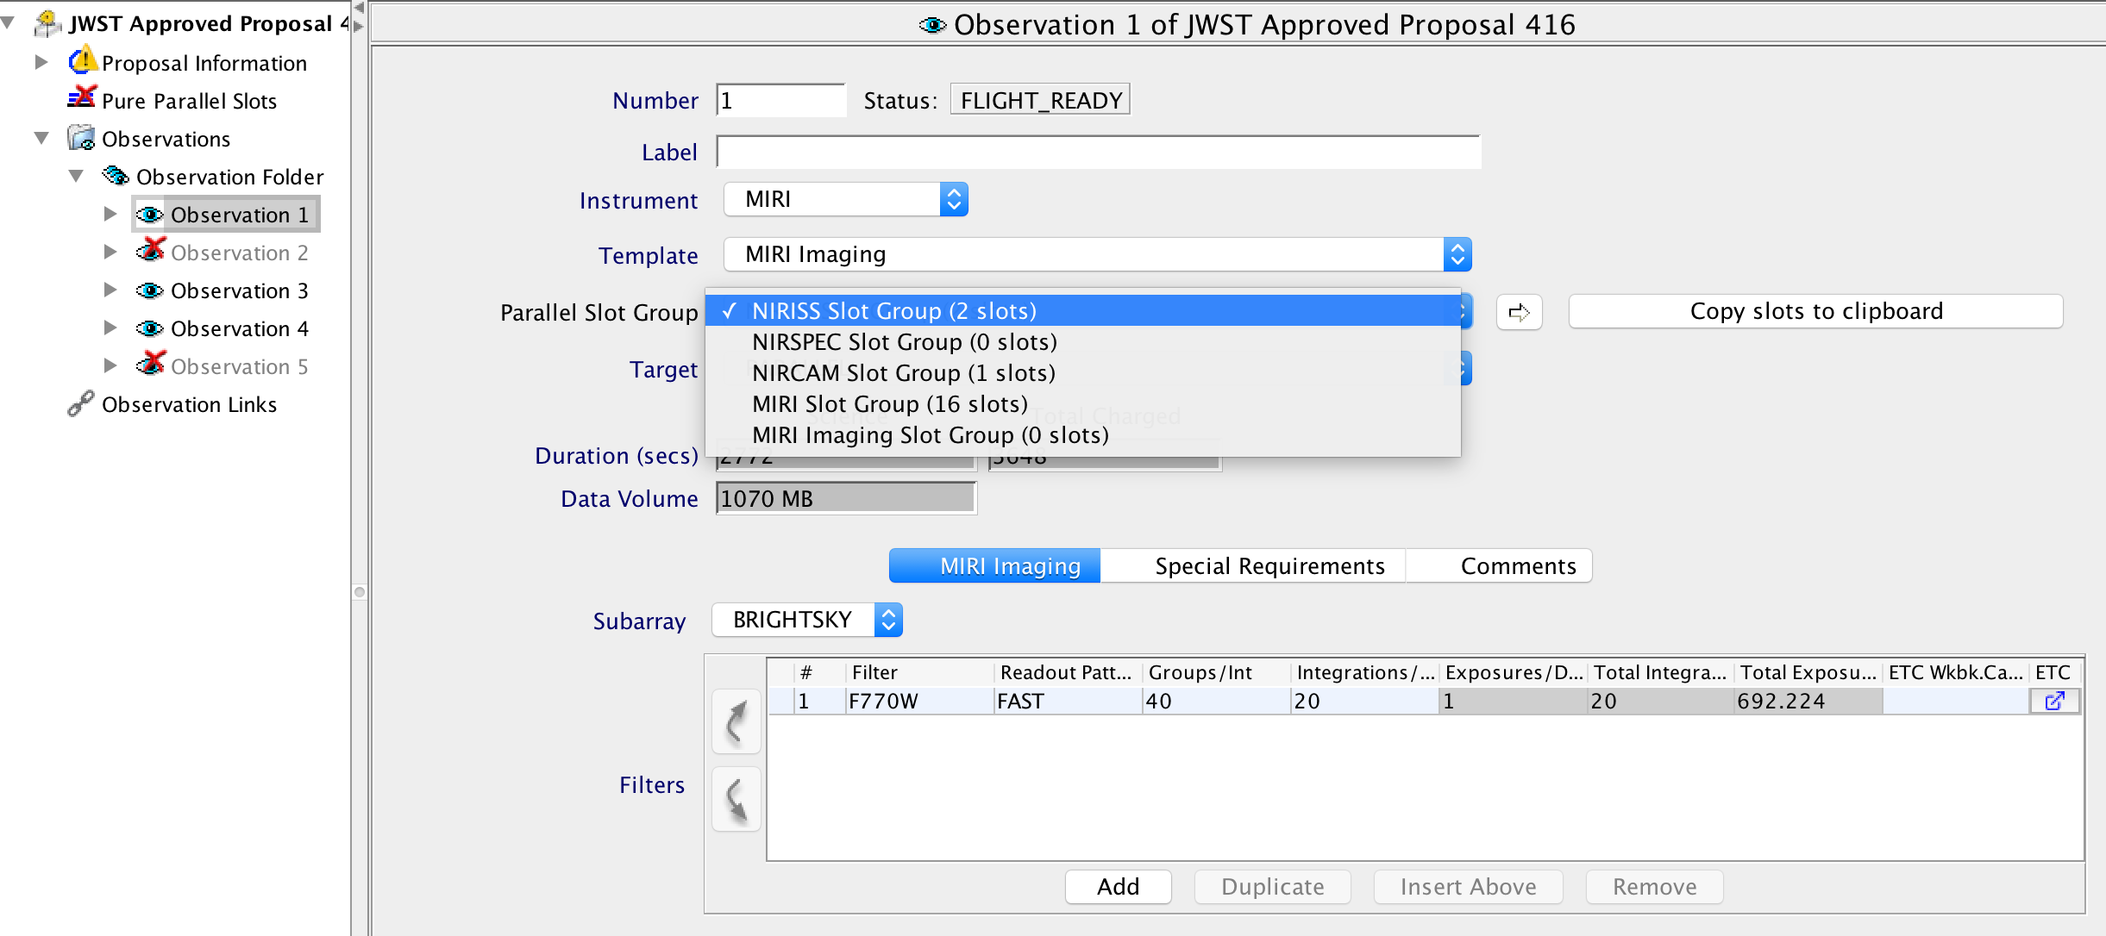
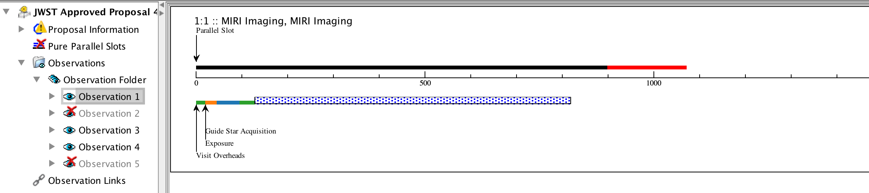
JWST Science Parallels: Phase II
Select an Observation, then select which Parallel Slot Group to attach.
Update your exposure time to fit within the Pure Parallel Slot Group
Open up the Timeline Tool to see how well your parallel observation fits into the attached prime observation
Note: Calibration Pure Parallels (i.e., darks) will get access to the parallel slots before science pure parallels do

