Slide 1
Cycle 2 Timeline and policies
Colin Jacobs
JWST MASTER CLASS MELBOURNE 2022

Slide 2
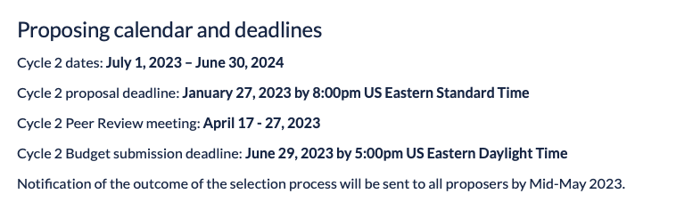
The timeline
Notes:
Still march 2020

Slide 3
What to expect
STScI anticipates receiving 1000 to 1600 proposals, and awarding approximately 300 recommended by the Time Allocation Committee (TAC) & Panels.
Approximately 6000 hours of observing time will be available for the Cycle 1 General Observer (GO), which include ~2000 hours in oversubscription to maximize scheduling efficiency.
Notes:
300 of 1600 proposals expected to be recommended; 6000 hours available for GO

Slide 4
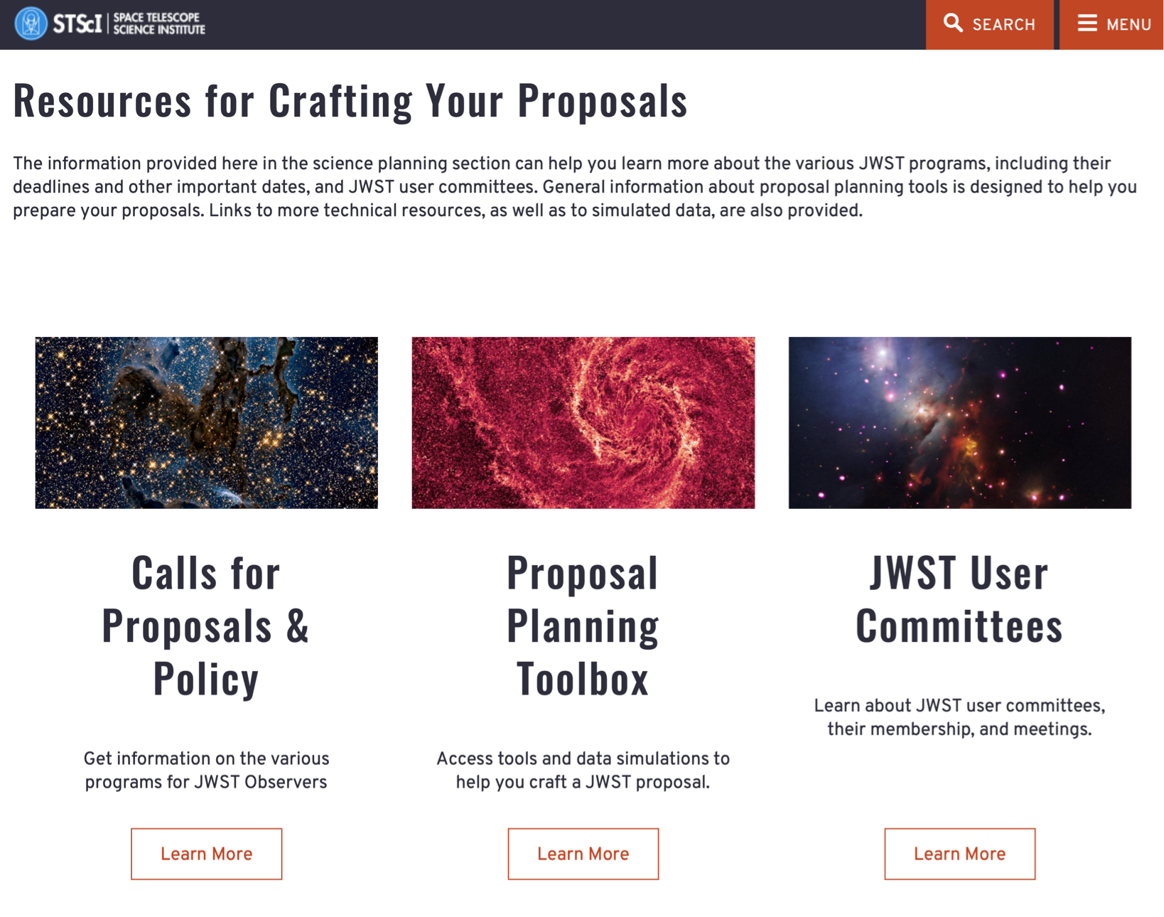
Where to find the information
https://www.stsci.edu/jwst/science-planning
Notes:
Lots of resources available!

Slide 5
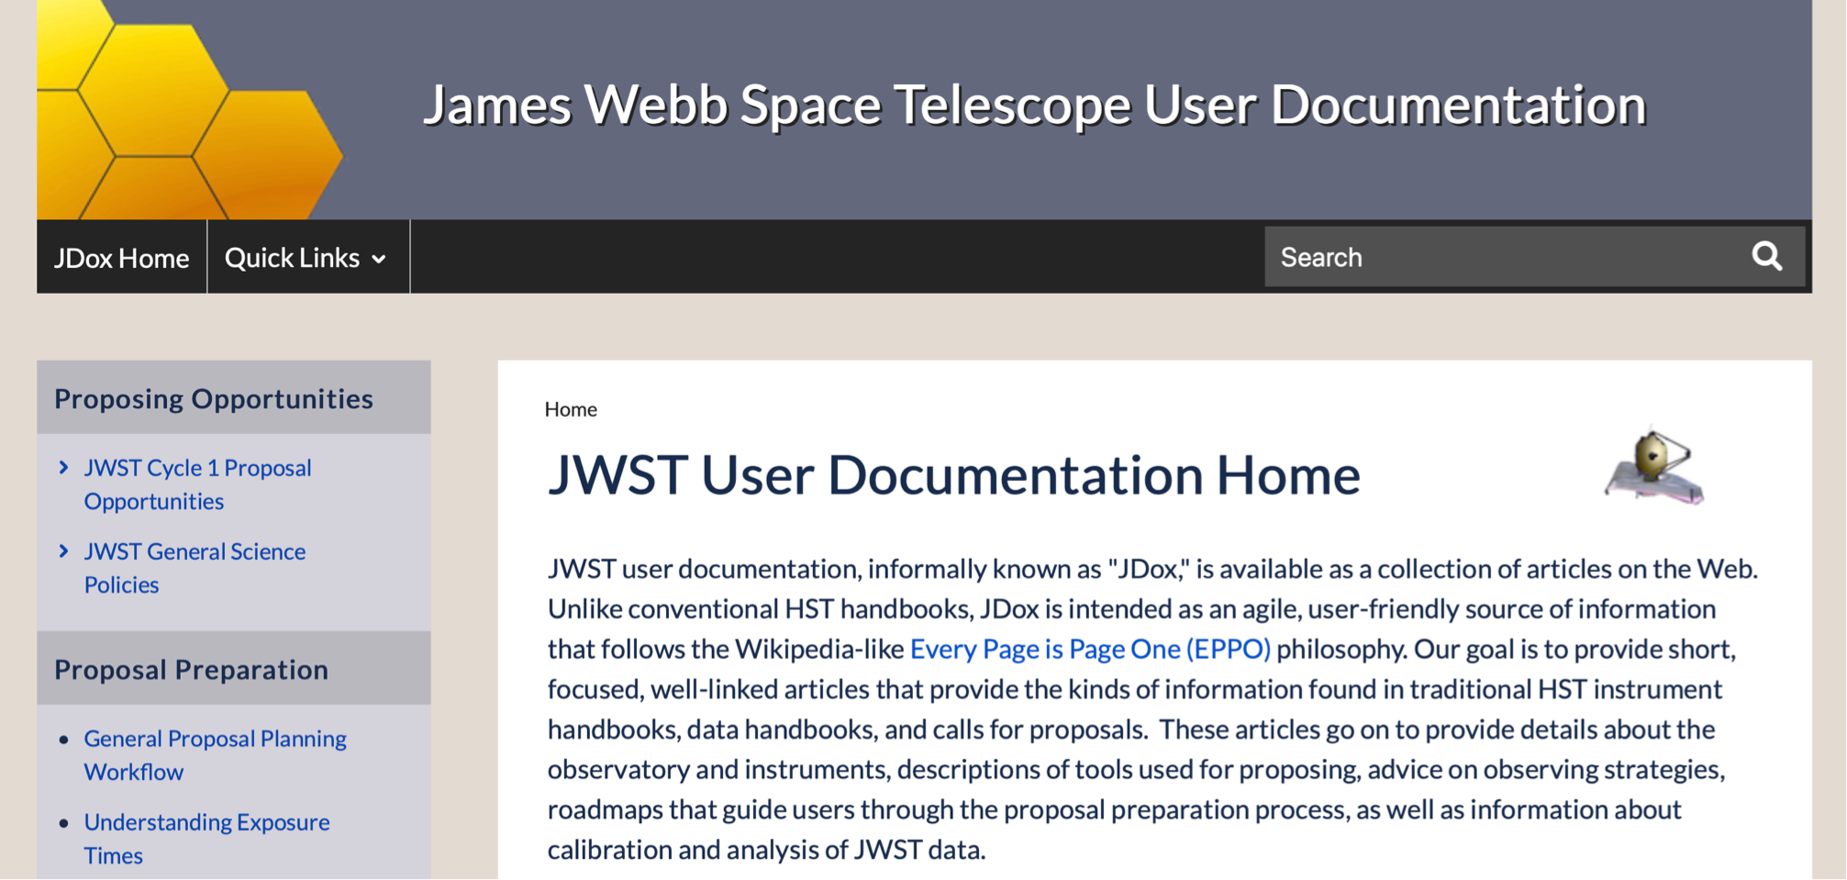

Where to find the information

Slide 6
Opportunities available in Cycle 2
For the Cycle 2 GO/AR Call there will be two overall categories of proposals.
New observations are requested through General Observer (GO) proposals.
Requests for support for JWST research that does not require new observations are made through Archival Research (AR) proposals.
Director’s Discretionary (DD) proposals will be accepted any time
Notes:
GO (new obs)
AR (no new obs)
Why? ERS, some GTO are public. AR = americans

Slide 7
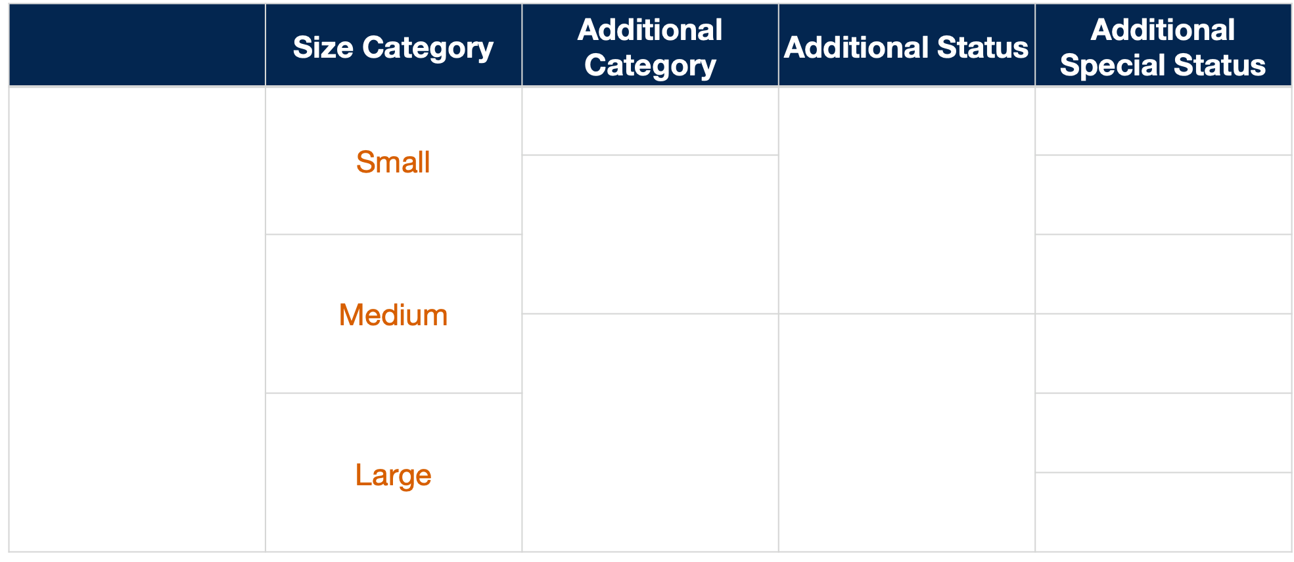
Opportunities available in Cycle 2
Joint*
Time-constrained
General
Observer
(GO)
Program
Long-term
Target of Opportunity
Calibration
Solar System
Coordinated parallel
Treasury
Survey
Pure Parallel
Pre-Imaging
Notes:
Long term: >1 cycle
Treasury like HST, additional products and tools for community
We will talk about parallels
ALMA, Chandra, HST, NASA Keck, NOIRLab and/or XMM-Newton

Slide 8
General Observer (GO) Proposals
Depending on size, GO proposals fall into the different categories:
Small Proposals are requests of up to 25 hours. We anticipate approximately 2900 hours for Cycle 2. These proposals are reviewed and recommended by topical panels. Small proposals have a default of 12 months of exclusive access rights.
Medium Proposals (25 to 75 hours) are expected to receive ~1250 hours in Cycle 2. These proposals will also be reviewed by topical panels. They also have a default of 12 months of exclusive access rights.
Large Proposals (>75 hours) are expected to receive approximately 750 hours (shared with Treasury programs), and will be reviewed by the TAC, which is the chairs panel. They have no default exclusive access period, but may request one in the proposal.
Notes:
<25, <75, >75 hours
3500/1400/1000 hours to be allocated
- Small and medium both topical panels, 12 mos exclusivity
Note: for large and treasure, the astronomers will be out of your field; no exclusivity

Slide 9
General Observer (GO) Opportunities
The Joint JWST-ALMA,Chandra, HST, NASA-Keck, NOIRLab, XMM-Newton opportunity recognizes the inherent “double jeopardy” in proposing to both reviews to do multi-wavelength work. The JWST TAC review can award time in which JWST observations comprise the primary science, and an ancillary allocation which complements the JWST proposal. The prime JWST observations can be small, medium, or large in size category.
Calibration Proposals - STScI will manage calibration data and software for the most important and most used observatory modes, but not all JWST configurations will be calibrated. Calibration Proposals allow the community to fill this gap. These should be for observations which are of benefit to the community. There is no set allocation, and proposals may be small, medium, or large in size.
Survey programs improve the efficiency of JWST by providing short, schedule-filling observations when gaps are identified. Analogous to the HST-Snapshots, filling targets will be drawn from these lists with no guarantee any will be observed. We anticipate allocating up to 1200 hours of Survey Proposals, of which we expect only about 200 hours (1 in 6) will be executed. Survey programs can be small, medium, or large in size category.
Notes:
150 orbits with HST that the JWST can award, Cycle 29 (future); STSCI still working on it
Calibration: For community to fill the gaps outside of the main modes. Any size (SML)
Survey: Fillers, short observations that can fill gaps where they are identified, cf HST snap
https://jwst-docs.stsci.edu/jwst-opportunities-and-policies/jwst-call-for-proposals-for-cycle-2/jwst-proposal-categories#JWSTProposalCategories-jointobservingprogramsJointObservingPrograms

Slide 10
General Observer (GO) Opportunities
The Treasury Programs are designed to create datasets of lasting value to the mission, by solving multiple scientific problems while simultaneously enabling a variety of compelling investigations. They should also provide scientific products that go beyond what will be produced by the JWST calibration pipeline. There is no size limit— proposals can be both Large and Treasury. Treasury status programs have no exclusive access periods..
The Long Term Programs scientifically require observing time to be split over more than one cycle to accomplish science goals. They may request up to 3 cycles— no continuation proposal. There is no size limit.
Notes:
Treasury provides products beyond the pipeline, no size limit.
Long term up to 3 cycles

Slide 11
General Observer (GO) Special Observation Types and Restrictions
Observations of Solar System objects are limited due to the limited field of regard. The Sun, Mercury, Venus, Earth, and Moon cannot be observed due to the orientation of the sunshade.
Target of Opportunity (ToO) observations are of transient phenomena that occur at unexpected times and locations. These programs are activated when alerted by the Principal Investigator (PI). Due to limits in inserting them into schedule, and effects on efficiency, ToOs in Cycle 2 will be limited to 8 disruptive (w/ turnaround less than 14 days) ToO triggers. Ultra-disruptive ToOs (w/ less than 3 day turnaround) incur an additional 45 minutes of overhead per activation.
Time Constrained observations require execution within a constrained time period, e.g., observations of specific phases of variable stars, exoplanet transits, and some solar system phenomena.
Time Series observations fall in this category.
Time Critical observations are those that require an activation at a precise time, specified to within a window of 1 hour. These observations carry an overhead of 60 minutes per activation.
Notes:
No inner SS
ToO == transients

Slide 12
General Observer (GO) Special Observation Types and Restrictions
Science parallel observations involve simultaneous operation of two instruments into increase science return.
Coordinated parallels are from a single program, to achieve complementary observations. Coordinated parallels have pre-defined APT templates.
Pure parallels involve separate, distinct programs, not necessarily with the complementary goals (see Section dedicated to parallels).

Slide 13
General Observer (GO) Special Observation Types and Restrictions
Investigators may propose for observations of targets that have not yet been discovered or identified. This applies to targets that would be impossible (or difficult) to observe in the following cycle, or would lead to diminished scientific returns. While generally applicable to ToO observation targets, there may also be other circumstances in which proposals for such targets are justified. This does not apply to targets without time criticality. Examples of targets that are not suitable for this type of proposal include color-selected galaxies, transiting exoplanets, or stars newly discovered in the course of an ongoing survey.
Notes:
Generally applicable to ToO (other circumstances?)

Slide 14
General Observer (GO) Special Observation Types and Restrictions
Follow-up observations of JWST pre-imaging. Same-cycle follow-up spectroscopic observations of sources identified through JWST NIRCam imaging programs are permitted. For example, a proposal may request imaging with NIRCam as a means of identifying a specific type of target (e.g. high redshift galaxies) for subsequent spectroscopy with NIRSpec. The proposal must include the imaging observation defined in APT, and specify the expected number density and magnitude distribution in the anticipated discovery of new targets.
Notes:
Pre imaging needed for accurate astrometry for NIRSpec Micro shutter array 5 mas
Subsequent cycles will already have NIRCam images, this means came cycle

Slide 15
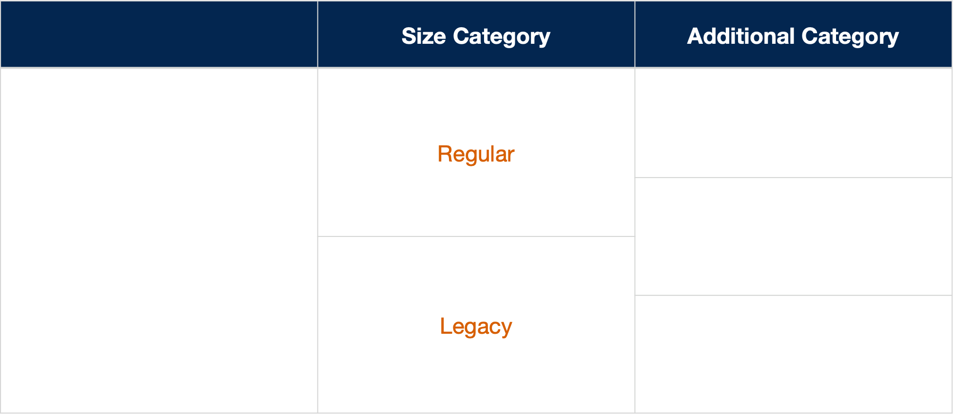
Opportunities available in Cycle 2
Calibration
Archival
Research (AR)
Program
Theory
Community Data
Science Software

Slide 16
Archival Research (AR) Proposals
Observations that are no longer in the exclusive access periods are freely available for analysis and are retrieved through MAST.
For Cycle 1 this included DD Early Release Science (ERS) datasets, which have no exclusive access periods, and some GTO datasets that will be made public.
For Cycle 2, this includes all Director's Discretionary Early Release Science datasets, which have no exclusive access period, and some approved GTO program datasets.
The JWST Archival Research (AR) Program can provide financial support for the analysis of such datasets.

Slide 17
Archival Research (AR) Proposals - US funding This is for information only, as Australian Astronomers do not have access to US funding
Regular AR proposals analyze a specific subset of JWST data to address a specific science issue not addressed by the original program. Awards will be typically less than $150,000 with a median of $75,000.
Legacy AR proposals differ in that they provide a homogeneous set of calibrated data or data products to the scientific community. Award will be a minimum of $150,000.
Calibration AR proposals may undertake a reanalysis of calibration data, or may develop a specialized software for JWST calibration. These should be consistent with Regular AR proposals in funding size.
Notes:
In case you have american collaborators

Slide 18
Archival Research (AR) Proposals
Theory proposals provide financial support for theoretical research that has a lasting benefit for the current or future observational programs with JWST. These should be consistent with the Regular AR funding size.
Community Data Science Software proposals are an opportunity to obtain financial support for the development of additional data science software products that will be made available to the community for the purposes of analyzing JWST data. There are numerous possibilities for the types of products that could be developed. Examples include: scripts to mitigate artifacts from specific detectors, tools to identify and extract fluxes/magnitudes from multiple sources within a field, utility software for working with JWST data products, or codes to produce background-subtracted spectra or software to interact with JWST archive services.
Notes:
"A Theory Proposal may be submitted by a non-U.S. PI if there are one or more U.S. Co-Is who request funding."
Software too

Slide 19
Director Discretionary Proposals
Nominally, up to 10% of the available JWST time in any cycle may be reserved for Director’s Discretionary (DD) time allocations. A substantial fraction has already been given to DD ERS programs.
DD proposals allow the timely follow-up of transient phenomena or other new discoveries that could not have been plausibly proposed for in response to the Cycle 2 call.
DD proposals will be accepted at any time during Cycle 2, post-commissioning.
Notes:
ERS comes from DD pool

Slide 20
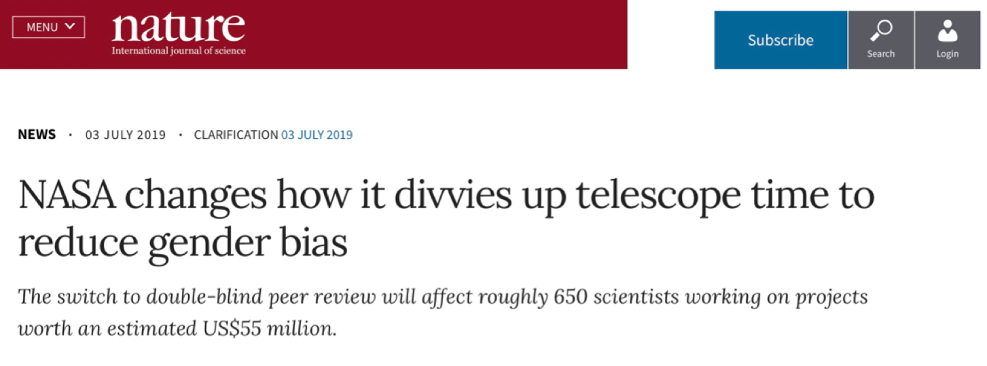
Proposal Submission - dual anonymous
STScI uses a dual anonymous proposal review for both JWST and HST.
The identity of proposers are not known to reviewers in the process of scientific ranking.
This requires thought in crafting proposals (see notes on “Tips on How to Write a Successful Proposal”).
Notes:
Double blind. Be careful when writing, see "how to write a successful proposal"
Non-compliant proposals are flagged

Slide 21
Proposal Submission & Review
Proposers craft and submit their proposals with the Astronomers Proposal Tool (APT) to include the technical description of their request (instrument setups, orbit planning and scheduling constraints, etc.) and a separate Scientific Justification and Observation Description (PDF) section.
Proposals are distributed to reviewers a few weeks after the proposal deadline for preliminary grading.
Results of the grading determine what proposals are carried forward to the in-person review (triage).
In person review discusses proposals not eliminated in the triage, to arrive at a scientific ranking, recommending awards up to a nominal orbit allocation.
The Director makes awards based on these recommendations.
Notes:
HST phase 2 is in proposal
Triage like hubble
Meeting end of July "in person" (cough, cough)

Slide 22
Proposal Submission & Review
Proposers must submit a Team Expertise and Background exposition with their Phase I submission. This section is separated from the main body of the proposal, not anonymous, and will be used in a final stage of the review after the scientific ranking is completed.
Notes:
Hubble tac people decline to know who the submitters are

Slide 23
Proposal Review Process
The Time Allocation Committee (TAC) review will span two weeks.
Week 1: “Galactic” topics; Week 2: “Extragalactic”.
~10 topical panels will meet each week, Monday through mid-day Wednesday, to review GO small and medium, and AR proposals.
Panel chairs will review Large, Treasury, and AR Legacy proposals mid-Wednesday through Friday.
Recommendations will be approved at the Director’s review, approximately 1 to 2 weeks after the Extragalactic TAC. The ESA Senior Representative is present at the Director’s review.
Full program to be announced by mid May.
All proposals will require a technical review to prepare the Cycle 2 Long Range Plan (LRP).
Notes:
Full program announced late August.
All require technical review for long range plane

Slide 24
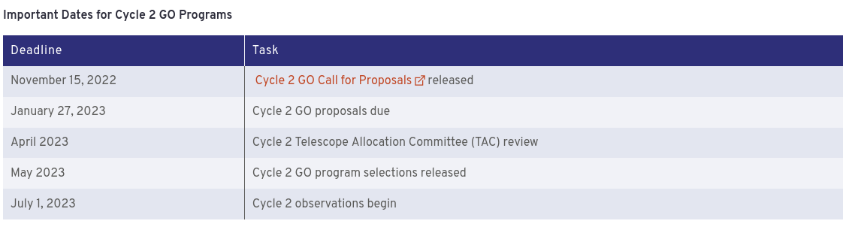
Timeline summary
Notes:
Full program announced late August.
All require technical review for long range plane

Slide 25
What happens if the launch slips
The JWST Space Telescope Users Committee (JSTUC) recommended the following:
“With the new Cycle 1 call scheduled for in January 2020, we strongly recommend that the call not be cancelled once it is opened. Although there is no indication that any further delay in launch is expected, the potential science impact of such a slip could be mitigated by advising proposers for Cycle 1 GO time to discuss how their science would be impacted by a delay in observations. Impact could be further mitigated by allowing a mechanism for PIs to change targets in the event of a delayed observing window.”
Notes:
Users committee: open to extension of the deadline
Depends on the slip (cough)

Slide 26
and when in doubt, ask the HelpDesk:
https://jwsthelp.stsci.edu/ THANK YOU!

