Slide 1
EER Model –
Chapter 4.1-4.3

Slide 2
Why EER? -- Enhanced Entity Relationship
There are limitations to the ER model
ER model enhanced (EER) to include:
  superclass/subclass relationships
  type inheritance
  specialization and generalization
  constraints

Slide 3
Subclasses
Subclass of an entity type
  relationship – is-a
  derive subclass from superclass
  manager “is a(n)” employee
    subset symbol in connecting line
  member of a subclass must also be a member of some superclass

Slide 4
Ù
Training
Evaluation

Slide 5
Type inheritance
inherit all attributes of superclass
useful for modeling, convenience

Slide 6
Specialization
Specialization
e.g. salaried and hourly – specialization of employee
  circle connecting all specialized subclasses
  still use subset symbol to connect subclass to circle
  specific attributes attached to subclass
  subclasses can also participate in specific relationship types

Slide 7
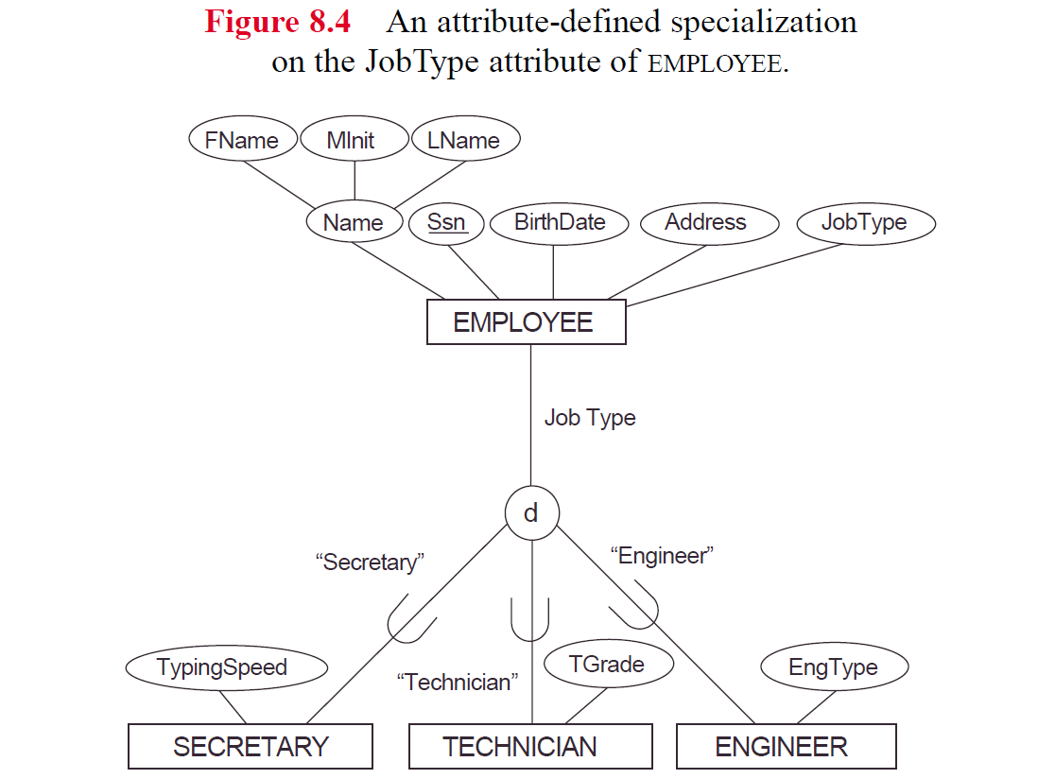

Slide 8
Specialization Constraints
Predicate defined (condition-defined) subclasses
manager = True
  has a defining predicate for the subclass
Attribute defined
  if all subclasses have membership based on same attribute
User defined - if no condition

Slide 9
Constraints cont’d
Disjointedness constraint
  subclasses disjoint
  member of at most 1 subclass
  use ‘d’ in circle to indicate
Otherwise,
Overlapping constraint
  sets of entities may overlap
  member of more than 1 subclass
  use ‘o’ in circle to indicate

Slide 10
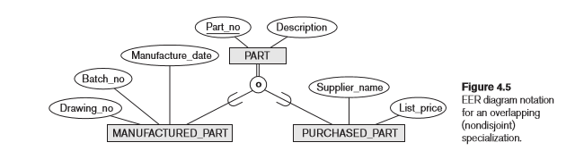

Slide 11
Constraints cont’d
Completeness constraint
  total specialization
    every entity in superclass must be member of some subclass of specialization
    indicate with double line from superclass to circle
  partial specialization
    entity does not have to belong to any subclass
    indicate with single line
    Can have disjoint total, disjoint partial, overlapping total, overlapping partial

Slide 12
Generalization
Generalization of entity types into a single superclass
vehicle is generalization of car, truck

Slide 13
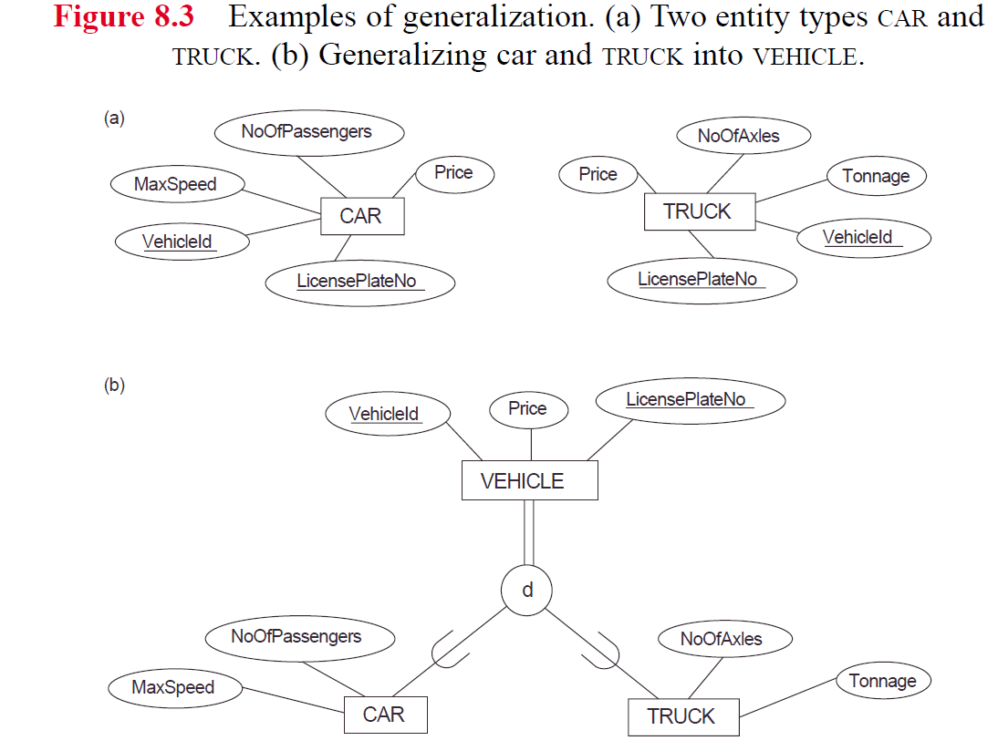

Slide 14
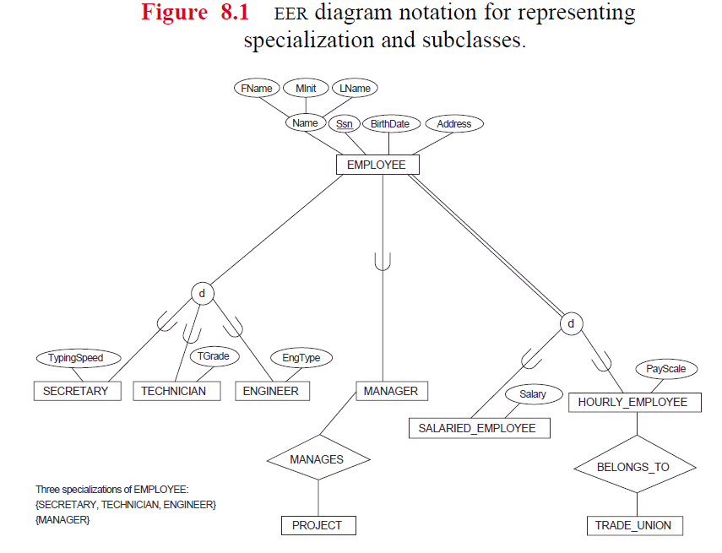

Slide 15
Specialization/Generalization Lattice
a class can be a subclass in more then one class/subclass relationship
an entity may exist in several leaf nodes
multiple inheritance

Slide 16
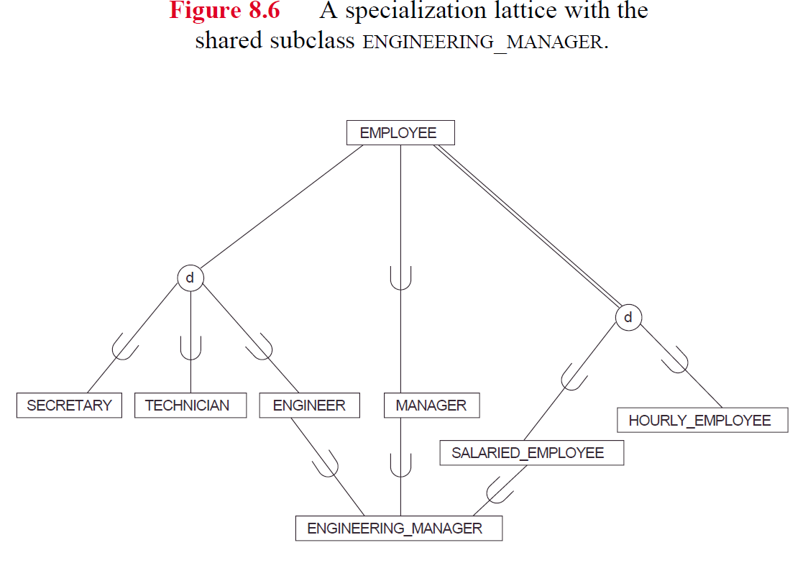

Slide 17
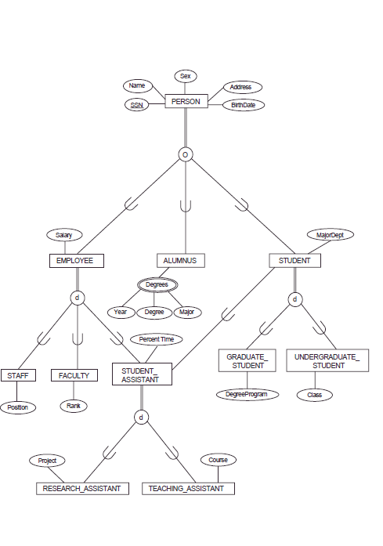

Slide 18
Union Types
Union of objects of different entity types (superclasses)
Union type is a subclass of a collection of objects that is a subset of the union of its superclasses
  Union means can only be a member of one of the superclasses
    Different from multiple inheritance, which was subset of intersection of superclasses, e.g. was an engineer and a manager and a salaried employee
  Can only inherit attributes from one superclass, not all
  Can even have different key attributes, depending on which inherit from

Slide 19
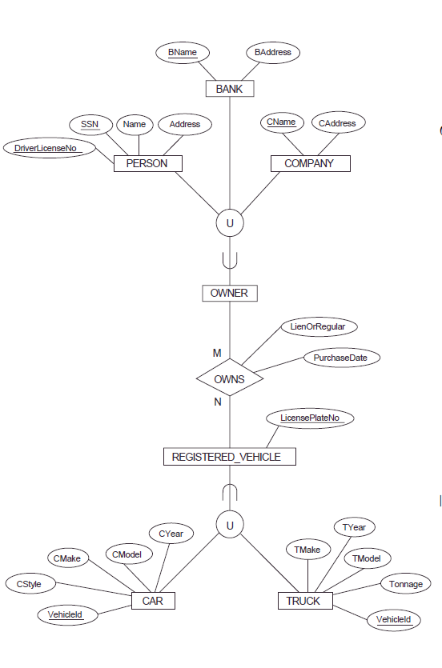

Slide 20
UML notation – Chap. 4.6
Specialization/generalization (is-a)
  Triangle to indicate
    blank triangle is disjoint
    filled triangle is overlapping
Subclass
  Aggregation – relationship between object and component parts (has-a relationship)
    Diamond indicates whole vs. part

Slide 21
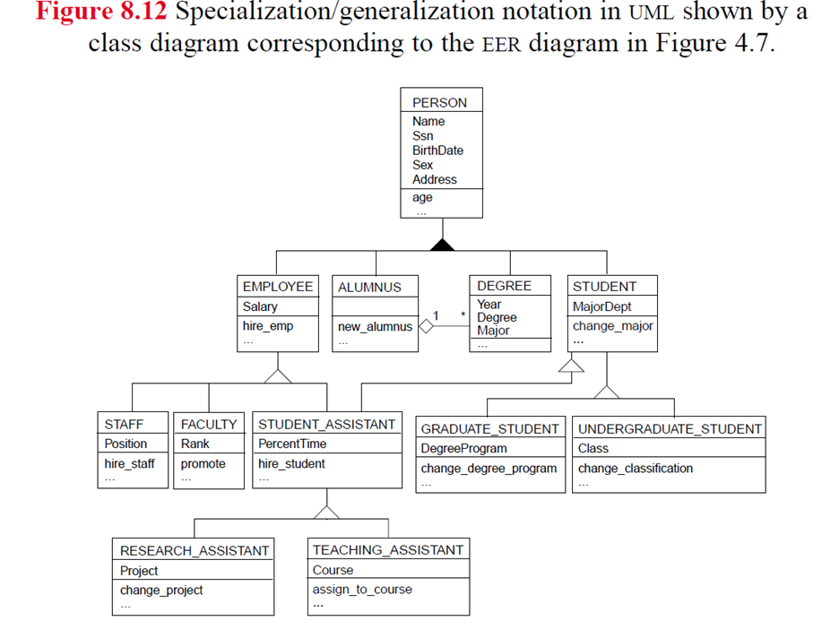

Slide 22
