Slide 1

53 Thorborn Avenue, Sabo, Yaba | 08033954301 | themobileprof.com@gmail.com | www.themobileprof.com

Slide 2
Nigeria has a PC penetration of 4.5%. However, our smartphone penetration is at 13%, and most young people have them. Thanks to advancements in Mobile technology, today we have more high powered phones, yet most people do not consider their phone a productivity tool for business or software development And most Tech schools will not teach you if you do not have a PC. This leaves many young people with a dream that seems out of reach, until life eventually catches up with them
Problem / Opportunity
(234)8033954301 | themobileprof.com@gmail.com | www.themobileprof.com

Slide 3
The Mobile Professional Academy, empowers users with knowledge to turn their Mobile Devices into powertools for business and productivity + Making easy to follow videos for English speaking Africans + Organizing onsite and offsite Training Courses include: # Linux administration (Bash, CLI tools, Vim, shell scripting) # Web Design (HTML, CSS, BootStrap) # Web Development (JavaScript, PHP, Python)
Value Proposition
(234)8033954301 | themobileprof.com@gmail.com | www.themobileprof.com

Slide 4
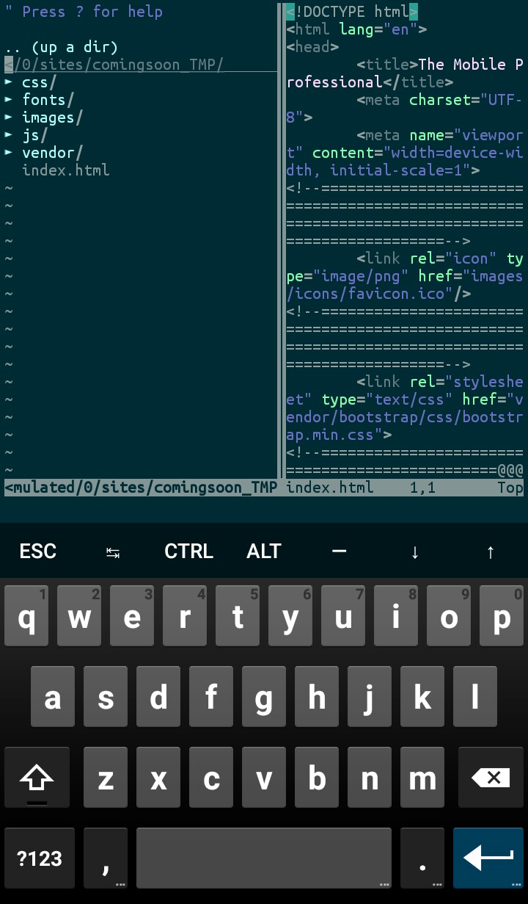
# Easy to follow Software development on Mobile videos made by African developers for Africa # The videos are short (10-15 minutes) and grouped into separate courses (about 10 videos per course). And several courses are packaged together to form different classes. Onsite and Offsite Training by instructors that use Mobile as their default work tools
Training & Training Videos
(234)8033954301 | themobileprof.com@gmail.com | www.themobileprof.com

Slide 5

After we have made up to 250 videos in mobile development with different programming Languages and Frameworks (Estimated 1 year worth of work).
The Software Development Academy
We start creating Software Development on Mobile curriculum based on our videos
We host the videos on The Otomatik network (this is preferred – details in next slide) instead of the Internet
We admit students for frontend, backend, or Fullstack classes
We train them for a minimum of 1 year depending on what they want to learn
We recruit them for companies that need developers and earn back the cost of training + profit from their salaries (Like Andela, Lambda school e.t.c.)

Slide 6
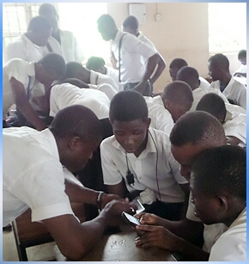
Why build on Otomatik in Technical colleges? # There is Otomatik Network in some Technical Colleges that assures hosting and distribution of our videos offline # Average age of students is 15 years (most enter from JSS3) # Not inundated with sometimes irrelevant SS1-SS3 subjects # No financial pressure to start earning money # Have 3 years to work with (Technical college is 3 years) # Technical colleges are more flexible to work with than Secondary schools, e.g. Recommending students to bring phones to school.
…continued
(234)8033954301 | themobileprof.com@gmail.com | www.themobileprof.com

Slide 7
# Making and Sales of Video training packages for Mobile Development and Productivity tools # Creating Software Development curricula based on the videos and generating revenue via Developers recruitment
Business Model
(234)8033954301 | themobileprof.com@gmail.com | www.themobileprof.com

Slide 8
Optional Immediate Revenue Source
While creating software development videos, if we are not able to get grants or investor funds, this is an alternative source of short term revenue:
# We offer onsite and offsite mobile training for Companies that use or could use Microsoft Office 365
# Sales of MS Office 365 licenses
(234)8033954301 | themobileprof.com@gmail.com | www.themobileprof.com

Slide 9
Digital Marketing: Sales of Software development Videos The Academy: Get Students: The Academy will be built mostly on Otomatik Non-Internet networks in Technical Colleges Get Companies: Direct marketing to prospective Companies requiring Developers
Go-to-Market Plan
(234)8033954301 | themobileprof.com@gmail.com | www.themobileprof.com

Slide 10
# Other Internet based training videos # Other Software Development Academies online and offline However, no direct competition for Mobile Software Development and no one offering offline video training academy
Competitive Analysis
(234)8033954301 | themobileprof.com@gmail.com | www.themobileprof.com

Slide 11
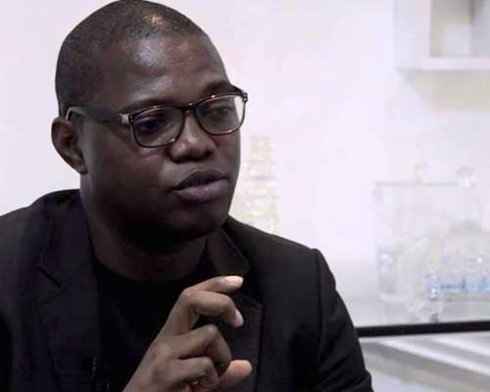

Management Team
Samuel Anyaele, CTO
Samuel Anyaele has over 8 years of Web Application Development experience. His experience includes working with PHP, Laravel, Bootstrap, HTML and CSS, databases (MySQL, SQLite, and MongoDB), Operating Systems (MS Windows, Ubuntu Linux, Debian Linux, Raspbian), Server Setups, and Networking.
An alumni of EDC and Fate Foundation
Bidemi Tunmise
Full Stack Web Developer
PHP, Python, JavaScript, HTML, CSS
(234)8033954301 | themobileprof.com@gmail.com | www.themobileprof.com

Slide 12
Financial Projections and Key metrics
REVENUE | Training | Videos | Academy | Estimated Year Revenue | Estimated Year Expenses
Year 1 | $24,000 a year (20 people per month at $100 per person) | 0.00 | 0.00 | $24,000 | $31,000
Year 2 | $60,000 a year (50 people per month at $100 per person) | $48,000 a year (Sell 200 courses per month at $20 per course) | 0.00 | $108,000 | $48,000
Year 3 | $120,000 a year (100 people per month at $100 per person) | $120,000 a year (Sell 500 courses per month at $20 per course) | $1,200,000 a year (50 developers. Monthly revenue per developer is $2,000 per month) | $1,440,000 | $108,000
(234)8033954301 | themobileprof.com@gmail.com | www.themobileprof.com

Slide 13
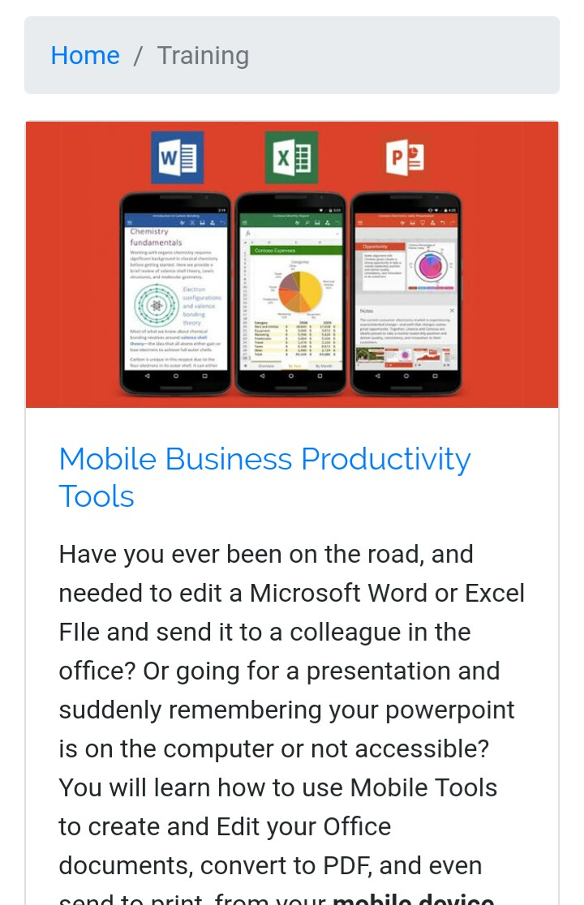
Current Status: # Organized a paid MS Office training for Mobile # Facilitated Web design classes for NGOs # Registered as a Microsoft Reseller Partner # Facilitating MS Office for Mobile at Fate Foundation Timeline: # Create 250 videos per year. We should have over 500 videos for the Academy curriculum by end of year 2 # By Year 3, we should have our first Academy graduates Use of Funds: # Development of Training Videos # Marketing of Training services and Videos
Current Status, Timeline, and use of funds
(234)8033954301 | themobileprof.com@gmail.com | www.themobileprof.com

Slide 14
Thank you!
Tel: +234 803 395 4301
Email: themobileprof.com@gmail.com
Website: www.themobileprof.com

