Slide 1


Slide 2
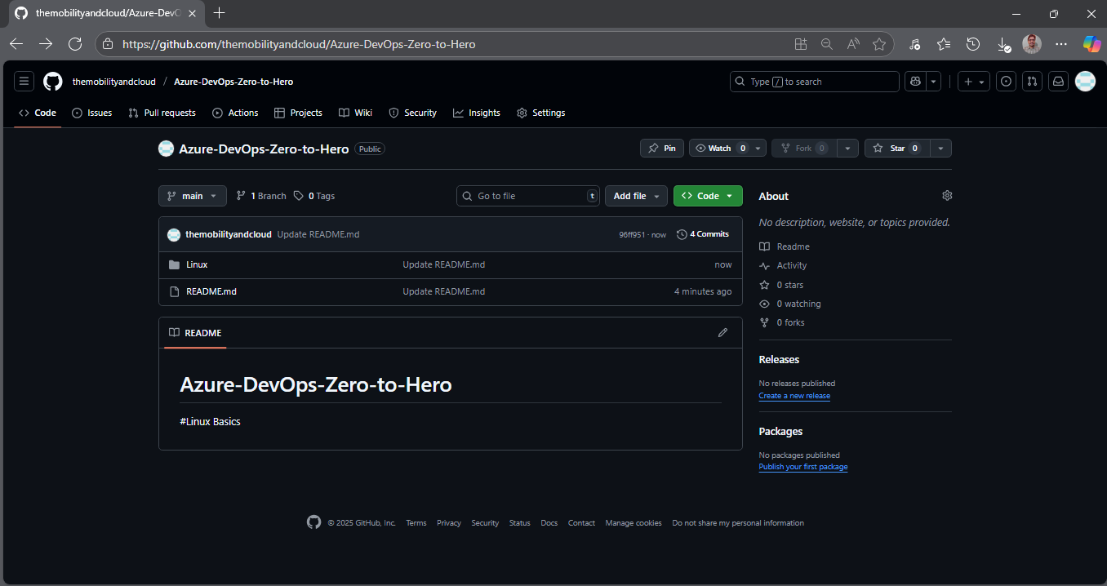



Slide 3
Linux

Slide 4
Definition:
Unix:
Unix is a powerful, multiuser, multitasking operating system, which serves as a foundation for many modern operating systems.
Linux:
Linux is one of the most widely used open - source operating system kernel that serves as the core of many different Linux distributions (distros).
Distros like Ubuntu, Fedora, and Debian are built on top of the Linux kernel and come with a variety of pre - installed software and configurations.
Linux is known for its security, flexibility.

Slide 5
History:
Unix is developed in 1970’s at AT&T’s Bell Labs.
Linux is developed by Linus Torvalds in 1991.
The name “Linux” comes from Linus+Unix.
Linux vs Unix:
Linux is inspired by Unix and is designed to be Unix-Like, it follows almost same principles and standards making it compatible with Unix software's and commands
Linux is open-source, and its source code is freely available to the public for modification and distribution. ,Unix is proprietary, requiring a license for use, and its source code is not publicly accessible.
Linux has massive global community support,
Unix has limited community support

Slide 6
Key components of a typical Linux-based system:
Kernel:
• The kernel is the core component of any operating system. It manages the system's resources, including the CPU, memory, and hardware devices.
•The Linux kernel, is responsible for tasks like process management, memory management, device management, and system calls.
Shell:
• The shell is the interface between the user and the kernel. It interprets user commands and communicates them to the operating system.
• Common Linux shells include Bash (Bourne Again Shell),
Zsh (Z shell), Ksh, Tcsh, & others.

Slide 7
Linux Distributions:
21 Asahi Linux
22 Lubuntu
23 SUSE Linux
24 Knoppix
25 VzLinux
26 Peppermint OS
27 Zorin OS
28 BlackArch Linux
29 SUSE Liberty Linux
30 Navy Linux
31 Tizen
1 Ubuntu
2 Debian
3 CentOS Linux
4 CentOS Stream
5 Red Hat Enterprise Linux (RHEL)
6 Gentoo
7 Fedora
8 OpenSUSE
9 Scientific Linux
10 CloudLinux
11 Elementary OS
12 Linux Mint
13 Arch Linux
14 Manjaro
15 Oracle Linux
16 Slackware
17 Mageia
18 Clear Linux
19 Rocky Linux
20 AlmaLinux

Slide 8
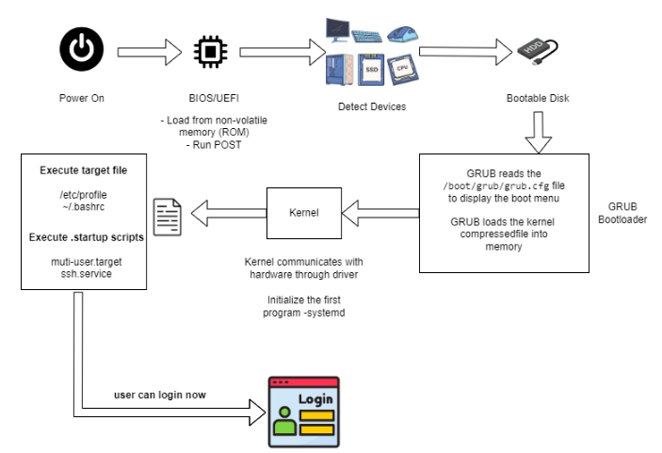
How Linux works

Slide 9
Linux File System Hierarchy
In Linux, everything is a file, including hardware. Files are stored in directories, in a tree
structure known as File System Hierarchy.
/ - Root Home Directory: Home directory for the root user, separate from /home.
/bin - User Binaries: Essential command-line programs available to all users.
/boot - Boot Loader Files: Contains files needed for the boot process like the kernel and init.
/dev - Device Files: Represents hardware devices
/home - User Home Directories: Contains personal directories like /home/alice, /home/bob, etc.
/mnt - Mount Directory: Temporary mount point for filesystems mounted manually.
/media - Removable Devices: Auto-mounted removable media (USB drives, CDs) appear here.
/opt - Third-Party Applications: Optional and third-party software is typically installed here.
/tmp - Temporary Files: Used to store temporary files; typically cleared on reboot.
/usr - User Applications: Contains user-space programs, libraries, and documentation.
/etc - Configuration Files: System-wide configuration files for services, networking, etc.
/sbin - System Binaries: System-level binaries for administration, mostly used by root.
/var - Variable Files: Dynamic files such as logs, application data.

Slide 10
Basic Commands:
echo $SHELL To check current shell
pwd – view current directory
ls - list files and directories
uname - shows kernel name
uname -r - shows kernel version
cd - change directory
clear - clear terminal screen
whoami - shows current user
history - shows command history
date - shows current date and time
tree - to display the directory structure of a path
or to display the entire file system in a hierarchical,

Slide 11
Create File/Directory:
mkdir dir - Create single dir
mkdir dir1 dir2 - Create multiple dirs
mkdir -p a/b/c - Nested directories
touch file - Create empty file
touch file{1..10} - Create multiple files
vim file11 - Create empty file
cat file11 – View the Content in file
cp - copy files/directories
rm - remove files/directories
mv - move/rename files/directories

Slide 12
Thanks for watching!!!!

