Slide 1


Slide 2
The concept
Through sanskritsahitya.com, we attempt to spread the values and morals depicted in various Sanskrit literary works.
sanskritsahithya.com is a new approach towards enriching one’s knowledge through great Indian epics like Ramayana, Mahabharata, Bhagavad Gita etc.
In the website, the user will be able to learn the meanings of slokas from epics say Ramayana-chapter wise, verse wise. Both translation will be given under each verse.
At the end of each chapter, the user will be directed to attend a quiz based on the chapter they read. Once the user completes the quiz with a passing score , next chapter will be unlocked automatically.

Slide 3
Target customers
People interested in Sanskrit literature
Mentors/ Teachers who need translation aid
People over the age of 40

Slide 4
SWOC Analysis
Strengths User friendly Provides easy access to Sanskrit literature Breaks the boundary of language | Weaknesses Dependence on internet
Opportunity To spread morals and values about among a wide range of audience | Challenges

Slide 5
Goals and objectives
Specific
To widen the reach of our ancient epics.
Measurable
By conducting a quiz at the end of each chapter, we ensure our users get in depth knowledge of whatever sloka they are learning.
Time based
“Anantha Vy Vedaha” – Brihadaranyakopanishad; As the Upanishads state that the epics and heritage of our Dharma are endless, it is a never ending process. In a cycle of inputs, we aim to provide more and more texts and scriptures to our users.
Attainable
Relevant
In today’s situation there is a significant need to promote our heritage in a user-friendly manner.
To inculcate reward based methodologies towards spiritual learning.
More the number of users, more people get to know about our ancient epics.
We are planning to expand our domains to Ramayana and Mahabharata
Provide academia approved certificates to mar course completion
Reward based approach gives the user positive reinforcement and inspiration to keep reading our epics
Preservation of our culture and heritage is extremely important and relavant.

Slide 6
A demo of how our website looks like

Slide 7
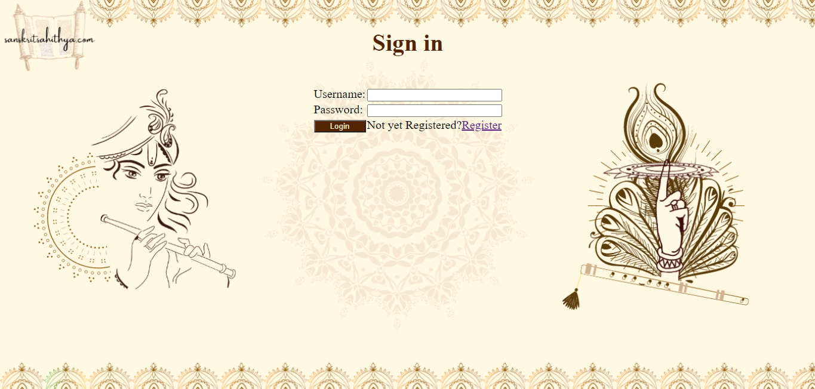

Slide 8
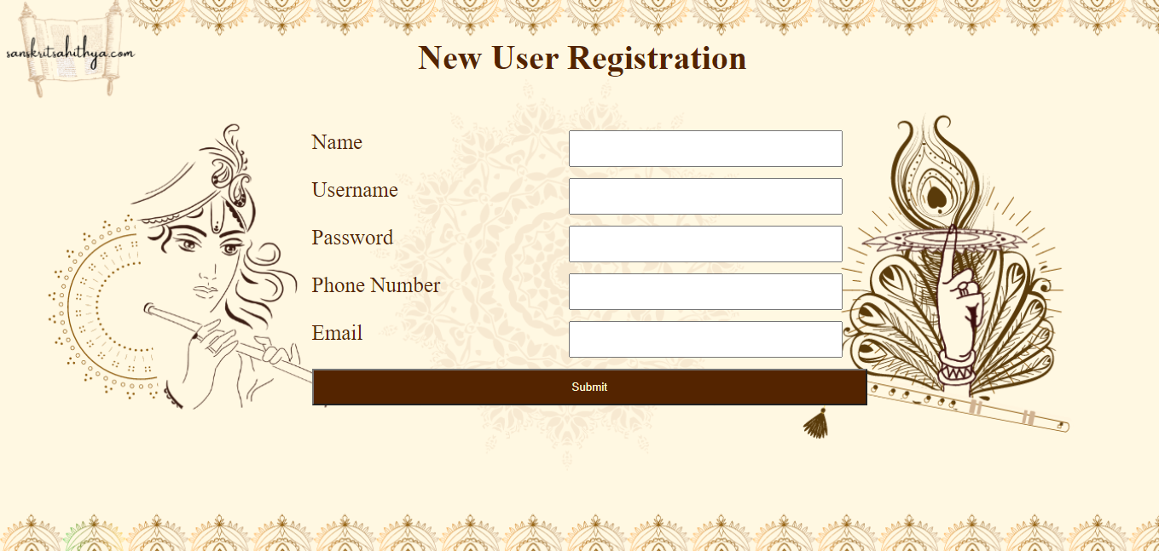

Slide 9
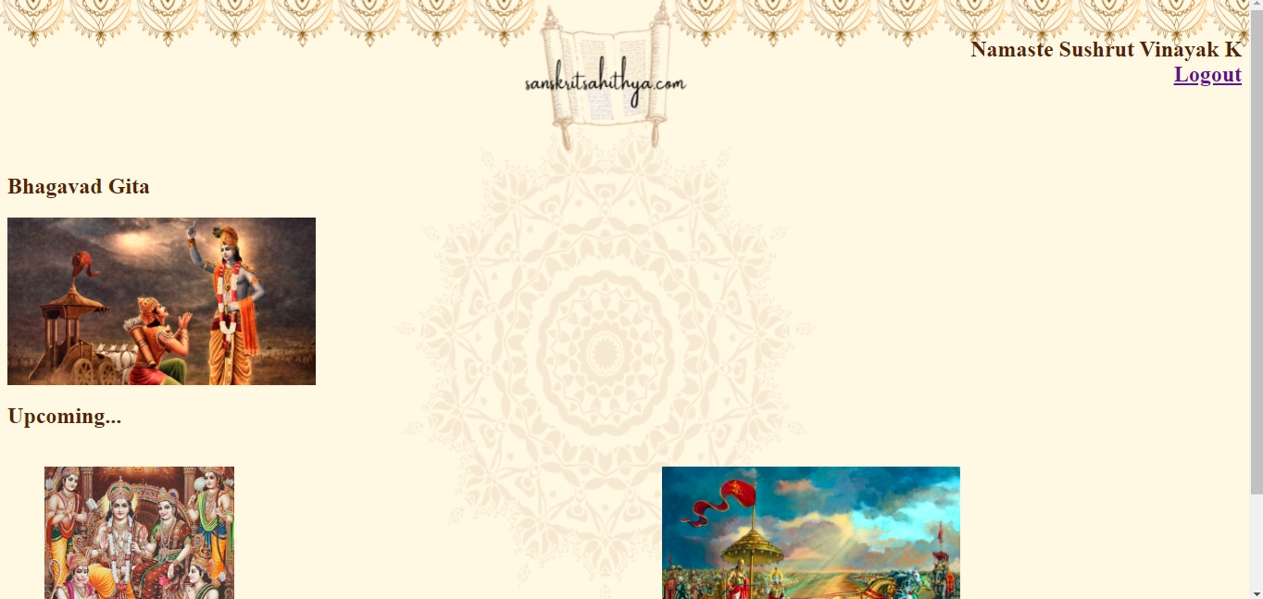

Slide 10
