Slide 1
Computer Networks
Amitabh Padmanabhan

Slide 2
Syllabus-Unit-2
Medium access sub layer: Channel allocations, LAN protocols, ALOHA Protocols- Pure ALOHA, slotted ALOHA, Carrier Sense Multiple Access Protocols, CSMA with Collision Detection, Collision free Protocols, IEEE standards, Ethernet, FDDI, Data Link Layer- basic design issues, error correction & detection algorithms, elementary data link layer protocols, sliding window protocols, error handling, High Level Data Link Control

Slide 3
Channel Allocation
What is channel allocation?
  A given radio spectrum is to be divided into a set of disjointed channels that can be used simultaneously while minimizing interference in adjacent channel by allocating channels appropriately (especially for traffic channels).
Channel allocation schemes can be divided in general into
  Fixed Channel Allocation schemes (FCA schemes)
  Dynamic Channel Allocation schemes (DCA schemes)
  Hybrid Channel Allocation schemes (HCA schemes: combining both FCA and DCA techniques)

Slide 4
Fixed Channel Allocation
In FCA schemes, a set of channels is permanently allocated to each cell in the network.
Due to short term fluctuations in the traffic, FCA schemes are often not able to maintain high quality of service and capacity attainable with static traffic demands. One approach to address this problem is to borrow free channels from neighboring cells.

Slide 5
Dynamic Channel Allocation
In DCA schemes, all channels are kept in a central pool and are assigned dynamically to new calls as they arrive in the system.
After each call is completed, the channel is returned to the central pool. It is fairly straightforward to select the most appropriate channel for any call based simply on current allocation and current traffic, with the aim of minimizing the interference.
DCA scheme can overcome the problem of FCA scheme. However, variations in DCA schemes center around the different cost functions used for selecting one of the candidate channels for assignment.

Slide 6
Dynamic Channel Allocation
DCA schemes can be centralized or distributed.
The centralized DCA scheme involves a single controller selecting a channel for each cell;
The distributed DCA scheme involves a number of controllers scattered across the network (MSCs).
Centralized DCA schemes can theoretically provide the best performance.

Slide 7
Medium Access Control
Medium Access Control (MAC):
  How to share a common medium among the users?
MAC layer is very important in LANs, nearly all of which use a multi access channel as the basis of their communication.

Slide 8
ALOHA Protocol
ALOHA was developed in the 1970s at the University of Hawaii.
The basic idea is simple:
  Let users transmit whenever they have data to be sent.
If two or more users send their packets at the same time, a collision occurs and the packets are destroyed.
If there is a collision,
  the sender waits a random amount of time and sends it again.
The waiting time must be random. Otherwise, the same packets will collide again

Slide 9
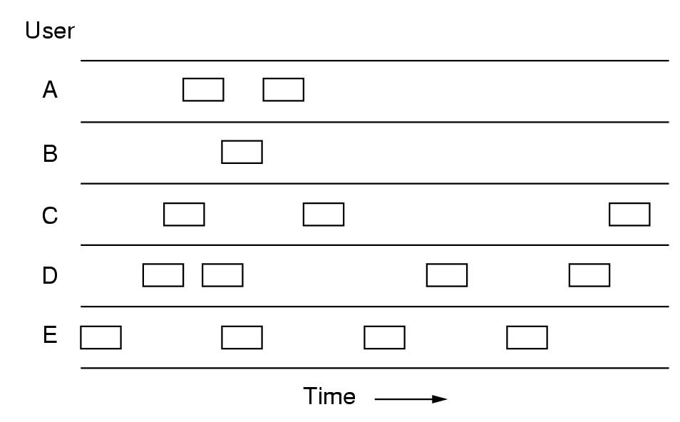
Frame Generation
all packets have the same length because the throughput of ALOHA systems is maximized by having a uniform packet size.

Slide 10
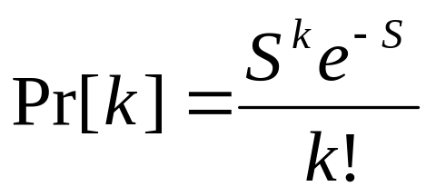
Throughput
Throughput:
  The number of packets successfully transmitted through the channel per packet time.
  Assume that :
Infinite population of users
New frames are generated according to a Poisson distribution with mean S packets per packet time.
  Probability that k packets are generated during a given packet time:

Slide 11
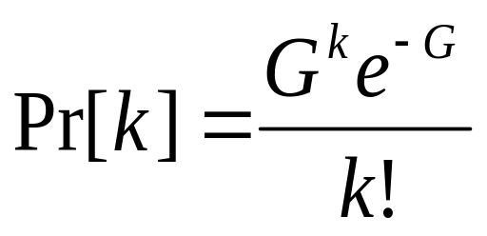
Observations
If S > 1, packets are generated at a higher rate than the channel can handle.
Therefore, we expect
0 < S < 1
If the channel can handle all the packets, then S is the throughput.
In addition to the new packets, the stations also generate retransmissions of packets that previously suffered collisions.
Assume that the packet (new + retransmitted) generated is also Poisson with mean G per packet time.

Slide 12

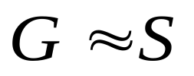
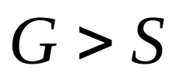
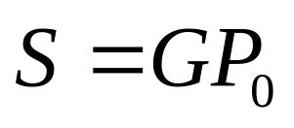
Relations
Clearly,
At low load, few collisions:
At high load, many collisions:
Under all loads,
where P₀ is the probability that a packet does not suffer a collision.

Slide 13
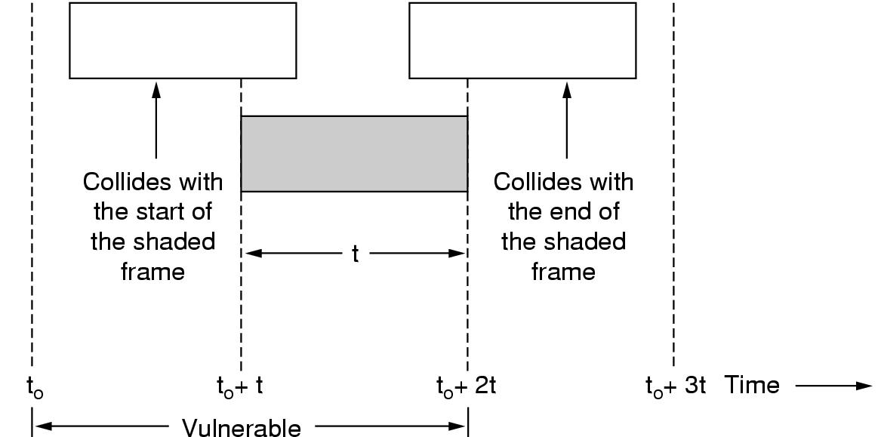
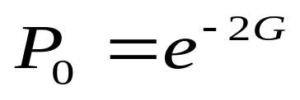
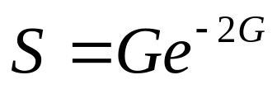
Vulnerable Period
Under what conditions will the shaded packet arrive undamaged?
Vulnerable period: from t₀ to t₀+2t
Probability of no other packet generated during the vulnerable period is:
Using S = GP₀, we get

Slide 14
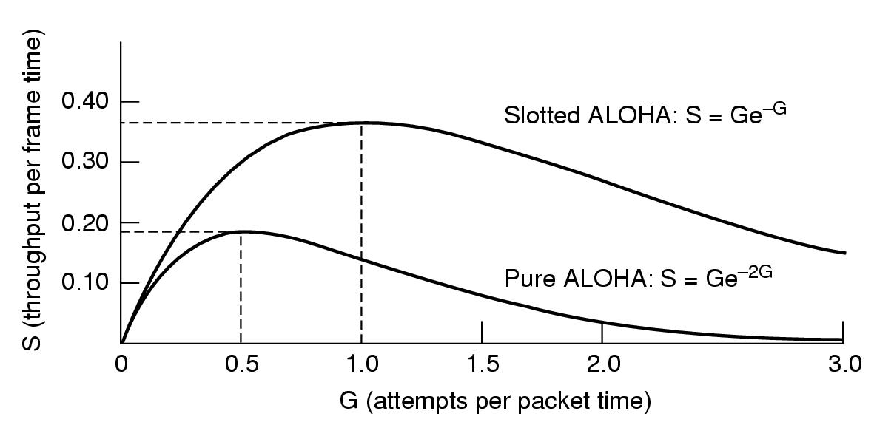
Relation b/w G & S
Max throughput occurs at G=0.5, with S=1/(2e)=0.184.
Hence, max. channel utilization is 18.4%.

Slide 15
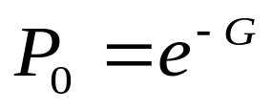
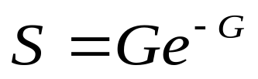
Slotted ALOHA
Divide time up into discrete intervals, each corresponding to one packet.
The vulnerable period is now reduced in half.
Probability of no other packet generated during the vulnerable period is:
Hence,

Slide 16
Carrier Sense Multiple Access
In many situations, stations can tell if the channel is in use before trying to use it.
If the channel is sensed as busy, no station will attempt to use it until it goes idle.
This is the basic idea of the Carrier Sense Multiple Access (CSMA) protocol.

Slide 17
Types
There are different variations of the CSMA protocols:
  1-persistent CSMA
  Nonpersistent CSMA
  p-persistent CSMA
1-persistent CSMA
The protocol:
  Listens before transmits
  If channel busy, waits until channel idle
  If channel idle, transmits
  If collision occurs, waits a random amount of time and starts all over again
It is called 1-persistent because the station transmits with a probability of 1 whenever it finds the channel idle.

Slide 18
P-Persistent
1. If the medium is idle, transmit with probability p, and delay for one time unit with probability (1 - p)
(time unit = length of propagation delay)
2. If the medium is busy, continue to listen until medium becomes idle, then go to Step 1
3. If transmission is delayed by one time unit, continue with Step 1

Slide 19
Non-persistent/x-persistent
Step 1: If the medium is idle, transmit immediately
Step 2: If the medium is busy, wait a random amount of time and repeat Step 1

Slide 20
CSMA with collision detect
Step 1: If the medium is idle, transmit
Step 2: If the medium is busy, continue to listen until the channel is idle then transmit
Step 3: If a collision is detected during transmission, cease transmitting
Step 4: Wait a random amount of time and repeats the same algorithm

Slide 21
CSMA with collision Avoidance
All terminals listen to the same medium as CSMA/CD.
Terminal ready to transmit senses the medium.
If medium is busy it waits until the end of current transmission.
It again waits for an additional predetermined time period DIFS (Distributed inter frame Space).
Then picks up a random number of slots (the initial value of backoff counter) within a contention window to wait before transmitting its frame.
If there are transmissions by other terminals during this time period (backoff time), the terminal freezes its counter.
It resumes count down after other terminals finish transmission + DIFS. The terminal can start its transmission when the counter reaches to zero.

Slide 22
Collision free protocols
Bit-Map protocol
Stations are ordered and transmit a bit during their slot
At close of contention period, everyone knows who is transmitting
Transmitting done in station order

Slide 23
Collision free protocols
Binary countdown
  Stations broadcast their addresses as a binary bit string
  High order bit first
  Bits are ORed together
  Stations gives up if the 0 is overwritten by 1
  Eg.
  0010 0 }Gives up by seeing 1
  0100 0 }Gives up by seeing 1
  1001 100 } gives up by seeing 1
  1010 101 succeed in transmitting

Slide 24
IEEE 802 standards
A set of network standards developed by the IEEE. They include:
IEEE 802.1: Standards related to network management.
IEEE 802.2: General standard for the data link layer in theOSI Reference Model. The IEEE divides this layer into two sublayers -- the logical link control (LLC) layer and the media access control (MAC) layer. The MAC layer varies for different network types and is defined by standards IEEE 802.3 through IEEE 802.5.
IEEE 802.3: Defines the MAC layer for bus networks that useCSMA/CD. This is the basis of the Ethernet standard.
IEEE 802.4: Defines the MAC layer for bus networks that use a token-passing mechanism (token bus networks).
IEEE 802.5: Defines the MAC layer for token-ring networks.
IEEE 802.6: Standard for Metropolitan Area Networks (MANs).

Slide 25
Ethernet
The Ethernet specification served as the basis for the IEEE 802.3 standard
It is one of the most widely implemented LAN standards.

Slide 26
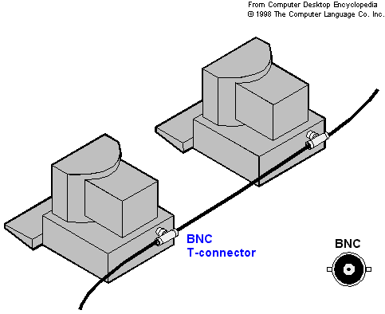
10Base-2
10 Mbps baseband(The original band of frequencies of a signal before it is modulated for transmission at a higher frequency.) Ethernet over coaxial cable with a maximum distance of 185 meters. Also referred to as Thin Ethernet or Thinwire.

Slide 27
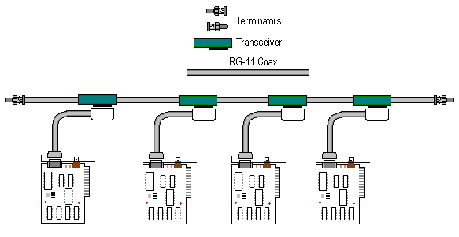
10Base-5
10 Mbps baseband Ethernet over coaxial cable with a maximum distance of 500 meters. Also referred to as Thick Ethernet or Thicknet

Slide 28
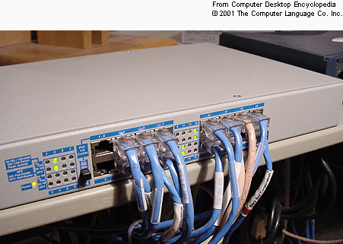
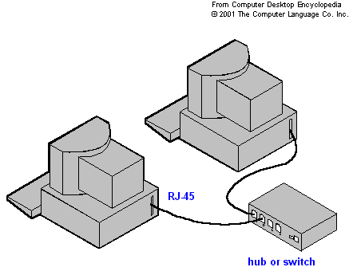
10 Base T
10Base-T is the most popular cabling method. Its also called Standard Ethernet, or twisted pair, 10Base-T works on a star topology connecting all computers to a hub. It is best used with Category 5 cable .
The specifications of Standard Ethernet include the following:
It uses RJ45 connectors on unshielded twisted-pair (UTP) cable.
The maximum cable length is 100 meters (before a repeater is needed).
The maximum number of devices per segment is 1,024.

Slide 29
Fiber Distributed Data Interface
FDDI logical topology is a token ring network, it does not use the IEEE 802.5 token ring protocol as its basis; instead, its protocol is derived from the IEEE 802.4 token bus timed token protocol.
As a standard underlying medium it uses optical fiber, although it can use copper cable, in which case it may be refer to as CDDI. FDDI uses a dual-attached, counter-rotating token ring topology.
A FDDI network contains two token rings, one for possible backup in case the primary ring fails. The primary ring offers up to 100 Mbit/scapacity. When a network has no requirement for the secondary ring to do backup, it can also carry data, extending capacity to 200 Mbit/s. The single ring can extend the maximum distance; a dual ring can extend 100 km (62 miles). FDDI has a larger maximum-frame size than standard 100 Mbit/s Ethernet, allowing better throughput.

Slide 30
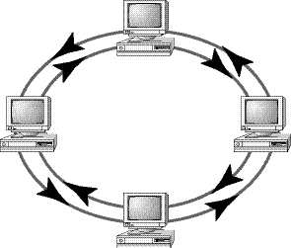

Slide 31
Data Link Layer Designing issues
Data Link Layer has number of specific functions to carryout. These functions include:-
Providing a well defined service interface to the Network Layer.
Determining how the bits of the Physical Layer are grouped into frames.
Dealing with transmission errors.
Regulating the flow of frames so that slow receiver are not overcome by a fast sender.

Slide 32
CRC The cyclic redundancy check, or CRC, is a technique for detecting errors in digital data, but not for making corrections when errors are detected. It is used primarily in data transmission. In the CRC method, a certain number of check bits, often called a checksum, are appended to the message being transmitted

