Slide 1
Department of Applied Mathematics and Statistics
AI TOOLS USAGE
& GPA ANALYSIS
Survey of 57 students | Logistic Regression on GPA

Slide 2
DATASET OVERVIEW
57
6
GPA
RESPONDENTS
FEATURES
TARGET
Students surveyed
Predictor variables
Binary: ≥3.5 = High
Renamed Columns:
ai_frequency — How often AI tools used (Never/Sometimes/Often/Daily)
hours_per_week — Weekly hours spent using AI for study
copy_behavior — How often AI content copied to assignments
improved_grades — AI improved grades? (1–5 Likert)
cannot_complete_without_ai — AI dependence level (1–5 Likert)
critical_thinking — AI improved critical thinking? (1–5 Likert)

Slide 3
DATA CLEANING
01
Skip Header Rows
04
Handle Missing Values
Skipped 2 decorative header rows in CSV; actual column headers on row 3.
Zero missing values found after header fix. Dataset is complete (57 × 7).
02
Rename Columns
05
Encode Categoricals
All 7 columns renamed to short, snake_case identifiers for analysis.
Ordinal encoding: AI Frequency (0–3), Hours/Week (0–7), Copy Behavior (0–4).
03
Drop Index Column
06
Create Binary Target
Removed 'No.' column — row number, not a feature.
GPA ≥ 3.5 → High (1) = 25 students | GPA < 3.5 → Low (0) = 32 students.

Slide 4
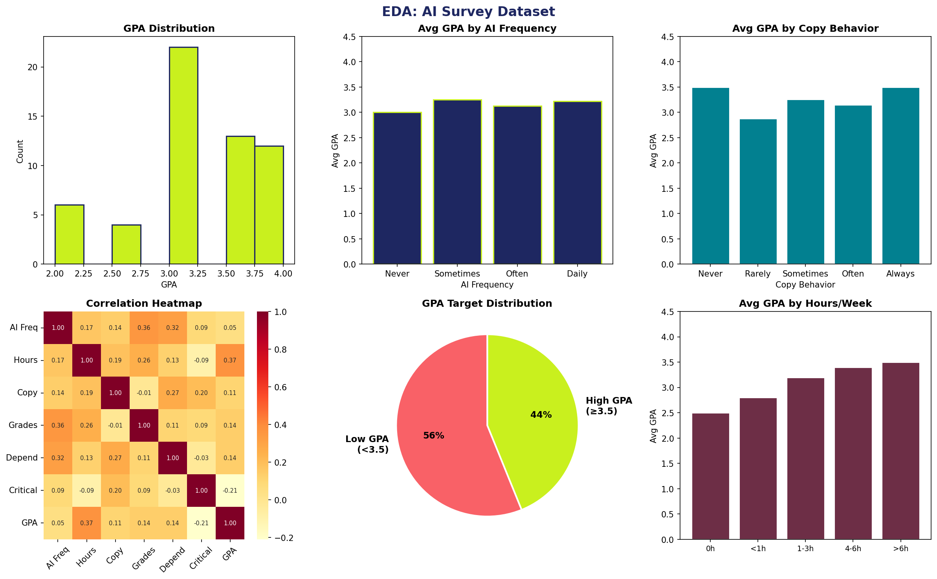
EXPLORATORY DATA ANALYSIS

Slide 5
KEY EDA FINDINGS
56%
3.18
44%
43%
use AI Daily
Mean GPA
High GPA (≥3.5)
copy Sometimes
AI Frequency vs GPA
Improved Grades Perception
Daily users averaged GPA 3.22, nearly identical to Sometimes users (3.25). Frequency alone doesn't predict GPA.
Students who rated AI as improving their grades (4–5) tend to have higher GPA. Strongest positive signal in correlations.
Copy Behavior Pattern
Hours per Week
Students who 'Never' copy averaged the highest GPA (3.50), same as 'Always' copiers. 'Rarely' had lowest avg (2.88).
Students using AI more than 6 hrs/week averaged GPA 3.10, while 1–3 hr users averaged 3.18. Moderate inverse pattern.

Slide 6
LOGISTIC REGRESSION MODEL
MODEL SETUP
CLASSIFICATION REPORT
66.7%
Algorithm
Logistic Regression
66.7%
Target
GPA ≥ 3.5 (Binary)
Data Split
No split (full dataset)
OVERALL ACCURACY
Class
Precision
Recall
F1
Samples
57 students
Low GPA
0.68
0.78
0.72
Class 0 (Low GPA)
32 students (56%)
High GPA
0.65
0.52
0.58
Class 1 (High GPA)
25 students (44%)
Weighted Avg
0.66
0.67
0.66
Max Iterations
1000
Confusion Matrix
Random State
42
TN=25 FP=7 FN=12 TP=13

Slide 7
FEATURE COEFFICIENTS
Impact on predicting High GPA (≥ 3.5)
AI Frequency
0.429
Hours/Week
0.408
Improved Grades
0.287
AI Dependence
0.179
Copy Behavior
-0.008
Critical Thinking
-0.034
Positive → increases High GPA probability | Negative → decreases it

Slide 8
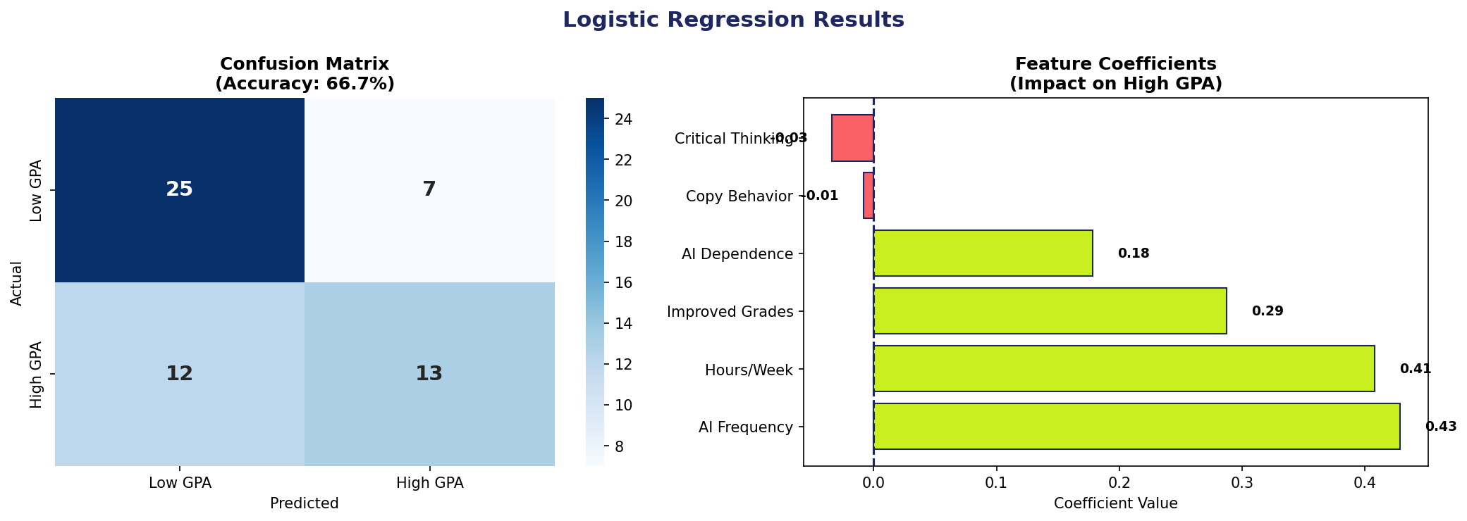
MODEL RESULTS

Slide 9
CONCLUSION
▶ AI Frequency & Hours/Week are the strongest positive predictors of high GPA.
▶ Copying AI content and critical thinking perception had near-zero or negative impact.
▶ The logistic regression achieved 66.7% accuracy on the full 57-student dataset.
▶ Students perceiving AI as improving their grades tended to score higher (coef +0.29).
▶ Responsible AI use — not just frequency — appears key to academic performance.

