Slide 1
Black Box Testing

Slide 2
Definition:
Black Box Testing is a type of software testing in which the functionality of the software is not Known.
Testing is done without the internal knowledge of the products.
Ways:
Black box Testing can be done in the following ways:
Syntax-Driven Testing: This type of testing is applied to systems that can be syntactically represented by some language.
Equivalence partitioning: It is often seen that many types of inputs work similarly so instead of giving all of them separately we can group them and test only one input of each group. i.e., if a test case in one class results in some error, other members of the class would also result in the same error

Slide 3
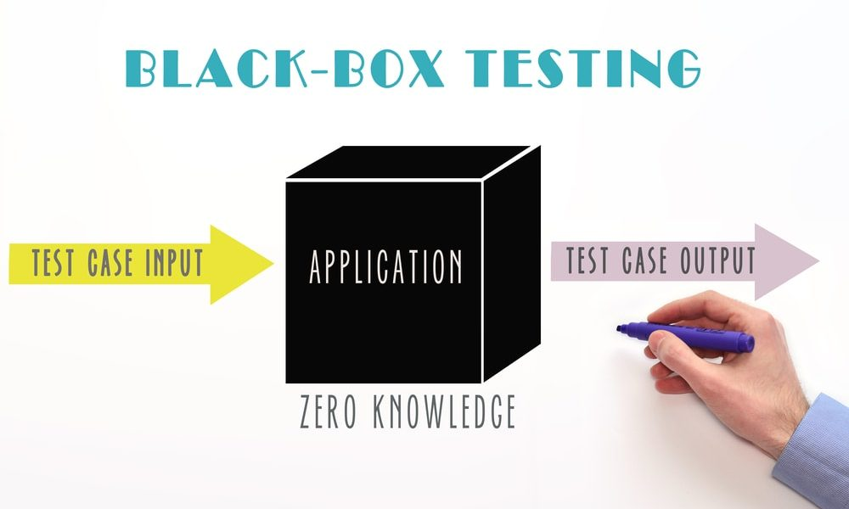

Slide 4
The techniques involve two steps:
Identification of equivalence class:
Partition any input domain into a minimum of two sets: valid values and invalid values. For example, if the valid range is 0 to 100 then select one valid input like 49 and one invalid like 104.
2. Generating test cases:
(i) To each valid and invalid class of input assign a unique identification number. (ii) Write a test case covering all valid and invalid test cases considering that no two invalid inputs mask each other.
3. Boundary value analysis:
Boundaries are very good places for errors to occur. Hence if test cases are designed for boundary values of the input domain then the efficiency of testing improves and the probability of finding errors also increases.
4. Cause effect Graphing:
This technique establishes a relationship between logical input called causes with corresponding actions called the effect. The causes and effects are represented using Boolean graphs. The following steps are followed:

Slide 5
Identify inputs (causes) and outputs (effect).
Develop a cause-effect graph.
Transform the graph into a decision table.
Convert decision table rules to test cases.

Slide 6
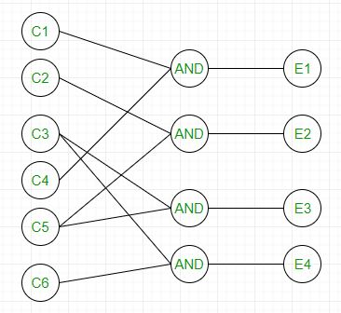

Slide 7
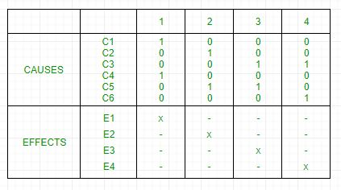

Slide 8
5. Requirement-based testing: It includes validating the requirements given in the SRS of a software system.
6.Compatibility testing: The test case result not only depends on the product but is also on the infrastructure for delivering functionality. When the infrastructure parameters are changed it is still expected to work properly. Some parameters that generally affect the compatibility of software are:
Processor (Pentium 3, Pentium 4) and several processors.
Architecture and characteristics of machine (32-bit or 64-bit).
Back-end components such as database servers.
Operating System (Windows, Linux, etc).

Slide 9
Black Box Testing Type:
1.Functional Testing:It determines the system’s software functional requirements.
2.Regression Testing: It ensures that the newly added code is compatible with the existing code.
3. Nonfunctional Testing: Nonfunctional testing is also known as NFT. This testing is not functional testing of software. It focuses on the software’s performance, usability, and scalability.

Slide 10
Tools Used for Black Box Testing:
Appium
Selenium
Microsoft Coded UI
Applitools
HP QTP.
Advantages:
1. The tester does not need to have more functional knowledge or programming skills to implement the Black Box Testing.
2.It is efficient for implementing the tests in the larger system.
3.Tests are executed from the user’s or client’s point of view.
4.Test cases are easily reproducible.

Slide 11
Disadvantages:
1. There is a possibility of repeating the same tests while implementing the testing process.
2.Without clear functional specifications, test cases are difficult to implement.
3. Sometimes, the reason for the test failure cannot be detected.
4.Some programs in the application are not tested.
Conclusion:
Black-box testing is testing the software from the end-users perspective. It is based on the input-output analysis of the system and ensures that the software meets the specified requirements and performs as expected.

Slide 12
THANK YOU

