Slide 1
CONTROLLERS UNIT TESTING
Unit testing is a software testing methodology where individual units or components of the software are tested in isolation from the rest of the system.
The goal of unit testing is to ensure that each unit or component of the software behaves as expected and meets the requirements.
There are three popular unit testing frameworks in C#
Xunit
Nunit
MSTest

Slide 2
XUnit: XUnit is an open-source unit testing framework for .NET that was heavily influenced by Junit. It has a focus on test parallelism and supports test parallelization by default. It is known for its simplicity, extensibility, and flexibility.
NUnit: NUnit is an open-source unit testing framework for .NET that is similar in many ways to JUnit and XUnit. It has built-in support for data-driven tests and test fixtures. It is known for its simplicity, ease of use, and strong community support
MSTest: MSTest is Microsoft's built-in unit testing framework for .NET that is included with Visual Studio.

Slide 3
In C#, controllers unit testing refers to the process of testing the controller logic of an ASP.NET application. Controllers are responsible for handling incoming requests, processing the request data, and returning the appropriate response.
Unit testing controllers involves creating test methods that simulate incoming requests and test the controller's response. These tests help to ensure that the controller logic is correct and handles all scenarios appropriately.
In order to unit test controllers in C#, you can use testing frameworks like NUnit, MSTest, or xUnit. These frameworks provide various methods for creating and executing unit tests, as well as assertions for checking expected results.

Slide 4
There are three AAA in unit testing stands for "Arrange, Act, Assert" and is a pattern or guideline for structuring unit tests.
Arrange sets up the necessary preconditions for the test, creating an instance of a class, including any inputs and dependencies.
Act performs the actual operation or method that is being tested with the preconditions arranged in the previous step.
Assert verifies that the expected results of the test have occurred.

Slide 5
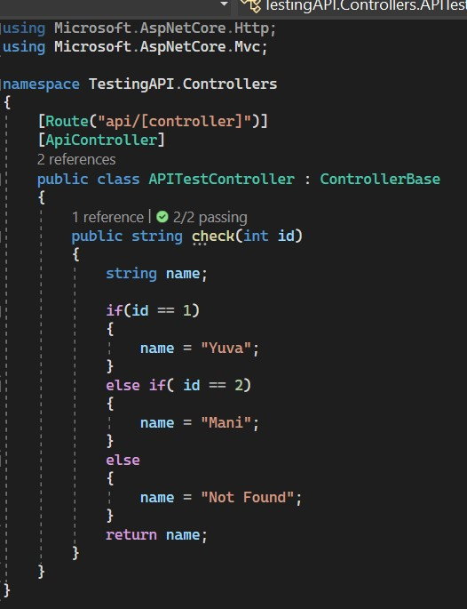
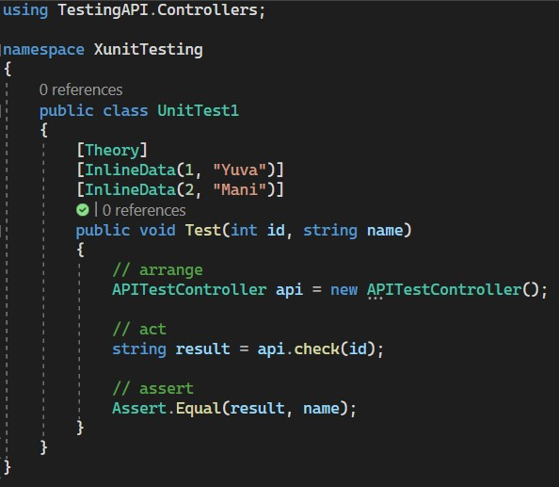
Controller testing using XUnit Testing

Slide 6
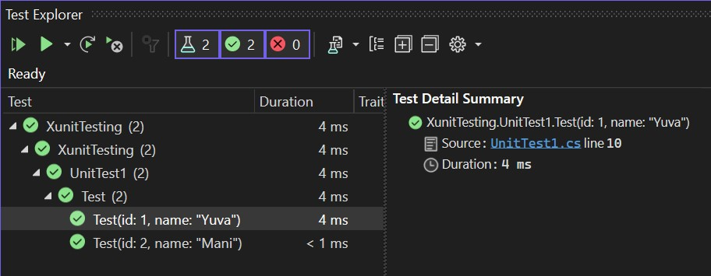
Result

