Slide 1

White box testing

Slide 2
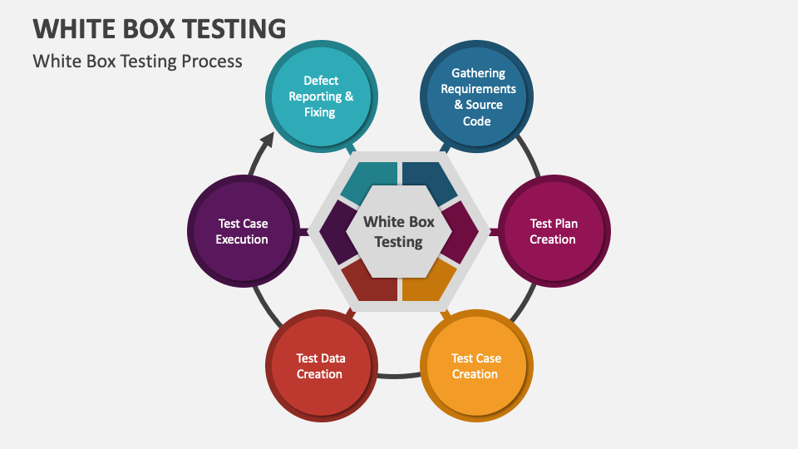
Definition:
Testing based on an analysis of the internal structure of the component or system
White Box Testing is also known as Clear Box testing, Glass Box testing, Transparent Box testing, and Structure-Based testing
It can be applied at all levels of SDLC
Most of the defects found in Unit, Component & Integration levels are through White-box.

Slide 3
White Box Testing Techniques:
Statement Coverage :
Statement coverage technique is used to design white box test cases.
This technique involves the execution of all statements of the source code at least once.
It is used to calculate the total number of executed statements in the source code out of the total statements present in the source code.
Formula:
Statement coverage = ( number of statements executed / total number of statements ) * 100

Slide 4
White Box Testing Techniques:
Decision Coverage:
Decision coverage or Branch coverage is a testing method, which aims to ensure that each one of the possible branches from each decision point is executed at least once and thereby ensuring that all reachable code is executed.
That is, every decision is taken each way, true and false.
Formula:
Decision Coverage = ( Number of decision outcomes exercised / total number of decision outcomes ) * 100

Slide 5
White Box Testing Techniques:
Condition Coverage:
Condition Coverage or expression coverage is a testing method used to test and evaluate the variables or sub-expressions in the conditional statement.
The goal of condition coverage is to check individual outcomes for each logical condition. Condition coverage offers better sensitivity to the control flow than decision coverage.
Formula:
Condition coverage = ( Number of executed operands / Total number of operands ) * 100

Slide 6
White Box Testing Techniques:
Branch coverage:
Branch coverage technique is a white box testing technique that ensures that every branch of each decision point must be executed.
Branch coverage technique is used to cover all branches of the control flow graph.
It covers all the possible outcomes (true and false) of each condition of the decision point at least once.
Formula:
Branch Coverage (%) = (Number of Functional Flow Implemented & Tested)/ (Total Number of Success & Fail Conditional Flow) * 100

Slide 7


