Slide 1
基于MPI+OpenMP的并行程序设计
崔焕庆
2021年5月

Slide 2
1
OpenMP简介
2
MPI简介
目录
CONTENTS
3
MPI+OpenMP编程
4
作业、项目和成绩评定

Slide 3
1 OpenMP简介
1.1 OpenMP的优势
OpenMP是由OpenMP Architecture Review Board牵头提出的，并已被广泛接受的、用于共享内存并行系统的多线程程序设计的一套编译指令 (Compiler Directive)。OpenMP支持、C、C++和Fortran；而支持OpenMP的编译器包括Sun Compiler、GNU Compiler和Intel Compiler等。OpenMP提供了对并行算法的高层的抽象描述，程序员通过在源代码中加入专用的pragma来指明自己的意图，由此编译器可以自动将程序进行并行化，并在必要之处加入同步互斥以及通信。当选择忽略这些pragma，或者编译器不支持OpenMP时，程序又可退化为通常的程序(一般为串行)，代码仍然可以正常运作，只是不能利用多线程来加速程序执行。

Slide 4
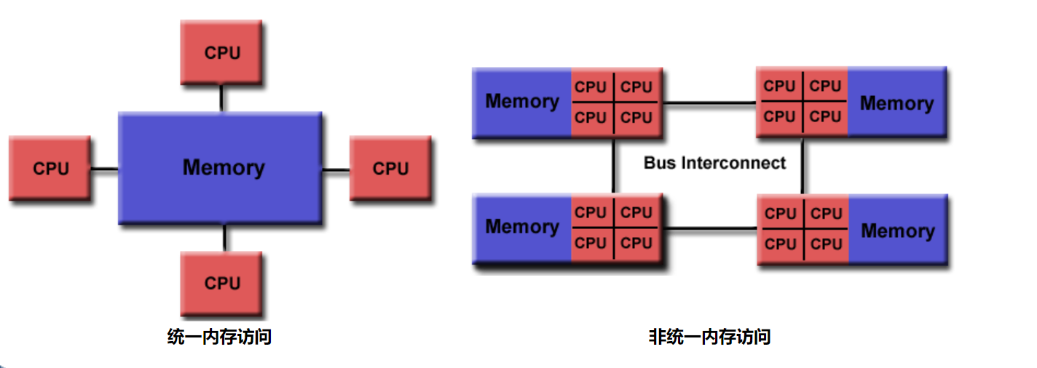
1 OpenMP简介
1.1 OpenMP的优势

Slide 5
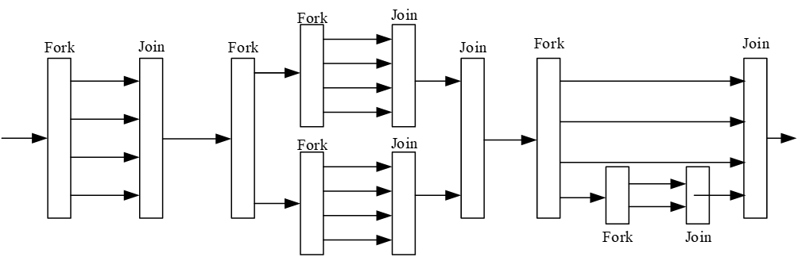
1 OpenMP简介
1.2 OpenMP的Fork-Join并行执行模型
起始时只有一个主线程，当遇到Fork操作时，创建或唤醒多个子线程进入并行任务执行，并行执行结束后，实现隐式的同步，汇合到主线程中，即Join。相邻的Fork和Join操作之间称为一个并行域，并行域可以嵌套。

Slide 6
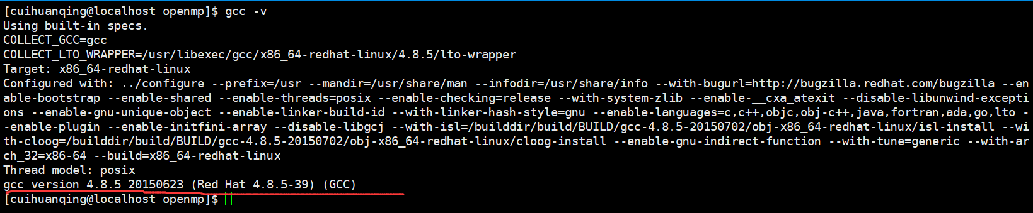
1 OpenMP简介
1.3 OpenMP的版本
$gcc -v
$echo |cpp -fopenmp -dM |grep -i openmp

Slide 7
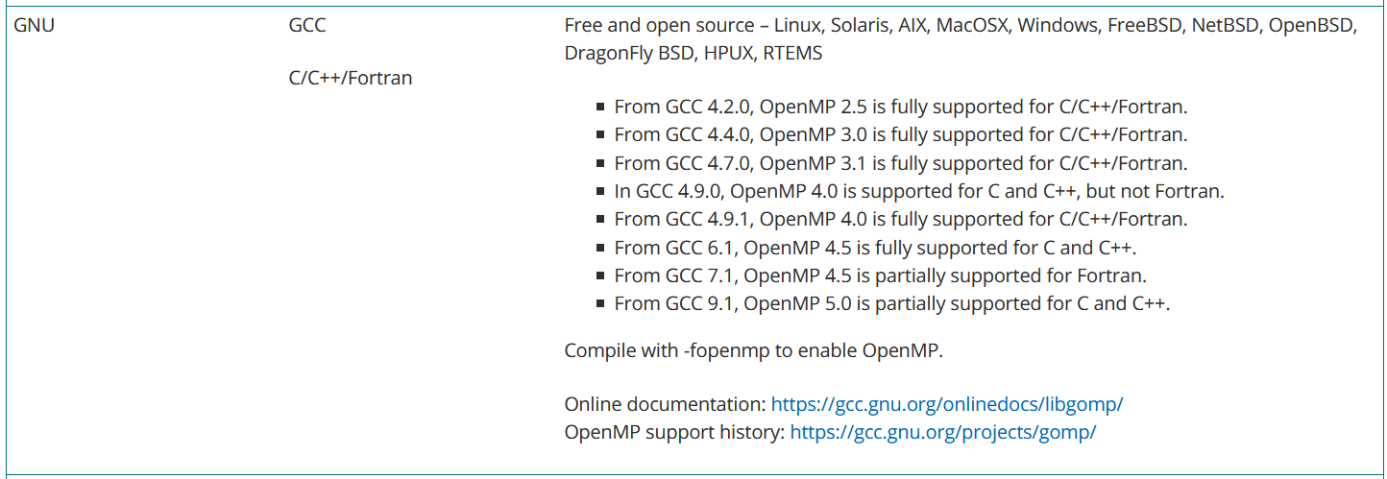
1 OpenMP简介
1.3 OpenMP的版本
https://www.openmp.org/resources/openmp-compilers-tools/

Slide 8
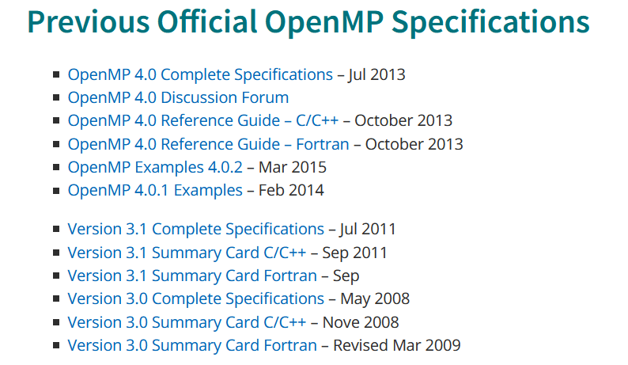
1 OpenMP简介
1.3 OpenMP的版本
https://www.openmp.org/specifications/

Slide 9
1 OpenMP简介
1.4 OpenMP编译制导
所有的编译制导指令必须以“#pragma omp”开头，directive-name是特定的指令名，指明需要OpenMP完成的动作，clause是从句，是可选项，用于作为对指定指令的进一步说明。需要指出的是，在C/C++语言中，编译制导指令是区分大小写的。
#pragma omp directive-name [clause[ [,] clause] ... ] new-line

Slide 10
1 OpenMP简介
1.4 OpenMP编译制导
(1) parallel指令
用于构造一个并行块，如果它所构造的并行块有多于1条的语句，需要用一对大括号括起来。
并行区域必须是一个完整的代码块，不能使用goto或其他语句跳出或转入。

Slide 11
1 OpenMP简介
1.4 OpenMP编译制导
(1) parallel指令
$gcc hello.c -o hello -fopenmp
#include <stdio.h>
int main(){
#pragma omp parallel
printf("The parallel region is run by thread %d.\n",omp_get_thread_num());
return 0;
}
运行时库函数，用于返回在线程组中一个线程的编号。

Slide 12
1 OpenMP简介
1.4 OpenMP编译制导
(2) for指令
用于对循环工作进行并行化，它通常需要与parallel合并使用。
for循环必须具备一定的规范格式：

Slide 13
1 OpenMP简介
1.4 OpenMP编译制导
(2) for指令
输出：
i = 0, threadId = 0.
i = 1, threadId = 0.
i = 2, threadId = 0.
i = 3, threadId = 0.
//没有与parallel同时使用，不能并行
#include <stdio.h>
int main(){
int i;
#pragma omp for
for (i = 0; i < 4; i++)
printf("i = %d, threadId = %d.\n", i, omp_get_thread_num());
return 0;
}

Slide 14
1 OpenMP简介
1.4 OpenMP编译制导
(2) for指令
输出：
i = 0, threadId = 0.
i = 1, threadId = 1.
i = 2, threadId = 2.
i = 3, threadId = 3.
//与parallel同时使用，能并行
#include <stdio.h>
int main(){
int i;
#pragma omp parallel for
for (i = 0; i < 4; i++)
printf("i = %d, threadId = %d.\n", i, omp_get_thread_num());
return 0;
}

Slide 15
1 OpenMP简介
1.4 OpenMP编译制导
(2) for指令
输出：
i = 0, threadId = 0.
i = 1, threadId = 1.
i = 2, threadId = 2.
i = 3, threadId = 3.
//与parallel同时使用，能并行
#include <stdio.h>
int main(){
int i;
#pragma omp parallel
{
#pragma omp for
for (i = 0; i < 4; i++)
printf("i = %d, threadId = %d.\n", i, omp_get_thread_num());
}
return 0;
}

Slide 16
1 OpenMP简介
1.4 OpenMP编译制导
(3) sections和section指令
用于使各个线程执行不同的工作。
每个section必须是一个结构化的代码块，不能有分支转入或跳出。
sections中可以定义多个section，每个section仅被一个一线程执行一次。
当线程多于section数量时，每个线程最多执行一个section。
当线程少于section数量时，有线程会执行多于一个的section。

Slide 17
1 OpenMP简介
1.4 OpenMP编译制导
(3) sections和section指令
用法
标识构件的开始
#pragma omp sections [clause[[,] clause]…]
{
[#pragma omp section]
structured block
[#pragma omp section]
structured block
……
}
标识不同的section

Slide 18
1 OpenMP简介
1.4 OpenMP编译制导
(3) sections和section指令
输出：
Bye from 17.
Hi from 28.
Hello from 36.
#include <stdio.h>
int main(){
#pragma omp parallel sections
{
#pragma omp section
printf("Hello from %d.\n", omp_get_thread_num());
#pragma omp section
printf("Hi from %d.\n", omp_get_thread_num());
#pragma omp section
printf("Bye from %d.\n", omp_get_thread_num());
}
return 0;
}

Slide 19
1 OpenMP简介
1.4 OpenMP编译制导
(4) single指令
用于让紧随其后的语句串行执行。
输出：
Run in parallel, thread id = 11.
Run in sequence, thread id = 11.
Run in parallel, thread id = 19.
Run in parallel, thread id = 30.
#include <stdio.h>
#include <omp.h>
int main(){
#pragma omp parallel {
printf("Run in parallel, thread id = %d.\n", omp_get_thread_num());
#pragma omp single {
printf("Run in sequence, thread id = %d.\n", omp_get_thread_num());
}
printf("Run in parallel, thread id = %d.\n", omp_get_thread_num());
}
return 0;
}

Slide 20
1 OpenMP简介
1.4 OpenMP编译制导
(5) private数据属性
将一个或多个变量声明为线程的私有变量。
每个线程都有它自己的变量私有副本，其他线程无法访问。
即使在并行区域外有同名的共享变量，共享变量在并行区域内不起任何作用，并且并行区域内不会操作到外面的共享变量。
并行区域内的private变量和并行区域外同名的变量没有存储关联。
如果需要继承原有共享变量的值，则应使用firstprivate子句。
如果需要在退出并行区域时将私有变量最后的值赋值给对应的共享变量，则可使用lastprivate子句。

Slide 21
1 OpenMP简介
1.4 OpenMP编译制导
(5) private数据属性
输出：
id: 2, A: 0
id: 5, A: 0
id: 7, A: 0
id: 3, A: 0
id: 8, A: 0
id: 6, A: 0
id: 4, A: 0
id: 1, A: 0
id: 9, A: 0
id: 0, A: 1218647392
//一个错误的程序
#include <stdio.h>
int main(){
int A=100;
int i;
#pragma omp parallel for private(A)
for(i = 0; i<10;i++){
printf("%d\n",A);
}
return 0;
}

Slide 22
1 OpenMP简介
1.4 OpenMP编译制导
(5) private数据属性
//第二个错误的程序
#include <stdio.h>
int main(){
int B, i;
#pragma omp parallel for private(B)
for(i = 0; i<10;i++){
B = 100;
}
printf("%d\n",B);
return 0;
}
输出：
0

Slide 23
1 OpenMP简介
1.4 OpenMP编译制导
(5) private数据属性
输出：
200
200
200
200
200
200
200
200
200
200
100
//第三个错误的程序
#include <stdio.h>
int main(){
int C = 100,i;
#pragma omp parallel for private(C)
for(i = 0; i<10;i++){
C = 200;
printf("%d\n",C);
}
printf("%d\n",C);
return 0;
}

Slide 24
1 OpenMP简介
输出：
k = 101 in thread 1.
k = 107 in thread 7.
k = 105 in thread 5.
k = 100 in thread 0.
k = 103 in thread 3.
k = 104 in thread 4.
k = 102 in thread 2.
k = 106 in thread 6.
Finally, k = 107.
1.4 OpenMP编译制导
(5) private数据属性
#include <stdio.h>
int main(){
int k, i;
k = 100;
#pragma omp parallel for firstprivate(k),lastprivate(k)
for (i = 0; i < 8; i++)
{
k += i;
printf("k = %d in thread %d.\n", k, omp_get_thread_num());
}
printf("Finally, k = %d.\n", k);
return 0;
}

Slide 25
1 OpenMP简介
1.4 OpenMP编译制导
(5) private数据属性
输出：
i=0, j=0 from id=0.
i=0, j=1 from id=0.
i=0, j=2 from id=0.
i=0, j=3 from id=0.
i=0, j=4 from id=0.
i=1, j=0 from id=1.
//默认是shared
#include <stdio.h>
int main(){
int i, j;
#pragma omp parallel for
for (i = 0; i < 2; i++){
for (j = 0; j < 5; j++) //j共享，线程1只执行了1次
printf("i=%d, j=%d from id=%d.\n", i, j, omp_get_thread_num());
}
return 0;
}

Slide 26
1 OpenMP简介
1.4 OpenMP编译制导
(5) private数据属性
输出：
i=0, j=0 from id=0.
i=0, j=1 from id=0.
i=0, j=2 from id=0.
i=0, j=3 from id=0.
i=0, j=4 from id=0.
i=1, j=0 from id=1.
i=1, j=1 from id=1.
i=1, j=2 from id=1.
i=1, j=3 from id=1.
i=1, j=4 from id=1.
#include <stdio.h>
int main(){
int i, j;
#pragma omp parallel for private(j)
for (i = 0; i < 2; i++){
for (j = 0; j < 5; j++)
printf("i=%d, j=%d from id=%d.\n", i, j, omp_get_thread_num());
}
return 0;
}

Slide 27



1 OpenMP简介
1.4 OpenMP编译制导
(6) shared数据属性
#include <iostream>
#include <omp.h>
using namespace std;
int main() {
int sum = 0;
cout << "Before: " << sum << endl;
#pragma omp parallel for shared(sum)
for (int i = 0; i < 10; ++i) {
sum += i; //存在数据竞争
}
cout << "After: " << sum << endl;
return 0;
}

Slide 28
1 OpenMP简介
1.4 OpenMP编译制导
(6) reduction子句
为变量指定一个操作符，每个线程都会创建reduction变量的私有拷贝，在OpenMP区域结束处，将使用各个线程的私有拷贝的值通过制定的操作符进行迭代运算，并赋值给原来的变量。
语法： reduction(operator:list)
operator：+ * - & ^ | && || max min

Slide 29
1 OpenMP简介
1.4 OpenMP编译制导
(6) reduction子句
#include <iostream>
#include <omp.h>
using namespace std;
int main() {
int sum = 0;
cout << "Before: " << sum << endl;
#pragma omp parallel for reduction(+:sum)
for (int i = 0; i < 10; ++i) {
sum += i;
}
cout << "After: " << sum << endl;
return 0;
}

Slide 30
1 OpenMP简介
1.5 OpenMP运行库例程与环境变量
(1)设置线程数量。
在OpenMP中，有三种方法可以设定线程个数，按照优先级从高到低分别是：
编译制导的num_threads()子句。如：#pragma omp parallel num_threads(8)
在并行区域外，使用运行库例程omp_set_num_threads()设定并行区域中使用。如： omp_set_num_threads(10);
环境变量OMP_NUM_THREADS。如： export OMP_NUM_THREADS = 3

Slide 31
1 OpenMP简介
1.5 OpenMP运行库例程与环境变量
（2）获取正在使用的线程数量和编号。
int omp_get_num_threads(void)：返回当前并行区域中的线程数量。
int omp_get_thread_num(void)：返回值当前并行区域中，当前线程在线程组中的编号。这个编号从0开始。
（3）获取程序可使用的CPU核心数。
int omp_get_num_procs(void)：返回值为当前程序可以使用的CPU核数。
（4）获取墙上时间。
double omp_get_wtime(void)：返回值是以秒为单位的墙上时间。在并行区域开始前和结束后分别调用该函数，并求取两次返回值的差，便可计算出并行执行的时间。

Slide 32
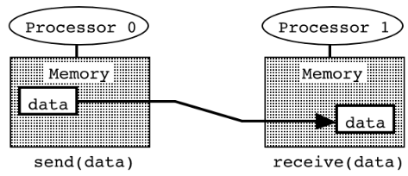
2 MPI简介
2.1 消息传递编程模型

Slide 33
2 MPI简介
2.2 What is MPI?
Message Passing Interface Specification
MPI is a standardized and portable message-passing system designed by a group of researchers from academia and industry to function on a wide variety of parallel computing architectures. The standard defines the syntax and semantics of a core of library routines useful to a wide range of users writing portable message-passing programs in C, C++, and Fortran.

Slide 34
2 MPI简介
2.2 What Is MPI?
Point-to-point communication
Collective operations
Process groups, Communication contexts, and Process topologies
Environmental management and inquiry
Process creation and management
Other functions

Slide 35
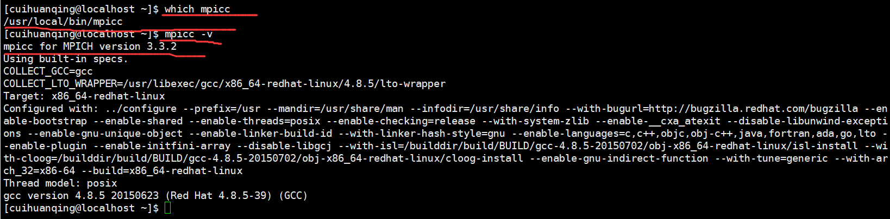
2 MPI简介
2.3 Check the Installation and Version

Slide 36
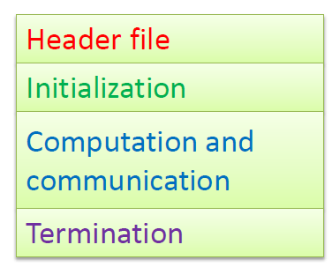
2 MPI简介
2.4 MPI Programs’ Structure
# include "mpi.h"
int main (int argc, char *argv[]){
MPI_Init (&argc, &argv);
MPI_Comm_size (COMM, &p);
MPI_Comm_rank (COMM, &id);
Communicate & Compute;
MPI_Finalize( );
return 0;
}

Slide 37
2 MPI简介
2.5 MPI Basic Functions
Communicators
Encapsulate all of these ideas in order to provide the appropriate scope for all communication operations.
Can be regarded as an ordered list of processes.
Each process has a unique rank, which starts from 0 (root).
It is the context of MPI communicators and operations.
When a function is called to send data to all processes, MPI needs to understand what “all” means.

Slide 38
2 MPI简介
2.5 MPI Basic Functions
Communicators
MPI_COMM_WORLD: the default communicator that contains all processes running the MPI program
Communicators are divided into two kinds:
intra-communicators for operations within a single group of processes.
inter-communicators for operations between two groups of processes.
A process can belong to multiple communicators.
The rank is usually different.

Slide 39
2 MPI简介
2.5 MPI Basic Functions
Getting Communicator Information
Get the rank of the calling process in group
int MPI_Comm_rank(MPI_Comm comm, int *rank);
Get the size in a communicator
int MPI_Comm_size(MPI_Comm comm, int *size);

Slide 40
2 MPI简介
2.5 MPI Basic Functions
An example
#include <stdio.h>
#include "mpi.h"
int main(int argc, char**argv){
MPI_Init(&argc, &argv);
printf("Hello world.\n");
MPI_Finalize();
return 0;
}

Slide 41
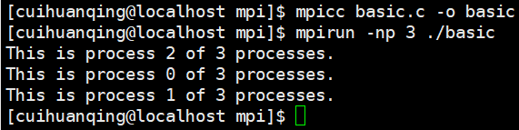
2 MPI简介
2.5 MPI Basic Functions
#include <stdio.h>
#include "mpi.h"
int main(int argc, char **argv){
MPI_Comm comm = MPI_COMM_WORLD;
int size, rank;
MPI_Init(&argc, &argv);
MPI_Comm_size(comm, &size);
MPI_Comm_rank(comm, &rank);
printf("This is process %d of %d processes.\n", rank, size);
MPI_Finalize();
return 0;
}
An example

Slide 42
2 MPI简介
2.6 Point-to-point communication
Communication between two processes
Source process sends message to destination process
Communication takes place within a communicator
Destination process is identified by its rank in the communicator
1
communicator
4
dest
3
2
0
source

Slide 43
2 MPI简介
2.6 Point-to-point communication
MPI_Send(
void* data,
int count,
MPI_Datatype datatype,
int destination,
int tag,
MPI_Comm comm)
Send a message
starting address of the data to be sent
number of elements to be sent (not bytes)
MPI datatype of each element
rank of destination process
message identifier (set by user)
MPI communicator of processors involved

Slide 44
2 MPI简介
2.6 Point-to-point communication
MPI_Recv(
void* data,
int count,
MPI_Datatype datatype,
int source,
int tag,
MPI_Comm comm,
MPI_Status* status)
Receive a message
starting address of buffer to store message
number of elements to be received (not bytes)
MPI datatype of each element
rank of source process
message identifier (set by user)
MPI communicator of processors involved
structure of information about the message

Slide 45

2 MPI简介
2.6 Point-to-point communication
int main(int argc, char **argv){
MPI_Comm comm = MPI_COMM_WORLD;
MPI_Status status; int size, rank; char str[100];
MPI_Init(&argc, &argv);
MPI_Comm_size(comm, &size); MPI_Comm_rank(comm, &rank);
if (rank == 0) {
strcpy(str, "hello world");
printf("Process 0 send 1 to process %s.\n", str);
MPI_Send(str, strlen(str) + 1, MPI_CHAR, 1, 99, comm);
}
else if (rank == 1) {
MPI_Recv(str, 100, MPI_CHAR, 0, 99, comm, &status);
printf("Process 1 receives messages %s.\n", str);
}
MPI_Finalize();
return 0;
}

Slide 46
2 MPI简介
2.7 Elementary MPI datatypes
MPI datatype | C equivalent
MPI_SHORT | short int
MPI_INT | int
MPI_LONG | long int
MPI_LONG_LONG | long long int
MPI_UNSIGNED_CHAR | unsigned char
MPI_UNSIGNED_SHORT | unsigned short int
MPI_UNSIGNED | unsigned int
MPI_UNSIGNED_LONG | unsigned long int
MPI_UNSIGNED_LONG_LONG | unsigned long long int
MPI_FLOAT | float
MPI_DOUBLE | double
MPI_LONG_DOUBLE | long double
MPI_BYTE | char

Slide 47
2 MPI简介
2.8 Collective Communication
Collective vs. Point-to-point
More concise program : One collective operation can replace multiple point-to-point operations
Optimized collective communications usually are faster than the corresponding point-to-point communications

Slide 48
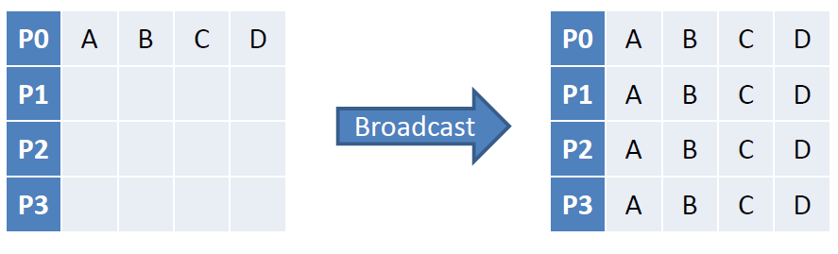
2 MPI简介
2.8 Collective Communication
Data Movement: Broadcast
Broadcast copies data from the memory of one processor to that of other processors —— One to all operation

Slide 49
2 MPI简介
2.8 Collective Communication
Data Movement: Broadcast
int MPI_Bcast(
void* buffer,
int count,
MPI_Datatype datatype,
int root,
MPI_Comm comm)
starting address of buffer
number of entries in buffer
data type of buffer
rank of broadcast root
communicator

Slide 50
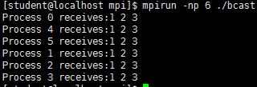
2 MPI简介
2.8 Collective Communication
Data Movement: Broadcast
int main(int argc, char** argv){
int arr[3], i, rank;
MPI_Init(&argc, &argv);
MPI_Comm_rank(MPI_COMM_WORLD, &rank);
if (rank == 0){
for (i = 0; i < 3; i++)
arr[i] = i + 1;
}
MPI_Bcast(arr, 3, MPI_INT, 0, MPI_COMM_WORLD);
printf("Process %d receives:", rank);
for (i = 0; i < 3; i++)
printf("%d ", arr[i]);
putchar('\n');
MPI_Finalize();
return 0;
}

Slide 51
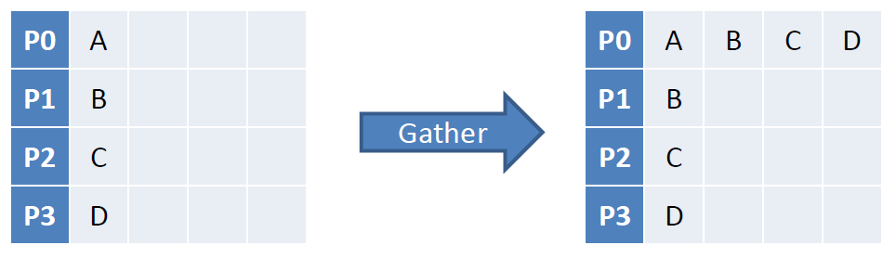
2 MPI简介
2.8 Collective Communication
Data Movement: Gather
Gather copies data from each process to one process, where it is stored in rank order—— One to all operation

Slide 52
2 MPI简介
2.8 Collective Communication
Data Movement: Gather
int MPI_Gather(
const void* sendbuf,
int sendcount,
MPI_Datatype sendtype,
void* recvbuf,
int recvcount,
MPI_Datatype recvtype,
int root,
MPI_Comm comm)
starting address of send buffer
number of elements in send buffer
data type of send buffer elements
address of receive buffer (significant only at root)
number of elements for any single receive (significant only at root)
data type of recv buffer elements(significant only at root)
rank of receiving process
communicator

Slide 53
2 MPI简介
2.8 Collective Communication
Data Movement: Gather
int main(int argc, char **argv){
int rank, size, sbuf[3], *rbuf, i;
MPI_Init(&argc, &argv);
MPI_Comm_size(MPI_COMM_WORLD, &size);
MPI_Comm_rank(MPI_COMM_WORLD, &rank);
for (i = 0; i < 3; i++) sbuf[i] = rank * 10 + i;
if (rank == 0) rbuf = (int*)malloc(sizeof(int) * 3 * size);
MPI_Gather(sbuf, 3, MPI_INT, rbuf, 3, MPI_INT, 0, MPI_COMM_WORLD);
if (rank == 0){
printf("Process 0 receives:");
for (i = 0; i < size * 3; i++)
printf("%d ", rbuf[i]);
putchar('\n');
}
MPI_Finalize();
return 0;
}

Slide 54
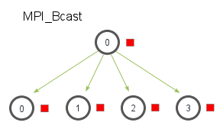
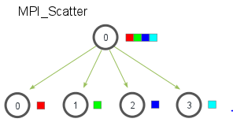
2 MPI简介
2.8 Collective Communication
Data Movement: Scatter
Typically data is in an array on the root process and we want to send a different portion of the array to each worker process (often including the root).

Slide 55
2 MPI简介
2.8 Collective Communication
Data Movement: Scatter
int MPI_Scatter (
void * sendbuf , // pointer to send buffer
int sendcount , // items to send per process
MPI_Datatype sendtype , // type of send buffer data
void * recvbuf , // pointer to receive buffer
int recvcount , // number of items to receive
MPI_Datatype recvtype , // type of receive buffer data
int root , // rank of sending process
MPI_Comm comm ) // MPI communicator to use

Slide 56

2 MPI简介
2.8 Collective Communication
Data Movement: Gather
int main(int argc, char** argv){
int rank, size, *sbuf, rbuf[3], i;
MPI_Init(&argc, &argv);
MPI_Comm_size(MPI_COMM_WORLD, &size);
MPI_Comm_rank(MPI_COMM_WORLD, &rank);
if (rank == 0){
sbuf = (int *) malloc(sizeof(int) * 3 * size);
for (i = 0; i < size * 3; i++) sbuf[i] = i + 1;
}
MPI_Scatter(sbuf, 3, MPI_INT, rbuf, 3, MPI_INT, 0, MPI_COMM_WORLD);
printf("Process %d receives: ", rank);
for (i = 0; i < 3; i++) printf("%d ", rbuf[i]);
putchar('\n');
MPI_Finalize();
return 0;
}

Slide 57
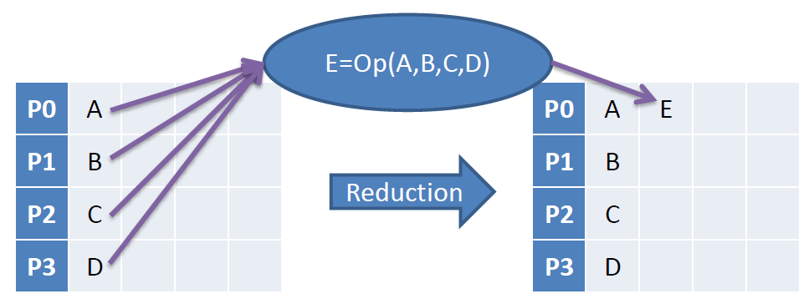
2 MPI简介
2.8 Collective Communication
Data Movement: Reduce
MPI reduction collects data from each process, reduces them to a single value, and store it in the memory of one process.

Slide 58
2 MPI简介
2.8 Collective Communication
Data Movement: Reduce
MPI_Reduce(
void* send_data,
void* recv_data,
int count,
MPI_Datatype datatype,
MPI_Op op,
int root,
MPI_Comm communicator)
address of send buffer
address of receive buffer
number of elements in send buffer
data type of elements of send buffer
reduce operation
rank of root process
communicator

Slide 59
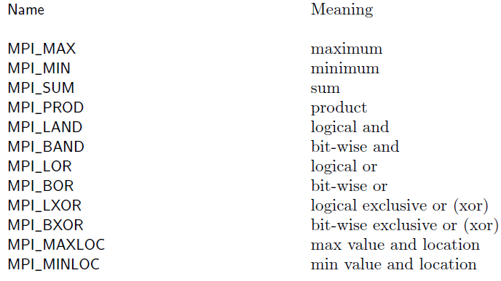
2 MPI简介
2.8 Collective Communication
Data Movement: Reduce

Slide 60
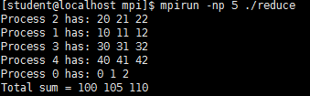
2 MPI简介
2.8 Collective Communication
Data Movement: Reduce
int main(int argc, char** argv) {
int size, rank, sbuf[3], rbuf[3], i;
MPI_Init(&argc, &argv);
MPI_Comm_rank(MPI_COMM_WORLD, &rank);
MPI_Comm_size(MPI_COMM_WORLD, &size);
for (i = 0; i < 3; i++) sbuf[i] = rank * 10 + i;
printf("Process %d has: ", rank);
for (i = 0; i < 3; i++) printf("%d ", sbuf[i]);
putchar('\n');
MPI_Reduce(sbuf, rbuf, 3, MPI_INT, MPI_SUM, 0,MPI_COMM_WORLD);
if (rank == 0) {
printf("Total sum = ");
for (i = 0; i < 3; i++) printf("%d ",rbuf[i]);
putchar('\n');
}
MPI_Finalize();
}

Slide 61
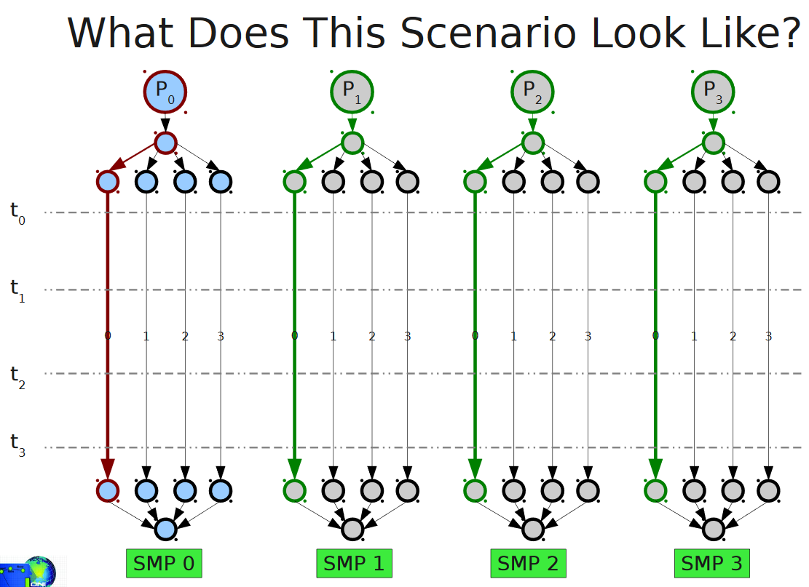
3 MPI+OpenMP混合编程简介
A Common Execution Scenario：
A single MPI process is launched on each SMP node in the cluster;
Each process spawns N threads on each SMP node;
At some global sync point, the master thread on MPI process 0 communicates with the master thread on all other nodes;
The threads belonging to each process continue until another sync point or completion;

Slide 62
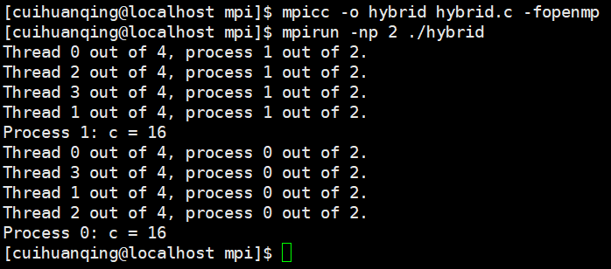
3 MPI+OpenMP混合编程简介
#include <omp.h>
#include "mpi.h"
#include <stdio.h>
#define _NUM_THREADS 4
int main(int argc, char *argv[]) {
int numprocs,my_rank,c, iam, np;
omp_set_num_threads(_NUM_THREADS);
MPI_Init(&argc, &argv);
MPI_Comm_size(MPI_COMM_WORLD,&numprocs);
MPI_Comm_rank(MPI_COMM_WORLD,&my_rank);
#pragma omp parallel reduction(+:c) private(iam)
{
np = omp_get_num_threads();
iam = omp_get_thread_num();
c = omp_get_num_threads();
printf("Thread %d out of %d, process %d out of %d.\n", iam, np, my_rank, numprocs);
}
printf("Process %d: c = %d\n",my_rank, c);
MPI_Finalize();
return 0;
}

Slide 63
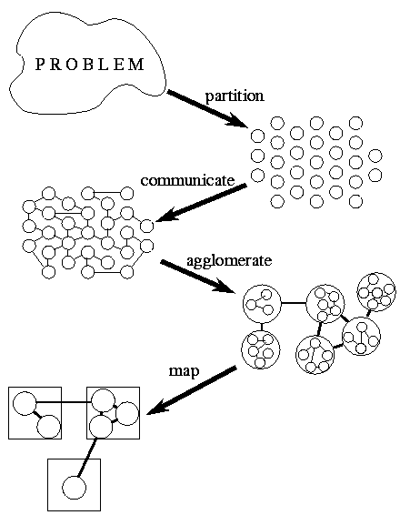
4 Design of Parallel Programs
Methodical Design
Partitioning. The computation that is to be performed and the data operated on by this computation are decomposed into small tasks. Practical issues such as the number of processors in the target computer are ignored, and attention is focused on recognizing opportunities for parallel execution.

Slide 64
4 Design of Parallel Programs
Methodical Design
Communication. The communication required to coordinate task execution is determined, and appropriate communication structures and algorithms are defined.

Slide 65
4 Design of Parallel Programs
Methodical Design
Agglomeration. The task and communication structures defined in the first two stages of a design are evaluated with respect to performance requirements and implementation costs. If necessary, tasks are combined into larger tasks to improve performance or to reduce development costs.

Slide 66
4 Design of Parallel Programs
Methodical Design
Mapping. Each task is assigned to a processor in a manner that attempts to satisfy the competing goals of maximizing processor utilization and minimizing communication costs. Mapping can be specified statically or determined at runtime by load-balancing algorithms.

Slide 67
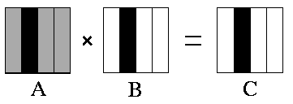
4 Design of Parallel Programs
Example: Matrix multiplication
Each process requires all of matrix A, and has several columns of matrix B, to compute the corresponding columns of matrix C. Finally, a root process collects all results in one matrix.

Slide 68
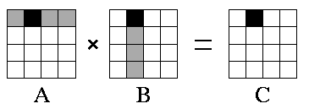
4 Design of Parallel Programs
Example: Matrix multiplication
Each task requires several rows of matrix A, and several columns of matrix B, to compute the corresponding sub-matrix of C.

Slide 69
5 作业、项目和成绩评定
5.1 作业（每个同学独立完成程序和实验报告）
实现一种或多种并行排序算法。
（1）使用MPI、OpenMP、MPI+OpenMP编写上述并行程序。
（2）使用VTune等工具对程序进行瓶颈分析和优化。
（3）提交程序源代码、变量和语句的详细说明。
（4）在实验报告中通过图表说明CPU串行程序和三种并行程序在各种规模的运行时间。
（5）（选做）在实验报告中通过图表说明三种并行程序使用不同的数据分配方法在各种规模的运行时间。

Slide 70
5 作业、项目和成绩评定
5.2 项目（按照小组完成）
题目1：实现Cannon算法或LU分解或QR分解或Jacobi迭代算法。
题目2：实现DBSCAN等聚类算法。
服务器：192.168.139.21
用户名和密码：跟之前的一样

Slide 71
5 作业、项目和成绩评定
5.3 成绩和要求
要求：
1、要求每个学生必须独立完成作业要求的内容（及格）
2、要求每个团队至少正确完成一个项目（良好）
3、正确完成2个项目（优秀）
成绩组成：
工作态度：10%
作品质量和掌握程度：30%
实训报告质量：20%
沟通汇报能力：10%
独立分析与解决问题能力：20%
团队与合作：10%

Slide 72
参考资料
[美]帕切克 著，邓倩妮 等译， 并行程序设计导论，机械工业出版社，2013-1
[德]贝蒂尔·施密特（Bertil Schmidt） 乔治·冈萨雷斯-多明格，并行程序设计：概念与实践，机械工业出版社，2020-06-25
雷洪，胡许冰 著，多核并行高性能计算 OpenMP，冶金工业出版社，2016-5
张武生，薛巍，李建江，郑纬民编著，MPI并行程序设计实例教程，清华大学出版社，2009年

