Slide 1
SQL fundamentals http://github.com/minorg/sql
Minor Gordon, Ph.D.
http://minorgordon.net
mail@minorgordon.net

Slide 2
SQL
„S-Q-L“ or „Sequel“
Structured Query Language
  Data Definition Language (DDL): CREATE TABLE, ALTER TABLE
  Data Manipulation Language (DML): SELECT, INSERT, UPDATE, DELETE
    „CRUD“ model of data manipulation: CREATE-READ-UPDATE-DELETE
Typically used with relational databases (MySQL, Oracle, DB2, et al.)
  ~ dense tables of rows and columns, no value nesting
  Nulls/3-valued logic
Originally intended for non-programmers

Slide 3
Relational databases vs. CSV
Advantages of relational databases vs. CSV:
Store large amounts of data (millions of rows)
Faster queries using indices („find all rows with column X = 1“ )
  Avoid checking every row
Faster insertions and deletions in the middle of the data
Support concurrent writers and ensure data integrity using transactions
  ACID: Atomicity – Consistency - Isolation – Durability
Typed values (integer, date, etc.) and constraints (NOT NULL)
Schema changes (add, remove columns)
Dynamically join data between tables
Advantages of CSV vs. relational databases:
Simplicity: CSV is just text, can be opened with Excel on a desktop machine

Slide 4
SQLite sqlite.org
Most widely-deployed SQL database in the world: used in OS X, Firefox, Skype, iPhones, web applications
Built in to the standard library of many programming languages: Python, Ruby, PHP
  Third party libraries for others e.g., RSQLite in R
Database = one file
Full-featured, performs well
Supports most of standard SQL (ANSI/ISO SQL)
  Relatively little dialect compared to Oracle, DB2

Slide 5
Working with SQLite
SQLite has an interactive command shell/interpreter (sqlite3-shell). There are also third-party graphic user interfaces for working with SQLite.
But you would rarely use it this way in actual applications.
Actual applications take user input, transform it to SQL queries or updates on the database, and return the results to the user in some form (printing to the screen, writing to a file, web application, etc.)
Do all that in a programming language.
I'll be using Python.
You can use R, MATLAB, Perl, or whatever language suits you.

Slide 6
Goals
Data definition
CREATE TABLE with different column types
Data manipulation
DELETE, INSERT, UPDATE
SELECT
  WHERE predicates
  Basic JOINs between tables

Slide 7
Plan
Today:
Demonstrate CREATE TABLE, INSERT, basic SELECT using the Chinook sample database
Listen +/- try in PyCharm
Next session:
Bring your own data (e.g., one or more CSV files or another format)
Work in groups if you wish
Goal: get your data into SQLite and manipulate it

Slide 8
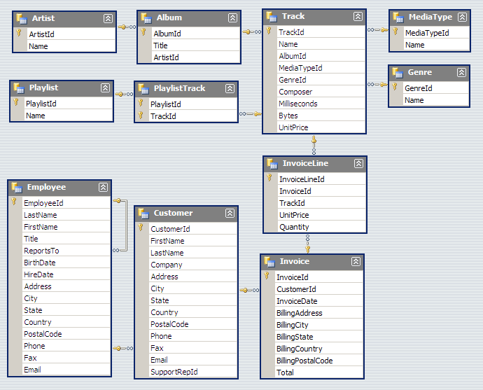
The Chinook sample database

