Slide 1

Playoff Predictions
Evaluating performance of hockey metrics as a predictor of playoff success
By: Matt “MP” Markezin-Press

Slide 2
Project Outline
Background
The problem
Datasets
Exploratory Data Analysis
Features
Collinearity
Models
Logit
Decision Tree
Predicting 2016
Next Steps
Appendix

Slide 3
Project Background
In Hockey, there has been a renaissance of “advanced” statistics.
Fans, the league itself and teams have made their work publically available.
The average person now has access to a variety of metrics and many opportunities to test his/her own hypothesis.
The NHL Playoffs Start on April 12th
There is an excellent opportunity to train a model using historical data and then test it on 2015-2016 season

Slide 4
Problem Summary
Problem Statement:
Using data provided from the NHL and the fan community, what statistics are most useful for predicting a playoff appearance for a team given their season’s performance.
Hypothesis:
“Possession” based statistics are going to be better predictors than traditional statistics like “score differential” or “penalty minutes.”

Slide 5
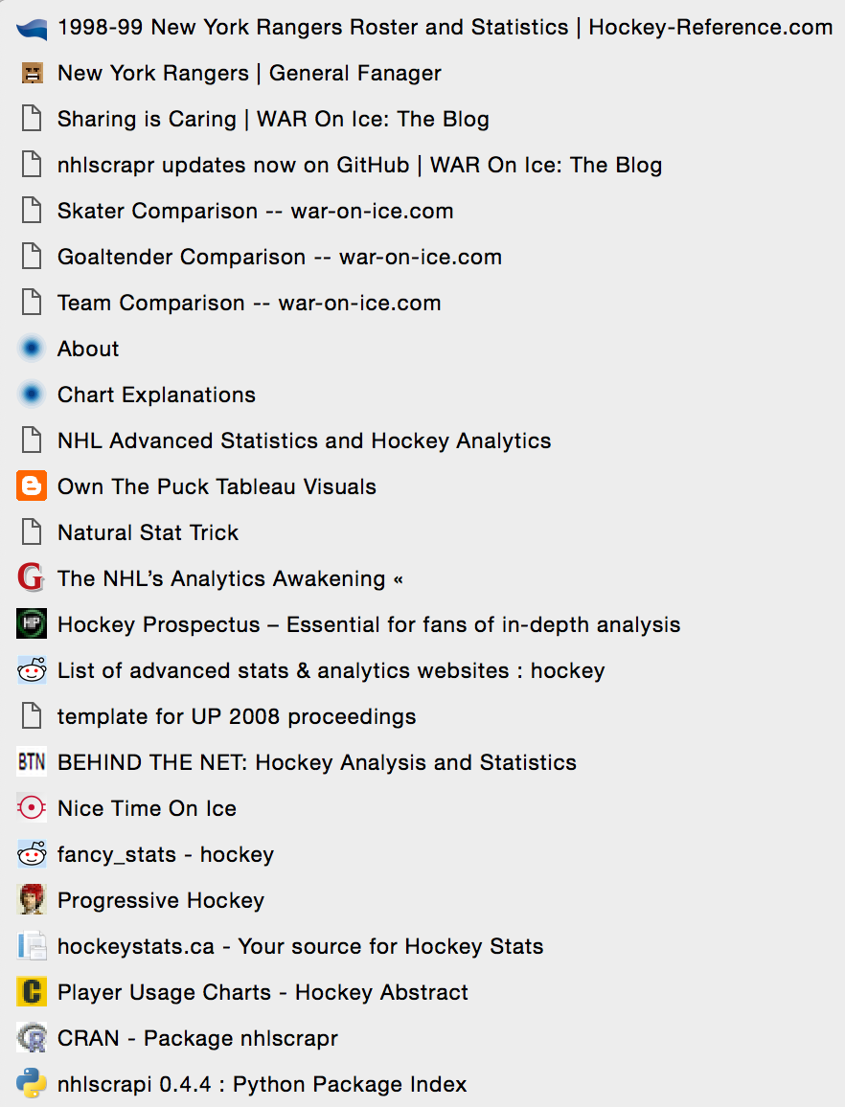
The Datasets
The massive amount of available data is the biggest hurdle to the project’s success
Data is available from:
NHL.com
Hockey-Reference.com
War On Ice
Hockey Analytics
Hockey Viz
Over 10 other websites and data sources
After hours of looking at tables, I decided to use the “Advanced Stats” set form Hockey Reference
1 of 3 bookmark folders for data

Slide 6
A Roadmap To Predictions
Data is not easily aligned from one set to another
It was necessary to identify a schema and stick with it
The time cost of preprocessing data to ensure consistency is high
After identifying the dataset, plan modeling methods
Binary Logit Model
Decision Tree
Desired Results
A clear identifier or classifier for achieving the playoffs
Easily replicable models to apply 2015-2016 statistics to

Slide 7
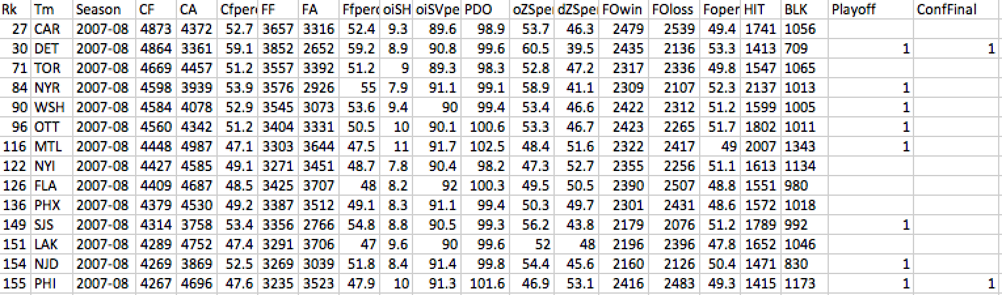
Sample Dataset
Dataset consists of each teams individual season statistics for a single season.
The key is identifying the features that are the best predictors

Slide 8
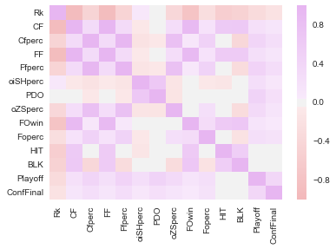
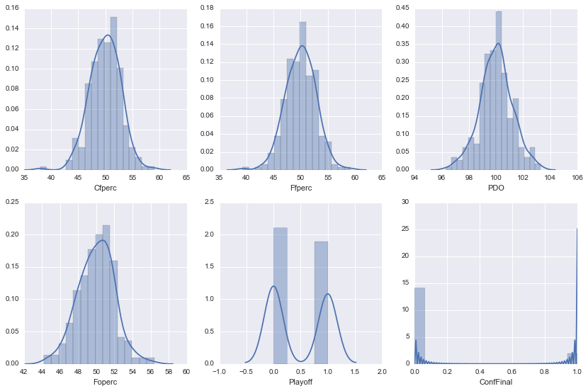
Exploratory Data Analysis
After looking through the datasets it was easy to see that certain statistics had high levels of collinearity
Data also appears to be normally distributed
This will make it easier for modeling as it will mean avoiding a transformation

Slide 9
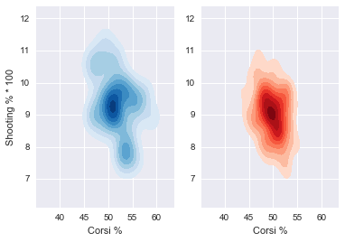
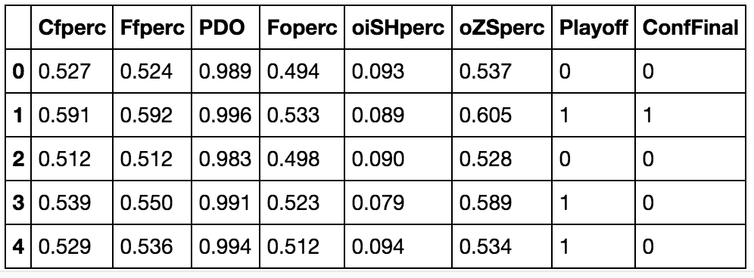
Exploratory Data Analysis
There is a clear indication that making the playoffs (Blue) shows that a higher shooting percentage and Corsi make the playoffs
However, there is a significantly wider distribution of results for those that make the playoffs
Some statistics like Corsi “for” and “against” are analogues so one is dropped to limit amount of possible features

Slide 10
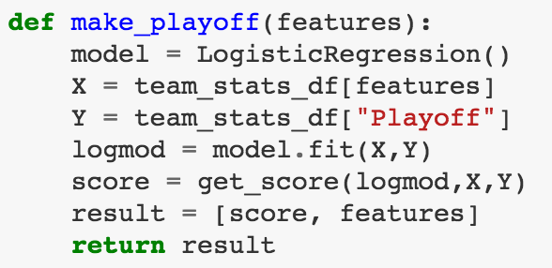
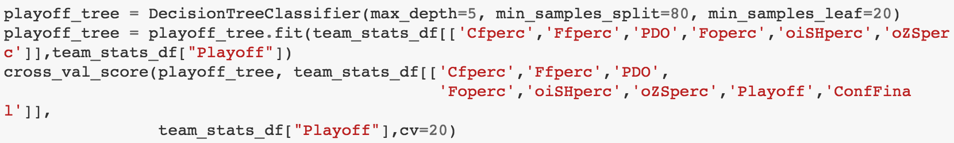
Modeling Approach
Logit Model
Iterate through every feature combination
Identify best fit
Ensure best Adj. R²
Decision Tree Model
Minimize tree depth
Use even splits
Strong confidence in results

Slide 11
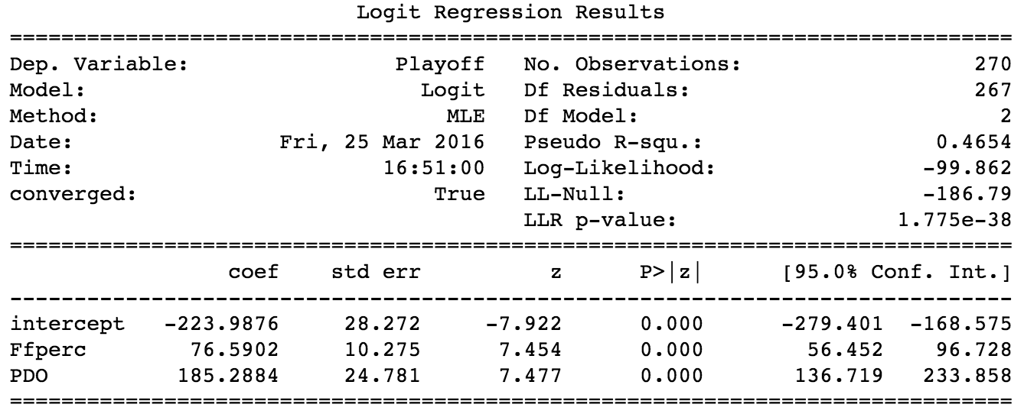
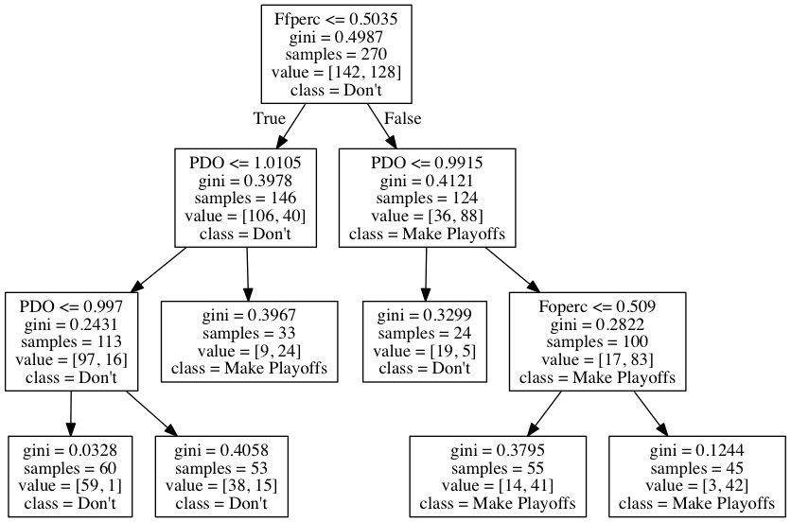
Modeling Results, Features
Logit Model:
Fenwick For and PDO
Decision Tree Model:
Fenwick For, PDO & Faceoff Win %

Slide 12
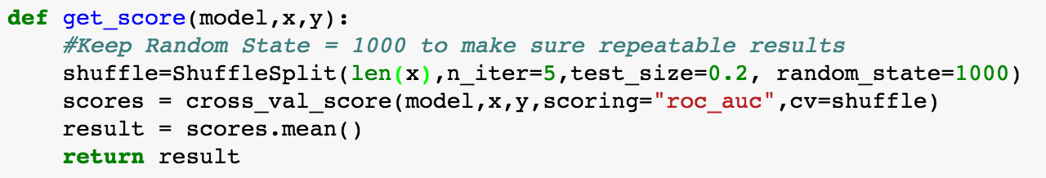
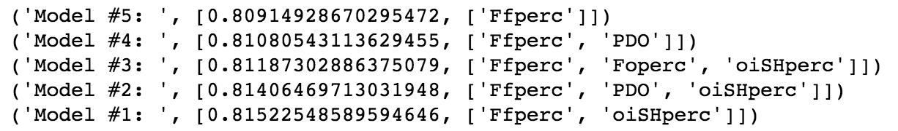
Cross Validation
Using Itertools models using every possible combination of features were created
Using a “Random Shuffle” each model was trained with 20% of samples and the best five feature sets were evaluated.
Results with non-statistically significant variables that did not improve Adj. R² were removed and the model with the best AUC curve and no collinearity was chosen.

Slide 13
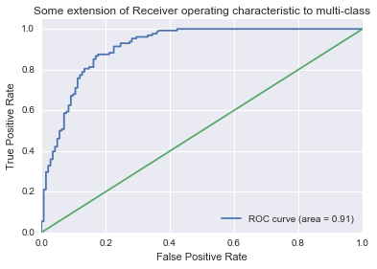
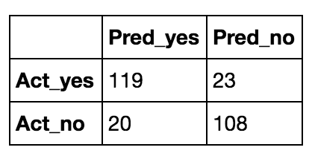
Logit Model
Confusion Matrix
Precision | 86%
Recall | 84%
Accuracy | 84%

Slide 14
Decision Tree

Slide 15
Results Retrospective
The results were better than I expected given the relatively small sample size.
The decision tree model is easier to understand, however it does not make a definite binary conclusion on the data.
The ROC Curve shows the better than average results compared with random chance.
Conclusion:
I can confirm that there are in fact “advanced statistics” can act as predictors for making the playoffs.
Fenwick and PDO are the best predictors.

Slide 16
Conclusions Using Current Season
Using this season’s statistics, my decision tree model is predicting that the following teams will make the playoffs.
Florida
Los Angeles
Nashville
Anaheim
Washington
San Jose
Pittsburgh
Dallas
Tampa Bay
Philadelphia
St. Louis
As of 3/28/16 the following teams are in playoff position. 11/16
EAST
Washington
New York Rangers
Pittsburgh
Florida
Tampa Bay
Boston
New York Islanders
Philadelphia
WEST
Dallas
St. Louis
Chicago
Los Angeles
Anaheim
San Jose
Nashville
Minnesota

Slide 17




Next Steps
Next Steps would be to utilize an even larger feature set to find the right balance between advanced stats and traditional statistics.
Instead of looking at total season statistics, use a set of individual game data to predict the outcome of the next game to be played and thus long term win/loss records
See what features are most important to predict player success or where player success and team success are correlated.
Publish report on web and seek response from community.

Slide 18
Appendix
All of the technical information, Jupyter Notebooks and datasets can be found on my GitHub:
https://github.com/themp731/Projects/tree/master/Final_Data

