Slide 1
PROJECT TITLE
SUBTITLE
NAMES(S)
Department of Mathematical and Computer Science
Fountain University, Department of Computer Science, 2025

Slide 2
Introduction
Nigeria’s admission age policy requires students to be at least 16 or 18 years old to enter higher institutions
The policy intends to promote better academic outcomes through maturity and readiness
However, there’s ongoing debate about whether age at admission truly affects academic performance
Key Question: Does age at admission influence students’ academic success?
Fountain University, Department of Computer Science, 2025

Slide 3
Objectives and Dataset Overview
🎯 Objectives of the Study
Examine the relationship between age group and academic performance
Assess students’ awareness and opinions on admission age policies
Explore how beliefs about age, cognition, maturity, and readiness relate to performance
📊 Dataset Overview
Source: Structured student questionnaire
Key Data Collected:
Bio-data (Gender, Institution, Age Group, Academic Level, Mode of Entry)
Academic performance (Degree Class)
Awareness of admission age policies
Opinions on performance, maturity, and readiness
📁 Final Dataset Summary
Total Responses: 453 complete records
Key Variables:
Demographics: Gender, Institution, Age Group, Level, Mode of Entry
Academic Performance: Degree Class
Policy Awareness: Awareness of 16-Year and New Admission Policies
Beliefs: On age and its effect on performance, maturity, readiness, and cognition
Fountain University, Department of Computer Science, 2025

Slide 4
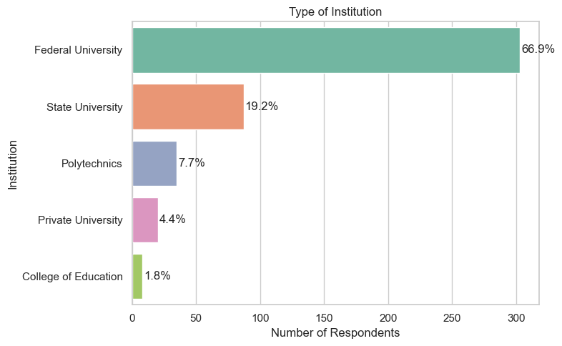
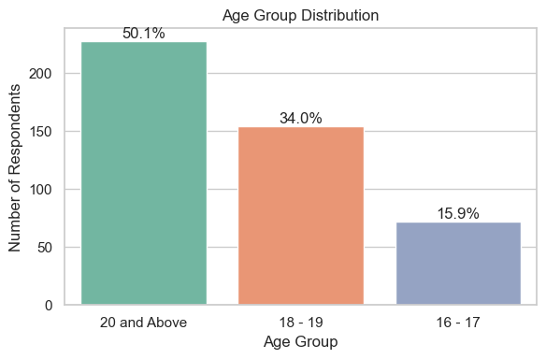
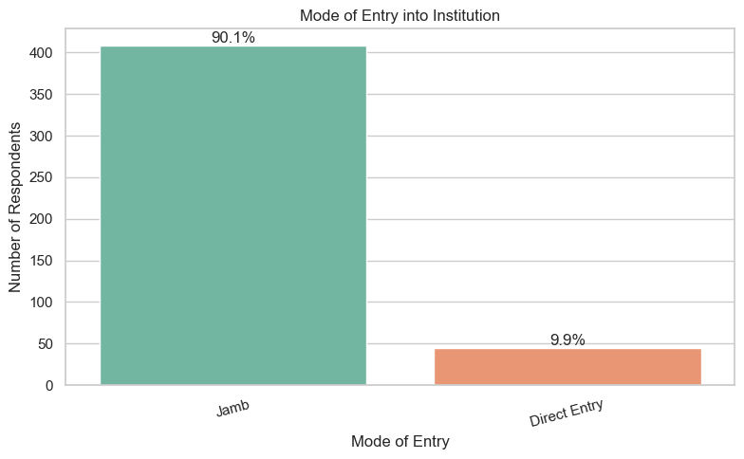
Demographic Breakdown
Type of Institution
Age Group Distribution
Mode of Entry
66.9% of respondents attend Federal Universities, indicating a federal-dominated sample.
50.1% are aged 20 and above, suggesting a more mature student population.
90.1% gained admission via JAMB (UTME), confirming mainstream entry patterns.
Fountain University, Department of Computer Science, 2025

Slide 5
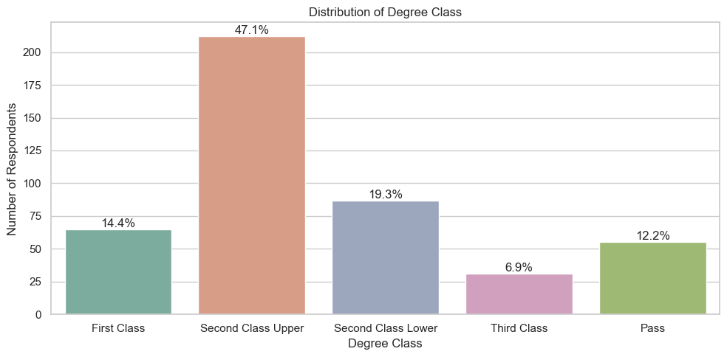
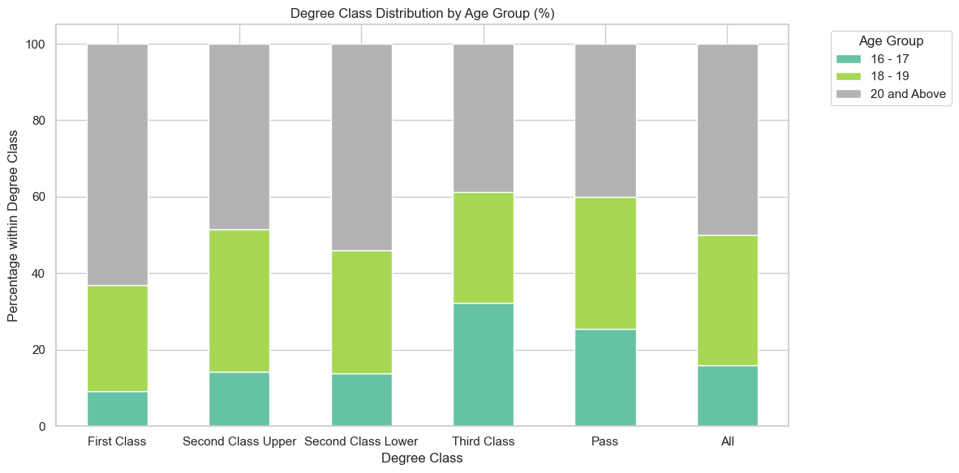
Academic Performance Insights
Degree Class by Age Group
Degree Class Distribution
47.1% of students earned Second Class Upper, showing generally strong academic outcomes.
Older students (20+) dominate the top tiers:
54% of Second Class Upper
48.6% of First Class
Fountain University, Department of Computer Science, 2025

Slide 6
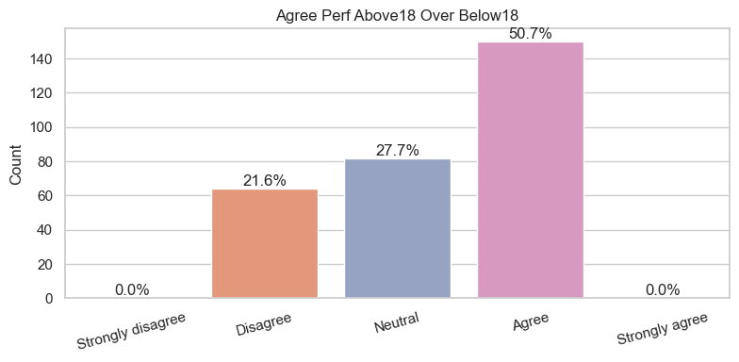
Policy Awareness & Beliefs
📌 Key Insights
94.5% are aware of the 16-Year Minimum Age Policy
66.4% also know about the New Admission Policy
65.6% support the idea of regulating admission age
🧭 Beliefs on Age Impact
59.8% believe age affects academic performance
70.4% believe it affects readiness
53.6% believe it affects maturity
⚖️ Opinions on Age & Cognition
42.2% agree cognition improves above 18
33.9% agree cognition is strong below 18
Views here are mixed — with many respondents staying neutral
🎯 Overall Perception
50.7% believe students admitted above 18 perform better than younger peers

Slide 7
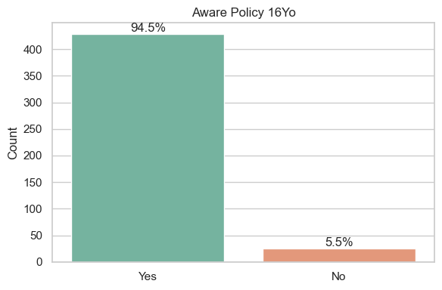
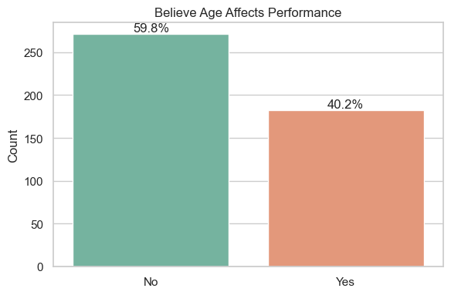
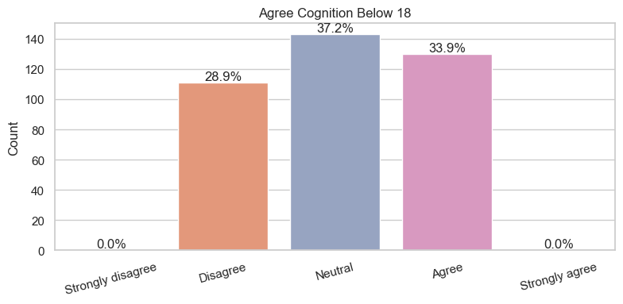
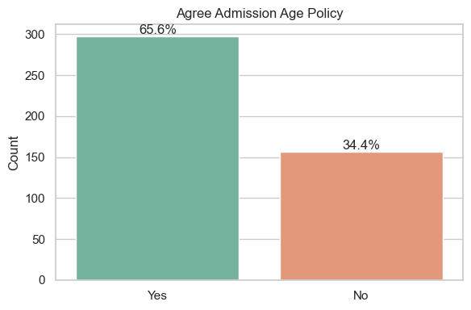
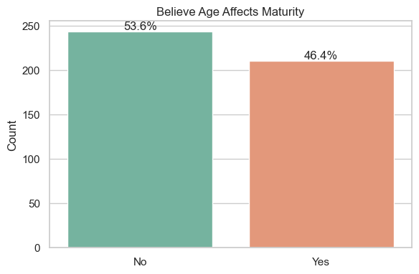
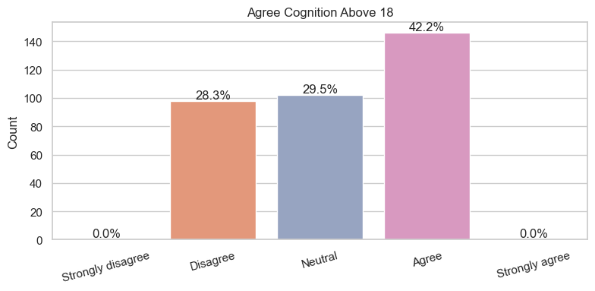

Slide 8
Statistical Testing & Findings
🧪 1. Chi-Square Test – Age Group vs Degree Class
Chi² = 16.993, df = 8, p = 0.0302
✅ Significant association
🔍 Insight: Older students (20+) are more likely to earn First Class or Second Class Upper.
📊 2. Other Chi-Square Tests (Policy/Belief vs Degree Class)
❌ No significant associations
Variables tested: Policy awareness, belief in age affecting performance, maturity, readiness, etc.
🔍 Insight: Beliefs and awareness don’t predict performance outcomes.
📌 Final Takeaway
Only age group shows a meaningful relationship with academic performance. Beliefs and awareness, while insightful, are not statistically linked to outcomes.
Fountain University, Department of Computer Science, 2025

Slide 9
Conclusion & Key Takeaways
🔧 What We Did
Collected and analyzed responses from students across various Nigerian tertiary institutions.
Explored how age, policy opinions, and academic level relate to degree outcomes.
Applied descriptive stats, bar charts, and statistical tests (Chi-square, Spearman correlation).
🔍 What We Found
Older students (20+) consistently performed better, especially in First & Second Class Upper.
94.5% were aware of the old admission age policy; 65.6% supported it.
Many believe age affects readiness (70.4%), performance (59.8%), and maturity (53.6%).
Chi-square test: Age group significantly affects degree class (p = 0.0302).
🧠 Final Takeaways
Age matters — older students show better academic outcomes.
Policy awareness alone doesn’t impact grades — success likely depends more on individual readiness, not just age or opinions.
Fountain University, Department of Computer Science, 2025

Slide 10
Thank You / Questions & Discussion
Fountain University, Department of Computer Science, 2025

