Slide 1
Per-head orderings and OR amplification
Letting every attention head see a different arrangement of the same event — and why the way you implement it is worth 11x
ColliderML tracking · hepattn · OR-amplification branch

Slide 2
The problem in one slide
A pixel event has ~100,000 hits. Full attention is N² ≈ 10¹⁰ per layer.
So we let each hit attend only to a window of ~512 neighbours — a ~200x saving.
But attention operates on a 1-D list, and "nearby in the list" is not "nearby in the detector".
Ordering (serialization) is what makes those two things mean the same thing.
And no single ordering can keep every track intact.
Everything in this talk is downstream of that last line.
2

Slide 3
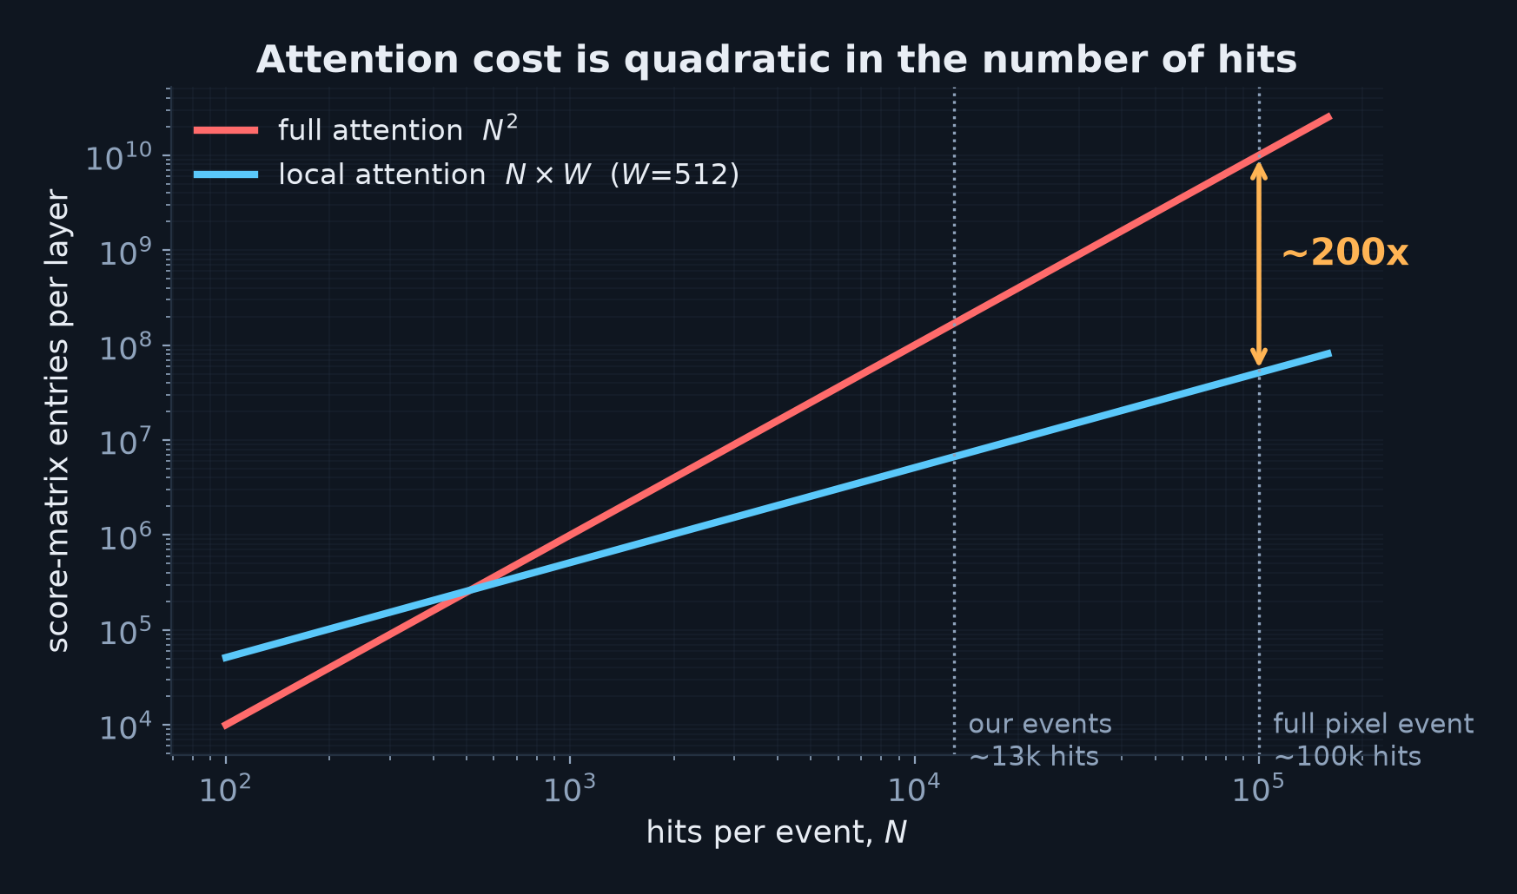
Why we cannot afford full attention
Local attention is not an optimisation — it is the only way this runs at all
3

Slide 4
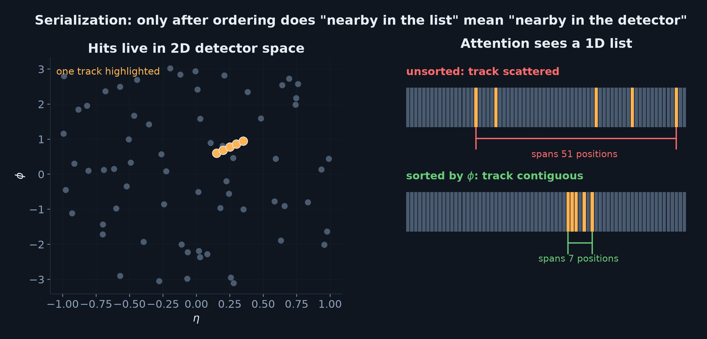
Serialization: flattening the detector onto a line
Sorting is what gives "my neighbours in the list" any physical meaning
4

Slide 5
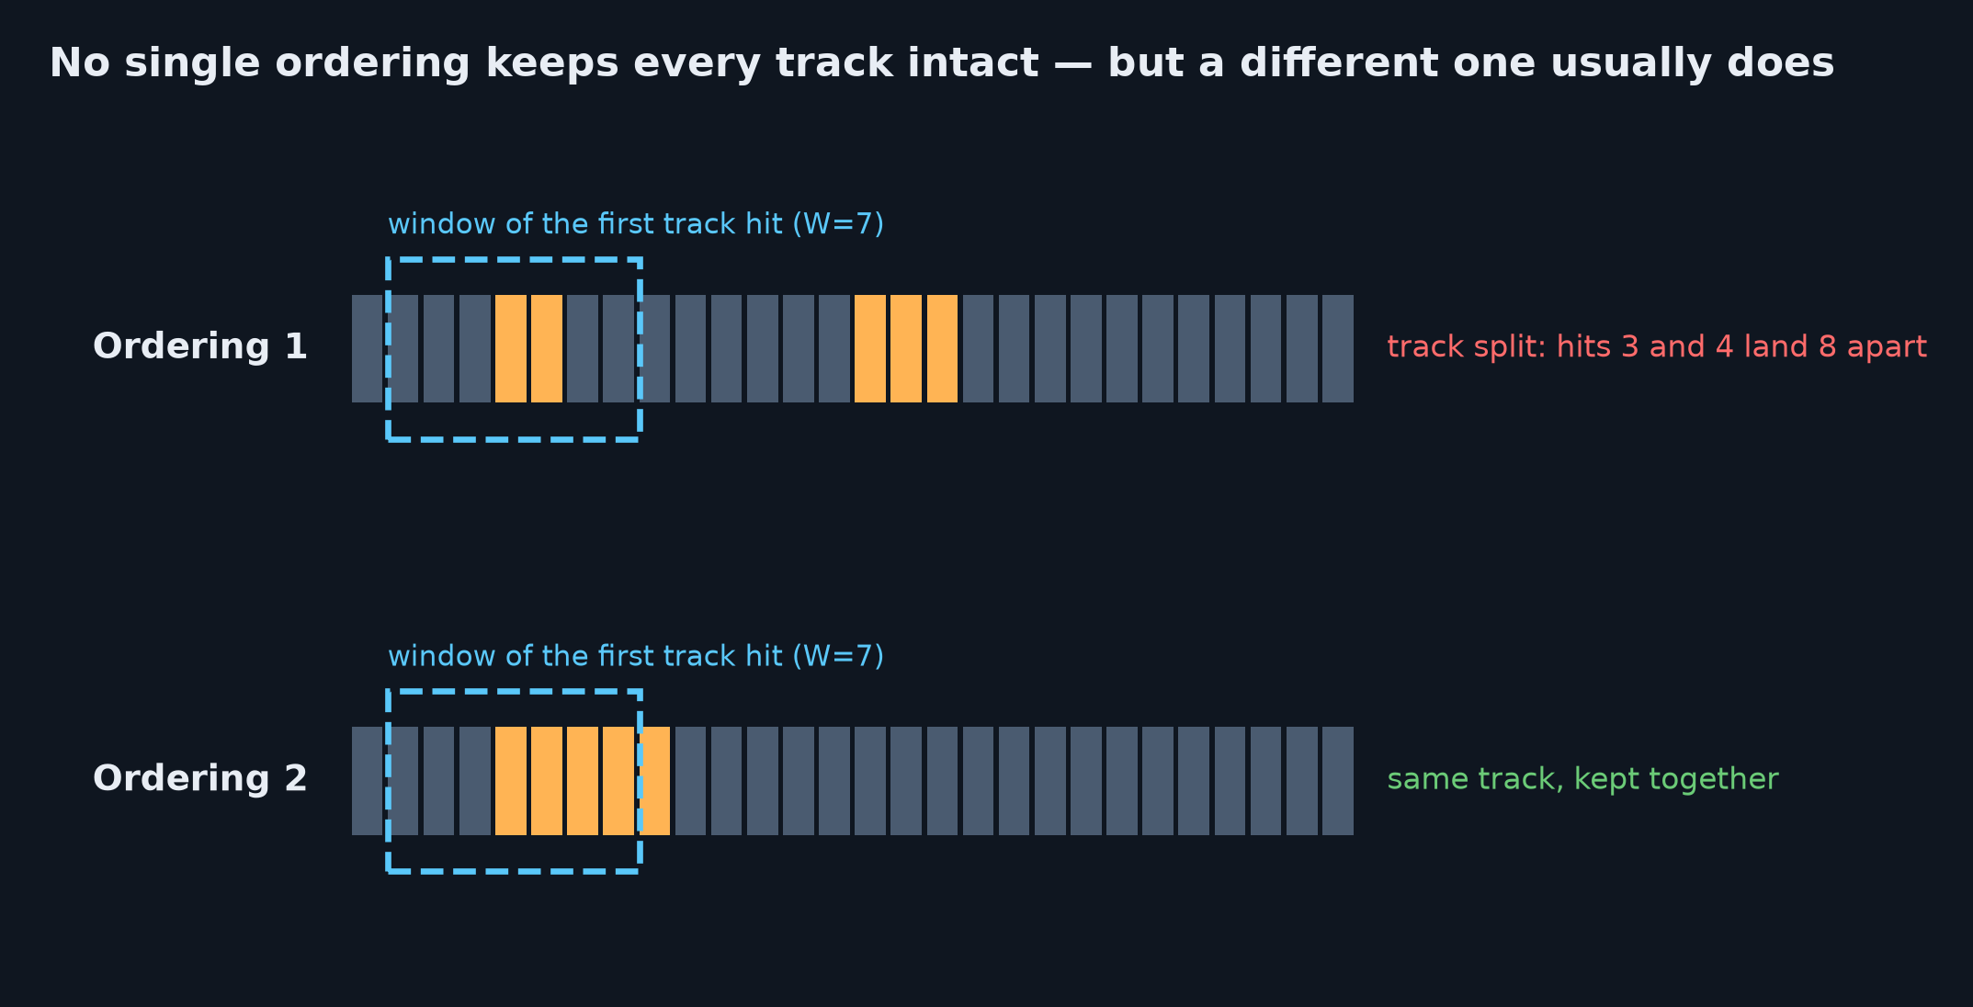
The catch: every ordering cuts somewhere
• 2-D geometry cannot be flattened to 1-D without cuts — this is structural, not a tuning problem
• A track split by one ordering is usually kept whole by a different one
• So give each head several orderings and combine them. That is OR amplification.
5

Slide 6
BACKGROUND
Which local-attention pattern, and why it matters
6

Slide 7
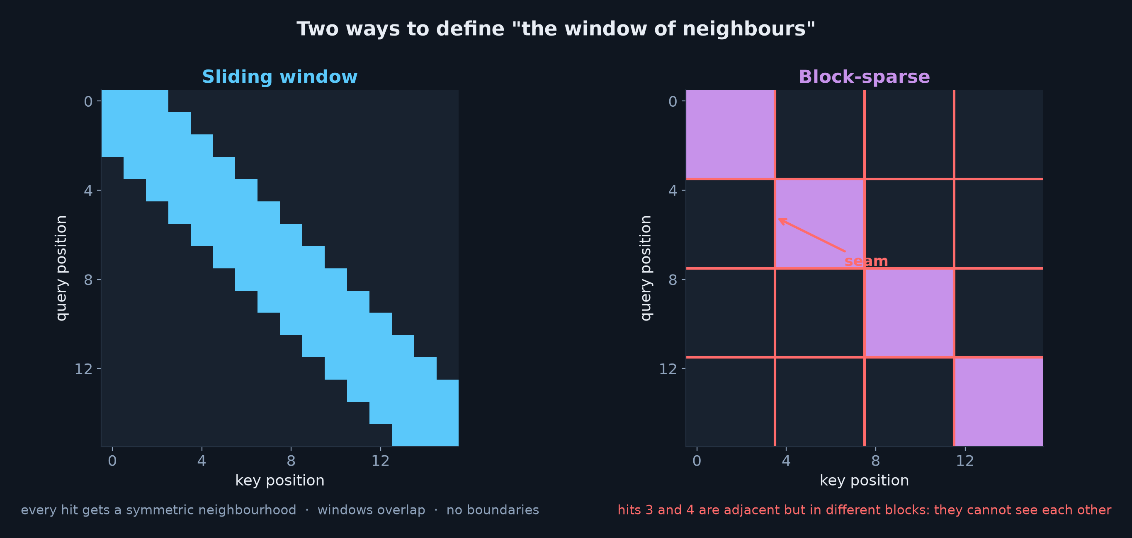
Two ways to define "the window of neighbours"
• Sliding window: symmetric, overlapping, no boundaries — but windows do not tile, so it needs a mask
• Block-sparse: fixed blocks, dense inside each, no mask at all — but it introduces seams
• HEPTv2 is block-sparse — code-confirmed: no mask argument anywhere in its encoder
7

Slide 8
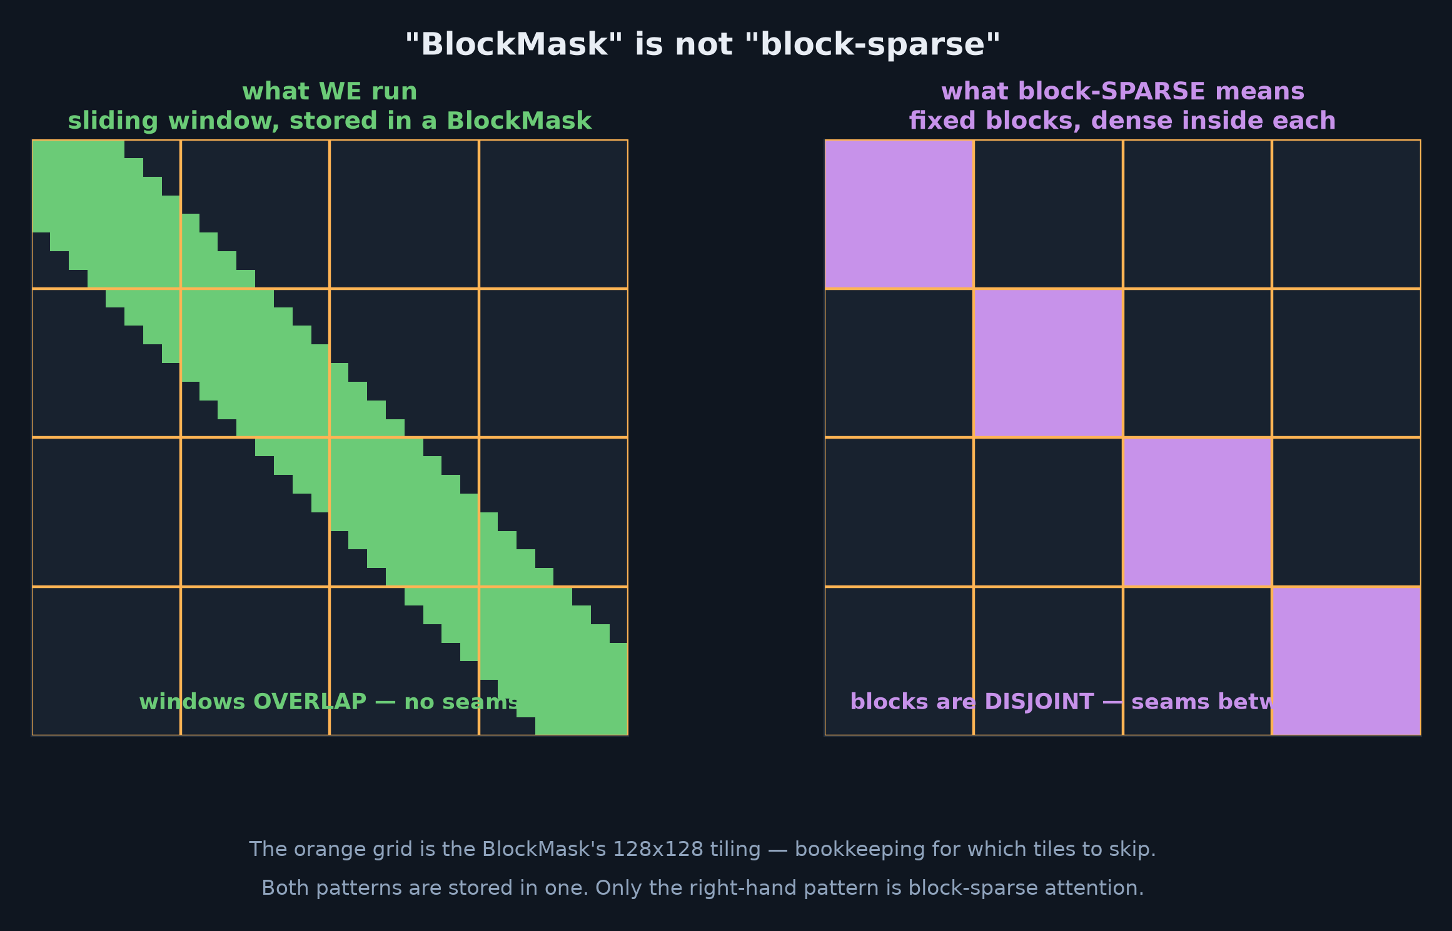
"BlockMask" is not "block-sparse"
• BlockMask is a PyTorch data structure: which 128x128 tiles hold any admitted pair
• Block-sparse is an attention PATTERN: fixed disjoint blocks, dense inside each
• We store a sliding window in a BlockMask — the structure, not the pattern
8

Slide 9
Sliding window vs block-sparse: which for us?
Block-sparse
Sliding window
• Hard seams every block_size tokens
• A track straddling a seam loses its other half at that layer
• Edge hits see companions on one side only
• But: gather → reshape → dense, no mask. Perfect kernel utilisation.
• No seams — every hit gets a symmetric neighbourhood
• Preserves more track locality per unit of compute
• Requires a real mask (flex mask_mod + BlockMask)
• Chosen: it is what our encoder and benchmarks are already built around
Key insight: block-sparse is not better in the abstract — it becomes SAFE once OR amplification exists to repair its seams. HEPTv2's two choices are a matched pair, not independent.
9

Slide 10
THE MECHANISM
How several orderings become one answer
10

Slide 11
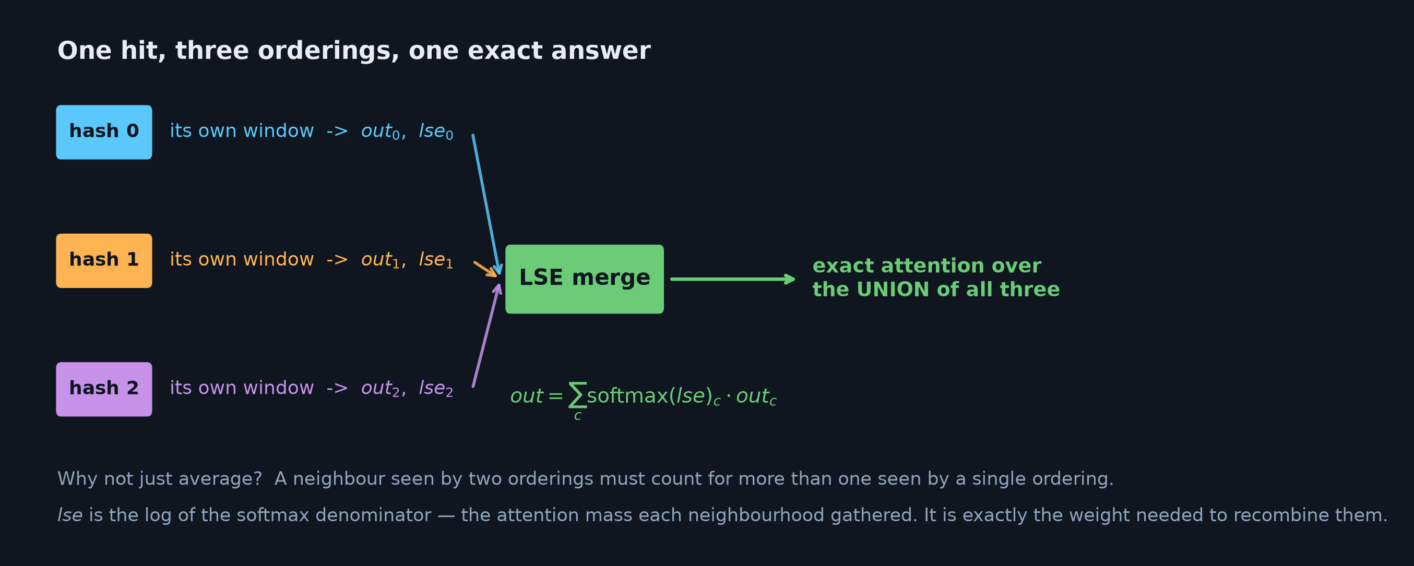
OR amplification: the log-sum-exp merge
• You cannot just average — a neighbour found by two orderings must count more than one found by one
• lse is the attention mass each neighbourhood gathered: exactly the right weight
• The result is mathematically EXACT attention over the union of all the neighbourhoods
11

Slide 12
Two axes that are easy to confuse
c = n_hashes different LSH orderings → merged by LSE, inside each head
buys: OR amplification, i.e. recall
h = num_heads different learned subspaces → concat + out_proj
buys: ordinary multi-head capacity
Head-mixing is NOT OR. OR is the LSE merge.
You cannot fake this with a cleverer global sort: one list gives each hit exactly one set of
neighbours. Multi-ordering must live INSIDE the attention layer.
12

Slide 13
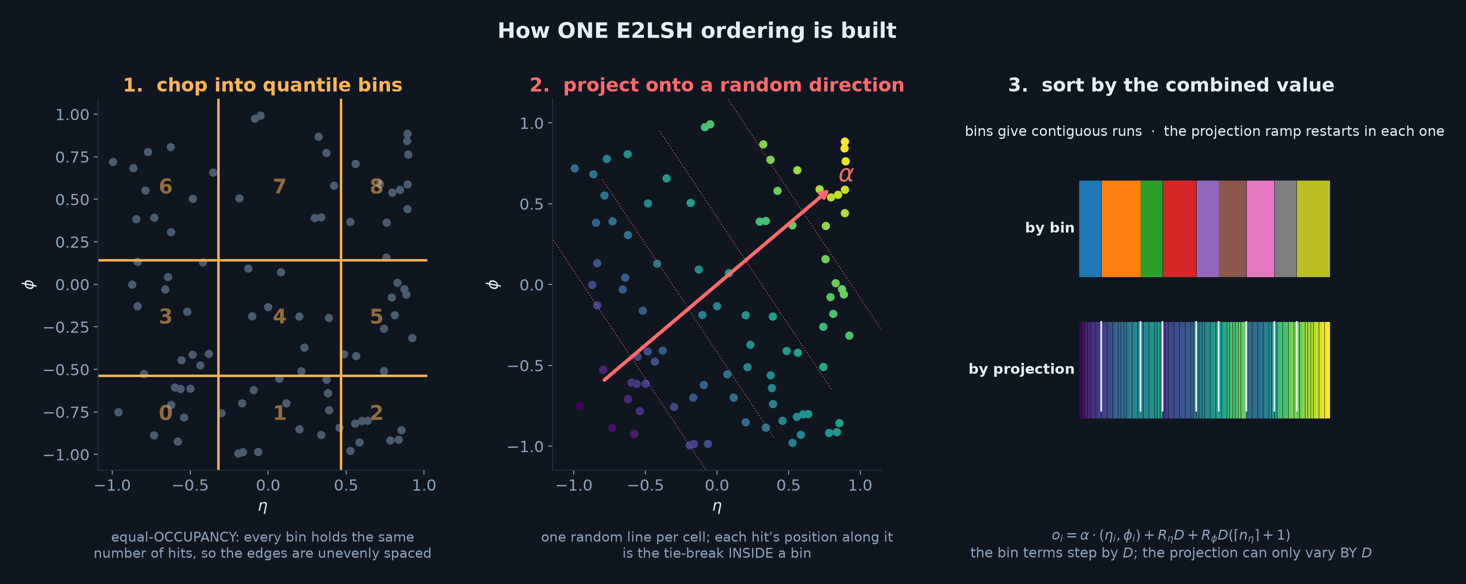
How one ordering is actually built
• Equal-OCCUPANCY quantile bins in eta and phi — each bin holds the same number of hits
• Plus a random projection direction, which breaks ties INSIDE a bin
• Bin terms step by D, the projection can only vary by D — so bins are coarse, projection fine
13

Slide 14
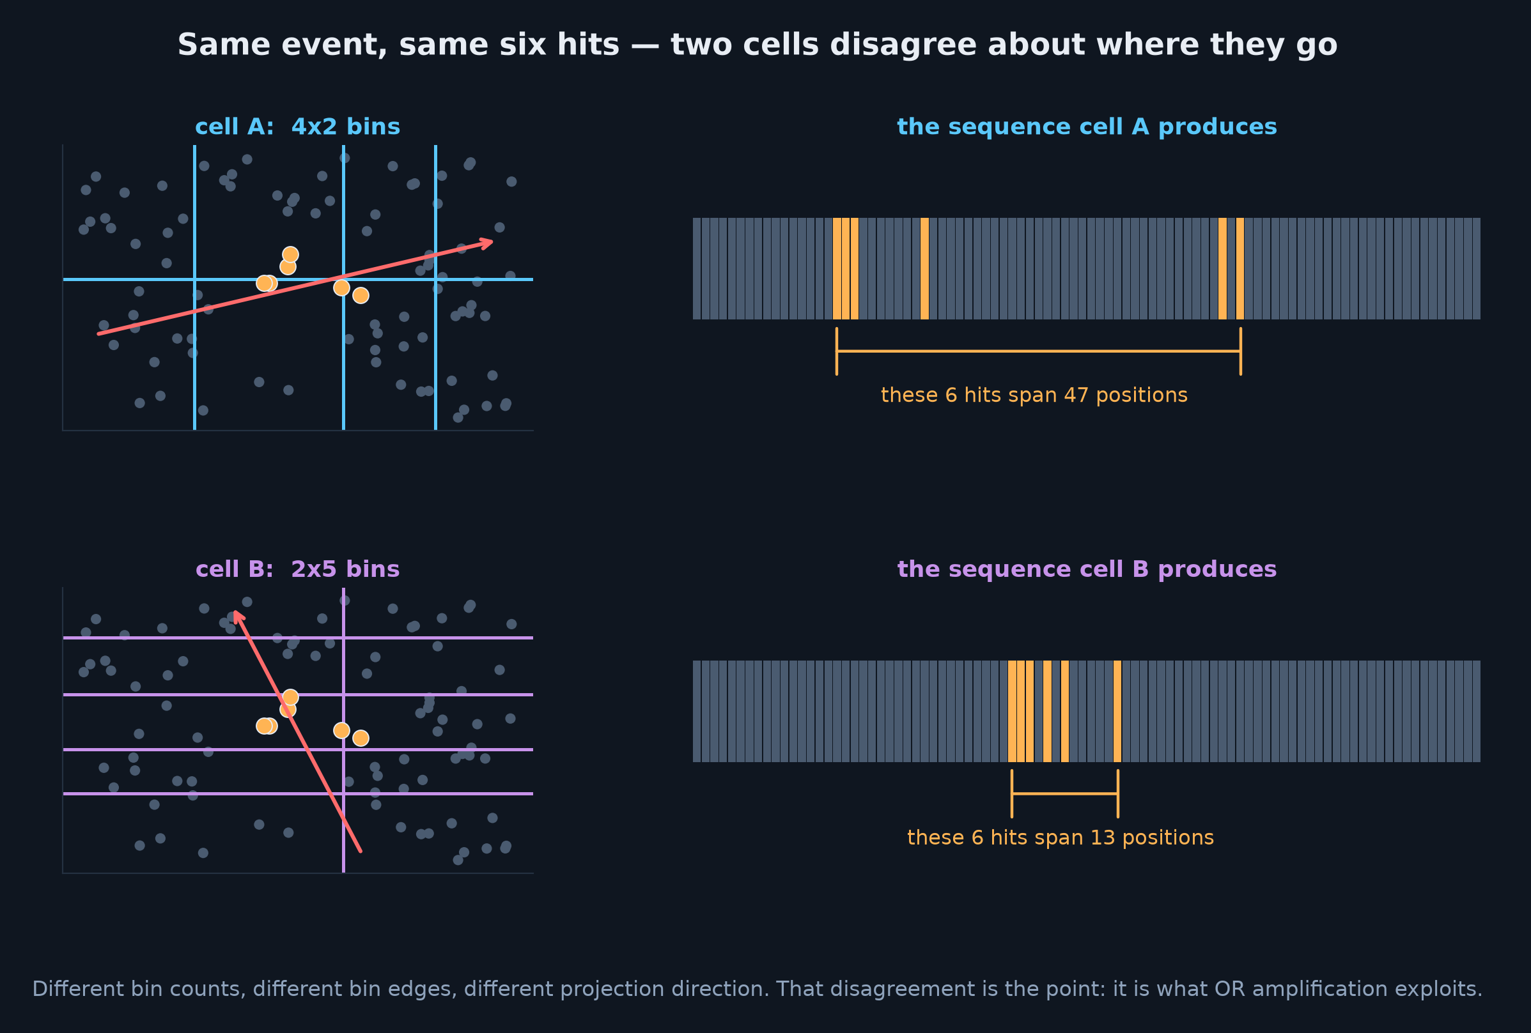
Why two cells disagree
• Each cell draws its own bin counts, its own bin edges, and its own projection direction
• The same six hits end up spanning very different stretches of the sequence
• That disagreement is not a defect — it is exactly what OR amplification exploits
14

Slide 15
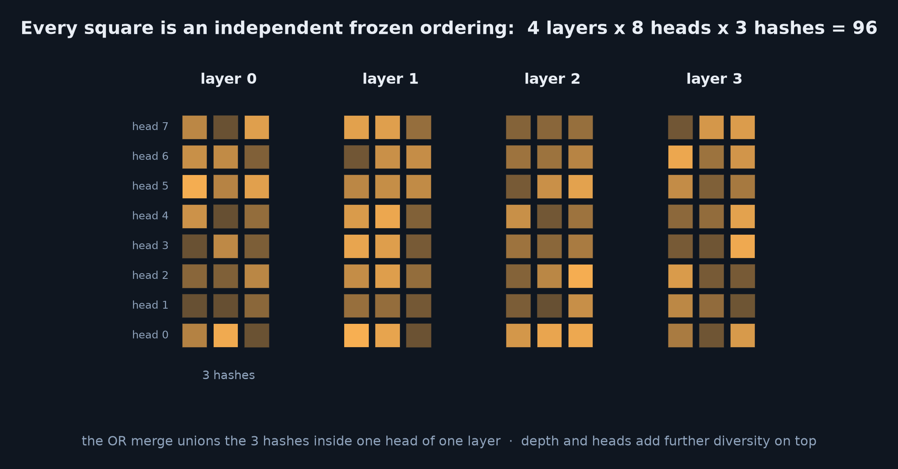
Where the diversity comes from
• Each (layer, head, hash) cell draws its own random projection and quantile grid
• Frozen at construction — the same event always serialises the same way, so inference is reproducible
• The RULE is frozen, not the order: different events still give different permutations
15

Slide 16
IMPLEMENTATION
Two ways to build it — and they are not equal
16

Slide 17
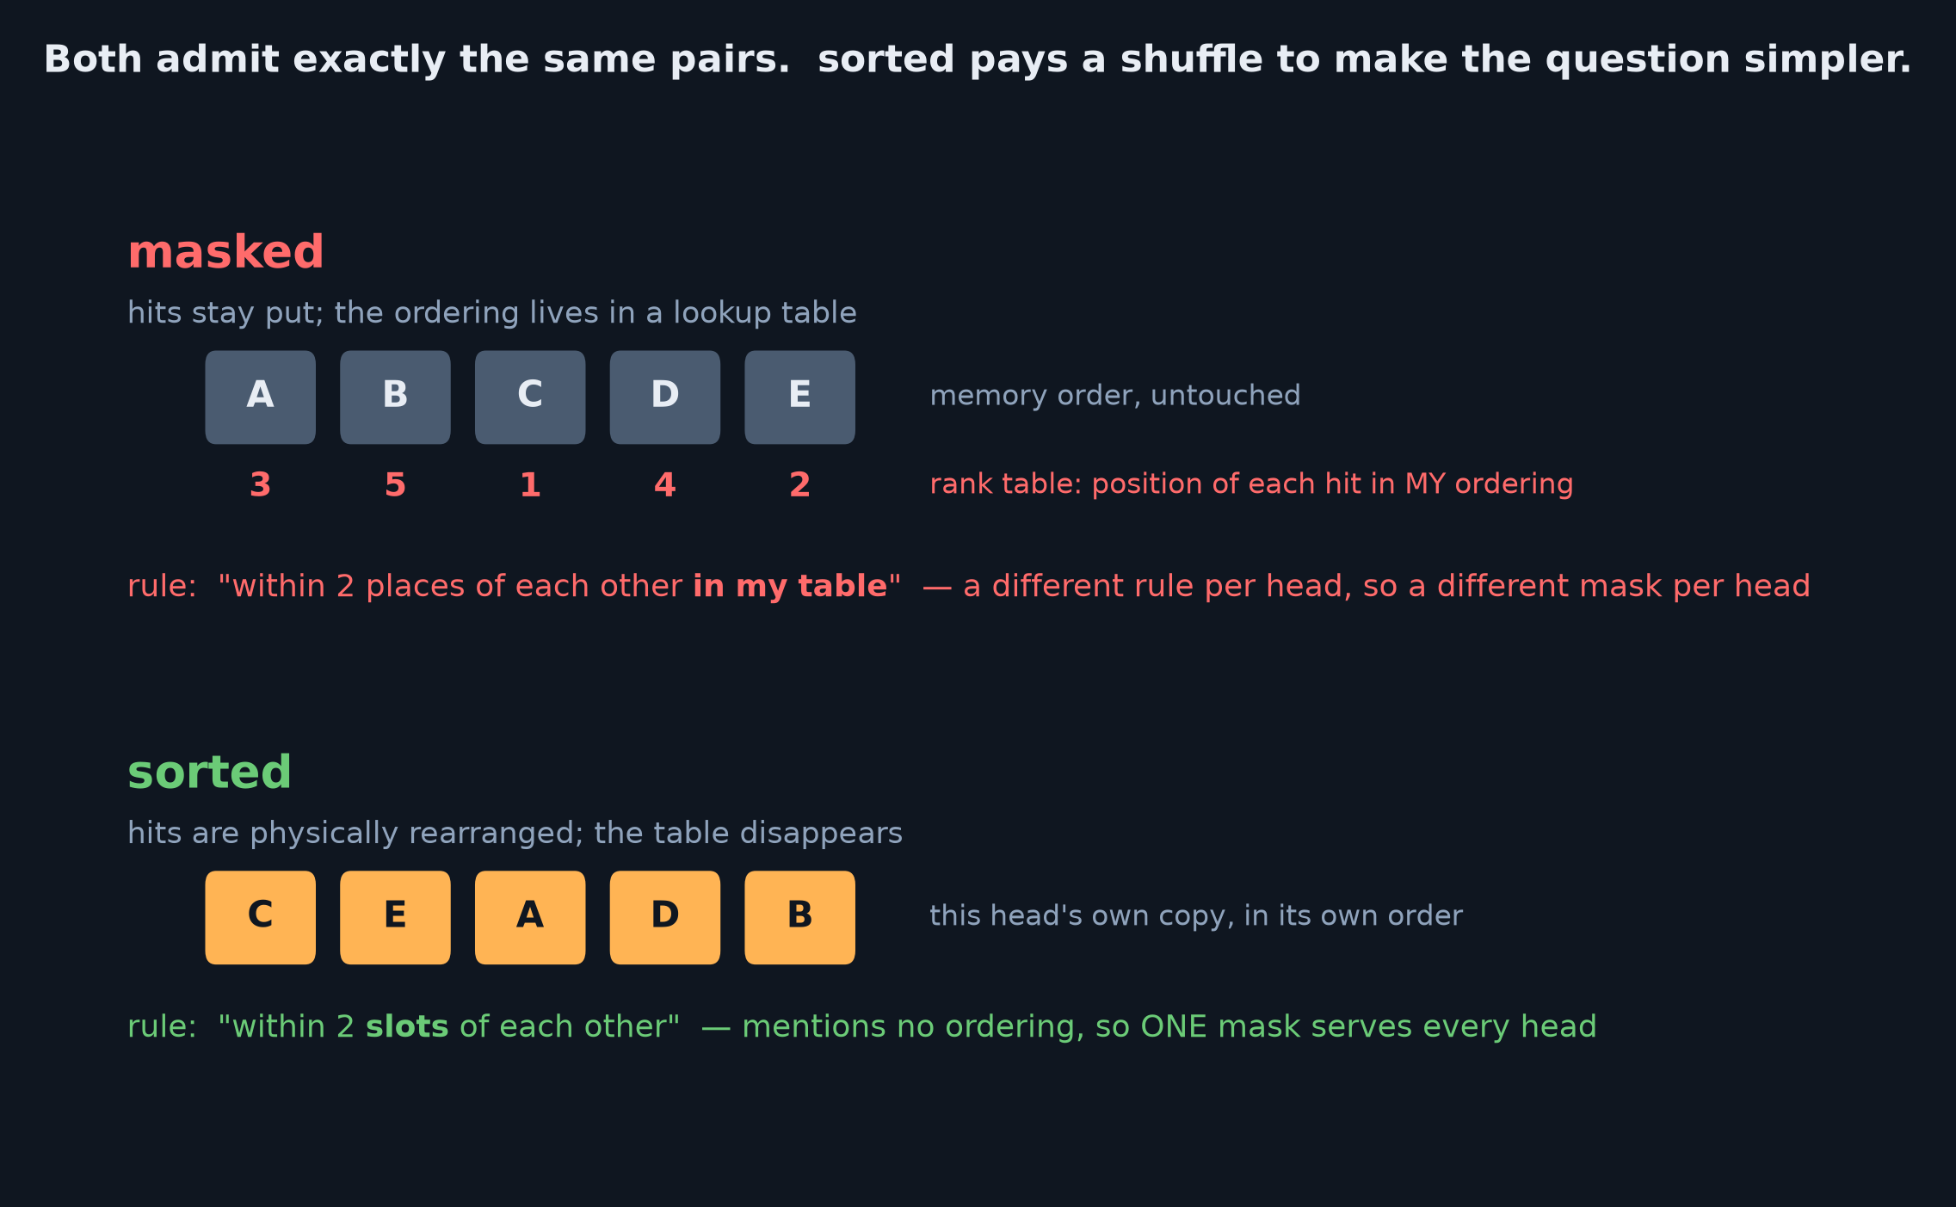
masked vs sorted: same pairs, different question
• masked — leave the hits, put the ordering in a lookup table. Every head needs its OWN mask.
• sorted — rearrange the hits, and the rule stops mentioning any ordering. ONE mask for all 24 cells.
• Both compute bit-for-bit identical output. A test asserts it.
17

Slide 18
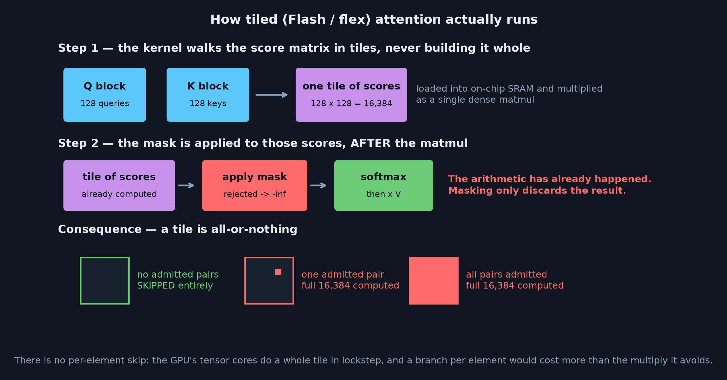
Background: how tiled attention actually runs
• Flash and flex never build the full N x N matrix — they walk it in tiles sized for on-chip SRAM
• The mask is applied to the scores AFTER the tile's matmul: masking discards, it does not save
• So a tile is all-or-nothing — skipped entirely, or paid for in full
18

Slide 19
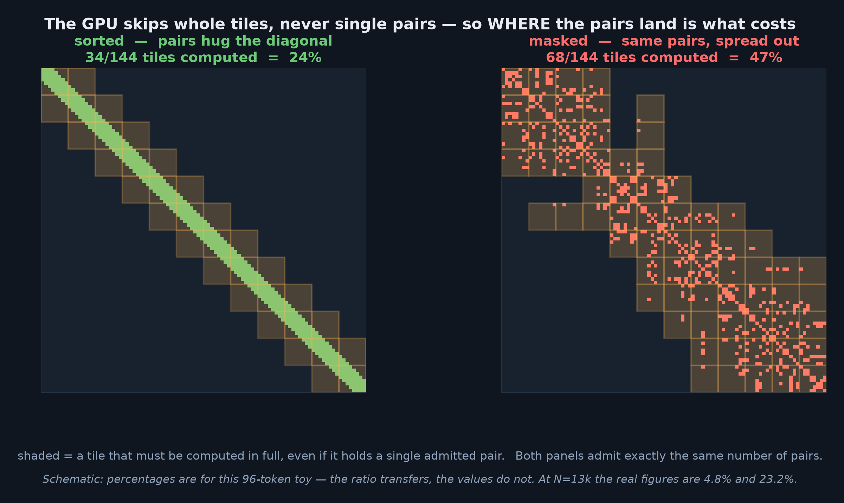
Why that matters: the GPU skips tiles, not pairs
• Same number of admitted pairs in both panels — only their POSITION relative to the tile grid differs
• Schematic at 96 tokens; on real events the measured figures are 4.8% and 23.2% of tiles
19

Slide 20
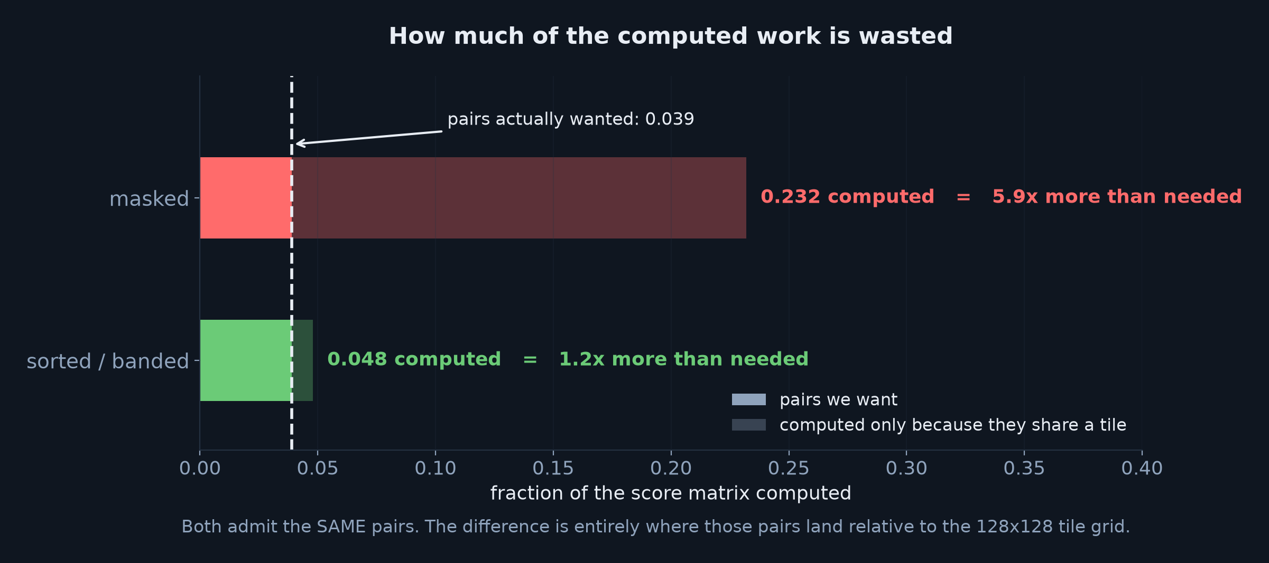
How much of that computed work is wasted
• Only 3.9% of the score matrix is genuinely wanted — and that is identical for every ordering
• sorted computes 1.2x more than needed; masked computes 5.9x more
20

Slide 21
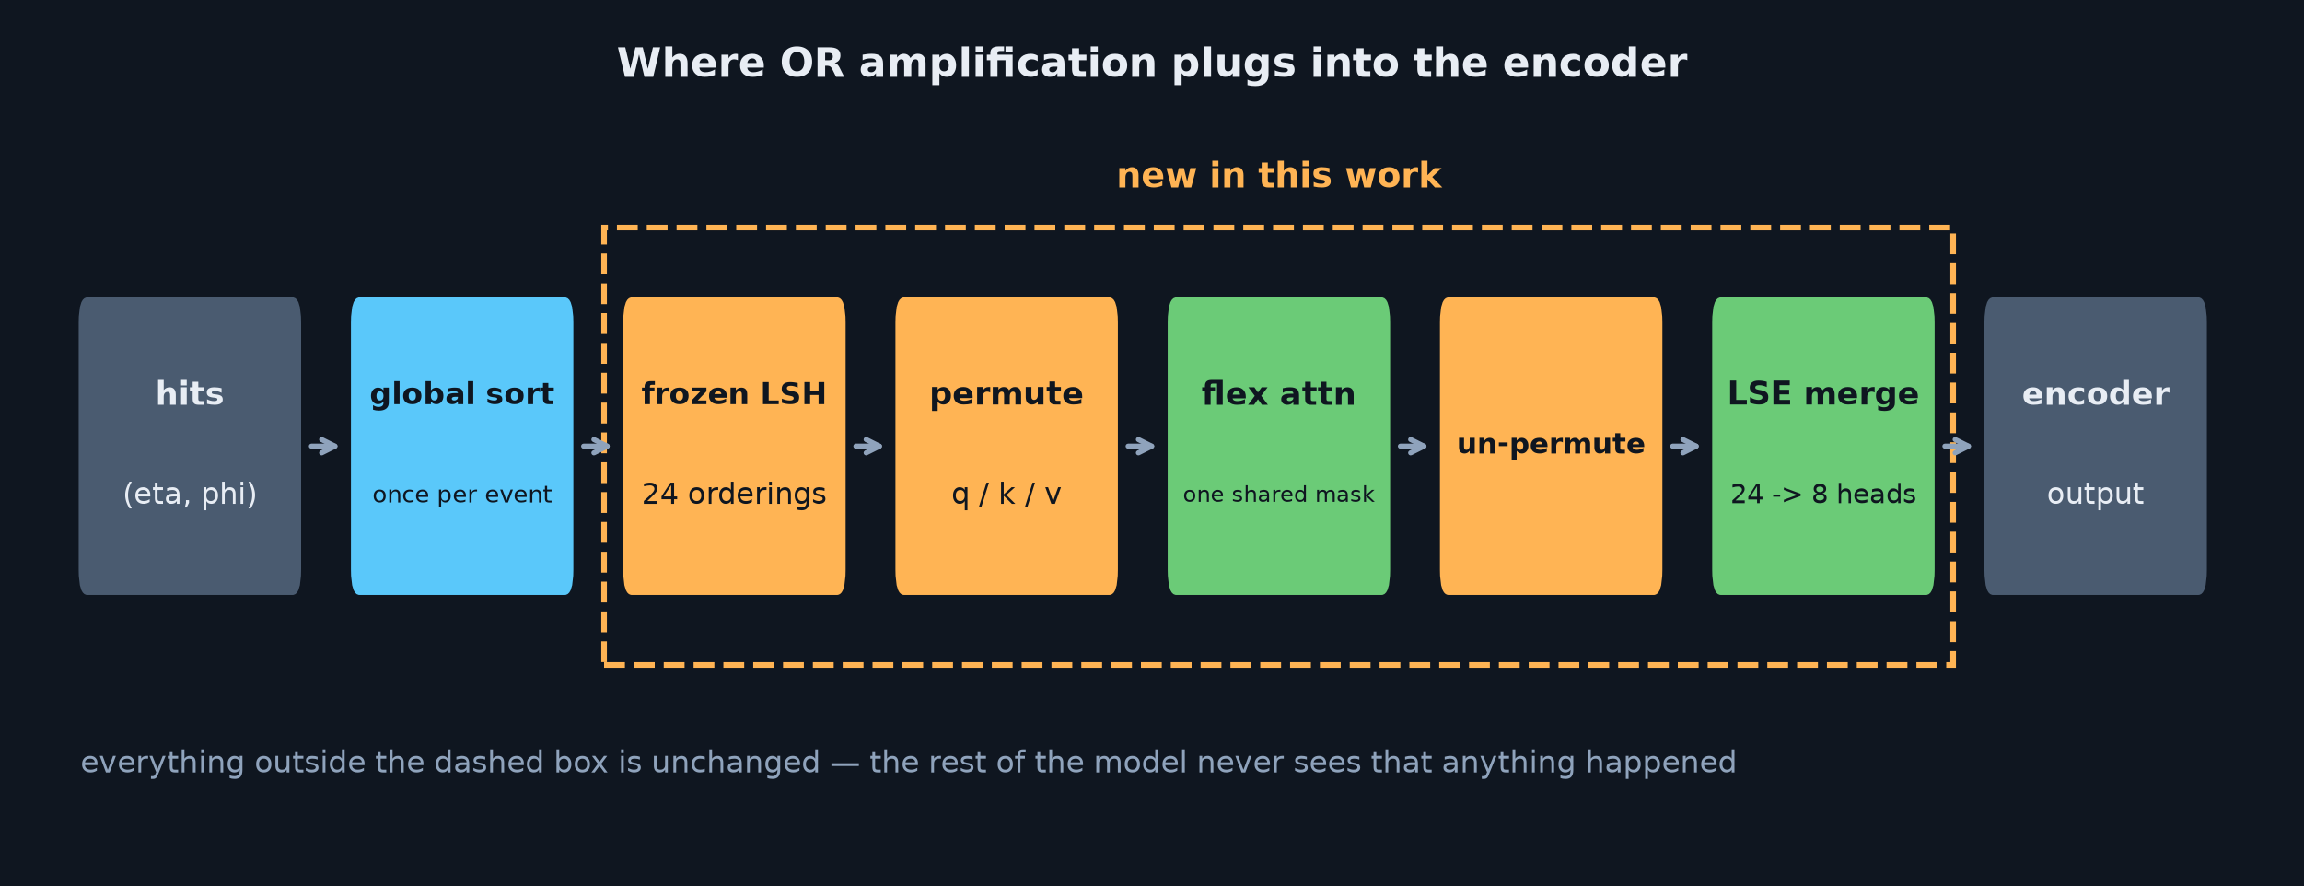
Where it plugs into the encoder
• Coordinates must be permuted alongside the tokens — the subtlest bug in the whole feature
• Padding sorts to the tail of every ordering, so one shared mask can still exclude it
21

Slide 22
RESULTS
What we measured
22

Slide 23
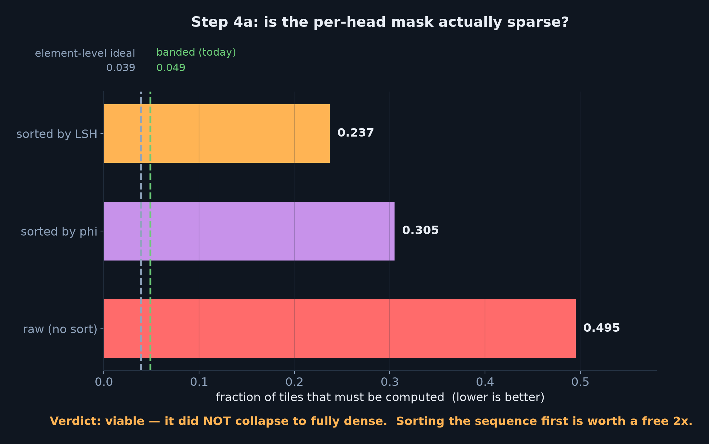
Step 4a — the go/no-go: is the mask actually sparse?
• Worry: 24 different orderings over one layout could make every tile non-empty (density 1.0)
• It did not — LSH orderings sort the same geometry, so they stay correlated
• How you lay the sequence out matters as much as the orderings do
23

Slide 24
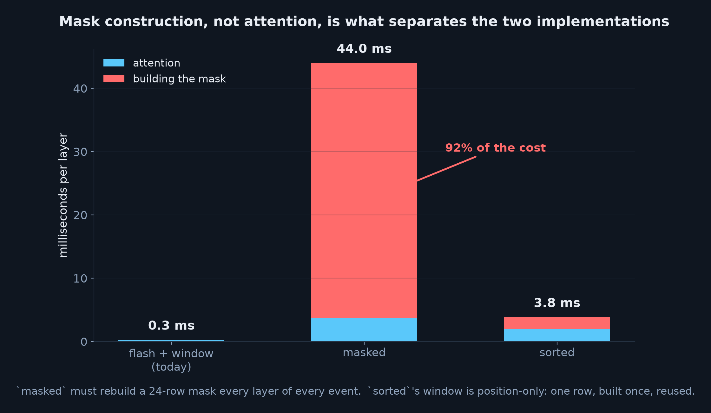
Where the time actually goes
• masked must rebuild a 24-row mask every layer of every event — its rule depends on the event
• sorted's window is position-only: one row, built once, reused across layers and events
24

Slide 25
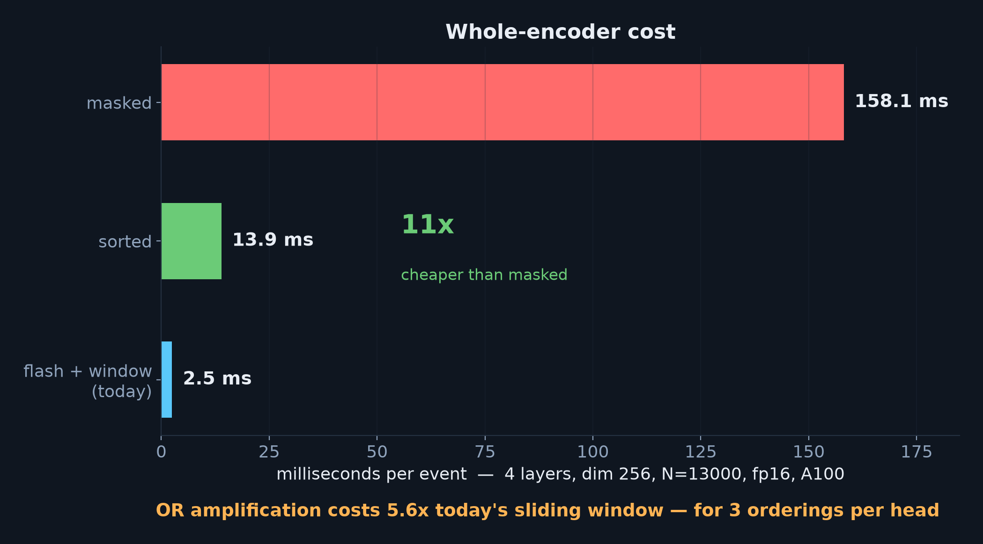
The headline numbers
• sorted is 11x cheaper than masked, for identical output — this decided the design
• vs today's sliding window: 5.6x for the encoder, but only 1.44x per training step
• (attention is a smaller share of the full model than the isolated benchmark suggests)
25

Slide 26
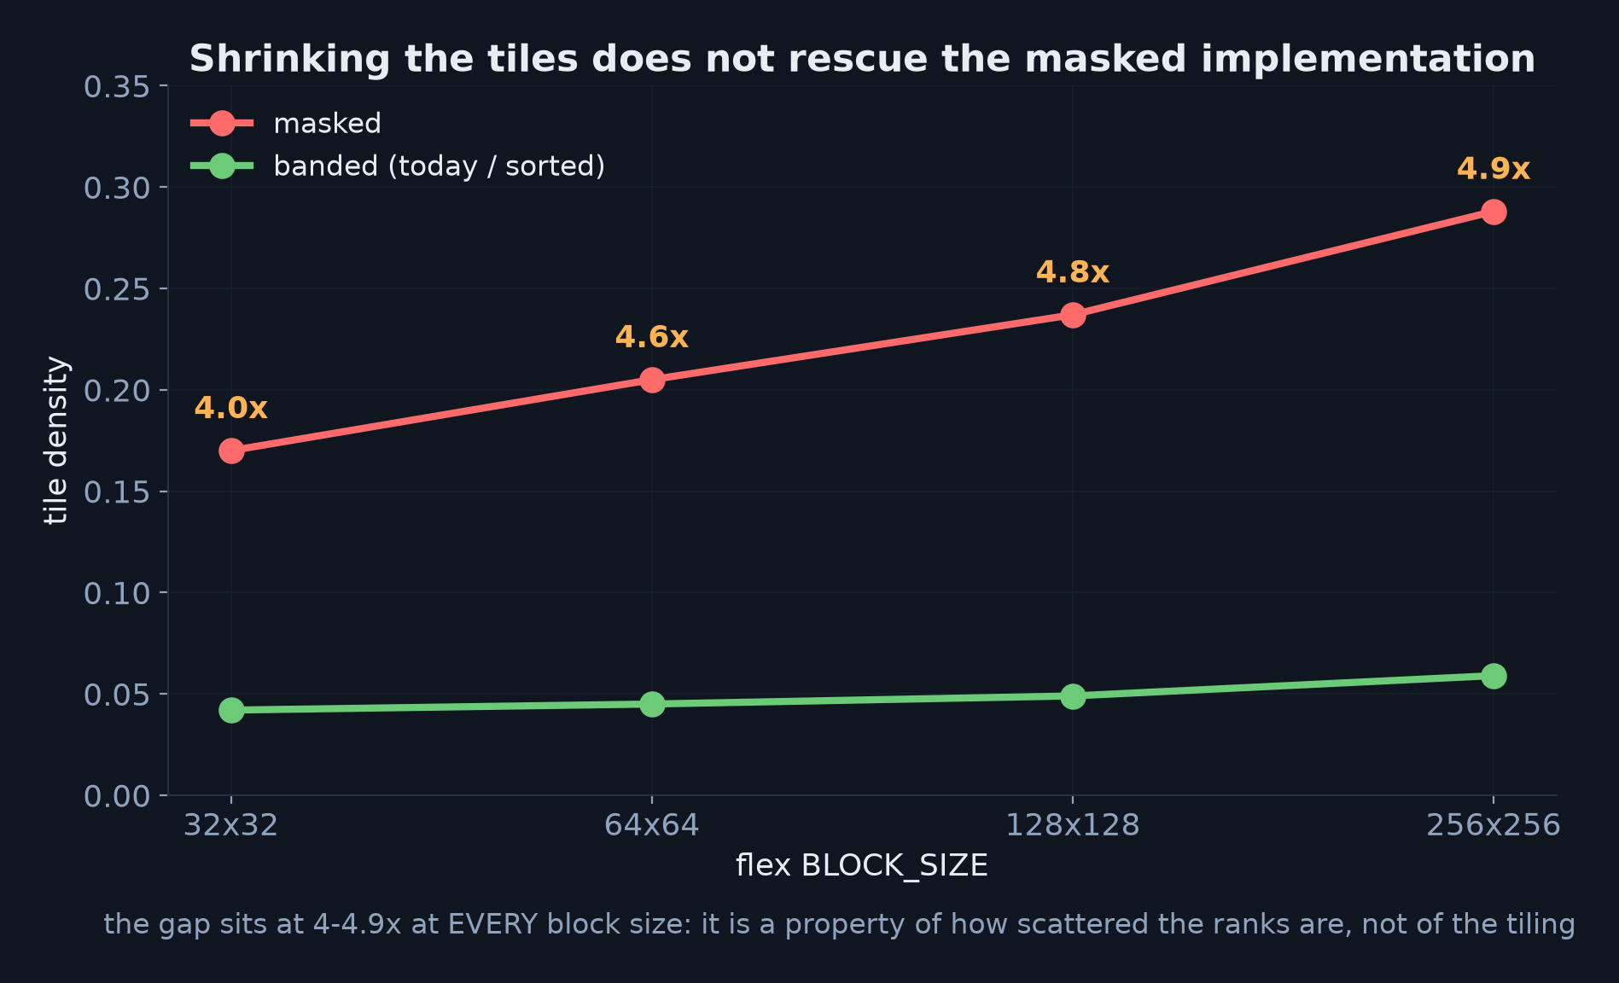
Tiling cannot rescue the masked implementation
The gap is a property of how scattered the ranks are, not of the tile size
26

Slide 27
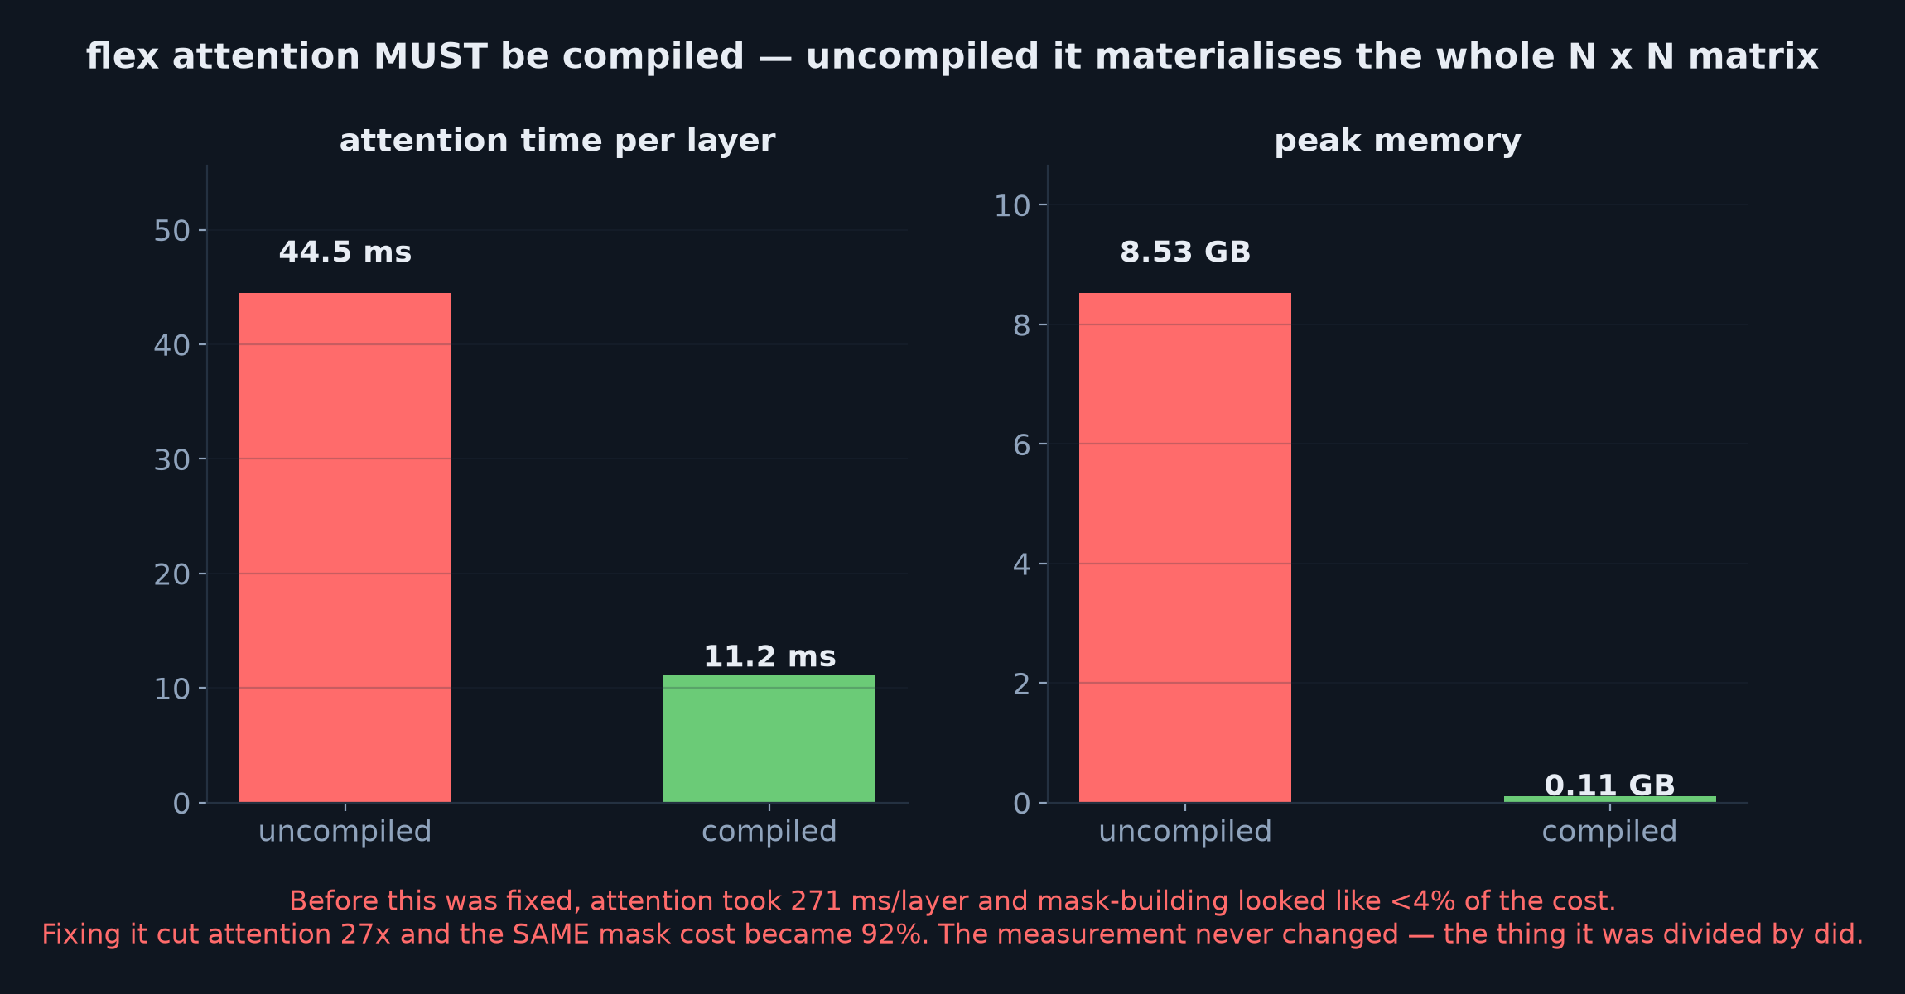
A methodology warning worth your time
• This flipped a conclusion: mask-building went from "<4% of the cost" to "92% of the cost"
• Nothing about the mask changed — only what it was being divided by
27

Slide 28
CORRECTNESS
How we know it is right
28

Slide 29
Testing strategy: degenerate cases with known answers
1. One hash + identity ordering MUST reproduce the plain sliding window, exactly.
Collapses the new path onto an old, trusted one.
2. Give ONLY head 0 the identity ordering — catches head-major vs hash-major flattening,
which the single-hash test structurally cannot see.
3. sorted and masked must agree — this is what makes changing the default safe.
4. Padding must not change the answer for real hits.
Every test was checked by reintroducing the bug and confirming it goes red.
Bugs found this way: a fp16 dtype mismatch that would have crashed the first real forward pass, and a cached mask reusing the first event's padding.
29

Slide 30
Bugs found along the way — all silent
Coordinates not permuted with their tokens → every ordering describes hits that have moved
OR merge returned float32 into a half-precision layer → would have crashed the first real step
Cached mask captured the first event's padding → every later event masked wrongly
set_backend silently dropped the sliding window → benchmarks against an unwindowed baseline
flex attention ran uncompiled everywhere → 27x slower, and it inverted a design conclusion
None of these raise. All were found by testing against a known answer, or by running at realistic size and precision.
30

Slide 31
STATUS
Where we are, and the open question
31

Slide 32
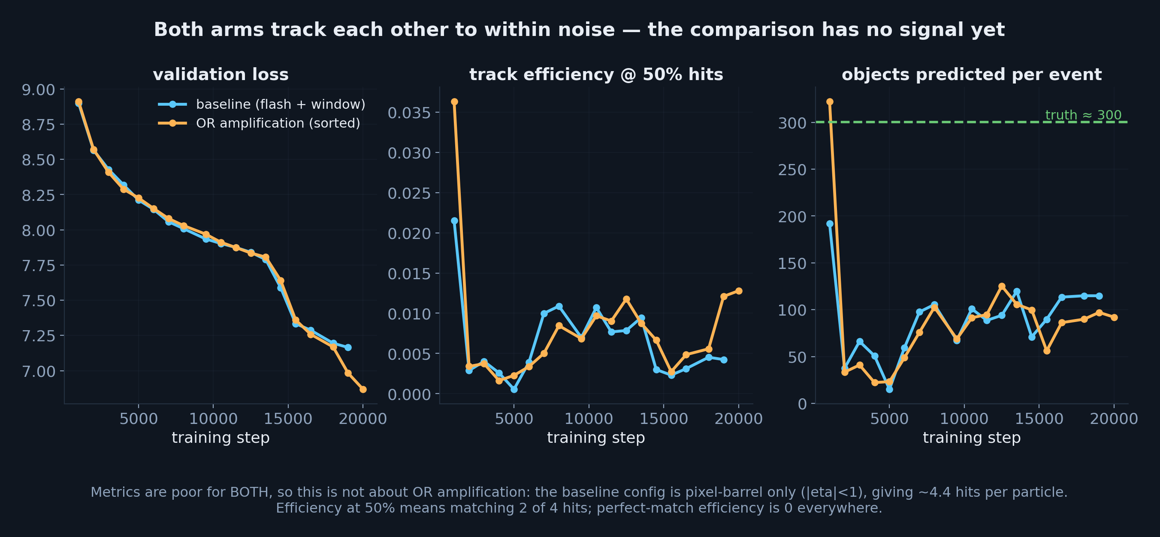
Training comparison — in flight
• Both arms are indistinguishable, so this says nothing about OR amplification YET
• Metrics are poor for both: the config is pixel-barrel only, ~4.4 hits per particle
• Next: fix the baseline setup before the A/B can mean anything
32

Slide 33
Status and what is next
Done: frozen ordering grid · OR axis + LSE merge · per-head mask · encoder and MaskFormer wiring
padding · 452 tests passing · benchmarked · audited
Default is or_impl="sorted"; masked stays as the reference implementation for benchmarking.
The open question is not engineering:
Does OR amplification earn its cost? That needs a training run on a config whose
baseline actually reconstructs tracks — and ideally two seeds per arm, because a
single-seed A/B cannot separate a real effect from noise.
Nothing measured so far shows the feature HELPS — only that it is correct and what it costs.
33

