Slide 1
OR Amplification vs Baseline
Fixing the ColliderML setup, choosing what to reproduce on TrackML, and various fixes
TrackML · ColliderML · hepattn · work since the OR-amplification talk

Slide 2
Where we left off
OR amplification is built, tested and benchmarked: about 1.44x per training step.
But the A/B comparison said nothing — both arms trained equally badly.​
Plan: fix the ColliderML baseline at 0 PU,
and in parallel reproduce a published TrackML baseline to test OR against.
​
Goal: the OR encoder with UCL's MaskFormer decoders.
2

Slide 3
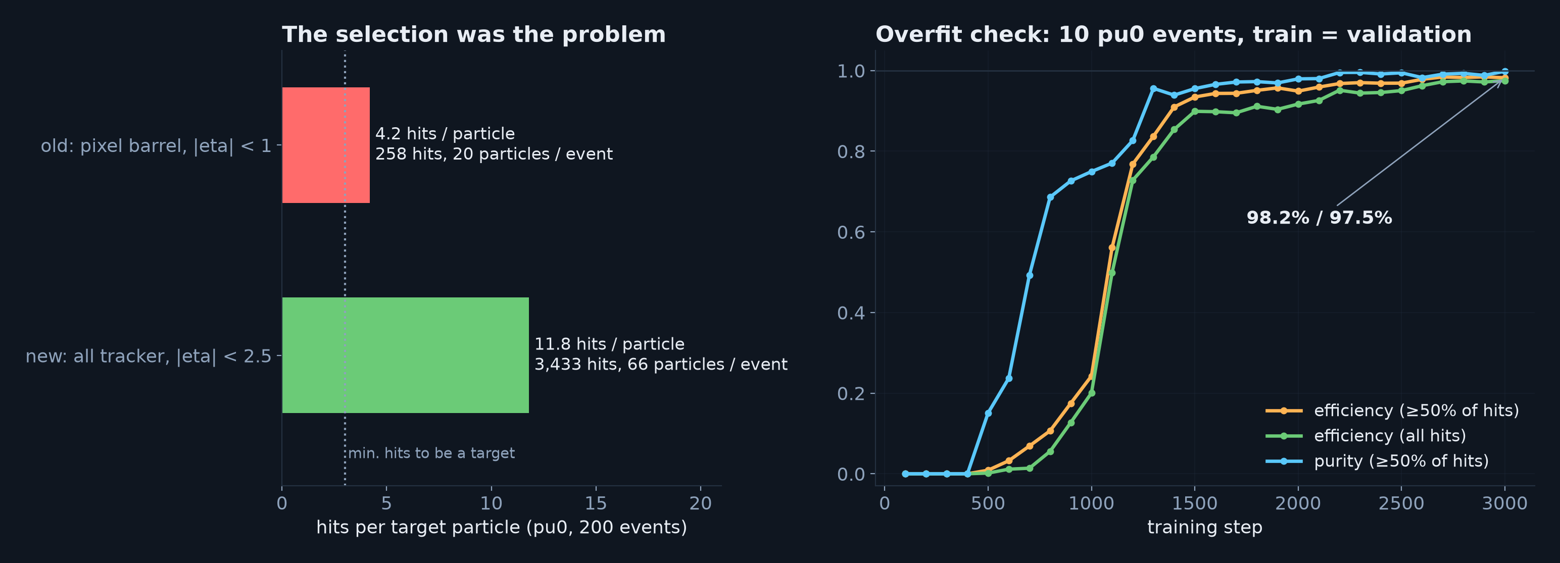
ColliderML: the selection was the problem, not the model
• Pixel barrel with |eta| < 1 left 4.2 hits per particle — barely more than the 3 needed to be a target
• Widened to the whole tracker out to |eta| < 2.5 at zero pile-up: 11.8 hits per particle
• Overfit on 10 events reaches 98% efficiency — targets, masks and matching all work
3

Slide 4
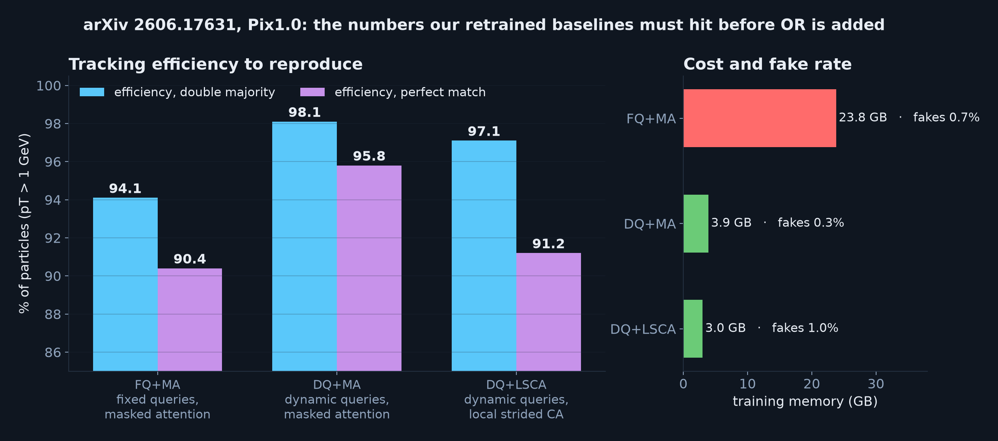
TrackML: to reproduce
• UCL's June paper (arXiv 2606.17631) compares three decoders on one filter + encoder
• Three of the five decoders we want for our paper, with every training setting stated
• DQ+MA at 98.1% is the baseline OR has to beat
4

Slide 5
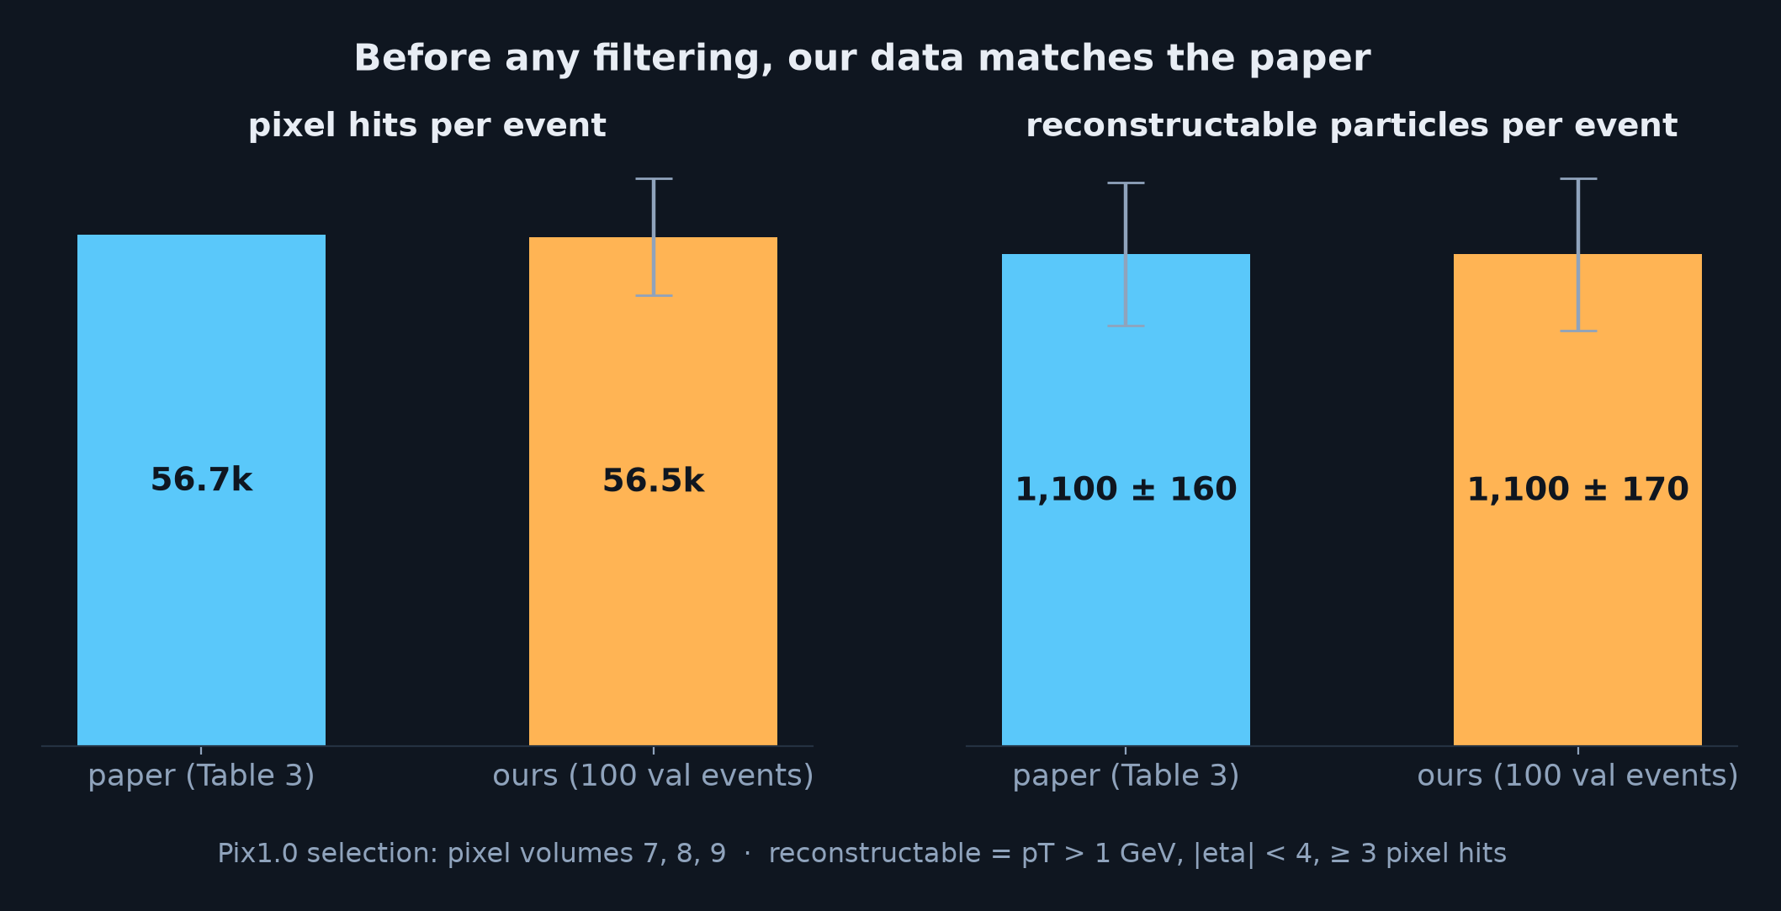
Verified: TrackML data on NGT Cluster matches the paper
• All 8,850 Kaggle training events, prepped; 100 val / 100 test as in the paper
• Pixel hits and particle counts agree with the paper's Table 3
• So any difference later comes from the models, not the data
5

Slide 6
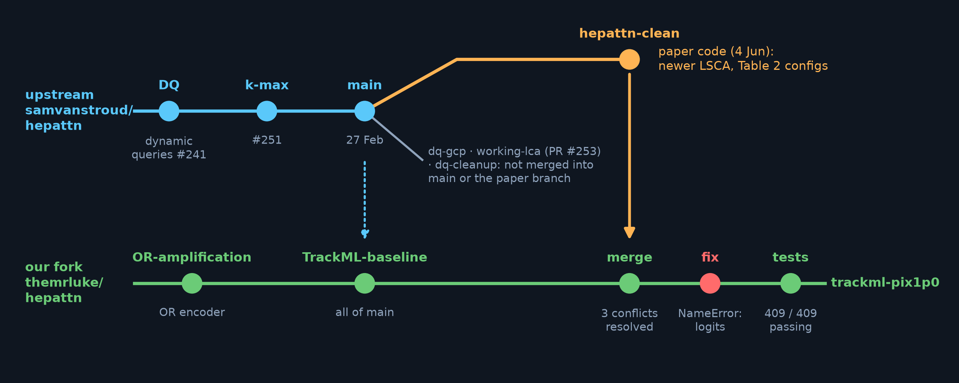
Getting the code the paper actually used
• Paper code on hepattn-clean?
• After fixes; 409 / 409 tests pass
• All OR-amplification tests still pass after the merge
6

Slide 7
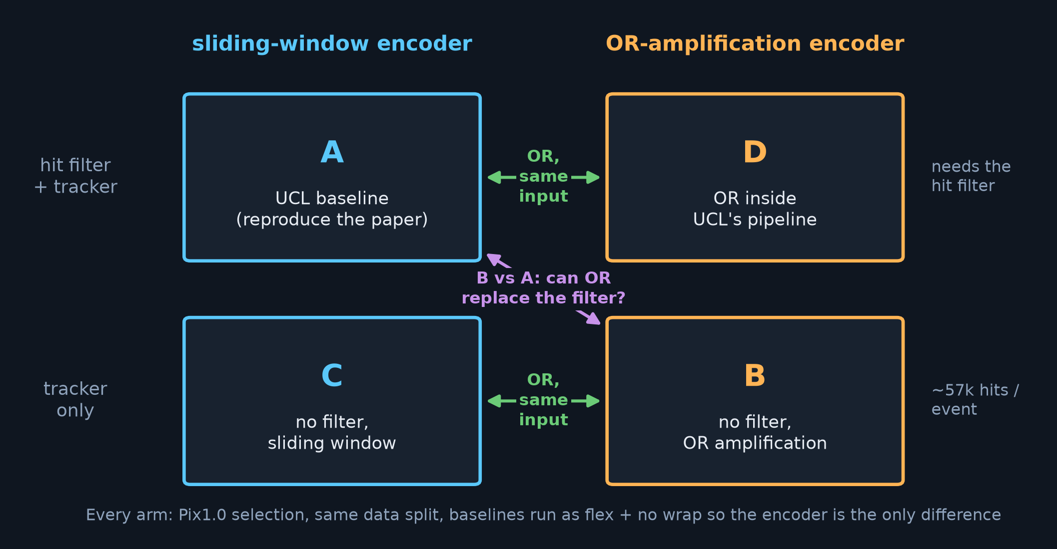
The experiment: 4 arms
• A vs D: OR inside UCL Maskformer pipeline — same input, only the encoder differs
• B vs C: OR with no filter, ~57k hits per event, where a 512-hit window misses the most
7

Slide 8
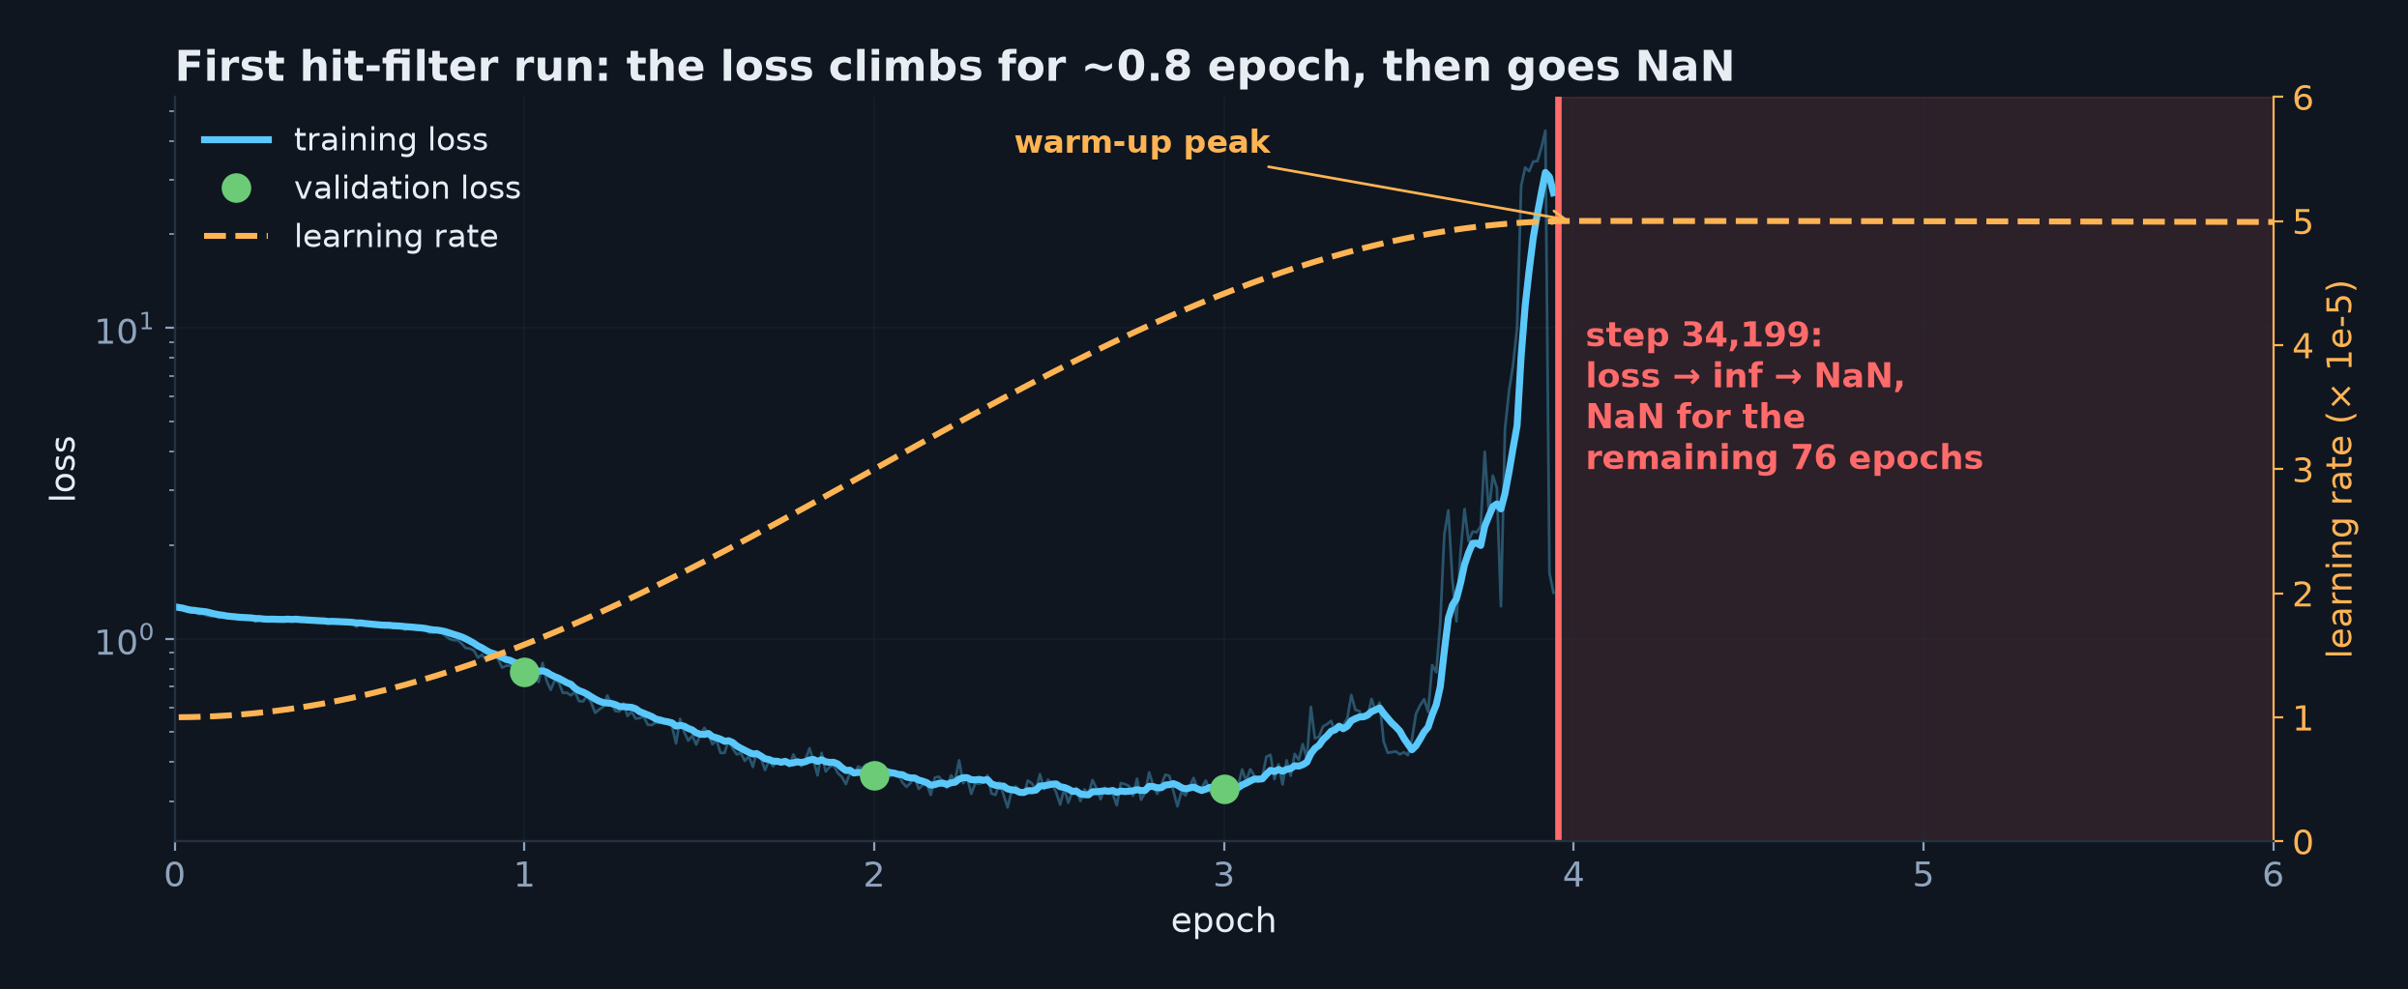
First hit-filter run: diverged after 3 epochs
• The loss climbed for ~0.8 epoch as the warm-up took the learning rate to 5e-5, then went NaN at the peak
• Not the corrupt events (fp16 skips their step — tested), and not the schedule alone: the retrain, with identical settings, passed the same peak cleanly
• Cause still open — most likely a borderline fp16 instability near peak learning rate
8

Slide 9
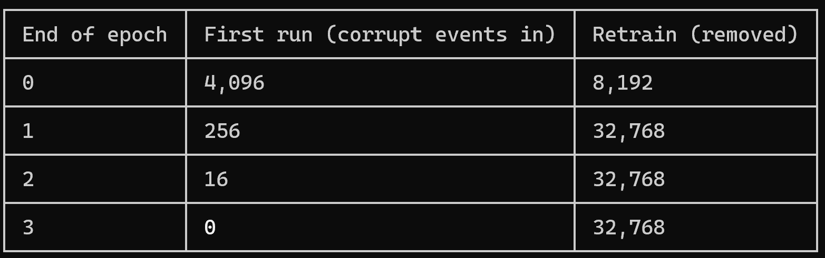

Slide 10
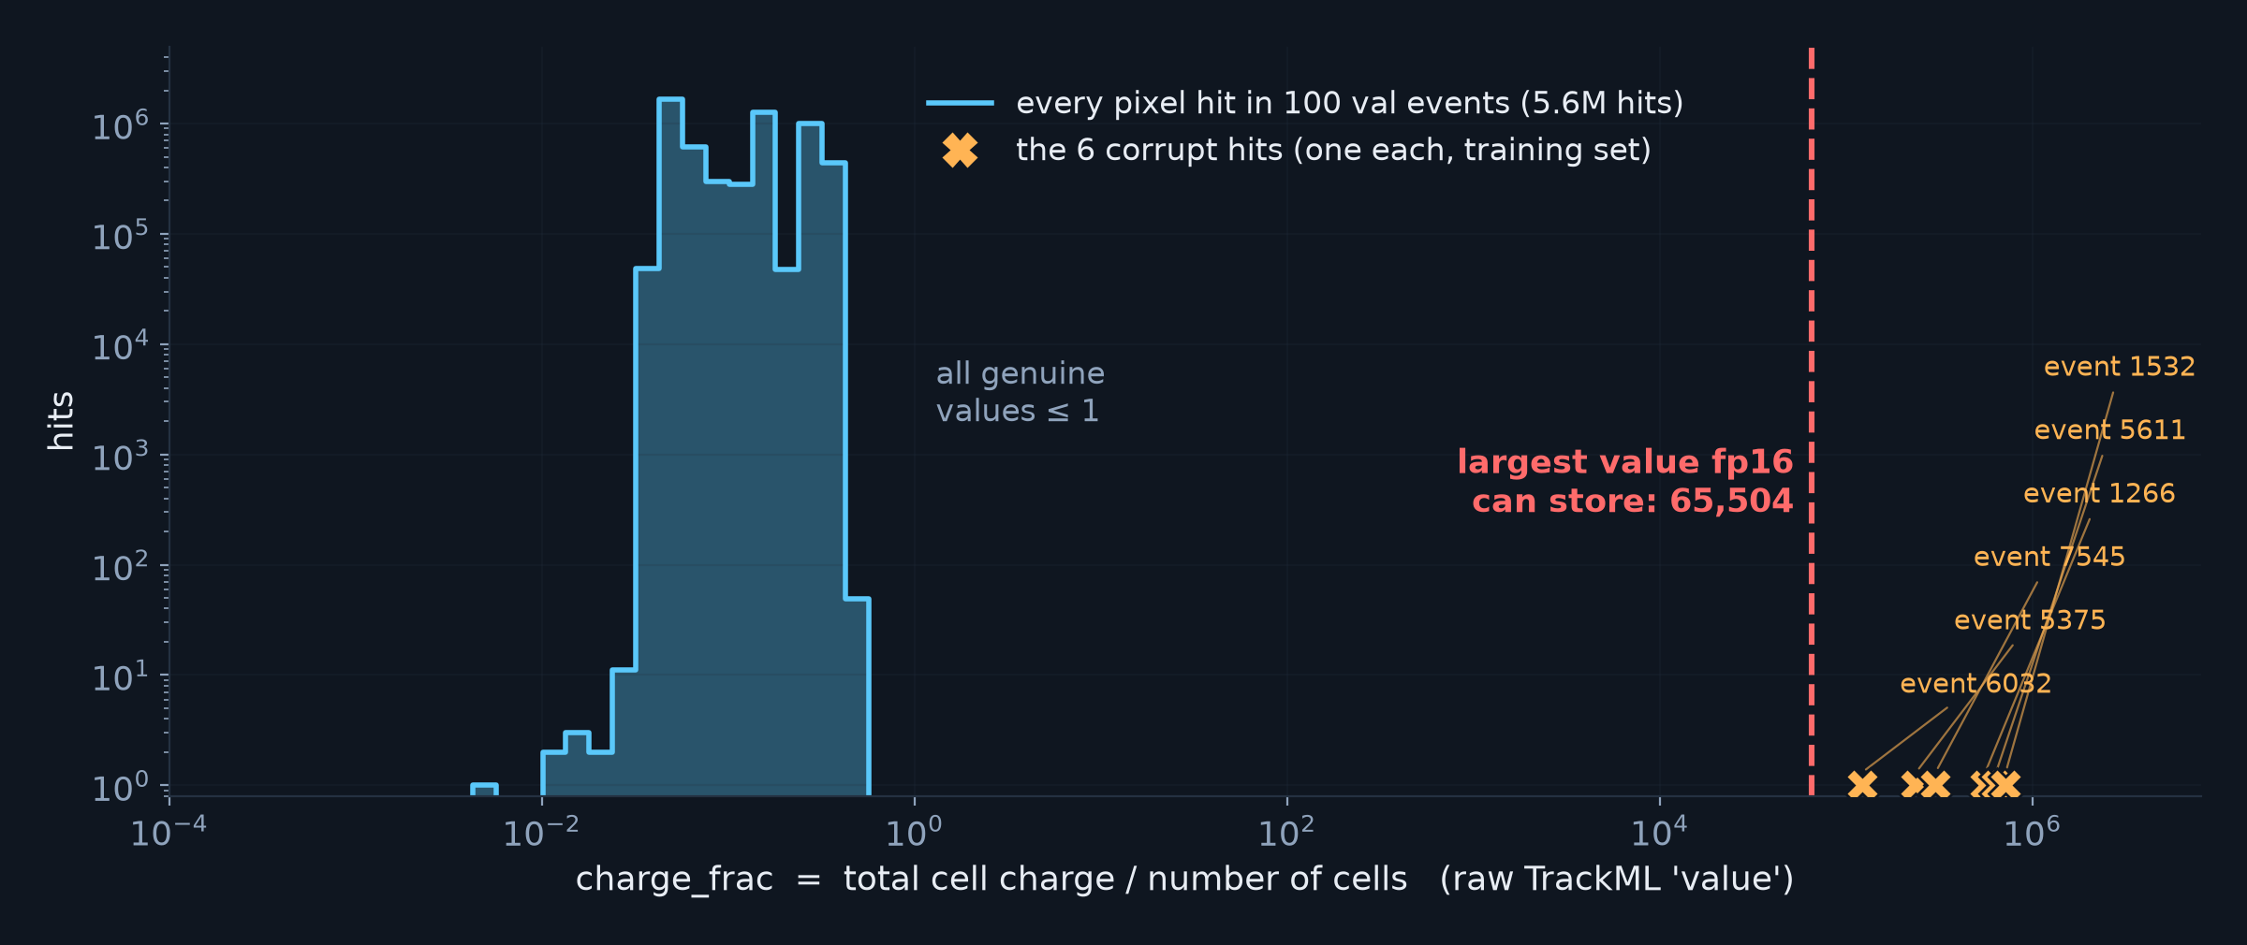
Six corrupt pixels in the TrackML data
• Kaggle's raw files: one pixel per event with charge up to 716,689, where every other value is ≤ 1
• Re-downloaded and checksum-verified; not in Kaggle's blacklist; not documented anywhere we found
• No hepattn dataloader — ours or any upstream branch — cleans them: cast to fp16, they become inf
9

Slide 11
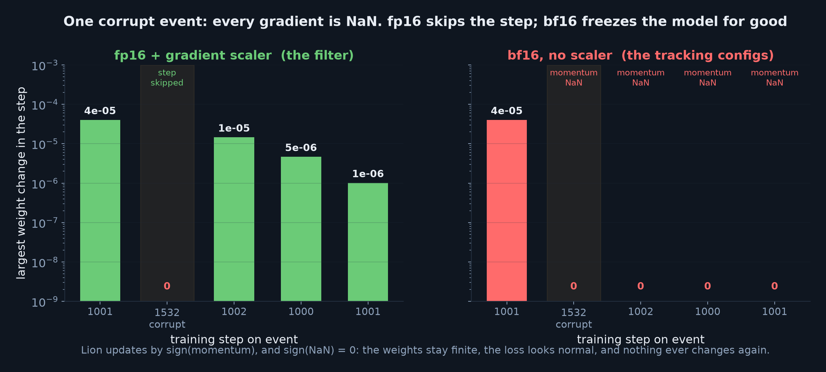
Harmless for the filter, fatal for the trackers
• fp16 (the filter): the gradient scaler skips the step — so they did NOT cause the filter's failure
• bf16 (every tracking config): Lion's momentum turns NaN and the model silently stops learning
• Removed from training (6 of 8,650 events) — worth reporting to UCL
10

Slide 12
Next, and what we need from UCL
Next
1. Check the filter against the paper: 98.6% retention, 9.7k hits per event
2. Train DQ+MA (arm A) to 98.1%, then the OR arms
3. Full ColliderML pu0 run​
12

Slide 13
Next, and what we need from UCL
Next
1. Check the filter against the paper: 98.6% retention, 9.7k hits per event
2. Train DQ+MA (arm A) to 98.1%, then the OR arms
3. Full ColliderML pu0 run​
12

