Slide 1
Reproducing UCL's Pix0.6 tracker
Training 2–3× faster, an inconsistency in the paper, and some OR-vs-baseline results
Luke Johnson · Tracking meeting · 8 Oct 2026

Slide 2
Where we left off last week
Hit-filter run diverged: six corrupt pixels + fp16 gradient scale hitting zero
Plan: confirm the filter, train DQ+MA to the paper's number, then the OR arms
This week
• Switched to UCL's own data and 600 MeV filter: Pix0.6
• Made training 2–3× faster, with identical results
• Reproduced the paper, and found Table 4 mixes two pT thresholds
• First OR vs baseline comparison; window sweep running
2

Slide 3
We now use UCL's data and their 600 MeV hit filter
Data: the CodaLab release UCL used, 8,543 train / 100 val / 100 test events
56.7k pixel hits and 2607 ± 329 particles per event: Table 3 says 56.7k and 2600 ± 340
Filter: Pippa's 600 MeV filter outputs, threshold 0.1
99.13% particle retention, 20.3k hits per event: Table 3 says 99.1% and 20.3k
So we reproduce Pix0.6: trained on pT ≥ 0.6 GeV, evaluated on pT > 1 GeV
Configs set to the paper's values: 3,900 queries, focal weight 25, LSCA window 64
3

Slide 4
PART 1
Training speedup
4

Slide 5
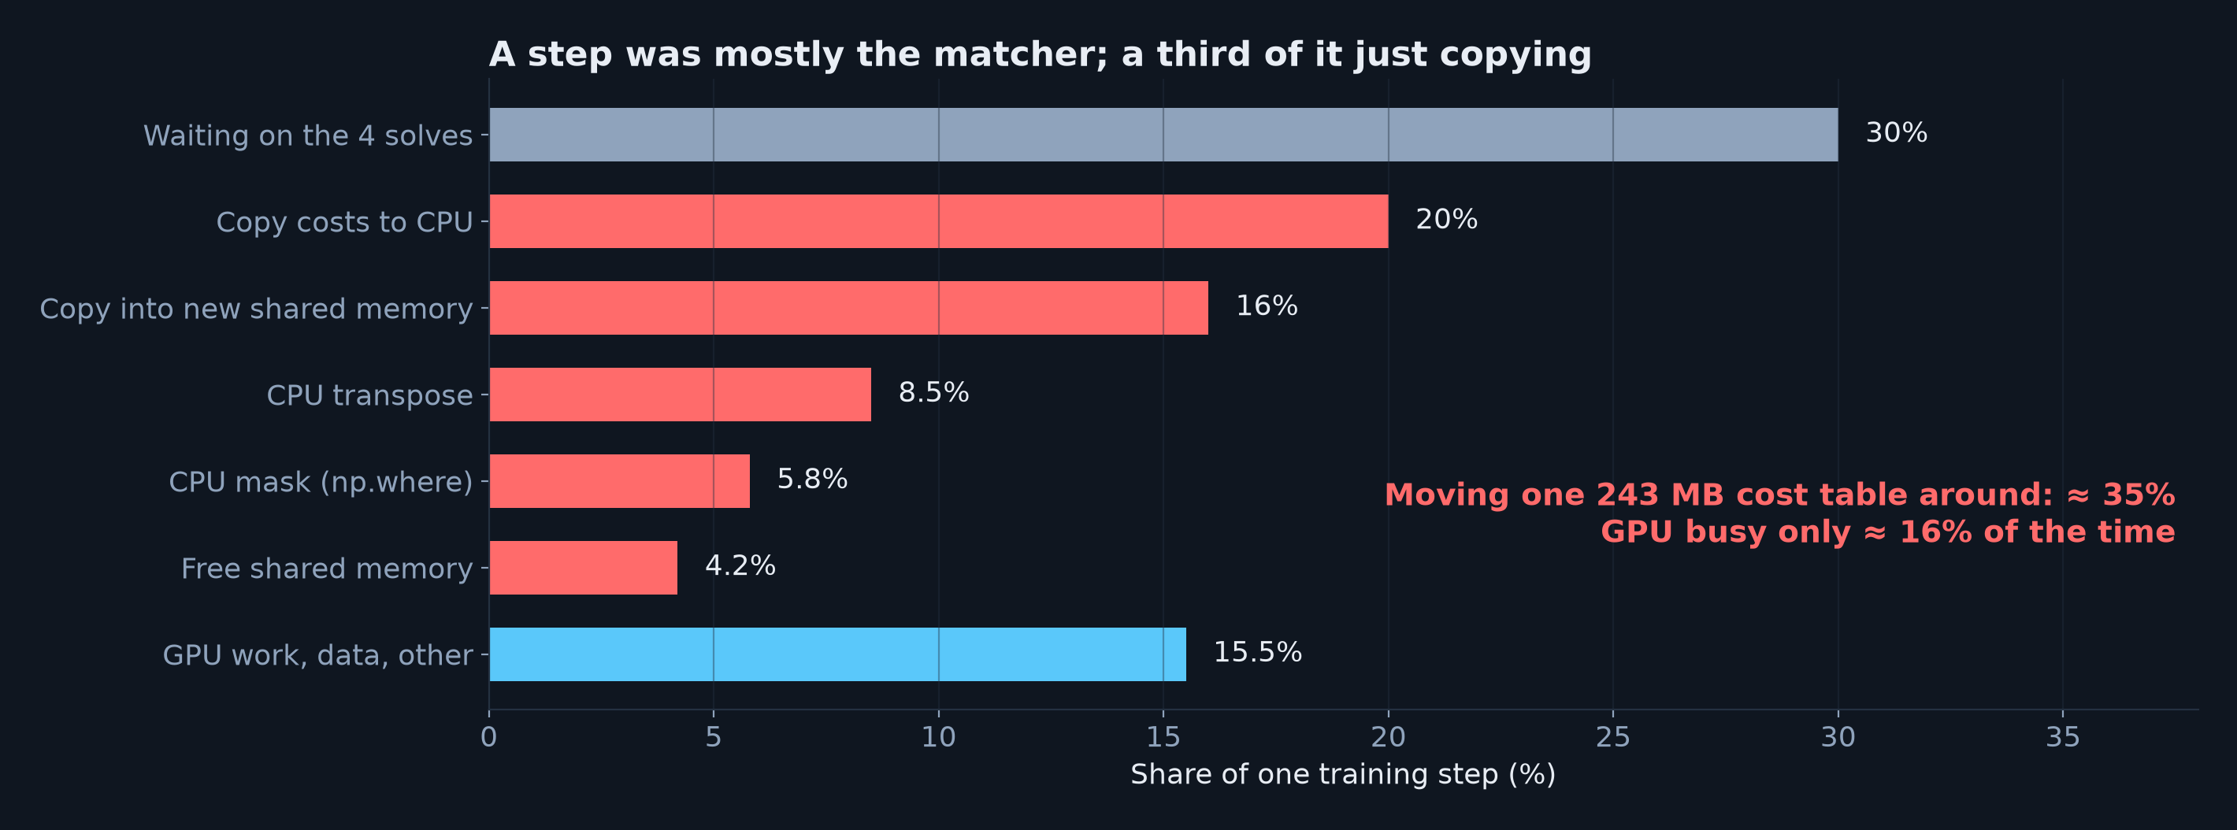
Training was waiting on the Hungarian matcher
• Matching pairs ~3,900 predicted tracks with ~2,500 particles, 4× per step, on the CPU
• ≈ 35% of every step was just copying the 243 MB cost table around
5

Slide 6
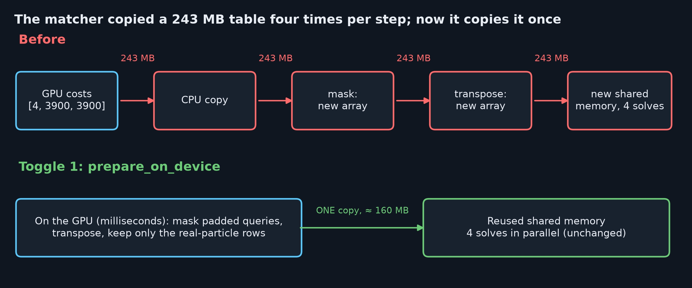
Fix: do the reshuffling on the GPU, copy once
• Toggle 1 (prepare_on_device): same numbers reach the same solver → identical matching
• Toggle 2 (trim_padded_queries): also drops the 18–39% padded query columns → smaller solve
• Toggle 2 changes which leftover queries get the 'no object' loss (0.16% early, 0% late)
6

Slide 7
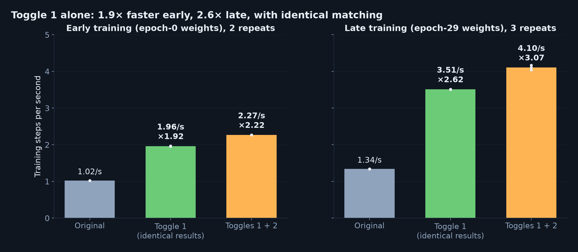
Measured: 1.9–2.6× faster, 3.1× with both toggles
• Same config, seed and events; timed over steps 150–600, after compile
• Toggle 1 cuts a 30-epoch run from ≈ 53–70 h to ≈ 20–36 h, with identical results
7

Slide 8
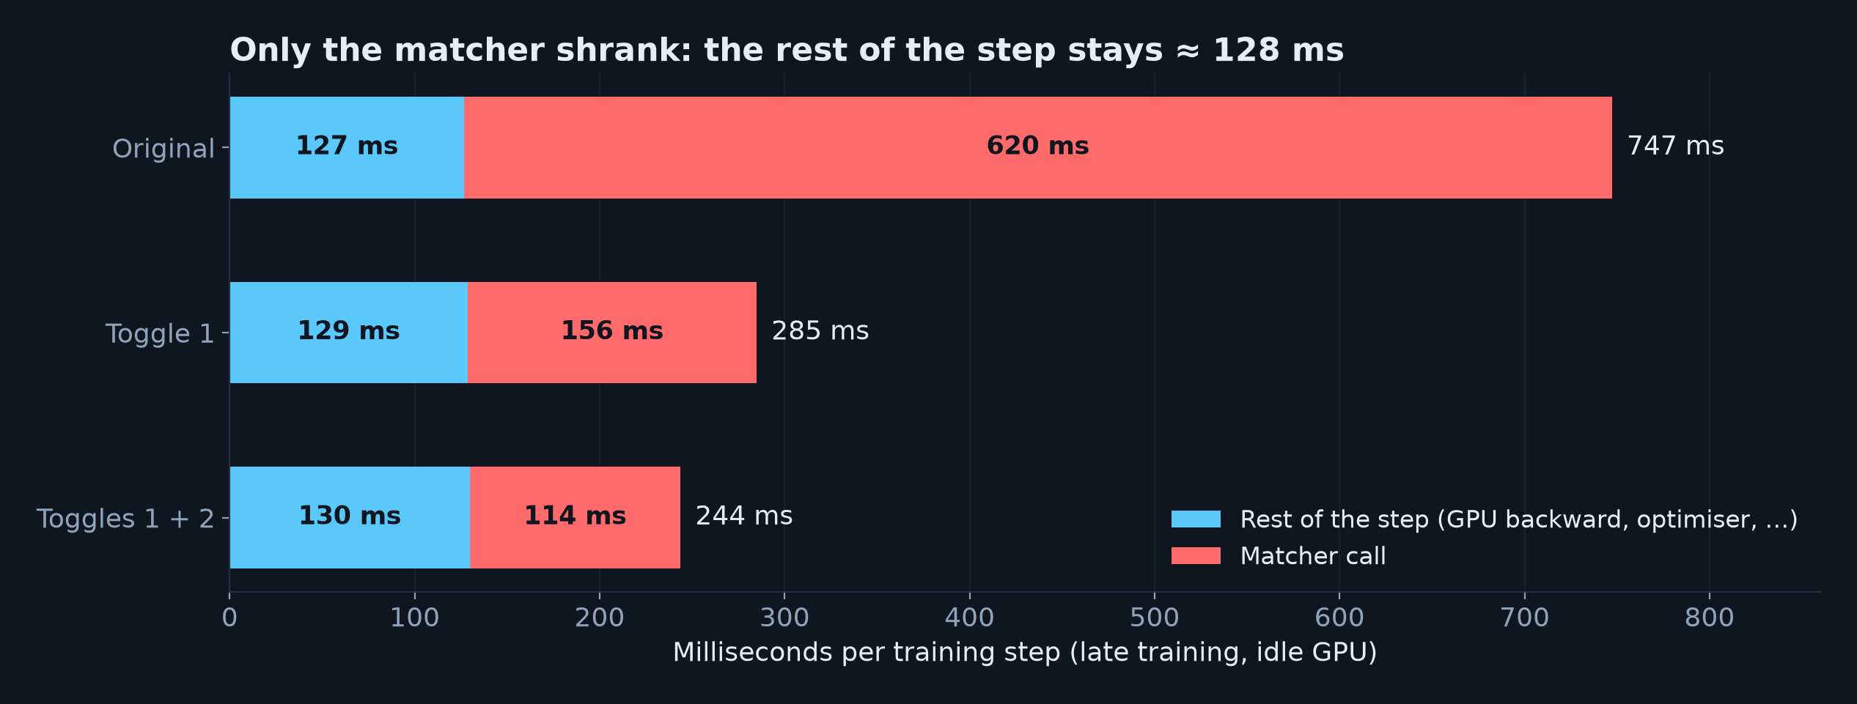
Only the matcher got faster
• Faster on 100% of steps; repeats agree within 1%; other users' CPU load didn't move it
• Left in the matcher (≈ 114 ms): 69 ms waiting for the GPU forward, 38 ms of actual solves
• Next gain: overlap the solves with the forward pass (up to ≈ 1.2×)
8

Slide 9
PART 2
Reproducing the paper
9

Slide 10
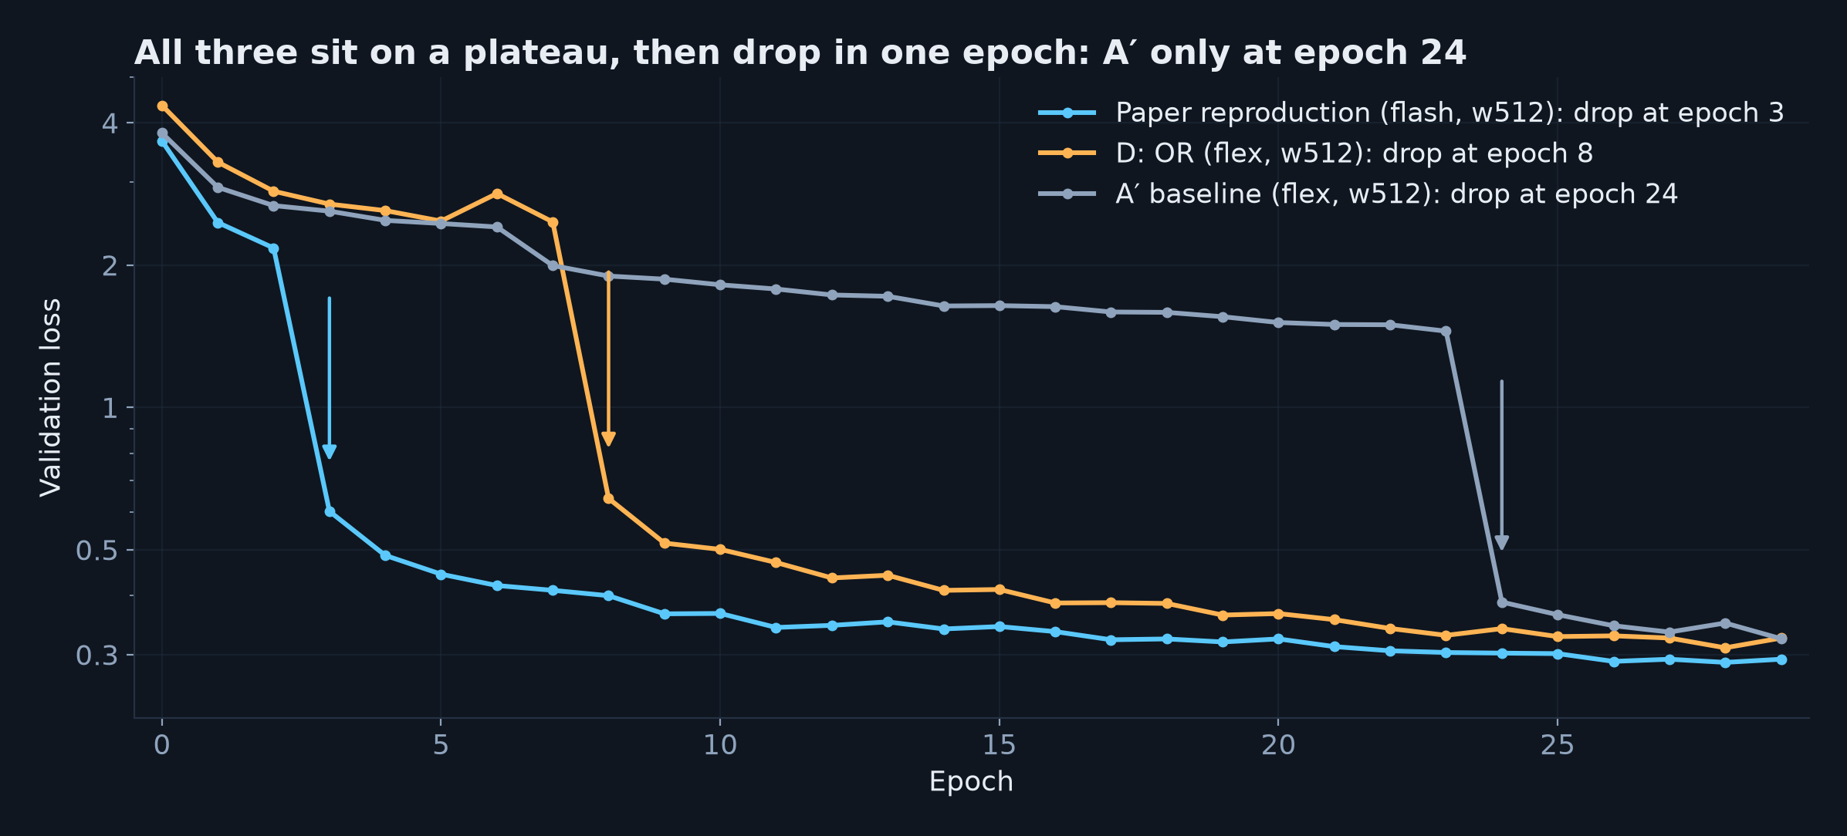
Some runs
• Plateau: track masks are poor (dice ≈ 0.3); first-hit finding is already ≈ 96% efficient
• A′ (flex) only escaped at epoch 24: same model, much less real training
• How long a run stays on the plateau is very sensitive → the sweep uses two seeds
10

Slide 11
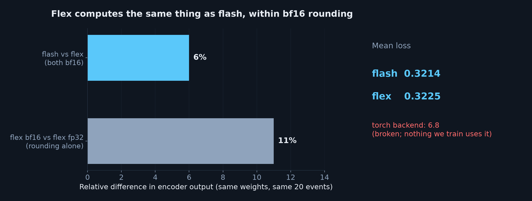
A′ isn't worse because of flex attention
• Paper-run weights through both backends: outputs differ by less than bf16 rounding, loss equal
• The flash/flex gap in A′ is the plateau, not the attention kernel
11

Slide 12
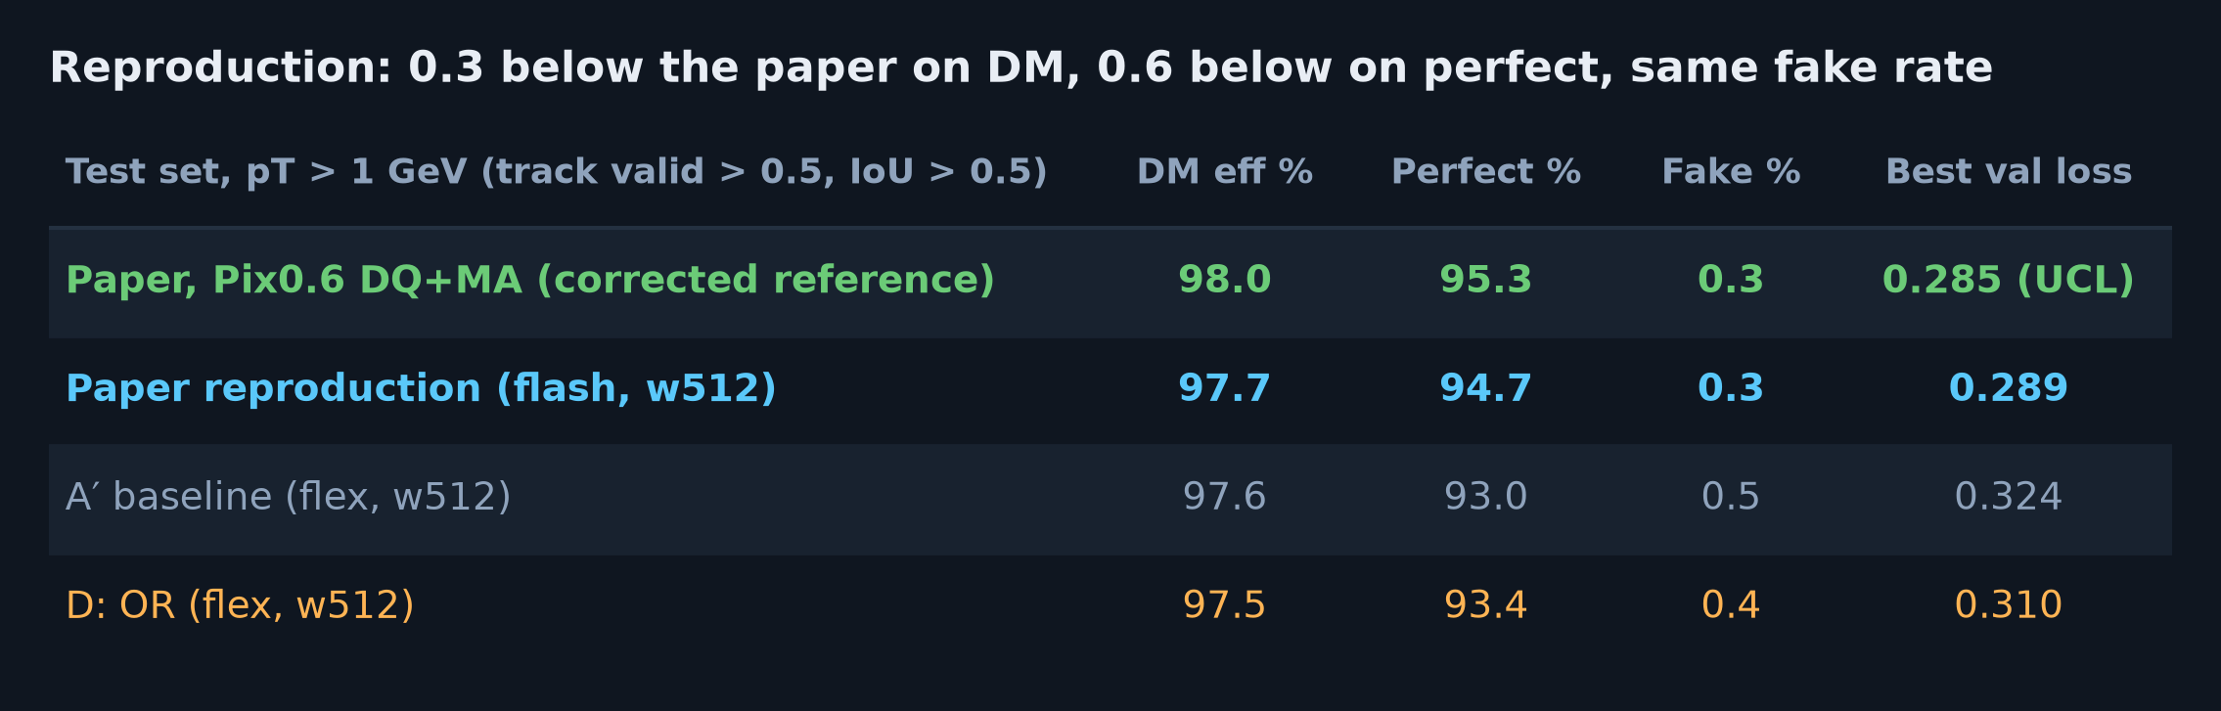
Test set: the reproduction is close to the paper
• UCL's evaluator, pT > 1 GeV, track valid > 0.5, IoU > 0.5, 100 test events
• DM 97.7% vs 98.0%, perfect 94.7% vs 95.3%, fake rate 0.3% vs 0.3%
• Best val loss 0.289 vs UCL's own run 0.285, both at epoch 28
12

Slide 13
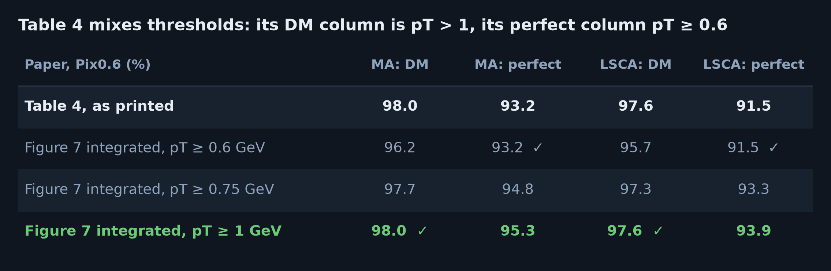
Table 4's perfect efficiency is a pT ≥ 0.6 number
• Integrating the paper's own Figure 7 (values extracted from the PDF) over each pT threshold
• DM column = pT > 1, perfect column = pT ≥ 0.6, for both decoders: 93.2 → 95.3, 91.5 → 93.9
• The updated paper (23 Sep) still has it, and repeats 93.2% in the conclusion
13

Slide 14
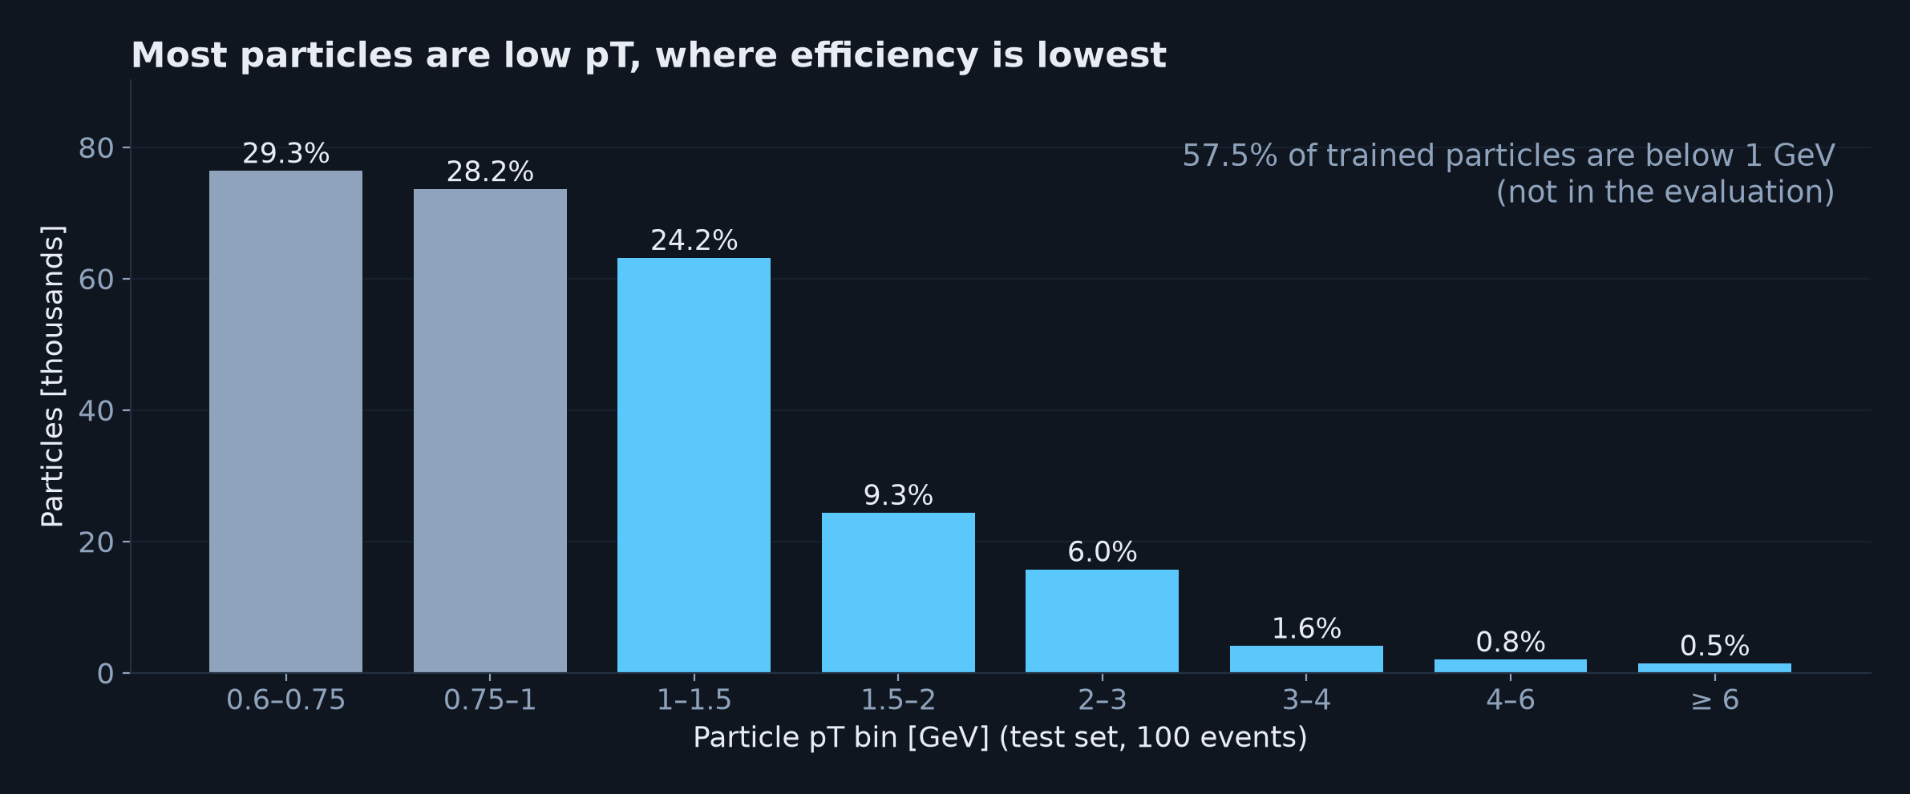
Why the threshold matters so much
• 57.5% of trained particles are below 1 GeV, where efficiency is lowest (≈ 93% and 97%)
• Including them pulls efficiency down ≈ 2 points: Table 4's 98.0% couldn't be a pT ≥ 0.6 value
14

Slide 15
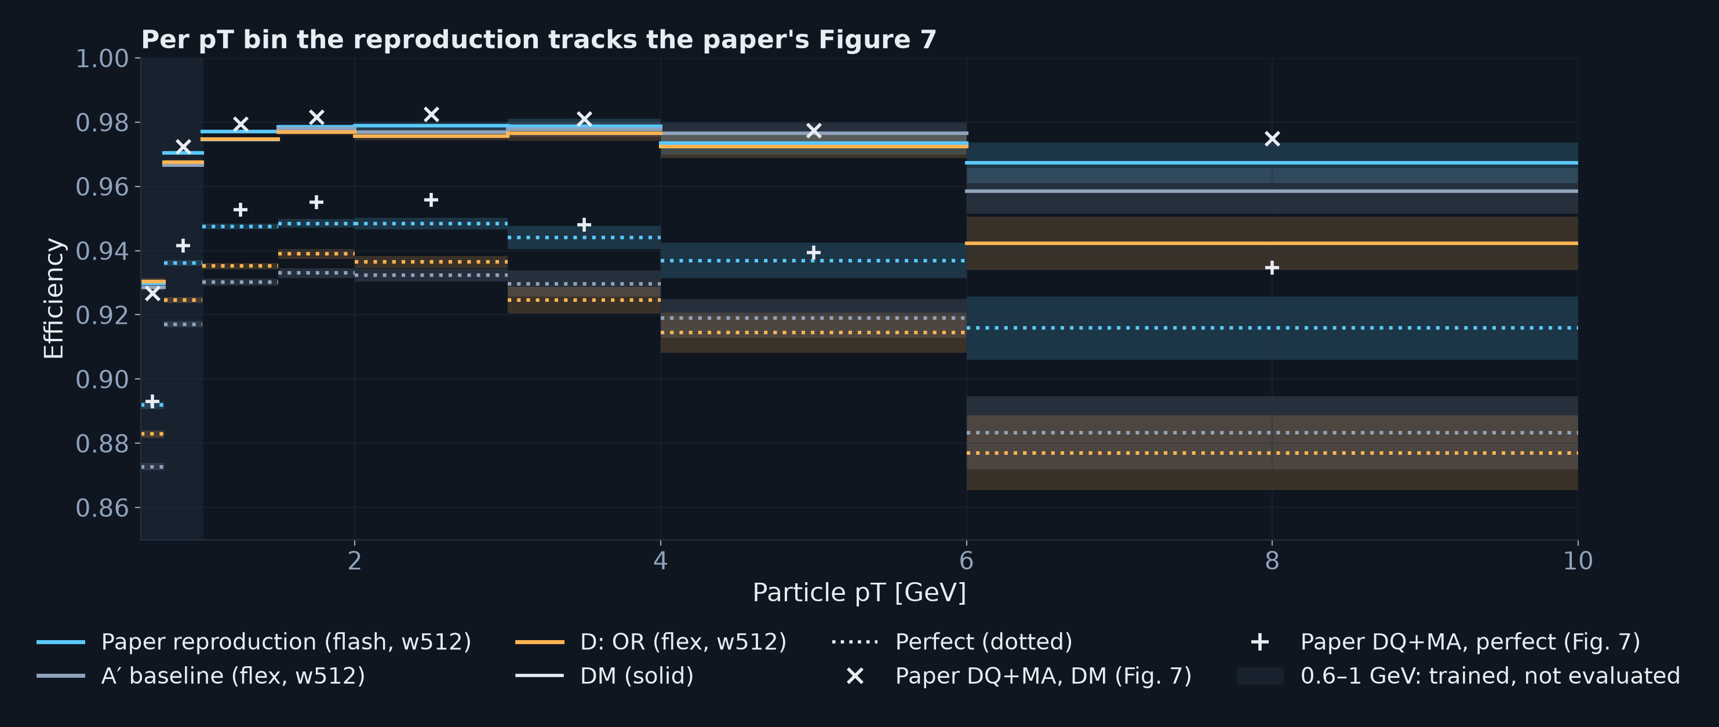
Per pT bin we track the paper's Figure 7
• DM within ≈ 0.5 points of the paper up to 6 GeV; perfect ≈ 0.5–0.8 below at 1–3 GeV
• The remaining gap is in complete hit assignment, not in finding tracks
15

Slide 16
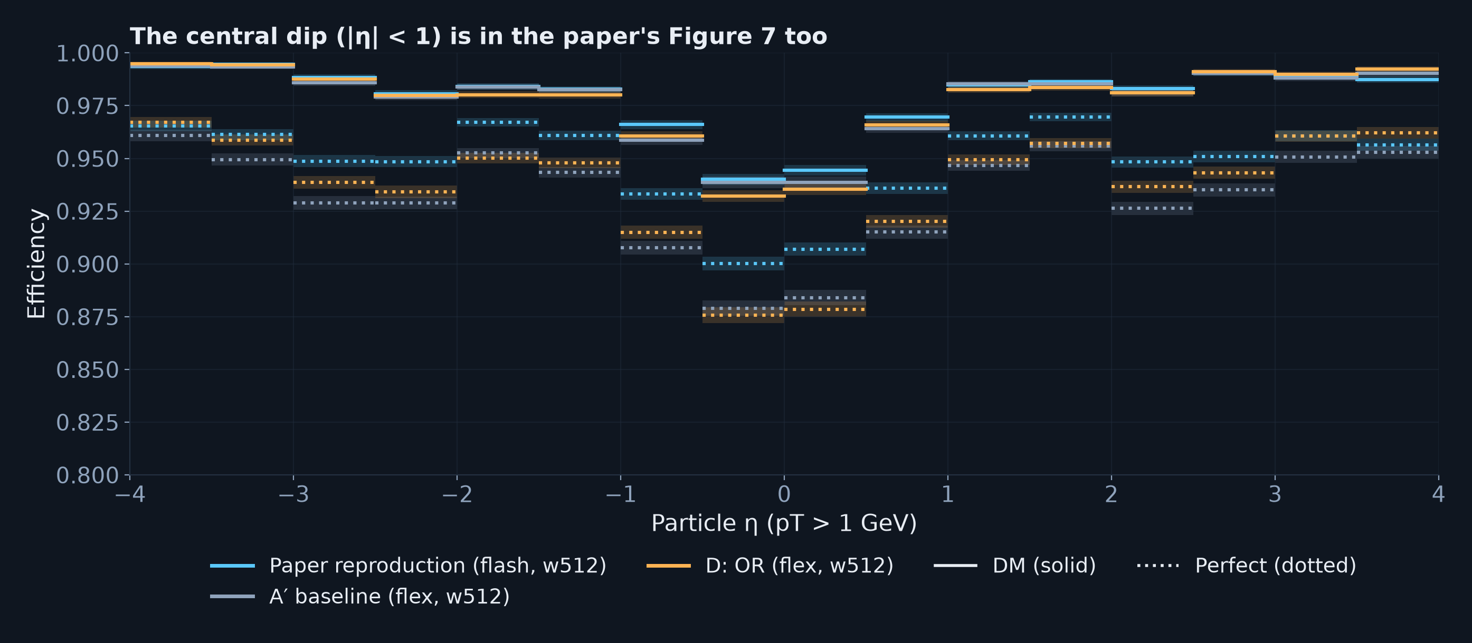
Efficiency vs η matches the paper's shape
• Evaluated particles (pT > 1 GeV); the central dip at |η| < 1 is in the paper's Figure 7b too
• The paper reproduction has the best perfect efficiency almost everywhere
16

Slide 17
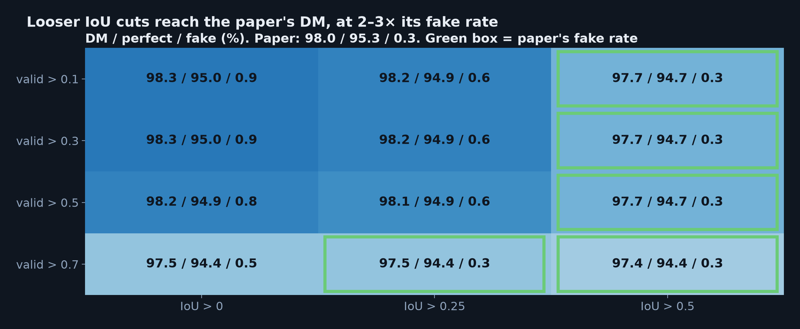
Operating points: the IoU cut is the lever
• Track-validity cut barely matters below 0.7; the predicted-IoU cut trades efficiency for fakes
• At the paper's fake rate: 97.7 / 94.7; loosest cuts: 98.3 / 95.0 at 3× the fakes
17

Slide 18
PART 3
OR amplification
18

Slide 19
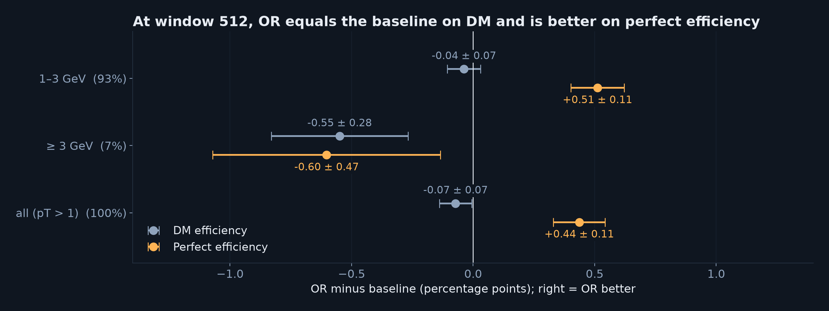
OR vs its fair baseline at window 512
• Fair pair: D (OR) vs A′ (flex baseline), same window, same seed; only OR differs
• DM equal (−0.07 ± 0.07); perfect +0.44 ± 0.11 for OR
• At 512 the plain window already sees enough; OR should matter at smaller windows
19

Slide 20
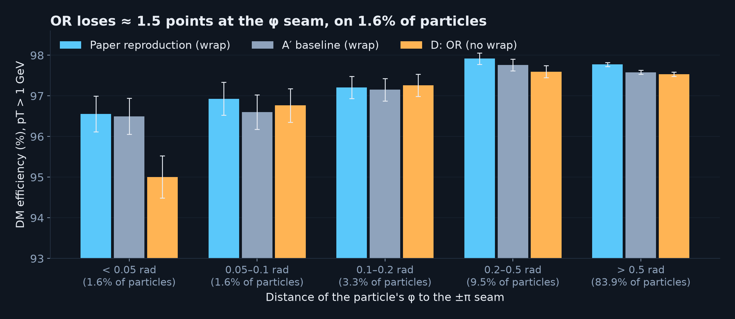
OR's one weakness: the φ seam
• OR's hash orderings treat φ as linear, so every table has a seam at ±π (baselines wrap)
• −1.5 points within 0.05 rad of the seam, but only ≈ 0.02 points overall
• Possible fix: rotate φ randomly per hash table so the OR merge repairs the seam
20

Slide 21
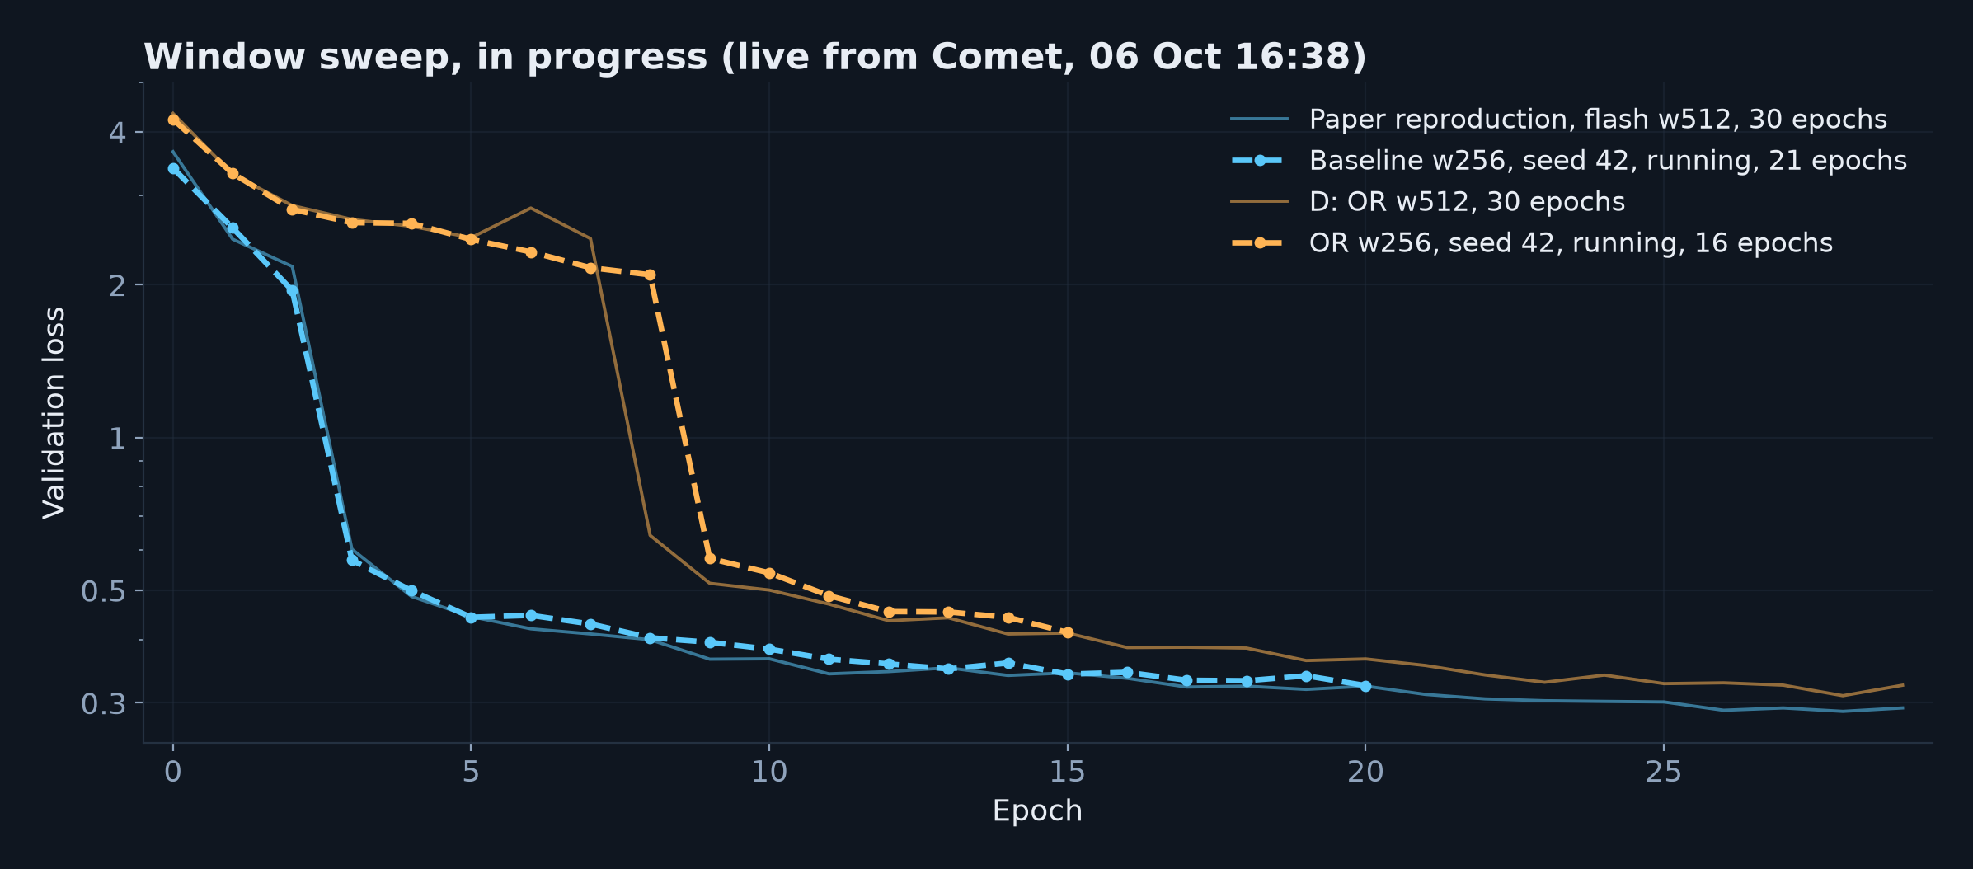
Window sweep: does OR hold up at smaller windows?
• 4 configs (windows 256 and 128, baseline and OR) × 2 seeds, two jobs at a time on the GPU
• Baseline at window 256 tracks the paper reproduction epoch by epoch (0.332 vs 0.324 at epoch 18)
• OR at window 256 left the plateau at epoch 9 (D at 512: epoch 8); test-set numbers once runs finish
21

Slide 22
Next
Finish the window sweep and evaluate every run (seed 42 first)
See if OR keep efficiency at windows 256 and 128?
DQ+LSCA reproduction (target: 97.6 / 93.9 / 0.4) from Mungo against OR
Periodic-φ OR to remove the seam
Overlap the matcher with the forward pass for more training speed-up
22

