Slide 1
Reproducing UCL's Pix0.6 tracker
Training 2–3× faster, an inconsistency in the paper, and the first OR-vs-baseline results
Luke Johnson · Tracking meeting · 8 Oct 2026

Slide 2
Where we left off last week
Hit-filter run diverged: six corrupt pixels + fp16 gradient scale hitting zero
Plan: confirm the filter, train DQ+MA to the paper's number, then the OR arms
This week
• Switched to UCL's own data and 600 MeV filter: Pix0.6
• Made training 2–3× faster, with identical results
• Reproduced the paper, and found Table 4 mixes two pT thresholds
• First OR vs baseline comparison; window sweep running
2

Slide 3
We now use UCL's data and their 600 MeV hit filter
Data: the CodaLab release UCL used, 8,543 train / 100 val / 100 test events
56.7k pixel hits and 2607 ± 329 particles per event: Table 3 says 56.7k and 2600 ± 340
Filter: Pippa's 600 MeV filter outputs, threshold 0.1
99.13% particle retention, 20.3k hits per event: Table 3 says 99.1% and 20.3k
So we reproduce Pix0.6: trained on pT ≥ 0.6 GeV, evaluated on pT > 1 GeV
Configs set to the paper's values: 3,900 queries, focal weight 25, LSCA window 64
3

Slide 4
PART 1
Making training 2–3× faster
4

Slide 5
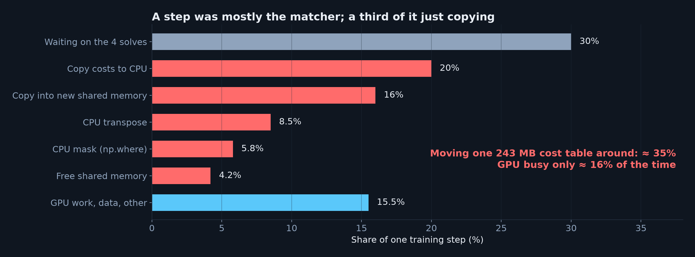
Training was waiting on the Hungarian matcher
• Matching pairs ~3,900 predicted tracks with ~2,500 particles, 4× per step, on the CPU
• ≈ 35% of every step was just copying the 243 MB cost table around
5

Slide 6
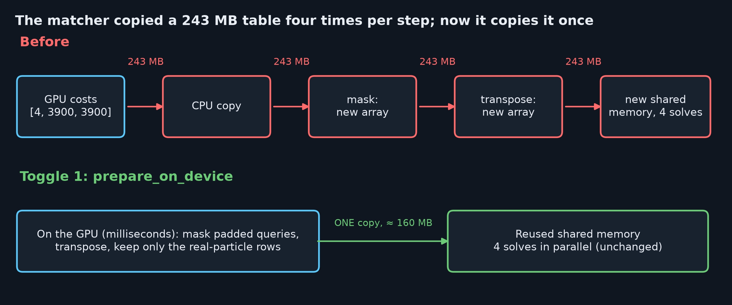
Fix: do the reshuffling on the GPU, copy once
• Toggle 1 (prepare_on_device): same numbers reach the same solver → identical matching
• Toggle 2 (trim_padded_queries): also drops the 18–39% padded query columns → smaller solve
• Toggle 2 changes which leftover queries get the 'no object' loss (0.16% early, 0% late)
6

Slide 7
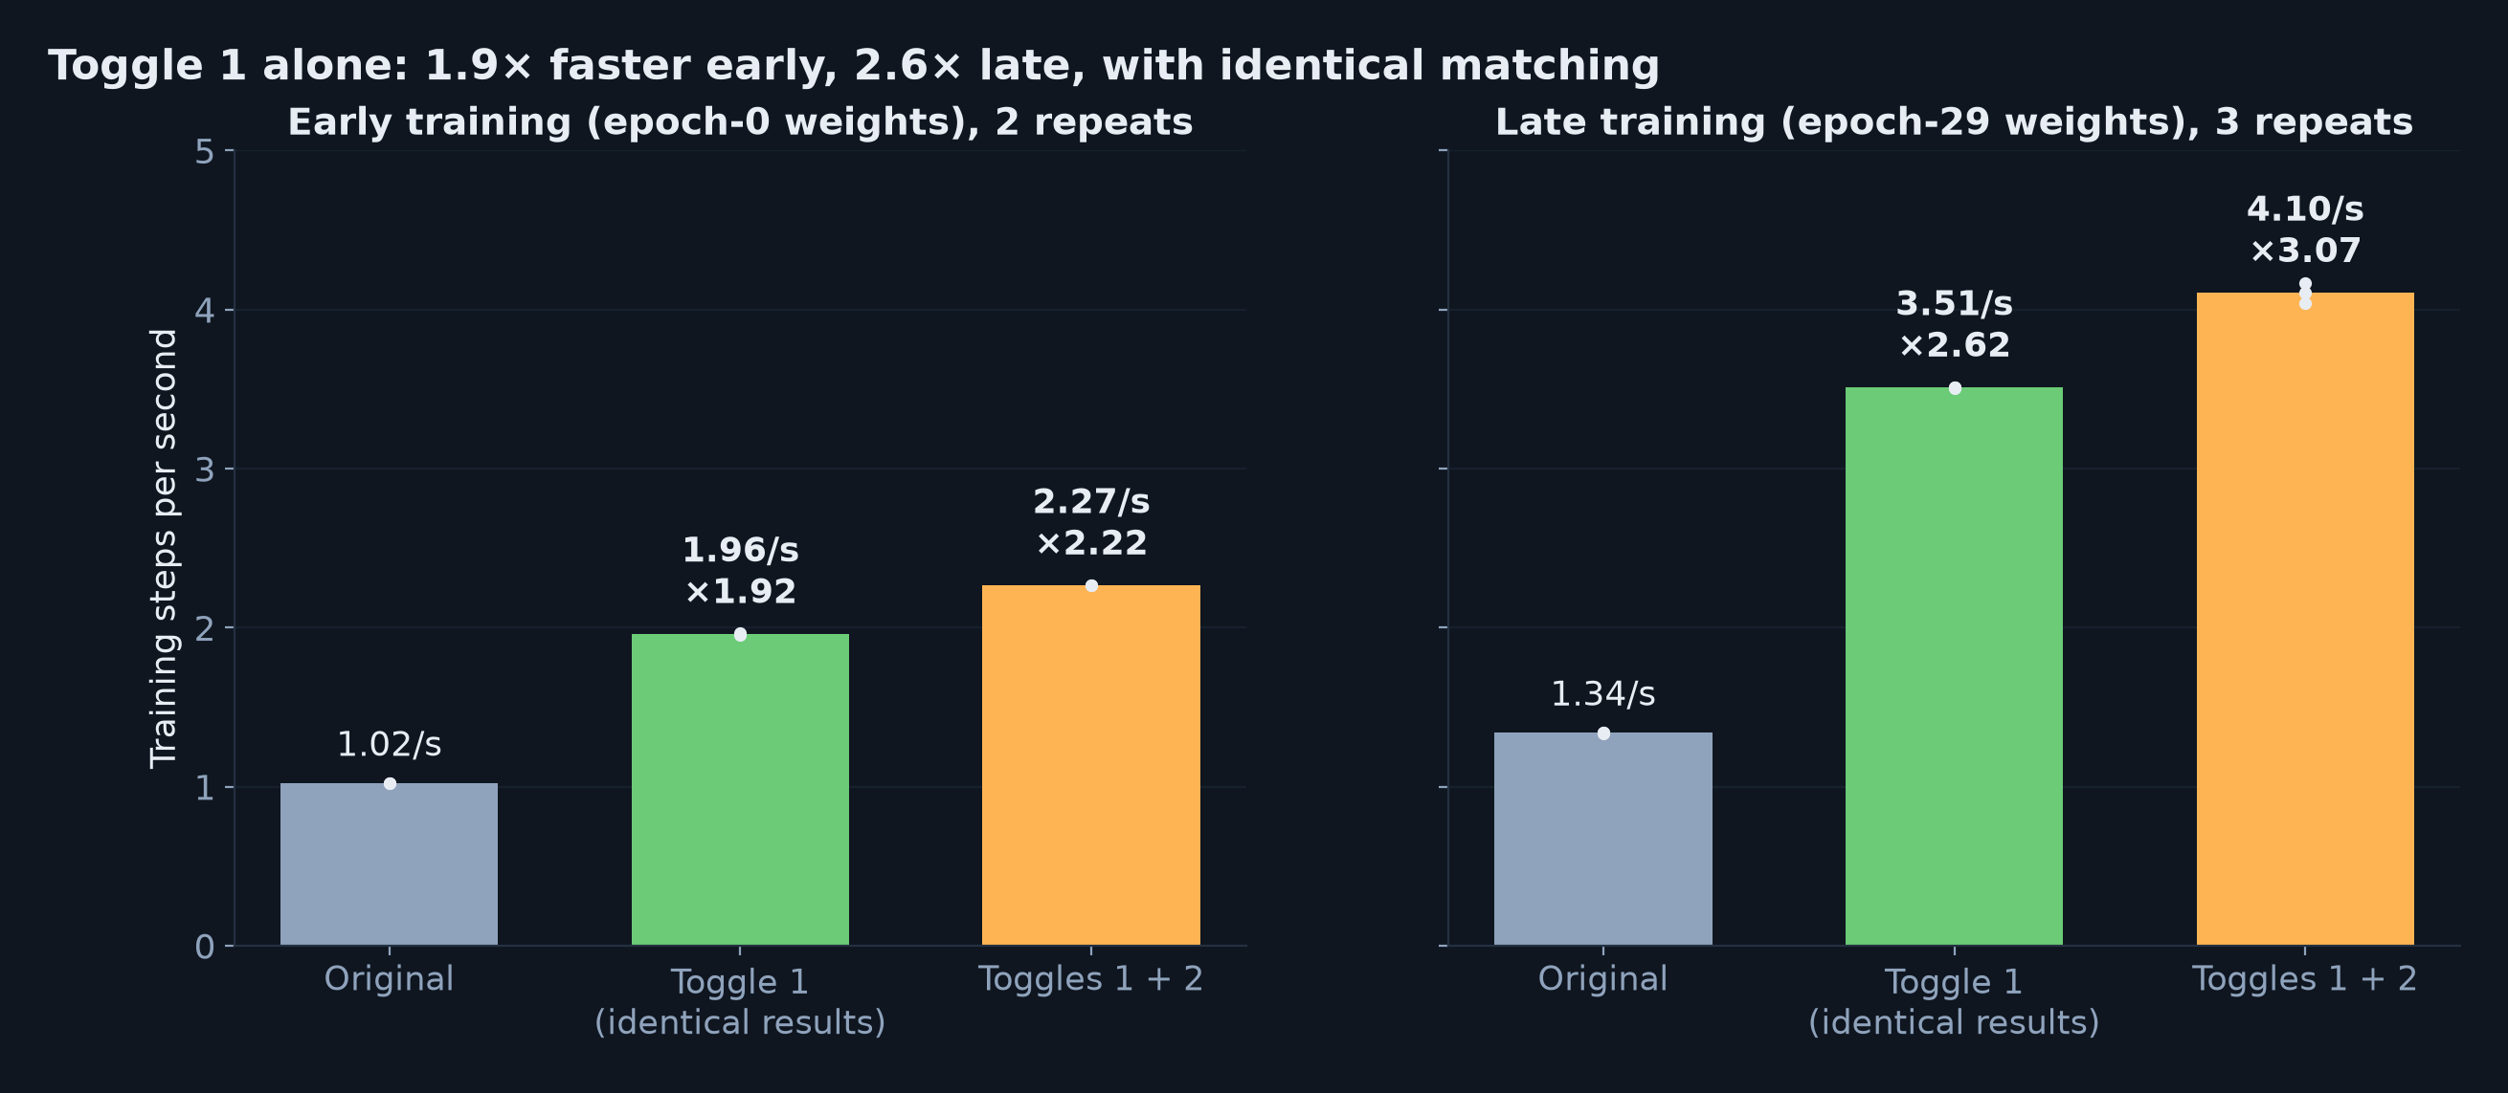
Measured: 1.9–2.6× faster, 3.1× with both toggles
• Same config, seed and events; timed over steps 150–600, after compile
• Toggle 1 cuts a 30-epoch run from ≈ 53–70 h to ≈ 20–36 h, with identical results
7

Slide 8
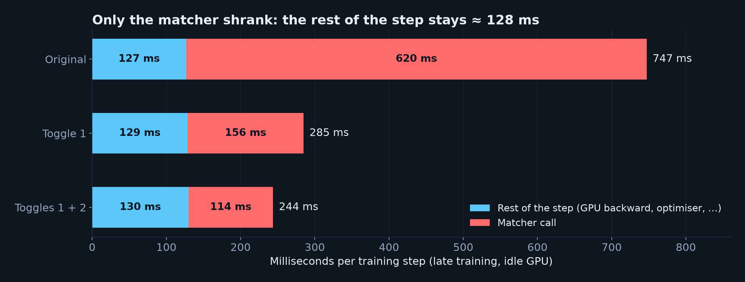
Only the matcher got faster, and it's robust
• Faster on 100% of steps; repeats agree within 1%; other users' CPU load didn't move it
• Left in the matcher (≈ 114 ms): 69 ms waiting for the GPU forward, 38 ms of actual solves
• Next gain: overlap the solves with the forward pass (up to ≈ 1.2×)
8

Slide 9
PART 2
Reproducing the paper
9

Slide 10
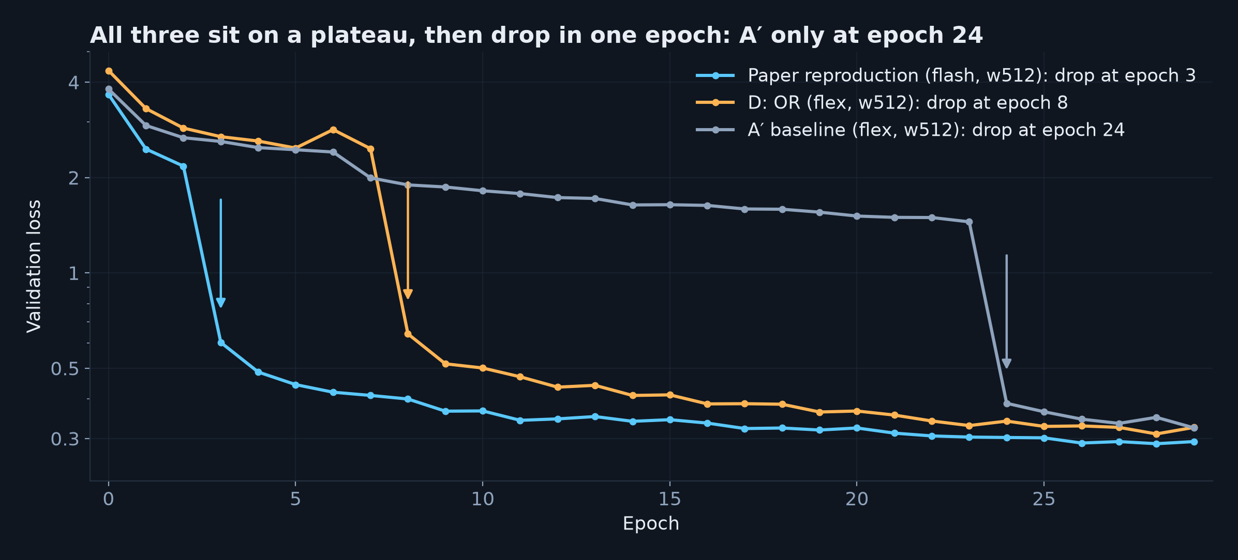
Every run plateaus, then its masks snap into place
• Plateau: track masks are poor (dice ≈ 0.3); first-hit finding is already ≈ 96% efficient
• A′ (flex) only escaped at epoch 24: same model, much less real training
• How long a run stays on the plateau is very sensitive → the sweep uses two seeds
10

Slide 11
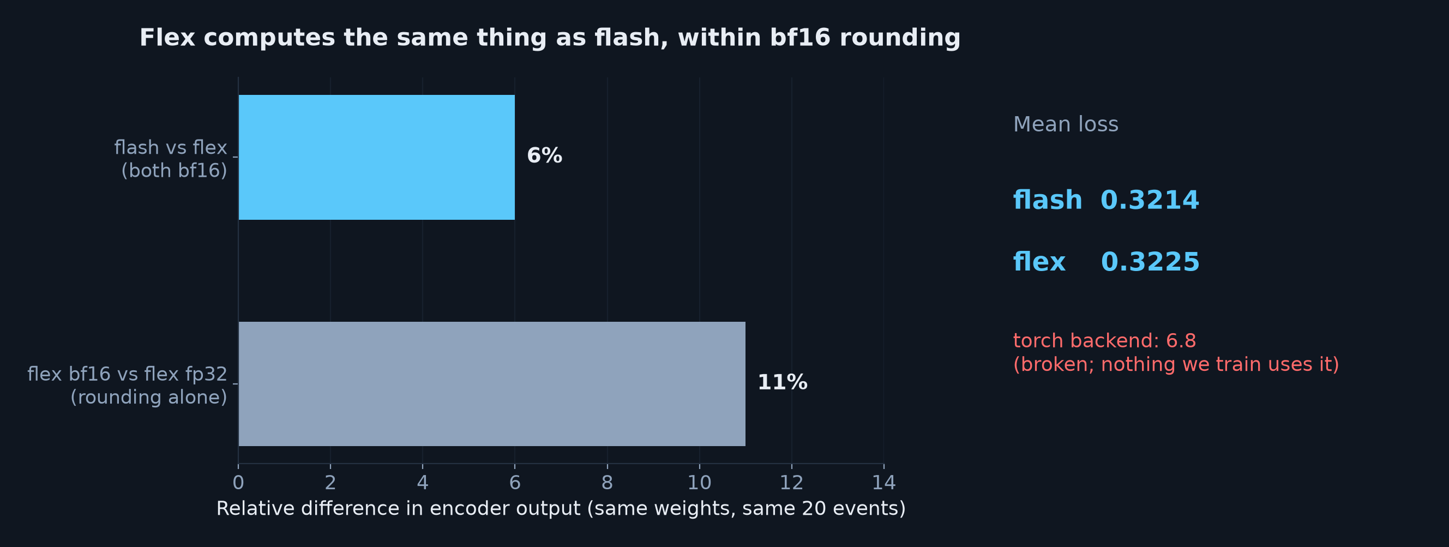
A′ isn't worse because of flex attention
• Paper-run weights through both backends: outputs differ by less than bf16 rounding, loss equal
• The flash/flex gap in A′ is the plateau, not the attention kernel
11

Slide 12
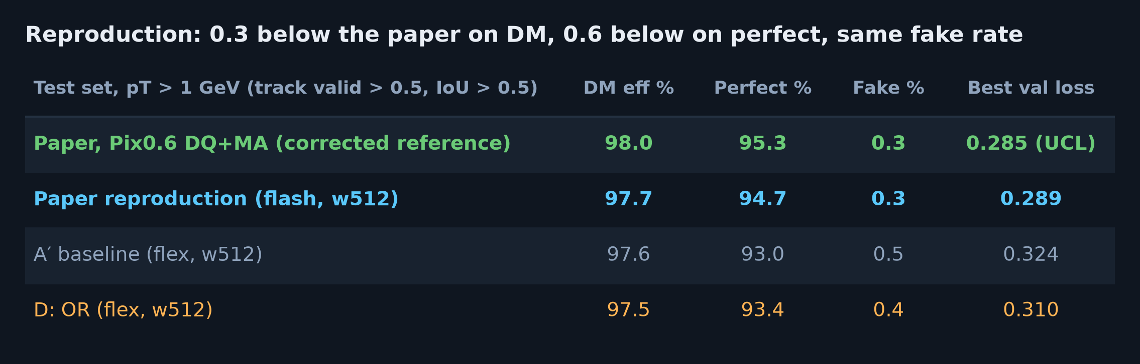
Test set: the reproduction is close to the paper
• UCL's evaluator, pT > 1 GeV, track valid > 0.5, IoU > 0.5, 100 test events
• DM 97.7% vs 98.0%, perfect 94.7% vs 95.3%, fake rate 0.3% vs 0.3%
• Best val loss 0.289 vs UCL's own run 0.285, both at epoch 28
12

Slide 13
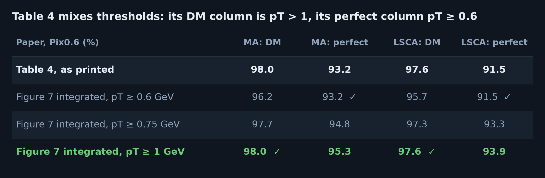
Table 4's perfect efficiency is a pT ≥ 0.6 number
• Integrating the paper's own Figure 7 (values extracted from the PDF) over each pT threshold
• DM column = pT > 1, perfect column = pT ≥ 0.6, for both decoders: 93.2 → 95.3, 91.5 → 93.9
• The updated paper (23 Sep) still has it, and repeats 93.2% in the conclusion
13

Slide 14
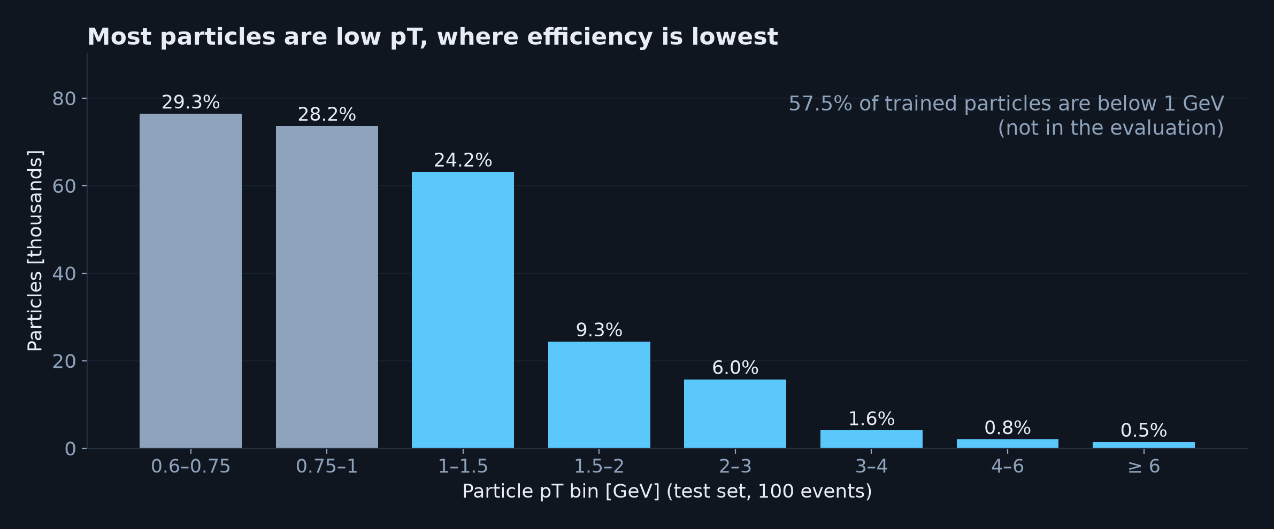
Why the threshold matters so much
• 57.5% of trained particles are below 1 GeV, where efficiency is lowest (≈ 93% and 97%)
• Including them pulls efficiency down ≈ 2 points: Table 4's 98.0% couldn't be a pT ≥ 0.6 value
14

Slide 15
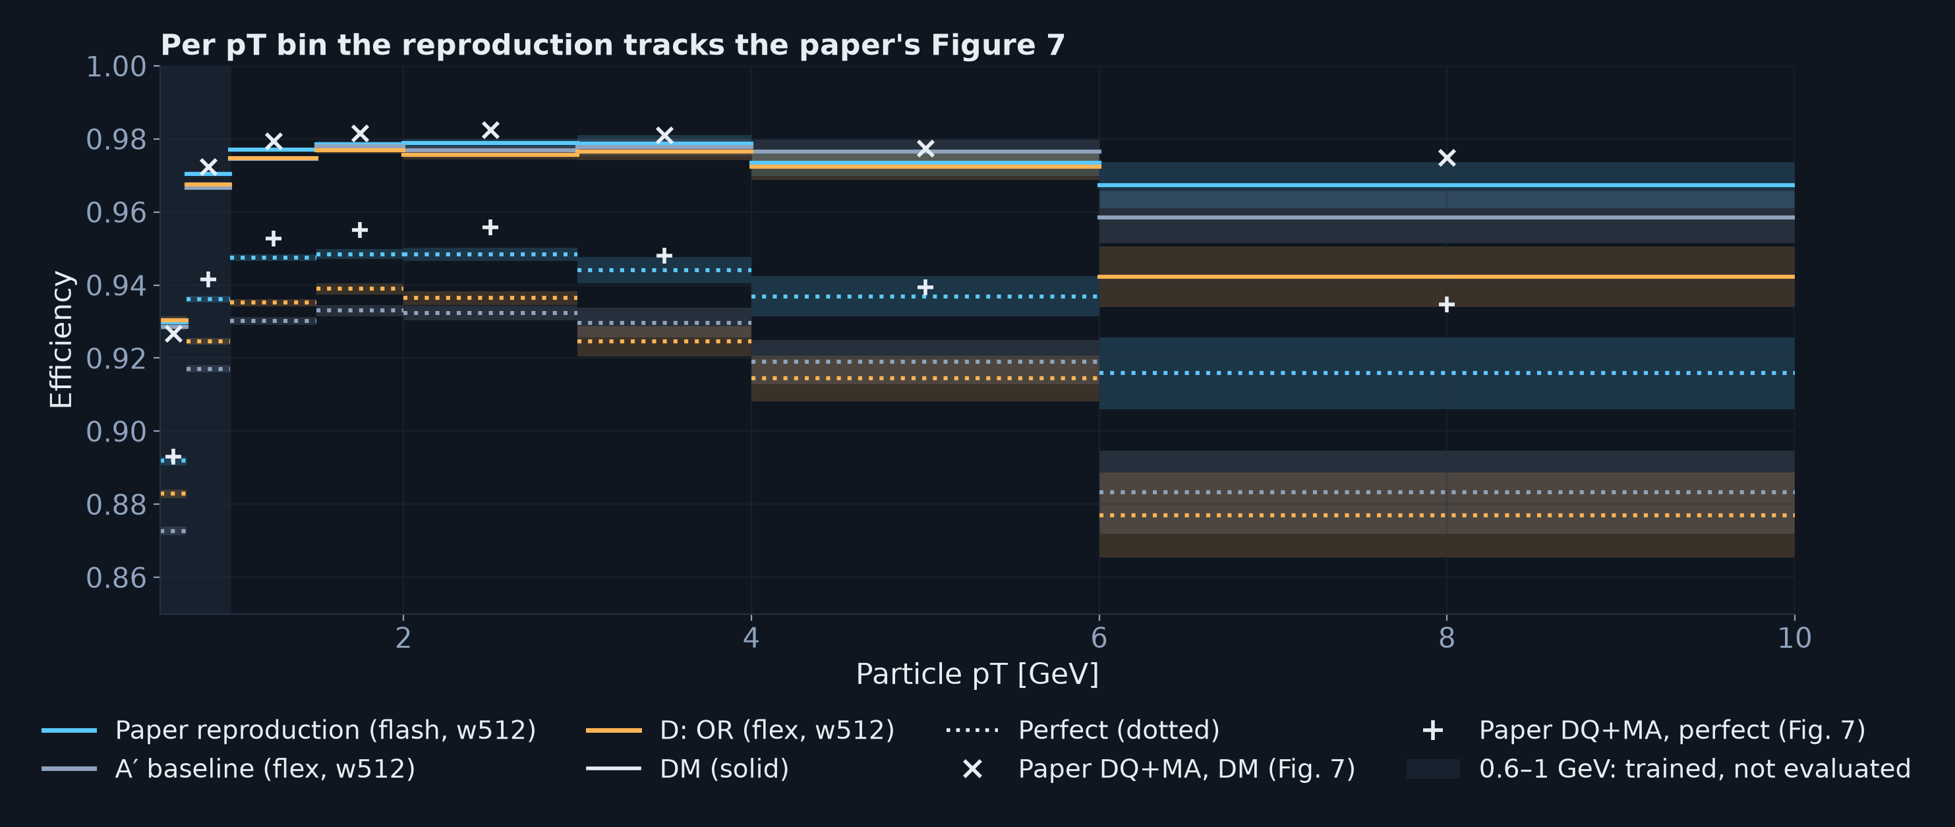
Per pT bin we track the paper's Figure 7
• DM within ≈ 0.5 points of the paper up to 6 GeV; perfect ≈ 0.5–0.8 below at 1–3 GeV
• The remaining gap is in complete hit assignment, not in finding tracks
15

Slide 16
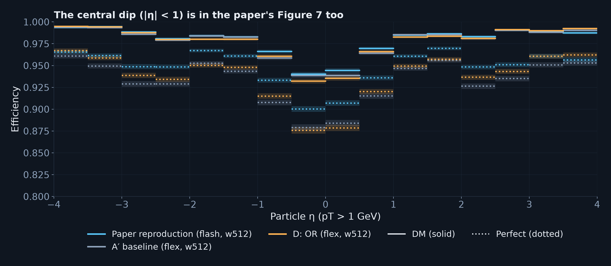
Efficiency vs η matches the paper's shape
• Evaluated particles (pT > 1 GeV); the central dip at |η| < 1 is in the paper's Figure 7b too
• The paper reproduction has the best perfect efficiency almost everywhere
16

Slide 17
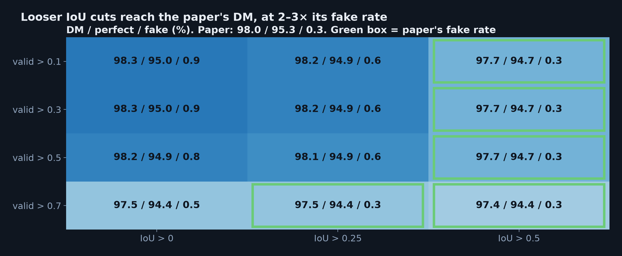
Operating points: the IoU cut is the lever
• Track-validity cut barely matters below 0.7; the predicted-IoU cut trades efficiency for fakes
• At the paper's fake rate: 97.7 / 94.7; loosest cuts: 98.3 / 95.0 at 3× the fakes
17

Slide 18
PART 3
OR amplification
18

Slide 19
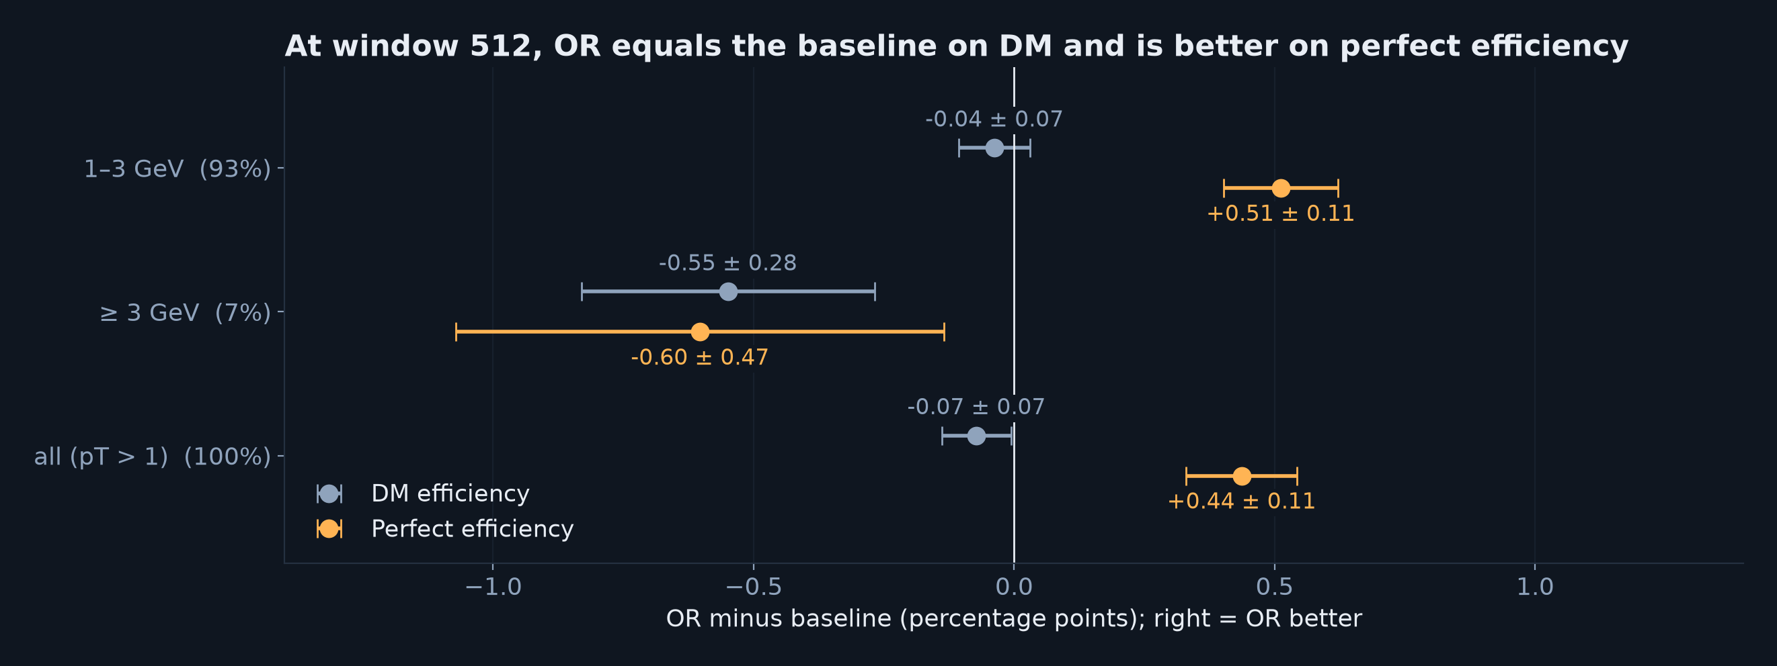
OR vs its fair baseline at window 512
• Fair pair: D (OR) vs A′ (flex baseline), same window, same seed; only OR differs
• DM equal (−0.07 ± 0.07); perfect +0.44 ± 0.11 for OR
• At 512 the plain window already sees enough; OR should matter at smaller windows
19

Slide 20
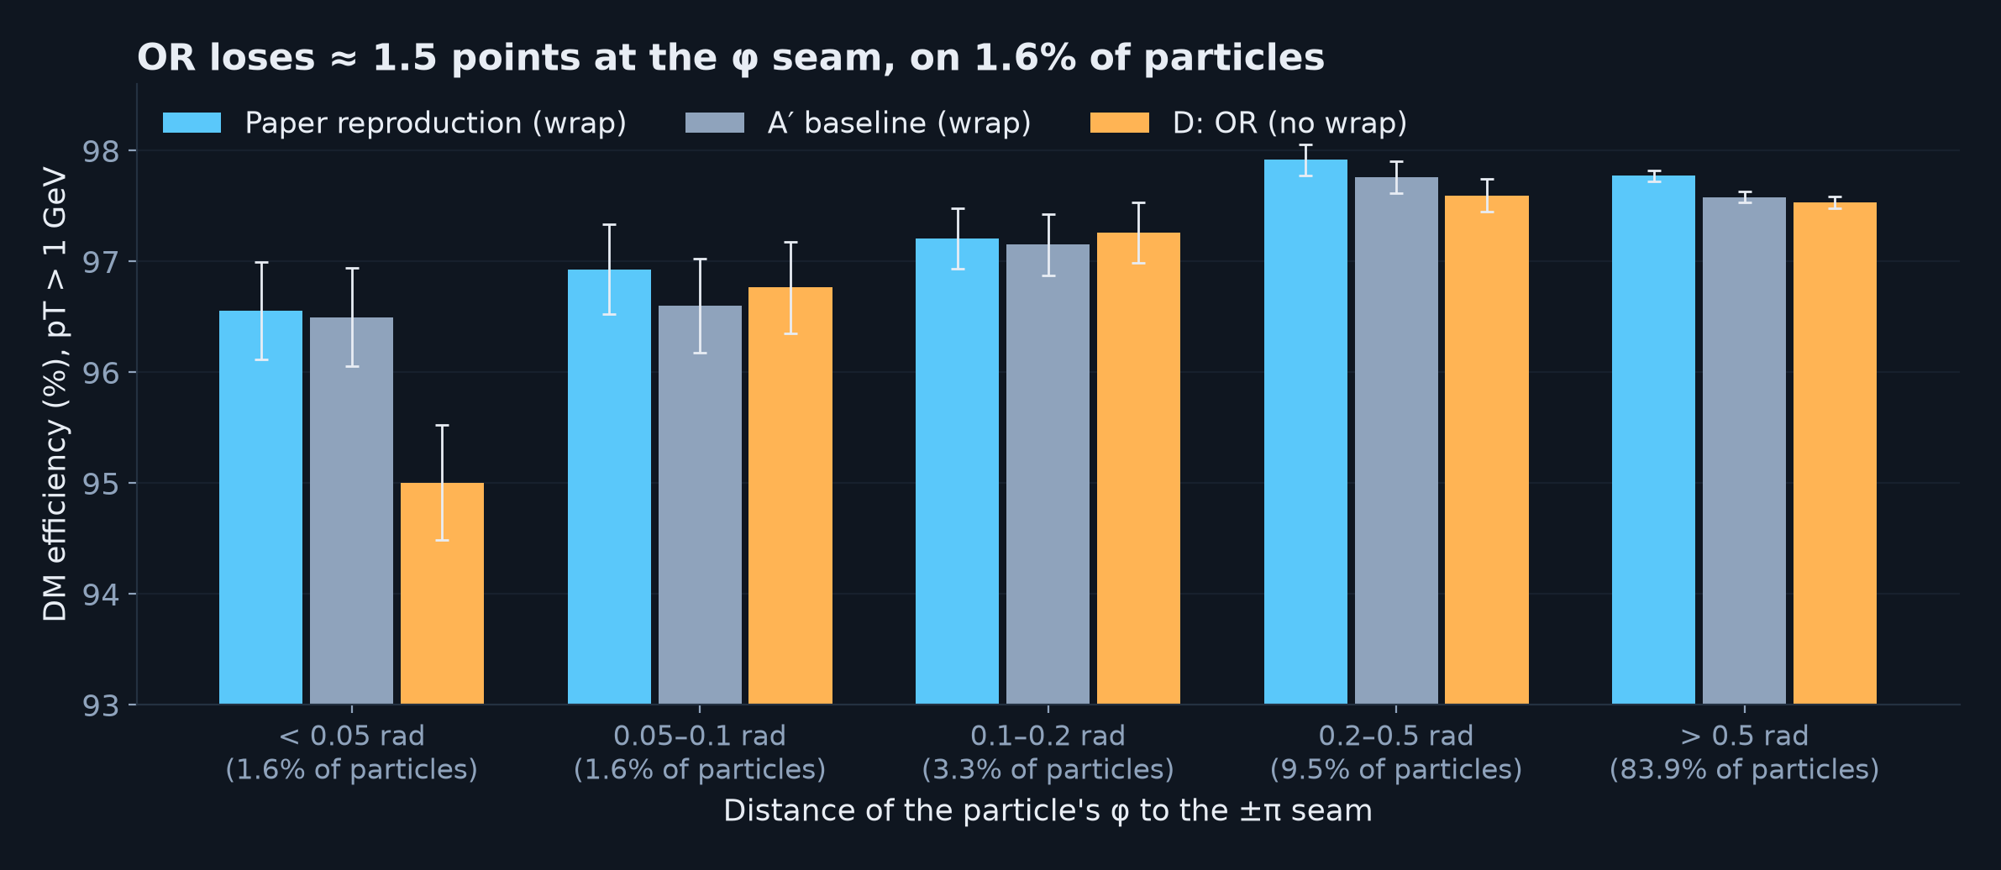
OR's one weakness: the φ seam
• OR's hash orderings treat φ as linear, so every table has a seam at ±π (baselines wrap)
• −1.5 points within 0.05 rad of the seam, but only ≈ 0.02 points overall
• Possible fix: rotate φ randomly per hash table so the OR merge repairs the seam
20

Slide 21
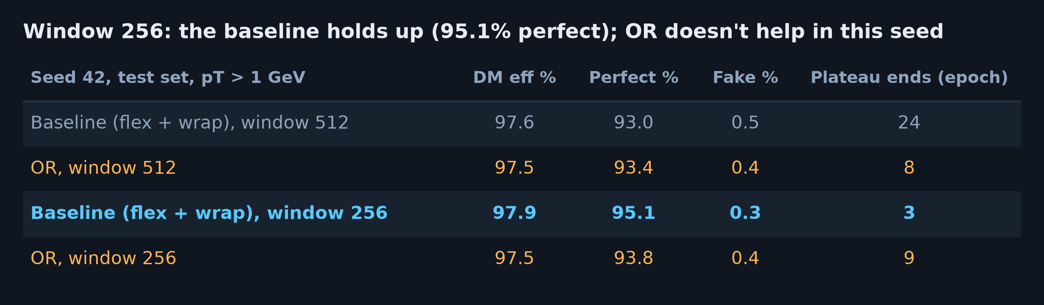
Window 256: the baseline holds up, OR doesn't help (yet)
• Seed 42, test set: OR is 0.4 below the baseline on DM and 1.3 below on perfect efficiency
• Halving the window costs the baseline nothing: 97.9 / 95.1 / 0.3, as good as the flash reproduction
• One seed; the run that leaves the plateau first wins (also at 512). Seed 43 and window 128 running
21

Slide 22
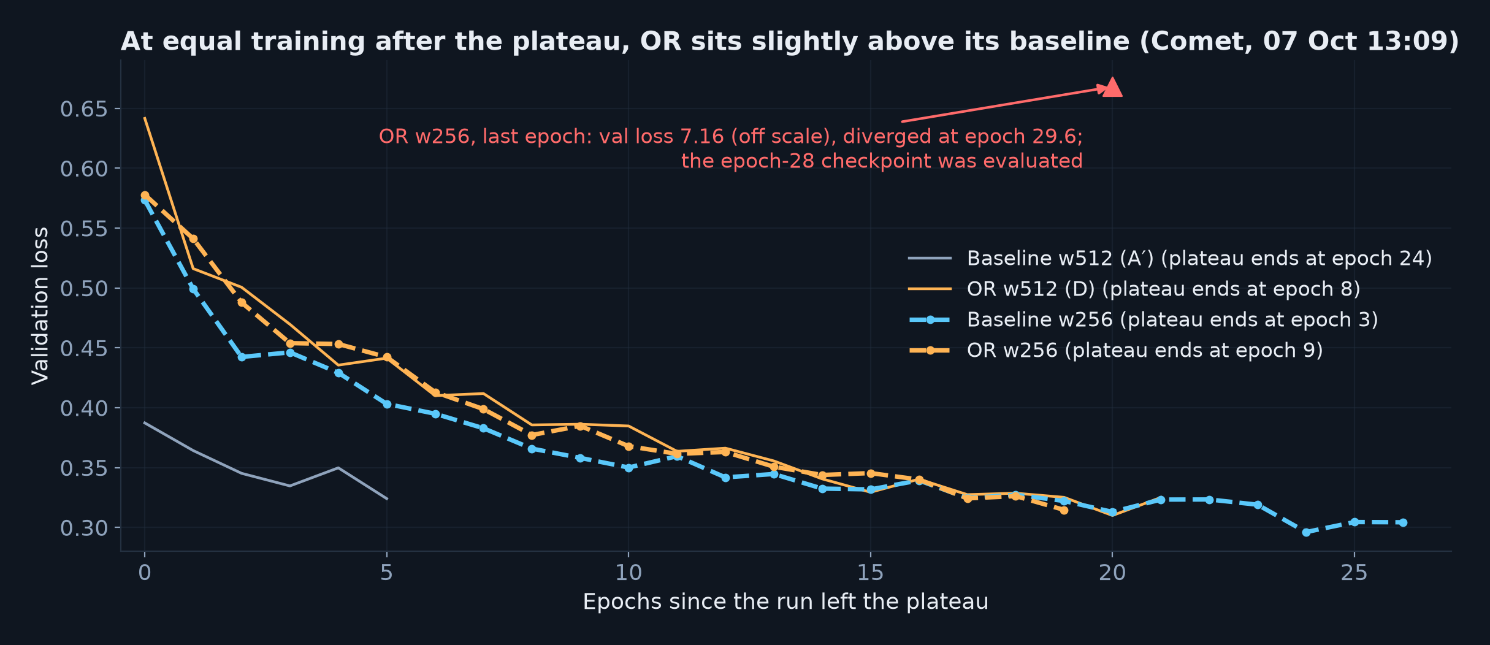
Compared at equal training after the plateau
• x = epochs since each run left the plateau, so runs are compared at equal real training
• At window 256 OR stays slightly above its baseline until they converge ≈ 16 epochs in
• OR w256 diverged in its last epoch (loss 0.46 → 660,829 in one step); its epoch-28 checkpoint was evaluated
22

Slide 23
Status
Paper reproduction, A′, D and both window-256 runs: finished and evaluated (pT > 1 GeV)
Window 128, seed 42: training, done ≈ 8 Oct 23:00 and 9 Oct 03:00; seed 43 ≈ 10–12 Oct
Each sweep run is evaluated automatically as it finishes (same evaluator, same cuts)
The notebook session has a 7-day lifetime: it expires 12 Oct 10:08
That is what killed A′ and D on 5 Oct (not a reboot). Checkpoints survive on /shared, so the
last sweep runs will be resumed in the next session, losing at most one epoch
23

Slide 24
Questions for UCL
1. Table 4, Pix0.6: is the perfect efficiency (93.2%, 91.5%) a pT ≥ 0.6 value?
Figure 7 integrated over pT > 1 gives 95.3% and 93.9%. Could we get your __test.h5?
2. Which track-validity and IoU cuts are behind Table 4?
3. Did you see the training plateau? Anything that avoids it (warm-up, seeding)?
4. Two upstream issues we found:
• the loss masks padded queries with an unpermuted query_mask after matching
• attn_type: torch gives garbage (loss 6.8 with good weights); lap1015_early is broken
5. Interested in the matcher toggles? Toggle 1 is a drop-in, identical-results speed-up
24

Slide 25
Next
Finish the window sweep and evaluate every run (seed 42 first)
Seed 43 and window 128: is the window-256 result a plateau effect or real?
Find out why OR w256 diverged at epoch 29.6 (numerical? which event?)
DQ+LSCA reproduction (target: 97.6 / 93.9 / 0.4)
Periodic-φ OR to remove the seam
Overlap the matcher with the forward pass for the next speed-up
25

