Slide 1
Minesweep you off your feet
Hawiar Hussein && Jordan Holly

Slide 2


Slide 3
Minesweeper? What?
Minesweeper is a game where you have a
board sized X * Y with B number of mines and (X * Y) - B free spaces
Objective: Clear all the free spaces without touching a mine.

Slide 4
Free Spaces
Blank: A blank free space indicates that all surrounding blocks are a number and NOT a mine
A numbered free space indicates the number of mines surrounding a space

Slide 5
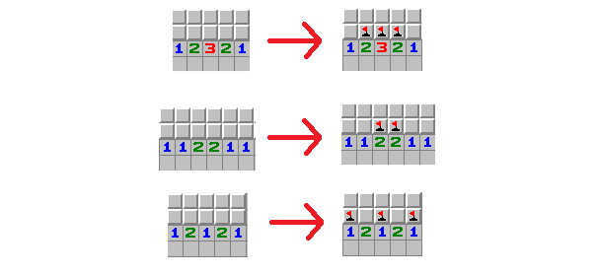

Slide 6
Why Minesweeper?
Jordan: Favorite game
Hawiar: Never played, fun challenge?

Slide 7
Goals?
Actually make a functional game of Minesweeper
Create an incentive to play more: Unlockables
Create an incentive to score higher: Leaderboard
Add a hint button for the inexperienced

Slide 8

Tools: Heroku
Cloud platform as a service
Focus on applications, not infrastructure
Easy deployment from Git
Dyno – Lightweight Linux container that runs single user-specific command. We only have one (free option). More dynos handle more traffic, therefore, free option is a bit on the slow side. Bigger dynos scale up to handle more RAM intensive web pages.

Slide 9

Tools: Ruby on Rails
Web App Framework written in Ruby
Uses MVC Architecture
Convention over Configuration – Rails decides default conventions so the user doesn’t have to specify minute details right off the bat. Assumes what every developer needs to get started and gives it to the dev.
Upon creating new application, Rails automatically creates directories for database schema, controllers, models, views. Helpers, mailers, etc.

Slide 10
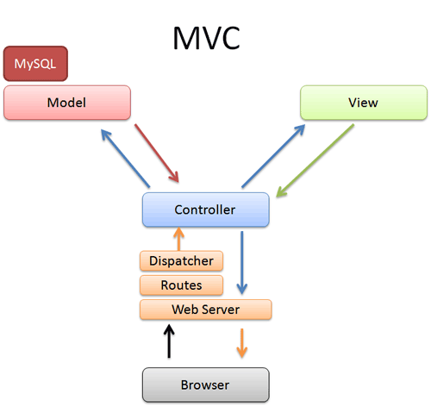

Slide 11

Embedded Ruby
Template System that allows you to embed Ruby code into text documents like HTML.
You can use this to display dynamic information, perform loops, and plenty more that Ruby has to offer.

Slide 12
Embedded Ruby Example
%tr
 | %th User
 | %th High Score
 | -users.each do |user|
 | %tr
 | %td=link_to user.username, player_path(id: user.id)
 | %td= user.high_score

Slide 13
Video: LINK!

