Slide 1
DEVICE DRIVER
I²C OLED Driver on Raspberry Pi
MURUGESAN A
25MES1005

Slide 2
Device driver
A device driver is a piece of kernel-level software that allows the Linux user space to communicate with hardware devices.
It acts as a translator between user-space applications and the physical hardware.
Applications don’t directly access hardware registers; they call system calls.
If you connect a UART to an embedded linux environment. User programs just use simple APIs (like read(fd, buf, size)) without worrying about register addresses or bit fields.

Slide 3
Hardware Interfacing in Linux
Hardware interfacing means connecting and controlling external hardware devices (sensors, actuators, displays, storage, communication modules) through the embedded board’s I/O peripherals (Linux).
In Linux, this usually involves:
Hardware Layer (Registers & Signals) → The actual physical device (e.g., I2C temperature sensor).
Driver Layer → Kernel driver provides access via /dev or /sys/class.
User Space Applications → Access hardware through system calls or libraries.
Example: I2C Temperature Sensor
Hardware: Sensor connected to I2C bus of ARM processor.
Driver: I2C driver registers a device at /dev/i2c-1.
User Space: Application can open("/dev/i2c-1"), configure sensor via ioctl, and read values.

Slide 4
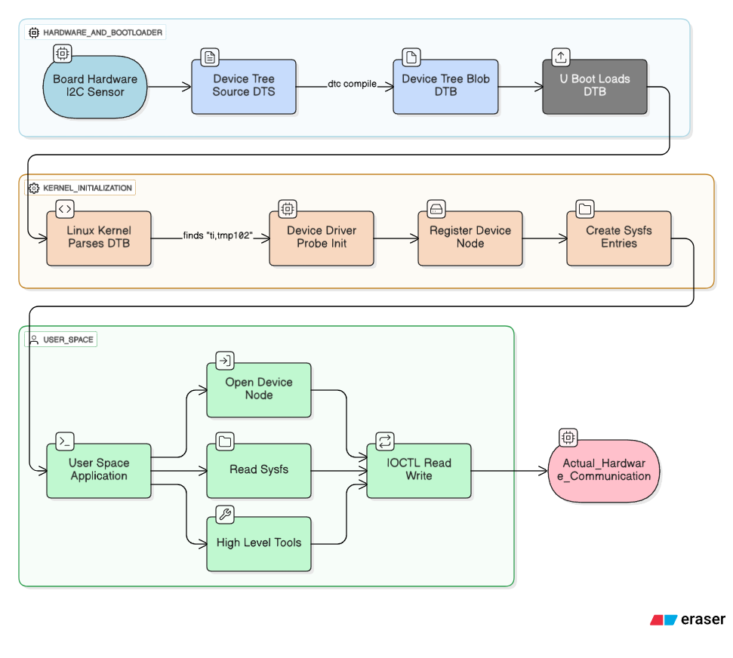
THE FLOW

Slide 5
Types of device drivers
1. Character Devices
Transfer data character by character (byte stream).
Accessed via /dev/ nodes.
Examples: keyboard, mouse, serial port (UART), sensors.
2. Block Devices
Transfer data in fixed-size blocks.
Support random access and are usually used with filesystems.
Examples: hard drives, SSDs, SD cards, USB drives, CD-ROMs.
3. Network Devices
Handle packet-based data transfer over networks.
Exposed as network interfaces (e.g., eth0, wlan0).
Examples: Ethernet cards, Wi-Fi adapters, CAN bus controllers.

Slide 6
Types of device drivers
4. Platform Devices
On-chip SoC integrated peripherals (not hot-pluggable).
Typically defined in Device Tree.
Examples: I²C controller, SPI controller, GPIO controller, timers.
5. USB Devices
Plug-and-play devices connected over USB.
Can be storage, input, or communication devices.
Examples: USB keyboard, pen drive, USB Wi-Fi dongle.
6. Virtual / Pseudo Devices
No real hardware, but behave like devices.
Provide special kernel–user space interfaces.

Slide 7
commands
To list all the device files use the below command.
1. ls -l /dev
To display the details of the file system. Using grep we can filter real hard disk files.
2. df -h | grep ^/dev
Lists details about the hardware components in the file system.
3. inxi -D -xx

Slide 8
CHAR DRIVER
Character drivers play a pivotal role in interfacing user-level applications with hardware devices.
Character drivers are used to interact with devices in the Linux kernel.
Char devices refer to hardware components like memory areas, often called pseudo devices.
Userspace applications communicate with these devices using system calls like open, read, and write.

Slide 9
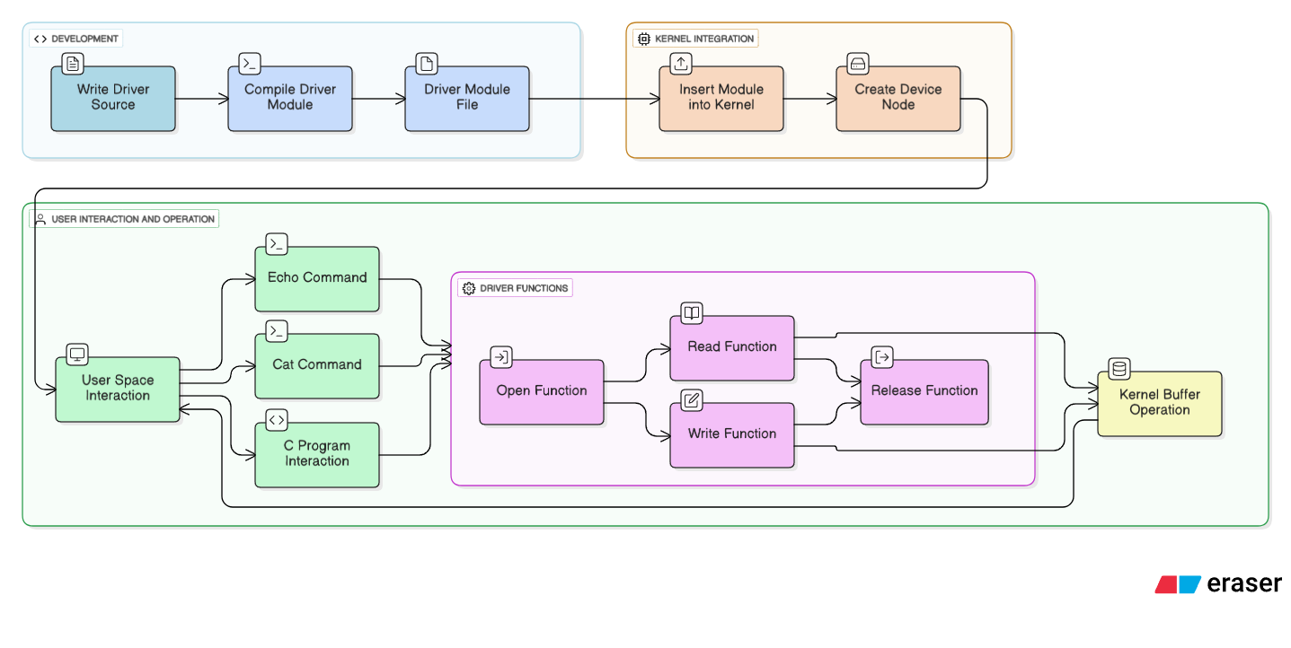
FLOW

Slide 10
RASPBERRY-PI GPIO DEVICE DRIVER
Structure/Function | Purpose
dev_t dev | Stores major+minor device number.
struct cdev etx_cdev | Represents character device in kernel.
struct class *dev_class | Creates sysfs class & device node.
struct file_operations fops | Maps file ops (open, read, write, release) to driver functions.
etx_open() | Runs on open() – logs info.
etx_release() | Runs on close() – logs info.
etx_read() | Reads GPIO pin state, sends to user.
etx_write() | Writes to GPIO (LED ON/OFF).
etx_driver_init() | Initialization (device, GPIO setup).
etx_driver_exit() | Cleanup when driver is removed.

Slide 11
GPIO Function | Purpose
gpio_is_valid(gpio) | Check if the given GPIO number is valid on the hardware.
gpio_request(gpio, "name") | Reserve the GPIO so no other driver or subsystem can use it.
gpio_direction_output(gpio, value) | Configure GPIO as output and set initial value (0 = LOW / 1 = HIGH).
gpio_direction_input(gpio) | (Alternative) Configure GPIO as input to read values.
gpio_set_value(gpio, value) | Set output value of GPIO (turn LED ON/OFF).
gpio_get_value(gpio) | Read the current value of GPIO (button press / LED state).
gpio_export(gpio, false) | Make GPIO visible in sysfs (/sys/class/gpio/).
gpio_unexport(gpio) | Remove GPIO from sysfs entry.
gpio_free(gpio) | Release the GPIO when driver is unloaded.

Slide 12
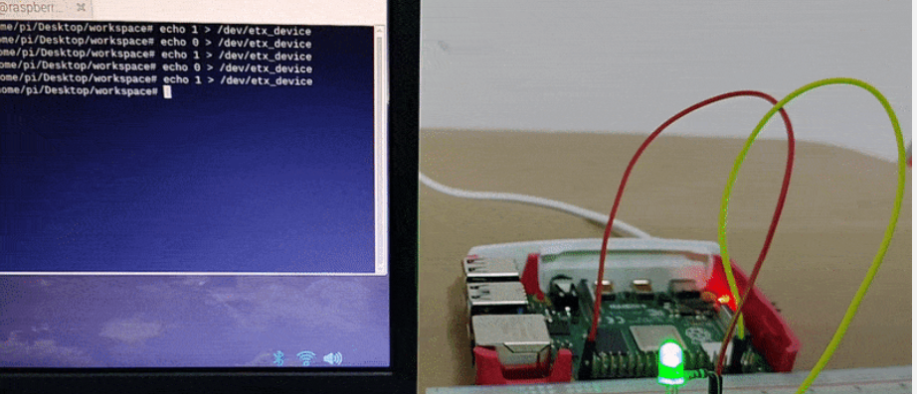

Slide 13
Introduction to the Driver
• This project demonstrates writing a Linux Kernel I²C driver.
• The driver interfaces with an SSD1306 OLED display over I²C bus.
• Tested on Raspberry Pi with kernel version 6.12.25+rpt-rpi-v8.
• Objective: Initialize display, send commands/data, and control pixels.

Slide 14
Important Kernel Structures
• struct i2c_driver → Describes the I²C driver (name, probe, remove).
• struct i2c_client → Represents an I²C slave device (OLED).
• struct i2c_adapter → Represents the I²C controller (bus).
• struct i2c_device_id → Used for matching devices during registration.

Slide 15
Driver Code Flow
sudo insmod i2c_driver.ko
↓
etx_driver_init()
↓
i2c_new_client_device() creates OLED client
↓
i2c_add_driver() registers driver
↓
Kernel matches device → calls etx_oled_probe()
↓
OLED initialized and filled white

Slide 16
Driver Code Flow
sudo insmod i2c_driver.ko
↓
etx_driver_init()
↓
i2c_new_client_device() creates OLED client
↓
i2c_add_driver() registers driver
↓
Kernel matches device → calls etx_oled_probe()
↓
OLED initialized and filled white

Slide 17
I²C Communication Functions
• I2C_Write(): Sends data to OLED using i2c_master_send().
• I2C_Read(): Reads data using i2c_master_recv().
• SSD1306_Write(): Formats command/data bytes and writes to OLED.
• SSD1306_DisplayInit(): Sends initialization command sequence.
• SSD1306_Fill(): Fills display with given data pattern.

Slide 18
MAKE FILE
Makefile snippet:
obj-m += i2c_driver.o
KDIR := /lib/modules/$(shell uname -r)/build
all:
$(MAKE) -C $(KDIR) M=$(PWD) modules
Build Commands:
$ make
$ sudo insmod i2c_driver.ko

Slide 19
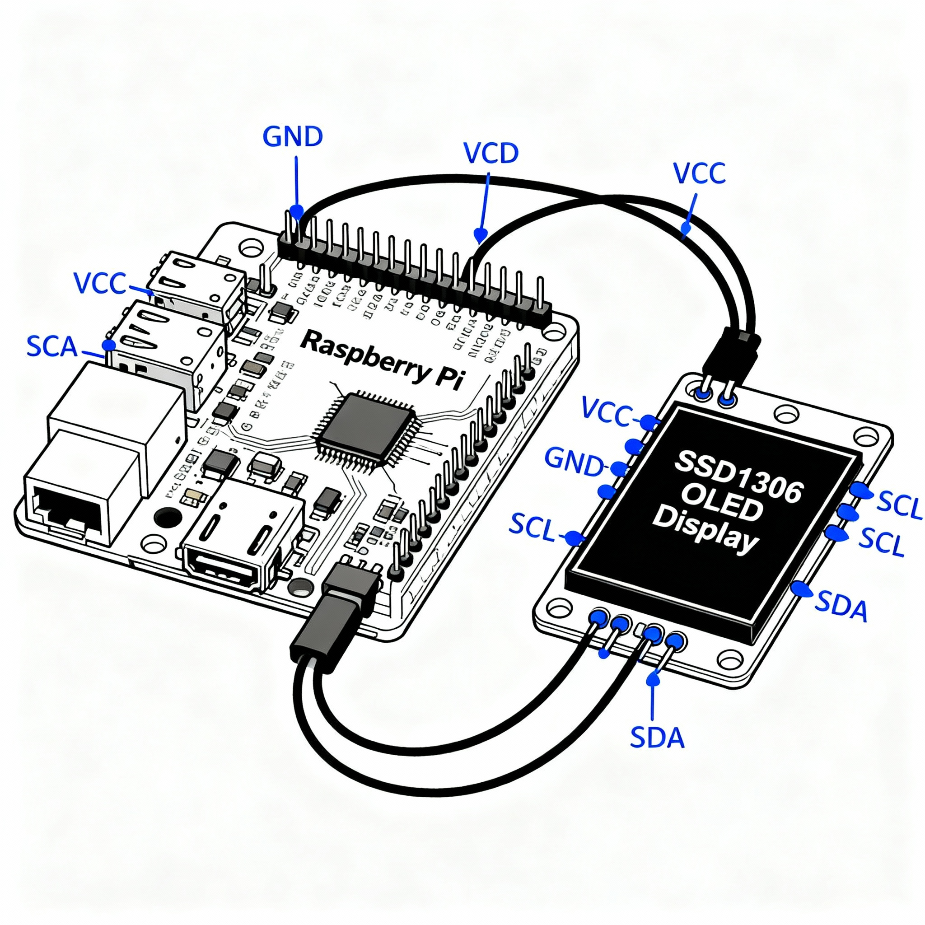

Slide 20
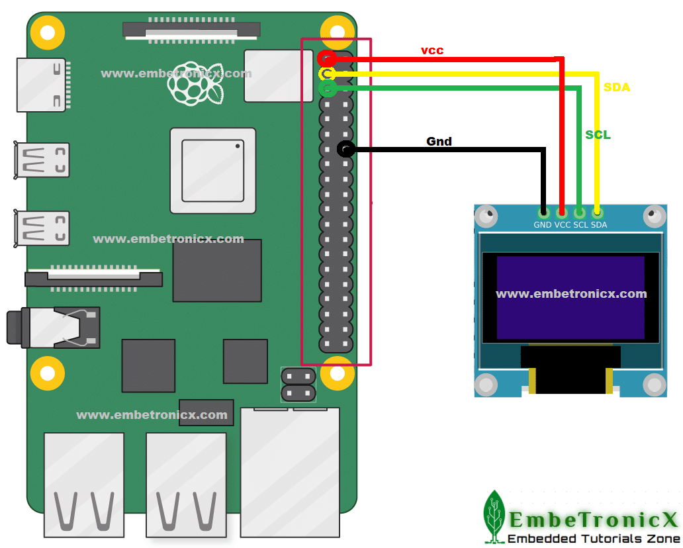

Slide 21

Any
Questions

Slide 22
THANK YOU

