Slide 1
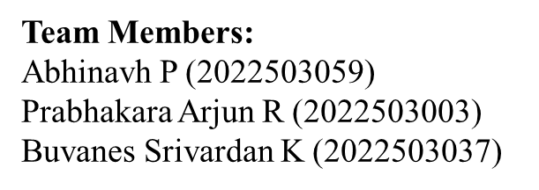
Federated Learning for Code Generation with Hallucination-Aware Fine Tuning
CS6811 – Project Work
MENTOR
Dr. B. Thanasekhar,
Professor,
Computer Technology, MIT

Slide 2
INTRODUCTION
Large Language Models (LLMs) have remarkable capabilities in code generation ,enabling automated solutions to a wide range of software engineering tasks.
However LLMs frequently suffer from hallucinations in code generation, producing syntactically valid but semantically incorrect programs, non-existent APIs, or logically flawed implementations.
Existing approaches to mitigating code hallucinations primarily rely on prompt engineering, repeated sampling, or full model fine-tuning.
Full fine-tuning is computationally expensive and impractical in low-resource or decentralized settings, and repeated sampling does not address the underlying causes and mitigation of hallucination.
In real-world development environments, code generation systems are often deployed across multiple decentralized clients where data cannot be centrally aggregated due to privacy, ownership.
To address these limitations we propose a hallucination-aware code generation framework that combines program analysis, targeted automatic program repair, and federated parameter-efficient fine-tuning using LoRA.

Slide 3
PROBLEM STATEMENT
Code generation using large language models (LLMs) is currently hindered by hallucinations.
Existing mitigation strategies typically rely on supervised fine-tuning or reinforcement learning from human feedback (RLHF), where models are trained to align with human preferences .
While parameter-efficient fine-tuning methods such as LoRA reduce computational overhead compared to full fine-tuning, both approaches primarily optimize model behavior but without explicit verification of program correctness.
As a result, these methods may improve correctness but often fail to systematically detect and correct deeper structural, semantic, and execution-level errors in generated code.
Furthermore, in real world scenarios, high-quality code and execution feedback are distributed across multiple organizations making centralized data collection infeasible due to privacy concerns.
Without a secure and decentralized learning mechanism, models are unable to effectively learn from diverse hallucination patterns observed across clients.
This creates a critical gap for a unified framework that integrates explicit hallucination detection and automated program verification with privacy-preserving, parameter-efficient adaptation to improve the quality of code generation .

Slide 4
OBJECTIVES
To fine-tune large language models using parameter-efficient LoRA in a federated learning setting.
To evaluate the proposed framework on standard code generation benchmarks and analyze hallucination reduction.
To design a hallucination-aware code generation framework that integrates static and dynamic program analysis.
To detect and classify different types of hallucinations in code generation.

Slide 5
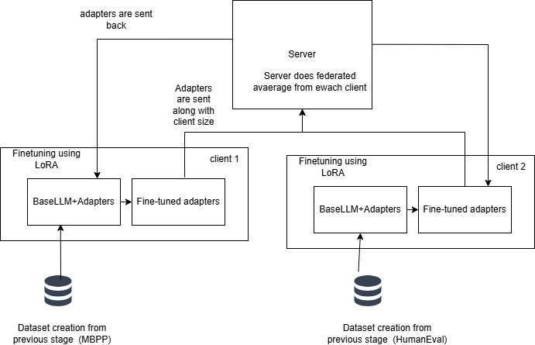
ARCHITECTURE DIAGRAM
Federated learning + LoRA for fine-tuning

Slide 6
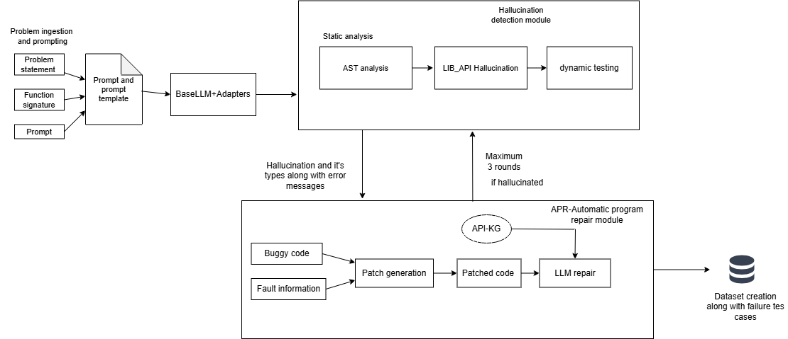
ARCHITECTURE DIAGRAM
Client side hallucination detection and mitigation framework

Slide 7
DATASET CREATION
This is the final output of hallucination detection and mitigation framework.
It contains these columns,
Dataset ,task_id , prompt ,status , ast_info ,dynamic_info ,lib_info, generated_code
patched_code , error_sources , error_types , error_lines , canonical_solution
Prompt and canonical solution will be used for fine-tuning
Error count and types will be used against fed weighted average.

Slide 8
LoRA and FINE TUNING
Here we do supervised fine-tuning usng Low-rank Adaptation technique.
The rank choosen is 16 and alpha value to be 32 to bring down the scaling factor as 2.
We have used the 7 projection layers Query,Key,Value,Object projection which belong to
self-attention layer and gate,up,down belongs to MLP layer.
For SFT we fine-tuned for 3 epochs with batch size 1 and gradient accumulation to be 8.
SFT is done for all the datasets MBPP,DS1000,Humaneval and adapters are generated.
Each fine-tuned adapters are checked for correctness and then verified for improvement in hallucination
reduction.

Slide 9
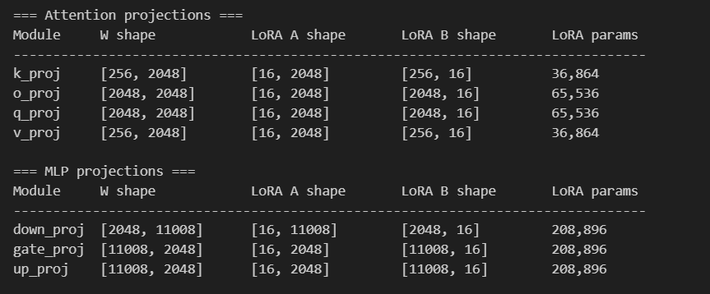
ADAPTERS

Slide 10
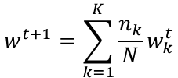
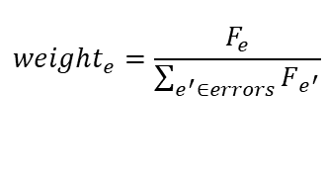

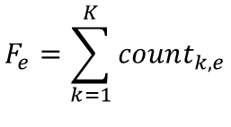

FEDERATED AVERAGE
FedAVG Function
Error frequency
$$F_{e}=\sum_{k=1}^{K}{count_{k,e}}$$
$$w^{t+1}=\sum_{k=1}^{K}{\frac{n_{k}}{N}}w_{k}^{t}$$
K - client
Weight fefinition
​n_{k} = number of training samples on client $k$
$$weight_{e}=\frac{F_{e}}{\sum_{e^{′}∈errors}{F_{e^{′}}}}$$
N – total number of samples used across all clients
F_{e}​ = total occurrences of error type ‘$e’$across all clients count_{k,e​} = number of errors of type ‘$e’$in client $k$

Slide 11
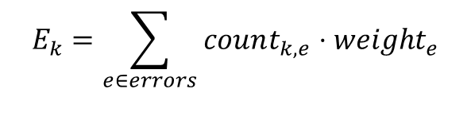
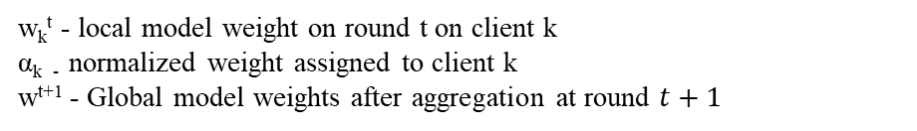
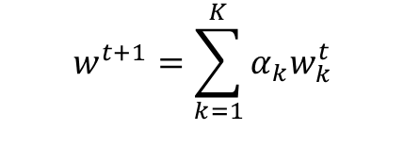
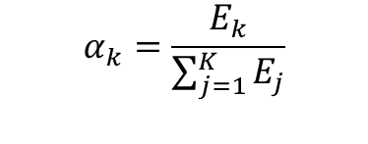
FEDERATED AVERAGE
Error Score
Augmented FedAvg
$$E_{k}=\sum_{e∈errors}{count_{k,e}}⋅weight_{e}$$
$$w^{t+1}=\sum_{k=1}^{K}{α_{k}w_{k}^{t}}$$
For each client, the total count of each type of error along with its computed weight is accounted for
w_{k}^{t}​ - local model weight on round t on client k
α_{k​ -} normalized weight assigned to client k w^{t+1} - Global model weights after aggregation at round $t+1$
Normalisation
$$α_{k}=\frac{E_{k}}{\sum_{j=1}^{K}{E_{j}}}$$

Slide 12
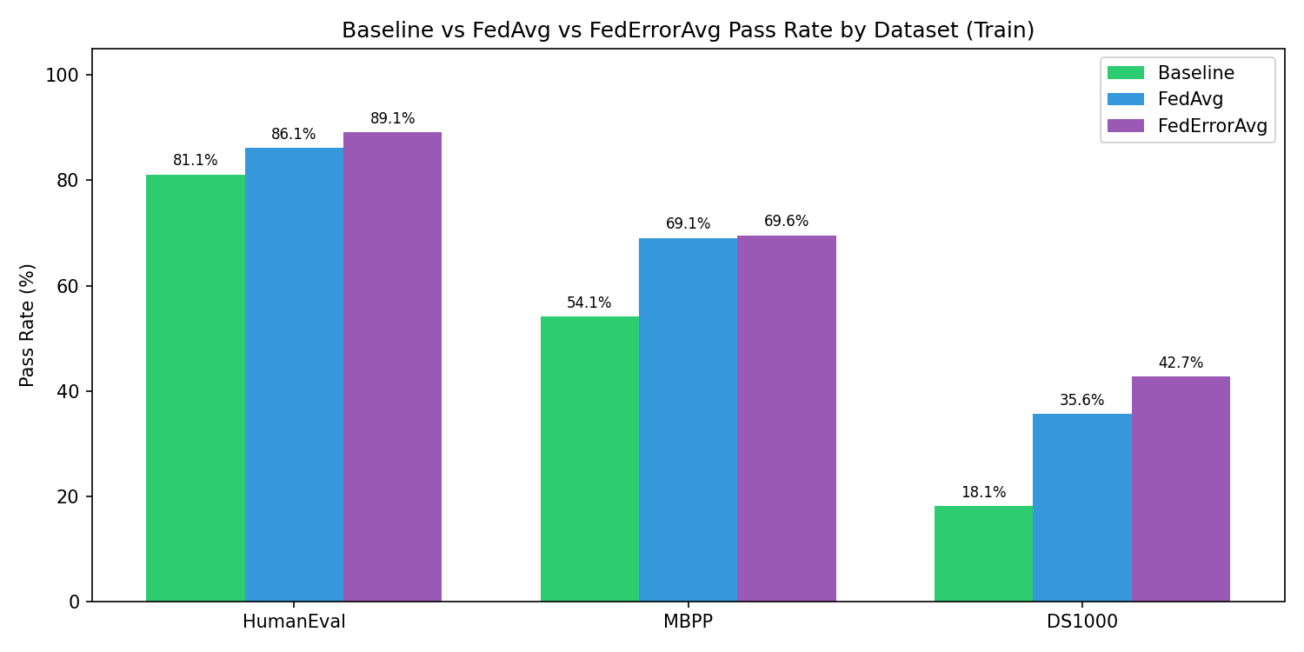
RESULT AND ANALYSIS
A comparison on how federated average and error average
reduces hallucinations across 3 datasets.(using train and test)

Slide 13
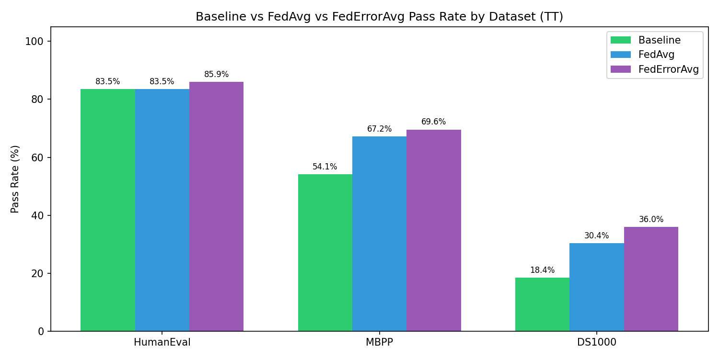
RESULT AND ANALYSIS
A comparison on how federated average and error average
reduces hallucinations across 3 datasets.

Slide 14
RESULT AND ANALYSIS
Error type | Baseline | FedAvg | Reduction
AssertionError | 5 | 5 | 0
NameError | 2 | 2 | 0
SyntaxError | 1 | 1 | 0
Error distribution for HumanEval after federated average

Slide 15
RESULT AND ANALYSIS
Error type | Baseline | FedAvg | Reduction
AssertionError | 42 | 52 | 0
IndentationError | 1 | 0 | 1
IndexError | 1 | 1 | 0
NameError | 26 | 4 | 22
SyntaxError | 17 | 8 | 9
TypeError | 6 | 2 | 4
UnboundLocalError | 1 | 0 | 1
ValueError | 1 | 1 | 0
Error distribution for MBPP after federated average

Slide 16
RESULT AND ANALYSIS
Error type | Baseline | FedAvg | Reduction
AssertionError | 79 | 78 | 1
AttributeError | 14 | 5 | 9
AxisError | 1 | 2 | 0
FileNotFoundError | 1 | 0 | 1
IndentationError | 17 | 16 | 1
IndexError | 1 | 3 | 0
InternalError | 0 | 5 | 0
InvalidIndexError | 1 | 0 | 1
KeyError | 5 | 16 | 0
NameError | 43 | 11 | 32
NotFittedError | 2 | 2 | 0
RuntimeError | 3 | 2 | 1
SyntaxError | 1 | 0 | 1
TimeoutError | 3 | 0 | 3
TypeError | 18 | 15 | 3
ValueError | 15 | 19 | 0
Error distribution for DS1000 after federated average

Slide 17
RESULT AND ANALYSIS
Error Type | Baseline Count | FedErrorAvg Count | Reduction
AssertionError | 5 | 4 | 1
NameError | 2 | 2 | 0
SyntaxError | 1 | 1 | 0
Error distribution for HumanEval after federated error average

Slide 18
RESULT AND ANALYSIS
Error Type | Baseline Count | FedErrorAvg Count | Reduction
AssertionError | 42 | 51 | 0
IndentationError | 1 | 0 | 1
IndexError | 1 | 2 | 0
NameError | 26 | 3 | 23
SyntaxError | 17 | 5 | 12
TypeError | 6 | 2 | 4
UnboundLocalError | 1 | 0 | 1
ValueError | 1 | 0 | 1
Error distribution for MBPP after federated average

Slide 19
RESULT AND ANALYSIS
Error Type | Baseline Count | FedErrorAvg Count | Reduction
AssertionError | 79 | 71 | 8
AttributeError | 14 | 7 | 7
AxisError | 1 | 1 | 0
FileNotFoundError | 1 | 0 | 1
IndentationError | 17 | 16 | 1
IndexError | 1 | 3 | 0
InternalError | 0 | 5 | 0
InvalidIndexError | 1 | 0 | 1
KeyError | 5 | 6 | 0
NameError | 43 | 8 | 35
NotFittedError | 2 | 0 | 2
RuntimeError | 3 | 3 | 0
SyntaxError | 1 | 4 | 0
TimeoutError | 3 | 0 | 3
TypeError | 18 | 16 | 2
ValueError | 15 | 20 | 0
Error distribution for DS1000 after federated average

