Slide 1
CS6611- CREATIVE AND INNOVATIVE PROJECT
TEAM 40
Enhancing QR Code Security Using Blockchain-Backed Chaotic Permutation and Share-Based Diffusion for Secure Data Transmission
Team members:
Abhinavh Parthiban(2022503059) Mentored by: Dr. B. Thanasekhar
Prabhakara Arjun R(2022503003)
Buvanes Srivardan K (2022503037)

Slide 2

Problem Statement:
QR codes are widely utilized in various fields for quick and efficient information sharing. However, they are vulnerable to security threats such as information leakage, data tampering, and unauthorized access, especially during transmission and storage. Ensuring the confidentiality and integrity of QR code data in such scenarios is crucial to prevent misuse and maintain trust.

Slide 3
Proposed solution:
This project aims to address these challenges by utilizing a permutation block scramble method to modify the image into an undiscernible QR image. Furthermore, the system is reinforced by using share splitting algorithm to diffuse the image into multiple noisy counterparts, which can further be sent through a secure channel and decrypted to reveal the original QR image to the user based on a OTP system.

Slide 4
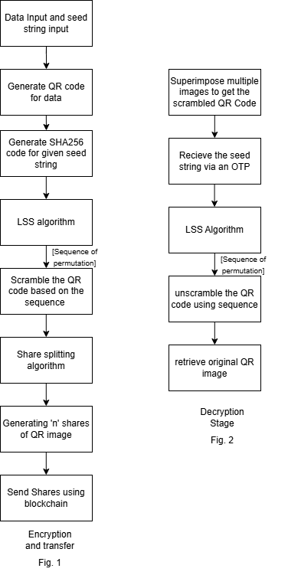
Flowchart:

Slide 5
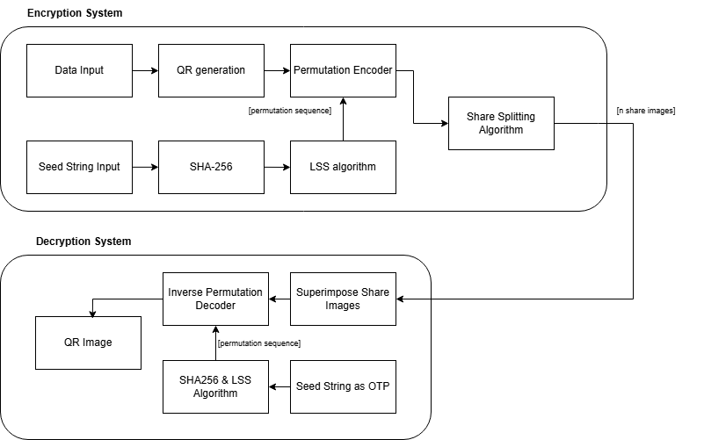
Proposed System Model:
Fig. 3

Slide 6
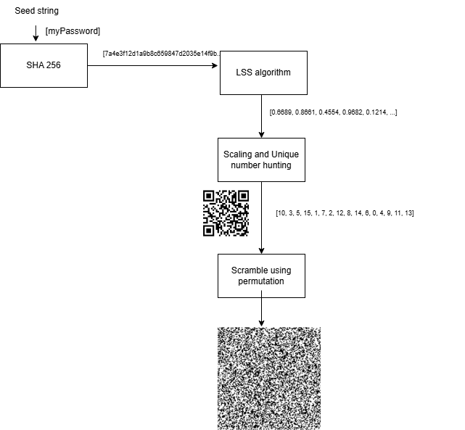
Permutation Encoder Sub-System Model:
Fig. 4
6

Slide 7
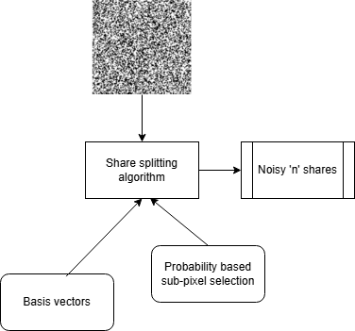
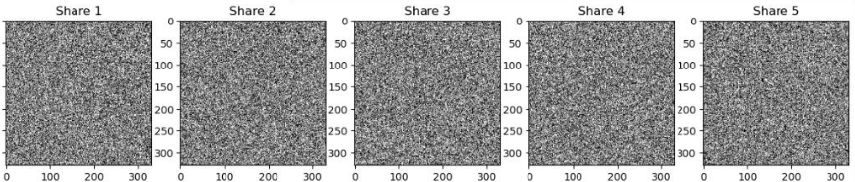
Share Splitting Algorithm Sub-System Model:
Fig. 5

Slide 8
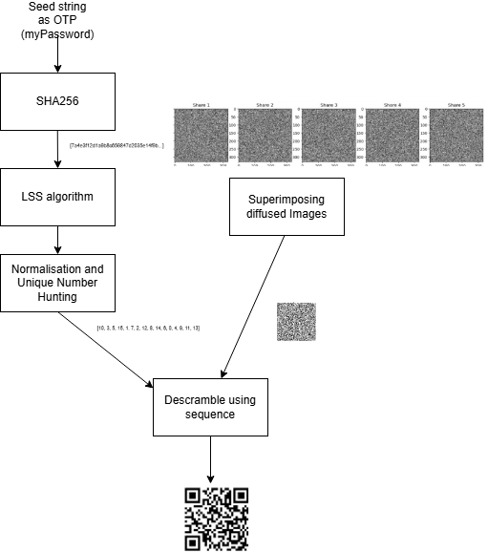
Decryption Process Sub-System Model:
Fig. 6

Slide 9
Randomisation Algorithm Using Logistic-Sine System (LSS)
The Logistic-Sine System (LSS) is a chaotic system used in the encryption scheme to generate pseudo-random sequences for block permutation. It combines features from Logistic Map and Sine Map, making it more chaotic and suitable for encryption.
In this project, the LSS algorithm is used to generate a random sequences to decide the permutation order for block scrambling the QR code.
The LSS system is the most suitable algorithm to randomization components for image encryption algorithms as it provides
Wider chaotic range
Better pseudo-randomness factor
Highly sensitive to inputs

Slide 10

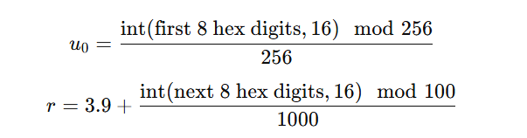
Formulae:

Slide 11
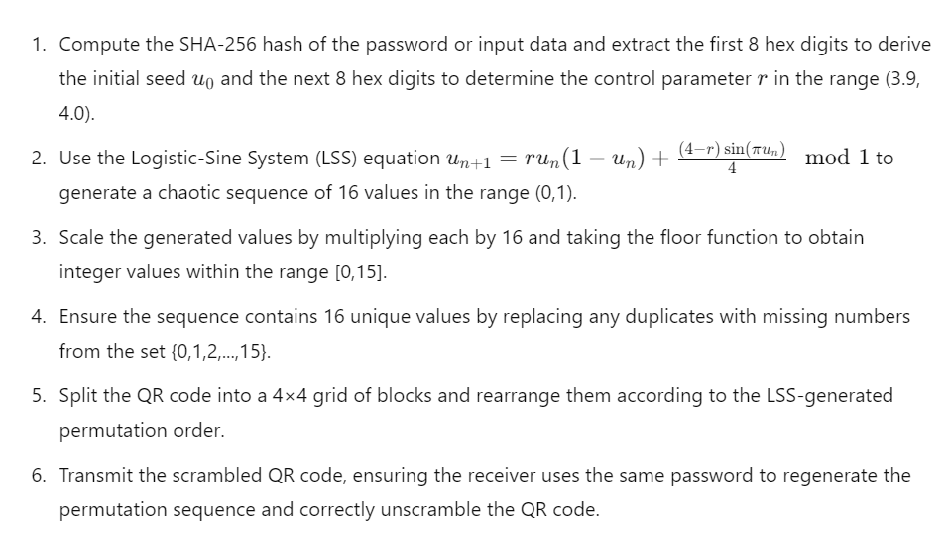
Proposed Algorithm:

Slide 12
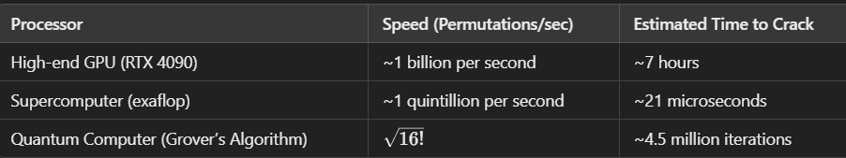
Why is Permutation Block Scrambling used?
The time complexity required to crack a permutation for a 4x4 system, we get a time complexity of 16! ~ 20,922,789,888,000 or 21 trillion possible permutations, it is really hard for traditional systems to crack this using traditional methods and computational devices
Why is it not enough to ensure safety?
Image pattern analysis algorithms (such as frequency analysis, histogram analysis, and edge detection) can be used to attack permutation scrambling effectively
So, additionally we will also employ diffusion into several parts to combat attacks

Slide 13
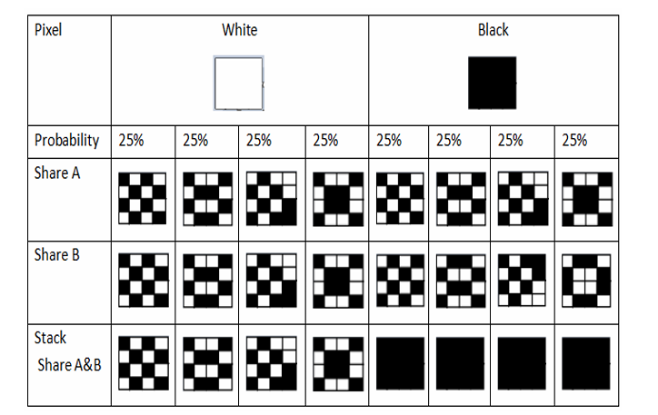
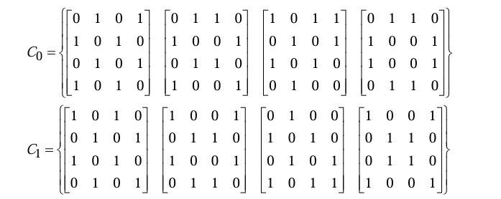
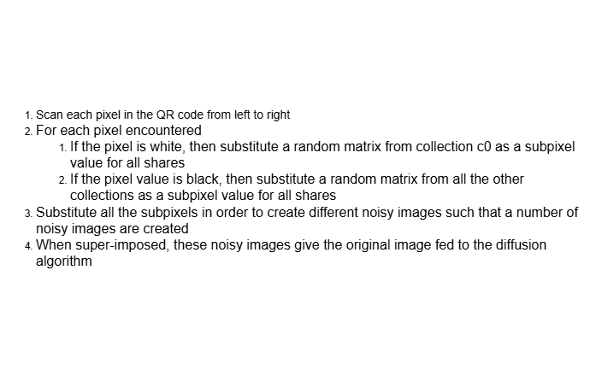
Diffusion Algorithm Principle:
Bases Vector Collections
Fig.8
Proposed Algorithm
SubPixel Probability
Fig.7

Slide 14
Real Time Applications:
Drone Landing Confirmation: Encrypted QR codes serve as secure landing markers for UAVs, ensuring that drones only land at authorized locations. This prevents unauthorized deviations or interceptions. Blockchain technology logs and verifies each landing event, maintaining a tamper-proof record to enhance security in critical applications such as deliveries, surveillance, and emergency response.
Semi-Physical Two-Factor Authentication (2FA): Encrypted QR codes are used in a multi-stakeholder security framework where different entities hold separate shares of an image. Only when all shares are combined can the QR code be fully reconstructed and authenticated, ensuring access to sensitive assets like bank lockers. Blockchain records policy agreements and authentication events, preventing fraud and ensuring transparency in high-security environments.

Slide 15
Literature Survey
S.no | Title | Authors | Journal/ Conference and Year | Proposed Work | Limitations
1 | An Approach for Securing QR code using Cryptography and Visual Cryptography | Cheshtaa Bhardwaj , Hitendra Garg And Shashi Shekhar | 1 st International Conference on Computational Intelligence and Sustainable Engineering Solution (CISES-2022) | The proposed work includes enhancing the security of QR codes by combining cryptography and visual cryptography techniques. The process begins with embedding information into a QR code, which is then encrypted using a key value. The encrypted QR code is further secured using a 'k out of n' visual cryptography scheme, dividing the QR code into 'n' shares, with at least 'k' shares required for reconstruction. The quality of the reconstructed QR code is assessed using Peak Signal-to-Noise Ratio (PSNR) and Structural Similarity Index (SSIM), confirming that the reconstructed QR code is of good quality and identical to the original. | The limitations of this paper involve the absence of an algorithm to split the QR code into its shares, leaving the implementation details unclear. Additionally, the paper does not provide insights into the time and space complexity of the encryption, visual cryptography, and decryption processes. Moreover, it overlooks the possibility that all shares could be intercepted or "sniffed" if not transmitted in a secure environment, which could undermine the security of the system.
2 | Secure QR Code Scheme Based on Visual Cryptography | Xiaohe Cao, Liuping Feng*, Peng Cao and Jianhua Hu | 2nd International Conference on Artificial Intelligence and Industrial Engineering (AIIE2016) | The proposed work presents a novel encryption method that uses a pseudo-random matrix and collections of basis vectors to secure QR codes. The approach also introduces a technique for inducing noise into the QR code image by splitting each pixel into subpixels, resulting in two shares of the QR code. | The limitations of this method include a limited algorithm that could be enhanced for generating more shares through matrix manipulation, as well as the absence of a method to effectively induce noise into the image, potentially weakening encryption strength. These factors indicate the need for further refinement to improve robustness and scalability. Moreover, only two shares on the QR code was made possible by the existing, un-augmented algorithm

Slide 16
Literature Survey
S.no | Title | Authors | Journal/ Conference and Year | Proposed Work | Limitations
3 | A fast chaos-based image encryption scheme with a novel plain image-related swapping block permutation and block diffusion | Xiuli Chai & Zhihua Gan & Miaohui Zhang | Published online: 1 September 2016 Springer Science+Business Media New York 2016 | The paper presents a fast image encryption scheme utilizing block permutation and block diffusion to enhance security and efficiency. The use of a one-dimensional Logistic-Sine System (LSS) generates pseudo-random sequences throughout the encryption process, demonstrating effectiveness and security through experimental results. | The limitations of this work include not having any citations to review greyscale images and related images with no associated greyscale value. The paper also uses the LSS algorithm to diffuse images, incurring massive overhead
4 | Survey of Visual Cryptography Schemes | P.S.Revenkar,AnisaAnjum,W.Z.Gandhare | International Journal of Security and Its Applications Vol. 4, No. 2, April, 2010 | The proposed work studies various visual cryptography schemes. The proposed work involves a visual cryptography scheme that splits a secret image into multiple shares, allowing for secure sharing and reconstruction of the original image when the shares are combined. The method utilizes meaningful shares, which are designed to appear as random images, thus enhancing security and reducing the risk of detection by potential attacker | The limitations of this paper include no mentions about implementation feasibility, no calculation of effective algorithm which can be used to split the image into its meaningful shares.

Slide 17
Literature Survey
S.no | Title | Authors | Journal/ Conference and Year | Proposed Work | Limitations
5 | Image Quality Assessment through FSIM, SSIM, MSE and PSNR—A Comparative Study | Sara, U., Akter, M. and Uddin, M.S | Journal of Computer and Communications, 7, 8-18 | The proposed work implements PSNR (Peak Signal to Noise Ratio) and SSIM (Structured Similarity Indexing Method) to measure the integrity of recovered QR code. | The proposed paper does not give any insights into how binary coloured (black and white) images may be studies under these metrics.
6 | Cryptanalysis of Permutation-Only Image Ciphers | Alireza Jolfaei, Xin-Wen Wu, and Vallipuram Muthukkumarasamy | IEEE Transactions on Information Forensics and Security, vol. 11, no. 2, pp. 236-242, Feb. 2016. | The proposed work explains the security concerns involved in the Permutation based scrambling process, affirming that image-based pattern learning algorithms can crack the encryption given | The limitations of this paper include no mentions about implementation feasibility and no alternative solution suggested for the given problem.
17

Slide 18
Literature Survey
S.no | Title | Authors | Journal/ Conference and Year | Proposed Work | Limitations
7 | Threshold progressive visual cryptography construction with unexpanded shares | Xuehu Yan & Shen Wang & Xiamu Niu | Ms. Ashvini Kute et al Int. Journal of Engineering Research and Applications ISSN : 2248-9622, Vol. 5, | The paper proposes a general threshold progressive visual secret sharing (PVSS) construction method that extends traditional (2, n) PVSS schemes to (k, n) thresholds without pixel expansion | The proposed method does not split the shares as meaningful and meaningless. Also, it does not account for any practical implementation
8 | Cryptanalysis of Permutation-Only Image Ciphers | Alireza Jolfaei, Xin-Wen Wu, and Vallipuram Muthukkumarasamy | IEEE Transactions on Information Forensics and Security, vol. 11, no. 2, pp. 236-242, Feb. 2016. | The paper proposes a general threshold progressive visual secret sharing (PVSS) construction method that extends traditional (2, n) PVSS schemes to (k, n) thresholds without pixel expansion | The proposed method does not split the shares as meaningful and meaningless. Also, it does not account for any practical implementation
18
18

Slide 19
Literature Survey
S.no | Title | Authors | Journal/ Conference and Year | Proposed Work | Limitations
9 | Modern Method for Detecting Web Phishing Using Visual Cryptography (VC) and Quick Response Code (QR code) | A. Kute, S. Kadam, et al | Int. Journal of Engineering Research and Applications, vol. 5, no. 1, Part 3 | The paper presents a modern method for detecting web phishing using Visual Cryptography (VC) and Quick Response (QR) codes, focusing on secure One Time Password (OTP) distribution | The proposed method relies heavily on the security of the two separate servers. If either server is compromised, the security of the entire system could be at risk, as a hacker could potentially access one meaningful share and attempt to decode the secret image with other means
10 | A survey on the security of blockchain systems | Xiaoqi Li , Peng Jiang , Ting Chen. Xiapu Luo , Qiaoyan Wen | Future Generation Computer Systems 107 | The paper systematically examines security risks in blockchain technology, focusing on popular systems like Ethereum and Bitcoin. Implement a distributed storage system (like IPFS), a smart contract platform (such as Ethereum or Hyperledger), and cryptographic hashing (e.g., SHA-256) to securely store, verify, and reconstruct the QR code shares on the blockchain | The paper does not specify practical implementation of the given technology and only discusses security concerns.
19
19
19

Slide 20
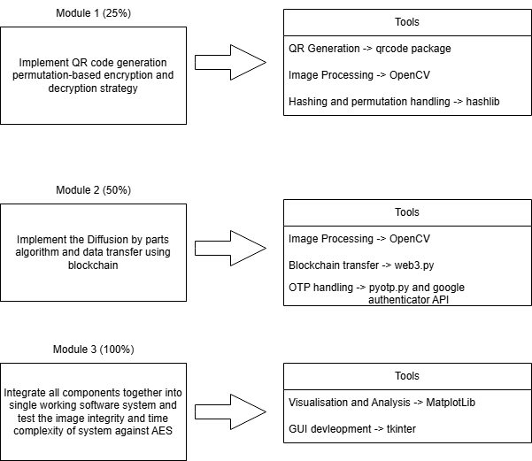
Modules:
^{Fig. 9}

Slide 21
THANK YOU!

