Slide 1

Customer Churn Analysis in the Telecom Industry
The telecom industry is a highly competitive landscape where customer loyalty is essential for long-term success. Understanding and predicting customer churn is crucial for businesses to maintain revenue streams, optimize marketing strategies, and enhance customer relationships. This presentation dives deep into a customer churn analysis project using Tableau and SQL, exploring the data-driven insights that can empower telecom companies to make informed decisions.
By Thenmozhi Sundararaman

Slide 2



Leveraging Tableau and SQL for Optimal Results
Tableau and SQL play complementary roles in providing a comprehensive analysis of customer churn. Tableau's user-friendly interface and powerful visualization capabilities empower analysts to uncover hidden patterns, while SQL provides the foundation for data querying and manipulation.
SQL for Data Extraction and Transformation
Tableau for Visualization and Exploration
Collaborative Insights
The combined power of SQL and Tableau facilitates collaboration between data analysts, business stakeholders, and decision-makers, enabling informed decisions based on robust insights.
SQL is used to extract relevant data from databases, clean and prepare it for analysis, and perform complex calculations to derive meaningful insights.
Tableau's interactive dashboards enable analysts to visualize data trends, identify patterns, and create compelling presentations that facilitate decision-making.

Slide 3
Data Acquisition and Preparation
The initial step in any data-driven project is acquiring and preparing the data. In this instance, we gathered data from a telecom company, focusing on customer demographics, service usage patterns, and subscription details. The data was then meticulously cleaned and preprocessed, ensuring data integrity and removing inconsistencies to enable accurate analysis.
1
Data Source
2
Data Cleaning
3
Data Transformation
A comprehensive dataset encompassing customer details, subscription plans, service usage, and billing information. This diverse data set enables a holistic analysis of customer churn patterns.
Addressing missing values, handling outliers, and correcting inconsistencies in the data. This step ensures data accuracy and reliability for insightful analysis.
Transforming raw data into a format suitable for analysis. This may involve creating new variables, combining data from different sources, or standardizing data types to ensure consistent analysis.

Slide 4
Exploring Customer Churn Patterns
After data preparation, we embarked on an exploratory analysis of customer churn patterns. This involved leveraging Tableau's powerful visualization capabilities to gain insights into the key factors influencing customer churn. This visual exploration revealed significant trends and relationships that provided a foundation for further investigation.
Contract Types
Total Charges
Monthly Charges
Customers with month-to-month contracts were found to have significantly higher churn rates compared to those with one-year or two-year contracts. This suggests a strong correlation between contract duration and churn probability.
Customers with higher total charges exhibited a higher propensity to churn. This suggests that high-value customers may be more susceptible to leaving if they perceive a lack of value or are dissatisfied with service quality.
Analyzing average monthly charges revealed that customers with higher monthly charges, especially those on month-to-month contracts, were more likely to churn. This highlights the importance of balancing pricing strategies to ensure customer value perception.

Slide 5
Identifying Key Drivers of Churn
Armed with the initial insights from exploratory analysis, we delved deeper into identifying the key drivers of customer churn. This involved employing statistical analysis techniques and building predictive models using SQL to understand the factors that most significantly influence churn decisions.
Driver
Impact on Churn
Contract Type
Month-to-month contracts exhibit higher churn rates.
Total Charges
High total charges correlate with increased churn probability.
Monthly Charges
Customers with higher monthly charges, particularly on month-to-month contracts, are more susceptible to churn.
Tenure
Shorter tenure customers are more likely to churn.
Internet Service
Customers with fiber optic internet service tend to have lower churn rates.
Customer Service Experience
Negative customer service experiences can significantly contribute to churn.

Slide 6
Actionable Insights for Customer Retention
The insights gleaned from data analysis and predictive modeling provide telecom companies with valuable tools to improve customer retention. By understanding churn patterns and predicting at-risk customers, companies can implement targeted strategies to enhance customer satisfaction and loyalty.
Personalized Outreach
Customer Service Improvements
Loyalty Programs
Proactive outreach to customers identified as at risk of churn through targeted promotions, discounts, or exclusive offers. This can incentivize them to stay and demonstrate customer appreciation.
Implement loyalty programs that reward long-term customers with exclusive benefits, discounts, or special access to services. This fosters customer loyalty and reduces churn rates.
Enhance customer service experiences by streamlining communication channels, addressing concerns promptly, and implementing training programs to improve agent expertise and empathy.

Slide 7
Churn Patterns: Contract Type & Total Charges
Contract Type
Total Charges
The analysis reveals a clear correlation between contract type and churn rates. Customers with month-to-month contracts exhibited the highest churn, indicating that shorter commitments are often associated with higher churn. Conversely, two-year contracts demonstrated the lowest churn rates, highlighting the value of longer-term commitments. This suggests that offering incentives for longer contracts could be a strategic move to retain customers.
Furthermore, the distribution of total charges among churned customers indicated a trend of higher churn rates among customers with high total charges. This suggests that expensive services might be a contributing factor to churn, potentially due to a perceived lack of value or affordability concerns. A comprehensive review of pricing and service tiers is recommended.

Slide 8
Tailored Retention Strategies: Segmentation & Customer Service
1
Targeted Marketing
2
Prioritizing High-Value Customers
Segmenting customers based on contract type, monthly charges, and other key variables can empower targeted marketing campaigns. For example, offering flexible bundles or price reductions to month-to-month customers with higher monthly charges could effectively address their specific needs and retain them.
Implementing proactive retention strategies for high-value customers, such as personalized support, loyalty rewards, or targeted discounts, is crucial for maximizing revenue. These customers contribute significantly to the business and deserve tailored attention.
3
Enhanced Customer Experience
4
Predictive Analytics & Feedback
Focusing on improving the customer experience for month-to-month subscribers, such as offering faster issue resolution or exclusive service features, could enhance satisfaction and encourage them to transition to longer-term plans.
Regularly collecting feedback from customers who churn and utilizing predictive analytics to identify early signs of dissatisfaction allows for proactive intervention. Automated alerts can address issues before customers decide to leave, maximizing retention efforts.

Slide 9
Revenue Lost Due to Churned Customers
Based on the analysis, 17.24% of the total revenue has been lost due to customer churn. This indicates that nearly one-fifth of the company's potential revenue is being lost as customers discontinue their services.
Major Churn Reasons
Competitor had better devices
Competitor made a better offer
Attitude of support person
313 customers
311 customers
220 customers

Slide 10
Top 5 Cities with Highest Churn Rates
City
Churn Rate
San Diego
65%
Fallbrook
55%
Temecula
50%
Santa Rosa
45%
North Hollywood
40%

Slide 11
Churn Percentages Across Categories
Churn Category
Churned Rev
Churn Percentage
Competitor
1694413
45%
Dissatisfaction
617979
18%
Attitude
579554
17%
Price
438124
12%
Other
354389
10%

Slide 12
Churn Rates by Contract Type
1
Month-to-Month
1,655 churned customers
2
One-Year
166 churned customers
3
Two-Year
48 churned customers
Impact of Total Charges on Churn
High Charges
Low Charges
Customers with high total charges (ranging from $5,700 to $8,648) correlate with higher churn.
Customers with low total charges are less likely to churn.

Slide 13
Key Insights
1
Significant Impact
2
Strategic Focus
3
Opportunity for Improvement
A revenue loss of 17.24% due to churn is substantial, highlighting the importance of addressing the factors driving customers to leave.
To mitigate this loss, the company should focus on key areas such as improving customer satisfaction, enhancing service offerings, and implementing retention strategies to reduce churn rates.
By reducing churn, even a small percentage improvement can translate into a considerable financial gain for the company.

Slide 14
Recommendations
1
Offer Discounts or Incentives for Long-Term Contracts
2
Monitor High-Charge Customers
3
Segmented Marketing Campaigns
Implement proactive retention strategies for customers with high total charges, such as personalized support, loyalty rewards, or targeted discounts.
Use customer segmentation based on contract type, monthly charges, and other key variables to tailor marketing and retention efforts.
To reduce churn, focus on converting month-to-month customers into long-term contracts by offering discounts, loyalty programs, or additional benefits.
4
Enhance Customer Service for Short-Term Subscribers
Focus on improving the customer experience for month-to-month subscribers, such as offering faster issue resolution or exclusive service features.

Slide 15
Conclusion: Empowering Telecom Businesses for Success
In the highly competitive telecom industry, understanding and managing customer churn is a critical priority for businesses. By harnessing the power of data analytics tools like Tableau and SQL, telecom companies can gain a profound understanding of customer churn patterns and identify the key drivers behind customer attrition.
This data-driven approach empowers telecom businesses to implement proactive strategies for enhancing customer retention. Through in-depth analysis of customer data, companies can pinpoint the factors that lead customers to leave, and then develop targeted interventions to address those pain points.
By optimizing customer relationships and enhancing revenue streams, telecom companies can navigate the competitive landscape with greater confidence and agility. The insights gleaned from data analytics enable these businesses to make informed decisions, allocate resources effectively, and ultimately, deliver a superior customer experience that fosters long-term loyalty and growth.

Slide 16
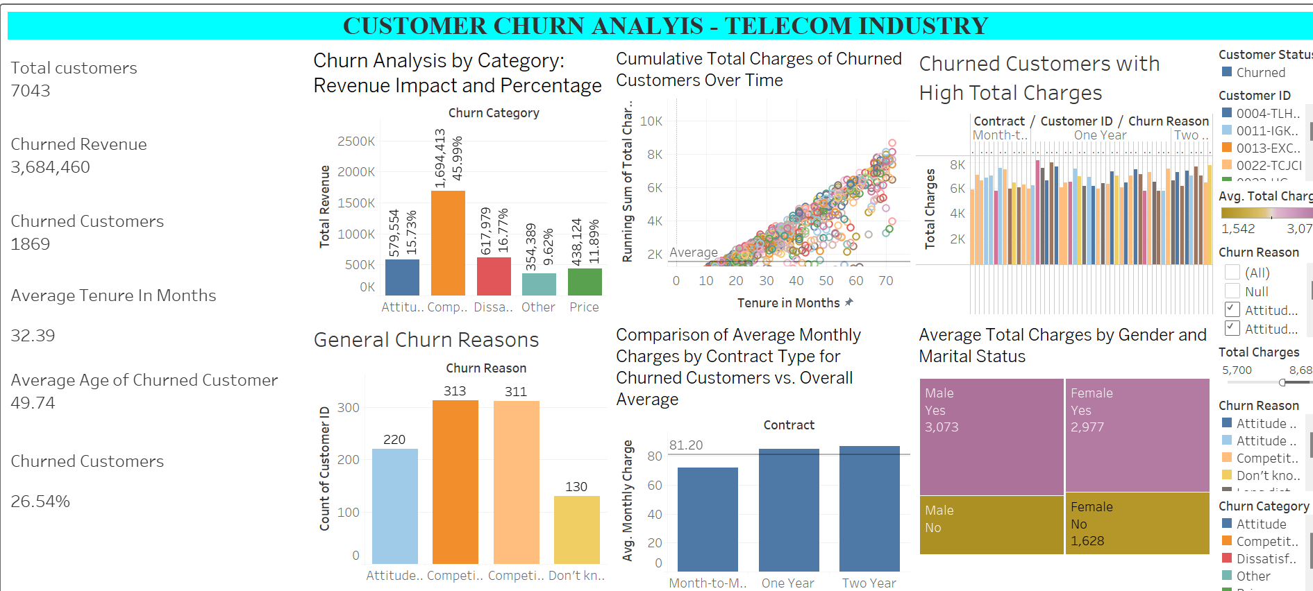

Slide 17
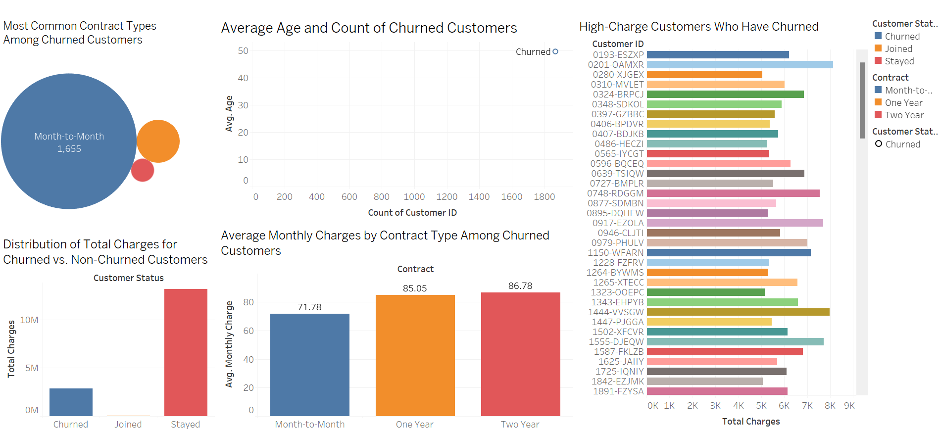

Slide 18
Thank You!

