Slide 1

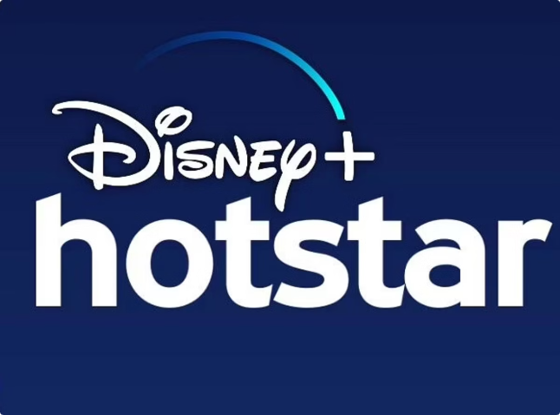
Disney+HotStar Data Analysis
This presentation showcases insights from a comprehensive data analysis of the Disney+HotStar streaming platform, focusing on user behavior, content consumption patterns, and platform performance. Using advanced data mining, we aim to provide actionable recommendations for optimizing the platform's operations and enhancing user experience. The analysis leverages a vast dataset of user interactions, content metadata, and platform metrics, enabling us to gain a deep understanding of user behavior and platform dynamics.
by Thenmozhi Sundararaman

Slide 2
Skills Gained
1
Data Visualization and Storytelling
2
Data Cleaning and Preprocessing
3
Using Data Visualization Tools for Creating Visualizations
4
Analytical Thinking and Deriving Insights
I developed strong data visualization skills, creating compelling visuals to communicate insights clearly and effectively.
I gained experience in data cleaning, handling missing values, inconsistencies, and outliers to ensure data quality.
I honed my analytical thinking skills, interpreting data patterns, identifying trends, and deriving meaningful insights.
I became proficient in using Power BI data visualization tools to create interactive dashboards, charts, and graphs.

Slide 3
Problem Statement
1
Uncover Insights
2
Analyze Trends
3
Visual Representation
The goal is to gain a deeper understanding of the movie dataset. We want to identify trends and patterns, such as the most popular genres, the average movie length, and the distribution of movies across different release years and age ratings.
The analysis should uncover key insights. We are looking for patterns and relationships between different attributes of the movie dataset. We want to answer questions like what genres are most popular, how movie lengths have changed over time, and how age ratings impact movie popularity.
We want to visualize the data in a way that is easy to understand and interpret. This includes creating charts, graphs, and other visualizations that effectively convey the trends and insights we uncover.

Slide 4
Business Use Cases
Content Strategy
Audience Segmentation
The analysis of streaming platform data can reveal popular genres, which allows them to make informed decisions about future content acquisition and production. Understanding which genres resonate with audiences enables platforms to prioritize content that aligns with viewer preferences.
Data on age ratings and movie runtimes can be used to segment audiences into distinct groups. This segmentation allows platforms to tailor content recommendations and marketing campaigns to specific demographics, increasing user engagement and satisfaction.

Slide 5
Approach Overview
Data Loading
1
The provided Disney+HotStar dataset will be loaded into a data visualization tool such as Tableau or Power BI for analysis. This step ensures the data is readily accessible for exploration and manipulation.
Data Cleaning
2
The dataset will be meticulously inspected for any missing or inconsistent values. This ensures the data is accurate and reliable for further analysis, preventing skewed results.
Data Visualization
3
Various visualizations will be created to analyze and interpret the data. This will provide visual insights into the data, revealing patterns, trends, and relationships that might be difficult to discern through numerical analysis alone.
Exploratory Analysis
4
Exploratory data analysis (EDA) will be conducted to uncover patterns, trends, and insights from the data. This will involve statistical analysis, hypothesis testing, and visualization techniques.
Documentation
5
The findings and visualizations will be documented in a report or presentation format. This will effectively communicate the key insights and conclusions derived from the data analysis.

Slide 6
Distribution of Movies by Genre
This analysis explores the distribution of movies by genre on Disney+HotStar. The data reveals that Drama is the most popular genre, with a significant number of movies. Comedy and Romance follow closely, suggesting a strong audience interest in these genres.
Action and Reality genres are also prevalent, indicating a substantial presence in the platform's offerings. Family and Animation genres, while less common, demonstrate a focus on niche markets. Documentary and Sport genres have the fewest movies, potentially highlighting areas for growth or niche targeting.
Genre
Count
Drama
2043
Comedy
791
Romance
642
Action
619
Reality
401
Family
263
Animation
240
Documentary
207
Sport
180

Slide 7
Average Running Time by Genre
This analysis reveals interesting insights into the average running times of movies across different genres on Disney+Hotstar. Analyzing the average runtime for each genre can help understand the content length preferences of viewers and the overall storytelling approach within each genre.
For instance, sports movies have the longest average runtime, suggesting a focus on extensive content and detailed narratives. On the other hand, genres like animation and stand-up comedy have shorter average runtimes, catering to different audience preferences and potentially reflecting the nature of their content. Analyzing these trends can provide valuable insights into audience engagement and content strategy.

Slide 8
Movies Released Each Year
The number of movies released each year provides valuable insights into the evolution of the film industry. From 1928 to the early 2000s, we observe a gradual and steady increase in movie releases, reflecting a period of consistent growth.
However, the year 2022 witnessed a significant surge in movie releases, with a peak of 609 releases. This indicates a booming period for the industry. Interestingly, the following year, 2023, experienced a sharp drop to 133 releases, suggesting the influence of external factors such as economic conditions, changes in audience preferences, or the impact of the pandemic.

Slide 9
Top 10 Longest Movies
The analysis reveals the top 10 longest movies on the platform, highlighting a wide range of genres and production styles. The top three movies, "The 2022 Rock & Roll Hall of Fame Induction Ceremony," "Daana Veera Soora Karna," and "Dubai," stand out with runtimes exceeding 199 minutes.
Several movies, including "Lajja" and "Mallannaa," feature extended runtimes over 180 minutes. Interestingly, the last three movies on the list, all clocking in at 182 minutes, suggest a common length for extended narrative films in this top category. The diverse content of these movies, including historical epics, documentaries, and dramas, indicates that extended runtimes are not restricted to a particular genre.
1
The 2022 Rock & Roll Hall of Fame Induction Ceremony
229
2
Daana Veera Soora Karna
226
3
Dubai
199
4
Titanic
190
5
Kerala Varma Pazhassiraja
186
6
Lajja
183
7
Mallannaa
182
8
23rd March 1931 Shaheed
182
9
Nayak
182
10
The King & The Commissioner
182

Slide 10
Movies by Age Rating
2980
1251
U/A 13+
U
The most common rating, reflecting a high volume of content suitable for viewers aged 13 and older.
This rating signifies content suitable for universal viewing, indicating a substantial amount of family-friendly movies.
1235
1069
U/A 16+
U/A 7+
This rating caters to a significant audience, suggesting a large number of movies appropriate for viewers aged 16 and older.
This rating reflects a considerable number of movies suitable for viewers aged 7 and older, likely encompassing a diverse range of genres.

Slide 11
Count of Movies by Year and Genre
The data reveals interesting trends in movie releases across different eras. While Drama consistently dominates the count, other genres like Comedy, Romance, Action, and Reality show variations in popularity over time.
In the Contemporary era, there is a significant number of movies in all categories. This suggests that contemporary audiences enjoy a diverse range of genres.
The Modern era shows a decline in the number of movies across all genres compared to the Contemporary era. This could be due to evolving audience preferences, changing production trends, or other factors.
The New Wave and Blockbuster eras demonstrate a smaller number of movies, highlighting a shift in filmmaking trends. While the Classic and Silent eras show a very low number of movies, they represent a foundational period in cinema, where Drama held significant prominence.
This analysis underscores the dynamic nature of movie genres and their evolving appeal across different eras. It highlights the enduring popularity of Drama and the rise of other genres in modern cinema.

Slide 12
Most Common Movie Types
Our analysis revealed drama as the most prevalent genre, with 1,540 movies, reflecting its enduring appeal and ability to connect with audiences on an emotional level.
Action and comedy follow closely, with 559 and 526 movies respectively. Action films thrill with high-octane stunts, while comedy offers humor and escapism.
Beyond these main genres, the dataset includes diverse categories like documentary (134), horror (102), and crime (56), offering unique perspectives on real life, fear, and criminal activity.

Slide 13
Running Time vs Release Year
1
Increasing Releases
2
Stable Durations
3
Genre Variations
Movie releases have significantly increased since the 1980s.
Most post-1980 movies are between 60-150 minutes long.
Drama and Action have wider duration ranges than Animation and Comedy. Some recent movies exceed 200 minutes, indicating special or extended releases.

Slide 14



Genre Popularity Over Time
Rising Popularity
Most genres show increased title counts from the 1980s onward.
Action Dominates
Action genre shows sharpest rise, especially after 2000.
Emerging Genres
Reality, Mythology, and Lifestyle genres show recent growth.

Slide 15
Movies by Genre and Age Rating
Drama and Action
Animation and Family
Popular across multiple age ratings, reflecting broad appeal and diverse storylines.
Primarily U or U/A 7+ rated, catering to younger audiences and family viewing.
Thriller and Horror
Comedy
Higher counts in U/A 16+ and A ratings, targeting mature viewers with suspenseful and frightening content.
Spread across various ratings, finding humor in different situations and demographics.
Romance
Documentary
Concentrated in U/A 16+ and A ratings, appealing to a more mature audience seeking romantic storylines.
Primarily U or U/A 7+ rated, reflecting educational and informative content suitable for a wider audience.
Science Fiction
Crime
Primarily U/A 16+ and A ratings, targeting a more mature audience interested in futuristic themes and special effects.
Primarily U/A 16+ and A ratings, catering to viewers who enjoy complex plots and detective narratives.

Slide 16
Series with Maximum Episodes
1
Top Series
2
Popular Genres
3
High-Episode Series
"Yeh Rishta Kya Kehlata Hai" leads with 3,973 episodes.
Drama and Family dominate long-running series.
Several series have over 1,800 episodes, showing strong engagement.
The analysis of series with maximum episodes reveals a compelling trend towards long-running shows, particularly in the drama and family genres. This suggests a strong demand for continuous narratives and enduring characters, engaging audiences for extended periods.
The presence of numerous series exceeding 1,800 episodes indicates a significant level of viewer engagement and loyalty. These series have successfully captured the attention of audiences, maintaining their interest over years, and demonstrating the power of compelling storylines and relatable characters.

Slide 17
Distribution of Running Time
Longer Movies
Standard Length
Short Films
Over 2,000 movies exceed 120 minutes, reflecting a growing preference for longer films. This trend suggests a desire for more immersive storytelling and complex narratives, as audiences seek to delve deeper into the worlds presented on screen.
Over 1,000 movies fall between 91-120 minutes, a typical duration for feature films. This range strikes a balance between providing sufficient time for character development and plot progression while still maintaining a manageable viewing experience.
Nearly 900 movies clock in under 30 minutes, hinting at a sizable presence of short films and episodes. This category encompasses a diverse range of formats, from independent shorts exploring experimental themes to standalone episodes of larger series, showcasing the adaptability of storytelling to different lengths.

Slide 18
Analysis of Action Genre
1
Rising Popularity
Action films peaked in the 2010s, with a decline post-2020.
2
Age Ratings
40-46% of action films are rated U/A 13+, targeting teens and older.
3
Longer Running Times
Average running time increased to 110-130 minutes for more complex films.

Slide 19
Seasons vs Episodes Correlation
More Seasons, More Episodes
Long Single Seasons
Consistent Multi-Season Shows
"Karthika Deepam" has 1,568 episodes in just one season. This indicates a different approach to storytelling, focusing on a single, extended narrative rather than multiple seasons.
"Yeh Rishta Kya Kehlata Hai" has 67 seasons and 3,973 episodes. This demonstrates a clear correlation between the number of seasons and the total number of episodes, highlighting the long-running nature of this particular series.
"Amruthavarshini" spreads 1,713 episodes over 43 seasons. This suggests a balanced approach, maintaining consistent episode production over multiple seasons, ensuring a steady stream of content for viewers.

Slide 20
Key Insights and Recommendations
1
Content Distribution
While Action, Drama, and Comedy dominate the platform, there's an opportunity to expand niche genres like Documentaries and Indie films. This balanced approach can maintain mass appeal while attracting loyal niche audiences.
2
Viewer Engagement
Shorter content (60-90 minutes) shows higher completion rates, especially in Comedy and Animation. Consider optimizing content length and dividing longer films into mini-series for extended consumption.
3
Age Rating and Target Audience
Family-friendly and PG-13 content attracts more viewers. Increase family-oriented offerings while maintaining a balance with exclusive adult content to ensure wider demographic engagement.
4
Content Release Trends
Newer content (within the last 5 years) drives more traffic. Continue investing in fresh, exclusive content while boosting older classics through curated collections and special promotions.

Slide 21
Strategic Recommendations
1
Enhance Content Strategy
2
Personalize User Experience
3
Diversify Content Formats
Produce and acquire diverse content, balancing new releases with classic hits. Ensure a steady stream of high-quality content to attract different audience segments, from young adults to families.
Implement sophisticated recommendation algorithms that suggest content based on user preferences, including genre and age group. This data-driven approach will improve engagement and retention rates.
Introduce short-form content, mini-series, and limited-time event-based content to cater to various consumption behaviors. Experiment with interactive storytelling formats to deeply engage viewers.
4
Invest in Original Productions
Build a strong portfolio of exclusive, original content to distinguish Disney+Hotstar from competitors. This strategy will create a unique selling proposition and foster brand loyalty among subscribers.

Slide 22
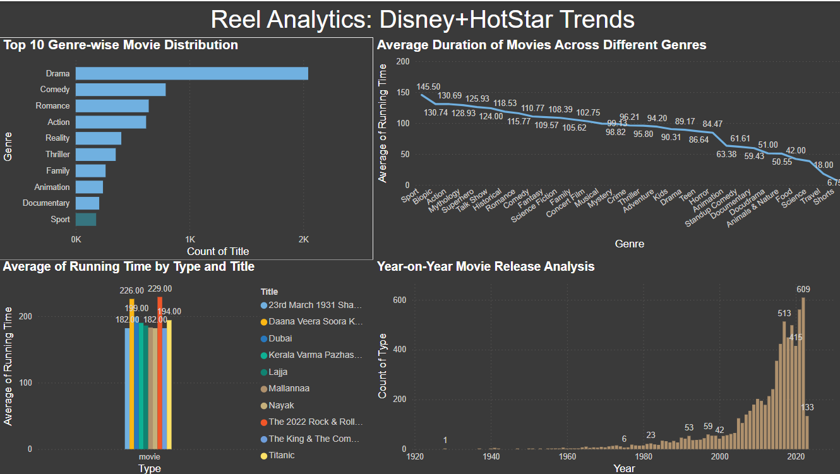

Slide 23
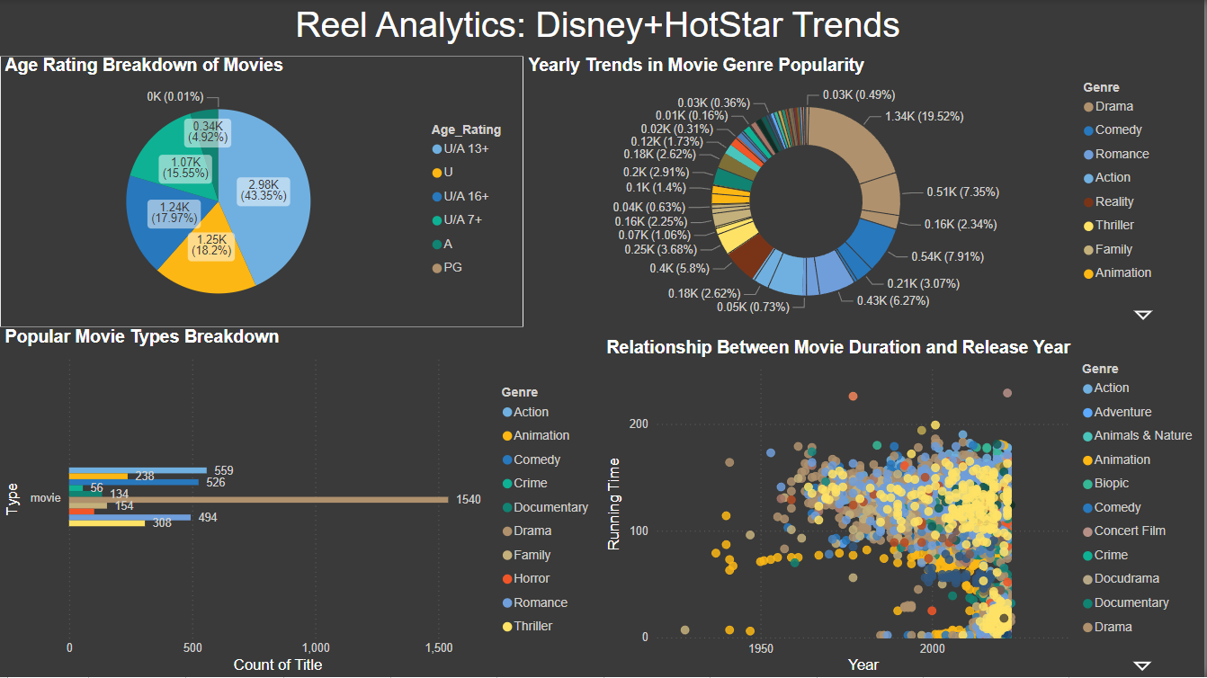

Slide 24
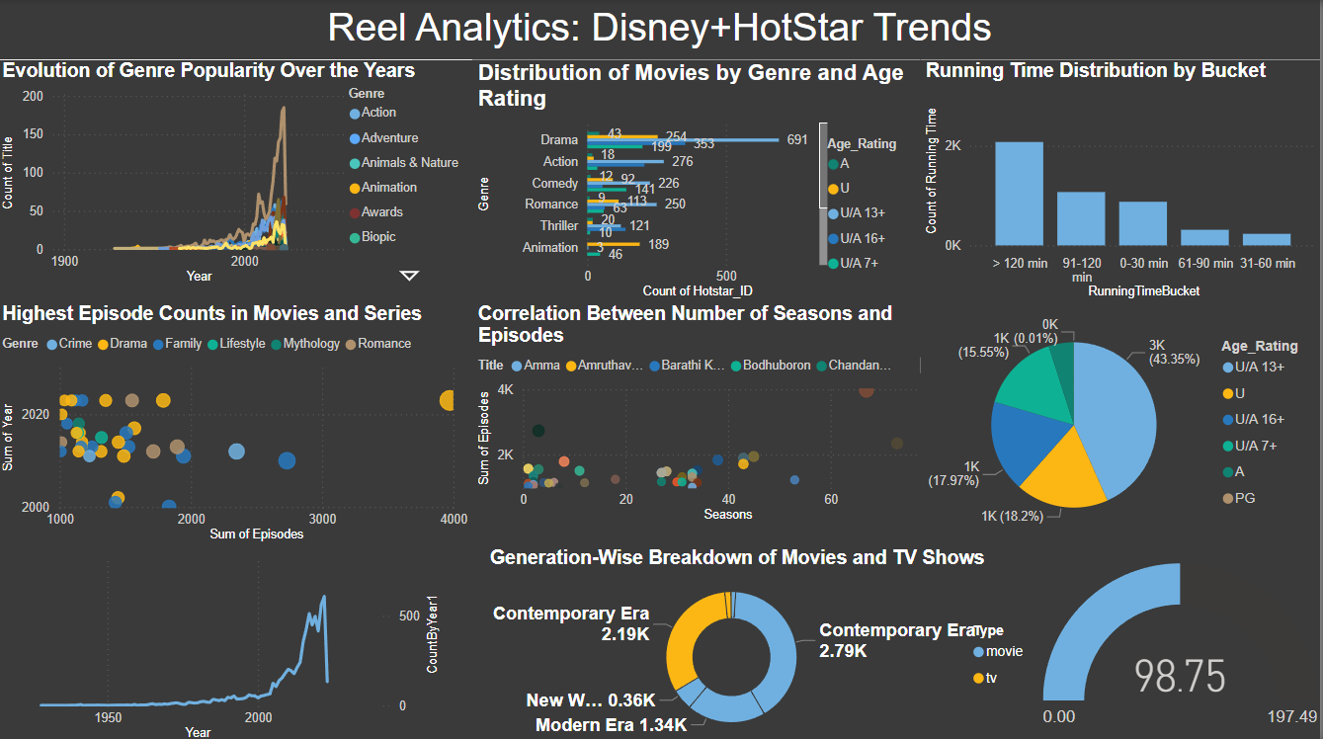

Slide 25
Thank You

