Slide 1
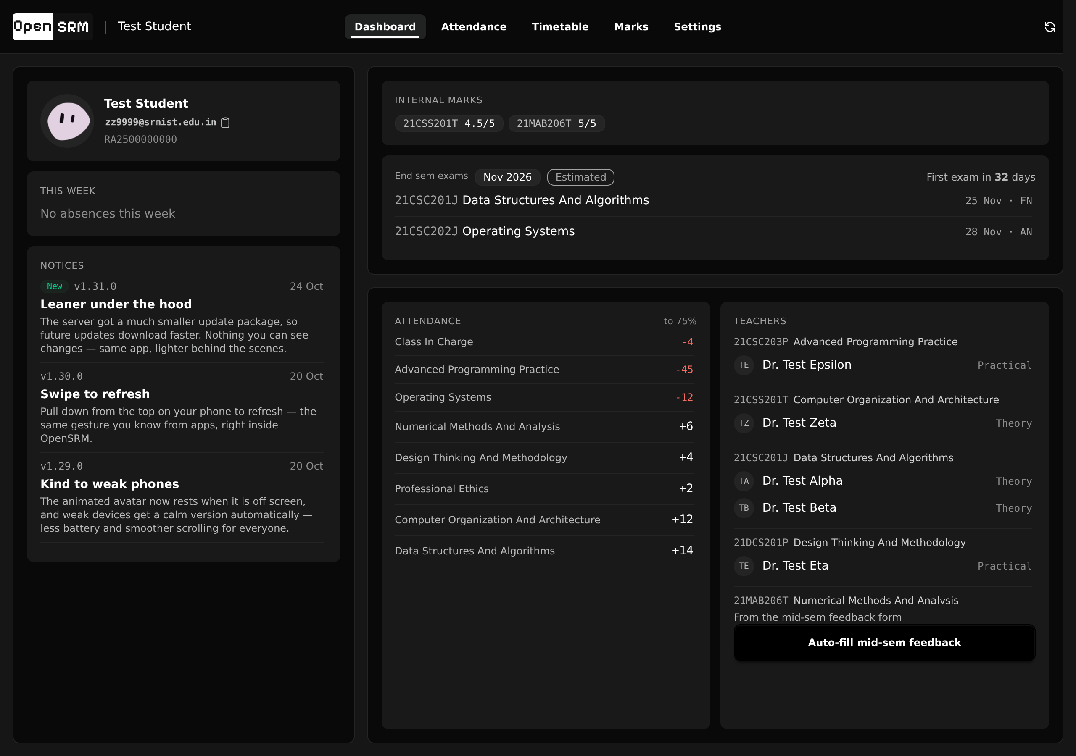

OpenSRM
Your whole semester
on one screen
A self-hosted dashboard over the SRM Student Portal. One login, one screen, no five-page crawl to answer a single question.
github.com/thenabbu/OpenSRM · srm.200871.xyz · v1.31.0 · MIT
Notes:
Open by naming the friction nobody defends: the portal makes you click five pages to answer one question. This is the product that answers it.

Slide 2
Five pages to answer
one question.
Attendance
Marks
Timetable
Exam schedule
Subject to teacher map
Am I safe to skip the next class?
Notes:
The five items are literal: the portal splits them across five pages behind a captcha and a fresh login. The student's actual question is much narrower than the portal assumes.

Slide 3
What the dashboard answers
Every card knows its own emptiness. A widget with no data does not render, and a card with no widgets does not render either.
75%
6
24h
1
attendance line
classes you may still miss
cold data window
portal pipeline
per subject, measured, not averaged
example: 18 of 24 attended
profile and courses reused until stale
serialized behind a bounded queue
Notes:
The self-guarding card is the design thesis. The page is only ever as loud as your data warrants, so empty data produces empty space rather than placeholder noise.

Slide 4
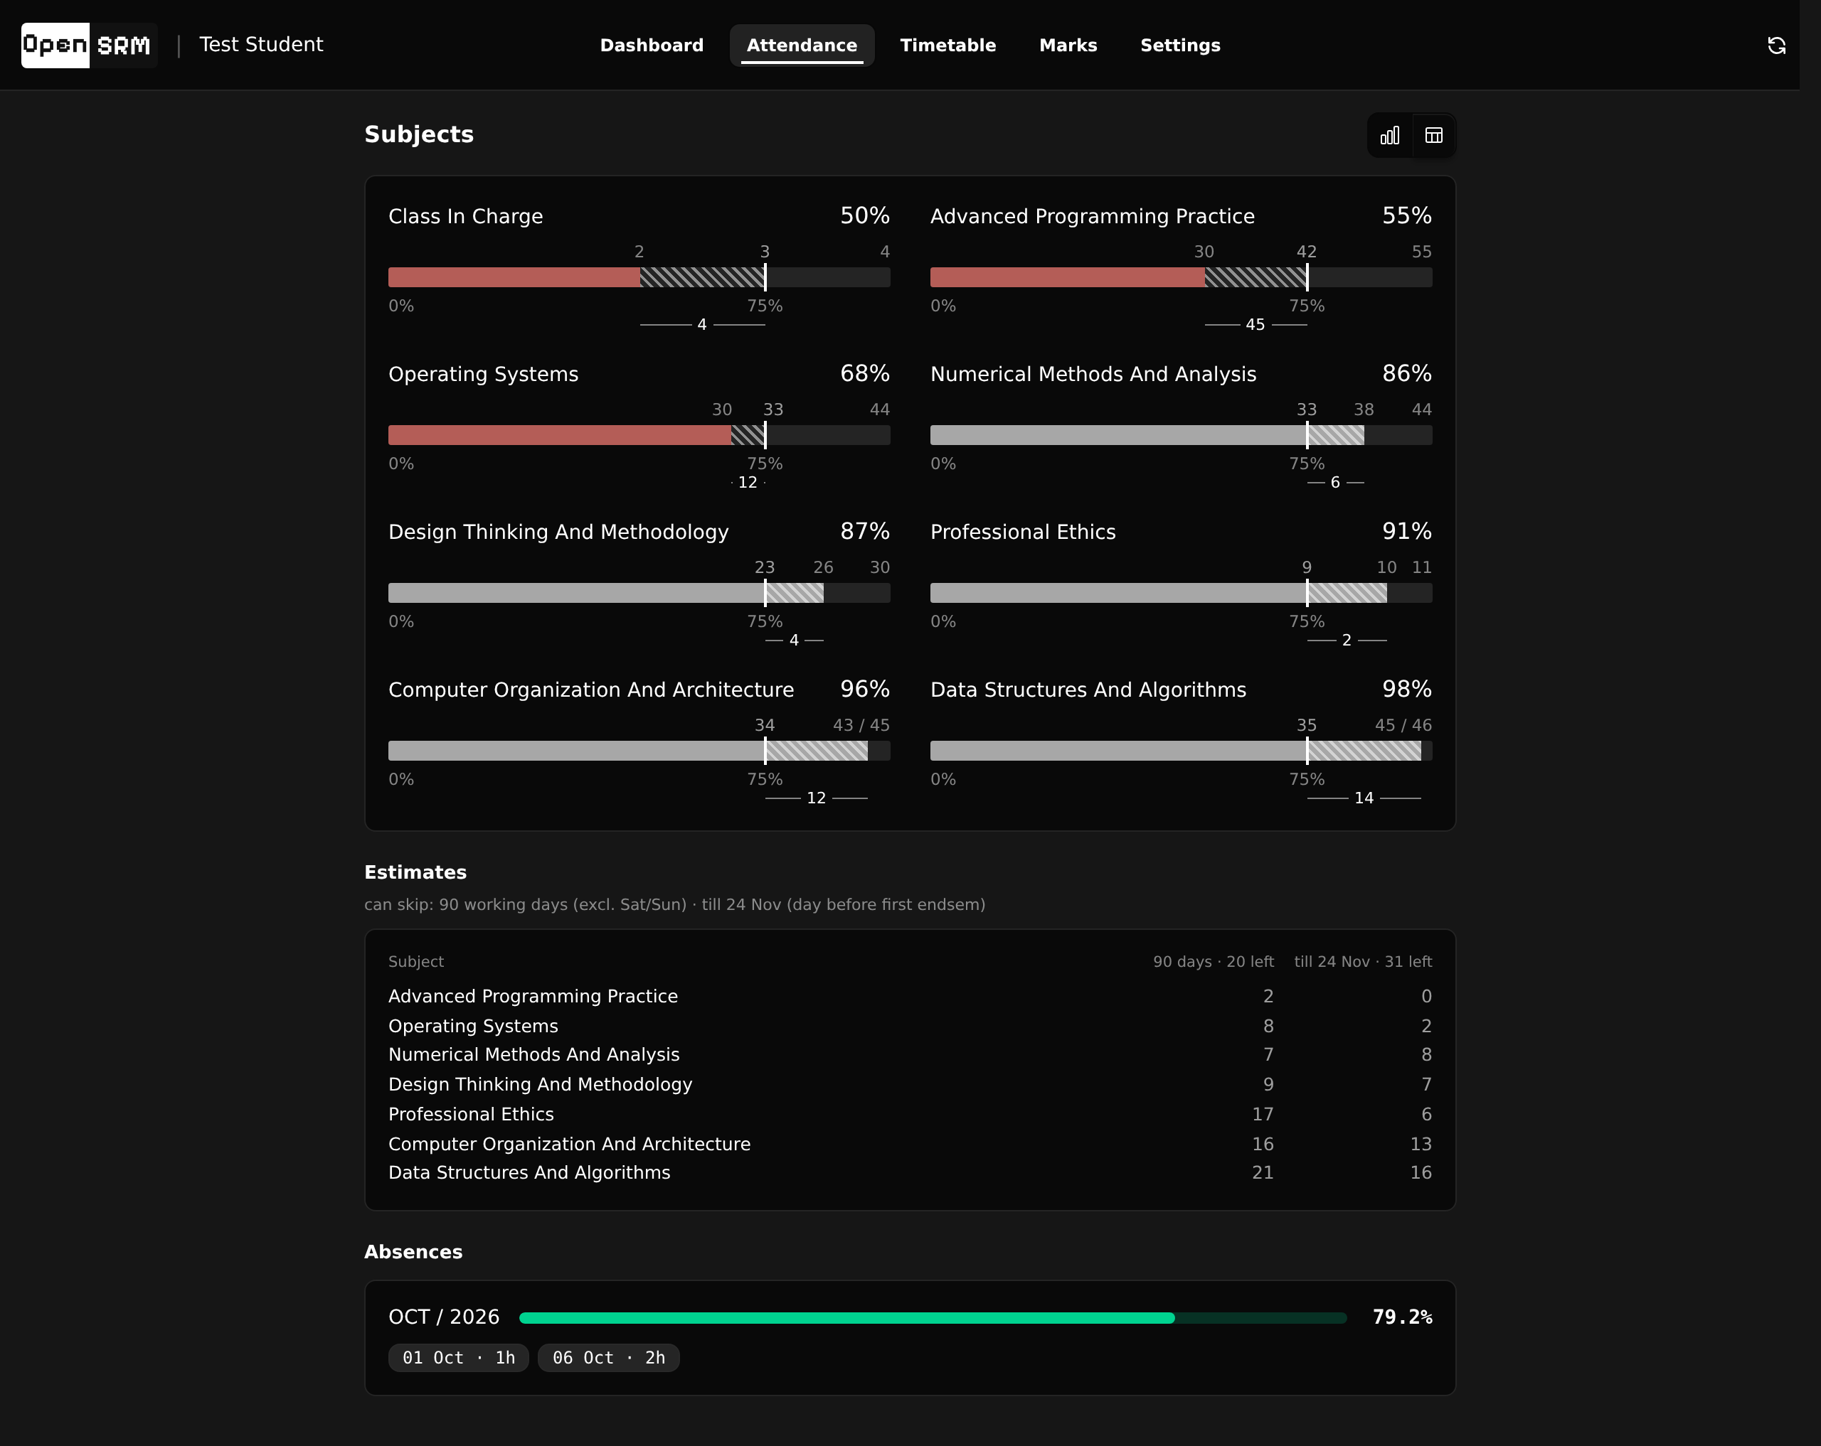
Attendance that does the math
Not your percentage. How many classes you can still miss and stay above the line.
Meter per subject against the 75% threshold
Pinned attended / needed / total numbers
Semester skip budgets in working days
Colour only on deviation, never on healthy state
Notes:
The number students want is not their percentage, it is their remaining room to manoeuvre. Colour appears only when something is actually off.

Slide 5
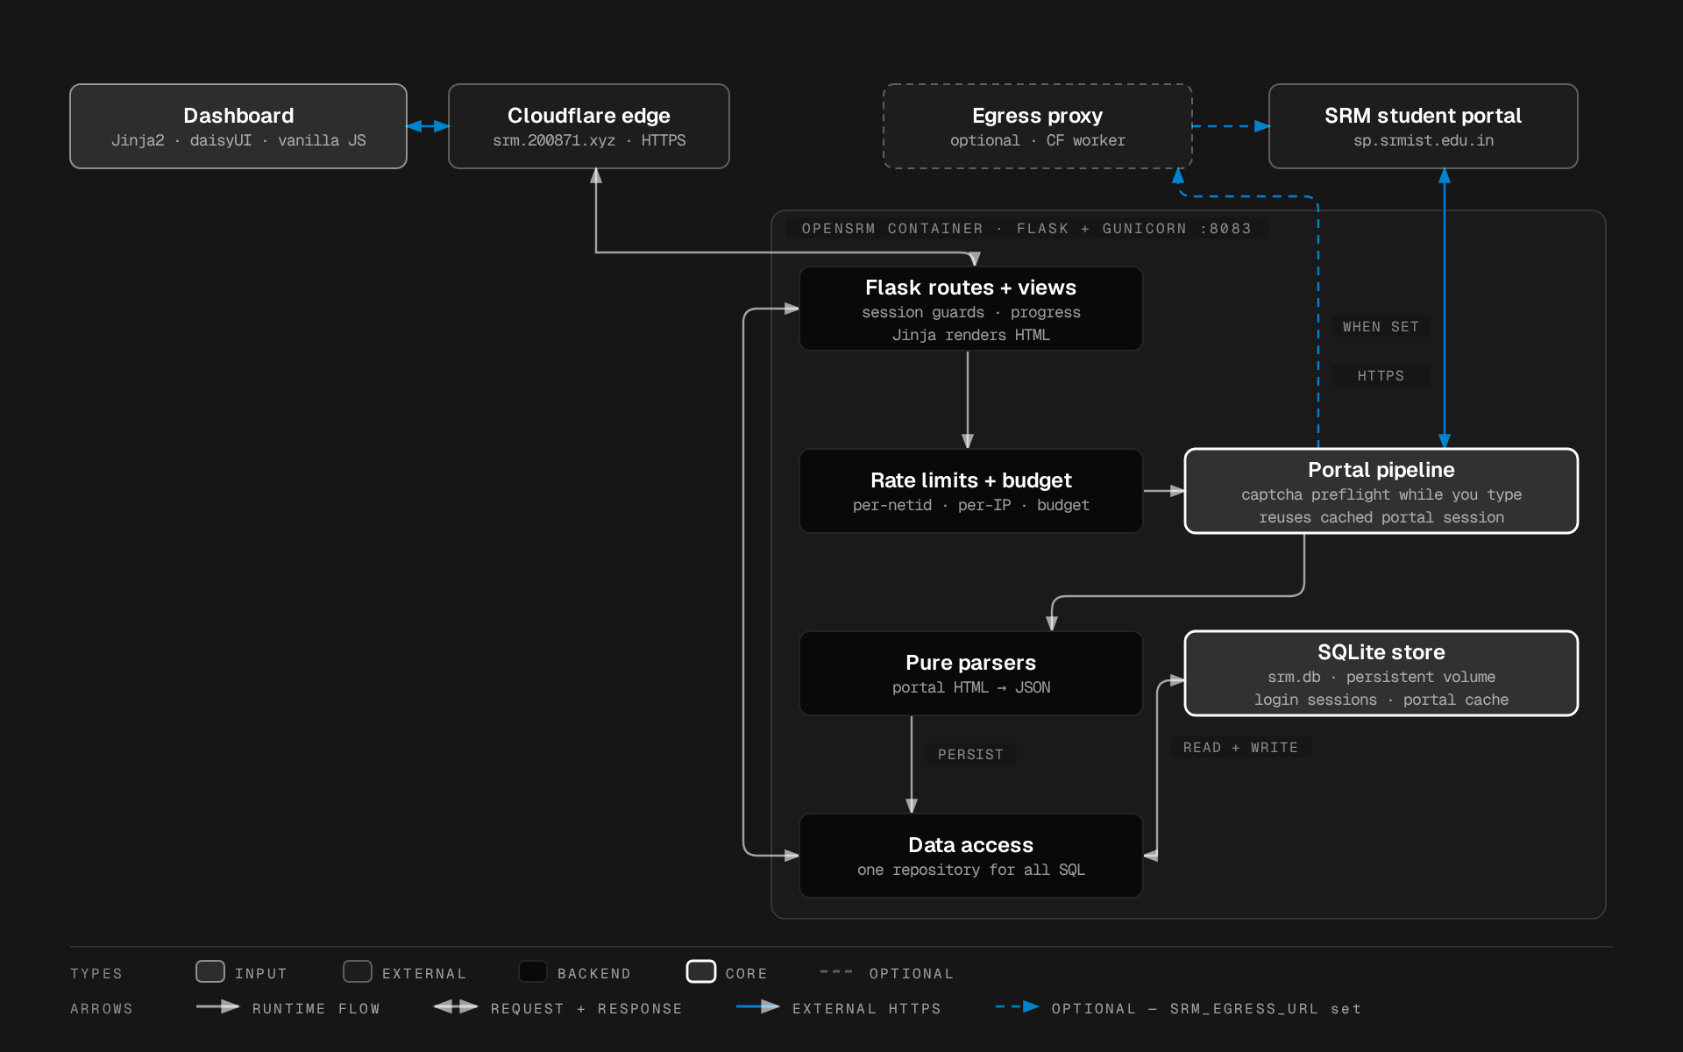
Cache first, portal second
One Flask process, one SQLite file, one fetch pipeline. The whole data path, portal to pixel.
Browser
PWA shell, installable on Android, iOS and Windows
Cloudflare edge
Tunnel for HTTPS, no open ports
Flask container
captcha OCR, login, parse, persist
SQLite
every page renders from here, not from the portal
Notes:
A failed fetch degrades to last-good data instead of an error page. That is the resilience claim, and it is structural, not a retry loop.

Slide 6
The pipeline, honestly
The captcha is solved while you are still typing your password.
PREFLIGHT
OCR solves the captcha on password-field focus, kept warm 150 s
LOGIN
Pure HTTP POST, up to 3 captcha re-solves, wrong password caught on attempt one
HOT FORMS
Attendance 9, marks 13, timetable 10, exams 126, refreshed every sync
COLD FORMS
Profile 17, courses 7, refreshed only past 24 h
LIMITS
3 scrapes per NetID per 10 min, 10 logins per IP per hour, 30 requests per 10 min aggregate
Notes:
The rate limits are the honest part of this slide. They exist because every sync is a real login against a system that neither wants nor expects automation.

Slide 7
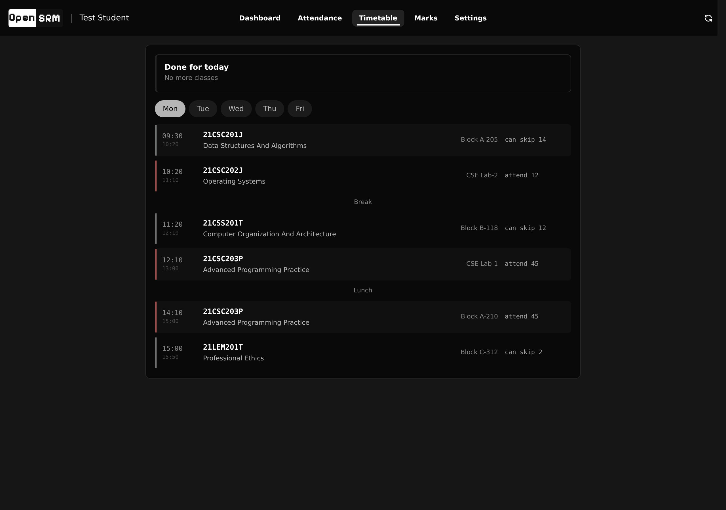
Timetable you can read at a glance
The portal's own grid, corrected for the campus clock, painted from cache.
Official grid offsets applied per period
Break and lunch dividers the portal never draws
Left rim colour coded by attendance risk
Paints instantly even when a fetch fails
Notes:
The campus clock runs sixty minutes off for the first four periods. OpenSRM corrects it on read, and a test pins the corrected grid against the legacy slots.

Slide 8
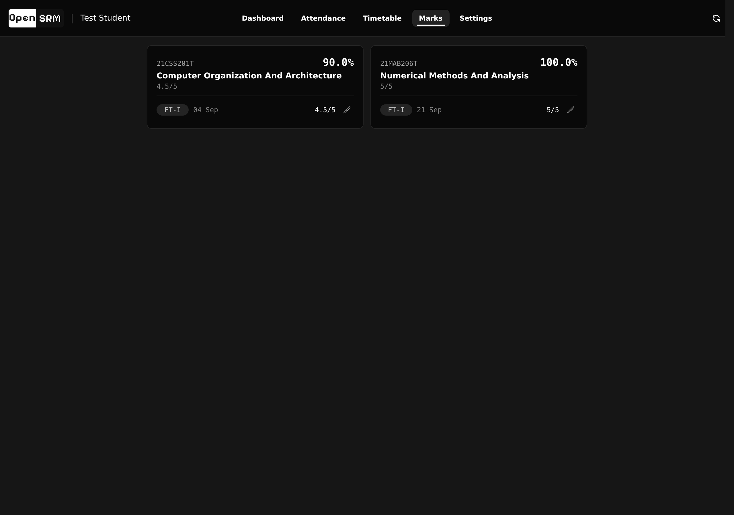
Marks, component by component
Internal marks with entered dates, and IE-1 and IE-2 roles derived from the component maxima.
Component-wise marks per subject
Entered date on every component
IE roles derived, confirmable per class
Feeds GPA prediction
Notes:
Marks are only useful if you can see which component is still open. The dates matter more than the totals.

Slide 9
It only ever reads from the portal.
The single feature that writes is mid-semester feedback autofill. It is opt-in, and it shows you exactly what it will submit before it submits anything.
Notes:
This is the trust slide. Say the two promises plainly: it only reads, and it is honest about attendance. Do not oversell the autofill, frame it as the exception that proves the rule.

Slide 10
Private by default
A leaked database should yield no live sessions. That is a design constraint, not a hardening pass.
Fernet at rest
Passwords encrypted, rotation supported without data loss
sha256 digests
Session tokens stored hashed, never in the clear
Strict CSP
No external origins, no third-party scripts, fonts or trackers
One transaction
Delete my data erases the account in a single atomic step
Notes:
Delete my data is the honest counterweight to caching someone's academic record. It has to be one transaction, or it is not a promise.

Slide 11
Built like production, because it is
The unglamorous parts that decide whether a scraper survives a semester.
BACKEND
Flask 3.1, Python 3.11, gunicorn gthread, single worker
STORE
SQLite, versioned migration registry, schema v17 across 16 migrations
FRONTEND
Tailwind 4.3.3 and daisyUI 5.7.46 pre-compiled, no runtime CDN
CAPTCHA
ddddocr, self-contained OCR, no external service
SHIP
GitHub Actions lint, unit, docker and e2e, then build and push to GHCR
Notes:
No Node at runtime, no CDN, no external captcha SaaS. Every dependency that could fail at 2am has been removed.

Slide 12
Try it
Sign in with your NetID. Everything else is already cached.
LIVE
SOURCE
LICENSE
srm.200871.xyz
github.com/thenabbu/OpenSRM
MIT, not affiliated with SRM Institute
Notes:
Give the URL and stop. Do not add a feature list here, the deck has already made the case.

