Slide 1
Factor Analysis in Entertainment Industry
Brand Equity Analysis: The Walt Disney Company
Lana Jalal Gidan
SSIE-605: Applied Multivariate Data Analysis
Professor Susan Lu
Binghamton University
Technical Presentation 2: Factor Analysis Application

Slide 2
Agenda
1.
Problem Statement
Why Factor Analysis in Entertainment?
7.
Reliability Analysis
Cronbach's Alpha Results
2.
Article Information
Research Papers & Sources
8.
CFA & Validity
Factor Loadings, AVE, CR
3.
Factor Analysis Overview
EFA vs CFA
9.
Model Fit Assessment
Goodness-of-Fit Indices
4.
Case Study Introduction
Disney Brand Equity
10.
SEM Path Analysis
Structural Model Results
5.
Research Framework
5 Dimensions of Brand Equity
11.
Supporting Study
Media Advertising Impact
6.
Research Methodology
Data Collection & Approach
12.
Discussion & Conclusion
Findings, Limitations, Improvements

Slide 3
Problem Statement
Why Factor Analysis in Entertainment?
•
• The Walt Disney Company manages a complex brand portfolio across multiple business segments
•
• Understanding which brand dimensions drive brand equity is critical for strategic decision-making
•
Key Questions:
• Which dimensions (awareness, image, quality, association, loyalty) most strongly influence brand equity?
• Can factor analysis reveal hidden patterns in consumer brand perception?
• How do entertainment brands differ from traditional product brands?
•
Business Impact:
• Disney's brand value: $57.0 billion (Brand Finance, 2022)
• Multi-segment strategy: Media, Parks, Studio, Streaming
• Factor Analysis helps identify which dimensions to invest in

Slide 4
Article Information
Paper 1 (Primary Case Study):
Gilitwala, B. & Nag, A.K. (2022). "Understanding Effective Factors Affecting Brand Equity."
Cogent Business & Management, 9(1), 2104431.
DOI: 10.1080/23311975.2022.2104431
Method: CFA + SEM | Sample: 400 | Application: Disney Brand Equity
Paper 2 (Supporting Study):
Sama, R. (2019). "Impact of Media Advertisements on Consumer Behaviour."
Journal of Creative Communications, 14(1), 54-68.
DOI: 10.1177/0973258618822624
Method: EFA + PCA | Sample: 529 | Application: Media Advertising
Paper 3 (Methodology Reference):
Shrestha, N. (2021). "Factor Analysis as a Tool for Survey Analysis."
American Journal of Applied Mathematics and Statistics, 9(1), 4-11.
DOI: 10.12691/ajams-9-1-2
Method: EFA | Application: FA Methodology & Best Practices

Slide 5
What is Factor Analysis?
Brief Recap
Definition:
A statistical method that reduces many observed variables into a smaller set of underlying factors
Mathematical Model:
Xi = ai1F1 + ai2F2 + ... + aimFm + ei
Xi = observed variable i
F1...Fm = common factors
ai = factor loading coefficients
ei = unique/error factor
In This Study:
Brand Equity = f(Awareness, Image, Quality, Association, Loyalty)
Two Main Types:
EFA (Exploratory):
Discovers factor structure
No prior assumptions
Uses eigenvalues & scree plots
Rotation: Varimax/Oblimin
CFA (Confirmatory):
Tests hypothesized structure
Requires theoretical model
Uses goodness-of-fit indices
Part of SEM framework
This study uses CFA + SEM

Slide 6
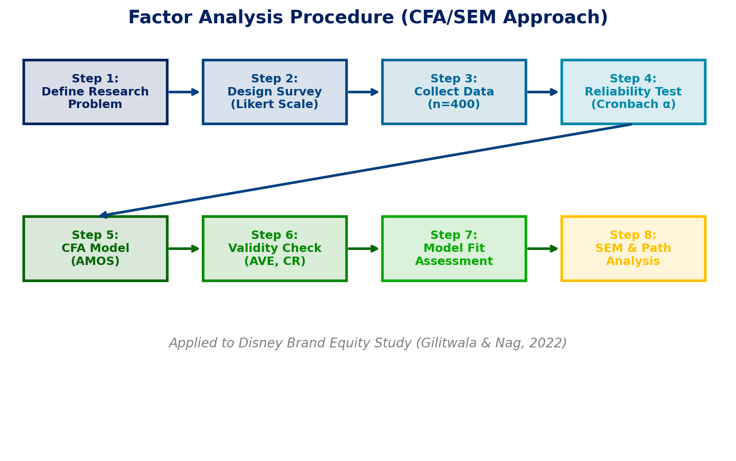
Factor Analysis Procedure (CFA/SEM)

Slide 7
EFA vs CFA: Understanding the Difference
Aspect | EFA (Exploratory) | CFA (Confirmatory)
Purpose | Discover factor structure | Test hypothesized structure
Theory | No prior theory needed | Theory-driven model
Extraction | PCA / Principal Axis | Maximum Likelihood
Rotation | Varimax / Oblimin | Not applicable
Fit Indices | Not typically used | CFI, RMSEA, TLI, etc.
Output | Factor loadings, eigenvalues | Path coefficients, fit indices
Software | SPSS, R, Python | AMOS, Mplus, lavaan
Used By | Sama (2019) | Gilitwala & Nag (2022)
This presentation primarily focuses on CFA + SEM (Gilitwala & Nag, 2022), with EFA comparison from Sama (2019)

Slide 8
Case Study: Disney Brand Equity
Gilitwala & Nag (2022)
About Disney:
The Walt Disney Company is one of the world's largest entertainment conglomerates
Four Business Segments:
Media Networks (ABC, ESPN, Disney Channel)
Parks, Experiences & Products
Studio Entertainment
Direct-to-Consumer (Disney+)
Why Disney?
Brand value: $57.0 billion (Brand Finance, 2022)
Global presence across 6 continents
Nearly 100 years of brand heritage
Study Details:
Location:
Disney Shop, DLF Mall, Noida, India
Sample Size:
400 respondents (online questionnaire)
Sampling:
Convenient sampling technique
Scale:
5-point Likert scale
Analysis Tool:
IBM AMOS (Version 24)
CB-SEM approach

Slide 9
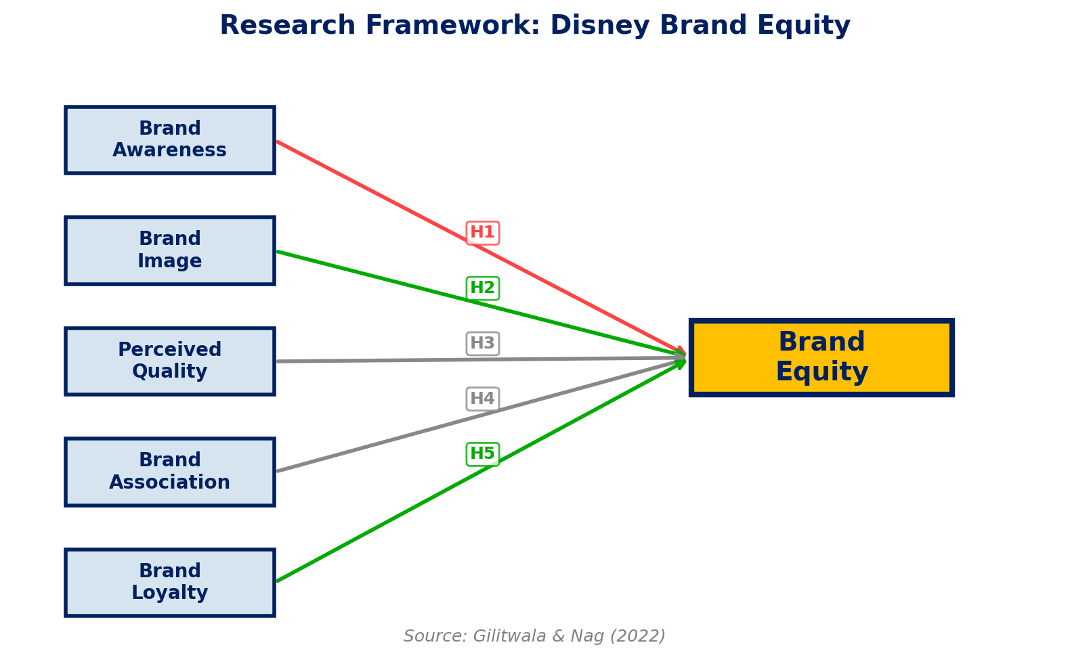
Research Framework: 5 Dimensions of Brand Equity
Five Hypotheses Tested:
H1: Brand Awareness → Brand Equity
H2: Brand Image → Brand Equity
H3: Perceived Quality → Brand Equity
H4: Brand Association → Brand Equity
H5: Brand Loyalty → Brand Equity
Theoretical Basis:
Aaker (1991) Brand Equity Model
Keller (1993) Customer-Based Brand Equity
Source: Gilitwala & Nag, 2022

Slide 10
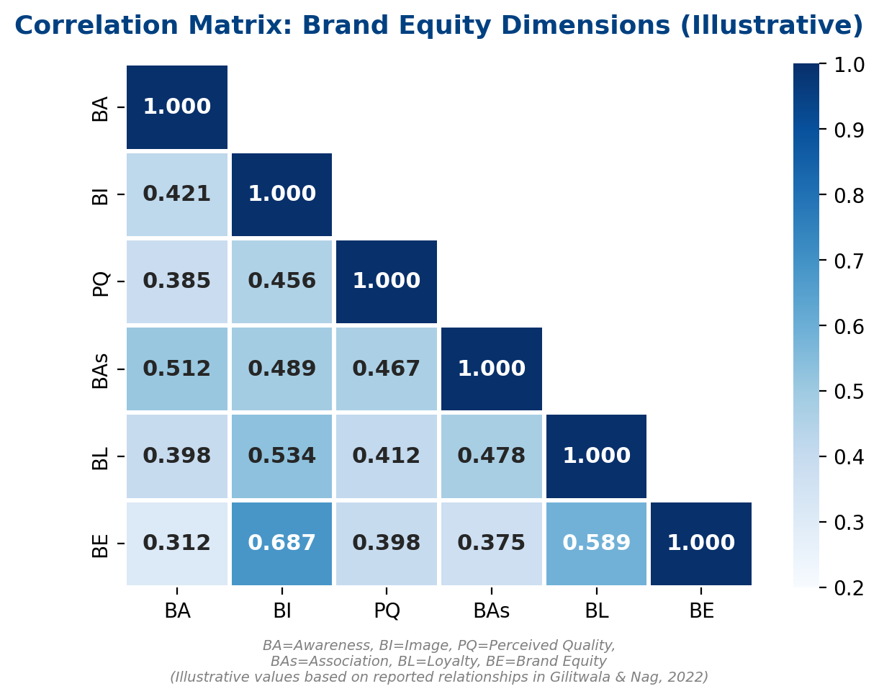
Step 1: Correlation Matrix
Examining Relationships Between Variables
Key Observations:
Brand Image has the strongest relationship with Brand Equity (highest β in SEM)
Brand Loyalty also strongly relates to Brand Equity
Brand Awareness has the weakest (negative) relationship with Brand Equity
Why This Matters:
Moderate correlations between variables suggest they share variance but are distinct constructs
This supports the applicability of CFA
Illustrative correlation pattern based on
reported SEM results in Gilitwala & Nag (2022)

Slide 11
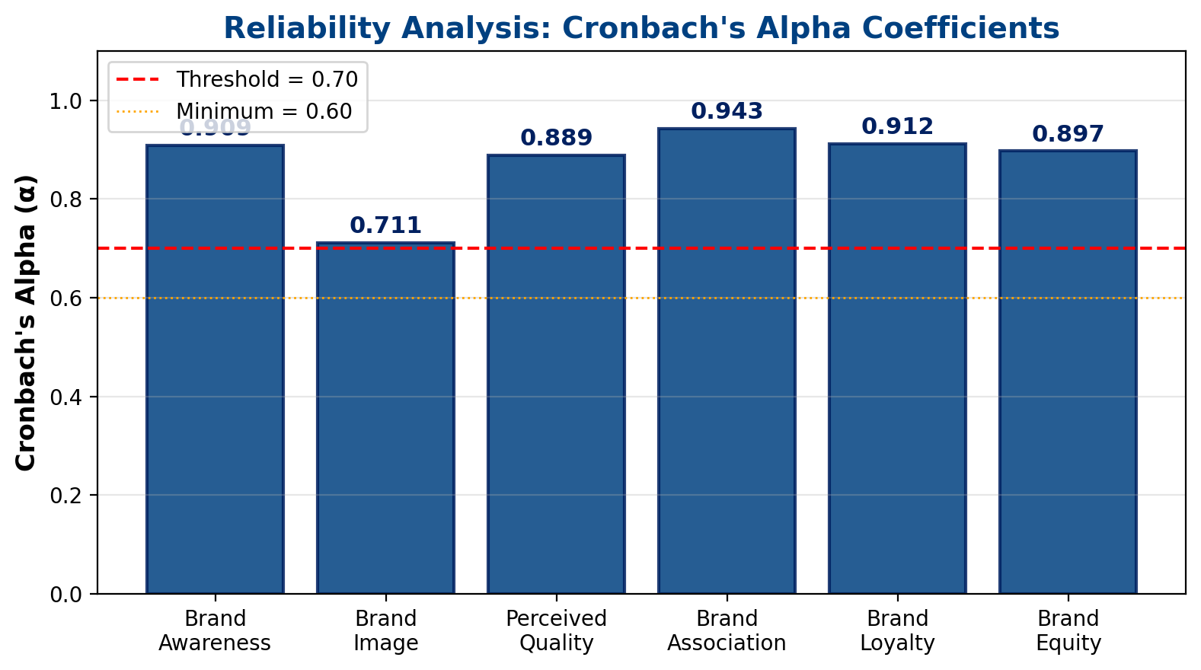
Step 2: Reliability Analysis (Cronbach's Alpha)
Variable | α Value | Status
Brand Awareness | 0.909 | Excellent
Brand Image | 0.711 | Acceptable
Perceived Quality | 0.889 | Good
Brand Association | 0.943 | Excellent
Brand Loyalty | 0.912 | Excellent
Brand Equity | 0.897 | Good
All values > 0.70 threshold
Questionnaire is reliable and acceptable for the study (Peterson, 1994)
Source: Gilitwala & Nag (2022), Table 1

Slide 12
Step 3: Confirmatory Factor Analysis Results
CFA Validity Criteria (Gilitwala & Nag, 2022):
Convergent Validity:
All factor loadings > 0.70 (threshold met)
Average Variance Extracted (AVE) > 0.50 for all constructs
Composite Reliability (CR) > 0.70 for all constructs
Discriminant Validity:
Square root of AVE > inter-construct correlations
All constructs are distinct from each other
What This Means:
The 5 brand equity dimensions are reliably measured
Each dimension captures a unique aspect of brand perception
The measurement model is valid for structural analysis
Construct | FL | AVE | CR | α
Brand Awareness | > 0.70 | > 0.50 | > 0.70 | 0.909
Brand Image | > 0.70 | > 0.50 | > 0.70 | 0.711
Perceived Quality | > 0.70 | > 0.50 | > 0.70 | 0.889
Brand Association | > 0.70 | > 0.50 | > 0.70 | 0.943
Brand Loyalty | > 0.70 | > 0.50 | > 0.70 | 0.912
Brand Equity | > 0.70 | > 0.50 | > 0.70 | 0.897
FL = Factor Loading, AVE = Average Variance Extracted
CR = Composite Reliability, α = Cronbach's Alpha
Source: Gilitwala & Nag (2022), Table 3

Slide 13
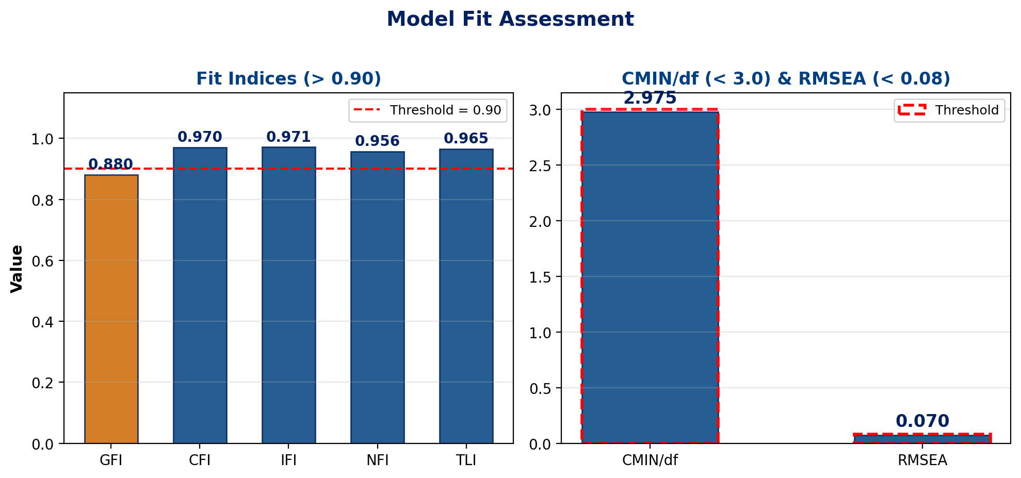
Step 4: Model Fit Assessment
Index | Value | Threshold | Result
CMIN/df | 2.975 | < 3.0 | Good Fit
GFI | 0.880 | > 0.90 | Marginal
CFI | 0.970 | > 0.90 | Good Fit
IFI | 0.971 | > 0.90 | Good Fit
NFI | 0.956 | > 0.90 | Good Fit
TLI | 0.965 | > 0.90 | Good Fit
RMSEA | 0.070 | < 0.08 | Good Fit
6 out of 7 indices indicate Good Fit
Source: Gilitwala & Nag (2022), Table 5

Slide 14
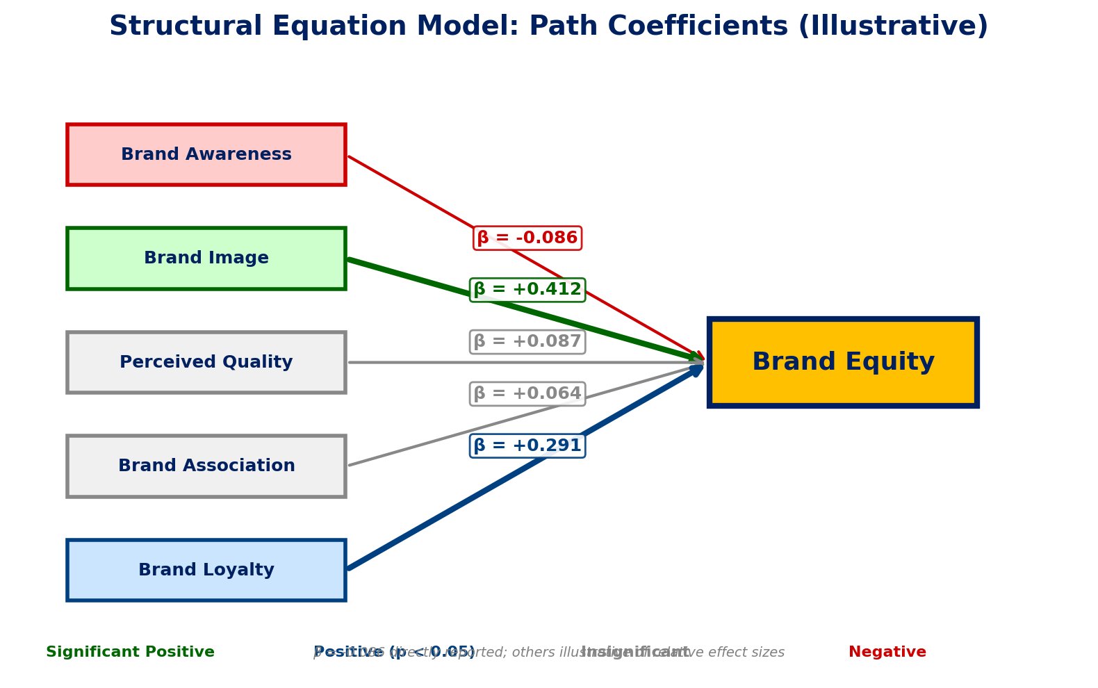
Step 5: Structural Equation Model (Path Analysis)
Path Coefficients (β):
Brand Image → BE:
Highest positive relationship (strongest predictor)
Brand Loyalty → BE:
Second strongest, significant relationship
Perceived Quality → BE:
Low, insignificant relationship
Brand Association → BE:
Low, insignificant relationship
Brand Awareness → BE: β = -0.086
Negative effect (saturation effect)
Source: Gilitwala & Nag (2022), Table 6
Note: β = -0.086 is directly reported;
other β values are illustrative of
reported relative effect sizes

Slide 15
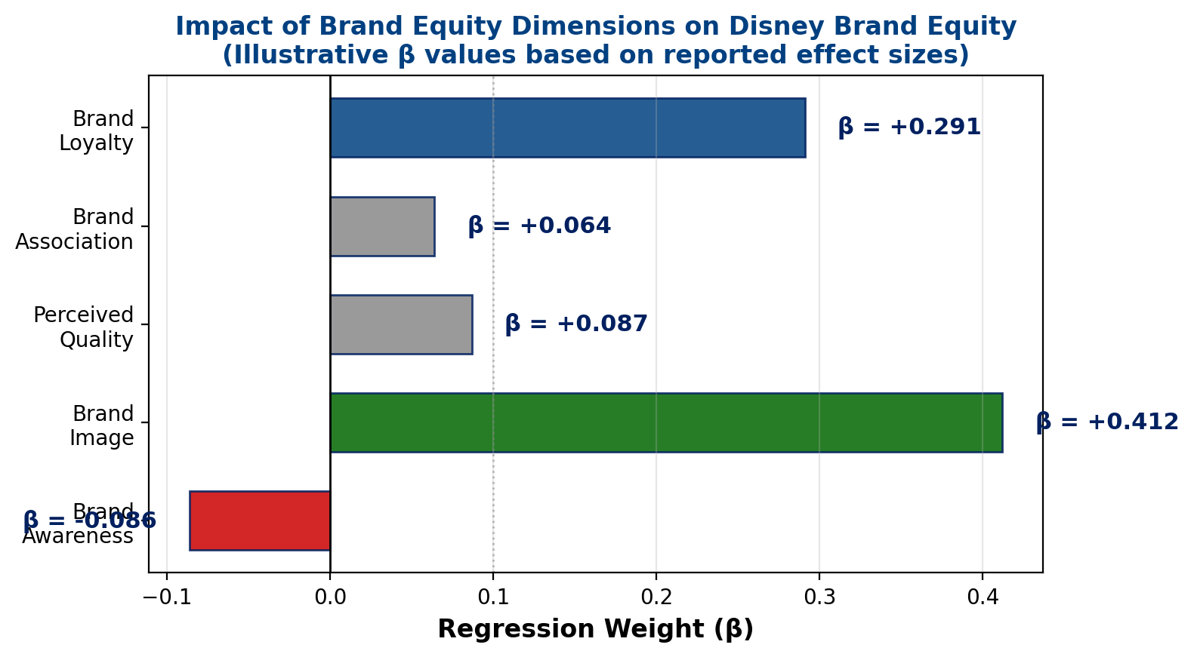
Step 6: Impact of Dimensions on Disney Brand Equity
Key Insights:
Brand Image is #1 driver
How consumers perceive Disney emotionally matters most
Brand Loyalty is #2 driver
Repeat purchase and devotion are crucial
Surprising Finding:
Brand Awareness has a negative effect (regression weight = -0.086)!
Possible saturation: everyone knows Disney, but awareness alone does not create equity
Source: Gilitwala & Nag (2022)
Chart shows illustrative β values

Slide 16
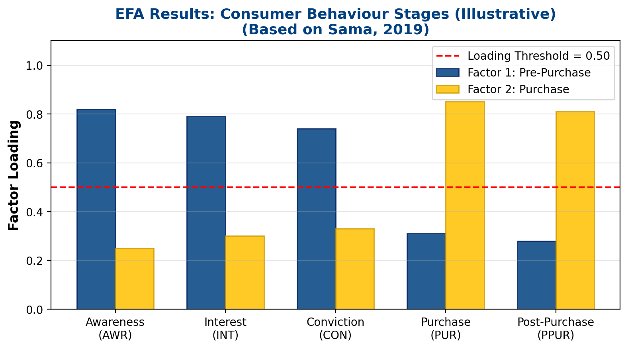
Supporting Study: Media Advertisements & Consumer Behaviour
Sama (2019) - EFA Application
Study Overview:
529 respondents, online survey
5 media: TV, Radio, Newspaper, Magazine, Internet
EFA Results:
Extraction: PCA with Varimax rotation
2 factors extracted (eigenvalue > 1):
Factor 1 - Pre-Purchase:
Awareness, Interest, Conviction
Factor 2 - Purchase:
Purchase, Post-Purchase behaviour
Both factors: Cronbach's α > 0.70
Chart: Illustrative loadings based on
the two-factor structure in Sama (2019)
DOI: 10.1177/0973258618822624

Slide 17
Factor Interpretation & Business Implications
Disney Brand Equity Drivers:
Most Important → Brand Image:
Emotional connection ('magical', 'fun')
Visual identity and character recognition
Nostalgic brand associations
Cross-generational appeal
Second Most Important → Brand Loyalty:
Repeat purchases of Disney products
Willingness to pay premium prices
Recommendation to family and friends
Theme park revisits & streaming retention
Implications for Disney:
For Disney:
Invest in brand image (content quality, emotional storytelling)
Build loyalty programs (Disney+, annual passes)
Strategic Recommendations:
Brand awareness alone is insufficient for Disney
Focus on emotional engagement over awareness
Loyalty drives long-term brand equity
Theme park experiences reinforce brand image

Slide 18
Discussion & Key Findings
Finding 1: Brand Image is the Primary Driver
Disney's emotional storytelling, character recognition, and 'magical' brand perception create the strongest impact on brand equity (highest positive relationship)
Finding 2: Brand Loyalty is the Second Driver
Repeat consumption, willingness to pay premium, and brand devotion significantly predict brand equity (second strongest relationship)
Finding 3: Brand Awareness Has Negative Effect
Surprising result: regression weight = -0.086. Possible explanation: Disney is so universally known that mere awareness creates a saturation effect without adding equity value
Finding 4: Media Advertising Operates in Two Stages
Sama (2019) found advertising effects split into Pre-Purchase (awareness, interest, conviction) and Purchase (buying decision, post-purchase) stages
Finding 5: CFA/SEM Validates Brand Equity Dimensions
The five-factor model (Aaker, 1991) is statistically validated for Disney with strong model fit (CFI = 0.970, RMSEA = 0.070)

Slide 19
Comments
Strengths of Gilitwala & Nag (2022):
Strong theoretical foundation based on Aaker's (1991) Brand Equity Model
Large sample size (n = 400) exceeds minimum requirements for CFA
Use of CB-SEM with AMOS provides rigorous statistical testing
All reliability and validity criteria met (CR > 0.70, AVE > 0.50)
Open access (CC-BY 4.0) promotes research transparency
Strengths of Sama (2019):
Comprehensive coverage of 5 media platforms across 5 behaviour stages
Large sample (n = 529) with diverse student population
EFA reveals clear two-factor structure in consumer behaviour
Practical Relevance:
Both studies provide actionable insights for entertainment marketing
Results can guide budget allocation between brand image vs. awareness campaigns
Factor analysis methodology is well-suited for brand equity measurement

Slide 20
Limitations
Gilitwala & Nag (2022) Limitations:
Single location: Only Disney Shop at DLF Mall, Noida, India
Convenience sampling: May not represent all Disney consumers globally
GFI = 0.880 is slightly below the recommended 0.90 threshold
Cross-sectional design: Cannot capture changes in brand equity over time
Cultural bias: Indian consumers may perceive Disney differently than Western markets
Sama (2019) Limitations:
Student-only sample (529 respondents): Limited generalizability
Did not include emerging media (social media influencers, podcasts)
Exact KMO and Bartlett's test statistics not prominently reported
General Limitations:
Self-reported data may contain response bias
Factor analysis assumes linear relationships between variables
Results are context-specific to Disney and may not generalize to other industries

Slide 21
Suggested Improvements
Methodological Improvements:
Use probability sampling (stratified random) for better generalizability
Include multi-location data collection (Disney parks, stores across countries)
Apply longitudinal design to track brand equity changes over time
Compare EFA and CFA approaches on the same dataset for robustness
Extended Scope:
Include comparison across different Disney business segments
Add digital brand equity dimensions: social media engagement, streaming metrics
Include Net Promoter Score (NPS) and Customer Lifetime Value (CLV)
Study the impact of Disney+ streaming launch on brand equity
Advanced Analytics:
Apply Multi-Group Analysis (MGA) to compare across demographics
Use higher-order CFA with second-order factor for overall brand equity
Incorporate sentiment analysis from social media as additional data source
Test mediation effects: Image → Loyalty → Equity (indirect effects)

Slide 22
Conclusion
Summary:
Factor Analysis (CFA/SEM) is a powerful tool for understanding brand equity in the entertainment industry
Disney's brand equity is primarily driven by Brand Image and Brand Loyalty, not just Brand Awareness
The five-factor model (Awareness, Image, Quality, Association, Loyalty) is validated for Disney with strong model fit indices (CFI = 0.970, RMSEA = 0.070)
Brand Awareness alone has a negative effect on equity, suggesting entertainment companies should focus on building emotional connections, not just recognition
Media advertising operates in two distinct stages (Pre-Purchase and Purchase), as confirmed by EFA in Sama (2019)
Key Takeaway:
For Disney, investing in brand image and customer loyalty yields stronger brand equity than increasing awareness alone

Slide 23
References
1. Gilitwala, B. & Nag, A.K. (2022). "Understanding Effective Factors Affecting Brand Equity." Cogent Business & Management, 9(1), 2104431. DOI: 10.1080/23311975.2022.2104431
2. Sama, R. (2019). "Impact of Media Advertisements on Consumer Behaviour." Journal of Creative Communications, 14(1), 54-68. DOI: 10.1177/0973258618822624
3. Shrestha, N. (2021). "Factor Analysis as a Tool for Survey Analysis." American J. of Applied Mathematics and Statistics, 9(1), 4-11. DOI: 10.12691/ajams-9-1-2
4. Aaker, D.A. (1991). Managing Brand Equity: Capitalizing on the Value of a Brand Name. Free Press, New York.
5. Keller, K.L. (1993). "Conceptualizing, Measuring, and Managing Customer-Based Brand Equity." Journal of Marketing, 57(1), 1-22.
6. Peterson, R.A. (1994). "A Meta-Analysis of Cronbach's Coefficient Alpha." Journal of Consumer Research, 21(2), 381-391.
7. Tong, X. & Hawley, J.M. (2009). "Measuring Customer-Based Brand Equity." Journal of Fashion Marketing and Management, 13(3), 357-376.

Slide 24
Thank You!
Questions & Discussion
Lana Jalal Gidan
SSIE-605 | Binghamton University | Professor Susan Lu

