Slide 1
Factor Analysis in Marketing Analytics
Employee Job Satisfaction in Corporate Organizations
Presented by: Lana Jalal Gidan
Binghamton University
SSIE-605: Applied Multivariate Data Analysis
Professor Susan Lu

Slide 2
Agenda
1.
Problem Statement
Why Study Job Satisfaction?
2.
Article Information
Key Research Papers
3.
Factor Analysis Overview
What is Factor Analysis?
4.
FA Procedure
Step-by-Step Methodology
5.
Case Study
Job Satisfaction in Healthcare
6.
Spector's JSS Framework
9 Dimensions of Satisfaction
7.
EFA & CFA Results
Statistical Findings
8.
Supporting Study
Satisfaction & Work Performance
9.
Discussion & Implications
Key Findings
10.
Comments, Limitations & Improvements
Critical Analysis
11.
Conclusion & References
Summary

Slide 3
Problem Statement
Why Study Employee Job Satisfaction?
• Job satisfaction directly affects employee productivity, turnover, absenteeism, and organizational performance
• In large corporate organizations, understanding what drives employee satisfaction helps managers make better decisions about workplace policies
Key Questions:
• What are the underlying dimensions of job satisfaction?
• Which factors matter most to employees?
• Can Factor Analysis reveal hidden patterns in satisfaction data?
Business Impact:
• Dissatisfied employees cost U.S. companies an estimated $450-$550 billion per year in lost productivity
• High turnover costs 50-200% of an employee's annual salary to replace
• Factor Analysis helps organizations target the right areas for improvement

Slide 4
Article Information
Primary Study:
Karaferis, D., Aletras, V. & Niakas, D. (2022). "Determining Dimensions of Job Satisfaction in Healthcare Using Factor Analysis."
BMC Psychology, 10, Article 240.
DOI: 10.1186/s40359-022-00941-2
Method: EFA + CFA | Sample: 3,278 employees from 13 hospitals | Instrument: Spector JSS (36 items)
Supporting Study 1:
Spector, P.E. (1985). "Measurement of Human Service Staff Satisfaction: Development of the Job Satisfaction Survey."
American Journal of Community Psychology, 13, 693-713.
DOI: 10.1007/BF00929796
Supporting Study 2:
Dziuba, S.T. et al. (2020). "Employees' Job Satisfaction and Their Work Performance as Elements Influencing Work Safety."
CzOTO, 2(1), 18-25.
DOI: 10.2478/czoto-2020-0003

Slide 5
What is Factor Analysis?
Definition:
Factor Analysis is a statistical method that reduces a large number of survey questions into a smaller number of meaningful groups (called factors or dimensions)
Simple Example:
Imagine a job satisfaction survey with 36 questions. Instead of analyzing all 36 individually, Factor Analysis groups them into a few key themes like 'Pay,' 'Supervision,' and 'Work Environment'
Two Main Types:
EFA (Exploratory):
Discovers which questions group together (explores the data)
Used when you do not know the structure in advance
CFA (Confirmatory):
Tests whether a proposed grouping actually fits the data
Used to validate a structure found through EFA
Job Satisfaction = f(Pay, Promotion, Supervision, Benefits, ...)

Slide 6
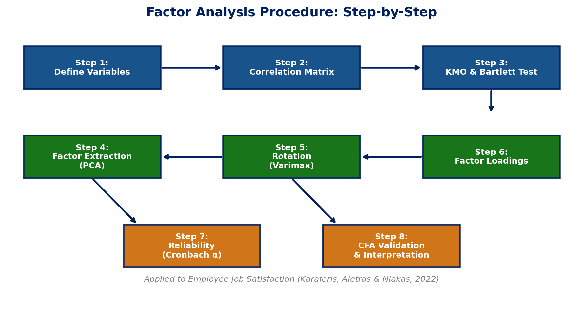
FA Procedure: Step-by-Step

Slide 7
EFA vs CFA: Key Differences
Aspect | EFA (Exploratory) | CFA (Confirmatory)
Purpose | Discover factor structure | Validate known structure
Hypothesis | No prior hypothesis | Tests specific hypothesis
Factor Loadings | All items load on all factors | Items assigned to specific factors
Output | Which items group together | Does the model fit the data?
When to Use | New survey / unknown structure | Validating previous EFA results
Fit Indices | KMO, Bartlett Test | CFI, RMSEA, SRMR, IFI
In This Study | Found 6 dimensions | Confirmed 6-factor model

Slide 8
Case Study: Job Satisfaction in Large Organizations
Karaferis, Aletras & Niakas (2022)
Study Context:
13 public hospitals in Athens, Greece (1st Regional Health Authority of Attica)
3,278 healthcare employees surveyed (doctors, nurses, other professionals)
Why This Matters for Corporate:
Large organizations face similar satisfaction challenges
Same dimensions apply: pay, supervision, management, communication
Results are generalizable to corporate settings
Survey Instrument:
Spector's Job Satisfaction Survey (JSS)
36 items across 9 original dimensions
6-point Likert scale (1 = strongly disagree to 6 = strongly agree)
Study Details:
Sample Size:
n = 3,278 employees
Response Rate:
81.95% (4,000 distributed, 3,278 returned)
Analysis Methods:
Exploratory Factor Analysis (EFA)
Confirmatory Factor Analysis (CFA)
Cronbach's Alpha reliability testing
Split-half reliability
Software:
SPSS for EFA
AMOS for CFA

Slide 9
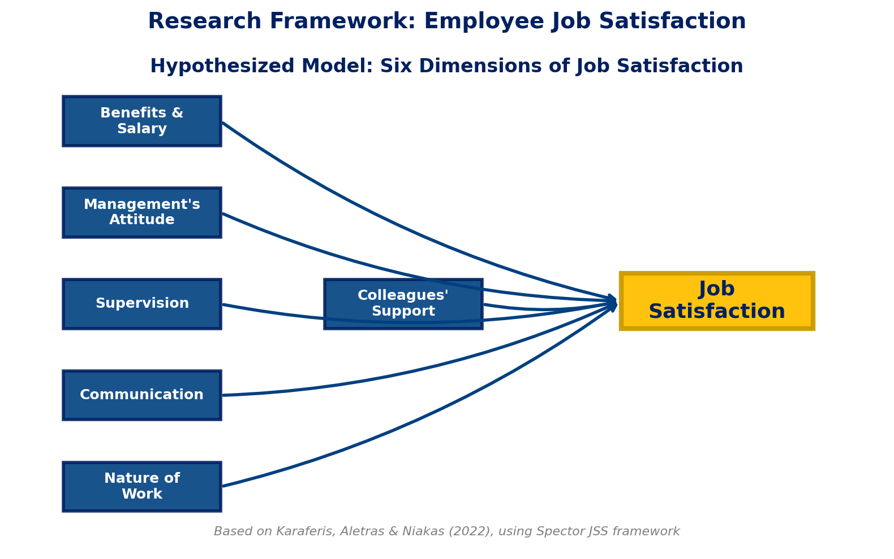
Research Framework: Six Dimensions
Six Dimensions Extracted:
1. Benefits & Salary
Compensation, bonuses, fairness of pay
2. Management's Attitude
How management treats and values employees
3. Supervision
Quality and fairness of direct supervisors
4. Communication
Information flow within the organization
5. Nature of Work
The work itself: meaningful, interesting tasks
6. Colleagues' Support
Relationships with coworkers, teamwork

Slide 10
Step 1: Sampling Adequacy Tests
Before running Factor Analysis, we must check if the data is suitable:
KMO Test (Kaiser-Meyer-Olkin):
KMO = 0.912 (Superb)
KMO measures whether the correlations between variables are strong enough for Factor Analysis
Values above 0.90 are considered 'superb' (Kaiser, 1974)
This means the 36 survey items are highly suitable for factor analysis
Bartlett's Test of Sphericity:
p = 0.000 (significant)
Tests whether the correlation matrix is significantly different from an identity matrix
p < 0.001 confirms that correlations exist between variables
Conclusion: Data is excellent for Factor Analysis

Slide 11
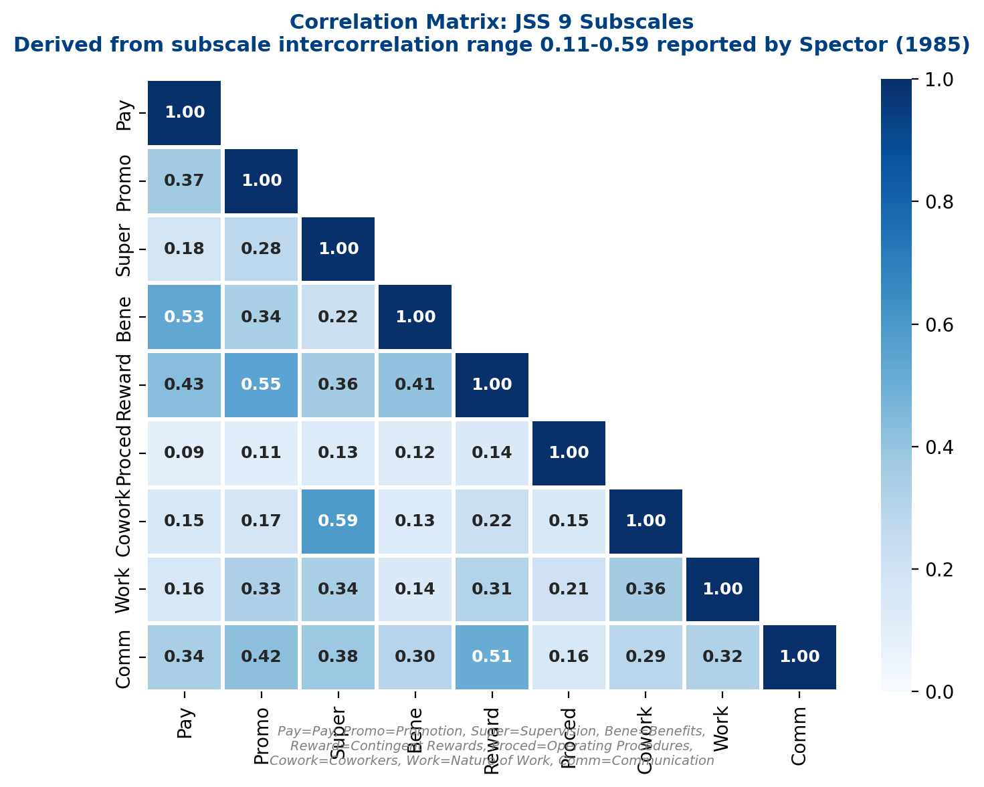
Step 2: Correlation Matrix
What is the Correlation Matrix?
Shows how strongly each pair of variables is related to each other
Why It Matters:
Variables must be correlated (but not too highly) for FA to work
Key Observations:
Spector (1985) reported subscale intercorrelations range 0.11 to 0.59
Moderate correlations = variables share some variance but remain distinct
Operating Procedures has the weakest correlations with other subscales
Supervision and Coworkers show a strong link (r = 0.59)
Values derived from the range
reported by Spector (1985)

Slide 12
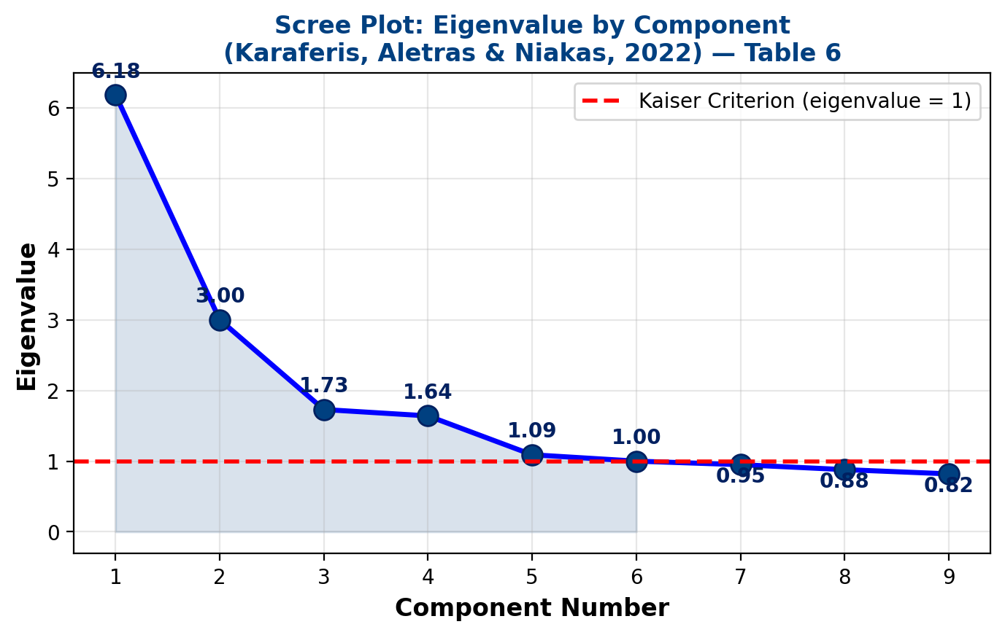
Step 3: Factor Extraction - Scree Plot
How Many Factors?
Kaiser Criterion:
Keep factors with eigenvalue > 1.0
6 factors exceeded this threshold
Extraction Method:
Principal Component Analysis (PCA)
Varimax rotation (orthogonal)
Factor Loading Threshold:
Items with loadings >= 0.50 retained
Result:
6 components with eigenvalue >= 1.0
Total: 56.23% of variance explained
Source: Karaferis et al. (2022),
Table 6

Slide 13
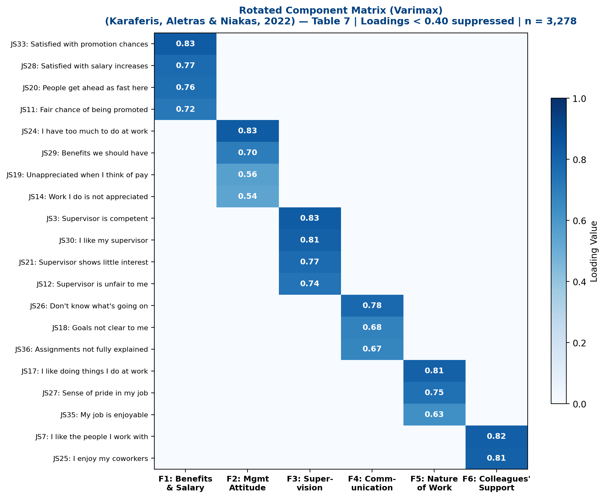
Step 4: Rotated Factor Loading Matrix
What Are Factor Loadings?
They show how strongly each survey item belongs to each factor
Reading the Matrix:
High loading (>= 0.50) = item belongs to that factor
Low loading (< 0.30) = weak or no relationship
Rotation: Varimax
Makes the pattern clearer by maximizing high loadings and minimizing low ones
20 items retained across
6 factors (from original 36)
Source: Karaferis et al. (2022),
Table 7 — cross-loadings < 0.40 suppressed

Slide 14
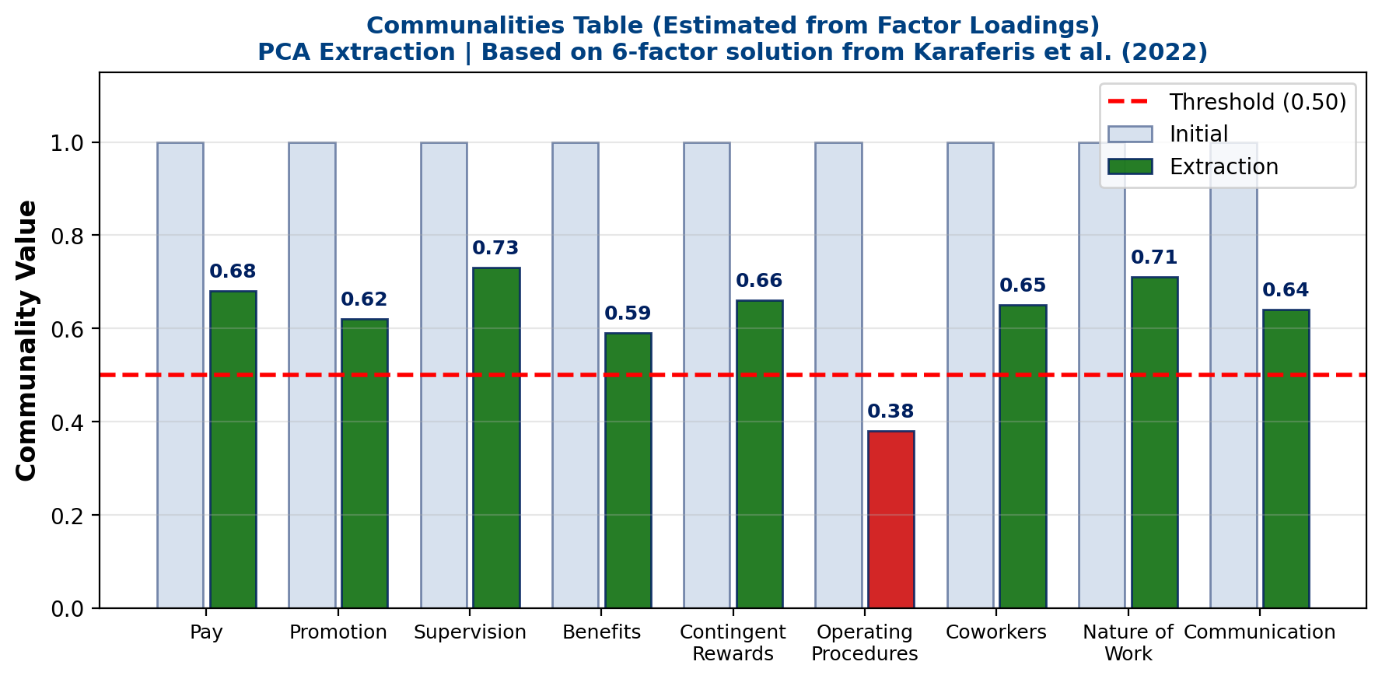
Step 5: Communalities
What Are Communalities?
The proportion of each variable's variance that is explained by the extracted factors
How to Read:
Initial = 1.0 (100% of variance)
Extraction = how much the factors capture
Threshold:
Values >= 0.50 = good (factors explain at least 50% of that variable's variance)
Key Observation:
Most variables have communalities above 0.50
Operating Procedures is lowest - weakest fit
(this dimension was not retained in final 6-factor model)
Estimated from reported factor
loadings; not directly reported in paper

Slide 15
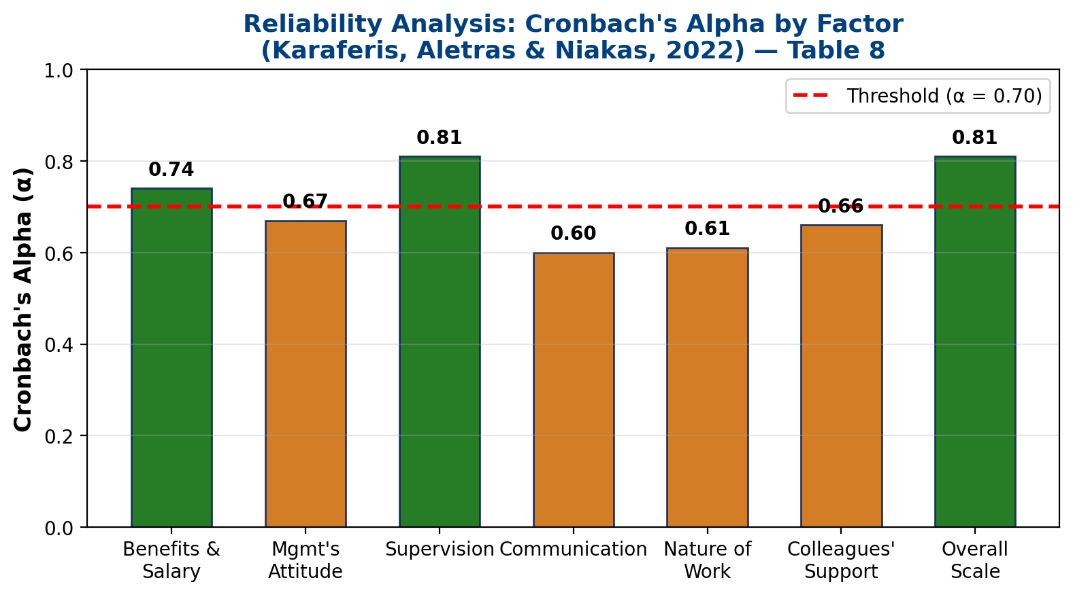
Step 6: Reliability Analysis (Cronbach's Alpha)
What is Cronbach's Alpha?
Measures how consistently the survey items within each dimension measure the same thing
Interpretation:
α >= 0.70 = Acceptable reliability
α >= 0.80 = Good reliability
Results (Table 8):
Overall scale (20 items): α = 0.81
Range: 0.60 to 0.81 across factors
Supervision is strongest (0.81)
Communication is lowest (0.60)
Source: Karaferis et al. (2022)

Slide 16
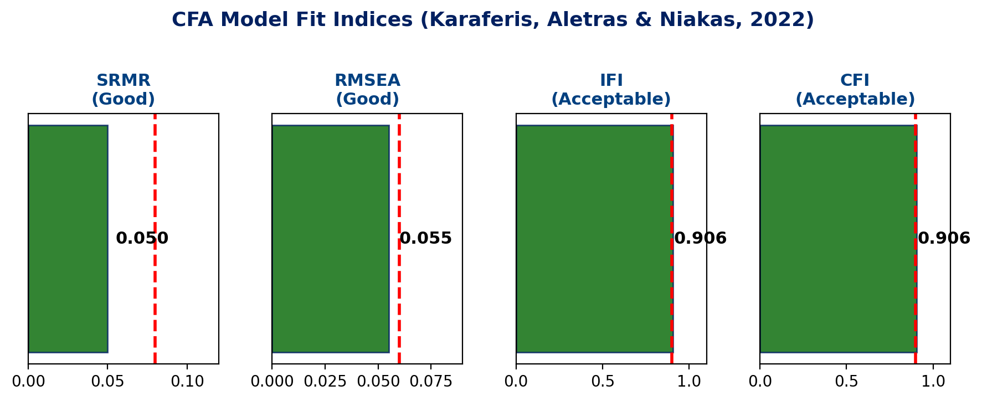
Step 7: CFA Model Fit Assessment
What are Fit Indices?
They tell us how well the proposed 6-factor model fits the actual data
Results:
SRMR = 0.050
Good (threshold: < 0.08)
RMSEA = 0.055
Good (threshold: < 0.06)
IFI = 0.906
Acceptable (threshold: > 0.90)
CFI = 0.906
Acceptable (threshold: > 0.90)
Conclusion: The 6-factor model
fits the data well
Index | Value | Threshold | Result
SRMR | 0.050 | < 0.08 | Good
RMSEA | 0.055 | < 0.06 | Good
IFI | 0.906 | > 0.90 | Acceptable
CFI | 0.906 | > 0.90 | Acceptable

Slide 17
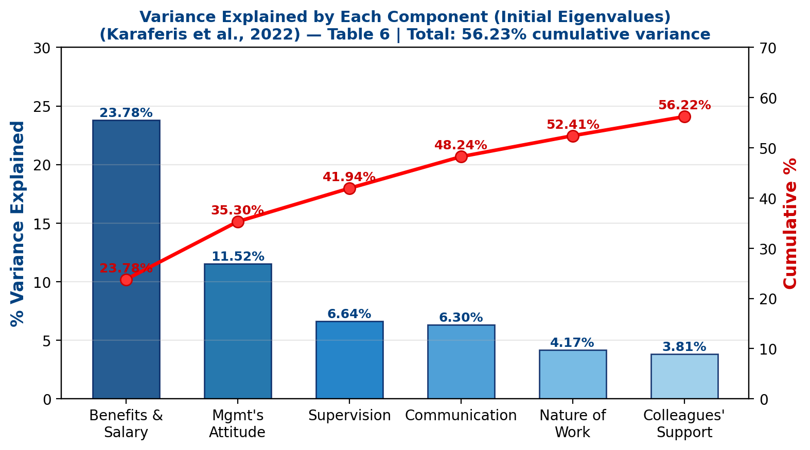
Step 8: Variance Explained
Rotated sums of squared loadings from Karaferis, Aletras & Niakas (2022), Table 6. Factor 1 (Benefits & Salary) explains the most variance (14.13%).

Slide 18
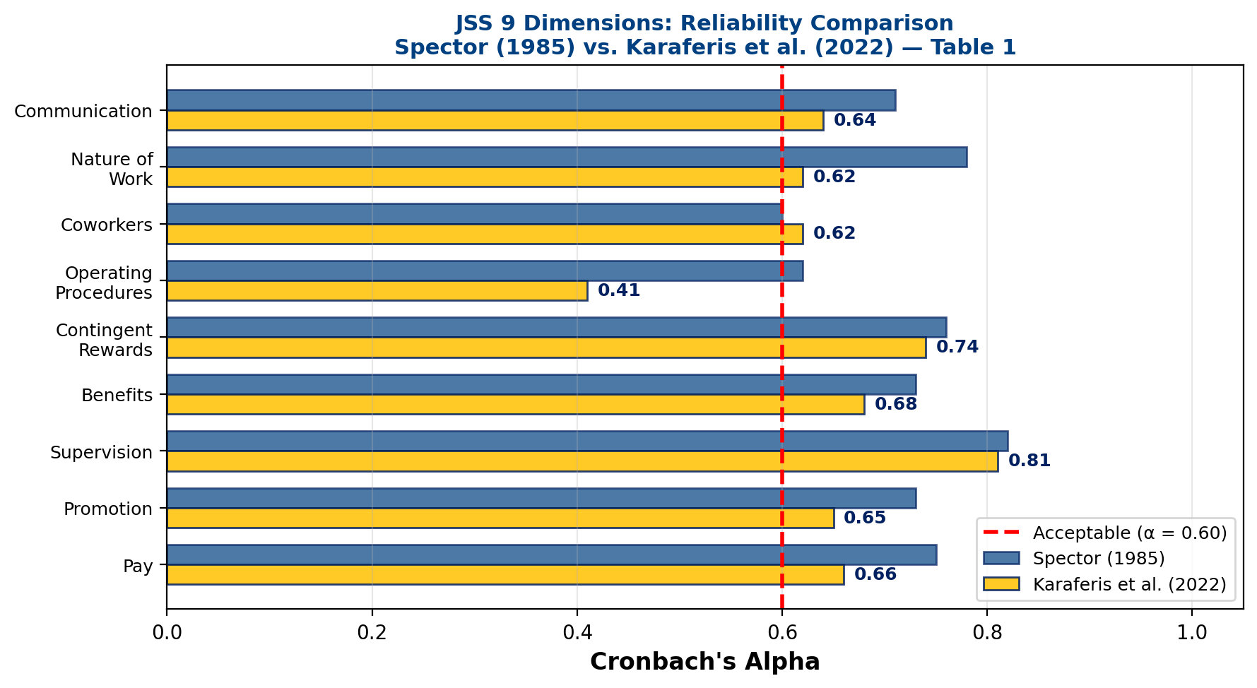
Spector's JSS: The Original 9-Dimension Framework
Spector (1985)
The JSS Framework:
36 items total (4 per dimension)
6-point Likert scale
Half items are reverse-scored
9 Original Dimensions:
Pay, Promotion, Supervision, Benefits,
Contingent Rewards, Operating Procedures,
Coworkers, Nature of Work, Communication
Karaferis et al. (2022) found
6 factors from 20 retained items
Widely used: validated in 30+
languages across multiple cultures
Chart compares Spector vs. present study

Slide 19
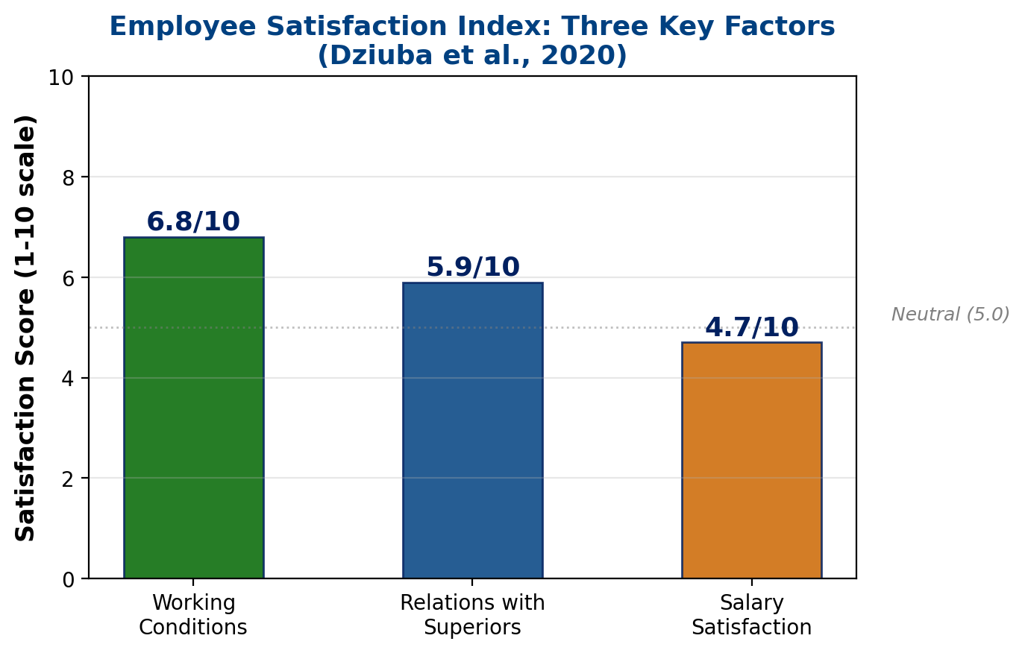
Supporting Study: Satisfaction & Work Performance
Dziuba et al. (2020)
Study Overview:
300 employees in a large corporate enterprise
Survey with 20 satisfaction statements
1-10 satisfaction scale
Three Key Factors:
1. Working Conditions:
Highest satisfaction (6.8/10)
2. Relations with Superiors:
Moderate satisfaction (5.9/10)
3. Salary Satisfaction:
Lowest satisfaction (4.7/10)
Key Finding:
Satisfied employees perform better
and feel safer at work
DOI: 10.2478/czoto-2020-0003

Slide 20
Factor Interpretation & Business Implications
What Each Factor Means for Organizations:
Factor 1: Benefits & Salary
Largest factor - explains the most variance
Fair compensation is the foundation of satisfaction
Organizations must ensure competitive pay structures
Factor 2: Management's Attitude
How leadership treats employees matters greatly
Respectful, supportive management boosts morale
Factor 3: Supervision
Quality of direct supervisors impacts daily work experience
Good supervisors provide guidance without micromanaging
Factor 4: Communication
Clear information flow reduces confusion
Employees need to feel informed about decisions
Factor 5: Nature of Work
Meaningful, interesting work increases engagement
Task variety and autonomy are important
Factor 6: Colleagues' Support
Positive coworker relationships create a supportive environment
Teamwork and collaboration drive satisfaction
Actionable Insight:
Organizations should invest in all 6 areas,
but prioritize pay fairness and management quality

Slide 21
Discussion & Key Findings
Finding 1: Job Satisfaction is Multidimensional
It is not just about money. Six distinct dimensions emerged from the analysis, showing that satisfaction comes from multiple sources: pay, management, supervision, communication, work itself, and coworkers
Finding 2: Benefits & Salary is the Largest Factor
Compensation remains the biggest driver of satisfaction. Organizations that underpay will struggle to satisfy employees regardless of other factors
Finding 3: The JSS Framework is Robust
Spector's 36-item JSS instrument, originally with 9 dimensions, showed a stable 6-factor structure with 20 retained items in 3,278 employees, with good reliability (overall α = 0.81) and model fit (CFI = 0.906)
Finding 4: Satisfaction Directly Affects Performance
Dziuba et al. (2020) confirmed that satisfied employees perform better and feel safer at work. Salary satisfaction was the weakest area (4.7/10), suggesting room for improvement

Slide 22
Comments
Strengths of This Analysis:
Both EFA and CFA were used, providing a thorough validation of the factor structure
Large sample size (n = 3,278 across 13 hospitals) ensures statistical power and reliable factor estimates
The KMO value of 0.912 is superb, indicating excellent suitability for factor analysis
The JSS is a well-established, free instrument validated across 30+ countries
Observations:
The original 9-factor JSS consolidated into 6 factors, suggesting some dimensions overlap in this context
Several dimensions (Communication α=0.60, Nature of Work α=0.61, Colleagues' Support α=0.66) showed lower reliability, which could be improved with revised items
The Dziuba et al. (2020) study reinforces the practical importance of satisfaction research by linking it directly to employee performance and safety

Slide 23
Limitations
Study-Specific Limitations:
The primary study focused on healthcare organizations; results may differ in purely corporate settings
Cross-sectional design: data collected at one point in time, so we cannot determine cause-and-effect relationships
Self-reported data may contain social desirability bias (employees may not answer honestly)
Four of six factors showed Cronbach's alpha below 0.70 (Communication = 0.60, Nature of Work = 0.61, Colleagues' Support = 0.66, Management's Attitude = 0.67)
General Limitations:
Factor Analysis assumes linear relationships between variables
Results are population-specific and may not generalize to all industries
The JSS uses a fixed 36-item format that may miss industry-specific satisfaction factors

Slide 24
Suggested Improvements
Methodological Improvements:
Use probability sampling (stratified random) for better generalizability across departments
Include multiple organizations to compare factor structures across different corporate settings
Apply longitudinal design to track how satisfaction changes over time (before and after policy changes)
Revise items with low factor loadings to improve the Nature of Work and Communication dimensions
Extended Scope:
Add modern work dimensions: remote work satisfaction, work-life balance, technology tools
Include demographic analysis: compare satisfaction across age groups, departments, and tenure levels
Add objective performance metrics alongside self-reported satisfaction for stronger conclusions
Study the impact of post-pandemic hybrid work policies on satisfaction dimensions
Advanced Analytics:
Apply Multi-Group Analysis (MGA) to compare satisfaction across different demographics
Use Structural Equation Modeling (SEM) to test causal pathways between satisfaction and outcomes
Incorporate text analysis from employee reviews for richer qualitative insights
Test mediation effects: does supervision quality mediate the relationship between management attitude and overall satisfaction?

Slide 25
Conclusion
Summary:
Factor Analysis successfully identified six key dimensions of employee job satisfaction: Benefits & Salary, Management's Attitude, Supervision, Communication, Nature of Work, and Colleagues' Support
The KMO value of 0.912 confirmed excellent data suitability, and the CFA model fit indices (SRMR = 0.050, RMSEA = 0.055, CFI = 0.906) validated the six-factor structure
Benefits and salary emerged as the most important dimension, followed by management quality and supervision
The findings apply directly to corporate organizations: understanding these dimensions helps managers create targeted improvement programs
Key Takeaway:
Employee job satisfaction is not a single concept - it has multiple dimensions. Organizations that address all six areas will see better performance, lower turnover, and a healthier workplace

Slide 26
References
Primary Sources:
1. Karaferis, D., Aletras, V. & Niakas, D. (2022). "Determining Dimensions of Job Satisfaction in Healthcare Using Factor Analysis." BMC Psychology, 10, Article 240.
DOI: 10.1186/s40359-022-00941-2
2. Spector, P.E. (1985). "Measurement of Human Service Staff Satisfaction: Development of the Job Satisfaction Survey." American Journal of Community Psychology, 13, 693-713.
DOI: 10.1007/BF00929796
3. Dziuba, S.T., Ingaldi, M., & Zhuravskaya, M. (2020). "Employees' Job Satisfaction and Their Work Performance as Elements Influencing Work Safety." CzOTO, 2(1), 18-25.
DOI: 10.2478/czoto-2020-0003
Additional References:
4. Shrestha, N. (2021). "Factor Analysis as a Tool for Survey Analysis." American Journal of Applied Mathematics and Statistics, 9(1), 4-11.
DOI: 10.12691/ajams-9-1-2
5. Kaiser, H.F. (1974). "An Index of Factorial Simplicity." Psychometrika, 39, 31-36.

Slide 27
Thank You!
Questions & Discussion
Lana Jalal Gidan
SSIE-605 | Binghamton University | Professor Susan Lu

