Slide 1
Factor Analysis in Marketing
Applications, Methodology & Real-World Case Study
SSIE 605 – Applied Multivariate Data Analysis
Professor Susan Lu
Lana Jalal Gidan
Binghamton University

Slide 2
Agenda
1. Problem Statement
2. Article Information
3. What is Factor Analysis?
4. Factor Analysis Methodology
5. Case Study: Consumer Preferences (Toothpaste Market)
6. Statistical Results & Numerical Outputs
7. Factor Interpretation & Visualization
8. Discussion & Key Findings
9. Comments, Limitations & Improvements
10. Conclusion

Slide 3
Problem Statement
• Marketing researchers collect large volumes of consumer data with many variables
• Too many correlated variables lead to multicollinearity and overfitting
• Understanding what really drives consumer decisions requires identifying hidden patterns
• Factor Analysis helps reduce complexity by uncovering latent (hidden) factors behind observed consumer behaviors
• Key Question: Can we identify a small number of underlying factors that explain consumer preferences in marketing surveys?

Slide 4
Article Information
Primary Reference:
Title: "Factor Analysis as a Tool for Survey Analysis"
Author: Noora Shrestha
Journal: American Journal of Applied Mathematics and Statistics, Vol. 9, No. 1, pp. 4-11
Year: 2021
DOI: 10.12691/ajams-9-1-2
Supplementary Reference:
Title: "An Easy Approach to Exploratory Factor Analysis: Marketing Perspective"
Authors: Noor Ul Hadi, Naziruddin Abdullah, Ilham Sentosa
Journal: Journal of Educational and Social Research, Vol. 6, No. 1
Year: 2016 DOI: 10.5901/jesr.2016.v6n1p215
Case Study Data: Toothpaste Consumer Survey (Malhotra, 2010)

Slide 5
What is Factor Analysis?
• A statistical method used for data reduction and summarization
• Identifies underlying dimensions (latent factors) that explain correlations among observed variables
• An interdependence technique – no distinction between dependent and independent variables
• Reduces a large set of correlated variables into a smaller set of uncorrelated factors
• Widely used in marketing for: customer segmentation, brand perception, satisfaction surveys, and product positioning
Mathematical Model:
Xi = Ai1F1 + Ai2F2 + ... + AimFm + ViUi
Where Xi = observed variable, Aij = factor loading, Fj = common factor, Ui = unique factor

Slide 6
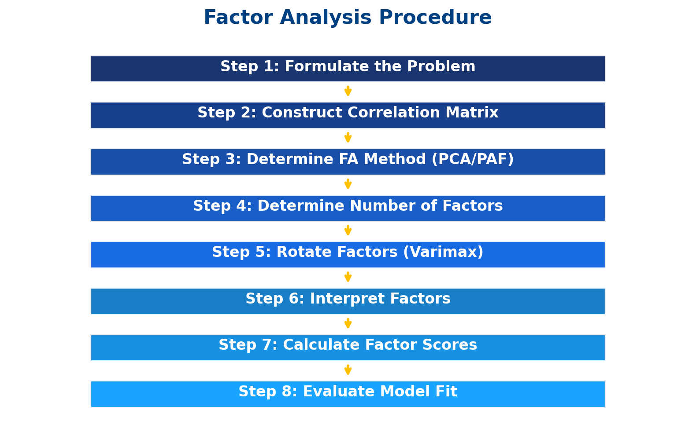
Factor Analysis Procedure

Slide 7
Factor Analysis vs. PCA
Factor Analysis (FA)
• Produces latent factors
• Analyzes covariance (communality)
• Close approximation to R matrix
• Explains covariance with minimum factors
• Multiple solutions possible
• Goals: data reduction, describe & explore relationships
Principal Component Analysis (PCA)
• Produces components
• Analyzes total variance
• Reproduces R matrix completely
• Extracts max variance with fewest factors
• Gives a unique solution
• Goal: variance reduction, fewer variables

Slide 8
Case Study: Toothpaste Consumer Preferences
Study Objective:
Determine the underlying benefits consumers seek when purchasing toothpaste
Survey Design:
30 respondents rated 6 statements on a 7-point Likert scale (1 = Strongly Disagree to 7 = Strongly Agree)
Variables Measured:
V1: Important to buy toothpaste that prevents cavities
V2: I like toothpaste that gives shiny teeth
V3: Toothpaste should strengthen gums
V4: I prefer toothpaste that freshens breath
V5: Prevention of tooth decay is NOT an important benefit
V6: Most important consideration is attractive teeth

Slide 9
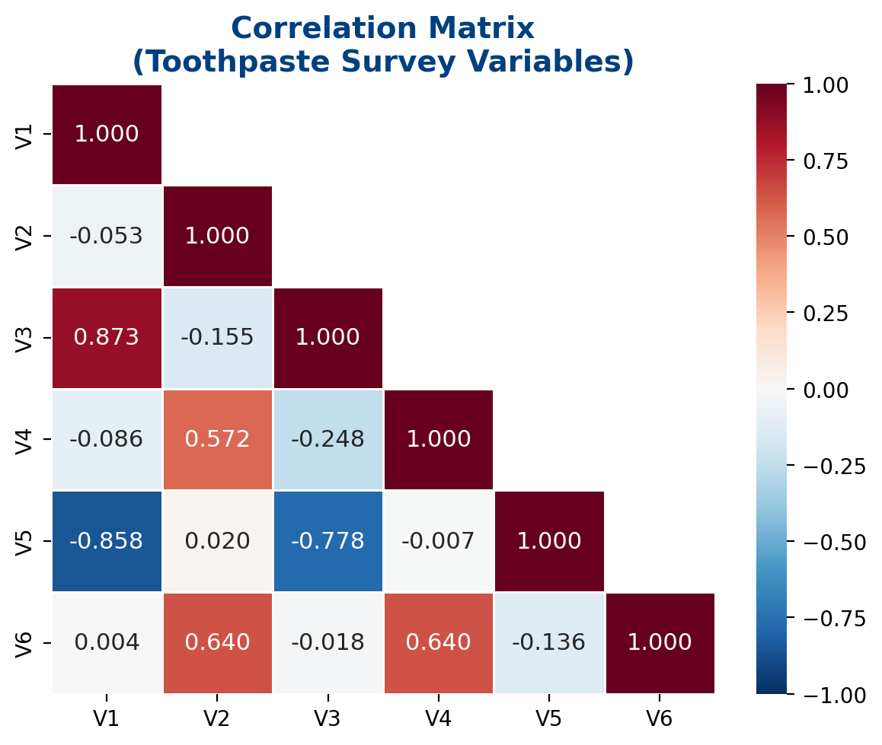
Step 1: Correlation Matrix
Source: Malhotra (2010)
Key Observations:
V1 & V3 highly correlated (r = 0.873) → both relate to dental health
V2, V4, V6 correlated with each other → cosmetic/aesthetic concerns
V1 & V5 strongly negative (r = -0.858) → opposite statements about decay prevention
Pattern suggests TWO distinct groups of variables
Conclusion:
Strong correlations indicate factor analysis is appropriate

Slide 10
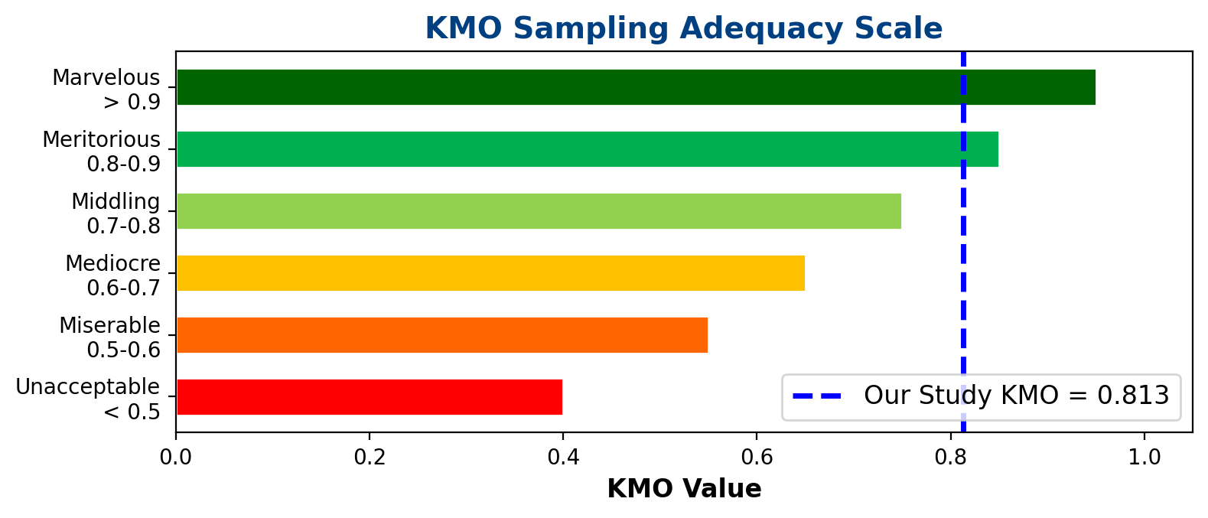
Step 2: KMO & Bartlett's Test of Sphericity
Results (Shrestha, 2021; DOI: 10.12691/ajams-9-1-2):
KMO Measure of Sampling Adequacy: 0.813 (Meritorious)
Bartlett's Test of Sphericity:
Chi-Square = 637.65, df = 55, Significance: p < 0.0001
Conclusion: Data is SUITABLE for Factor Analysis

Slide 11
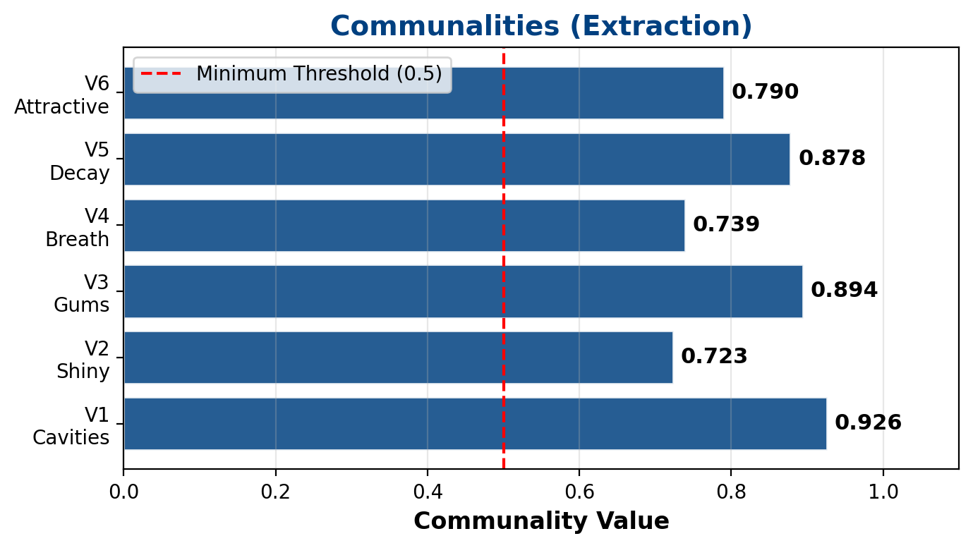
Step 3: Communalities
Source: Malhotra (2010)
What are Communalities?
Proportion of variance in a variable explained by the extracted factors
Interpretation:
All values exceed 0.5 threshold
V1 (Cavities): 0.926 → 92.6% of variance explained
V3 (Gums): 0.894 → 89.4% explained
V5 (Decay): 0.878 → 87.8% explained
Conclusion:
All variables are well-represented by the factor solution

Slide 12
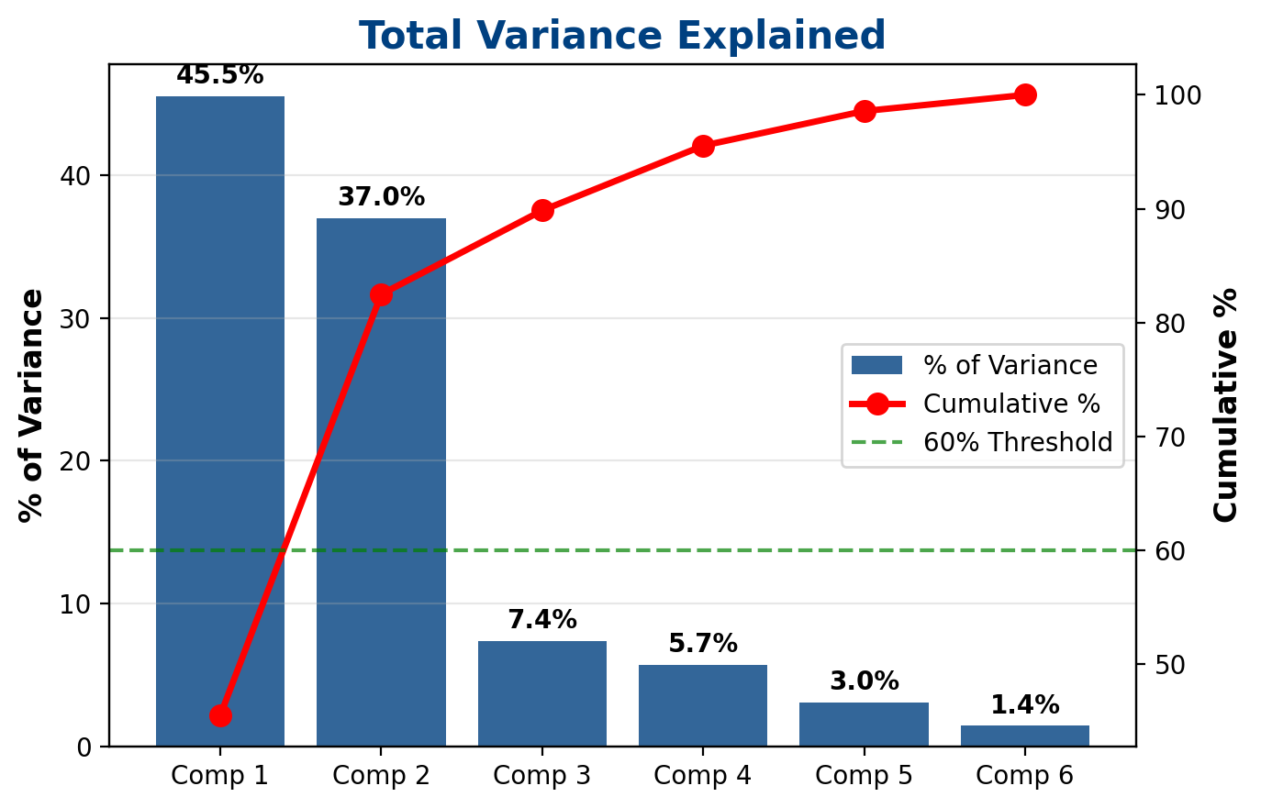
Step 4: Eigenvalues & Total Variance Explained
Source: Malhotra (2010)
Comp | Eigenvalue | % Variance | Cumulative %
1 | 2.731 | 45.52% | 45.52%
2 | 2.218 | 36.97% | 82.49%
3 | 0.442 | 7.36% | 89.85%
4 | 0.341 | 5.69% | 95.54%
5 | 0.183 | 3.04% | 98.58%
6 | 0.085 | 1.42% | 100.00%
Kaiser's Rule: Retain factors with eigenvalue > 1.0
→ 2 factors retained
→ Explain 82.49% of total variance
(Exceeds 60% minimum threshold)

Slide 13
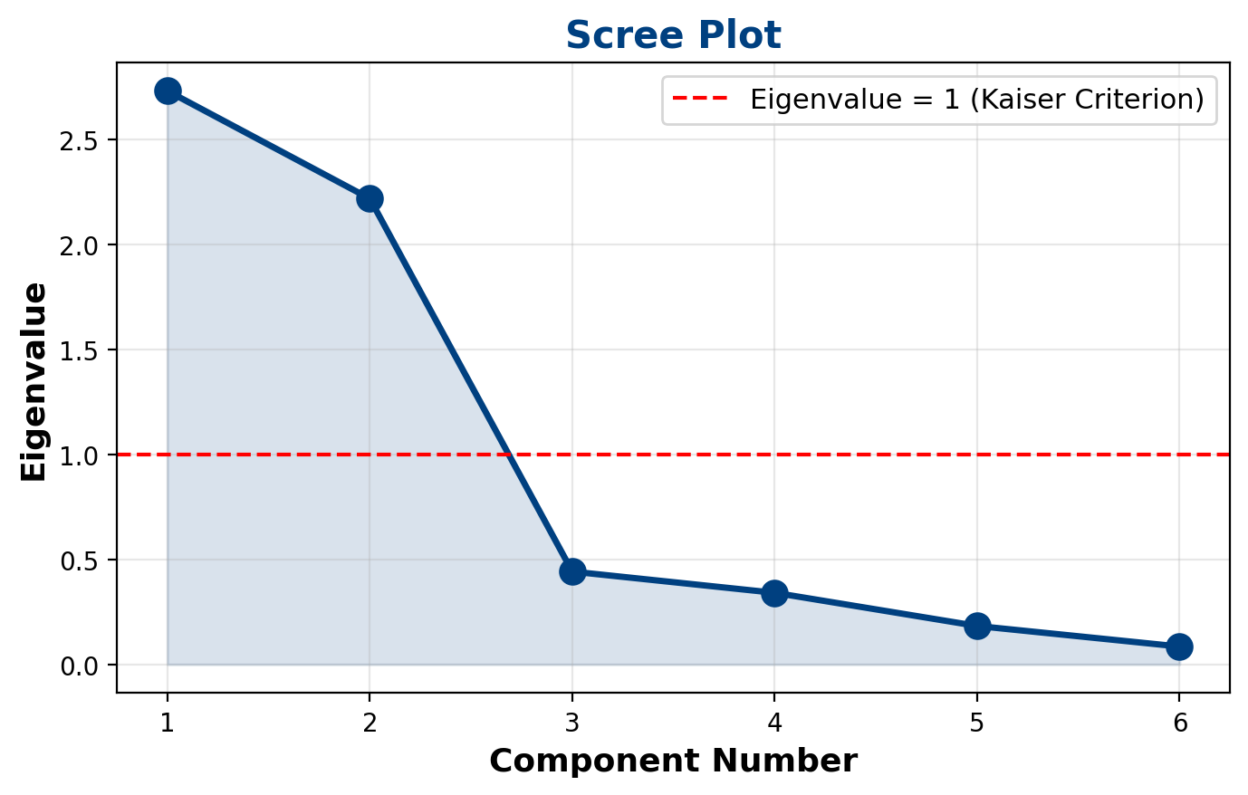
Step 4 (cont.): Scree Plot
The scree plot confirms 2 factors: sharp drop after Component 2, then leveling off (the "elbow")

Slide 14
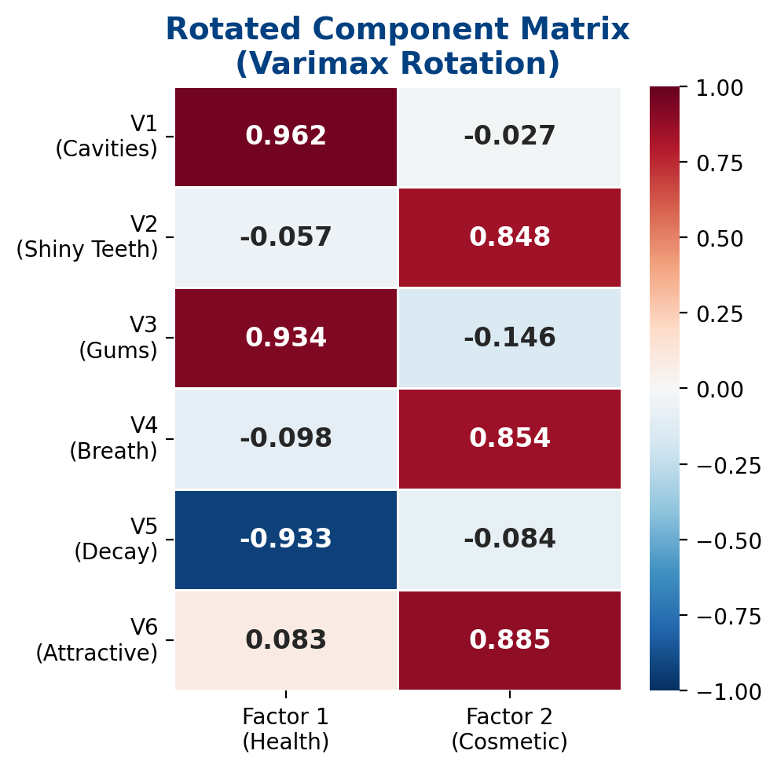
Step 5: Rotated Component Matrix (Varimax)
Source: Malhotra (2010)
Factor 1 – Health Benefits:
V1 (Cavities): 0.962
V3 (Gums): 0.934
V5 (Decay): -0.933 (reverse coded)
Factor 2 – Cosmetic Benefits:
V6 (Attractive teeth): 0.885
V4 (Fresh breath): 0.854
V2 (Shiny teeth): 0.848
Rotation Method:
Varimax with Kaiser Normalization
Converged in 3 iterations

Slide 15
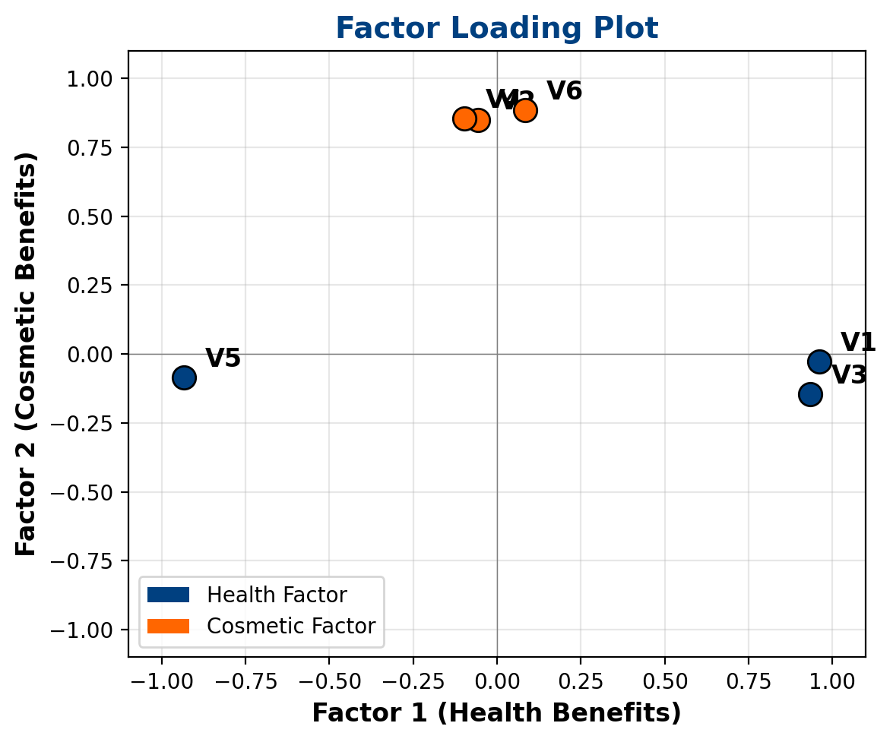
Step 6: Factor Loading Plot & Interpretation
Visual Interpretation:
V1, V3, V5 cluster along Factor 1 axis → Health dimension
V2, V4, V6 cluster along Factor 2 axis → Cosmetic dimension
Clear separation confirms two distinct consumer benefit dimensions
Marketing Insight:
Consumers evaluate toothpaste on TWO main dimensions: health protection and cosmetic appeal

Slide 16
Step 7: Factor Scores
Factor Score Equation:
Fi = Wi1X1 + Wi2X2 + Wi3X3 + ... + WikXk
Component Score Coefficient Matrix:
Variable | Factor 1 | Factor 2
V1 | 0.358 | 0.011
V2 | -0.001 | 0.375
V3 | 0.345 | -0.043
V4 | -0.017 | 0.377
V5 | -0.350 | -0.059
V6 | 0.052 | 0.395
Application:
Factor scores replace original 6 variables with 2 factor scores per respondent
These can be used in subsequent regression, clustering, or segmentation analysis

Slide 17
Discussion & Key Findings
Key Finding 1: Two-Factor Solution
Factor Analysis successfully reduced 6 correlated variables to 2 independent factors, explaining 82.49% of total variance
Key Finding 2: Clear Factor Structure
Factor 1 (Health): Cavity prevention, gum strength, decay prevention → functional benefits
Factor 2 (Cosmetic): Shiny teeth, fresh breath, attractive teeth → aesthetic benefits
Key Finding 3: High Data Suitability
KMO = 0.813 (Meritorious) and Bartlett's test significant (p < 0.0001) confirm data appropriateness
Key Finding 4: Marketing Implications
Toothpaste brands can position products along Health vs. Cosmetic dimensions
Different consumer segments prioritize different benefit dimensions

Slide 18
Comments
• The study demonstrates that Factor Analysis is a powerful tool for uncovering hidden patterns in marketing survey data
•
• The toothpaste example is a classic marketing case that clearly shows how correlated variables group into meaningful factors
•
• The two-factor solution (Health vs. Cosmetic) aligns well with marketing theory – consumers evaluate products on functional vs. emotional/aesthetic dimensions
•
• The high communalities (all > 0.72) indicate that the factor solution captures most of the information in the original variables
•
• Varimax rotation produced a clean, interpretable solution where each variable loads strongly on only one factor – this is the ideal "simple structure" in Factor Analysis
•
• The methodology used (PCA extraction + Varimax rotation) follows standard practice recommended by Hair et al. (2006) and Tabachnick & Fidell (2007)

Slide 19
Limitations
• Small sample size (n = 30): Below the recommended minimum of 50 observations; a ratio of at least 5:1 (observations to variables) is recommended
•
• Limited to 6 variables: A broader set of toothpaste attributes (price, brand loyalty, packaging, ingredients) could reveal additional factors
•
• Only Varimax (orthogonal) rotation was used: Oblique rotation (e.g., Promax) should be explored if factors are expected to be correlated – health and cosmetic concerns may not be fully independent
•
• Cross-sectional design: The study captures preferences at one point in time; consumer preferences change over time
•
• Subjective factor naming: The labeling of factors as "Health" and "Cosmetic" involves researcher interpretation, which introduces potential bias
•
• No Confirmatory Factor Analysis (CFA): EFA results were not validated using CFA on an independent sample

Slide 20
Suggested Improvements
• Increase sample size to at least 200-300 respondents for more reliable factor extraction and stable loadings
•
• Include more variables (10-15) covering additional attributes like price sensitivity, brand preference, ingredient awareness, and packaging appeal
•
• Apply both orthogonal (Varimax) and oblique (Promax) rotation methods and compare the solutions for robustness
•
• Use Parallel Analysis (Horn, 1965) in addition to Kaiser's eigenvalue > 1 rule for more accurate determination of the number of factors
•
• Follow up with Confirmatory Factor Analysis (CFA) using Structural Equation Modeling (SEM) to validate the factor structure
•
• Conduct longitudinal studies to track how consumer preference factors evolve over time
•
• Apply the factor solution to real marketing decisions – use factor scores for customer segmentation and targeted advertising

Slide 21
Conclusion
• Factor Analysis successfully reduced 6 correlated consumer preference variables into 2 meaningful, independent factors
•
• The two factors – Health Benefits and Cosmetic Benefits – explain 82.49% of the total variance in the data
•
• KMO = 0.813 and significant Bartlett's test confirmed data suitability for factor analysis
•
• The rotated component matrix showed clean factor loadings, making interpretation straightforward
•
• Factor Analysis proves to be a valuable tool in marketing research for uncovering hidden dimensions of consumer decision-making
•
• The methodology can be applied to any marketing survey to reduce complexity and identify key drivers of consumer behavior

Slide 22
References
1. Shrestha, N. (2021). "Factor Analysis as a Tool for Survey Analysis." American Journal of Applied Mathematics and Statistics, 9(1), 4-11. DOI: 10.12691/ajams-9-1-2
2. Hadi, N.U., Abdullah, N., & Sentosa, I. (2016). "An Easy Approach to Exploratory Factor Analysis: Marketing Perspective." Journal of Educational and Social Research, 6(1), 215. DOI: 10.5901/jesr.2016.v6n1p215
3. Malhotra, N.K. (2010). Marketing Research: An Applied Orientation. 6th Edition, Pearson.
4. Hair, J.F., Black, W.C., Babin, B.J., & Anderson, R.E. (2006). Multivariate Data Analysis. 7th Edition, Pearson.
5. Tabachnick, B.G. & Fidell, L.S. (2007). Using Multivariate Statistics. 5th Edition, Pearson Education.
6. Kaiser, H.F. (1974). "An Index of Factorial Simplicity." Psychometrika, 39(1), 31-36. DOI: 10.1007/BF02291575
7. Bartlett, M.S. (1951). "The Effect of Standardization on a Chi-Square Approximation in Factor Analysis." Biometrika, 38(3/4), 337-344.

Slide 23
Thank You!
Questions?
Lana Jalal Gidan
SSIE 605 – Binghamton University

