Slide 1
Repositioning Webex with AI
From Assistant-Led to Agentic Work
Cisco x WiB x SWE Spring 2026 Case Competition
What product and platform improvements can Cisco make to Webex,
powered by its AI Assistant, to outperform Zoom and Microsoft Teams
in the next phase of hybrid work?
Presented by: Lana Jalal Gidan
Watson College of Engineering and Applied Science
Binghamton University

Slide 2
Agenda
Industry Analysis
Problem Identification
Recommendations
Implementation
Financials & KPIs
Risks & Mitigations
Executive Summary
Industry Analysis | Problem Identification | Recommendations | Implementation | Financials | Risks | Executive Summary

Slide 3
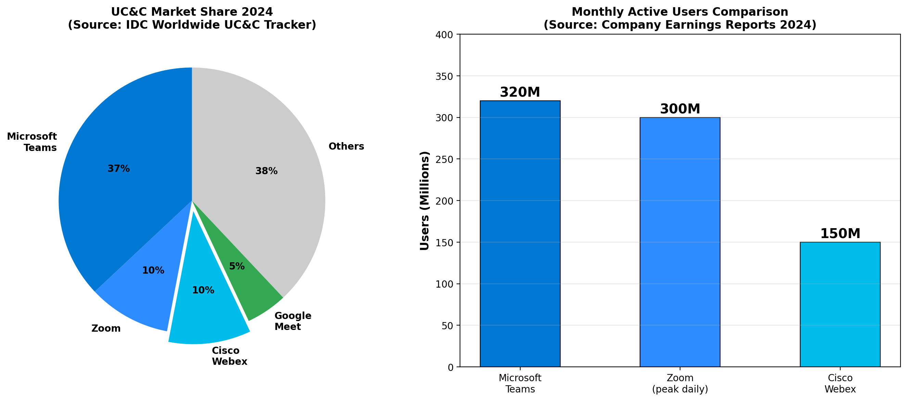
Industry Analysis
The UC&C Market: $55B and Growing at 8.4% CAGR
Industry Analysis | Problem Identification | Recommendations | Implementation | Financials | Risks | Executive Summary

Slide 4
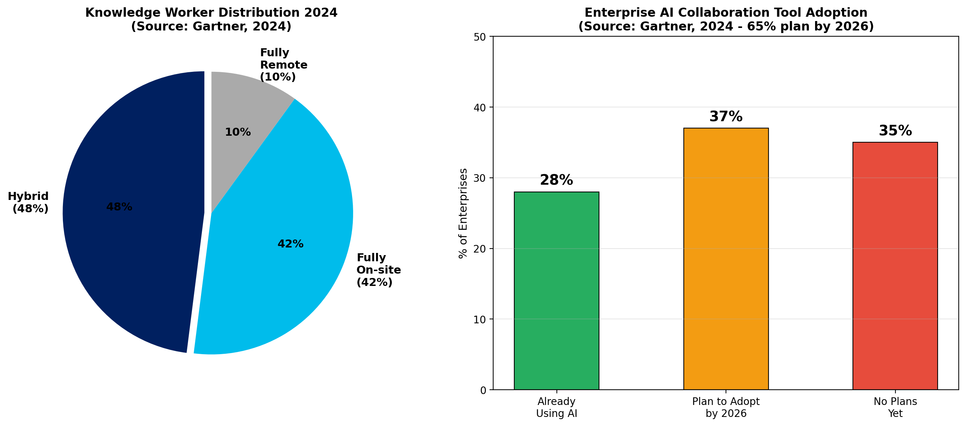
The Hybrid Work Revolution
48% of Knowledge Workers Now Operate in Hybrid Mode
Industry Analysis | Problem Identification | Recommendations | Implementation | Financials | Risks | Executive Summary

Slide 5
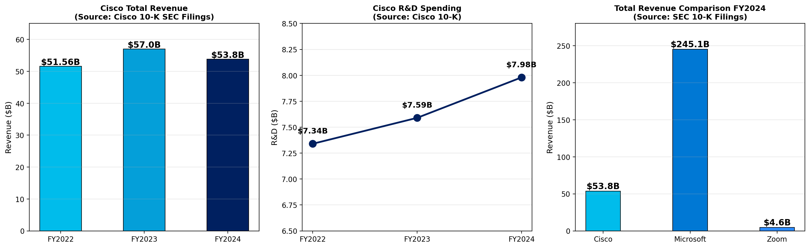
Financial Overview: Cisco vs. Competitors
Source: SEC 10-K Filings (FY2024)
Industry Analysis | Problem Identification | Recommendations | Implementation | Financials | Risks | Executive Summary

Slide 6
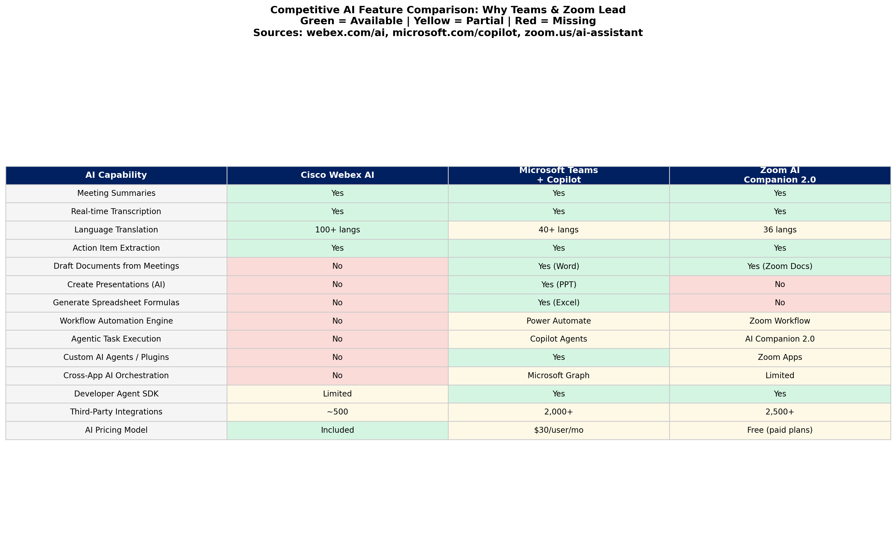
AI Feature Gap Analysis
Webex Trails in Agentic Capabilities
Industry Analysis | Problem Identification | Recommendations | Implementation | Financials | Risks | Executive Summary

Slide 7
Problem Identification
Three Root-Cause Problems Limiting Webex Competitiveness
Problem 1
Low User Engagement & Adoption Gap
Webex ~150M vs Teams 320M MAU Market share: ~10% vs ~37%
G2 Rating: 4.2 vs 4.5 (Zoom)
Problem 2
AI Limited to Passive Assistance
Only summarizes & transcribes vs. Copilot executes in Office 365
No autonomous task execution
Problem 3
Weak Ecosystem Integration
Limited 3rd-party app marketplace vs. Teams 2,000+ integrations
Low developer SDK adoption
Industry Analysis | Problem Identification | Recommendations | Implementation | Financials | Risks | Executive Summary

Slide 8
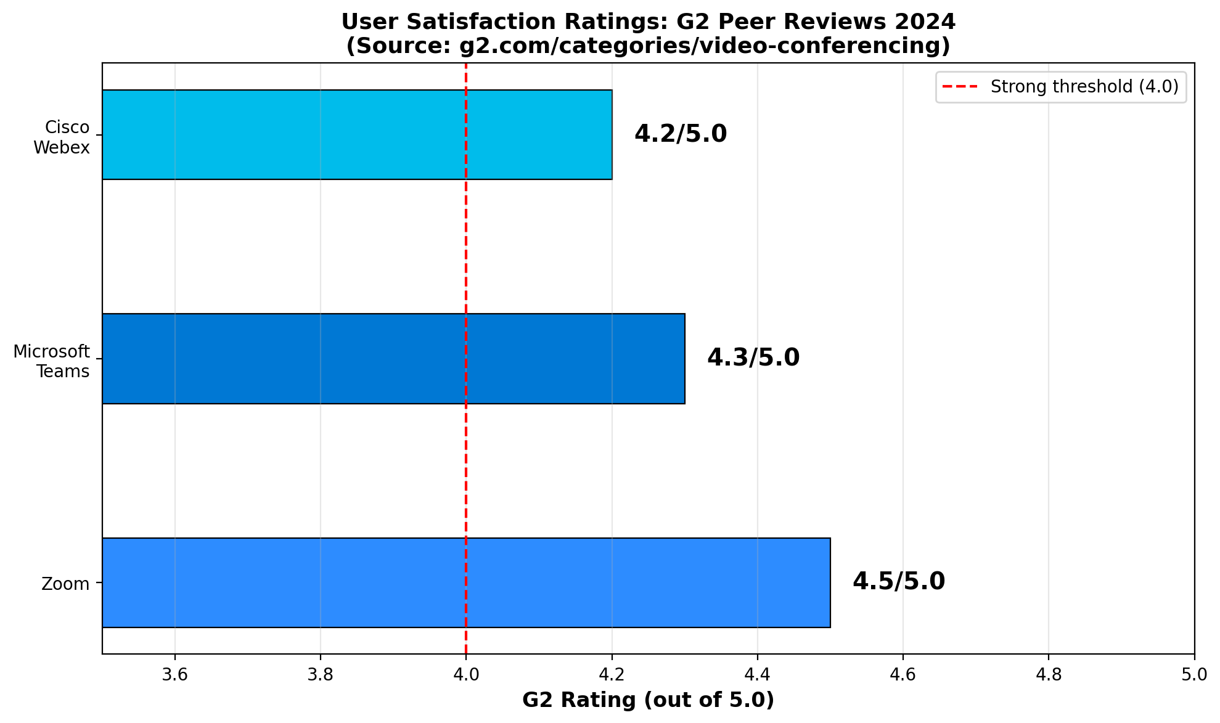
Problem 1: Low User Engagement
Webex Trails Competitors in Satisfaction & Adoption
Root Cause (5 Whys):
1. Low engagement?
Less intuitive UX
2. Less intuitive?
No differentiated value
3. No differentiation?
AI features are basic
4. Basic AI?
Passive assistant-only
5. ROOT CAUSE:
AI does not perform tasks
Industry Analysis | Problem Identification | Recommendations | Implementation | Financials | Risks | Executive Summary

Slide 9
Problems 2 & 3: Passive AI + Weak Ecosystem
Root Causes Traced Through 5 Whys Analysis
Problem 2: Passive AI
Current Webex AI can:
- Summarize meetings
- Transcribe in real-time
- Translate 100+ languages
But CANNOT:
- Execute follow-up tasks
- Draft documents
- Automate workflows
- Coordinate across tools
Root Cause: No agentic
architecture exists
Problem 3: Weak Ecosystem
Integration comparison:
- Teams: 2,000+ apps
- Zoom: 2,500+ apps
- Webex: Significantly fewer
Self-reinforcing cycle:
Fewer integrations ->
Lower stickiness ->
Fewer developers ->
Even fewer integrations
Root Cause: No open AI agent
platform for developers
Industry Analysis | Problem Identification | Recommendations | Implementation | Financials | Risks | Executive Summary

Slide 10
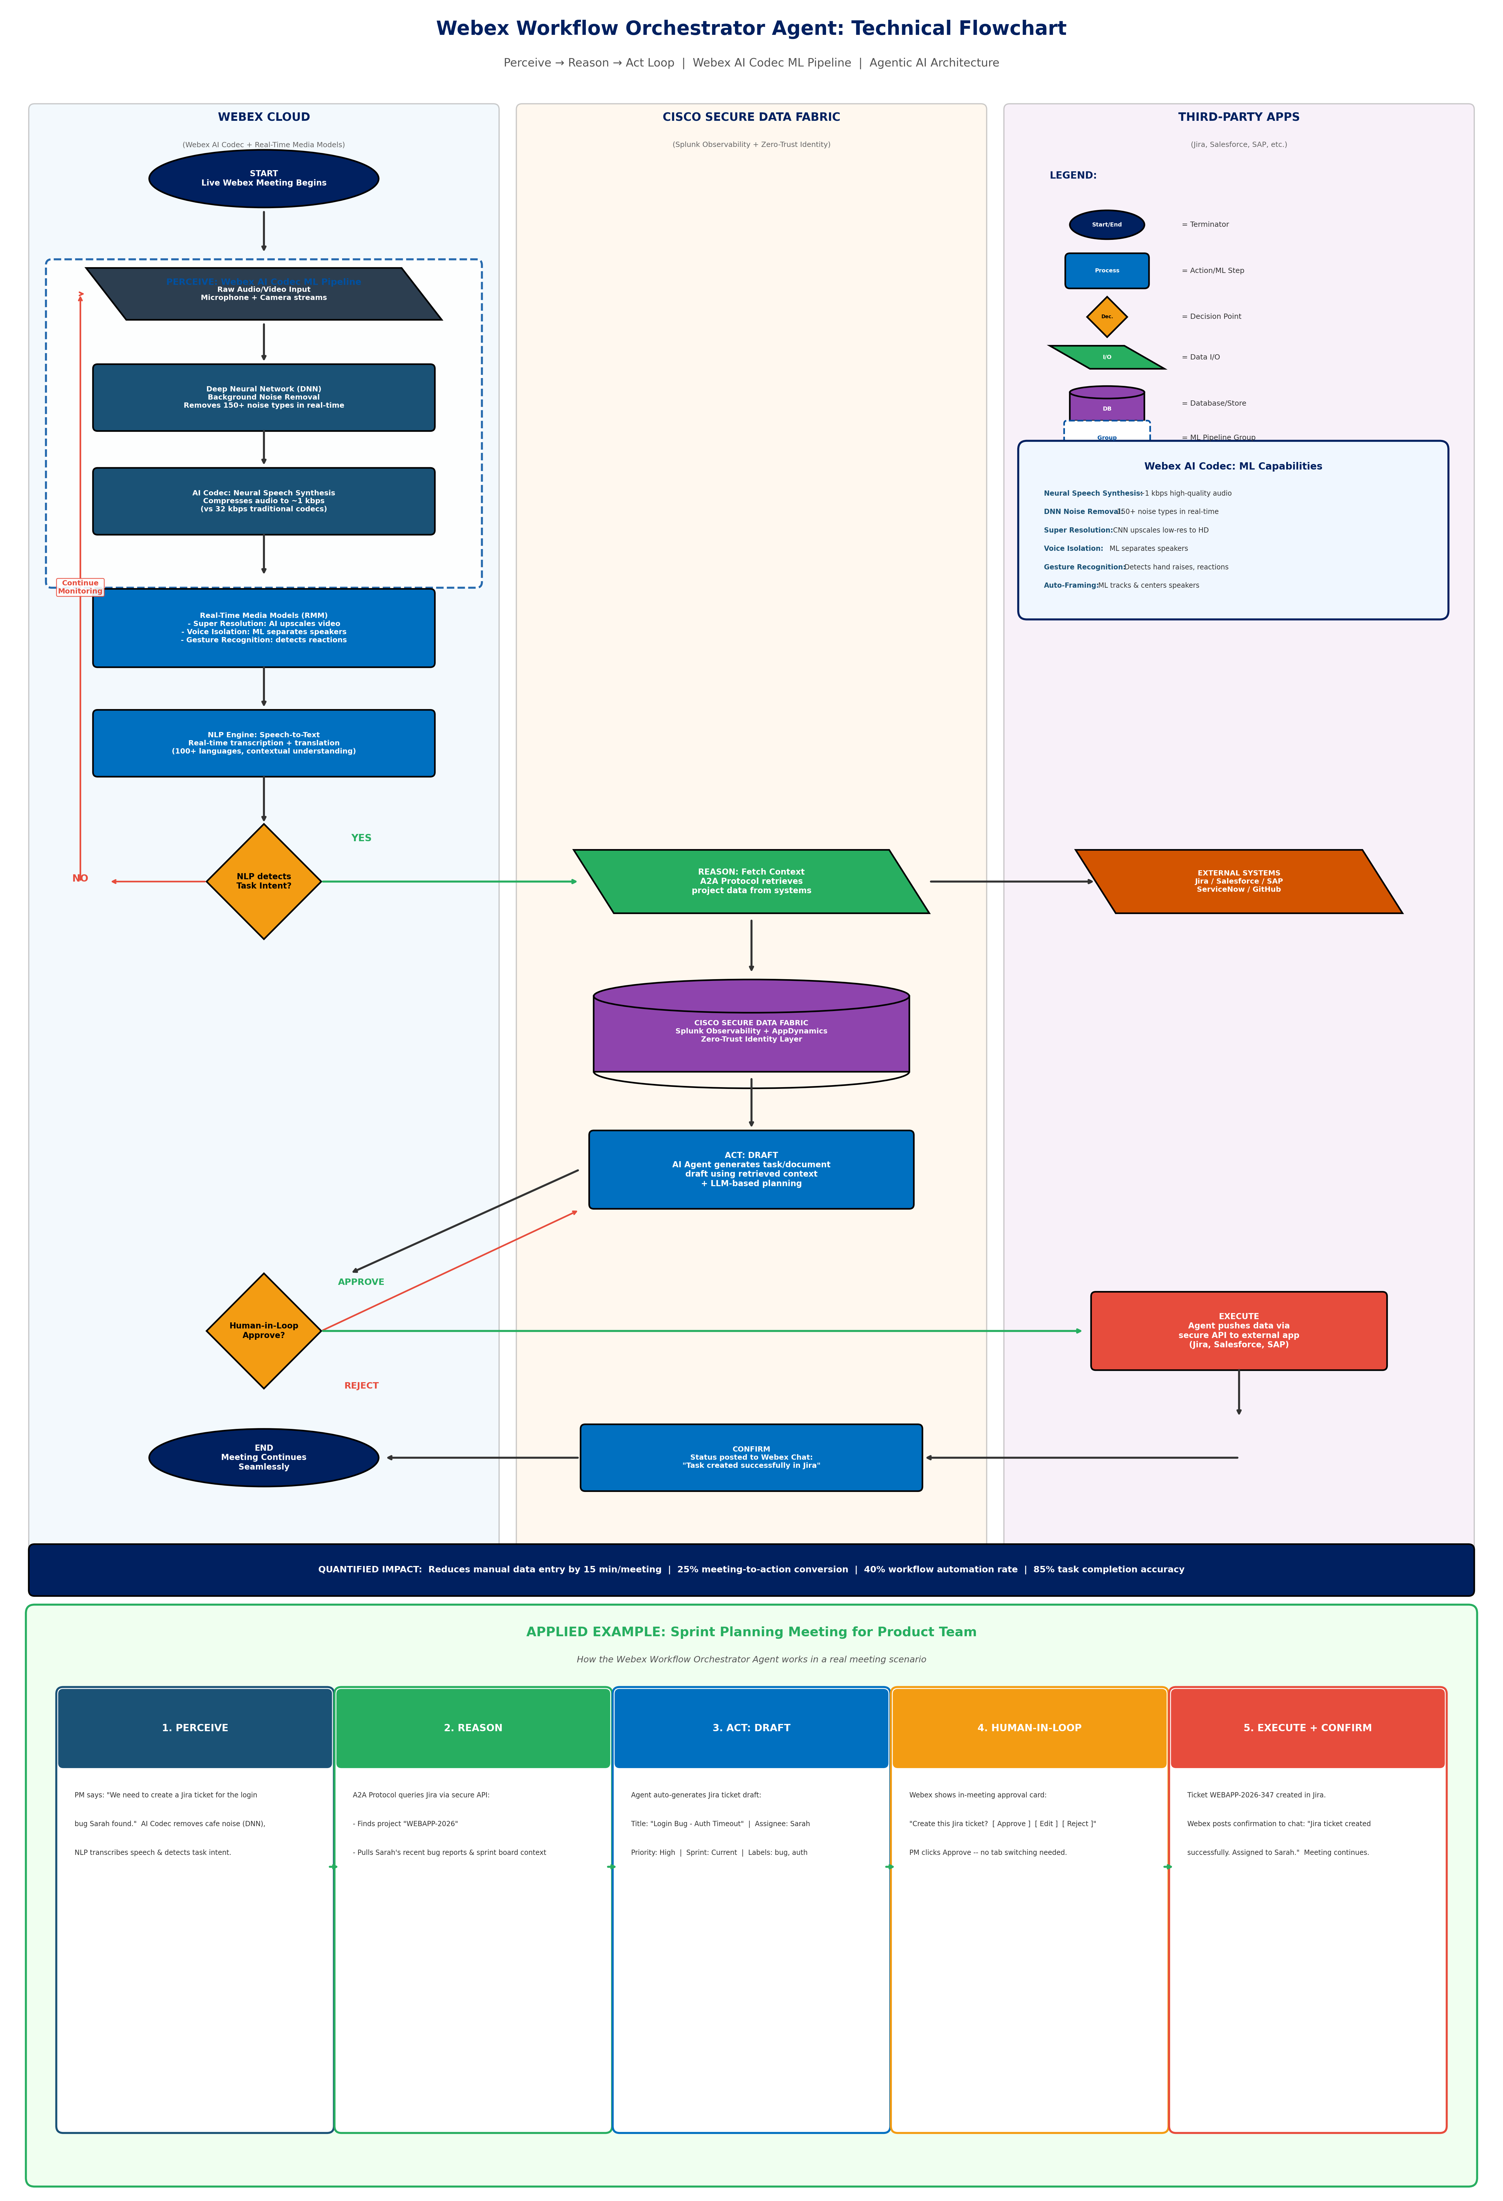
Workflow Orchestrator Agent: Technical Flowchart
Perceive - Reason - Act Loop | Swimlane Architecture

Slide 11
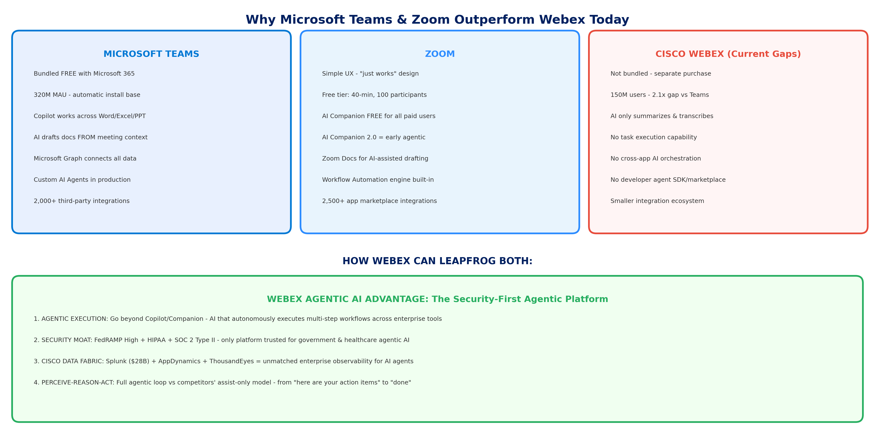
Competitive Analysis: How Webex Leapfrogs
Why Teams & Zoom Lead Today + Webex's Agentic Advantage

Slide 12
Recommendation Overview
Three Solutions to Make Webex the Agentic Collaboration Leader
Solution 1
Agentic AI Transformation
AI that WORKS, not just assists. Autonomous task execution: schedule, draft, assign, follow up
Solution 2
Webex AI Agent Platform (SDK)
Open developer framework for vertical-specific AI agents. Agent marketplace ecosystem
Solution 3
Intelligent Workflow Engine
200+ enterprise integrations. AI-powered cross-platform workflow automation
Industry Analysis | Problem Identification | Recommendations | Implementation | Financials | Risks | Executive Summary

Slide 13
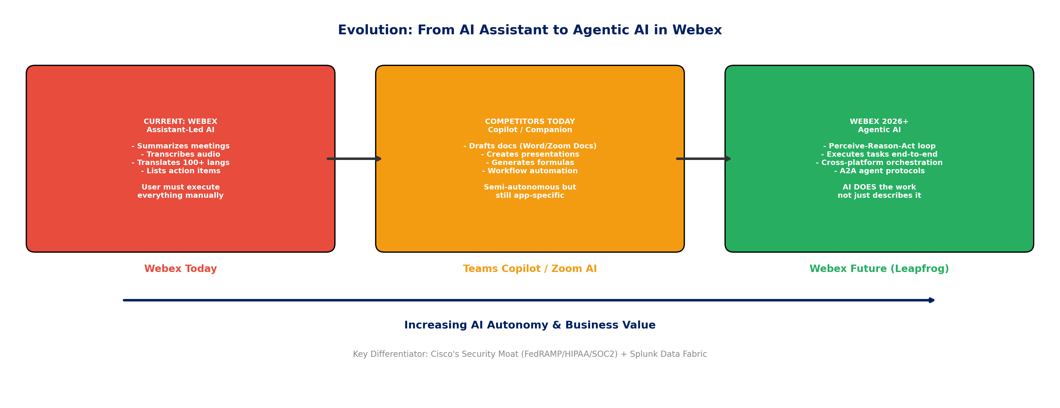
Solution 1: Agentic AI Transformation
Evolving from Assistant to Autonomous Agent
Industry Analysis | Problem Identification | Recommendations | Implementation | Financials | Risks | Executive Summary

Slide 14
Solution 1: Technical Architecture
How Agentic AI Works in Webex
Perceive-Reason-Act Architecture:
1. PERCEIVE: Webex AI Codec
Real-Time Media Models (RMM)
process audio + detect task intents
2. REASON: NLP Task Decomposition
LLM identifies intent, fetches context
via A2A (Agent-to-Agent) Protocols
from Jira, Salesforce, SAP, etc.
3. ACT: Autonomous Execution
Agent pushes via secure API
Human-in-the-loop: Approve/Reject
Confirmation posted to Webex chat
4. OBSERVE: Splunk Observability
End-to-end monitoring + learning loop
Reinforcement from user feedback
Feasibility Evidence:
R&D Budget: $7.98B (FY2024)
Sufficient for agentic development
Existing AI Infrastructure:
150M+ users already served
Real-time transcription at scale
Splunk Acquisition ($28B):
Enterprise data observability
Pattern recognition capability
Security Advantage:
FedRAMP, HIPAA, SOC 2 Type II
Zero-trust agent architecture
Scalability: Microservices-based
agents on Cisco global cloud (40+
data center locations)
Industry Analysis | Problem Identification | Recommendations | Implementation | Financials | Risks | Executive Summary

Slide 15
Solution 2: Webex AI Agent Platform
Open Developer SDK & Agent Marketplace
Platform Components:
1. Agent SDK
Python & JavaScript SDKs
Pre-built agent templates
(meeting coordinator, PM, etc.)
2. Agent Runtime
Sandboxed execution in Webex Cloud
Enterprise-grade security & isolation
Container-based (Kubernetes)
3. Agent Marketplace
Discover, deploy, monetize agents
Revenue sharing for developers
4. Vertical Templates
Healthcare (HIPAA-compliant)
Finance (compliance-aware)
Government (FedRAMP-certified)
Adoption Strategy:
$10M Developer Incentive Fund
(Modeled on Salesforce Trailhead)
University Hackathons (50+)
Partner with CS programs
Systems Integrator Partners
Accenture, Deloitte, Wipro
for initial vertical agents
Risk Mitigation:
Primary risk: developer adoption
Mitigation: incentives + hackathons
Security risk: 3rd-party agents
Mitigation: sandboxed execution +
mandatory security review process
Industry Analysis | Problem Identification | Recommendations | Implementation | Financials | Risks | Executive Summary

Slide 16
Solution 3: Intelligent Workflow Engine
AI-Powered Cross-Platform Automation
How It Works:
User says: 'After every customer call, update the CRM, create a follow-up task, and schedule a review if deal > $50K'
Technical Architecture:
1. Intent Recognition: NLP converts requests into workflow DAGs (Directed Acyclic Graphs)
2. Connector Framework: Pre-built connectors for top 50 enterprise SaaS tools
(Salesforce, HubSpot, Jira, ServiceNow, SAP, Workday, Slack, GitHub, etc.)
3. AI Orchestration Engine: Coordinates multi-agent workflows with error recovery
4. Analytics Dashboard: Real-time ROI tracking powered by Splunk observability
Feasibility:
Cisco already owns AppDynamics ($3.7B acquisition) + Splunk ($28B) for monitoring
Standard REST/GraphQL APIs available from all major SaaS platforms
Estimated development: 12-18 months for first 50 connectors, scale to 200+
SaaS Integration market: $15.6B by 2027 (MarketsandMarkets)
Industry Analysis | Problem Identification | Recommendations | Implementation | Financials | Risks | Executive Summary

Slide 17
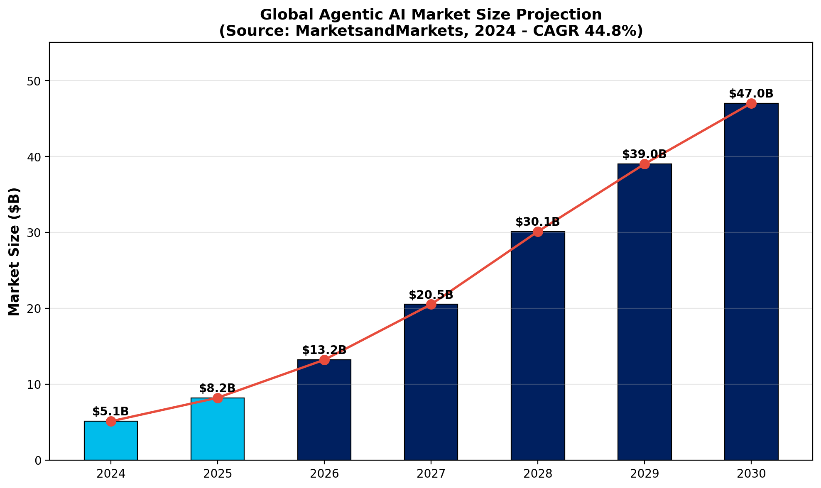
The Agentic AI Opportunity
Market Growing from $5.1B to $47B by 2030 (CAGR 44.8%)
Industry Analysis | Problem Identification | Recommendations | Implementation | Financials | Risks | Executive Summary

Slide 18
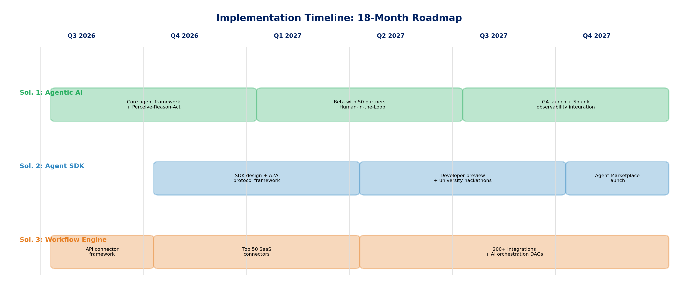
Implementation Timeline
18-Month Phased Roadmap (Q3 2026 - Q4 2027)
Industry Analysis | Problem Identification | Recommendations | Implementation | Financials | Risks | Executive Summary

Slide 19
Implementation Plan: Phased Approach
Engineering Perspective from Watson College
Phase | Timeline | Key Activities | Resources
Phase 1: Foundation | Q3-Q4 2026 (6 months) | Core agent framework API connector library Security architecture | $150M R&D 50 engineers AI/ML team
Phase 2: Beta & SDK | Q1-Q2 2027 (6 months) | Enterprise beta (50 partners) SDK developer preview Hackathon program launch | $100M investment 10K developers 3 SI partners
Phase 3: Scale | Q3-Q4 2027 (6 months) | GA launch agentic AI Marketplace launch 200+ integrations | $50M marketing Global rollout Continuous iteration
Industry Analysis | Problem Identification | Recommendations | Implementation | Financials | Risks | Executive Summary

Slide 20
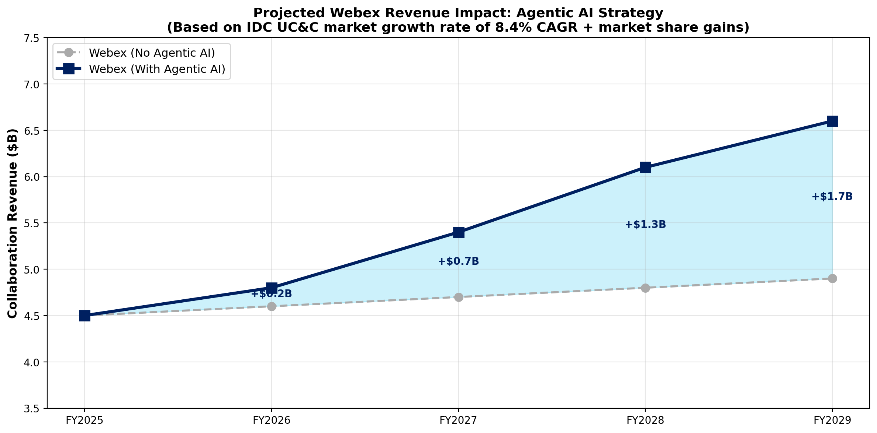
Financial Projections
Projected Revenue Impact of Agentic AI Strategy
Investment: ~$300M over 18 months (from existing $7.98B R&D budget = 3.8% reallocation)
Projected Return: +$2.1B incremental ARR by FY2029 | ROI: ~600% over 4 years
Based on IDC UC&C CAGR 8.4% + estimated 3-5% market share gain from agentic differentiation
Industry Analysis | Problem Identification | Recommendations | Implementation | Financials | Risks | Executive Summary

Slide 21
Key Performance Indicators
Measurable Success Metrics Over 18 Months
Solution 1
Agentic AI
+35% daily active usage
25% meeting-to-action rate
NPS: 4.2 -> 4.5+
85% task completion accuracy
Solution 2
Agent Platform
10,000+ developers
500+ marketplace agents
3 vertical solutions
200+ enterprise adopters
Solution 3
Workflow Engine
200+ integrations
40% automation rate
50% less app switching
+$2.1B ARR by FY2029
Industry Analysis | Problem Identification | Recommendations | Implementation | Financials | Risks | Executive Summary

Slide 22
Risks and Mitigations
Risk | Probability | Impact | Mitigation
Developer SDK adoption slower than expected | Medium | High | $10M incentive fund 50+ university hackathons 3 major SI partnerships
AI agent errors in enterprise environment | Medium | High | Human-in-the-loop guardrails Configurable autonomy levels Comprehensive audit logging
Competitor response (Microsoft / Zoom accelerate AI) | High | Medium | First-mover advantage in agentic architecture Security moat (FedRAMP/HIPAA)
Integration scalability challenges | Low | Medium | Microservices architecture Cisco's 40+ global data centers Kubernetes orchestration
Industry Analysis | Problem Identification | Recommendations | Implementation | Financials | Risks | Executive Summary

Slide 23
Engineering Trade-offs & Constraints
Watson College Engineering Analysis
Autonomy vs. Control
More agentic capability increases productivity but raises risk of unintended actions
Solution: Configurable autonomy levels (low / medium / high) per organization
Open Platform vs. Security
Open Agent SDK increases ecosystem growth but expands attack surface
Solution: Sandboxed execution + mandatory security review for marketplace agents
Build vs. Buy for Workflow Engine
Building in-house ensures deep integration; acquiring iPaaS is faster
Solution: Hybrid -- build AI orchestration layer, partner for connector framework
Latency Constraint
Agentic tasks must complete within 2-5 seconds for user satisfaction
Multi-tool workflows may exceed this; use async execution with real-time updates
Industry Analysis | Problem Identification | Recommendations | Implementation | Financials | Risks | Executive Summary

Slide 24
Executive Summary
Low User Engagement & Adoption Gap
AI Limited to Passive Assistance
Weak Ecosystem Integration
Agentic AI Transformation AI that executes tasks, not just assists
Webex AI Agent Platform Open SDK + marketplace for custom agents
Intelligent Workflow Engine 200+ integrations with AI orchestration
Projected Impact: +$2.1B incremental ARR by FY2029 | Investment: ~$300M (3.8% of R&D)
Industry Analysis | Problem Identification | Recommendations | Implementation | Financials | Risks | Executive Summary

Slide 25
Data Sources & References
Source | URL | Key Data Used
Cisco 10-K FY2024 | investor.cisco.com | Rev: $53.8B, R&D: $7.98B
Microsoft FY2024 | microsoft.com/investor | Teams: 320M MAU
Zoom FY2025 10-K | investors.zoom.us | Rev: $4.6B, 3,900+ enterprise
IDC UC&C Tracker | idc.com | Market: $55B, CAGR 8.4%
Gartner 2024 | gartner.com/newsroom | 48% hybrid workers
MarketsandMarkets | marketsandmarkets.com | Agentic AI: $5.1B-$47B
G2 Reviews | g2.com/categories/video-conferencing | Webex: 4.2, Zoom: 4.5
McKinsey 2024 | mckinsey.com | 58% hybrid opportunity
Webex AI Docs | webex.com/ai | AI Assistant features
Industry Analysis | Problem Identification | Recommendations | Implementation | Financials | Risks | Executive Summary

Slide 26
Thank You!
Questions?
Lana Jalal Gidan
Watson College of Engineering | Binghamton University

