Slide 1
Multiple Linear Regression
SSIE – 605: Applied Multivariate and Data Analysis
Professor Susan Lu
Presented by:~
Nafish Sarwar

Slide 2
Article
Title: The Effect Of Job Satisfaction And Organizational Commitment On Turnover Intention With Person Organization Fit As Moderator Variable
Year: 01 January 2022
Author(s): Eko Nur Pratama, Emi Suwarni, Maidiana Astuti Handayani
Affiliation: Manajemen, Universitas Teknokrat Indonesia
Journal: Aptisi Transactions on Management (ATM), 6(1), 74-81.
DOI: https://doi.org/10.33050/atm.v6i1.1722

Slide 3
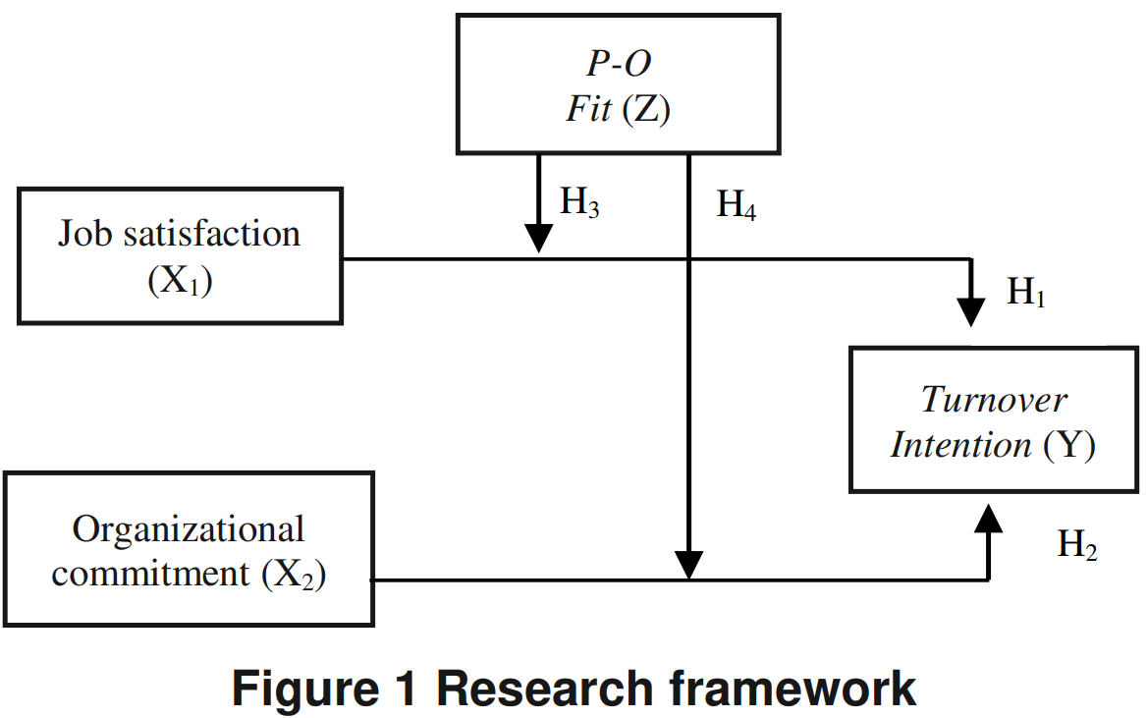
The research proposed the following hypotheses: H1: Job satisfaction has a negative and significant effect on turnover intention. H2: Organizational commitment has a negative and significant effect on turnover intention. H3: Person-organization fit moderates the relationship between job satisfaction and turnover intention. H4: Person-organization fit moderates the relationship between organizational commitment and turnover intention.
Purpose of the Research

Slide 4
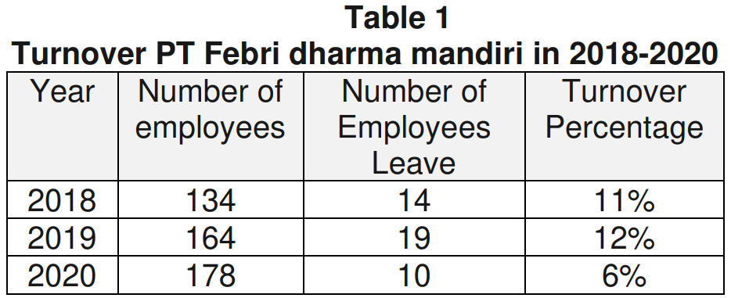
Methodology
Data were collected from 123 employees of PT Febri Dharma Mandiri through a questionnaire, but after removing outliers, 109 responses were analysed.
The research used multiple linear regression analysis & Moderated Regression Analysis to examine the relationships between job satisfaction, organizational commitment, turnover intention, & the moderating effect of person-organization fit.
SPSS software was used for data analysis, and a Likert scale (5 point) was applied to measure responses.
The sampling method was simple random sampling, an unbiased representation of employees.

Slide 5
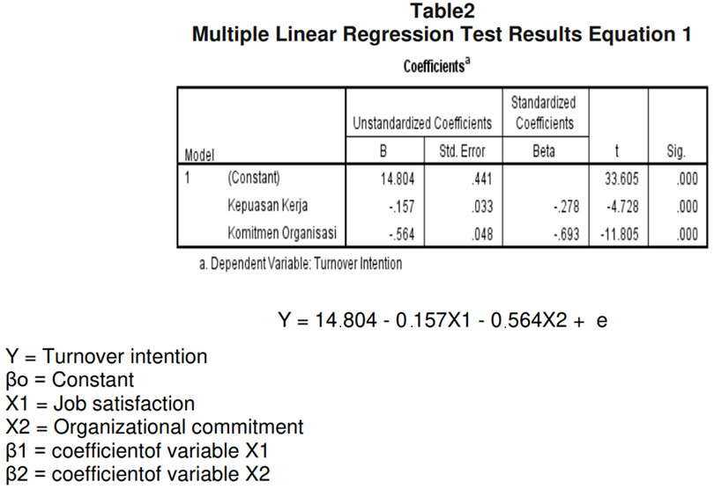
Results and Discussions

Slide 6
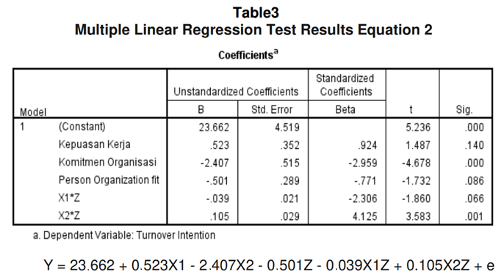
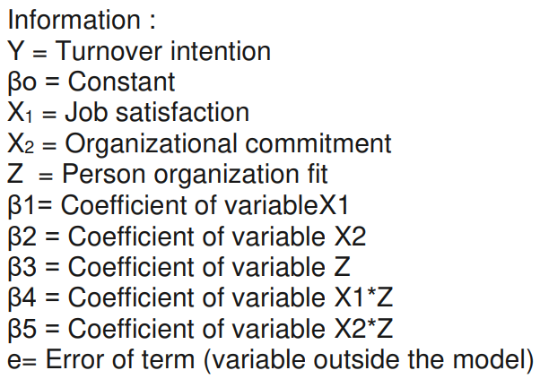
Results and Discussions (Continued)
Job satisfaction had a negative and significant effect on turnover intention
t-value = -4.728 (greater than t-table value of 1.659)
Significance (p-value) = 0.000 (less than 0.05)
Conclusion: Higher job satisfaction reduces turnover intention.
Organizational commitment had a negative significant effect on turnover intention
t-value = -11.805 (greater than t-table value of 1.659)
Significance (p-value) = 0.000 (less than 0.05)
Conclusion: Higher organizational commitment strongly reduces turnover intention.

Slide 7
Conclusion
The study found that:
Job satisfaction and organizational commitment both negatively and significantly impact turnover intention – meaning higher job satisfaction and stronger commitment reduce employees' desire to leave.
Person-organization fit does not moderate the relationship between job satisfaction and turnover intention – meaning job satisfaction's effect on turnover intention remains unchanged regardless of P-O fit.
Person-organization fit does moderate the relationship between organizational commitment and turnover intention – meaning organizational commitment's effect on turnover intention remains unchanged regardless of P-O fit.
Overall, organizational commitment played a more significant role in reducing turnover intention, regardless of a good person-organization fit.

Slide 8
Limitations
Limited Sample Size & Scope – The study focuses only on employees of PT Febri Dharma Mandiri, making it difficult to generalize the findings to other organizations or industries.
Single Point in Time – Data were collected at a single point in time, which does not account for changes in job satisfaction, commitment, or turnover intention over time.
Self-Reported Data – Responses were gathered through questionnaires, which may introduce bias due to social desirability or inaccurate self-assessment by employees.
Limited Moderating Effect – The study found that person-organization fit did not moderate the relationship between job satisfaction and turnover intention, suggesting the need to explore other moderating factors.
Thank You

